Slide 1
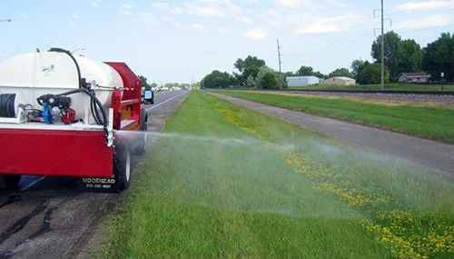
Sprayer Calibration -
Tips and Tricks
Tom Wolf
Agrimetrix Research & Training,
Saskatoon, Saskatchewan
Agrimetrix@gmail.com
Notes:
1
1

Slide 2
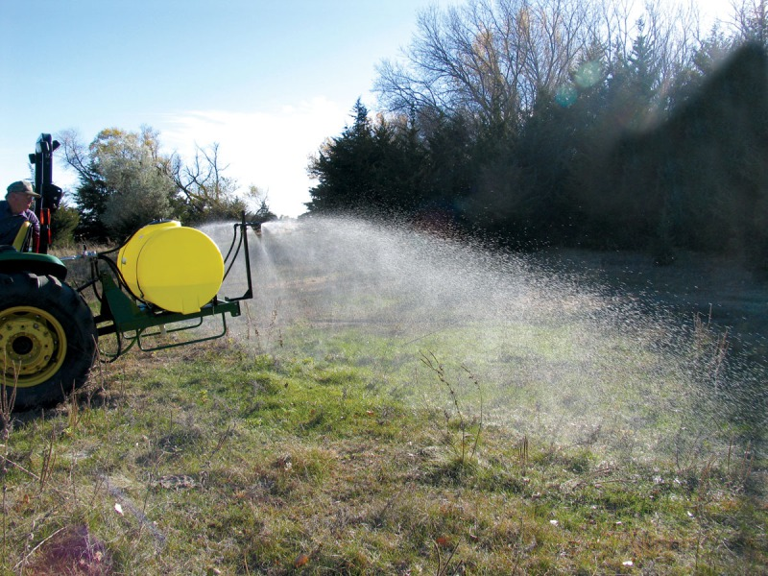

Slide 4
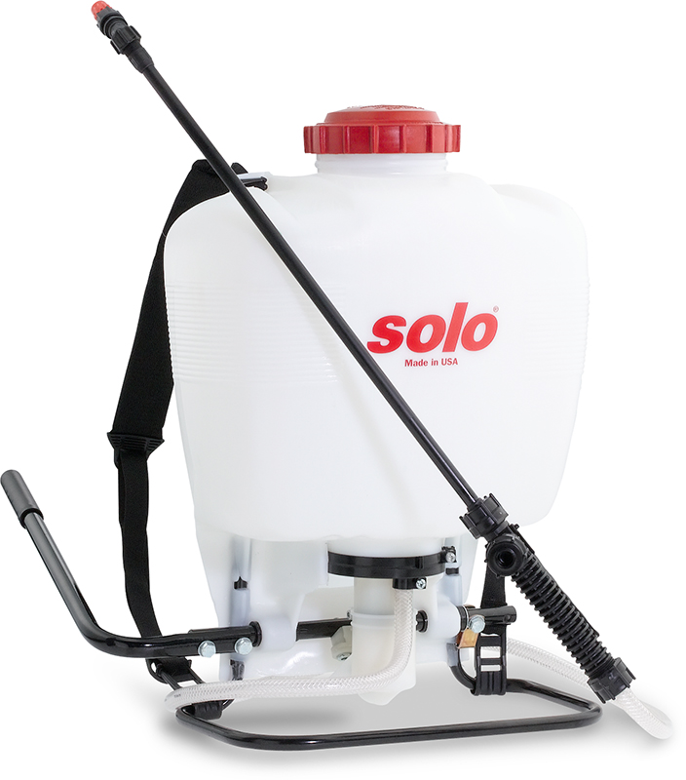
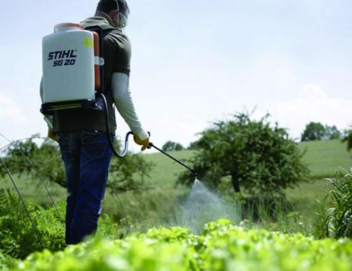
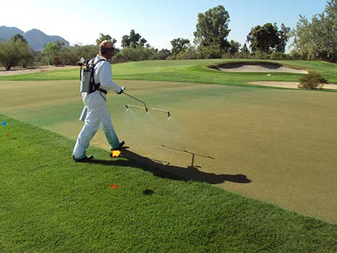

Slide 5
Remember the Basics
Accuracy
Uniformity

Slide 6
It’s Simpler than you Think
Only need three pieces of information:
Boom Flow (L/min, US gpm)
Boom width (m, ft)
Travel Speed (km/h, mph)

Slide 7
It’s Simpler than you Think
Only need a few pieces of equipment:
Collection vessels (graduated cylinders) or flow meters
Measuring tape
Stop watch
Calculator
Pencil and paper

Slide 8
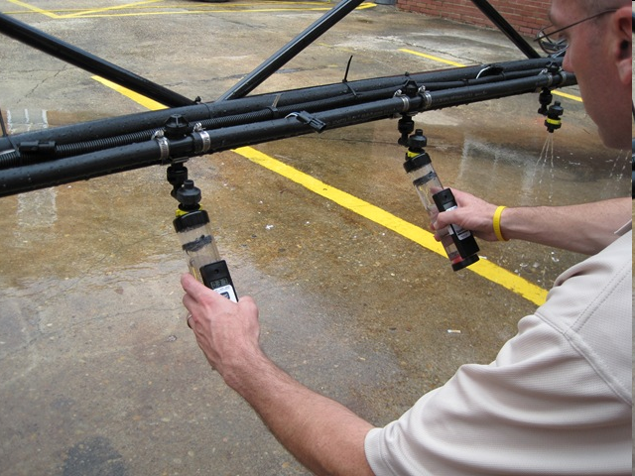
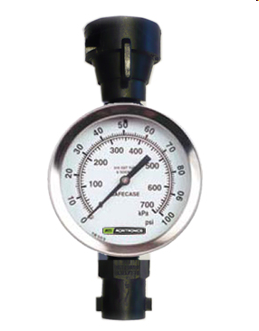
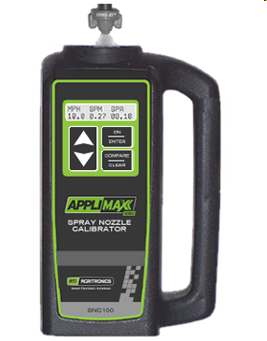

Slide 9
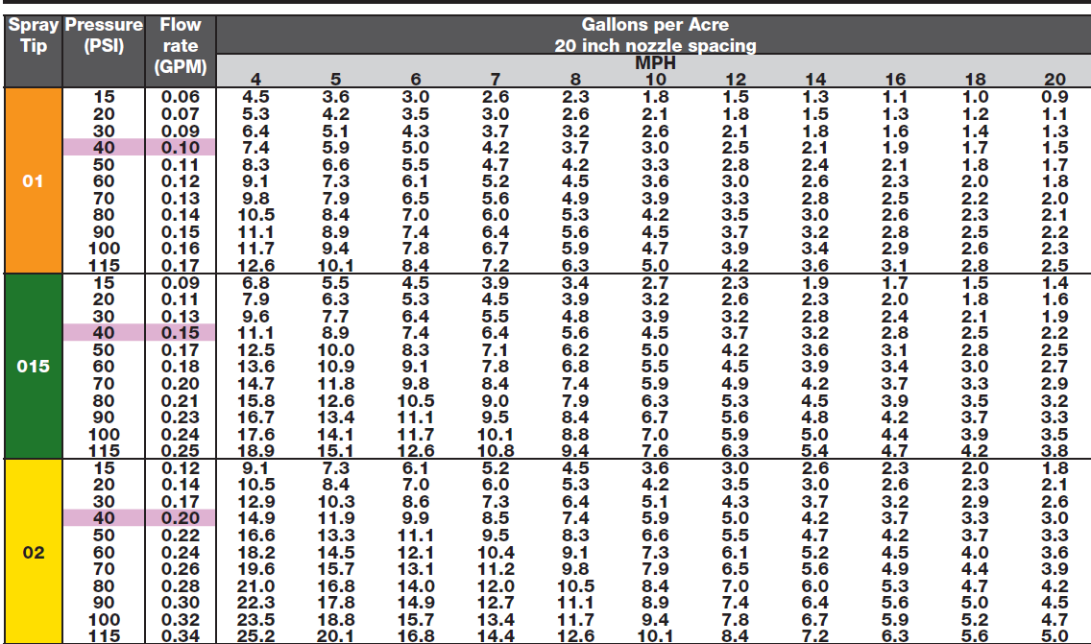
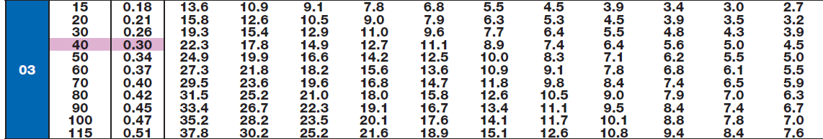
Use Manufacturer Charts

Slide 10
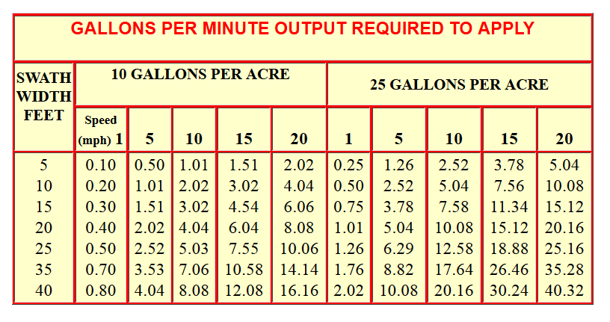
Radiarc Calibration Table

Slide 11
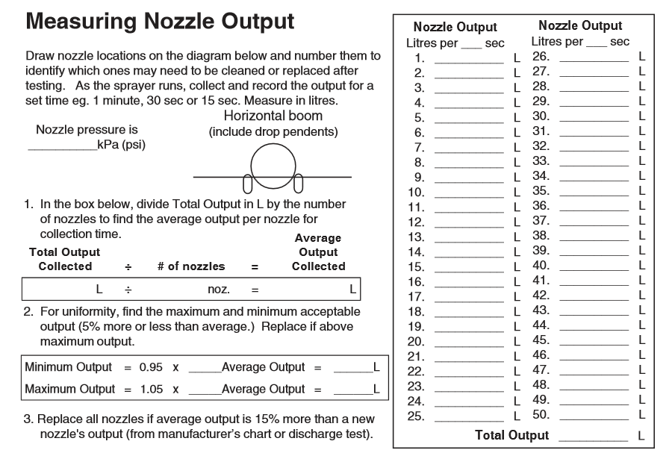
http://www.agf.gov.bc.ca/pesticides/boom_calib.pdf

Slide 12
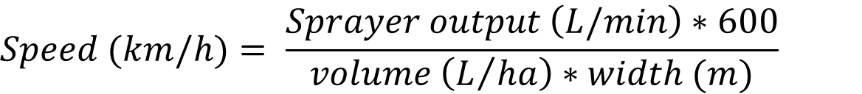
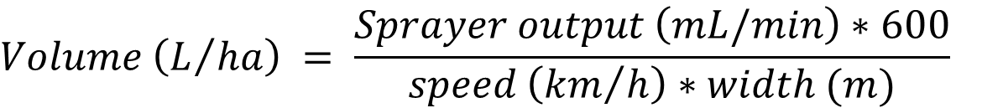
Consider metric – it’s easier
$$Speed (km/h)= \frac{Sprayer output \left(L/min\right)∗600}{volume \left(L/{ha}\right)∗width (m)}$$
$$Volume \left(L/{ha}\right) = \frac{Sprayer output \left(mL/min\right)∗600}{speed \left({km}/h\right)∗width (m)}$$
$$Sprayer output \left(L/{min}\right) = \frac{speed \left(km/h\right)∗volume\left(L/{ha}\right)∗width(m)}{600}$$

Slide 13
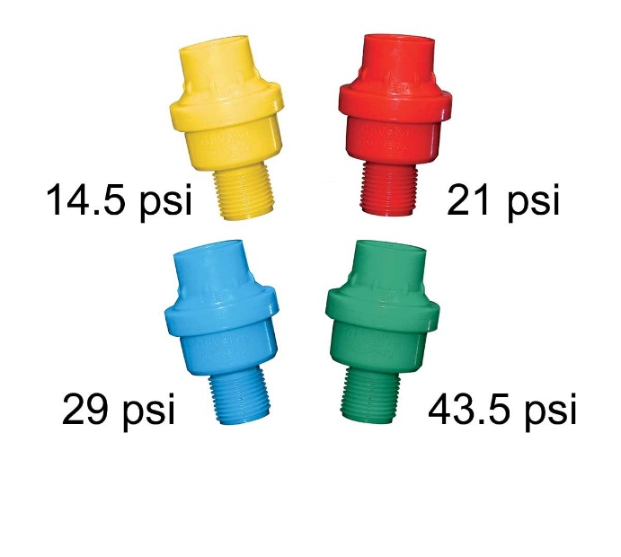
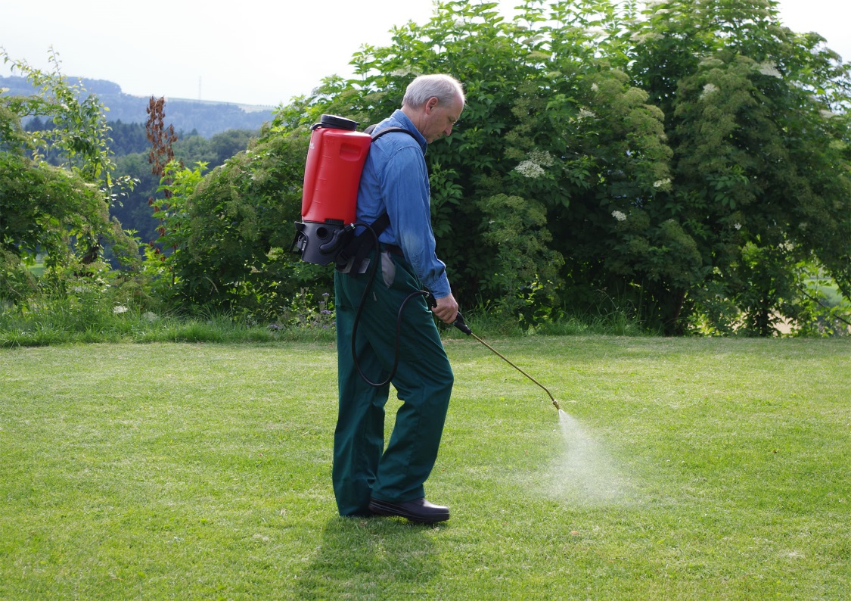
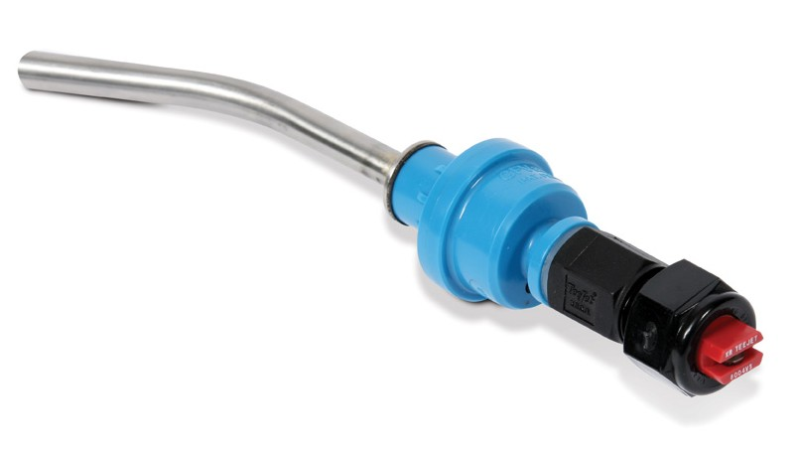
Use a Constant Pressure Valve with backpacks

Slide 14
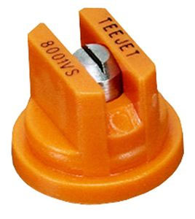
Understand Nozzle Numbers
8001
Fan angle (º)
Flow rate
(US gpm @ 40 psi)

Slide 15
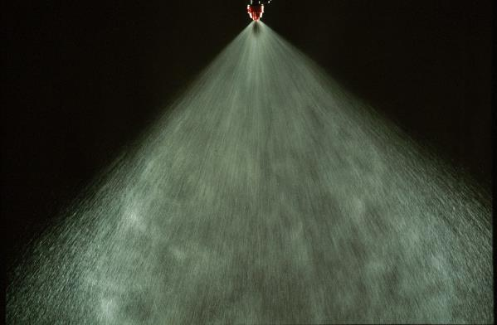
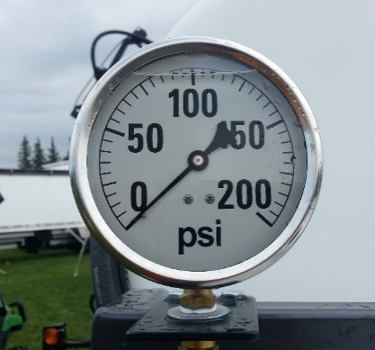
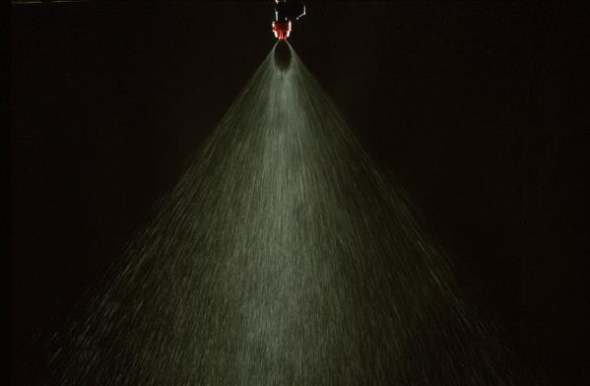
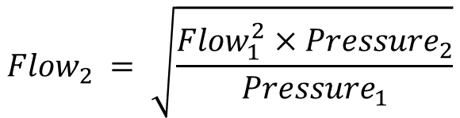
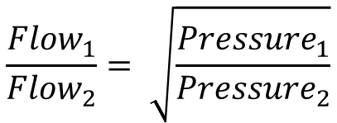
Change Pressure to get the flow you need
$$\frac{{Flow}_{1}}{{Flow}_{2}}= \sqrt{\frac{{Pressure}_{1}}{{Pressure}_{2}}}$$
Too High
$${Flow}_{2} = \sqrt{\frac{{Flow}_{1}^{2}×{Pressure}_{2}}{{Pressure}_{1}}}$$
Too Low

Slide 16
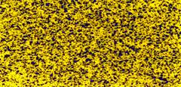
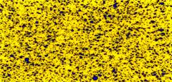













Use water-sensitive papers
12 gpa
8 gpa
4 gpa
Fine
Medium
Coarse
Very
Coarse
Extra
Coarse

Slide 17
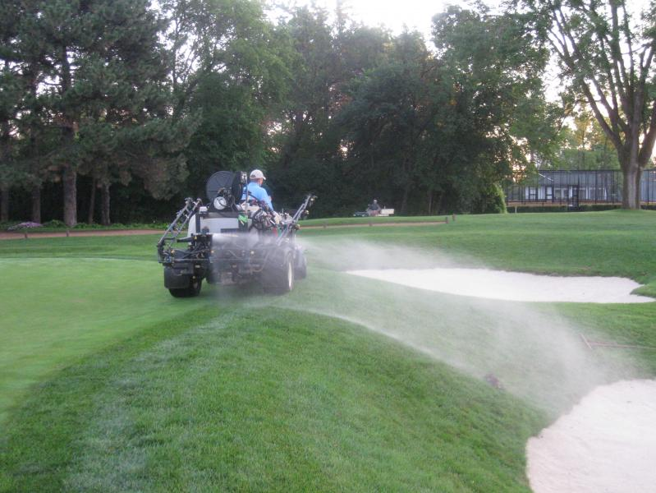
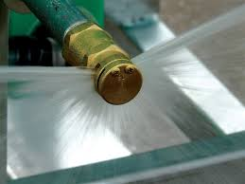
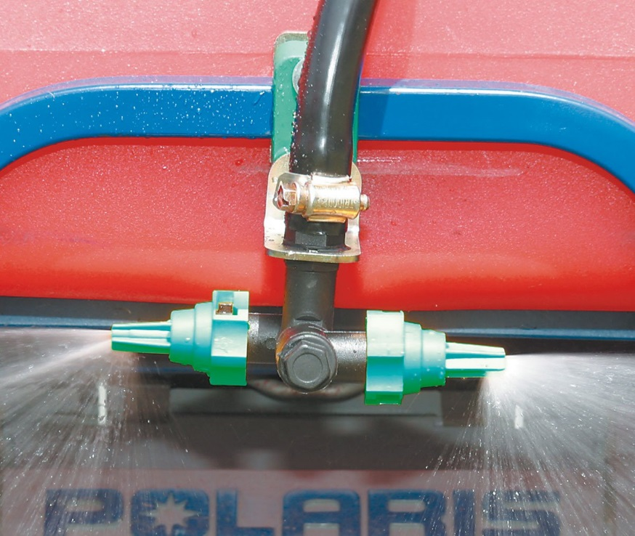
Boomless Nozzles

Slide 18
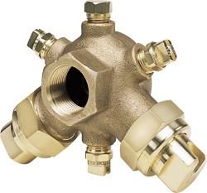
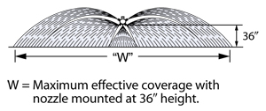

Slide 19
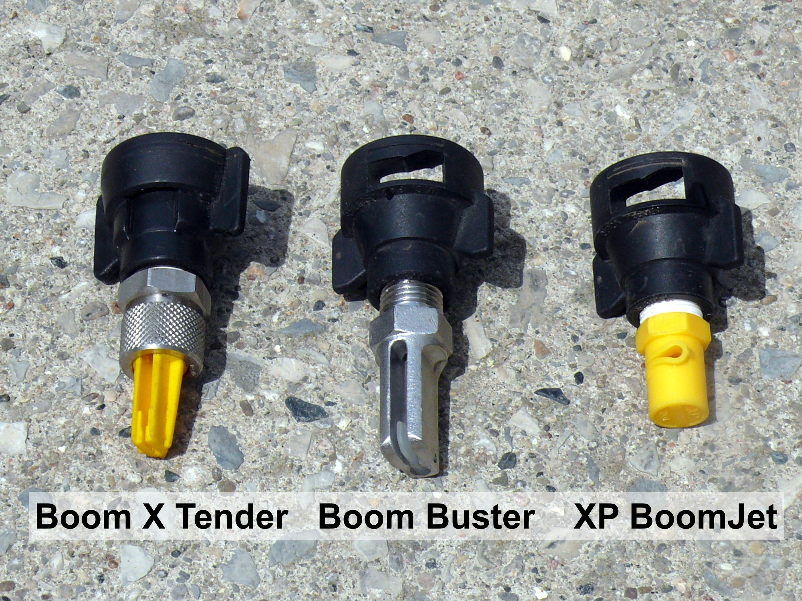
Courtesy Jason Deveau, OMAFRA

Slide 20
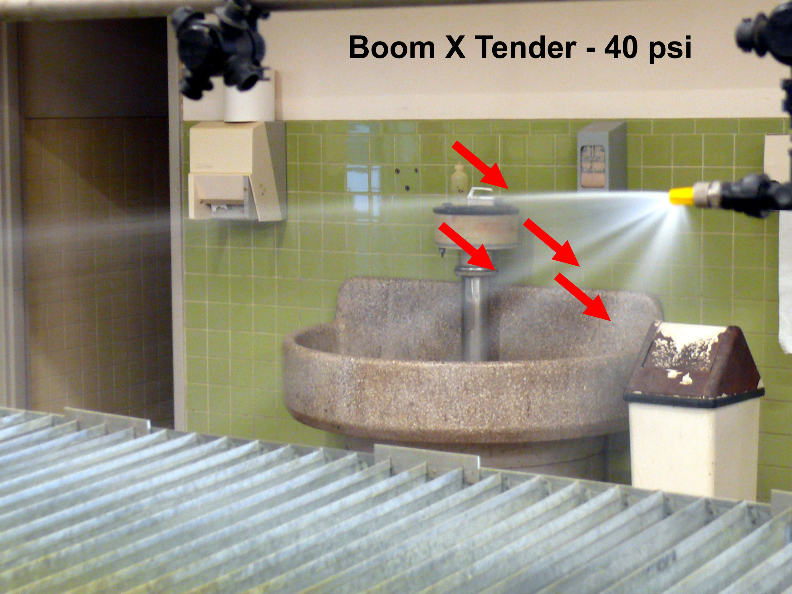
Courtesy Jason Deveau, OMAFRA

Slide 21
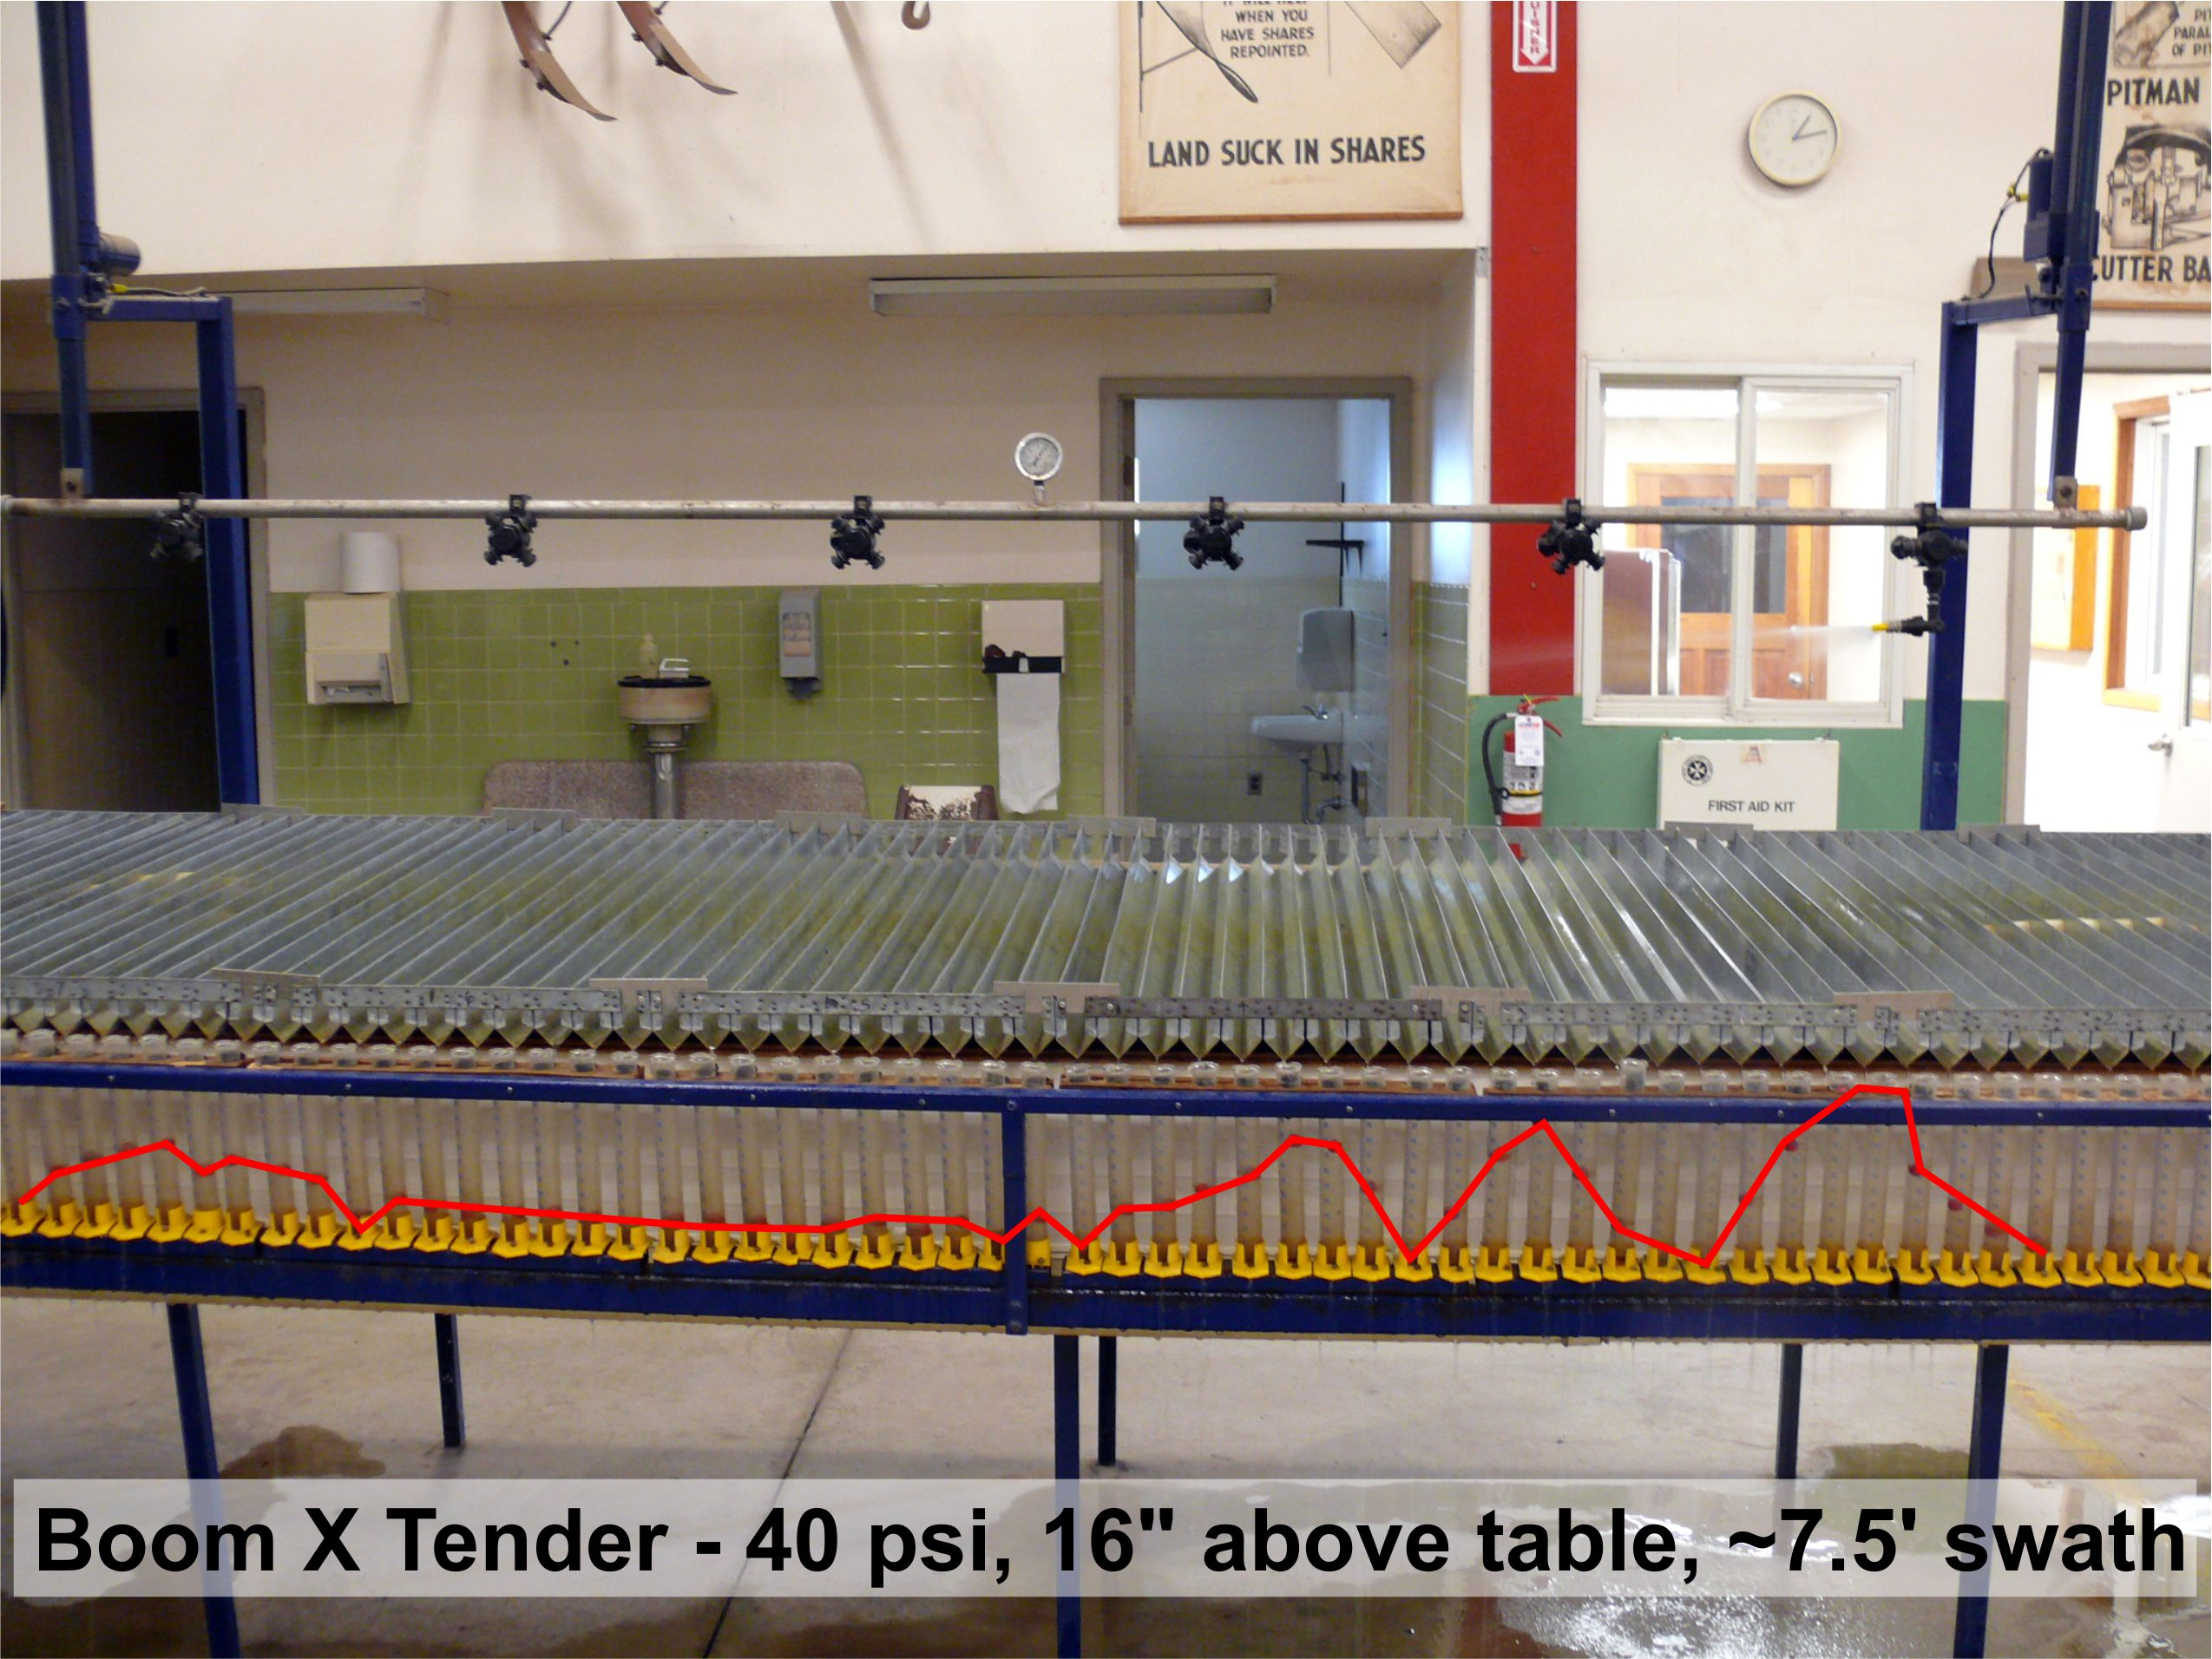
Courtesy Jason Deveau, OMAFRA

Slide 22
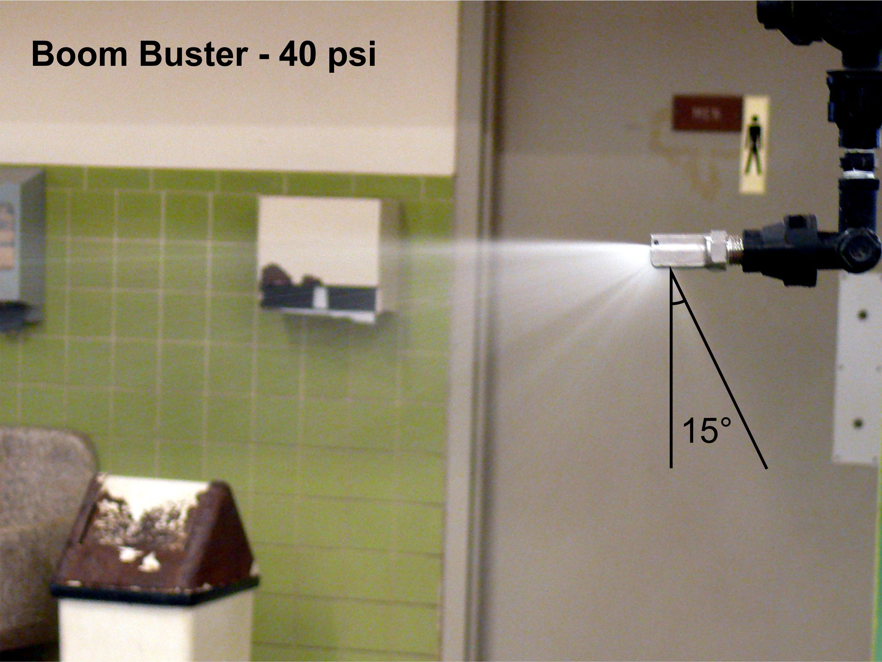
Courtesy Jason Deveau, OMAFRA

Slide 23
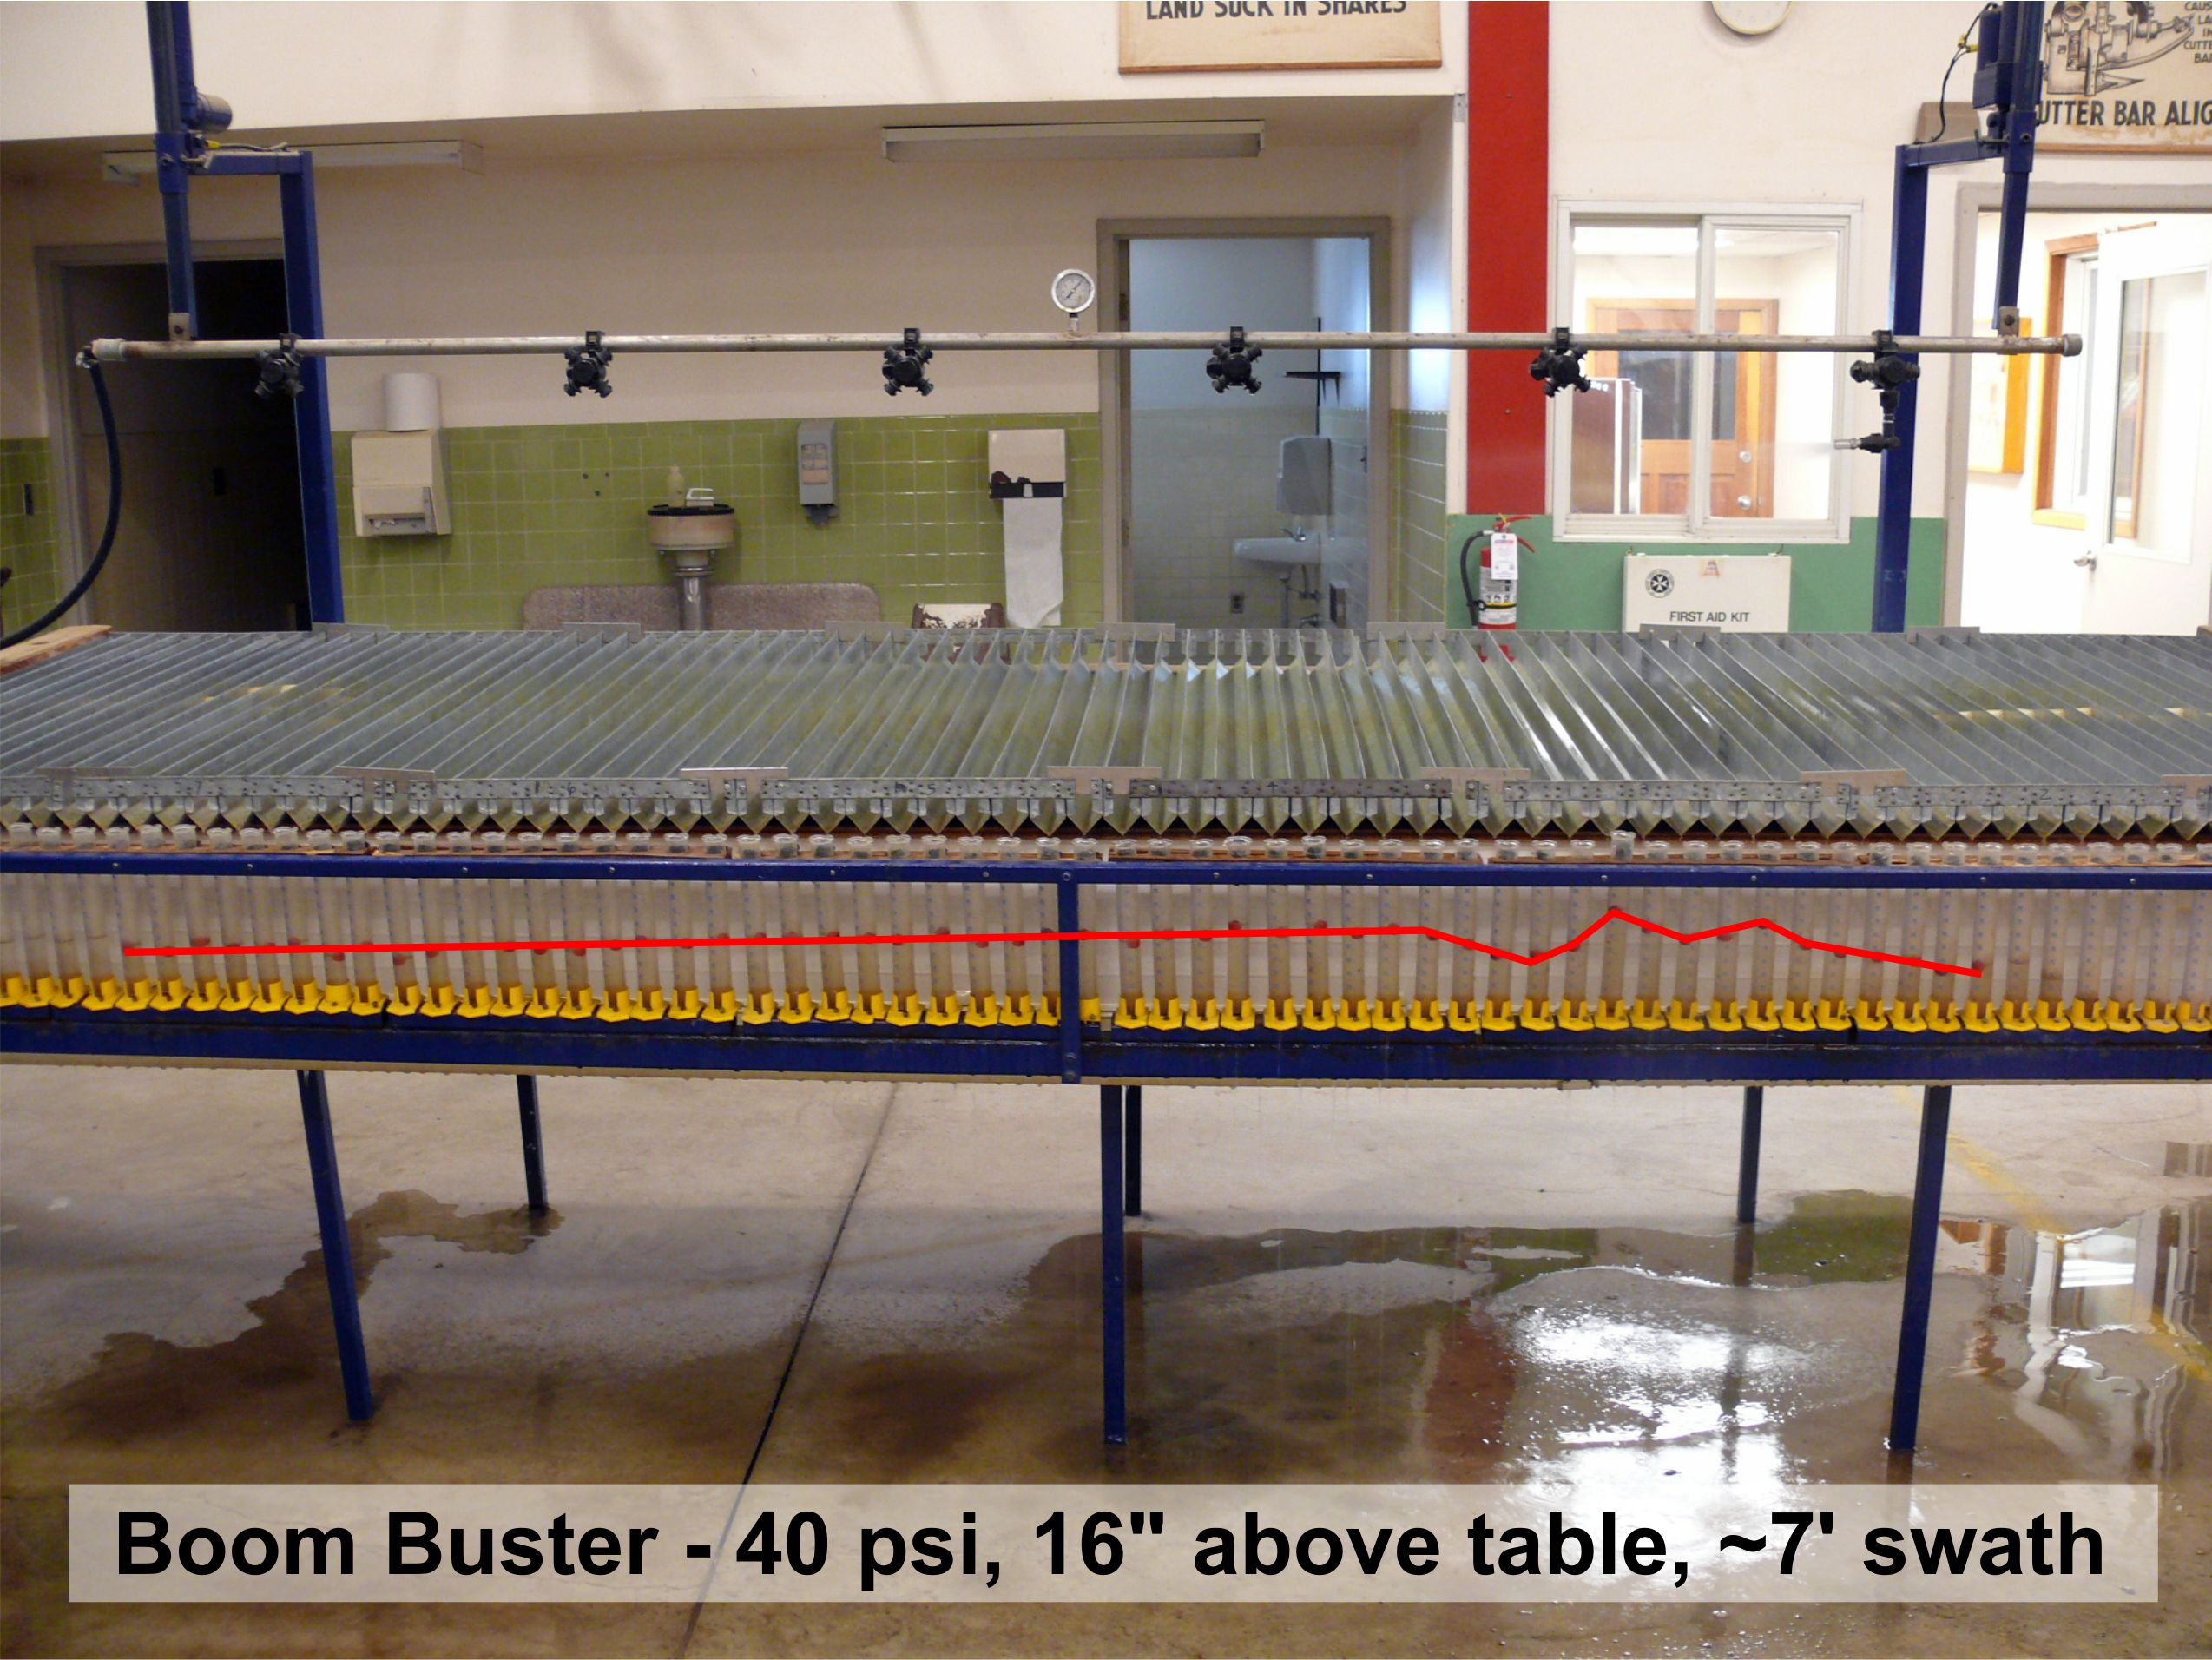

Slide 24
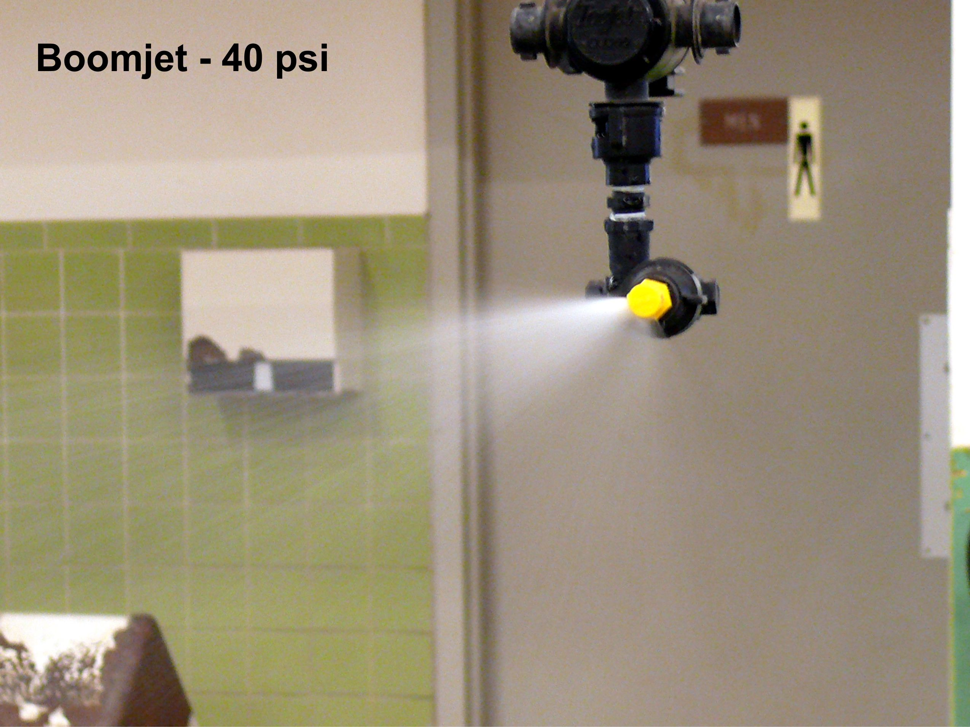
Courtesy Jason Deveau, OMAFRA

Slide 25
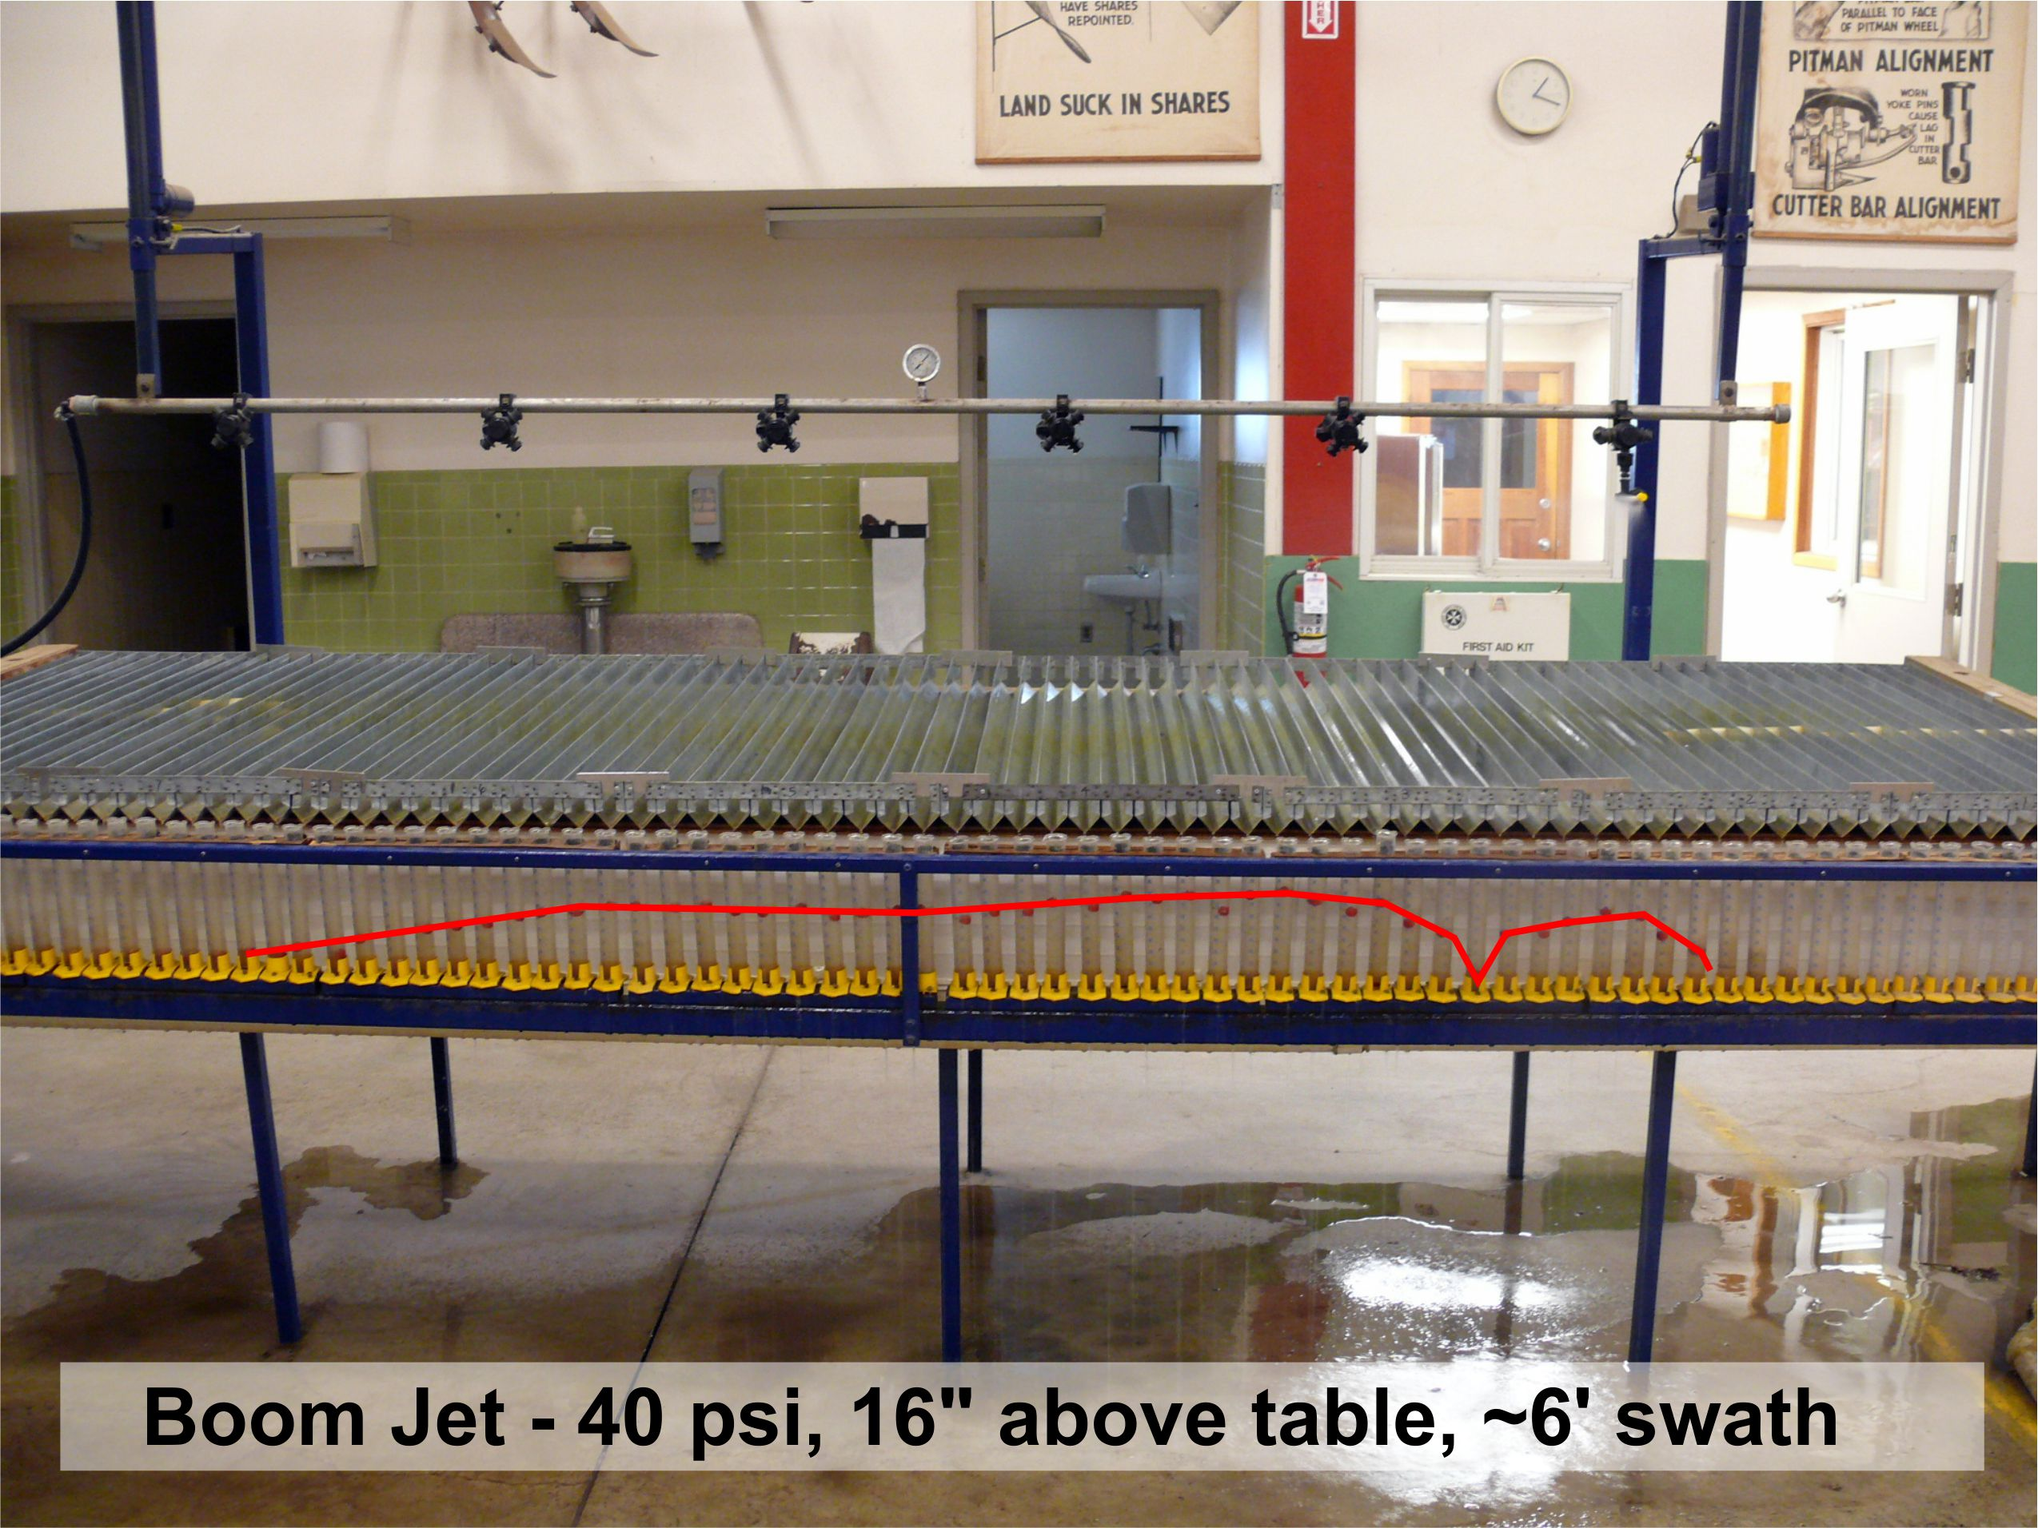

Slide 26
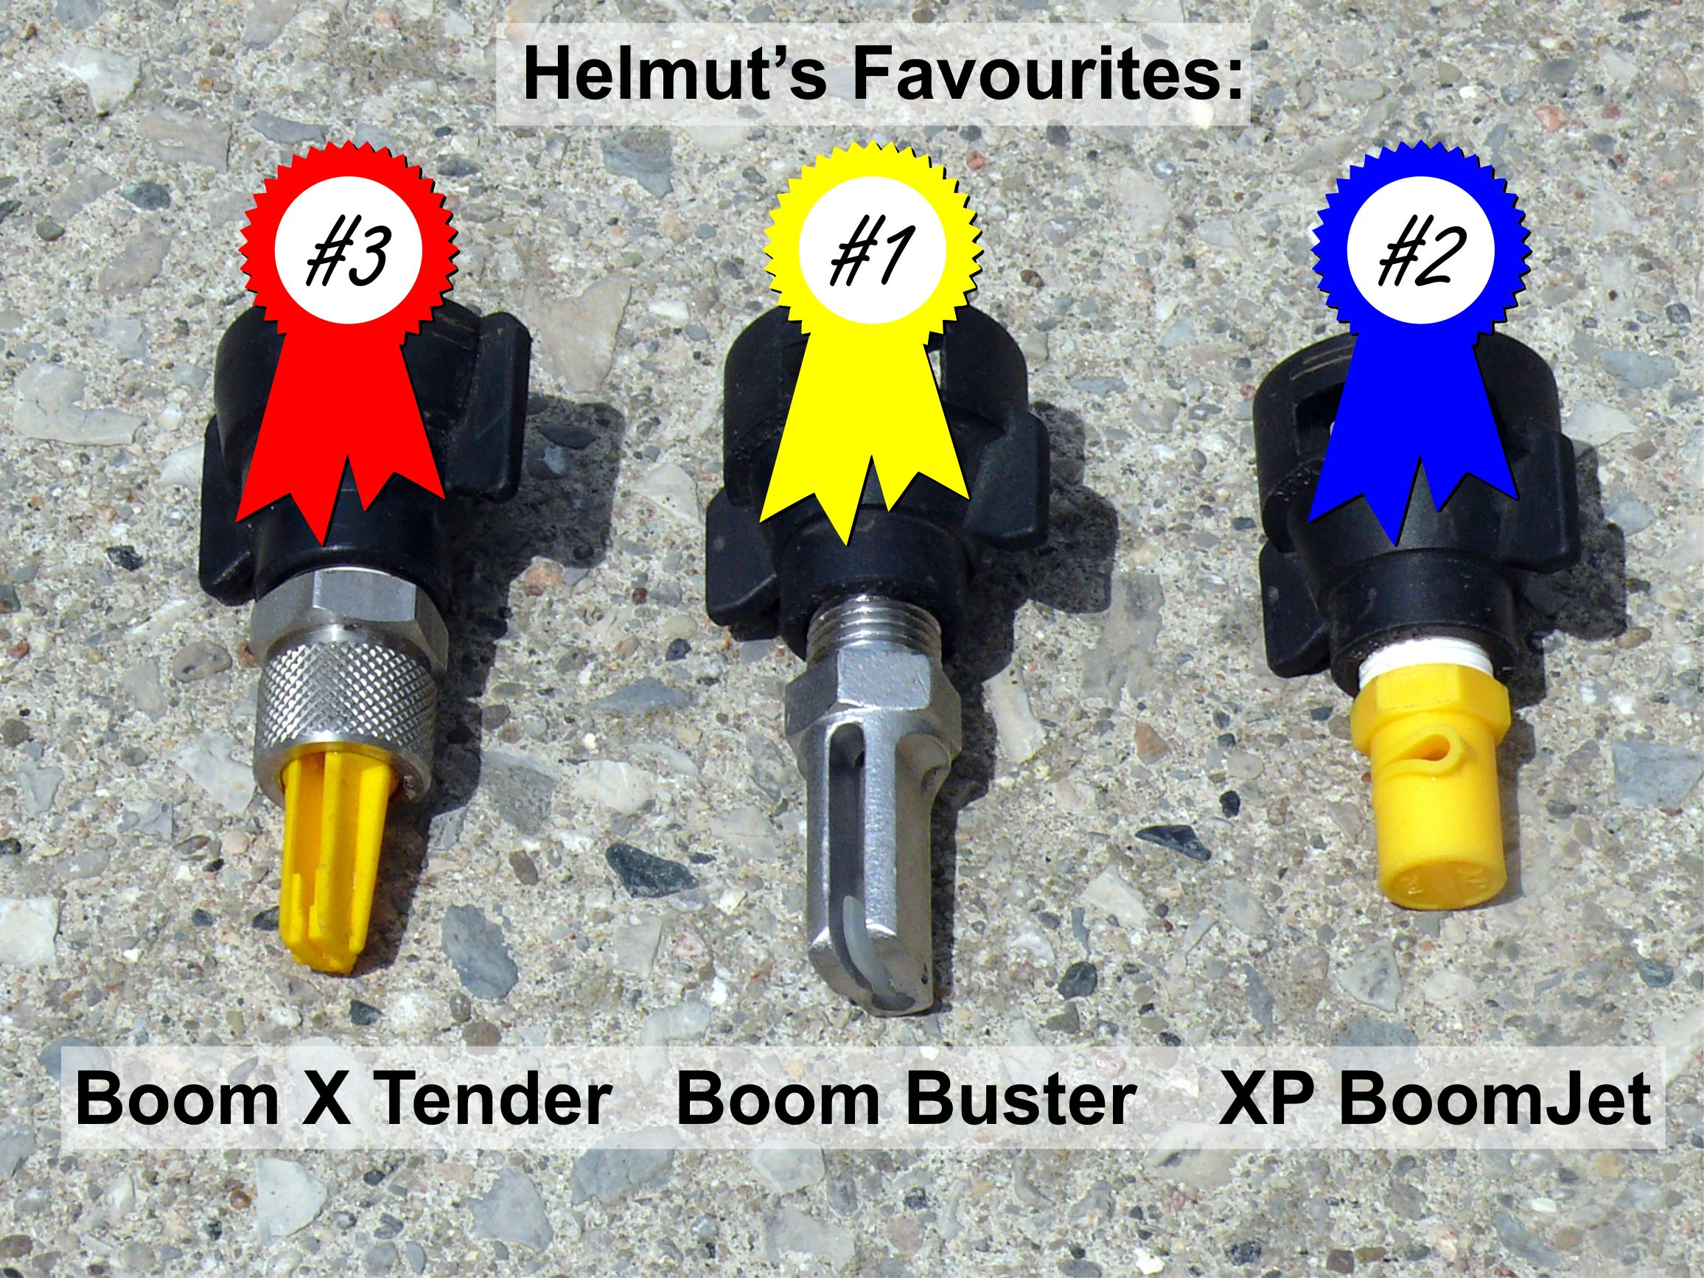
Courtesy Jason Deveau, OMAFRA

Slide 27
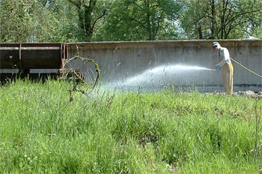

Slide 28



Small Drops don’t Fly Far

Slide 29
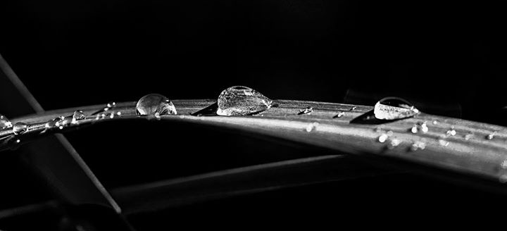
Don’t spray to point of runoff

Slide 30
Spray Retention on Foxtail

Slide 31
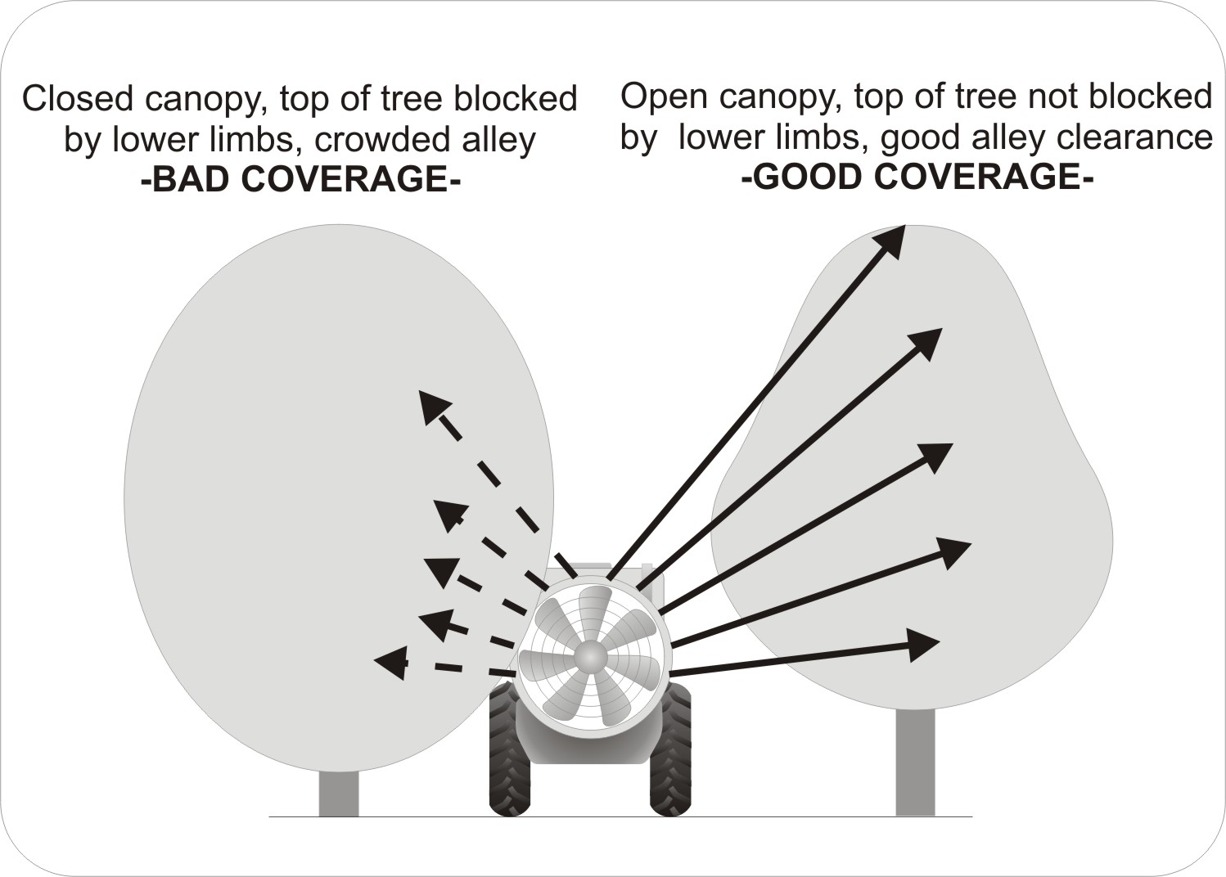
Tall Canopies
If you can’t see it, you can’t spray it
Courtesy Jason Deveau, OMAFRA

Slide 32
Example 1 – L/acre rate
Application volume is 20 US gpa
Tank Capacity is 80 US gallons
Area covered by tank is
80 gallons/20 gpa = 4 acres
Product rate is 1 L/acre
4 acres * 1 L/acre = 4 L product / tank

Slide 33
Example 2 – active ingredient rate
If product rate is g ai/acre, then you must know the ai concentration in the product
The label might say the product contains 150 g/L
The active ingredient rate is 300 g/acre
Divide the ai rate by the ai concentration:
e.g. 300 g/acre / 150 g/L = 2 L/acre product

Slide 34
Example 3 – adjuvant rates
Most adjuvants are added on a concentration basis, usually % v/v
If an adjuvant is to be added at 0.6% v/v, then 0.6 L should be added for each 100 L of tank mixture
Make sure the units agree, e.g., L/100 L or gallons/100 gallons

Slide 35

Thank You!
Tom Wolf
Agrimetrix Research & Training,
Saskatoon, Saskatchewan
Agrimetrix@gmail.com
Twitter: @nozzle_guy
Direct Line: 306-934-1620

