Slide 1

Managing right-of-way vegetation in conjunction with the Migratory Birds Convention Act.
Dan Tisseur
Integrated Vegetation Management Association of BC Bi-Annual Conference
October 29 2014
Notes:
Thank the IVMA of BC, the local first nation and all of the participants in the forum. Indicate that it is good to see a healthy turnout, as cooperative efforts are the keystone to successful invasive species management programs.
First Nation is : COAST SALISH peoples, specifically the Musqueam and Tsawassen Nations

Slide 2

Tech Check

Slide 3
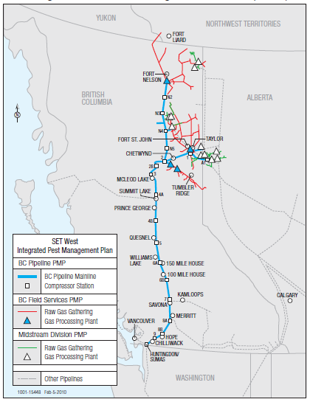
Natural Gas Pipelines- a primer
Part of the BC landscape since 1955
Spectra Energy pipelines transport ~ 60% of all natural gas produced in B.C.
Spectra Energy has over 2,900km of pipeline right-of-way in BC.
We are not the only pipeline...
  Kinder Morgan, FortisBC, Pembina
More pipeline projects in development...
  Spectra Energy
  Enbridge
  Trans-Canada, and others
Notes:
Spectra in BC since 1955, originally as westcoast, then Duke, and now as Spectra
2900km of RoW, widths from 15 to 45m depending upon type of line
60% of Natural Gas in BC moved through Spectra lines, but we are not the only players, nor the only product (oil also pipelined)
List others, Pembina, Kinder Morgan, Fortis, PNG
These are the tip of the iceberg, with a host of pipeline proposals in place: Spectra, Enbridge, Trans-Canada, and then who else

Slide 4
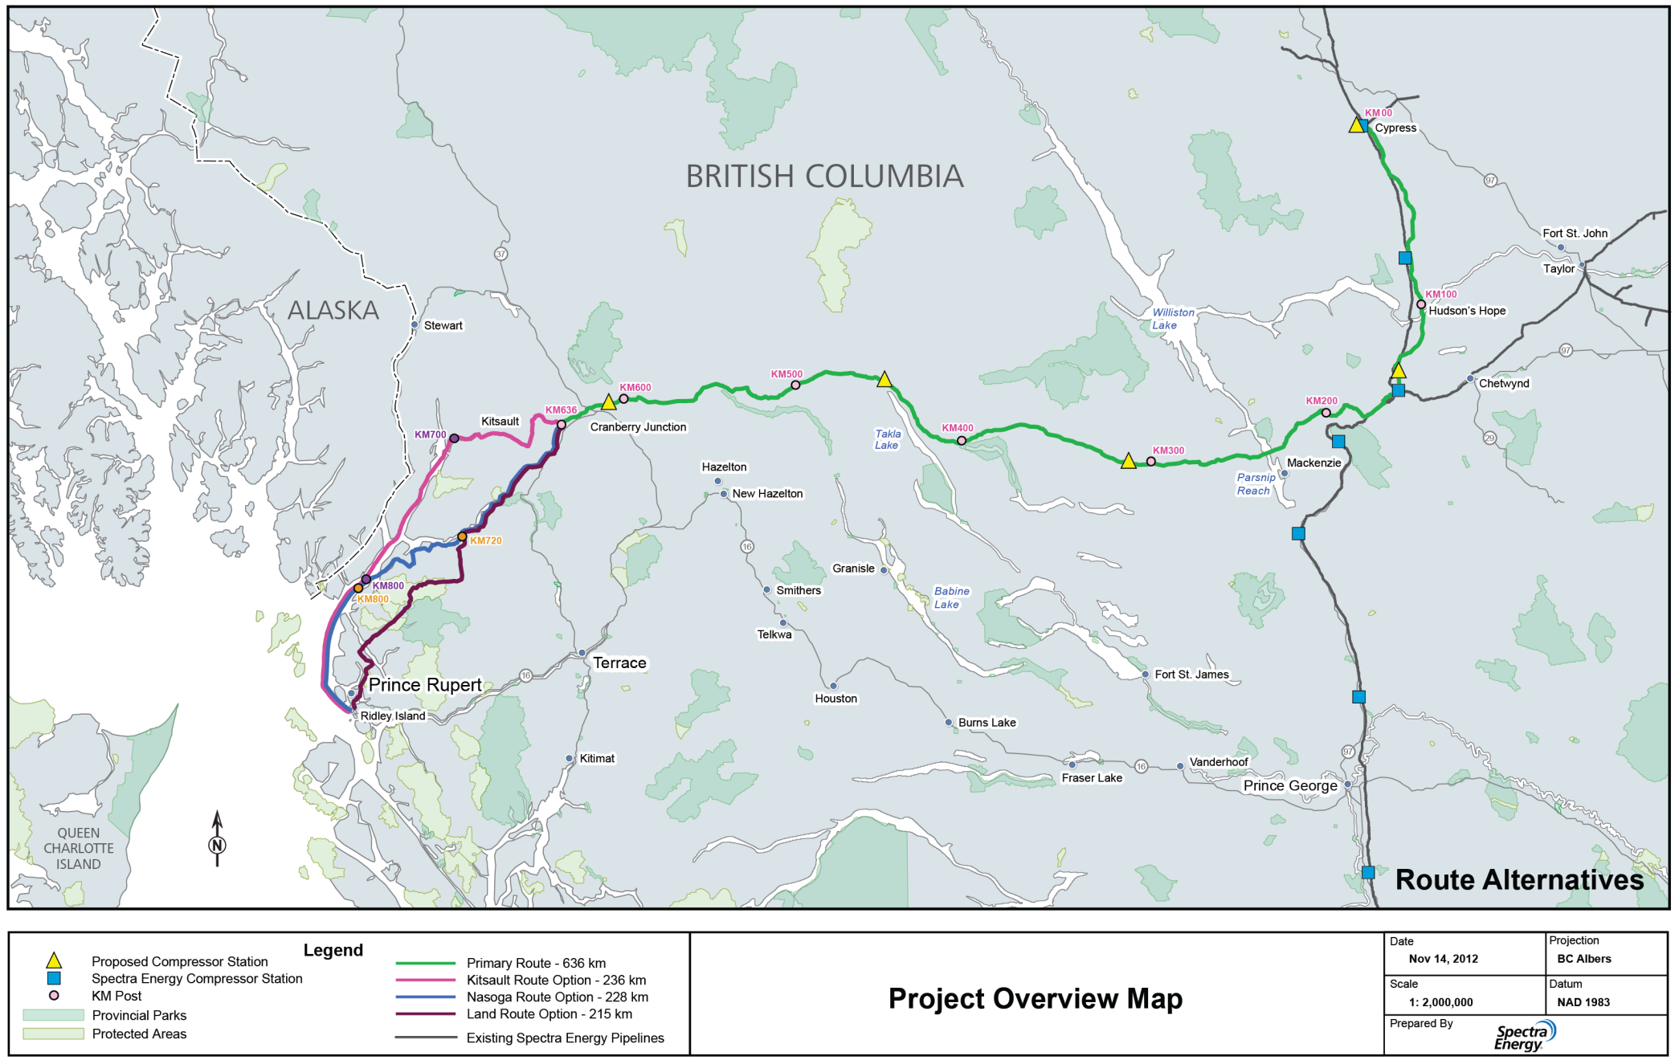
Proposed Route of New Natural Gas Pipeline Proposed by Spectra Energy
    New line to add ~ 850 kms of new right-of-way
    Avoids congested corridor to be used by other proposals
    NE BC to Prince Rupert
Notes:
Point out PG (bottom right) and Rupert (Center Left)
Point out congested route of other lines...

Slide 5
Linear Corridors and Birds
  Linear corridors are used by a variety of industries, and share common challenges in terms of environmental management.
  Today's presentation is focussed on managing vegetation while considering the needs of migratory birds
    Vegetation management activities have a high potential for conflict with migratory bird concerns.
Specific challenges and solutions associated with:
  Treatment types
  Operations and Maintenance Requirements
  Scheduling
Notes:
Note that the industries share commonalities
Presentation biased towards my experiences with NaturaL Gas pipelines
Increased public awareness about oil and gas pipelines draws attention to opractices on the RoW

Slide 6
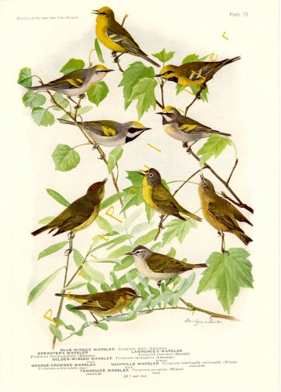
Migratory Birds – a Primer
The Migratory Birds Convention Act (MBCA) was first passed in 1917, last updated Sept. 29 2014
  Federal act bolstered by complimentary provincial regulations
    In BC: The Wildlife Act
  Pertains to species that migrate throughout N. America, Mexico and Japan
Image: Warblers 1917 Louis Agassiz Fuertes Edwardian Bird Lithographs

Slide 7
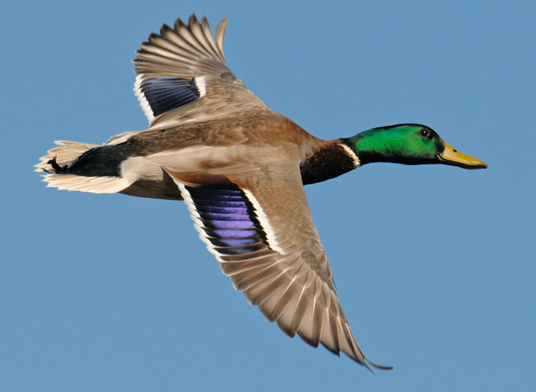
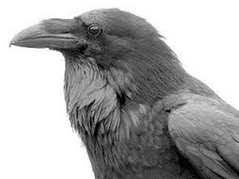
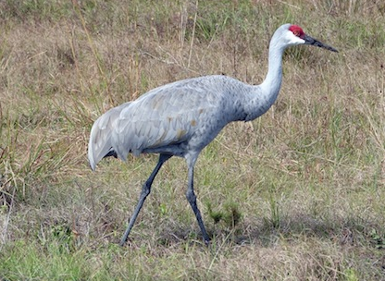
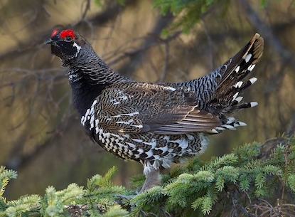
Migratory vs Non-Migratory
Notes:
Mallard vs Raven
Sandhill Crane vs Spruce Grouse

Slide 8
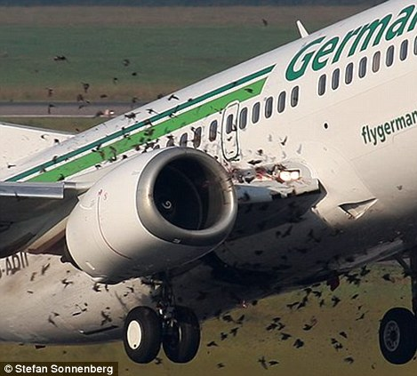
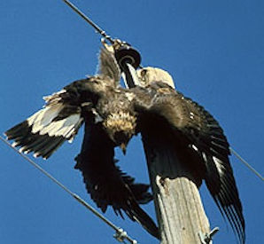
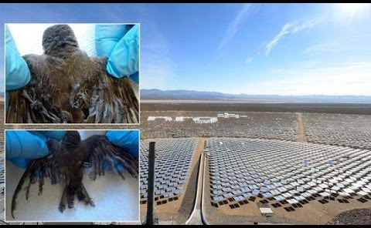
Birds and Industry
Interactions between birds and various industries may result in conflict, and must be managed.
Notes:
Many industries can negatively impact bird populations
Powerlines
Power generation
Transportation

Slide 9
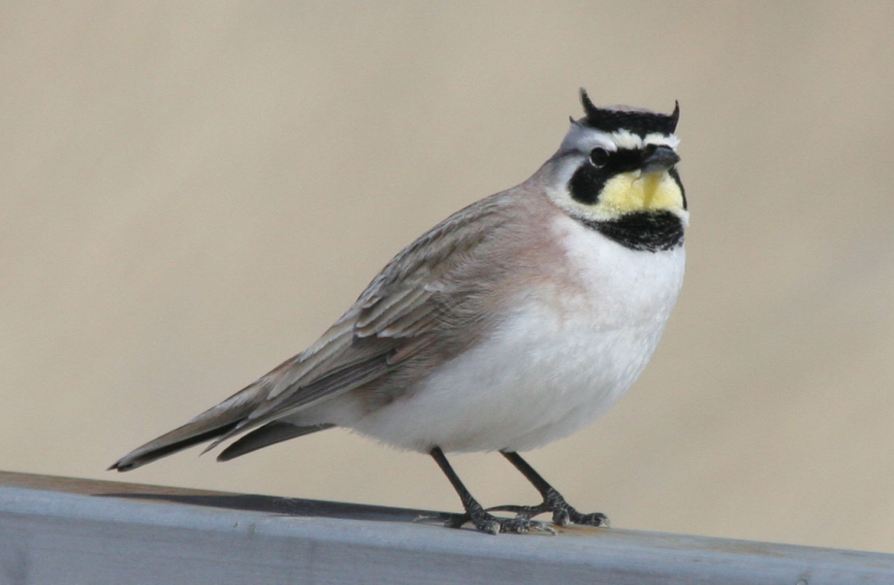
Birds and Industry
A long term relationship...
“Since we cannot conveniently abolish the telegraph, we must be content with fewer birds. The only moral I can discern is that larks must not fly against telegraph wires.”
Coues, E. The Destruction of Birds by Telegraph. The American Naturalist, Vol. 10, No. 12 (Dec., 1876), pp. 734-736
Horned Lark
Notes:
Conflict between birds and industry is not a modern problem, and has been observed alongside industrial development throughout history.

Slide 10
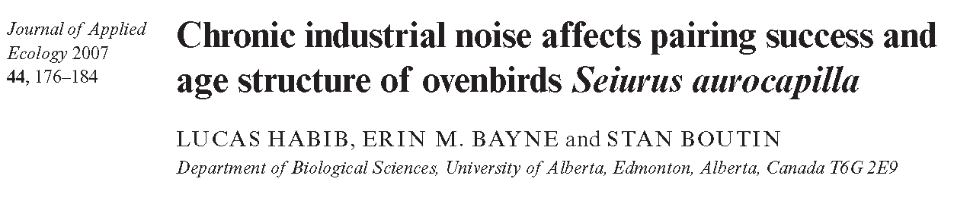
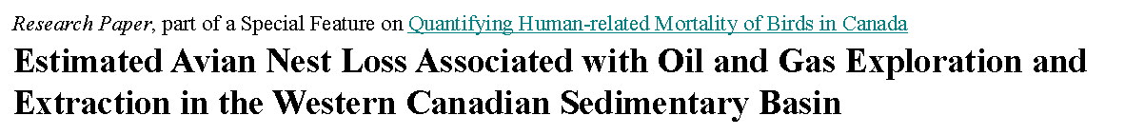
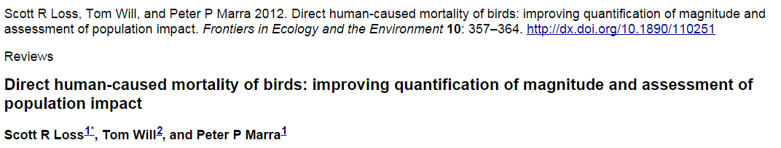
Birds and Industry
An established body of information exists
Impacts of various industrial interactions continue to be defined...
Notes:
Scientific literature continues to grow, and this information will be useful for resource managers.

Slide 11
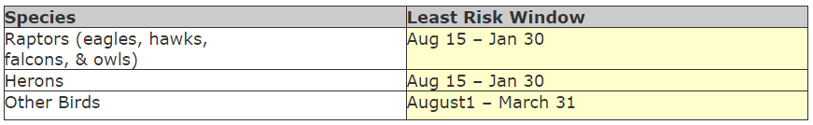
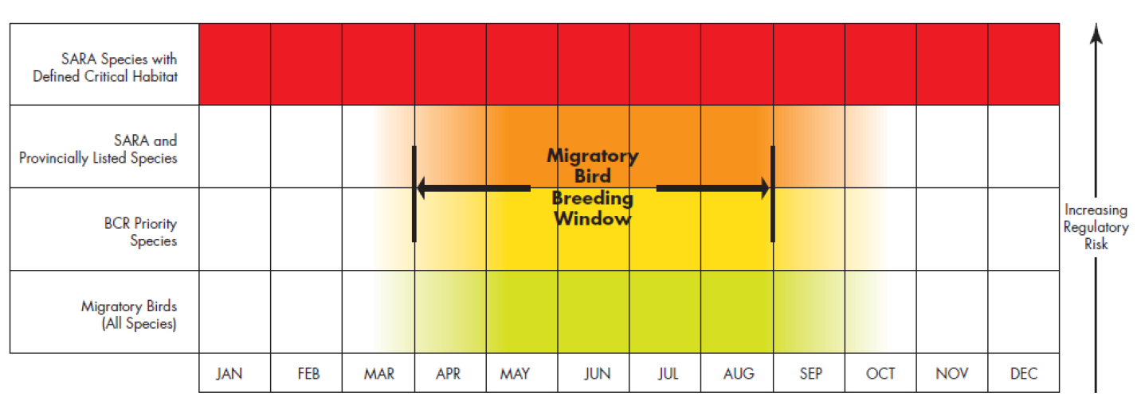
Birds and Industry
Regulatory standards devised from existing information
http://www.env.gov.bc.ca/wsd/regions/okr/wateract/workwindows.html
http://www.cepa.com/wp-content/uploads/2014/01/Migratory-Birds-Sept-26-2013-for-Publication.pdf

Slide 12
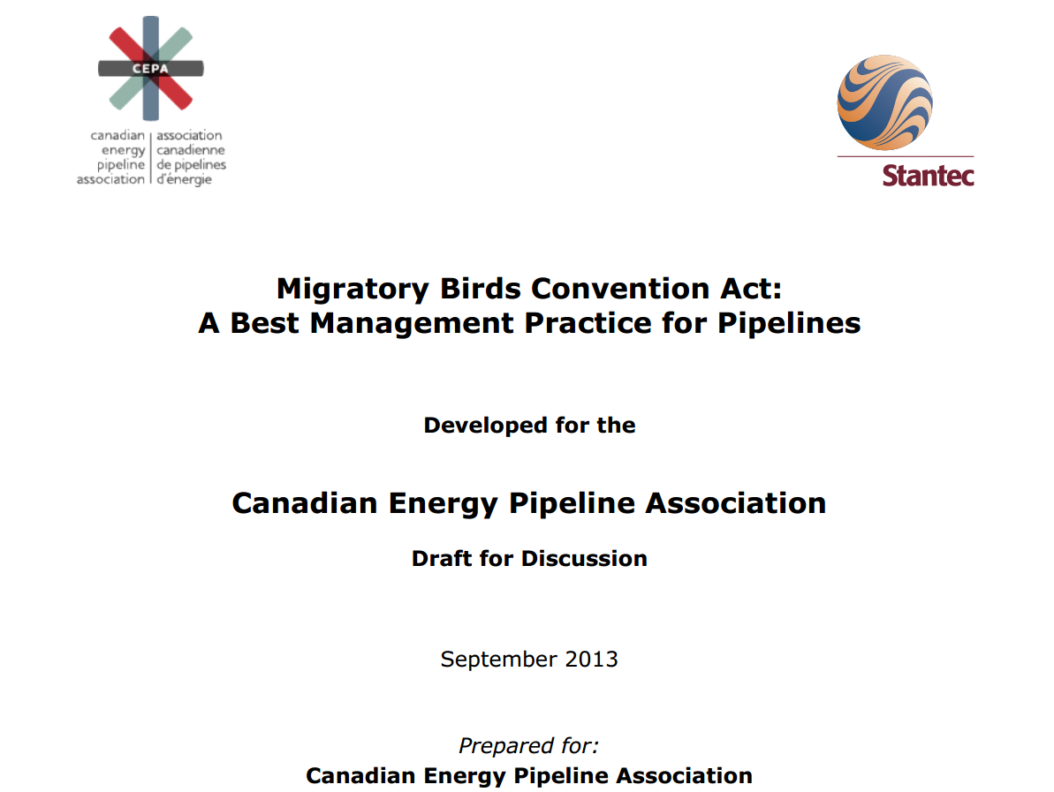
Industry Response
Best Management Practices developed to minimize impact
http://www.cepa.com/wp-content/uploads/2014/01/Migratory-Birds-Sept-26-2013-for-Publication.pdf

Slide 13
Birds and Pipelines
Interactions between birds and pipeline operations can be identified and managed to minimize risk.
Greatest risks associated with construction of new lines and maintenance activities on existing assets.
  Maintenance of existing pipelines/infrastructure
  Maintenance of vegetation on established right-of-way (RoW)
    CSA Z662 Oil and Gas Pipelines Systems 10.6.1 & 10.6.2
    National Energy Board Onshore Pipeline Regulations

Slide 14
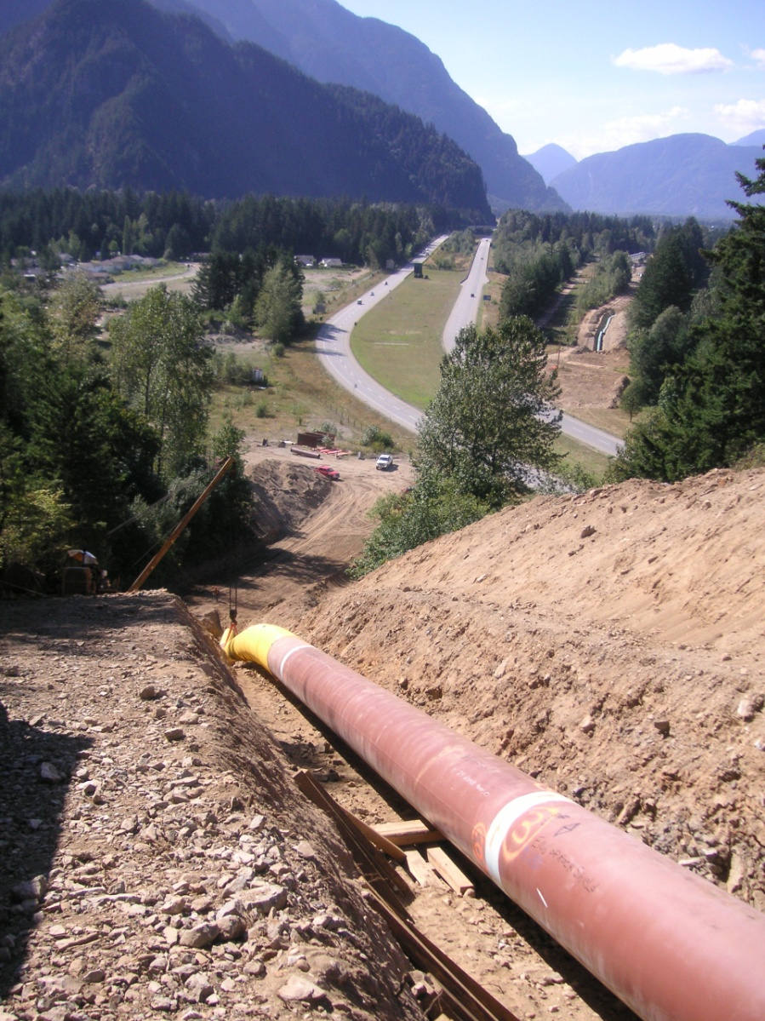
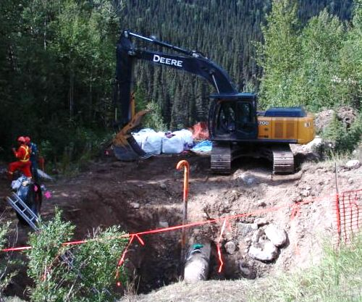
Operations and Maintenance
    Annually Spectra Energy spends ~ 400 million dollars in Canada inspecting and maintaining existing facilities.
Notes:
First Picture shows routine maintenance activities
Second picture shows pipeline maintenance activity in the congested fraser valley, note residences in top left of frame, and 2 lane highway crossing over the pipeline.
Discussion on these pictures as to how routing operations and maintenance activities, as well as new pipeline installation regularly
Spend ~$400 million/yr in Canada inspecting and maintaining existing facilities. These activities (especially on the pipeline RoW) often involve ground disturbances, and we all know how ground disturbances can contribute to the spread of invasive plant species.

Slide 15
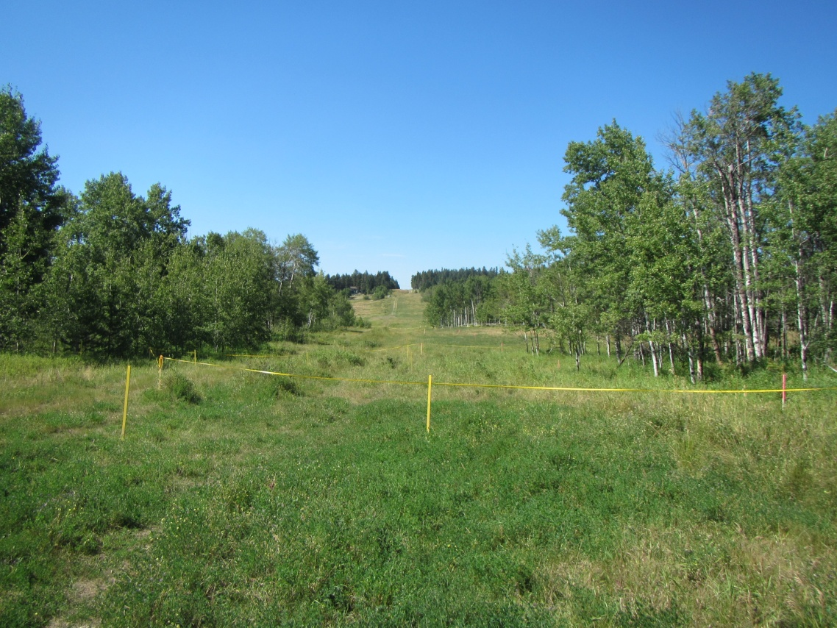
Operations and Maintenance
Potential points of conflict:
  Vegetation Disturbance
  Noise/ Activity
  Shared with new line construction
BMP’s
  Timing
  Machine free zones
  Site specific innovation
Ribbon delineating travel corridor

Slide 16
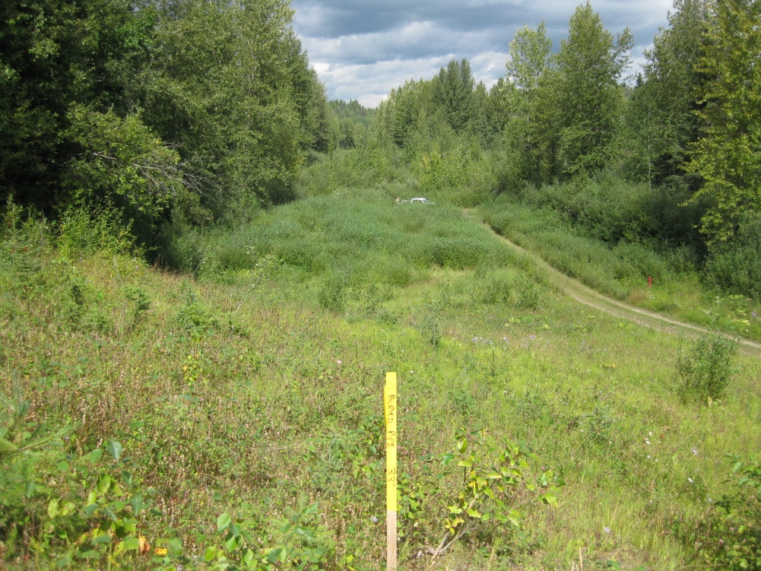
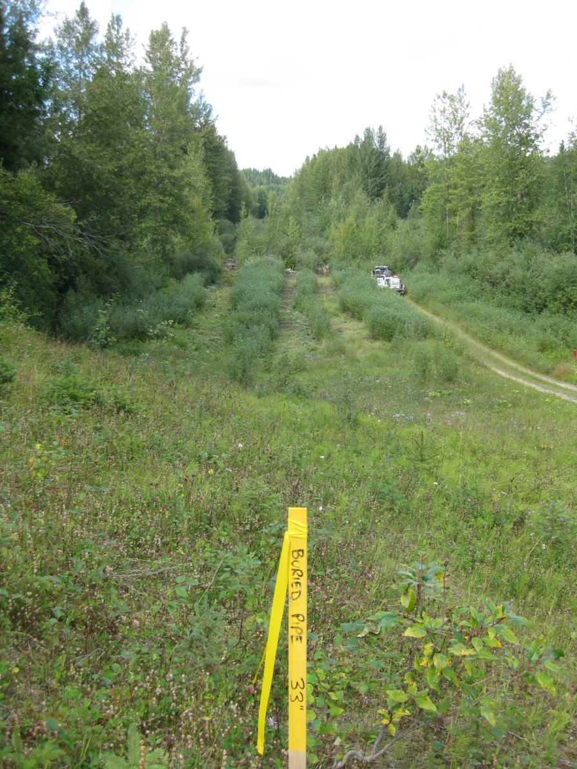
Project timing
Summer clearing using riparian zone BMPs.

Slide 17
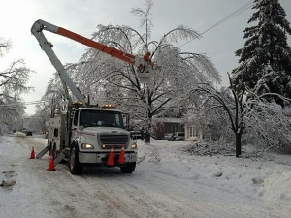
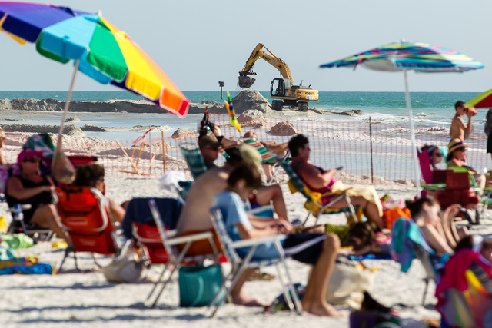
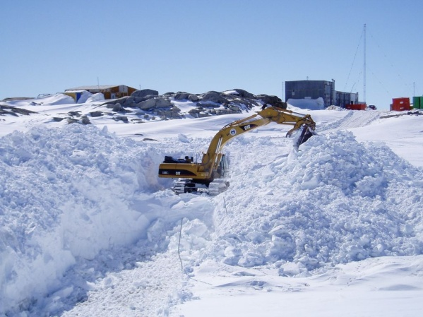
Project timing
Traditional preferred work windows conflict with potential nesting periods.

Slide 18
Timing modifications
Culture shift to change project timing
  Educate staff on migratory bird requirements
    Shift vegetation removal timing to less- traditional work periods
      Anticipate and accept changes in cost
      Cost increase mitigated by increased value of social licence
  Develop capacity amongst contractors
    Specialized equipment may be required
  Implement activities with minimal impact
    New timing may result in new challenges with permitting, access, and landowner relations

Slide 19
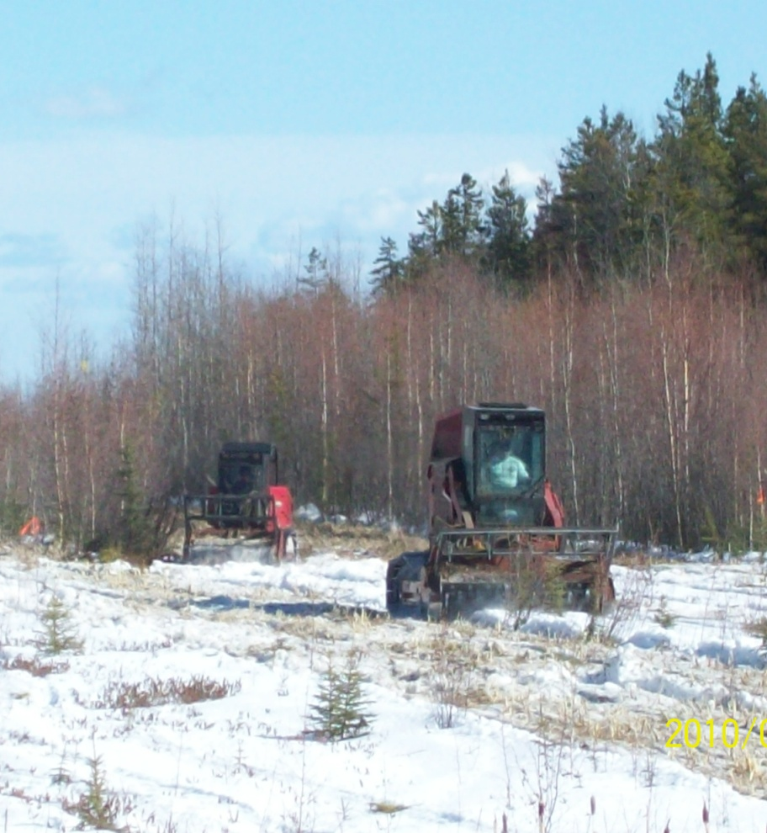
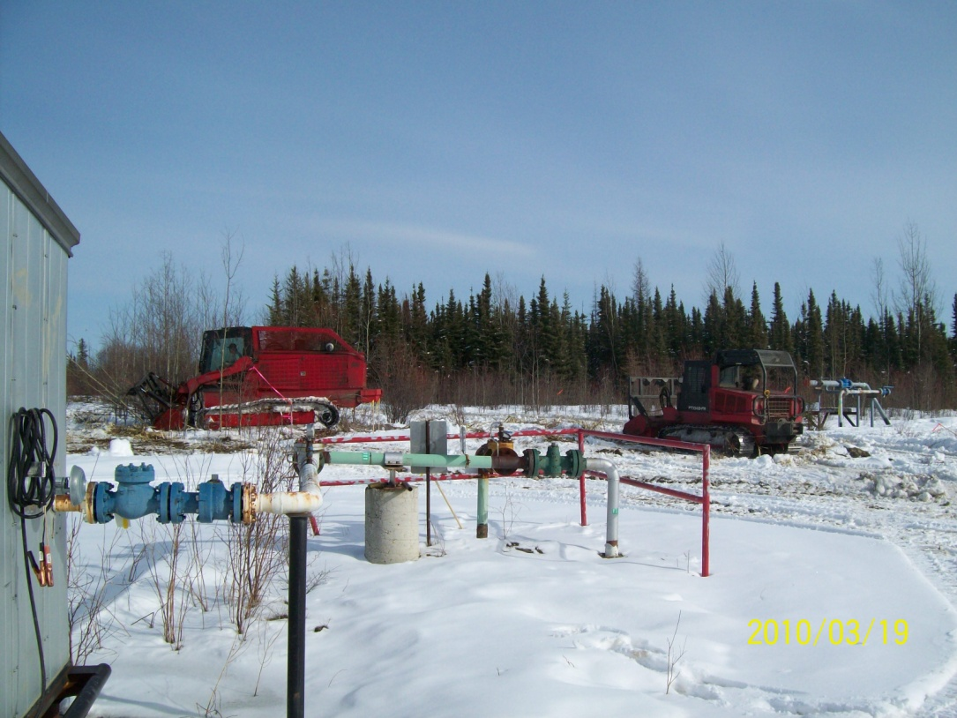
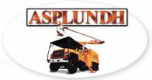
Veg. Mgt. In Winter

Slide 20
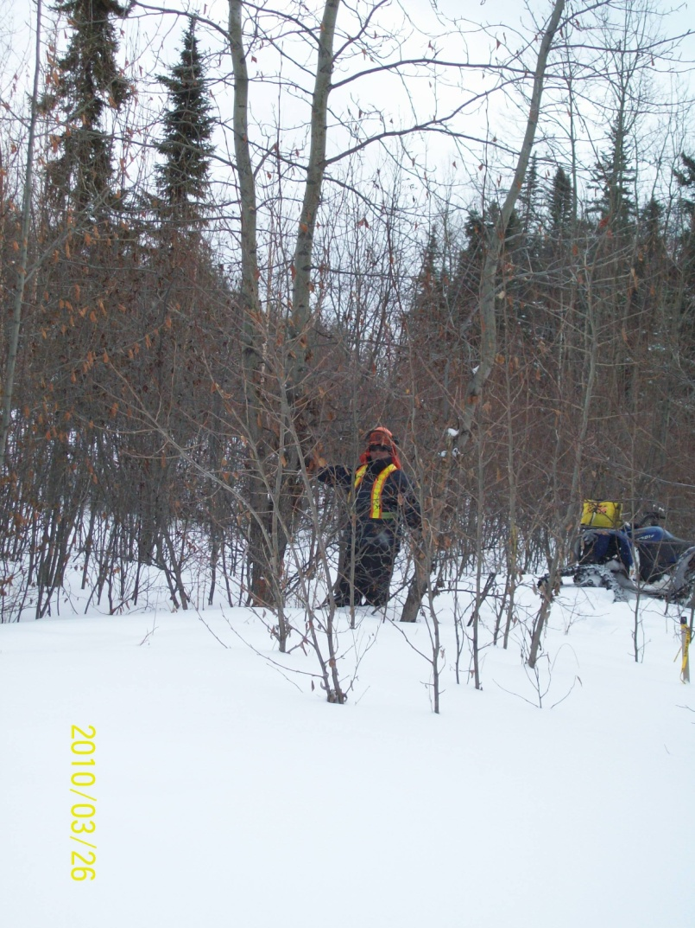
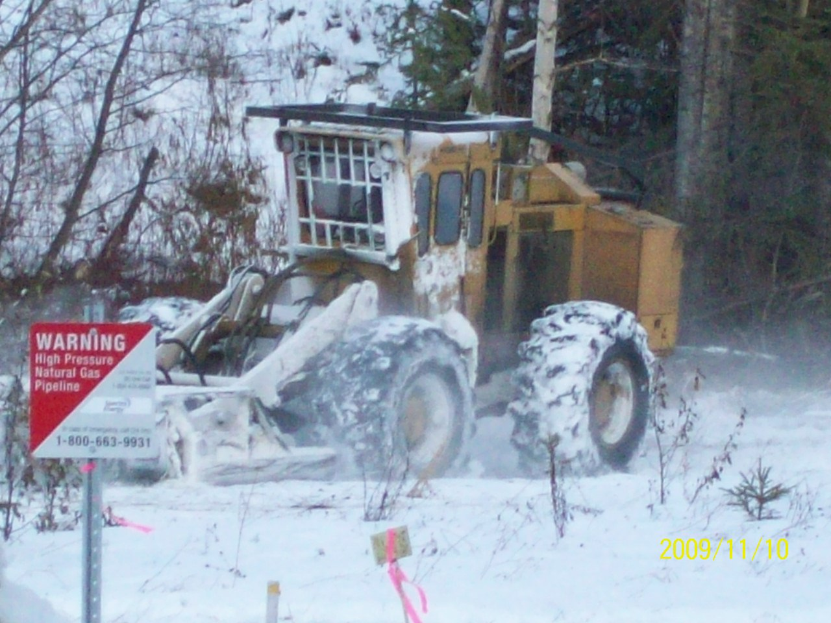
Veg. Mgt. In Winter
A routine activity in NE BC, may be considered in southern areas more frequently.

Slide 21
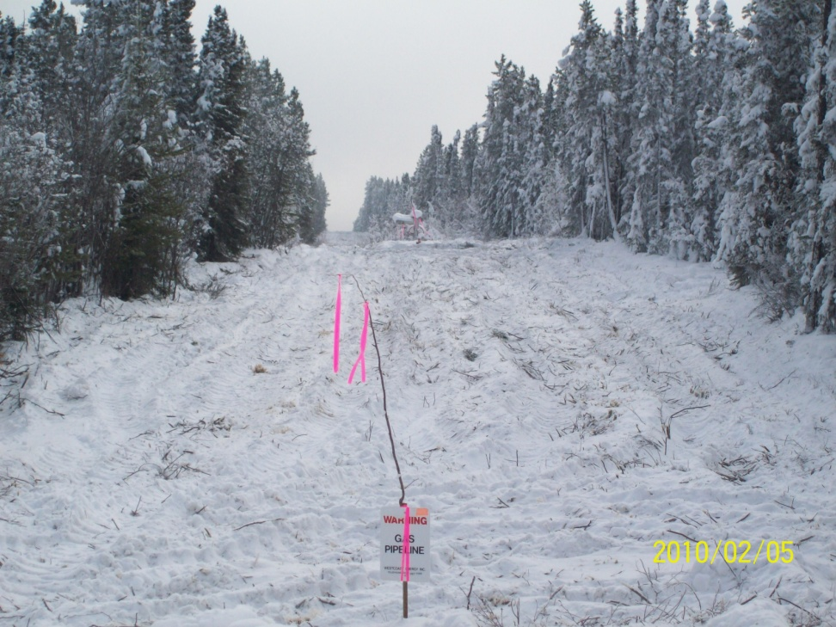
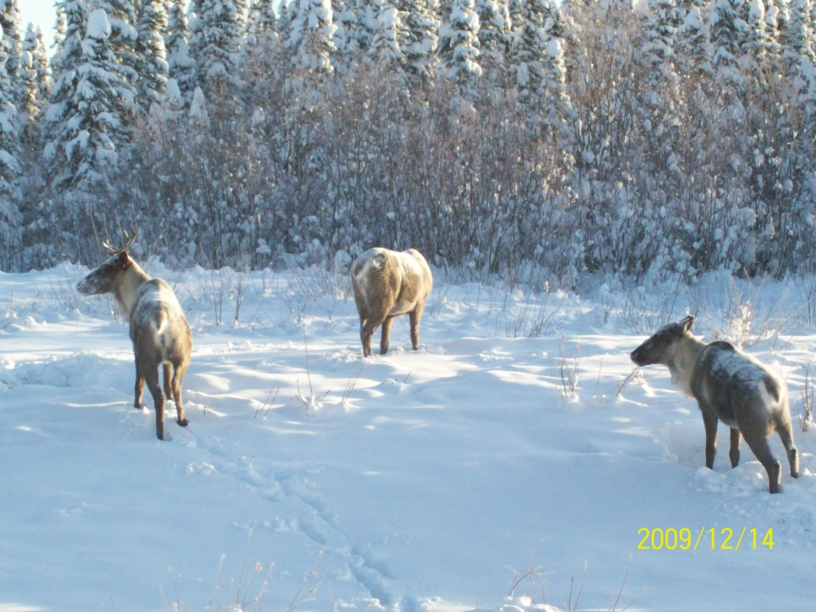
Veg. Mgt. In Winter
Required works can be completed with reduced impact, when using other BMPs.

Slide 22
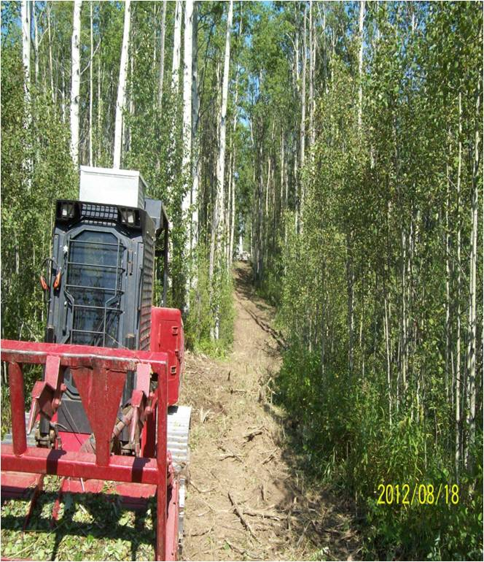
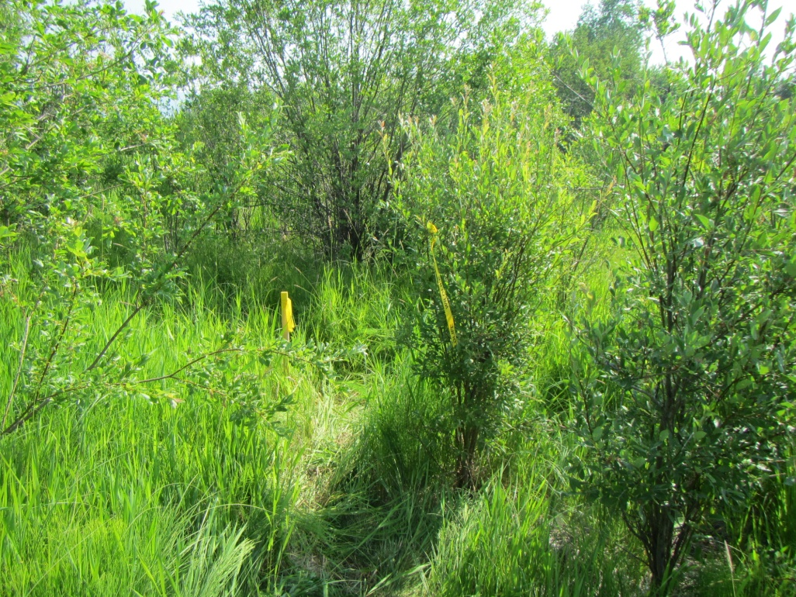
Interactions between birds and pipeline operations can be identified and managed..
Notes:
Mulcher
Note ribboned tree to mark nest area.

Slide 23
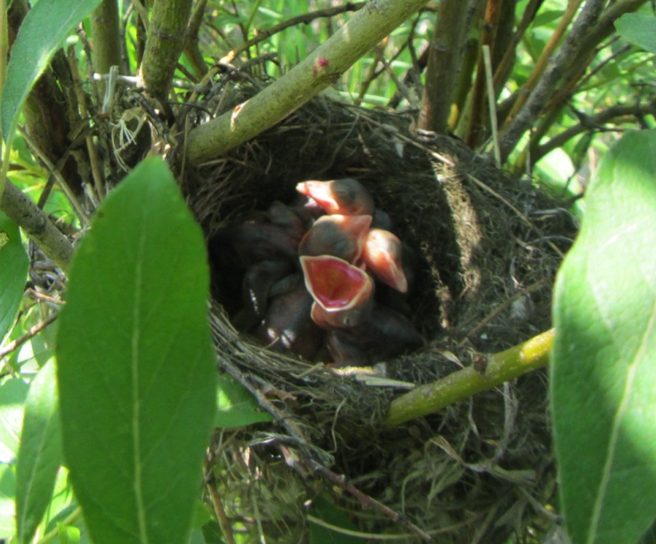
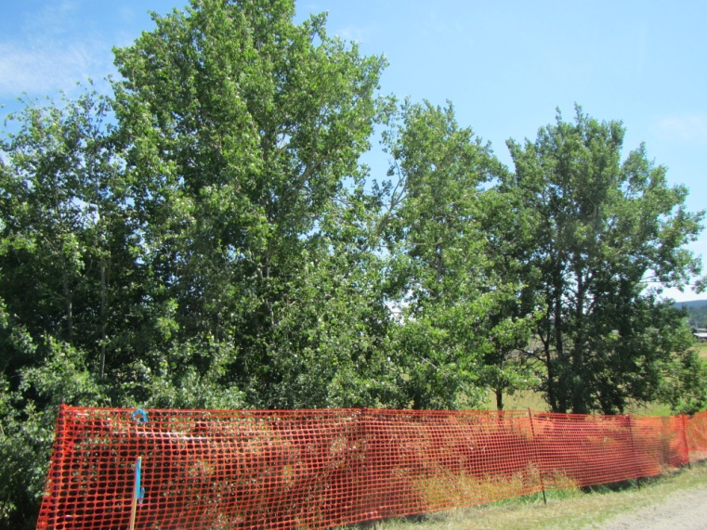
Vegetation Removal
Timing may conflict despite best efforts
  Bird nest surveys required
    May need to be an ongoing activity.
    Results will impact project
  Access restrictions may be required
    For duration of project within risk window
    Side benefit may be a reduced footprint

Slide 24

Nest surveys
Diligent assessment of area facilitates management...

Slide 25
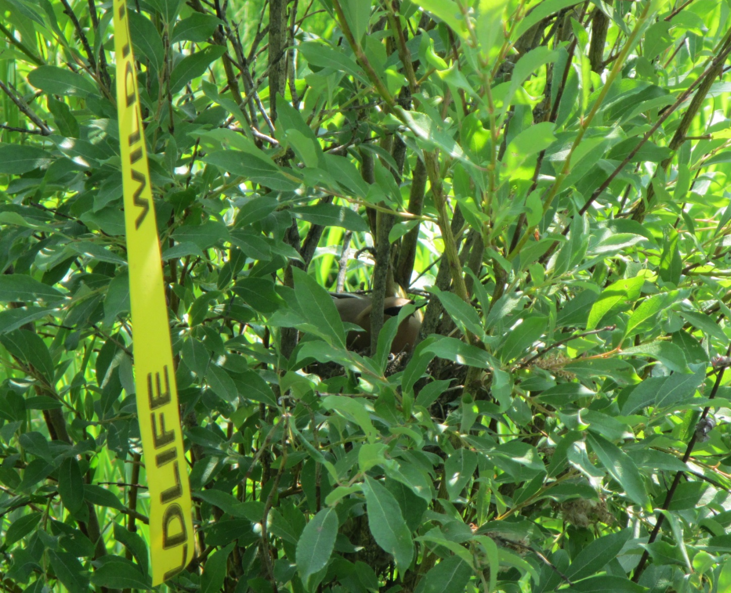
Nest Area Management
BMPs followed, activities in area reduced...

Slide 26
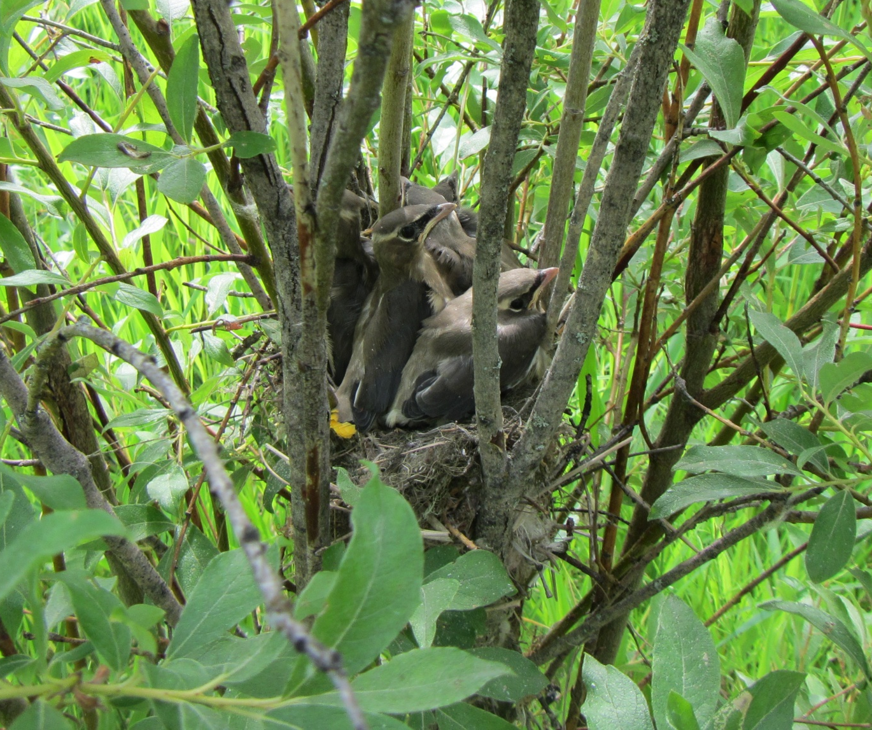
Nest Management success
Minimized impacts, and a successful brood.

Slide 27
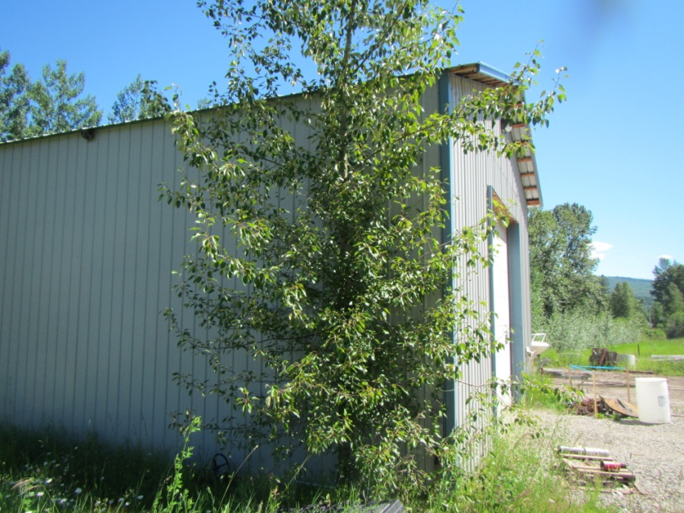
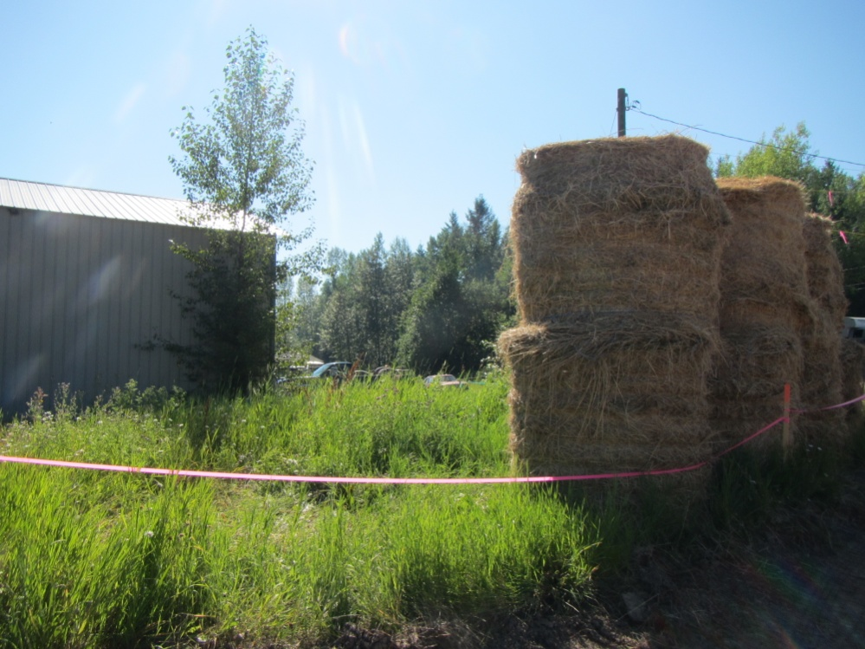
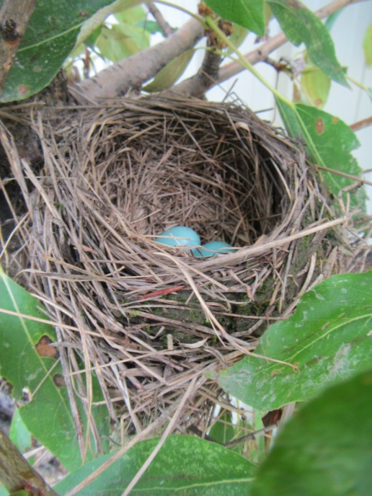
Site Specific Innovation
Adaptive measures to facilitate activity.
Hay Bales used as sight/sound barrier.

Slide 28
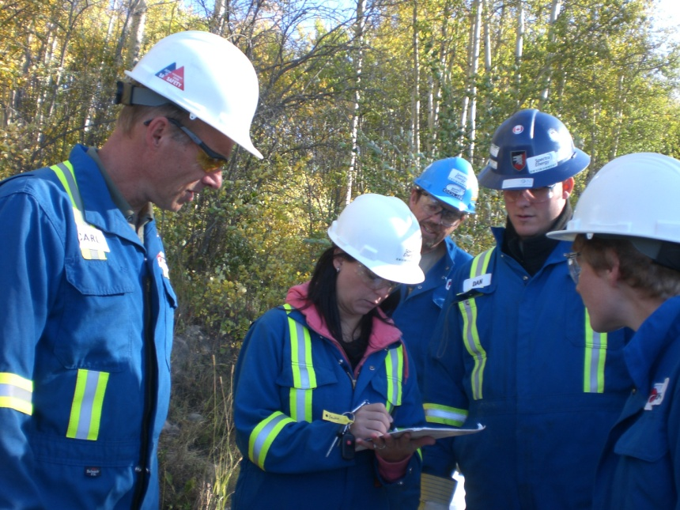
Site Specific Innovation
Innovative approaches require expert advice
  Utilize BMPs and work with conditions at hand
  Risk of failure must be articulated to project ownership
  Regulatory approval preferred

Slide 29
Challenges Remain
No single BMP document is perfect, challenges will be found
  Industry migratory birds BMP places unrealistic limitations on aerial reconnaissance programs
    Proposed minimum ceiling height limitations unattainable
      Integral part of pipeline integrity maintenance program
  Contradictions between provincial timelines and industry BMP
    Manage to the best standard when possible, triage to provincial standard when needed
      Due diligence still required

Slide 30
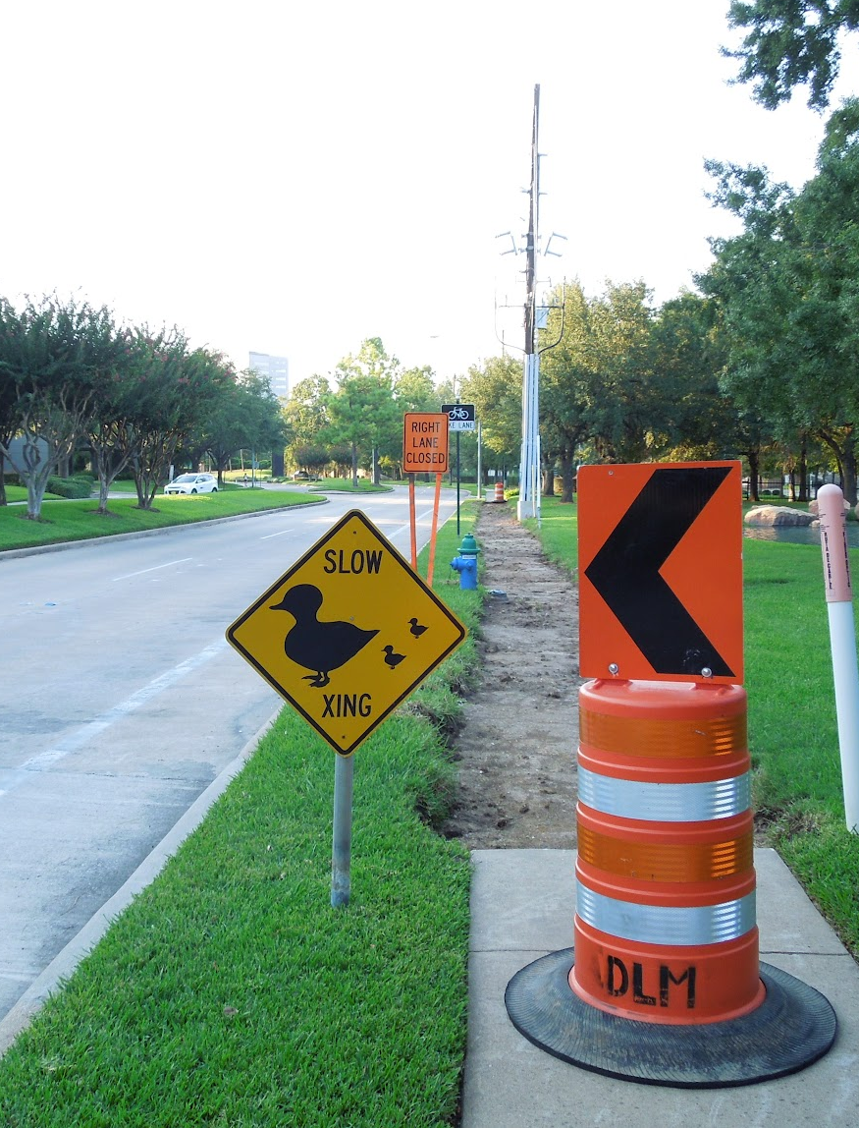
Solutions
Multiple Best Management Practices
  Representing industry and regulators
  All can be referenced in contracts
  Best use becomes regular practice over time
  Allows for problem solving in changing conditions

Slide 31
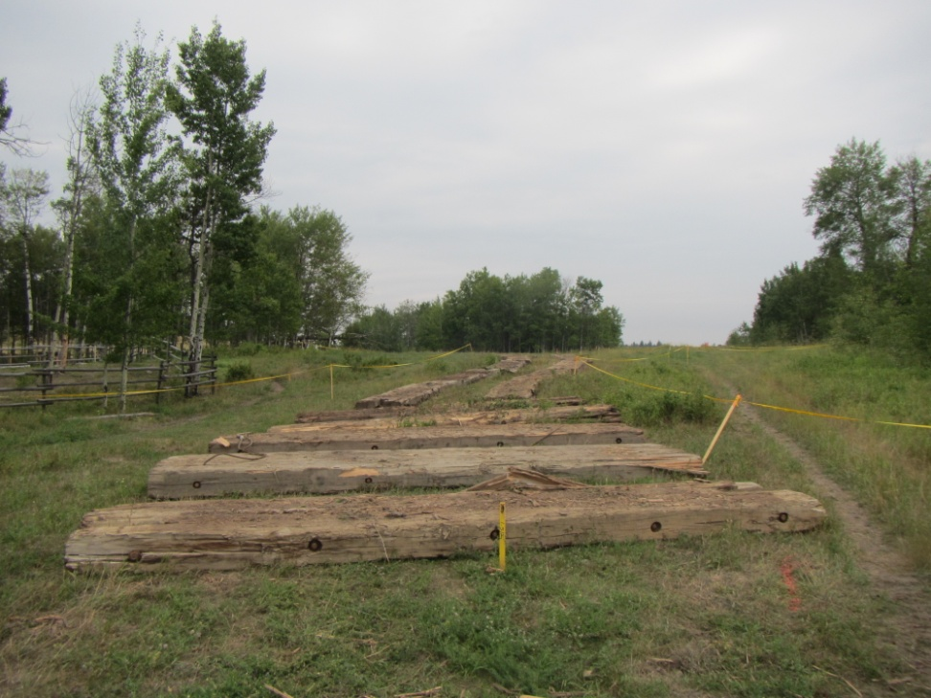
Access route change to avoid nesting areas resulted in the need to add protective matting overtop of active pipelines.

Slide 32
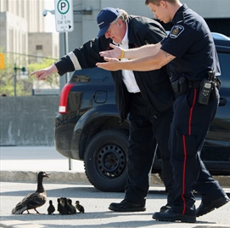
Solutions
Employee education
  In-house environmental training required
  Necessary for all levels (field to management)
  Complimented by BMPs
  Facilitates information gathering and promotes active management

Slide 33
Conclusions
The challenges associated with migratory bird habitat management on industrial right-of-ways are not insurmountable
  Innovation and BMPs mitigate operational disturbances
  Appropriate timing of disruptive activities reduces impacts
Migratory bird considerations will continue to be a part of linear corridor activities.
  Continued education of workforce required
  Contractors must also adapt and assist with problem solving

Slide 34
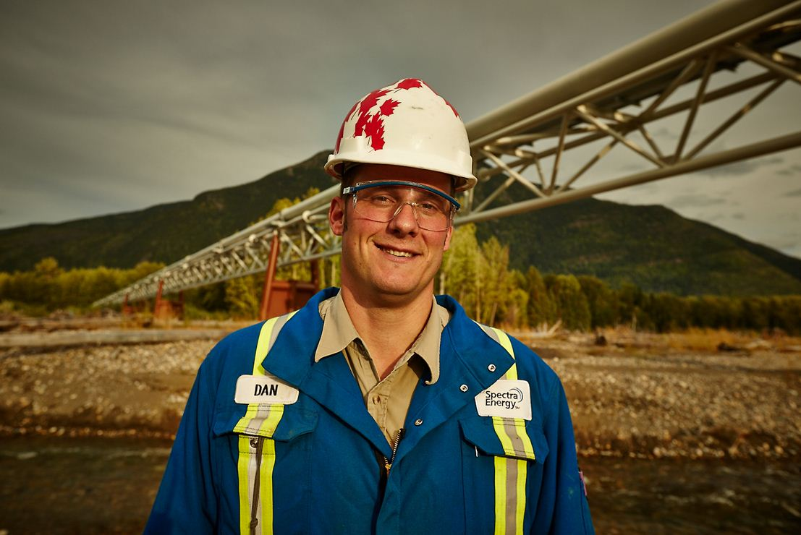
Thank You!

Slide 35




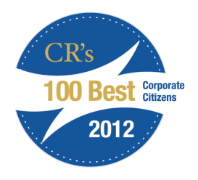





Sustainability Recognition
Environmental Social Governance Performance
Dow Jones Sustainability Index (DJSI) | 3rd time on the World Index and 5th consecutive on North America Index
Carbon Disclosure Project (CDP) | Named to the 2012 Global 500 and S&P Carbon Disclosure Leadership Indexes; 4th year to be named to one or more leadership index
Recognition and Awards
Ethisphere | World’s Most Ethical Companies, 2012
Newsweek Green Rankings | #381 on the top 500 North American companies and 14th in the energy sector
Corporate Responsibility Magazine | Top 100 corporate citizens: ranked 7th overall and first among energy companies
Employer Awards | Top 100 workplaces in Houston; Top 100 employers in Canada Canada’s Greenest Employers - Union Gas among the nation’s most environmentally-aware companies Corporate Equality Index Anti Defamation League: Community of Respect

