Slide 1

IVMA of BC
October 29, 2014

Slide 2

Global network of experience and expertise
7 field professionals across Canada
5 support personnel for field staff

Slide 3

Dow AgroSciences Pyridine Chemistry
Fluroxypyr - 2012
Aminopyralid - 2006
Clopyralid – 2000’s
Triclopyr – 1980’s
Picloram – 1960’s
Notes:
Pic 1964
Tric late 1980’s
Glyphosate in IVM late 1990’s
Clopyralid in IVM early 2000’s
Aminopyralid in IVM 2006
ClearView 2010, Sightline 2013

Slide 4













Aminopyralid
Clopyralid
Triclopyr
Picloram
1964
1970’s
1990
2000
2006
2013
2015

Slide 5
Aspect
ClearView Brush
Brush Portfolio

Slide 6
The new Tordon 101
Picloram, present as triisopropanolamine salt 97.5 g/L
2,4-D, present as choline salt 360 g a.e./L
Pending PMRA approval - February 2015

Slide 7
2014 Research Authorizations:
24 – 4 ha RA’s across Canada
Ground application
  Broadcast
  Hose & Handgun
All applications applied with GF-303 surfactant
Thanks to Great Lakes Power, Algoma Power, CP Rail, Asplundh, JL Vegetation Solutions Ltd, Spectrum Resource Ltd.

Slide 8
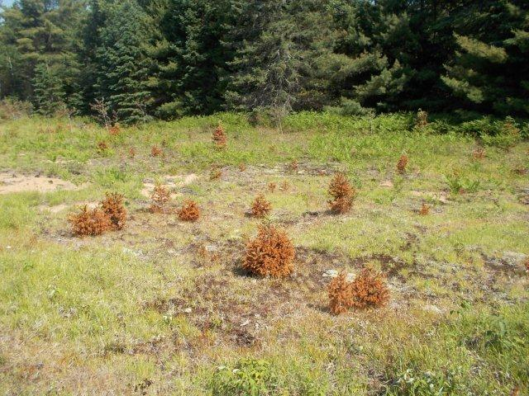
Aspect + GF-303 – Applied Directed Stem
6.67L/ha
9 days AA
Great Lakes
Power, ON

Slide 9
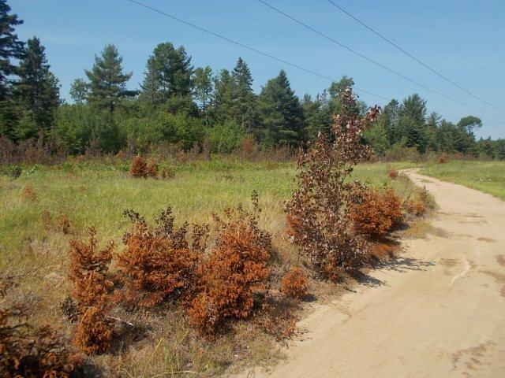
9 days AA

Slide 10
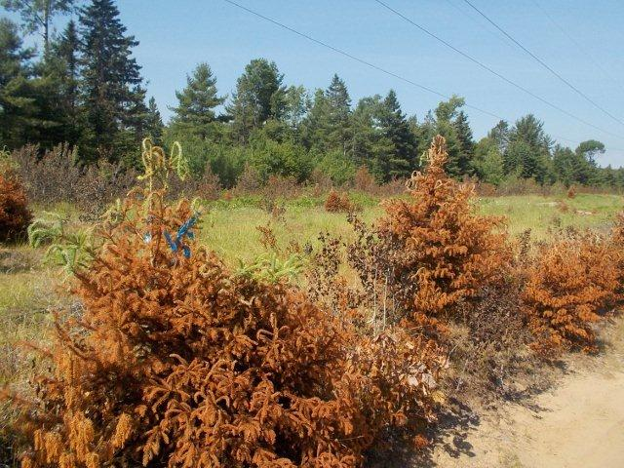
9 days AA

Slide 11
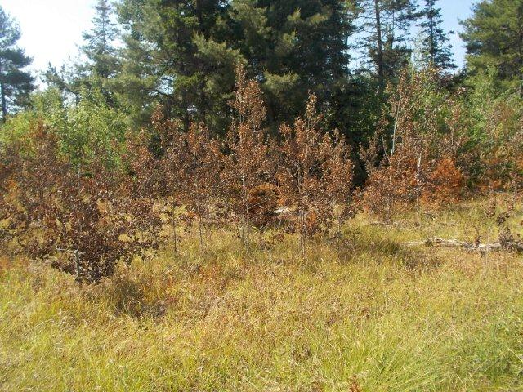
10 days AA

Slide 12
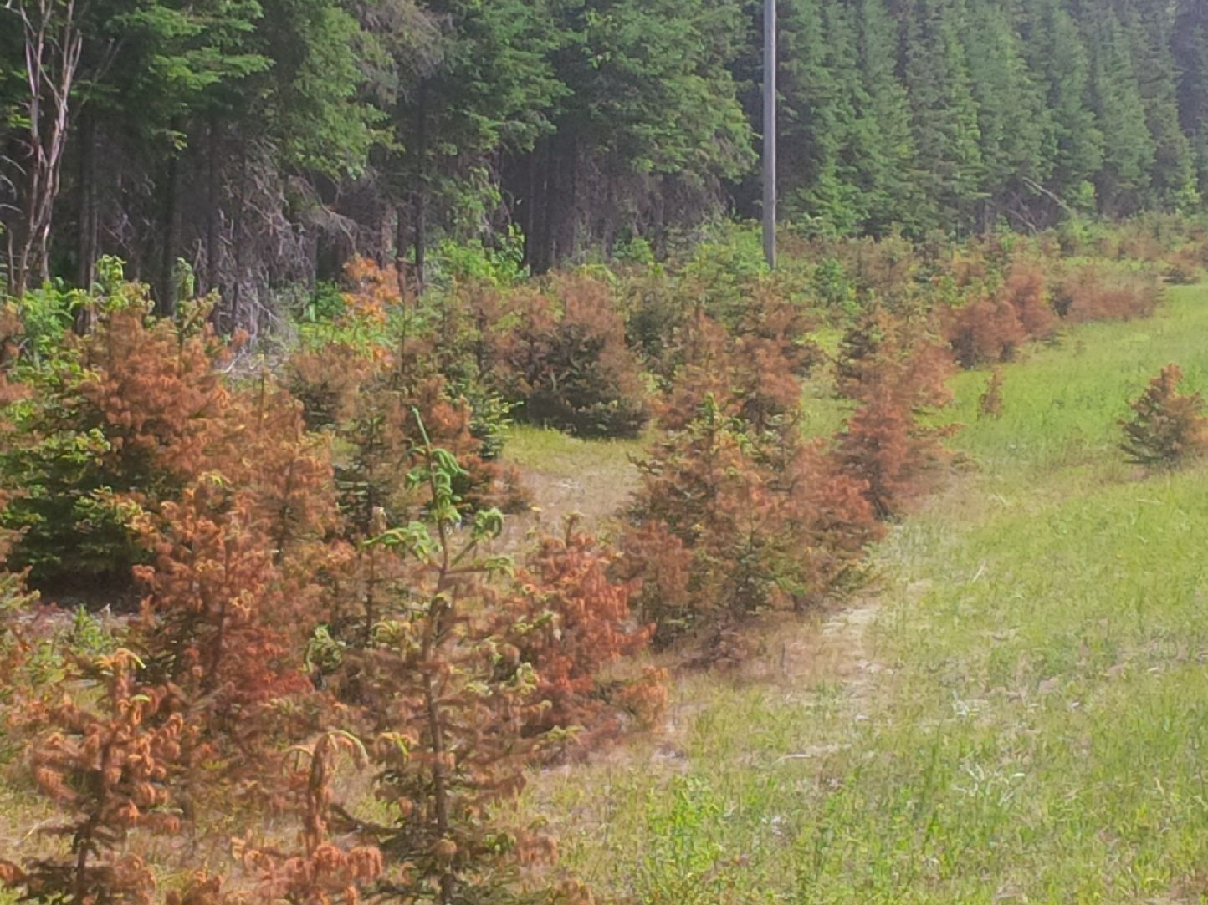
16 days AA
Algoma Power, ON

Slide 13
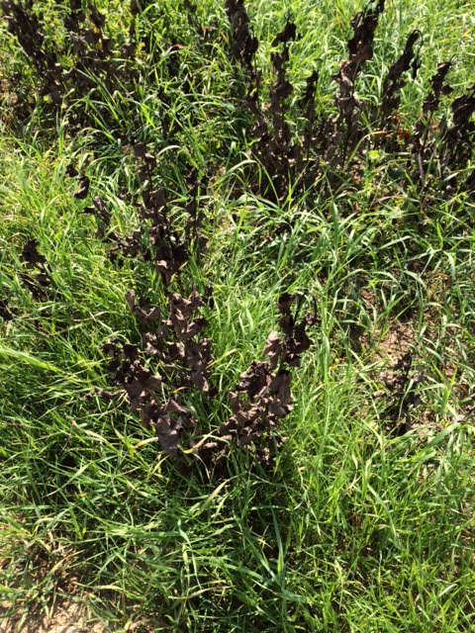
21 days AA – Broadcast
4.67 L/ha
Beaver County, AB

Slide 14
Trusted results – Best control and safe to grass
Freedom to operate - Removal of applicator restrictions
Easy to use - formulated as a liquid
Innovative formulation - lower use rates

Slide 15
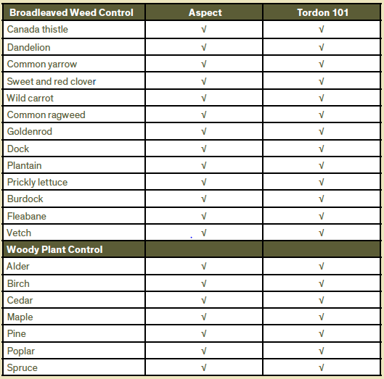
Trusted Results

Slide 16
Innovative Formulation
 | Aspect L/ha | Tordon 101 L/ha
Broadcast weeds | 4.67 | 7
Directed stem | 6.67 | 10
Broadcast trees | 11.5 | 17
1 jug of Aspect treats 50% more area vs. Tordon 101

Slide 17
Applicator Freedom to Operate
Removal of applicator restrictions
  Daily application limit per person
  Respirator requirement for handheld applications

Slide 18
Aspect
February 2015 approval
Aspect will be available for 2015

Slide 19
ANOTHER CLEAR CHOICE
FOR PROFESIONAL
RIGHTS-OF-WAY
MANAGERS

Slide 20
Provides control of hard-to-control woody species including Black Spruce
Excellent control of broadleaf and invasive weeds
Contains 3 active ingredients including aminopyralid

Slide 21
Enables applications up to the drip line of non-target woody species
Easy to use and has an excellent user safety profile
Excellent for sensitive foliar programs

Slide 22
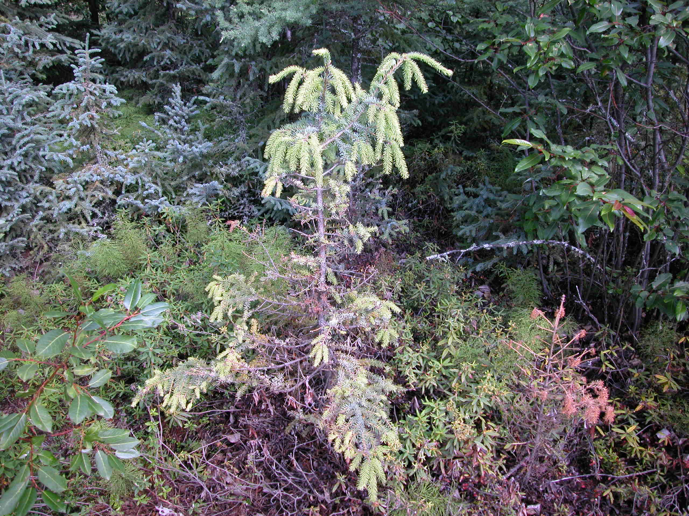
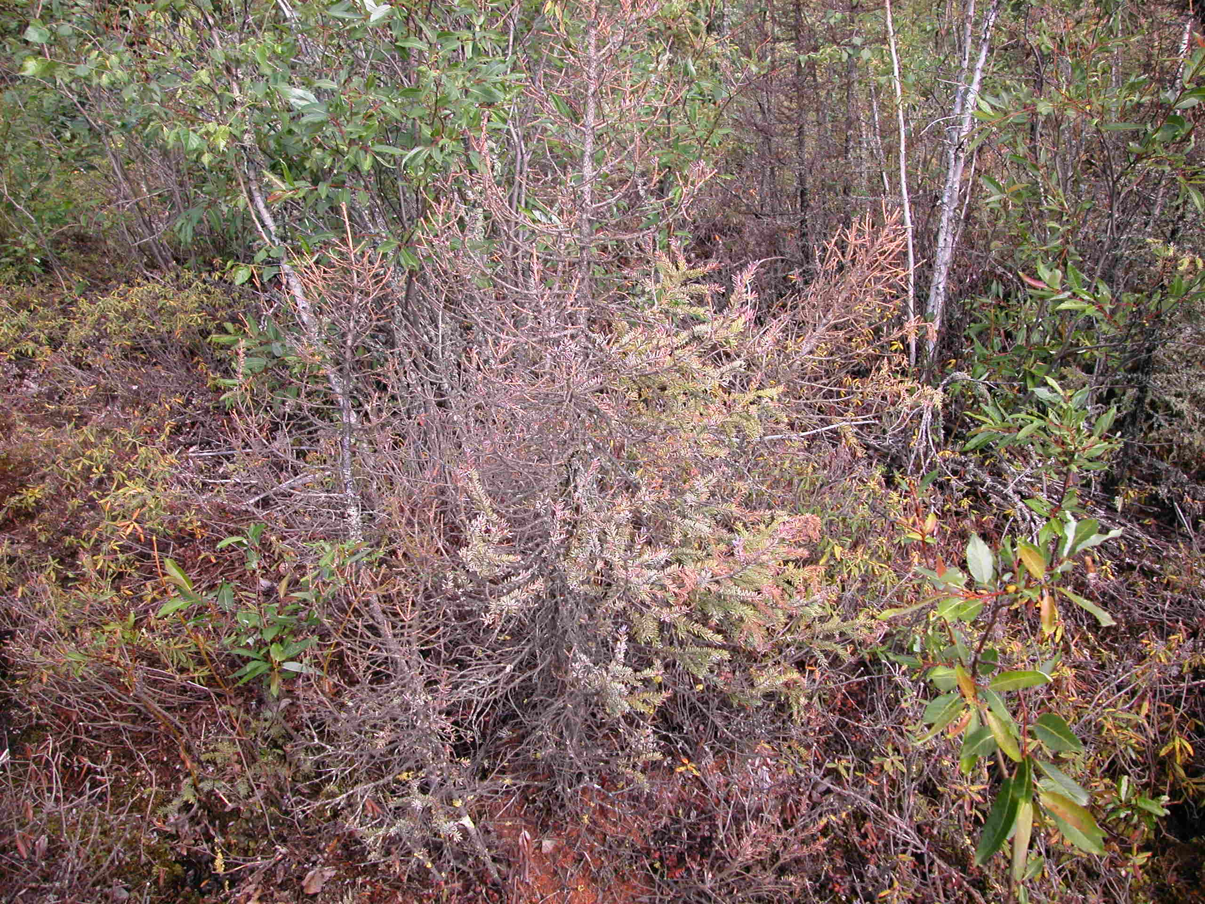
30 DAA
60 DAA

Slide 23
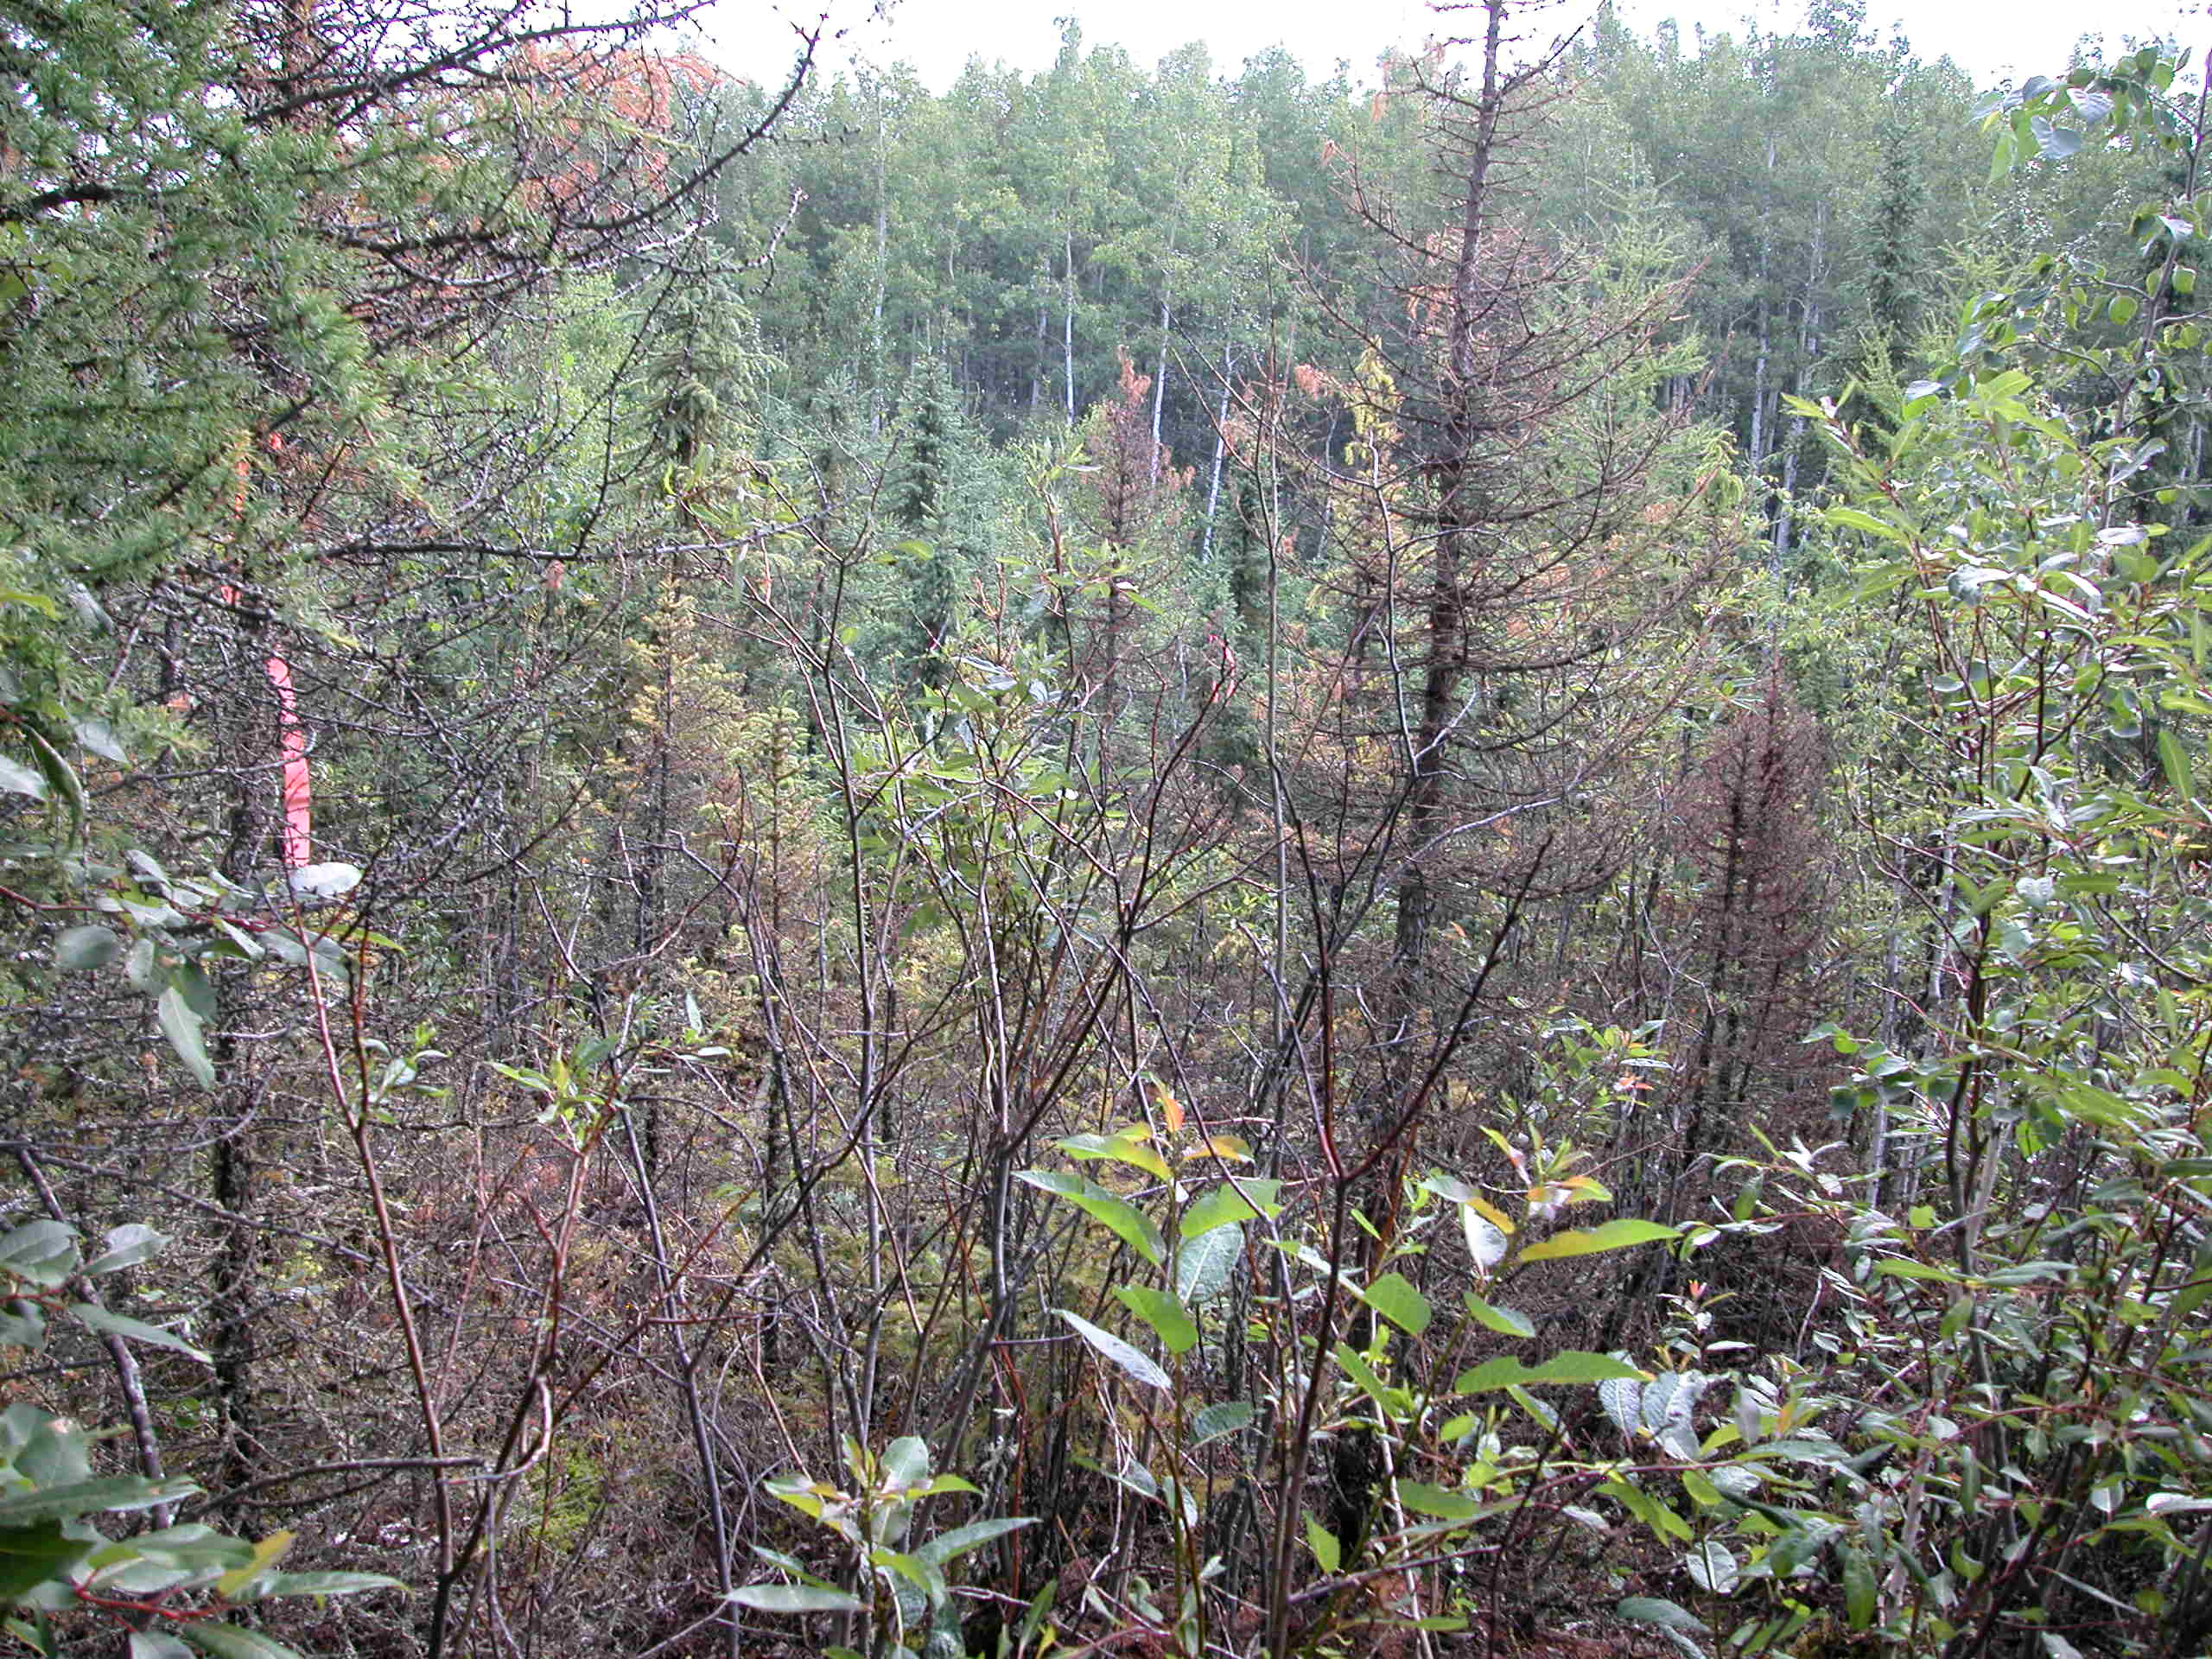
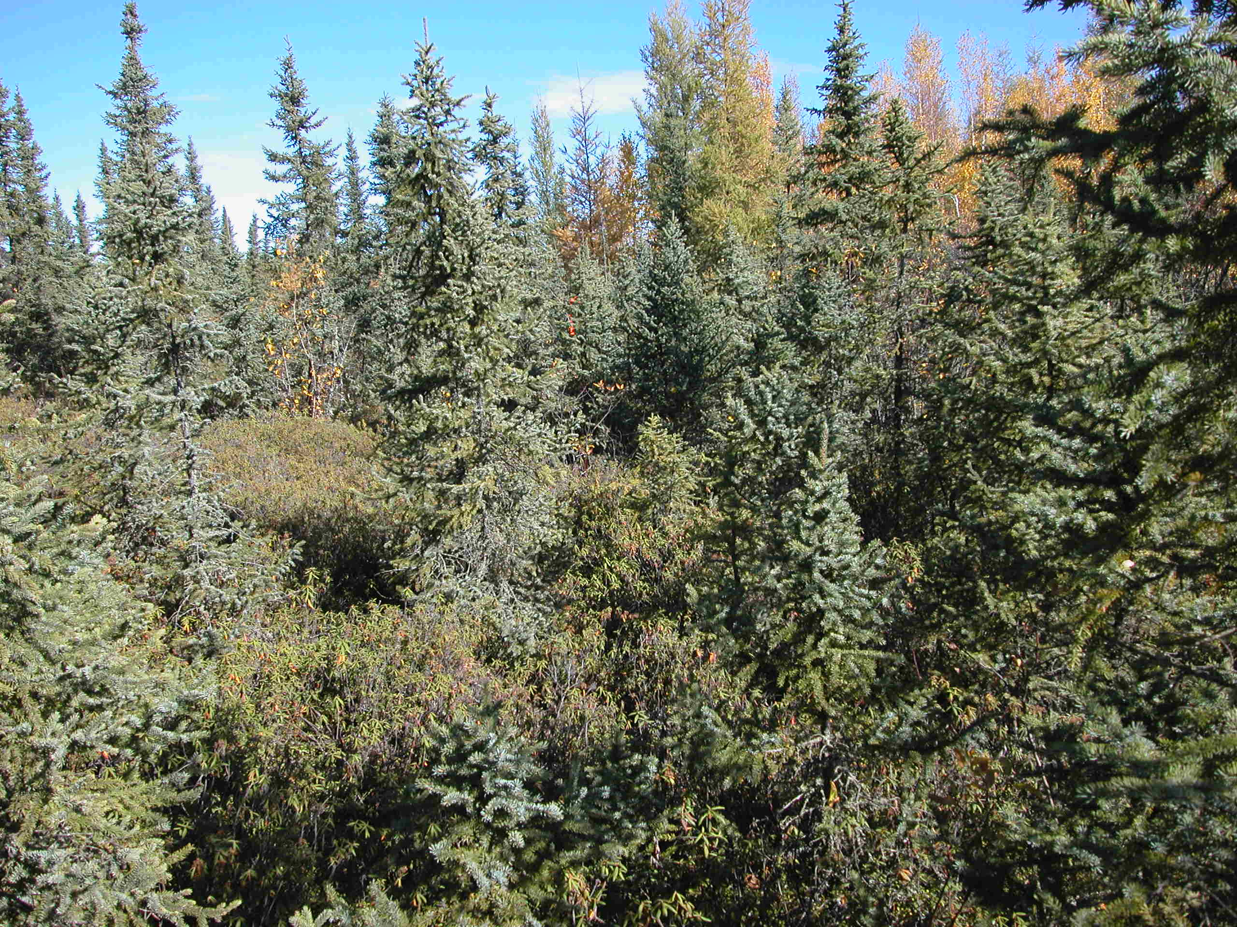
Untreated
90 DAA

Slide 24
Table 1. Tree Efficacy - Black Spruce – ClearView Brush Herbicide versus Standard-Tordon 101. Mean Control – All Observations
 | Trial | Common Name | BAYER Code |  | Product |  | T101 | ClearView Brush
 |  |  |  |  | Rate (g Pr/ha) |  | 1% V/V | 0.4%V/V + 230 g Pr/ha
 |  |  |  |  | Surfactant Rate |  | 0.375% V/V | 0.375% V/V
 |  |  |  |  | Surfactant |  | Sylgard | Sylgard or Intake
 |  |  |  |  | % Mean Control |  | 87.2 % | 87.3%
 |  |  |  |  | #Observations over time |  | (6) | (6)
 |  |  |  | DAA
 | DDH1047 | Black Spruce | PIEMA | 276 |  |  | 84 | 90
 | DDH1047 | Black Spruce | PIEMA | 369 |  |  | 90 | 80
 | DDH1047 | Black Spruce | PIEMA | 756 |  |  | 90 | 83
 | DDH1145 | Black Spruce | PIEMA | 379 |  |  | 83 | 87
 | DDH1145 | Black Spruce | PIEMA | 723 |  |  | 87 | 89
 | DDH1347 | Black Spruce | PIEMA | 89 |  |  | 89 | 95

Slide 25
Brush Solutions
Control of tough brush, perfect for sensitive programs
Trusted brush control, cost effective and easy to use
Reliable deciduous brush control
Convenient ready to use product for selective brush control

Slide 26
IVM Adjuvant - Gateway
Gateway is an adjuvant registered for use with a variety of IVM products in Canada
Gateway is a blend of non-ionic surfactants and an innovative Paraffinic Oil unique to Dow AgroSciences
This adjuvant has undergone extensive testing globally and is widely used in AUS and NZ

Slide 27
IVM Adjuvant - Gateway
Registered Rates = 0.25-1% v/v
Gateway will be included with purchases of ClearView and Sightline in 2015
Gateway can be used as a replacement to Sylgard or Xiameter Fluid for use with products such as ClearView Brush and Aspect (2015) for hard-to-control brush applications

Slide 28
Thank you

