Slide 1
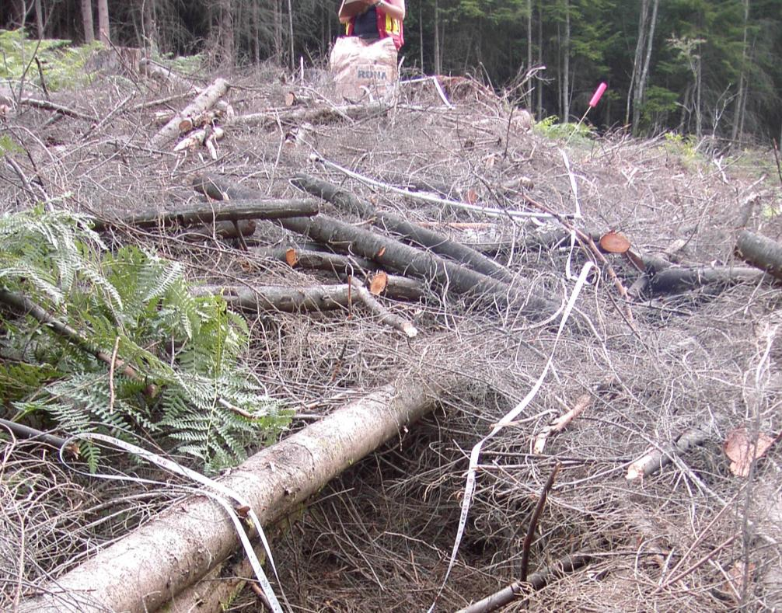
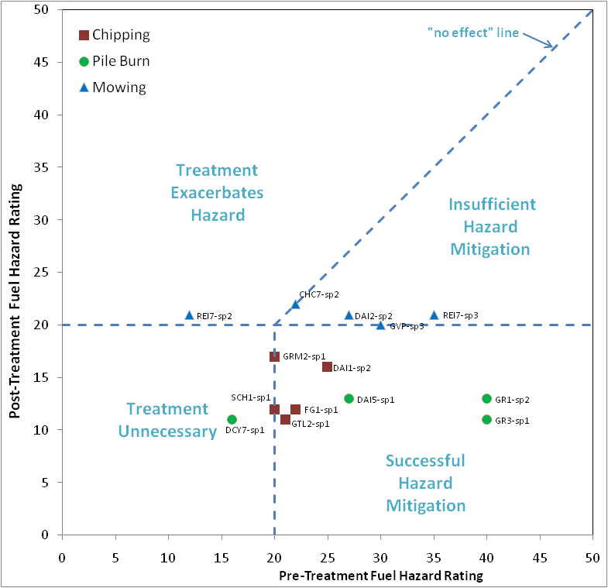
What’s A Hazard and What’s Not
By
Bruce Blackwell, BA Blackwell & Associates Ltd.
Credit: Gwen Shrimpton, Vegetation Management, BC Hydro/BCTC

Slide 2
Objectives:
Educate about fire hazards and liability related to vegetation management
Overview of Fuels Research Project
Introduce Fire Hazard Rating System

Slide 3
Outline
Why Manage Hazardous Fuels?
Wildfire Regulation Section 10:
“A person carrying out an industrial activity that is a utility transmission operation, on or within 300 m of forest land or grass land, must maintain the site in a manner that prevents any fire from spreading from the site.”
Vegetation managers must be able to differentiate benign fuels from those that constitute a liability.

Slide 4
Basic Fire Theory
Measures of Fire Behaviour
Fireline Intensity
Rate of Spread
Weather Effects
Wind Speed
Fuel Moisture
Temperature

Slide 5
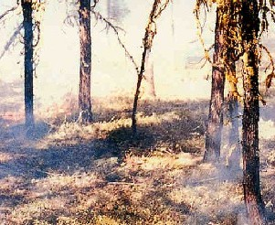
Basic Fire Theory
Fire Intensity Rank
http://bcwildfire.ca/fightingwildfire/firerank.htm
Rank | 1
Rate of Spread (m/min) | nil
Fireline Intensity (kW/m) | <10
Description | Smouldering ground or creeping surface fire
Qualitative Fire Behaviour | These fires have no open flame and produce white smoke
Response to Control Efforts | Firebrands and going fires tend to be virtually self-extinguishing unless high DC and/or BUI values prevail, in which case extensive mop-up is generally required.

Slide 6
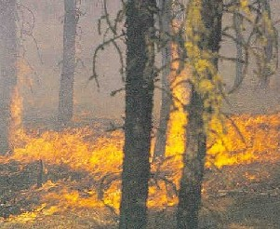
Basic Fire Theory
Fire Intensity Rank
http://bcwildfire.ca/fightingwildfire/firerank.htm
Rank | 2
Rate of Spread (m/min) | <1.5
Fireline Intensity (kW/m) | 10-500
Description | Low vigour surface fire
Qualitative Fire Behaviour | These fires produce visible open flame; have little or no spread, and have an unorganized flame front
Response to Control Efforts | Direct manual attack at fire's head or flanks by fire fighters with hand tools and water possible. Constructed fire guard should hold.

Slide 7
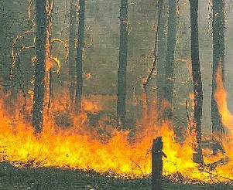
Basic Fire Theory
Fire Intensity Rank
http://bcwildfire.ca/fightingwildfire/firerank.htm
Rank | 3
Rate of Spread (m/min) | 1.5-3.0
Fireline Intensity (kW/m) | 500-2000
Description | Moderately vigorous surface fire
Qualitative Fire Behaviour | Vigorous surface fire with a moderate rate of spread. They have an organized front and may display "candling", which is when a tree's fuels ignite and flare up, along the perimeter and/or within the fire
Response to Control Efforts | Hand-constructed fire guards likely to be challenged. Heavy equipment generally successful in controlling fire.

Slide 8
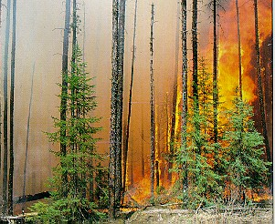
Basic Fire Theory
Fire Intensity Rank
http://bcwildfire.ca/fightingwildfire/firerank.htm
Rank | 4
Rate of Spread (m/min) | 3 to 6
Fireline Intensity (kW/m) | 2000-4000
Description | Highly vigorous surface fire, torching (or passive crown fire).
Qualitative Fire Behaviour | Grey to black smoke, has an organized surface flame front, and has a moderate to fast rate of spread along the ground. Short aerial bursts and short range spotting will occur with these fires
Response to Control Efforts | Control efforts at fire's head may fail.

Slide 9
Basic Fire Theory
Dead Fuel Diameter Classes
1-hour time lag fuels
  (< 0.625 cm diameter)
10-hour timelag fuels
  (0.625 - 2.5 cm diameter)
100-hour timelag fuels
  (2.5 cm - 7.6 cm diameter)
1000-hour timelag fuels
  (> 7.6 cm diameter)

Slide 10
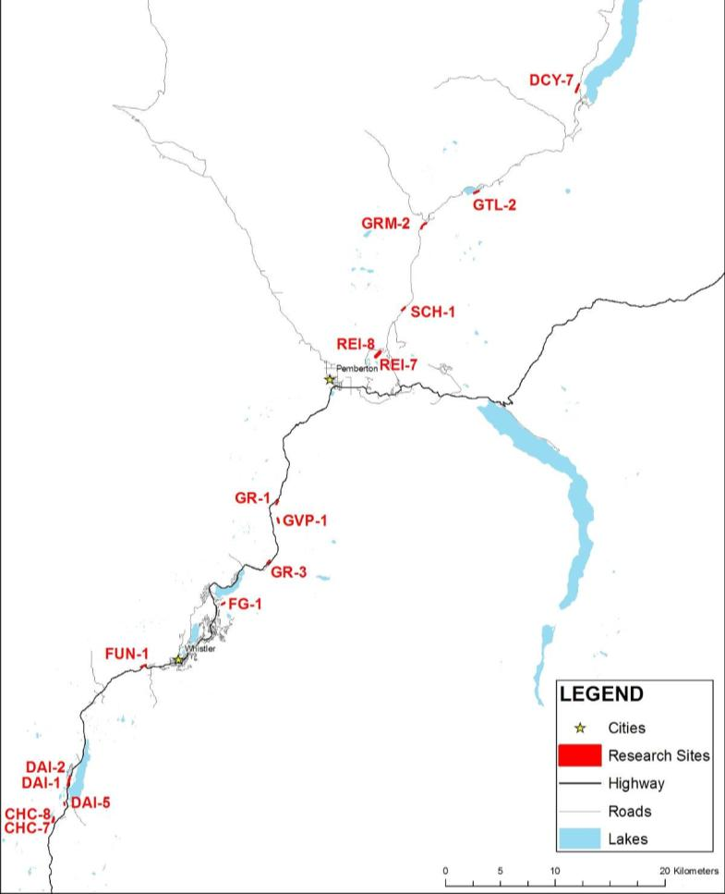
BC Hydro Fuels Research Project
Study Sites
18 study sites
Located between Squamish and Lillooet
Wide range of conditions

Slide 11
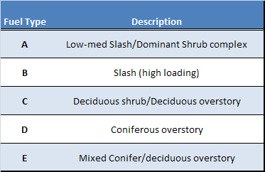
Fuel Types
Fuel Conditions in the study area
Standing Fuels
Slash Fuels

Slide 12
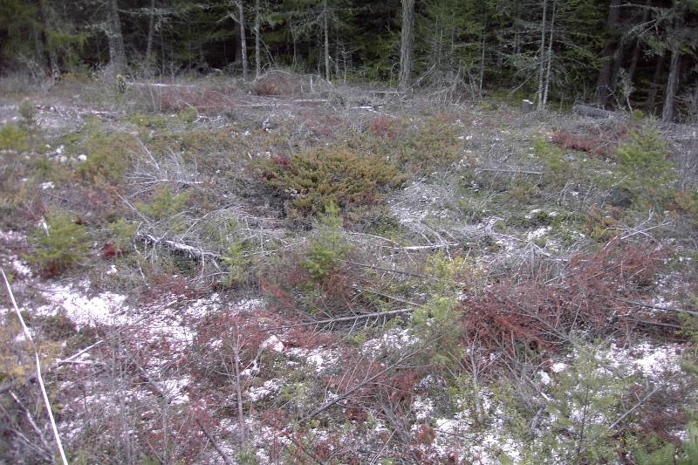
Fuel Types
Fuelbed Type A (Light-Medium slash)

Slide 13
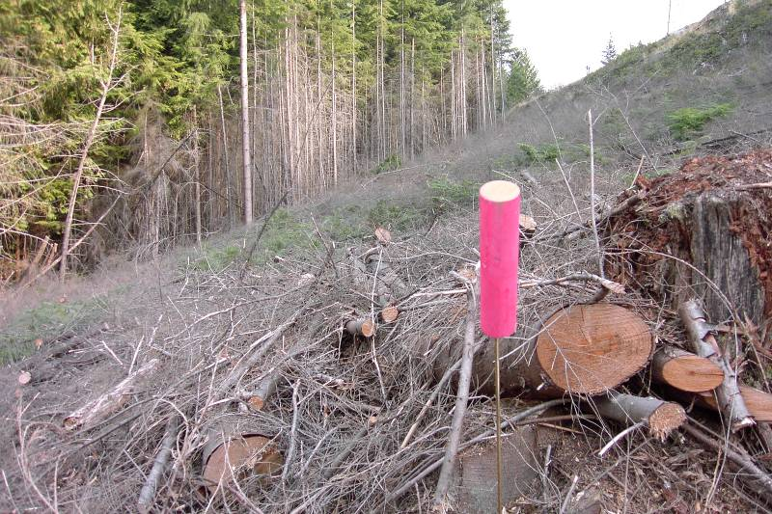
Fuel Types
Fuelbed Type B (Heavy Slash)

Slide 14
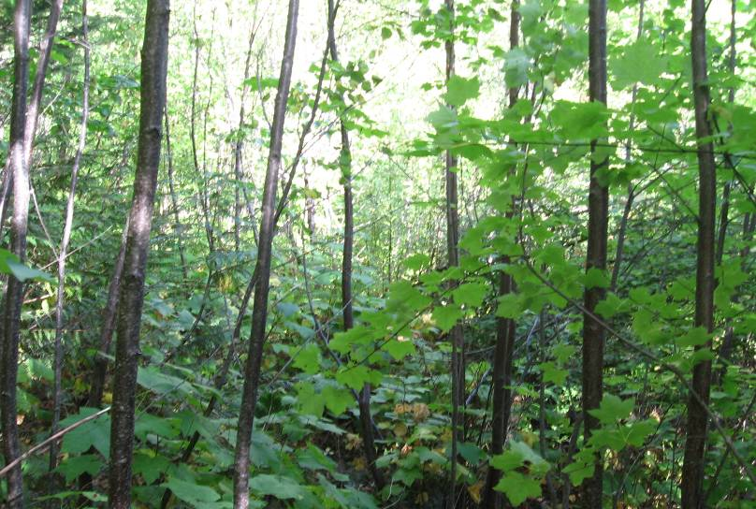
Fuel Types
Fuelbed Type C (Tall Shrubs/Deciduous)

Slide 15
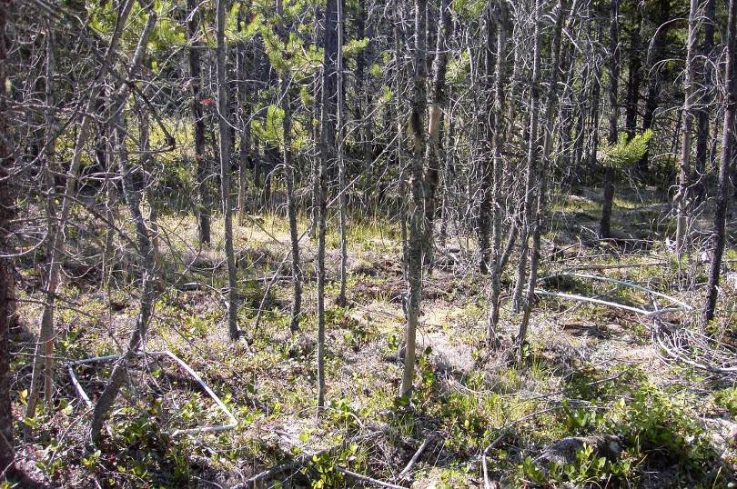
Fuel Types
Fuelbed Type D (Coniferous)

Slide 16
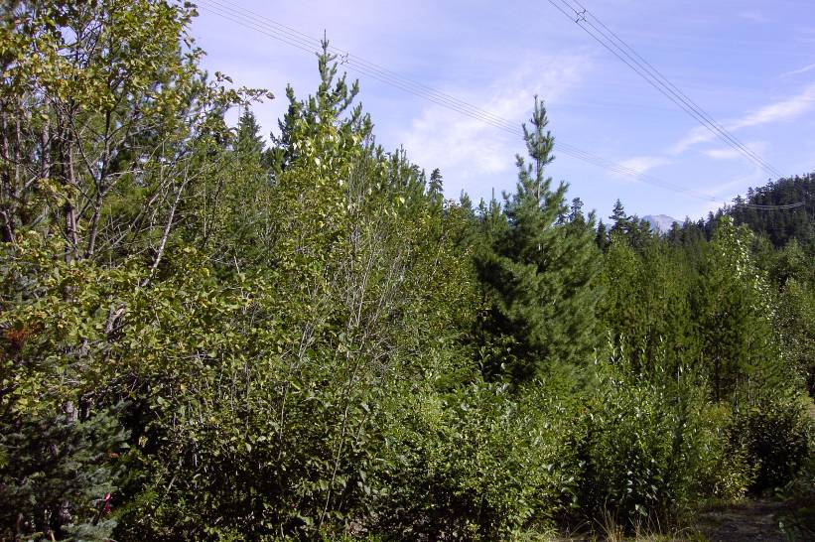
Fuel Types
Fuelbed Type E (Mixed)

Slide 17
Fuel Loading

Slide 18
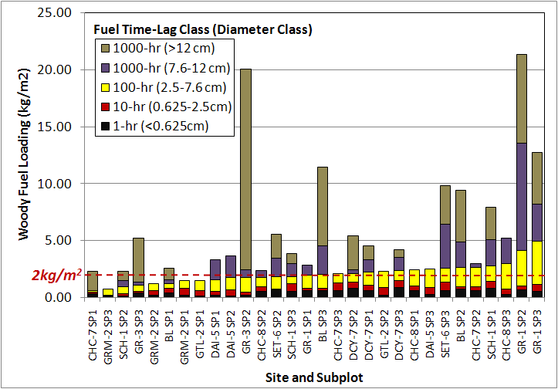
Fuel Loading

Slide 19
Hazard Rating
Purpose:
Objective and consistent means of assessing Fire hazard
Prioritize fuel treatment efforts
Assess effectiveness of treatments
Build understanding of factors affecting fire hazard

Slide 20
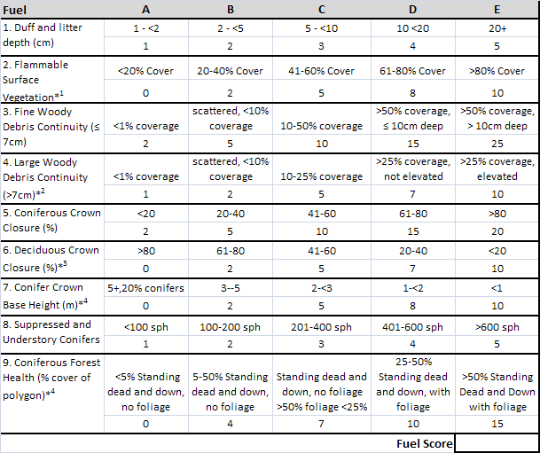
RoW Hazard Rating—Fuels
*¹Flammable fuel is defined as: Lichens, evergreen shrubs, pinegrass, juniper or scotch broom.
*² If (3)fine woody fuel continuity is less than 50% (level A, B, or C) then (4) large woody fuel continuity is scored level A.
*³ Deciduous Crown Closure is only a factor in conifer dominated stands. If (5) Conifer Crown Closure is 40% or less (level A or B) then (6) Deciduous Crown Closure is scored level A.
*⁴ If (5) coniferous crown closure is less than 20% (level A), then (7) "Conifer crown base height" and (9) "coniferous forest health" is scored level A.

Slide 21
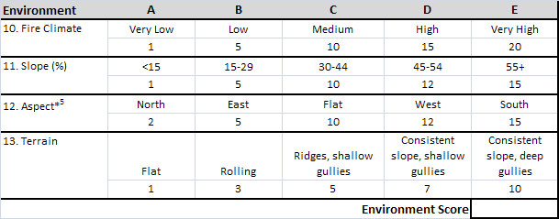
RoW Hazard Rating—Environment
*⁵ If (11) Slope is less than 30% (level A or B) then (12) aspect is considered flat (level C).

Slide 22
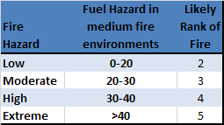
RoW Hazard Rating

Slide 23
Treatments
Treatments
Pile and burn (PB)
Standing Mow (STM)
Downed Mow (DM)
Chip (CH)

Slide 24
Treatment Outcomes

Slide 25
Treatment Outcomes

Slide 26
Treatment Outcomes

Slide 27
Treatment Outcomes

Slide 28
Treatment Outcomes

Slide 29
Conclusions
Take-home messages:
Amount of fuel is not as important as the type and distribution of fuels
Hazards exist in both standing and downed vegetation
Fuel management should focus on fine fuels (<7cm)
Management should discourage conifers and encourage deciduous shrubs
Purpose of management is not to prevent fire, but to prevent damage to infrastructure and adjacent values.
Vegetation management and fuels management go hand in hand.
Fuel-free zones can reduce fuel treatment costs in the rest of the RoW.

