Slide 1



BC Weed Control Act
Regulation
Proposed Amendments
to the
IVMA of BC Conference
October 29, 2014
Richmond BC
David Ralph
Invasive Plant Program
Ministry of Forests, Lands and Natural Resource Operations

Slide 2
Terminology
History
Proposed Amendment – Intentions
Next Steps
Notes:
Areas I will discuss during this presentation.

Slide 3
Terminology
Act – Also called a statute. When a Bill (proposed law) passes third reading in the Legislative Assembly, and receives Royal Assent, it is thereby enacted and becomes an Act or law.
Regulation – Whereas an Act provides the policy framework, the regulation under the Act provides the details to give effect to the policy.
Policy – sets out clear rules and expectations for delivery of programs and services.
Notes:
Act contains the administrative processes (must do’s – it is LAW)
Regulation contains the operational processes (how to’s – also legal requirement)
Policy – “Big P” policy is the legally enshrined items consisting of Acts, .
Regulations and Orders. Non-statutory policy - Internal or administrative policy.

Slide 4
Why change and why now?
  Too many lists
  Confusing
  Antiquated
  Call for Harmonization
  BC’s Regulatory Reform initiative
Notes:
Too many lists : WCA list; FRPA IP Reg List; Community Charter List
Confusing: Nomenclature, changing scientific names
Current WCA Reg is antiquated.
Harmonization: This has been brought forward in numerous ways and from several areas. Can’t we just have one list???? YES we can – consequential amendments will happen with the other regulations so they all point to the ONE List in the WCA REG.
The Regulatory Reform Initiative promotes clear, simple regulations and policy. Trying to avoid duplication – this proposed amendment fits the bill!

Slide 5
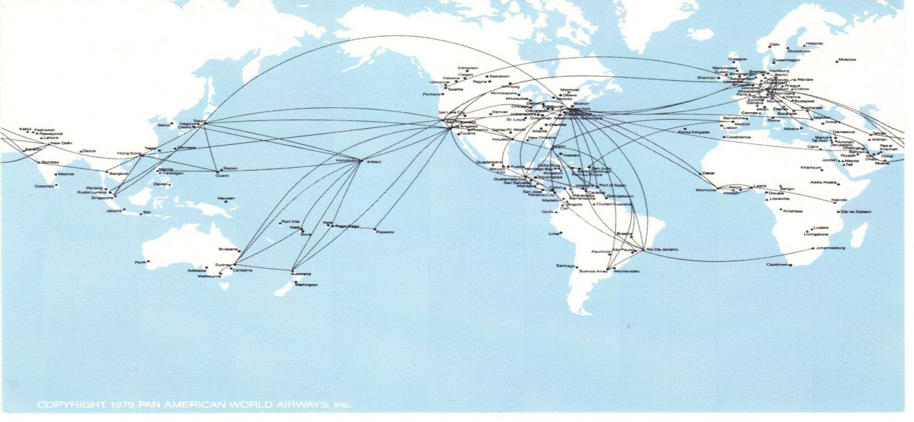
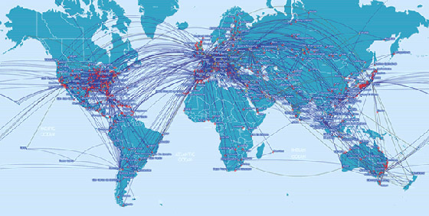
Pan American Airline route in 1970.
In 1973 PanAm had the 4th largest
revenue, of the 12 major U.S. airlines
Worldwide there were approx. 50 major non-communist airlines
In 2014, there are over 240 major
airlines in the world.
These are routes for 17 major
Non U.S. airlines
Notes:
Another driver for change is the recognition of the increasing potential for new introductions of invasive species, including plants, into BC.
BC has a very long history of weed control legislation....

Slide 6
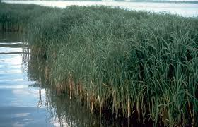
HISTORY
1871 - First weed legislation in the new Province of British Columbia
1888 - Noxious Weeds Act listed 8 species
1979 – 25 species listed in Regulation
2001 - 48 species listed
2011 – 66 species listed
Spartina spp.
Notes:
Until 2010, majority of listed species were of primary concern to Agriculture.
In 2011, 18 species were added including the Spartinas, Giant hogweed, the knotweeds and yellow flag iris to name a few. The species added are significant threats to BC’s environment – including aquatic habitats, the economy, and as in the case of giant hogweed - human health.

Slide 7
Recognition of Gaps in:
  Invasive plant species listed
  Ability to control vectors
  No offense provisions
    (a.k.a. ability to ticket (fine) offenders)
All lead to an extensive Policy review
Notes:
The IMISWG and IP Program staff have long recognized gaps in the current regulation.
Listed species – emerging and current threats were not all regulated
Limited language in the Regulation that address pathways of introduction and vectors of spread.
Limited administrative remedies, only cost recovery through property taxes.
Beginning in 2009, and extensive Legislative Policy review has been undertaken to define options to address these gaps.

Slide 8
Terminology
History
Proposed Amendment – Intentions
Next Steps
Notes:
While I can’t specifically present the language that may appear in the amended regulations, I will now discuss the specific intentions that are being recommended, then move on to the process that has been developed and analysis completed to produce the proposed listing of noxious weeds, and next steps/expectations.

Slide 9
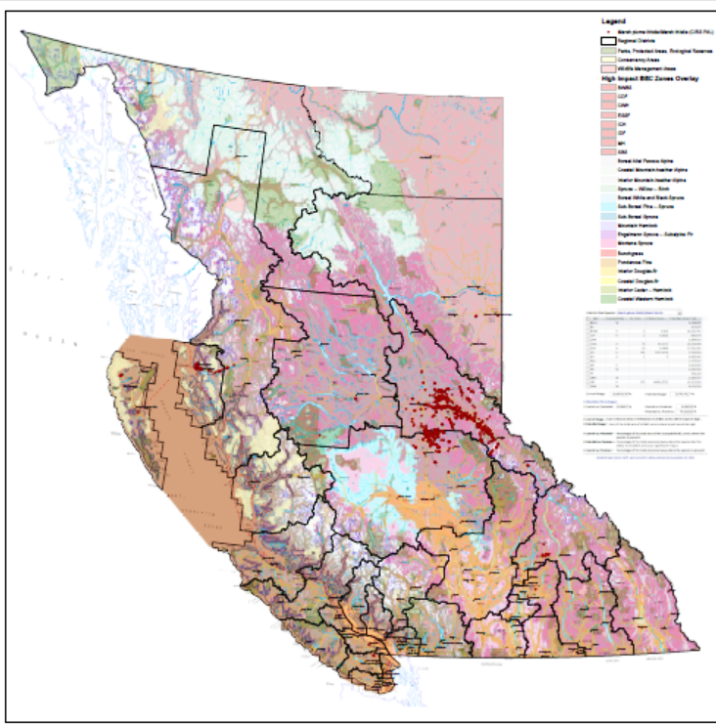
Assessing Invasive Plants
History
Sector Impact
Where/how they are listed elsewhere
Impact elsewhere
Current BC range & potential range
Inventory gaps
Invasiveness
Threat
  Impact on special values (R&E species, agriculture etc)
  Impact on human/animal health (toxicity)
  Difficulty to control
  Longevity of the problem

Slide 10
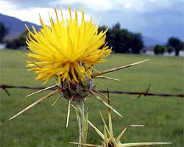
Proposed Amendment – Intentions
Establish a Prohibited Noxious Weed List
  Support Early Detection and Rapid Response
  Enable province to assist the occupier in fulfilling the duty to control noxious weeds
Notes:
Establish a Prohibited Noxious Weed List
Prohibited noxious weeds will include those species that are deemed to be a significant risk to BC and that are either not yet present in the province, or present in low enough population that eradication is possible. The intent with control of prohibited weeds is complete eradication. The IMISWG posted the proposed prohibited list on the website a couple of years ago.
Having a clear prohibited list of species ensures EDRR actions can be implemented in the province on these species.
The duty to control noxious weeds is stated in the ACT. However, we recognize that an incursion of a prohibited species into BC may not be a result of any individual landowner/occupier’s activities. EDRR to these species is a top priority for government, and we are proposing that language be included to enable the province to assist the landowner in accomplishing the “duty to control” that is required under the legislation. This will maintain the provincial accountability for managing prohibited species, while also providing the flexibility to require the occupier to control the incursion should it be determined they intentionally introduced the prohibited species.

Slide 11
Prohibited/Provincial EDRR
African Rue | Slender Foxtail | Meadow Clary | Spring Milletgrass
Black Henbane |  | Medusahead | Spurge Flax
Brazillian Elodea | Goatsrue | Silverleaf Nightshade | Starthistle, Iberian/purple/yellow
 | Halogeton/Saltover | North Africa Grass | Syrian Bean-Caper
Camel Thorn | Water Hyacinth | Nutsedge, purple/yellow | Texas Blueweed
Common Crupina | Hydrilla | Perennial Pepperweed | Italian Thistle
Common Reed | Jointed Goatgrass | Giant Reed | Slenderflower Thistle
Cordgrasses | Johnsongrass | Red Bartsia | Velvetleaf
Dyer’s Woad |  | Ricefield/BogRush | Vetiver Grass
Eggleaf Spurge | Squarrose knapweed | Clary Sage | Water Chestnut
Slender False Brome | Kudzu | Mediterranean Sage | Shiny Geranium
Revised May 2014

Slide 12
Proposed Amendment – Intentions
Add three Restricted Noxious Weed Categories – A, B & C
  Restricted A – invasive plants that are limited in extent in BC and pose a significant threat.
  Intent is to prevent these species from spreading to new areas and reduce current populations.
  Applies to the entire province.
  Ex: Blueweed, Common Bugloss, Rush Skeletonweed
  Field Scabious, Knotweed complex
Notes:
Restricted A: Pose significant threat to the province and are limited in extent provincially but have potential to spread to numerous areas. Contain existing infestations, prevent further spread and reducing current population to limit impacts. Applies to the entire province. Example species – Knotweeds, Marsh plume thistle, field scabious, yellow flag iris, garlic mustard.

Slide 13
Proposed Amendment – Intentions
Add three Restricted Noxious Weed Categories – A, B & C
  Restricted B – invasive plant species that may be widespread in some parts of the province, but rare or absent in other parts.
  Intent is to prevent these species from spreading into new areas and protect values within listed Regional District.
  Applies to listed Regional Districts.
  Ex: Scotch Broom, Spotted knapweed, Hoary Alyssum, Common Tansy
Notes:
Restricted B: Invasive plant species that pose significant threat to the province and specific regions and may be widespread in some parts of the province, and rare or not present in other regions. May also include species that because of their narrow ecological niche do not fit Restricted A (example is European Beach Grass).
Intent is to prevent these species from spreading to new areas and to protect values within listed RDs. Applies to listed Regional Districts and enables specific listing by RD request. Example species – common tansy, scotch thistle, tall yellow hawkweeds, spotted knapweed.

Slide 14
Proposed Amendment – Intentions
Add three Restricted Noxious Weed Categories – A, B & C
  Restricted C – invasive plants that are typically common and widespread in BC but pose a threat to specified values (e.g. Rare and endangered species; fine seed industry).
  intent is to enable Weed Inspectors to require occupiers to control Restricted C species if necessary
  Applies throughout the province.
  Ex: Kochia, English Ivy, Baby’s-breath, Wild Oats
Notes:
Restricted C: Pose threat to one or more specific values and are generally common and widespread in the province. May also include species that are under biological control in some but not all areas.
Intent is that the main focus for these species would be education and awareness, however it would also provide the opportunity for weed inspectors to require occupiers/owners of land to control a restricted C species that is threatening a specific value in their area. Applies to the entire province. Example species include: field bindweed, Cypress spurge, Russian thistle, sowthistle..

Slide 15
Proposed Amendment – Intentions
Simplify ability to update the Notice to Occupier to Control Weeds (Schedule B).
  Put in policy; form used requires Minister approval
Notes:
Simplify ability to update the Notice to Occupier to Control Weeds (Schedule B).
The current Schedule contains a form that must be used when issuing a Notice to Occupier to Control Weeds.
This approach is static and not easy to amend if the situation warrants. Moving to policy and a procedure for Minister approval of forms will simplify this component.

Slide 16
Proposed Amendment – Intentions
Provide a more generous provision to prevent the transport or movement of noxious weeds
  Address vehicles, equipment, trailers, boats, float planes, bicycles, ATVs, etc.
  Easier to enforce than requirements on cleaning vehicles & equipment
Notes:
Provide a more generous provision to prevent the transport or movement of noxious weeds
Focus on movement of infested items – vehicles, equipment, trailers, boats, quads, bicycles, float planes, wheelbarrows etc. And needs to apply to anything on water, land, air in BC. Will address aquatic noxious weed dispersal, along with terrestrial plants.

Slide 17
Proposed Amendment – Intentions
Prevent the introduction of listed noxious weeds not already established in an area.
  Restrict the sale, importation, or use of of contaminated material (grain, seeds, fertilizer, lime, topsoil, forage, aggregates etc)
  Want to also address receipt of infested products
Notes:
Prevent the introduction of restricted noxious weeds into areas where the particular species is not present.
Address sale, importation, or use of contaminated material.
Want to also address receiving infested items so that both the importer and exporter are held responsible.

Slide 18
Proposed Amendment – Intentions
Restrict the disposal of listed species on Crown land, parks, ditches, streams, lakes (bodies of water), roads, highways, etc.
  must include a provision to allow movement of noxious weeds in an appropriate manner to an appropriate disposal facility.
Notes:
Restrict the disposal of listed species on Crown land, parks, ditches, streams, lakes (bodies of water), roads, highways, etc.
Dumping invasive plants on public lands, waste places, and other specified areas is an ongoing challenge. We would like to address this explicitly in the Regulations.
Restricting the movement of invasive plants has to also have allowances for the transport to recognized and appropriate disposal sites.

Slide 19
Proposed Amendment – Intentions
Restrict the sale or use of any Prohibited or Restricted Noxious Weed
  must include a provision to allow research, taxonomic collection, and education
  Intent must ensure sale of a Category ‘B’ species is not sold in a Regional District where it isn’t listed.
Notes:
Restrict the sale or use of any Prohibited or Restricted Noxious Weed
The sale of noxious weeds - seeds, plants or plant parts – is an ongoing occurrence in BC. This pathway of introduction needs to be addressed.
Will have to ensure there are provisions to allow research, collections, and education.

Slide 20
Proposed Amendment – Intentions
Require any stored material infested with listed noxious weeds to be secured to prevent dispersal
  The Person storing must prevent dispersal of noxious weeds, including all reproductive parts.
Notes:
Require any stored material infested with listed noxious weeds to be secured to prevent dispersal
Storing infested material, whether the noxious weeds are locally abundant or not, will require adequate measures so as to prevent the weeds from dispersing.

Slide 21
Proposed Amendment – Intentions
Add offense provisions (ability to ticket)
  Could be used to address failure to control/comply with a weed notice; sale; transport/movement; storage; and disposal.
Notes:
Add offense provisions (ability to ticket)
Having offense provisions that would make it an offense to not comply with a weed notice and control noxious weeds, or sell the plants or their seeds, or transport the plants or plant parts, dump noxious weeds, etc.
This would provide for ticketing (fines) for contravention of specified sections.

Slide 22
Proposed Amendment – Intentions
Update Existing and Add Definitions for Terminology
  - Examples “Control” , “Eradicate”
Notes:
Adding definitions is very important in the Regulation. We can each read the same word – such as “control” – but how many of us have the same definition of it?
Terminology used in legislation and regulation that is not “common” language needs to be defined.

Slide 23
Terminology
History
Proposed Amendment – Intentions
Next Steps
Notes:
So let’s move on to NEXT STEPS…

Slide 24
Next Steps.....
Over the next couple of months:
Send out proposed noxious weed list to primary stakeholders for input;
Provide opportunity for feedback on our intentions;
Complete drafting amendment to Regulation;
Include consequential amendments; and
Submit for decision.
Notes:
Have to submit consequential amendments to FPRA IP Regs and Community Charters – Spheres of concurrent jurisdiction - environment and wildlife regulation at the same time. There may also be a delay as adding offences to the regulations takes a few additional steps within government.

Slide 25
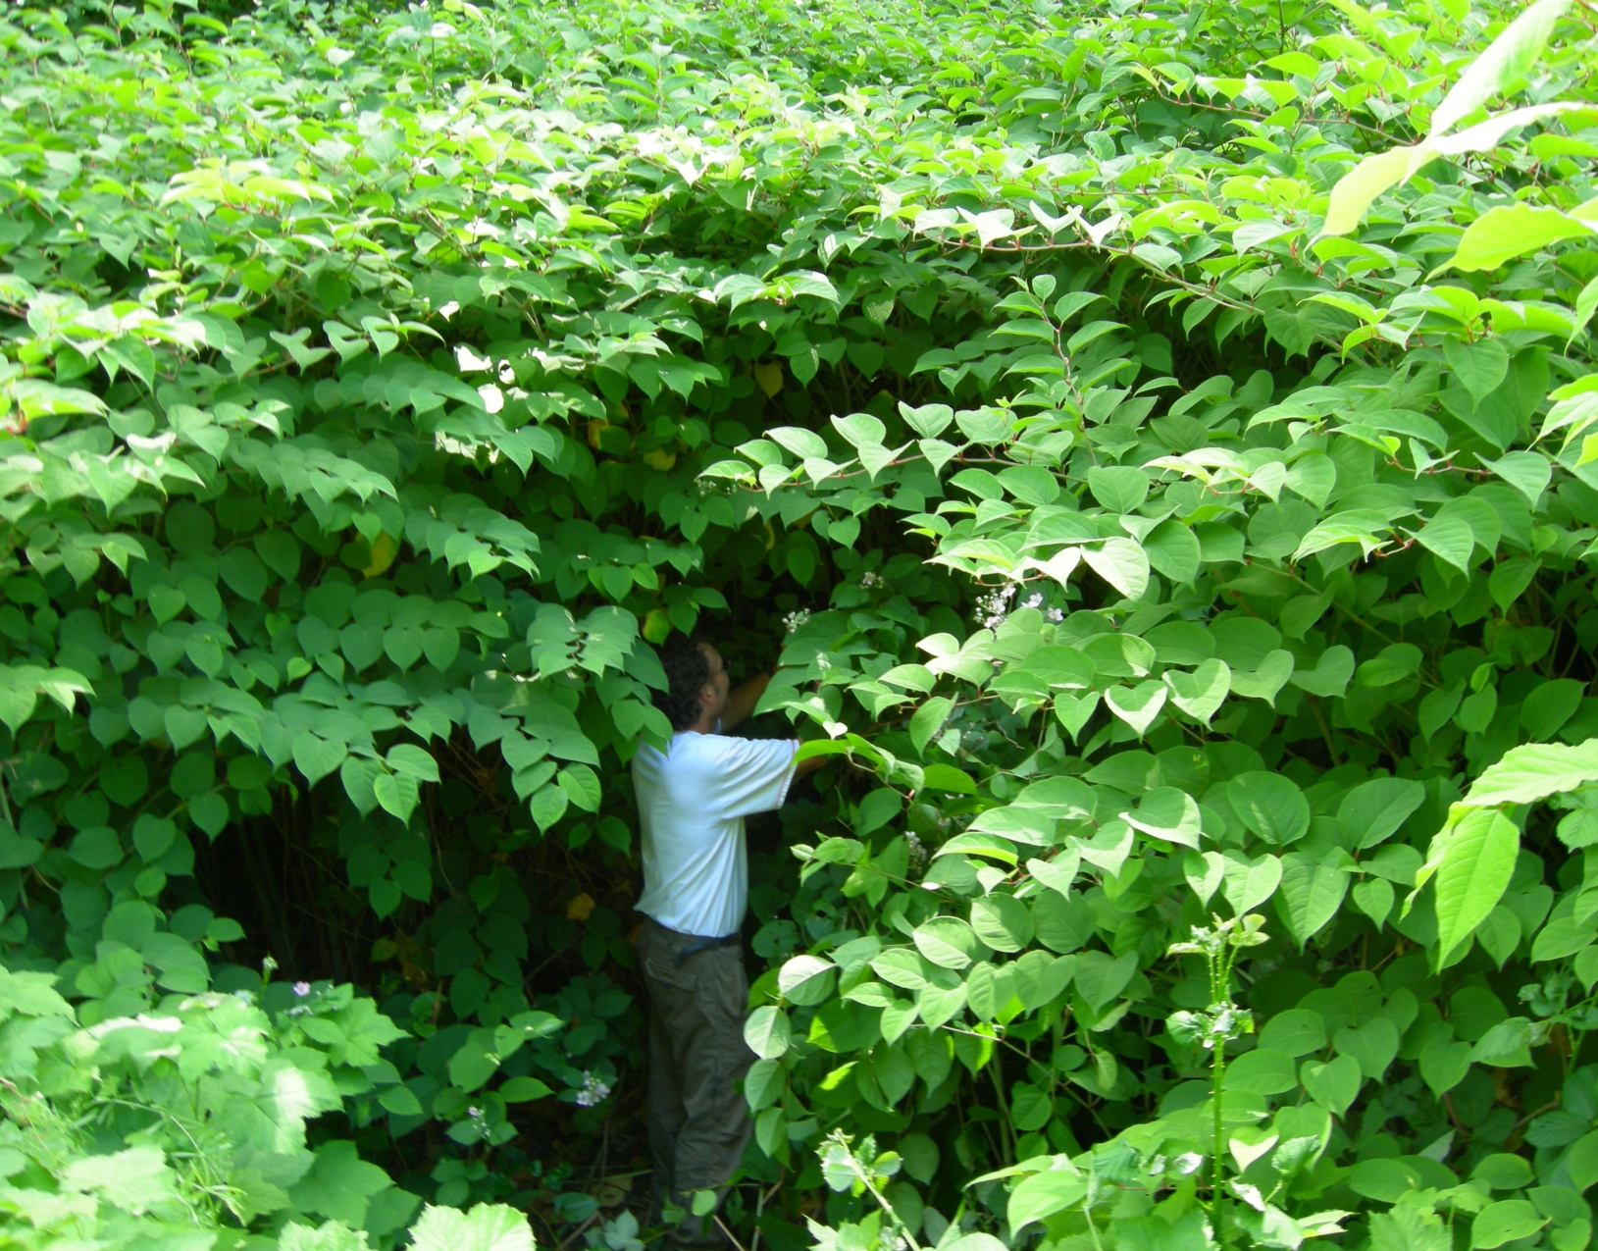
QUESTIONS?
THANK YOU
Notes:
I believe Amending the WCA Regulations and harmonizing with the other regulations is a major improvement to the foundation of invasive plant management in BC. I hope you do as well.
I may have time for one or two questions, or you can contact me later.
Thank you.

