Slide 1
ROW Stewardship Council
Professional Vegetation Management Accreditation
Gwen Shrimpton
GM Shrimpton & Associates
ROW Stewardship Auditor

Slide 2
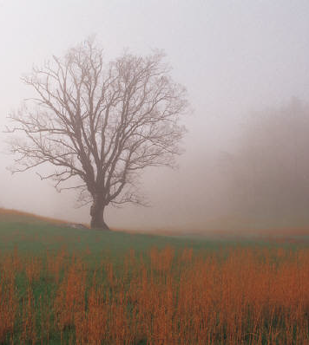
About the ROW Stewardship Council
The ROW Steward Program(RSP) grew out of the utility vegetation management industry’s commitment to the practice of Integrated Vegetation Management (IVM). It was developed to recognize excellence in the application and practice of IVM in electric utilities in North America.
The RSP was developed and is now led by a diverse group of stakeholders including electric utilities, vegetation management contractors, consultants and suppliers, academics, environmental non-government organizations (ENGO), regulators and more.

Slide 3
Utility Rights-of-Way Management
Notes:
New Diagrams and Applications for the Wire Zone–Border
Zone Approach to Vegetation Management on Electric
Transmission Line Rights-of-Way
Benjamin D. Ballard, Kevin T. McLoughlin, and Christopher A. Nowak

Slide 4
About the ROW Stewardship Council
The ROW accreditation program establishes standards for responsible vegetation management programs along corridors
Promotes the application of IVM and BMPs to utility vegetation managers
Maintain power system reliability and address ecological concerns

Slide 5
About the ROW Stewardship Council
Provides the opportunity for companies and corporations to demonstrate their commitment to environmental stewardship
Third party recognition conveys credibility and brings recognition to IVM programs
Benefits of accreditation can impact industry, communities, stakeholders, and agencies

Slide 6
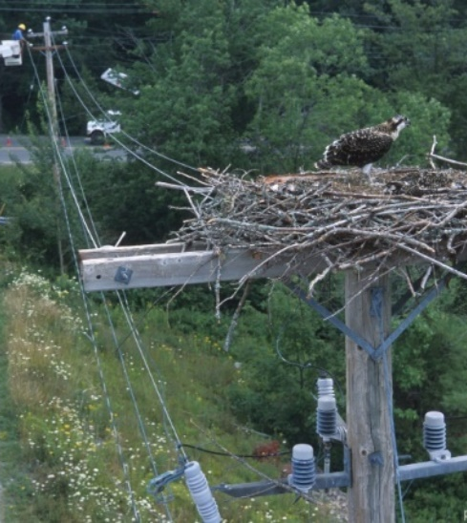
About the ROW Stewardship Council
ROWSC model follows the lead of the Electric Power Research Institute’s standards of assessing performance of IVM on ROWs
Informed by programs in forestry
  Forest Stewardship Council
  Sustainable Forestry Initiative

Slide 7
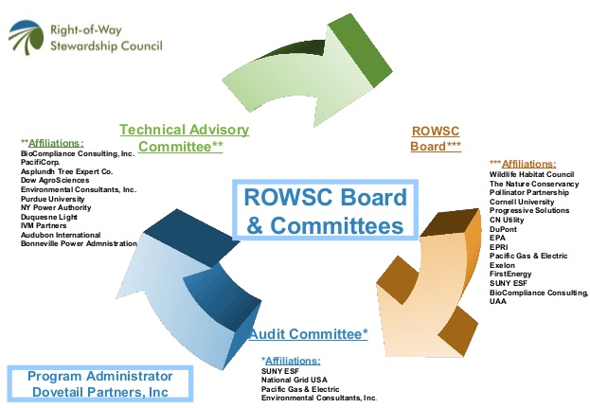
ROWSC Board and Committees

Slide 8
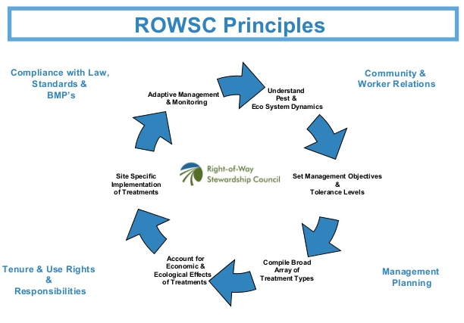

Slide 9
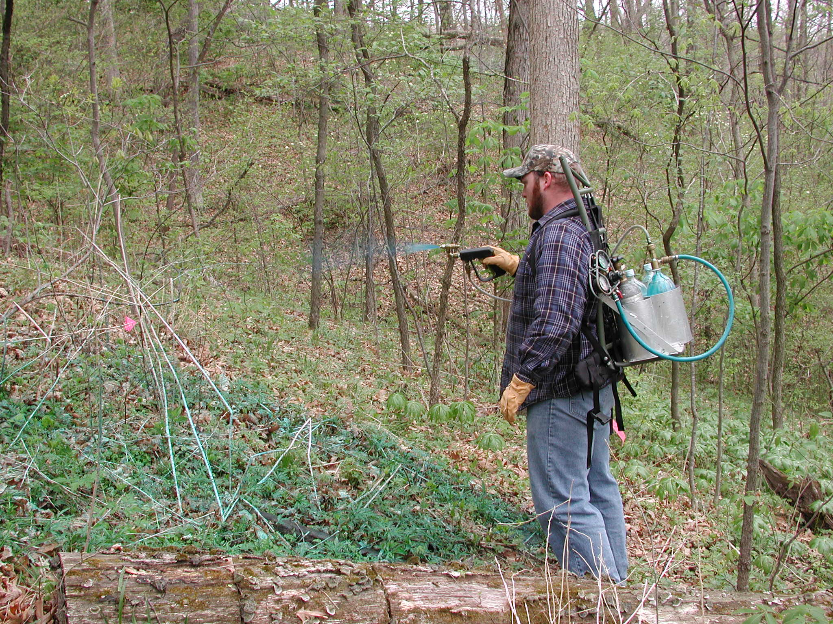
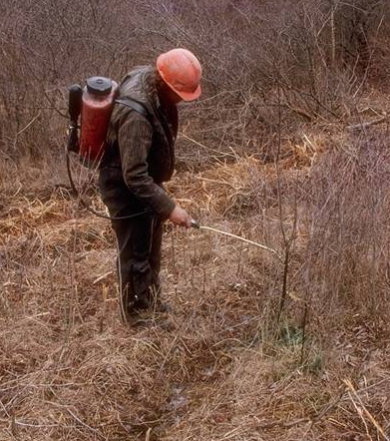
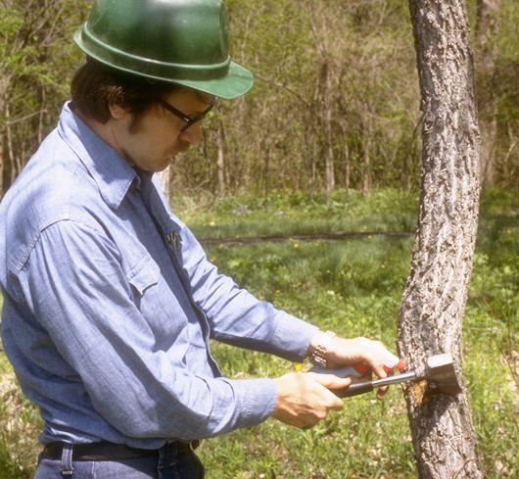
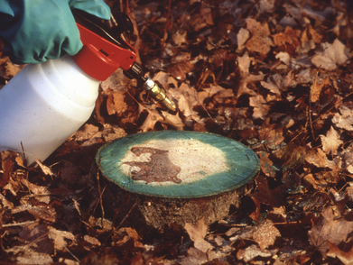

Slide 10

Program
Set of management standards
Formal application process
Enlists third party auditors to ensure compliance with standards
Managed by Dovetail Partners a Minneapolis -based environmental think tank

Slide 11
Benefits of Accreditation
Reduce treatment costs
  ROWSC principles emphasize proactive management of undesirable vegetation while establishing a compatible community of plants
  this leads to a reduction in treatment efforts and cost savings

Slide 12
Benefits of Accreditation
Improve positive relations with stakeholders
  Societal and community impacts are considered in IVM programs
  Leads to better understanding of impacts and increased confidence and trust by stakeholders
  Company recognition as an environmental steward

Slide 13
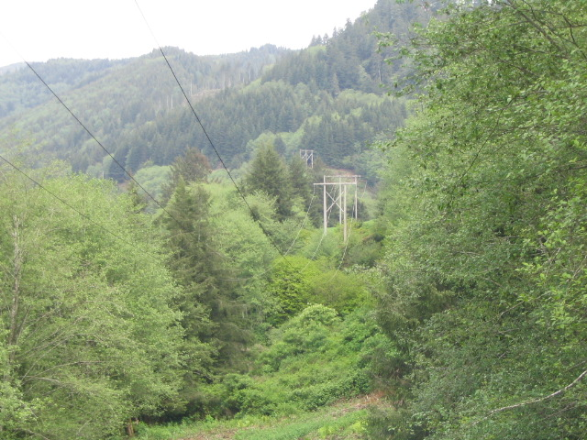
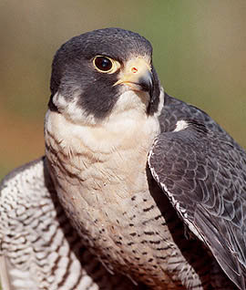
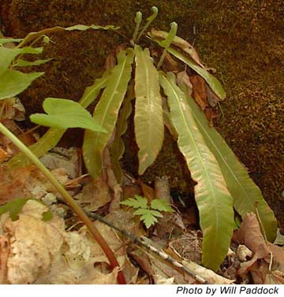
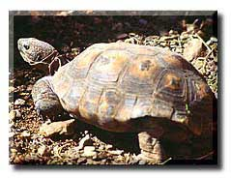
Utility Vegetation Management

Slide 14
Benefits of Accreditation
Institutionalize Sustainable Management
  Good systems ensure consistent practices and performance
  Comprehensive documentation ensures broader adoption, continuity and eliminates duplication
  New employees do not need to recreate the program
  Promotes documentation of the program a practice consistent with ISO 14001
  Environmental, social and economic benefits from corridors are maintained

Slide 15
Benefits of Accreditation
Surpass regulatory requirements
  Decreased likelihood of conflict and legal disputes
  Improves relations with government agencies
  Assures compliance with regulation and reduces need for new regulation

Slide 16

How to Become Accredited
The process has 4 phases
  Inquiry: complete application, pay a fee, discuss process and estimate costs
  Statement of work: supply pre-audit documentation as requested, conduct gap analysis, produce statement of work (estimate of time, schedule and cost)

Slide 17

How to Become Accredited
  On-site assessment : auditing team inspects random and representative sites, documentation and equipment and interviews staff
  Report Development: initial draft developed by audit team, reviewed by applicant, final report and recommendations

Slide 18

Time Required
Depends mostly on the size of the utility
The clearer and better organized the documentation submitted; the shorter the time
Usually 90 days for the full process
Can be up to 6 months for large utilities

Slide 19
Technical Requirements
10 Principles and 32 Criteria
  Principle #1: Compliance with laws, standards, and best management practices.
    Documents include lists of all applicable laws for safety and environment
    Personnel are aware of the requirements
    Records of training licensing and certification
    Safety records for employees
  Principle #2: Tenure and use rights and responsibilities
    Evidence of long term rights to use and manage the land (ie Right of Way agreements)
    Programs to identify and prevent illegal and unauthorized use
    Maintain access (ie road construction and maintenance)
  Principle #3: Community and worker relations
    Program is made readily available to workers and general public, evidence of notification
    Likely social effects on adjacent communities are considered
    Records of important stakeholder interactions

Slide 20
Technical Requirements
  Principle #4: Management Planning
    Formal written strategic vegetation management plan, maps, management activities, environmental issues and monitoring programs
    Annual work plans developed
  Principle #5: Understanding Pest and Ecosystem Dynamics
    Demonstrated plant identifications skills for target and compatible species
    Workers are provided for opportunities to improve skills
    RND activities
  Principle #6: Setting Management Objectives and Tolerance Levels
    Setting tolerance levels for incompatible species (ie limits of approach)
    Evidence that programs have been modified to address stakeholder and societal impacts

Slide 21
Technical Requirements
  Principle #7: Compilation of a Broad Array of Treatment Techniques
    Use a wide variety of treatments, manual, mechanical, herbicide
    Methods are continually improved
    Equipment and technology up to date and adequately maintained
  Principle #8: Accounting for Economic and Ecological Effects of Treatment
    water resources protected
    Wildlife and habitat
    Endangered species
    Invasive plants
    Esthetics considered
    Cultural resources and First Nations
    Spill response plans
    Selective treatments to enhance compatible vegetation

Slide 22
Technical Requirements
  Principle #9: Site-Specific Implementation of Treatments
    Land management units defined
    Site specific treatments based on surveys and site assessment
  Principle #10: Adaptive Management and Monitoring
    Monitoring program in place
    Audits of work and quality control
    Performance indicators

Slide 23








Rights-of-Stewards Accreditation Program

Slide 24
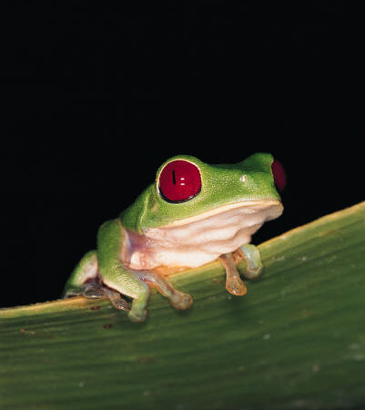
Approved ROWSC Marketing Statement
(insert utility name) is recognized as a “Right-of-Way Steward Utility” through the accreditation program of the Right-of-Way Stewardship Council. For more information, visit:
http://www.rowstewardship.org/

