Slide 1
WorkSafeBC
IVMA Conference
Anna Jean Billingsley
November 9, 2023
Sun Peaks, B.C.

Slide 2
Agenda
Due Diligence
First aid program
Mobile equipment
Working alone
What does an inspection look like
Questions

Slide 3
Due Diligence

Slide 4
Definition
Due diligence means taking all reasonable steps to protect workers from harm. “All reasonable steps” is based on considering what a reasonable person would do in the circumstances.

Slide 5
Steps to being duly diligent
Be aware
Ignorance is no defence, so know your legal obligations under the Workers Compensation Act and the Occupational Health and Safety Regulation, your health and safety responsibilities, and best practices for your industry.
2
3

Slide 6
Steps to being duly diligent
Be objective
Identify issues for your workplace through risk assessments, using appropriately knowledgeable people. Consider using external professionals for certain aspects of this analysis. Review your incidents and trends, inspections, audit findings, program evaluations, and input from workers.

Slide 7
Steps to being duly diligent
Be proactive
Develop a robust health and safety program that includes policies, procedures, and practices to minimize risk from specific hazards. Communicate these policies, procedures, and practices and ensure all workers are trained on them. Check to make sure procedures are being followed, and enforce compliance with the Regulation as well as your own internal policies and procedures.
An active health and safety management approach — one that demonstrates due diligence — ensures that workers are provided with valuable health and safety information, instruction, training, and supervision. It also confirms when knowledge and processes are working, and corrects for unsafe hazards and practices that are not.

Slide 8
Steps to being duly diligent
Be vigilant
Review your systems and processes frequently through self-evaluations. Continuously assess health and safety in the workplace. Monitor changes in regulation and industry practices and apply changes to your own operations as necessary.

Slide 9
Steps to being duly diligent
Be on record
Gather evidence of your health and safety program and all its components. Be able to demonstrate how you are implementing your health and safety policies, procedures, and practices and to provide proof of enforcement when necessary. Be able to demonstrate that appropriate checks and reviews are in place to ensure continued vigilance.

Slide 10
First aid Programs

Slide 11
Occupational First Aid
First Aid coverage is dependent upon hazard rating, worker count, and proximity to hospital.
Assigned hazard rating list in Guidelines is only a reference point.
A First Aid Assessment must be conducted.

Slide 12
OFA Assessment
Provides overview of the workplace(s). One location or more.
Identifies Hazard Rating- “LANDSCAPE IS MODERATE”.
Determines surface travel time to hospital. 20 minutes is the magic number!

Slide 13
OFA Assessment
Confirms worker count at each work location.
Consult Schedule 3-A for first aid services required.
Review on an annual basis.
*EVERY EMPLOYER MUST MAKE PROVISIONS FOR FIRST AID

Slide 14
Mobile Equipment

Slide 15
Mobile equipment
- Maintenance and inspection
- Training (CSA standard verse manufacture instruction)

Slide 16
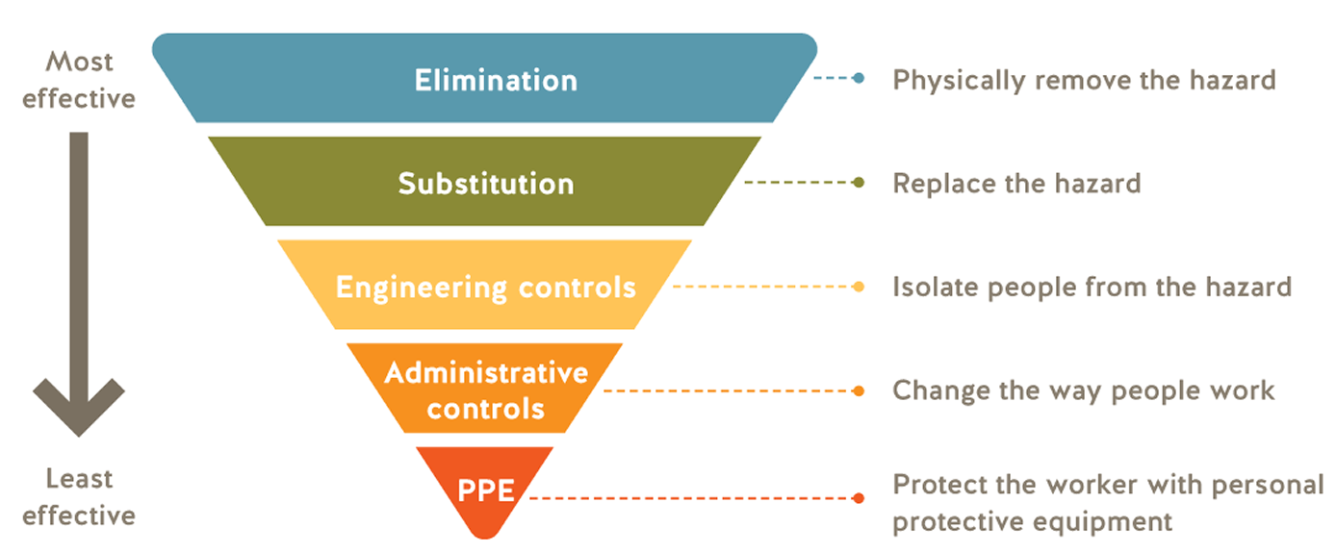
Hierarchy of control

Slide 17
Working Alone

Slide 18
Definition
4.20.1 Definition
In sections 4.20.2 to 4.23, "to work alone or in isolation" means to work in circumstances where assistance would not be readily available to the worker
(a) in case of an emergency, or
(b) in case the worker is injured or in ill health
*The Regulation applies to those “assigned” to work alone or in isolation.

Slide 19
Assistance Readily Available?
•Presence of others: Are other people in the vicinity?
•Awareness: Will other persons capable of providing assistance be aware of the worker's need?
•Willingness: Is it reasonable to expect those other persons will provide assistance?
•Timeliness: Will assistance be provided within a reasonable period of time?
Can I rely on customers? Other employers/workers?
Can’t I just give them a phone?

Slide 20
Before you Default to Working Alone
Hazard identification, elimination and control
Traffic or road accident
Falls, slips, trips
Cuts, contusions, struck by
Chemical exposure
Violence
Health Issues
Animals
Physical obstructions
Pools, ponds, ditches, other water hazards or excavation type hazards

Slide 21
4.21 Procedures for checking well-being of worker
The employer must develop and implement a written procedure for checking the well-being of a worker assigned to work alone or in isolation.
Determine if there are high risk activities or locations and define low risk activities.
Part of the Health and Safety Program.

Slide 22
4.21 Procedures for checking well-being of worker
The procedures for checking a worker's well-being must include the time interval between checks.
There must be procedures to follow in case the worker misses a check-in, check out, or cannot be contacted.
If applicable provisions for emergency rescue shall be included.

Slide 23
4.21 Procedures for checking well-being of worker
A person must be designated to establish contact with the worker at predetermined intervals and the results must be recorded by the person.
The designated person must follow the procedures and be able to implement the escalations when required and without delay.
The designated person must trained on this process.

Slide 24
4.21 Procedures for checking well-being of worker
In addition to checks at regular intervals, a check at the end of the work shift must be done.
The end of shift is critical.
This can be when they leave the shop or when they are home.
Pre-determine the threshold for acceptable time gap between missed checkout and when “all heck breaks loose”.

Slide 25
4.21 Procedures for checking well-being of worker
The procedure for checking a worker's well-being, including time intervals between the checks, must be developed in consultation with the joint committee or the worker health and safety representative, as applicable.

Slide 26
4.21 Procedures for checking well-being of worker
Time intervals for checking a worker's well-being must be developed in consultation with the worker assigned to work alone or in isolation.
Intervals must be reasonable.

Slide 27
4.21 Procedures for checking well-being of worker
High risk activities require shorter time intervals between checks.
Preferred method for checking is visual or two-way voice contact.
A one-way system which will send a call for help if the worker does not reset the device after a predetermined interval is acceptable.

Slide 28
4.21 Procedures for checking well-being of worker
Example of a process:
Start of shift sign on>Advise where working and what activities>Interval check if needed>End of shift check out.
Example of a missed check:
Call worker>Call workers home>Call a co-worker>Assign a person to drive-by>Call authorities if necessary.

Slide 29
WorkSafeBC Inspections
2023 inspectional approach
For 2023 inspections, prevention officers will take a risk-based approach to ensure that the most significant risks are effectively managed. This approach involves workers and employers identifying hazards, evaluating risks, and implementing the appropriate controls specific to the on-site activities.
In addition, it focuses on employers ensuring that these efforts are effectively communicated to workers and monitored through foundational occupational health and safety systems such as new and young worker orientations, training, supervision, incident investigations, worksite inspections, and (where applicable) joint health and safety committees that are effective, robust, and well supported.

Slide 30

Q?

