Slide 1
Glyphosate Uptake and Translocation
Abiotic and physiological factors
Presentation to IVMABC
By Daniel Chicoine, IFT Ltd.
Notes:
Thank you to the organizers for allowing me the opportunity to speak to you today.

Slide 2
Cascade of Events to Herbicide Effectiveness
Notes:
This is the cascade of events that must occur for herbicides to be effective. This is the outline of my presentation this afternoon.

Slide 3
Points of Influence
Notes:
Application and the interface between application and uptake are the only ‘events’ that we as applicators or program implementers can influence.

Slide 4
1. Application
Notes:
Lets start with what we can influence the most – application.

Slide 5
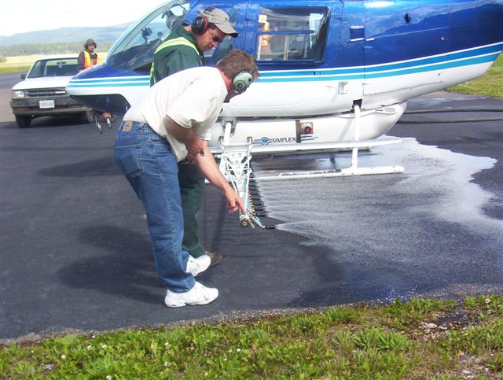
Droplets
Make droplets
  Nozzles
  Aircraft configuration and speed
It will not get better than what comes out of the atomizer
  Droplets will only get smaller making them more susceptible to movement and entrainment
Notes:
In aerial application we make droplets through the use of nozzles, aircraft configuration, and speed. It will not get any better than what comes out of the atomizer – droplets will only get smaller making them more susceptible to movement and entrainment.

Slide 6
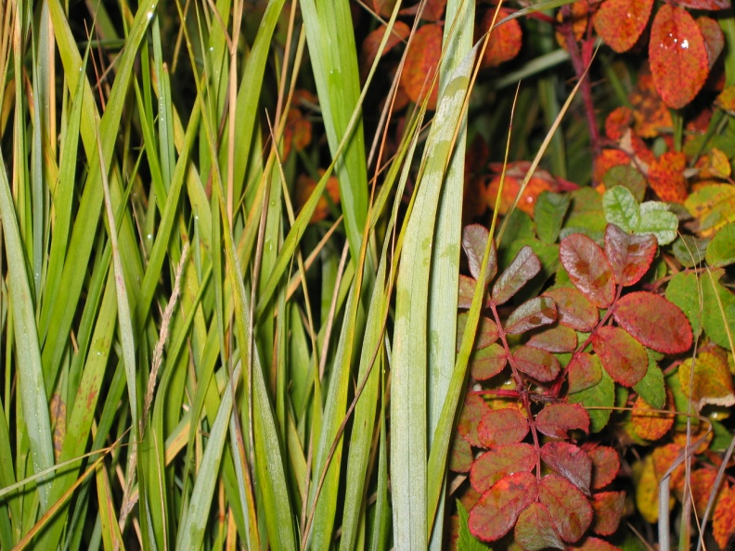
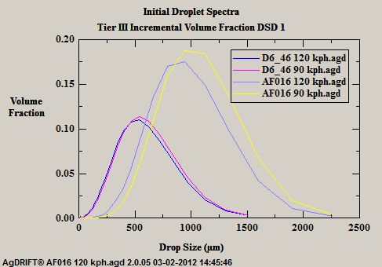
Droplets
Start with uniform droplets
Notes:
The more uniform the droplets – the better. Accuflo nozzles have larger droplets and more of them as compared to Diskcore nozzles.

Slide 7
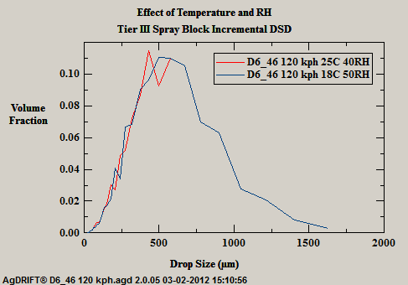
Droplets
Keep them uniform
  Effects of temperature and relative humidity on droplet size
Notes:
Understanding the effects of temperature and relative humidity on the droplet size will allow us to keep them uniform. Increasing temperature and/or decreasing relative humidity will increase the number of smaller droplets.

Slide 8
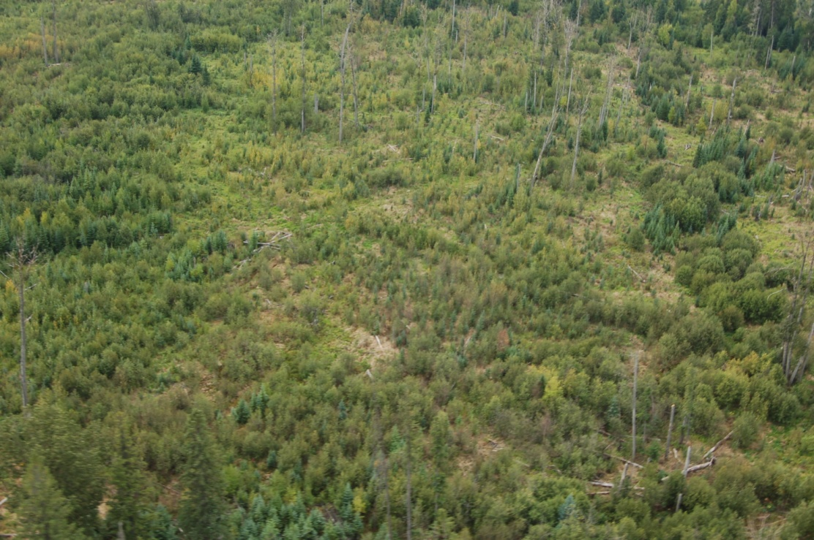
Droplets
Be wary of too large a droplet
  Can reach terminal velocity
  Sufficient kinetic energy to shatter on impacting leaf surface
  Then bounces off
Notes:
Creating too large a droplet is also not ideal – they can reach terminal velocity creating sufficient kinetic energy that the droplet may shatter on impacting the leaf and bounce off as many smaller droplets.

Slide 9
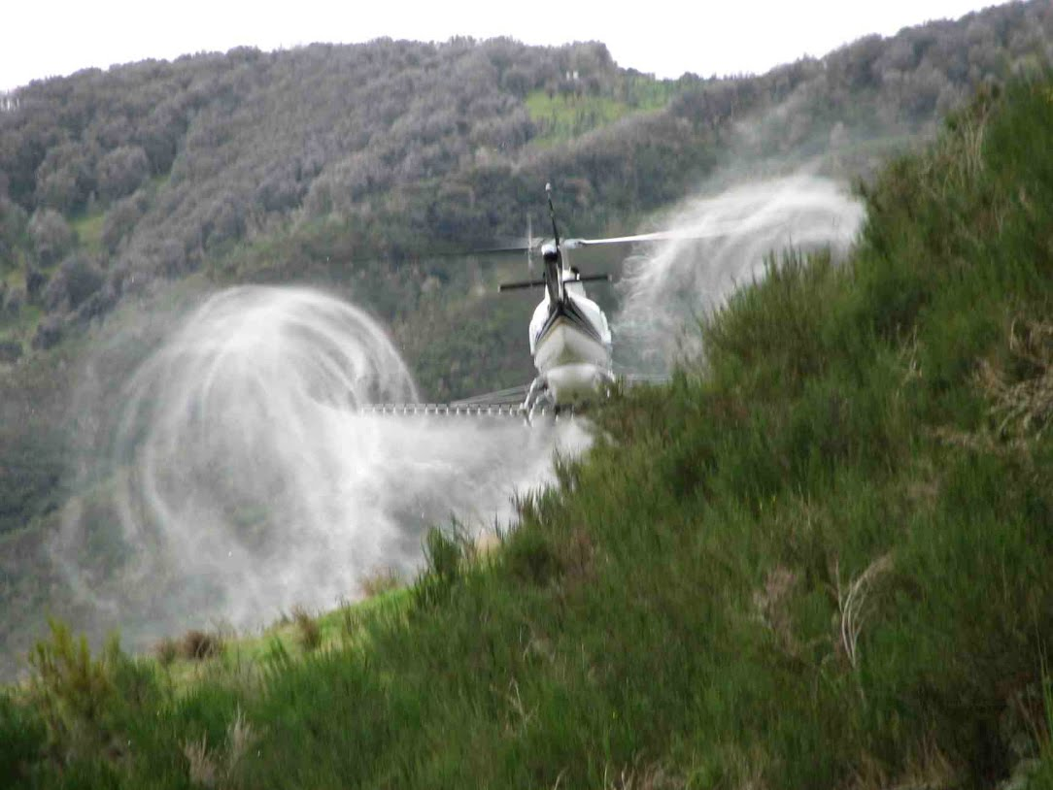
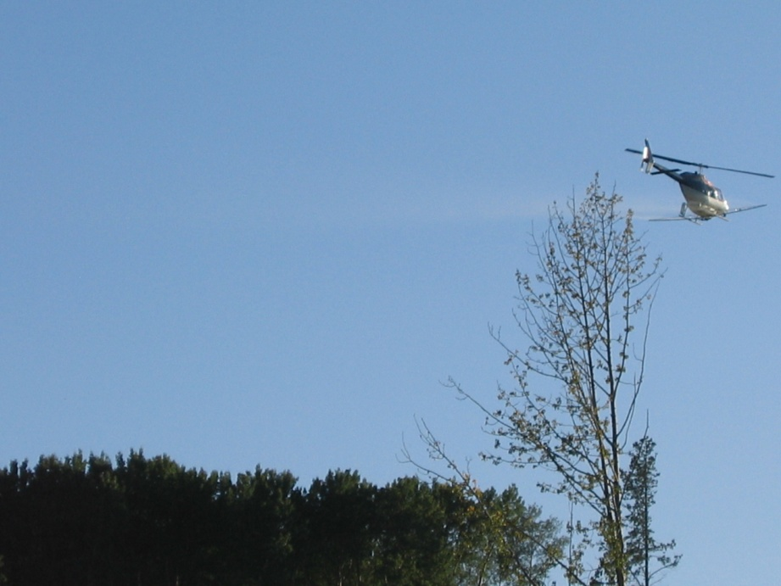
Application
Get droplets to the leaf of target plants
  Wind
  Temperature
  Relative humidity
  Drop height
  Canopy
Notes:
There are a number of factors that can impact our ability to get the droplets to the leaf of our target plants. Factors such as wind, temperature, relative humidity, drop height, and the canopy itself.

Slide 10
Use of Droplet Size and Rates to Manage Efficacy
Two largest factors in determining effective application (Spray Drift Task Force)
  Wind
  Release Height
Notes:
There are two main factors that determine effective application as demonstrated by the Spray Drift Task Force – wind and release or drop height.

Slide 11
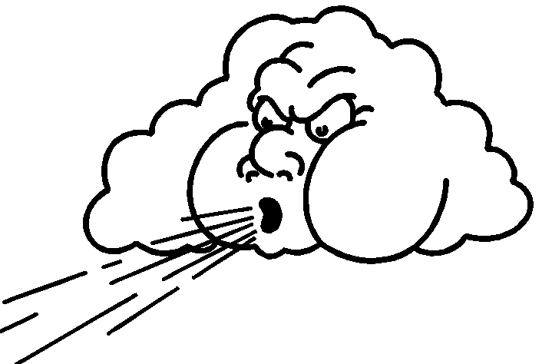
Use of Droplet Size and Rates to Manage Efficacy
Nozzle to target distance
Longer distances increase the time for wind and other weather and aircraft factors to affect pattern
Wind speed and direction
Wind = Impetus to droplet movement
Displacement if the whole pattern moves
Drift if parts of the pattern move
Notes:
Both speed and direction of wind influence droplet movement. If the whole pattern shifts it is known as ‘displacement’, if only parts of the pattern moves then it is known as ‘drift’. The distance from nozzle to the target vegetation influences displacement and/or drift. The larger the distance between nozzle and target the longer wind and other weather or aircraft factors can affect the pattern.

Slide 12
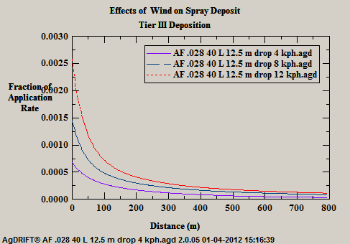
Effect of Wind Speed on Deposition
This portion of the spray material is
not landing on target vegetation.
Notes:
This chart illustrates the effect of three different wind speeds on deposition using the same nozzle type. {Click to advance slide} This portion of the spray material is not landing on the target vegetation.

Slide 13
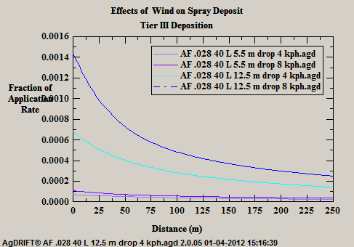
Effect of Drop Height on Deposition
This material does not land
on target vegetation.
Notes:
This chart illustrates the effect of drop height on deposition using the same nozzle type at two wind speeds. {Click to advance slide} This portion of the spray material is not landing on the target vegetation.

Slide 14
Application
Application system/configuration significantly affects DEPOSITION
  Deposition = REALIZED APPLICATION RATE
  Particularly critical with aerial application
    A function of fall time allowing more time for meteorological conditions to affect spray droplets
Notes:
The previous slides describing deposition are significantly affected by the application system or configuration. Deposition is the realized application rate. Given the drop heights of aerial application this is particularly critical as it allows more time for meteorological conditions to affect the spray droplets.

Slide 15
Table 1. Influence of droplet size on potential distance of drift.
----------------------------------------------------------
Lateral distance
droplets travel
Droplet Time in falling
diameter Type of required to 10 feet in
(microns) droplet fall 10 feet a 3 mph wind
----------------------------------------------------------
5 Fog 66 minutes 3 miles
20 Very fine spray 4.2 minutes 1,100 feet
100 Fine spray 10 seconds 44 feet
240 Medium spray 6 seconds 28 feet
400 Coarse spray 2 seconds 8.5 feet
1,000 Fine rain 1 second 4.7 feet
----------------------------------------------------------
Source: Klingman (9), Potts (11) and Akesson and Yates (2)
Notes:
This illustrates the influence of droplet size on the potential distance of drift or displacement. Remembering back to the slide on uniform droplet size Accuflo nozzles produce on average 1,000 micron droplets where as Diskcore nozzles are in the order of 400 microns with many in the ‘fine spray’ region.

Slide 16
Rate
Nominal vs. realized rate
  Nominal rate = mixing proportion i.e. L of product in total application solution applied per unit area
    E.g. 3 L of VisionMax in 35 L of solution per ha
  Realized rate = L of product on plant surfaces especially leaves and green bark
Notes:
It is important to understand the difference between nominal and realized application rates. The nominal rate is what we are mixing to – for example 3 litres of VisionMax in 35 litres of solution per hectare. The realized rate is that proportion of the solution that reaches the plant especially leaves and green bark.

Slide 17
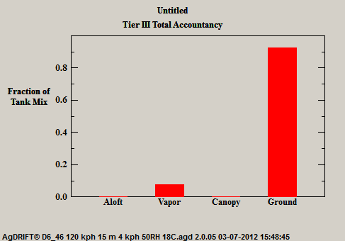
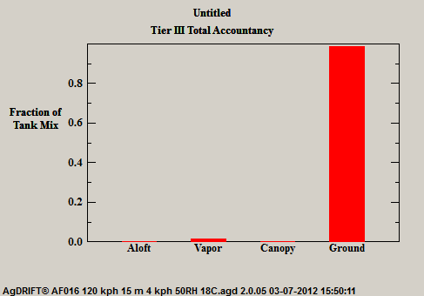
Nominal vs. Realized Rate
Realized Rate Under Optimal Application Conditions
D6-46 3L/ha nominal rate = 2.7 L/ha realized
AF .016 3L/ha nominal rate = 2.9 L/ha realized
Notes:
An example of realized rates from two nozzle types using a nominal rate of 3 litres per hectare. The realized rate for Diskcore nozzles could be 2.7 where as for Accuflo it could be 2.9 litres per hectare.

Slide 18
2. Uptake
Notes:
Lets talk about uptake now.

Slide 19
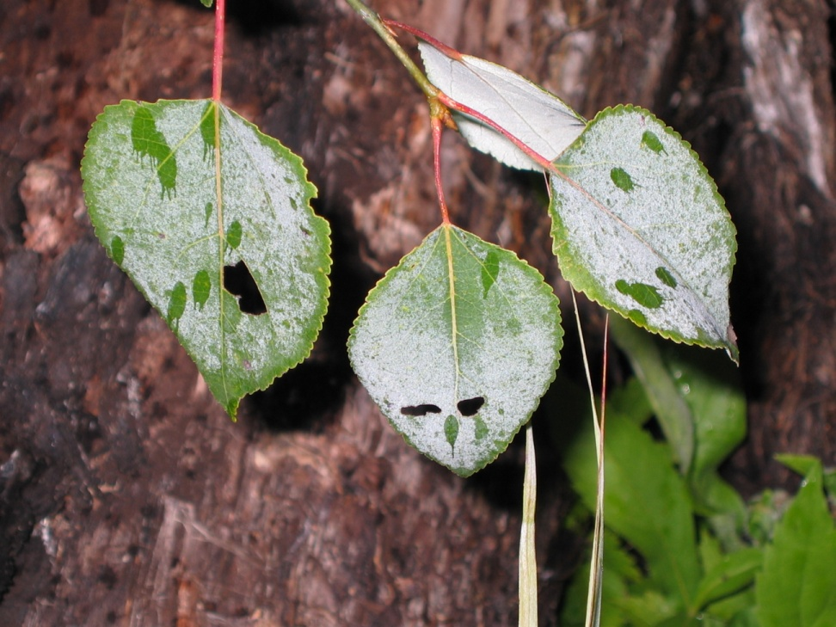
Uptake
Keep droplets on the leaf
  Moisture on leaf surface
  Frost on leaf surface
Notes:
We need to keep droplets on the leaf in order for the chemical to be taken in by the plant. Moisture or frost on the leaf surface can cause the droplet to be shed from the leaf surface.

Slide 20
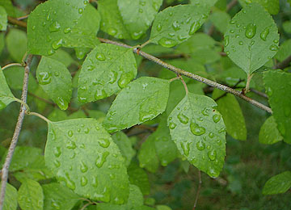
Abiotic Limitations to Uptake
Wet foliage at treatment
Notes:
A picture of wet foliage at treatment that likely will shed the droplets as they hit the leaf surface.

Slide 21
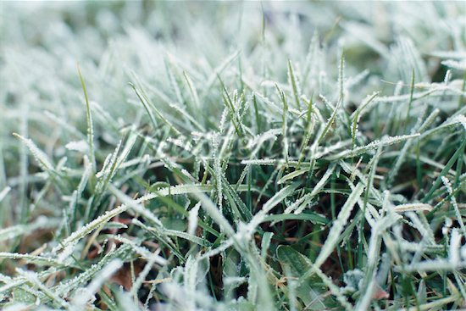
Abiotic Limitations to Uptake
Frost on foliage at treatment
Effect is not uniform as frost tends to be highly variable based on micro-terrain
Total of 7°C of frost will substantially reduce efficacy on reedgrass (herbaceous)
Notes:
A picture of frost on foliage at treatment. As the frost melts the moisture is likely to be shed from the leaf. Effects of frost are not uniform as it tends to be highly variable depending on micro-terrain. A cummulative total of 7 celius of frost will substantially reduce efficacy on Calamagrostis.

Slide 22
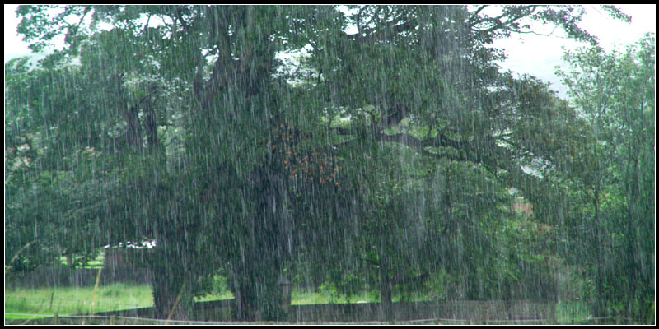
Abiotic Limitations to Uptake
Rain after treatment
Notes:
Rain immediately after treatment can ‘wash off’ the droplets. Time required since treatment prior to rain is chemical dependent.

Slide 23
Managing Abiotic Factors for Herbicide Uptake
Wet foliage, frost => AVOIDANCE
Rain – avoidance, or ∆ formulation
Notes:
So, avoid wet or frost on foliage and rain immediately following treatment. Again, some formulations are quicker to rain fast.

Slide 24
3. Translocation
Notes:
This is a ‘soft’ transition to Translocation since I will still talk about uptake as it relates to translocation.

Slide 25
(Uptake and) Translocation
Major limiter to herbicide effectiveness
  Cuticle is a complex of membrane and lipids that work to prevent dehydration
  Significant part of the herbicide development cycle is focused on getting active ingredient across the cuticle
  Dormancy (senescence) of vegetation
Notes:
In order to prevent a plant from dehydration leaves have a cuticle which is a complex of membranes and lipids. This same protection for the plant is a significant barrier to getting active ingredient into the plant. A significant part of herbicide development focuses on getting the active ingredient into plants. This cuticle thickness builds as dormancy of vegetation begins which is beneficial in protecting the crop trees (conifer) from injury but detrimental to herbicide effectiveness.

Slide 26
Role of Formulation
Soluble liquids do not depend on coverage for uptake (e.g. Glyphosate).
Esters and free radical inhibitors depend on coverage for uptake (e.g. Triclopyr).
Glyphosate is a soluble liquid so is relatively independent of coverage
Notes:
Soluble liquids such as glyphosate do not depend on coverage for uptake. Esters such as triclopyr do depend on coverage for uptake. Glyphosate is a soluble liquid and therefore is relatively independent of coverage.

Slide 27
Managing Uptake
Better done through recognition of risk factors
  Operational risk factors – frost, moisture on foliage, rain
  Drought
  Excessive moisture
  Seasonal senescence
Notes:
Managing uptake is better done through recognition of risk factors to herbicide effectiveness. Factors such as moisture on foliage, drought, excessive soil moisture, and seasonal senescence.

Slide 28
Managing Uptake
Managing spray system can affect realized rate so will have a modest impact on improving efficacy
  Focus on realizing full delivery of prescribed application volume
Notes:
We need to focus on delivering the full prescribed application volume to the target vegetation to improve efficacy. We can influence this as discussed earlier by managing the spray system.

Slide 29
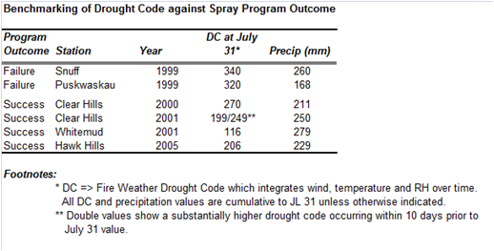
“Managing” Environmental Factors for Uptake and Translocation
Drought
  Study of several failures across most of boreal AB
  Found Fire Weather Drought Codes in excess of 300 for a few (3+) weeks prior to treatment substantially reduces efficacy
Notes:
Alberta experienced several failures best attributed to drought. A study found that fire weather drought codes in excess of 300 for several weeks prior to treatment substantially reduced efficacy.

Slide 30
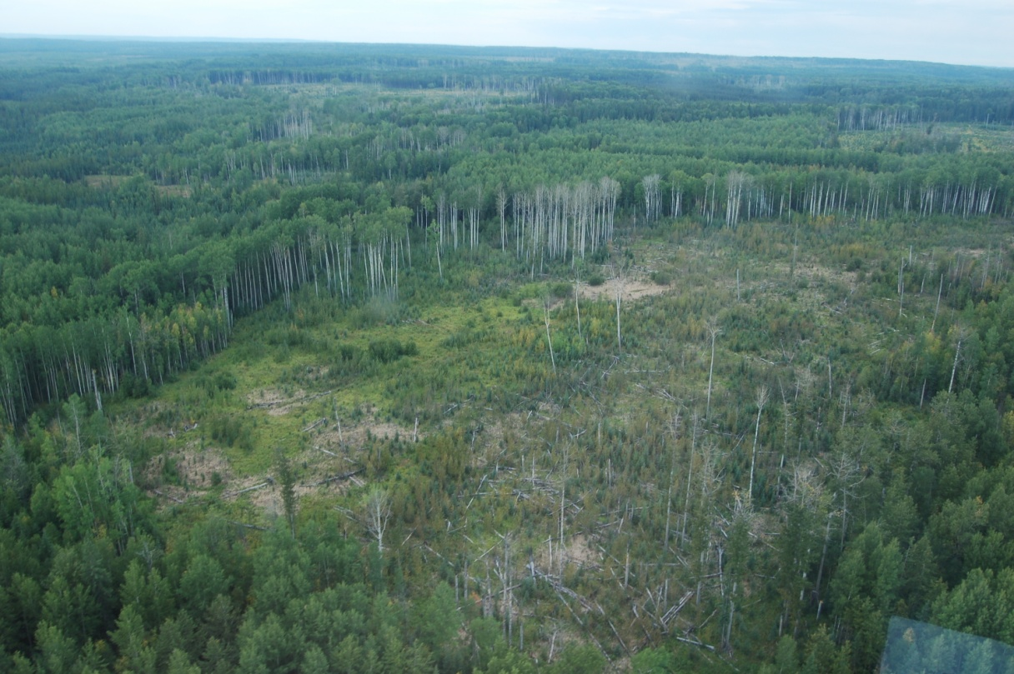
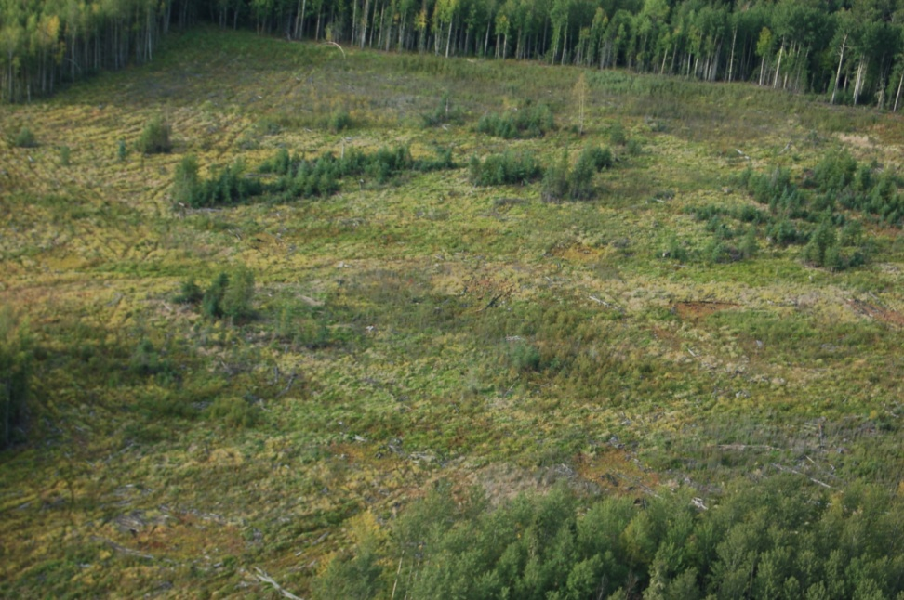
“Managing” Environmental Factors for Uptake and Translocation
Drought Code ~ 320
Drought Code ~ 380
Notes:
These are photos of treatment efficacy with drought codes in excess of 300.

Slide 31
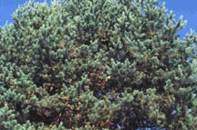

“Managing” Environmental Factors for Uptake and Translocation
Plant stress detection glasses
  Filter yellow and green light
  Red shades indicate stress
  http://apcomp.net/fs/stresssum1.html
Visible light
Stress detection
glasses
Notes:
One potential method for determining plant stress is through the use of plant stress detection glasses which filter yellow and green light to reveal shades of red to ‘see’ indicators of stress.

Slide 32
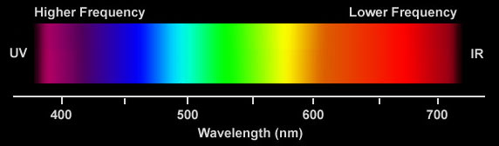
“Managing” Environmental Factors for Uptake and Translocation
Plant stress detection glasses
  The glasses do appear to have utility for forestry work. Some experience with the glasses appears to help when evaluating what one sees. They may not provide magic answers as to whether vegetation is about to die but they do amplify a person’s perceptions. They are a relatively inexpensive, small, and lightweight tool. They can easily be carried to the field and can aid in quickly picking out vegetation changes.
Visible Spectrum
Spectrum with Stress Detection Glasses
Notes:
These plant stress detection glasses are relatively inexpensive and may assist in amplifying a person’s perceptions to whether vegetation is experiencing stress.

Slide 33
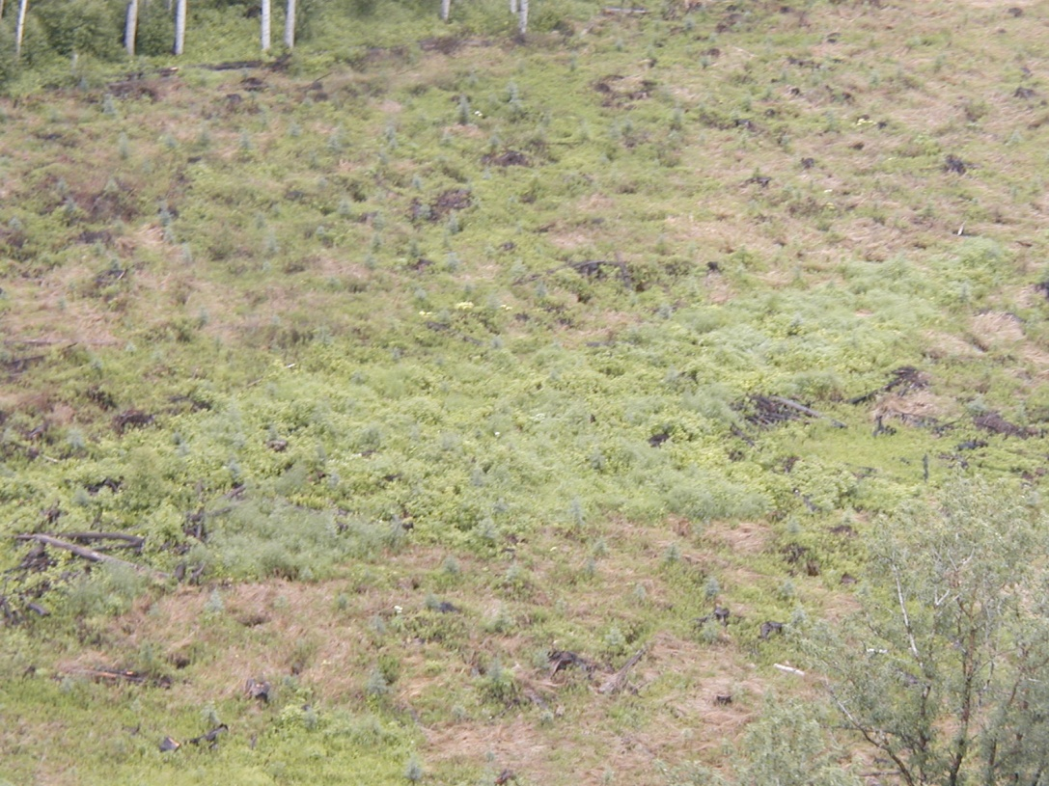
“Managing” Environmental Factors for Uptake and Translocation
Too Wet
  Harder than drought to quantify
  Frequently localized
Notes:
Another factor to consider is if vegetation is fully saturated to the point where it is no longer transpiring and therefore not taking in the active ingredient.

Slide 34
“Managing” Environmental Factors for Uptake and Translocation
Abiotic limitations to uptake can and are being managed routinely in spray programs
Physiological limitations to uptake can be managed by:
  Identification and avoidance of high risk seasons
  Changes in application technology
  Adjusting application rates
Notes:
Abiotic limitations to uptake can and are being managed routinely in spray programs. Physiological limitations to uptake can be managed by appropriate seasonal window ‘calls’, matching and applying application technology, and by adjusting application rates.

Slide 35
4. Mode of Action
Notes:
Lets discuss further the mode of action of active ingredient into a plant.

Slide 36
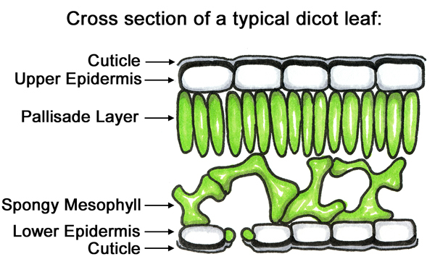
Leaf structure
Barrier to
herbicide entry
Region of
herbicide loading
and activity
Notes:
This is a cross section of a typical leaf. The cuticle acts as a barrier to herbicide entry which we need to get into the spongy mesophyll to affect the plant.

Slide 37
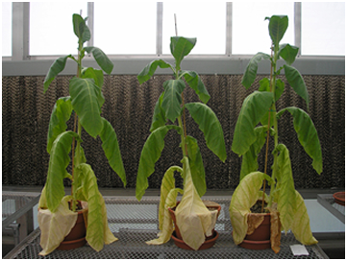
Mode of Action
Cuticle changes with seasonal climate
  Temperate, moist conditions result in less cutin (wax) than warm, dry conditions
  Moisture stress results in thickened cutin to reduce evapotranspirational loss of moisture
Notes:
Moisture stress results in thickened cutin (or wax) to reduce evapotranspirational losses therefore warm, dry conditions result in more cutin.

Slide 38
Mode of Action
Significant part of the herbicide development cycle is focused on getting active ingredient across the cuticle
  Surfactants e.g. siloxanes
  Formulation e.g. differing salts, esters vs. amines
Notes:
The use of surfactants in herbicides or added to herbicides has developed as a result of getting across the cuticle. Also, formulation as discussed earlier.

Slide 39
Optimizing Aerial Application of Herbicides
Harmony and Tuning
Notes:
Optimizing aerial application of herbicides is all about harmony and timing.

Slide 40
Optimizing Aerial Application
Configuration
  Aircraft type
  Nozzles
  Span X rotor or wing
  Boom position X centre of gravity
  Air speed
  Nozzle orientation
  Wing loading
Notes:
To optimize aerial application we need to consider the application system confiquration. We will elaborate on there in the next few slides.

Slide 41
Optimizing Aerial Application
Configuration
  Aircraft type
    R/W better than F/W
    Slippery better than chunky
Notes:
When considering aircraft type, rotary wing is better than fixed wing and streamline is better than bulky.

Slide 42
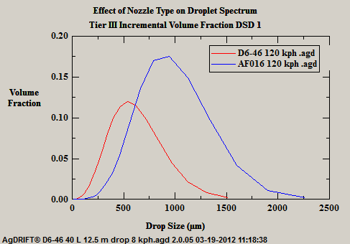
Optimizing Aerial Application
Configuration
  Nozzles
    Streams pulled into droplets are more consistent than shattered droplets
Notes:
With respect to nozzles, droplets created by streams being pulled into droplets are more consistent than shattered droplets.

Slide 43
Optimizing Aerial Application
Configuration X turbulence
  Span X rotor or wing
  Boom position X centre of gravity
  Air speed and trim
  Nozzle orientation
  Wing loading
Notes:
If not confiqured correctly, turbulence can be created. Factors such as boom width relative to the rotor or wing span, position of the boom relative to the aircrafts centre of gravity, the flying speed, whether the aircraft is being flown in trim, the orientation or angle of the nozzles, and the weight of the load relative to the maximum lift of the aircraft all play a part.

Slide 44
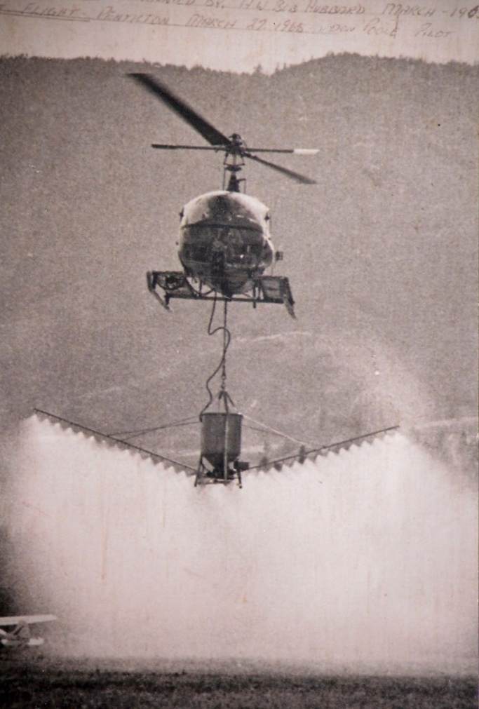
Optimizing Aerial Application
Early solution
Notes:
An early solution had the boom set quite low of the aircraft to get out of the affects of the rotors as well as reduce the height to target. It also created lots of fine droplets (almost a ‘fog’).

Slide 45
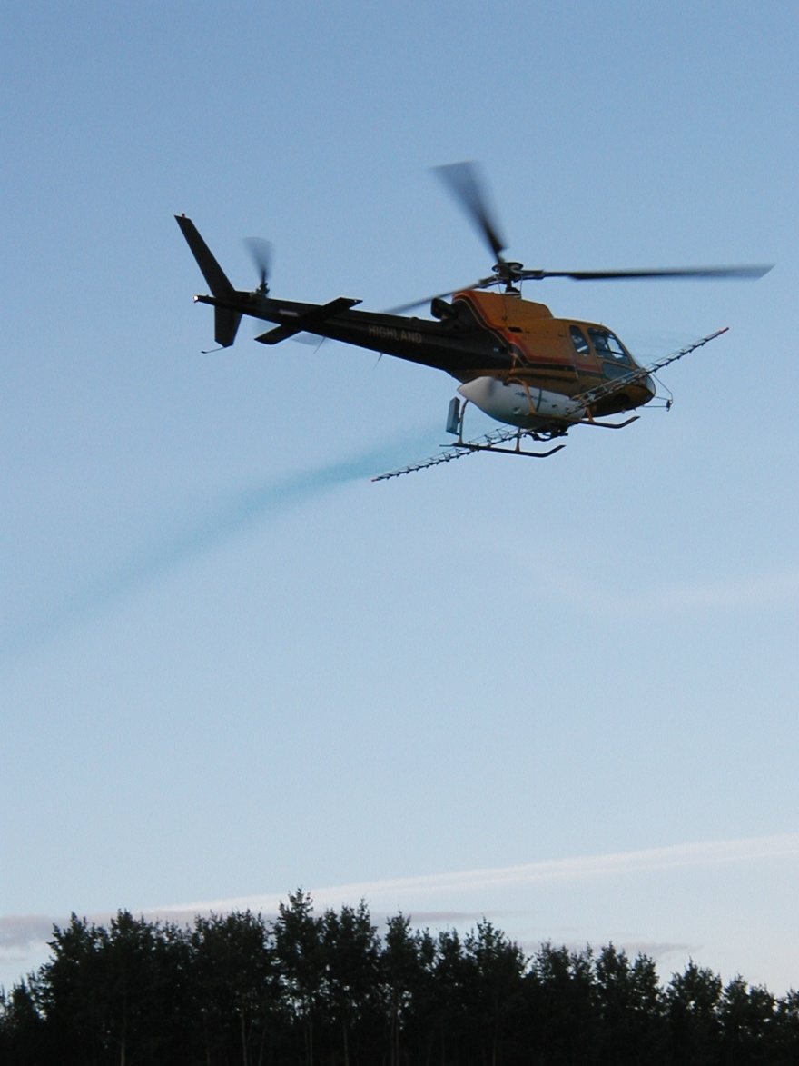
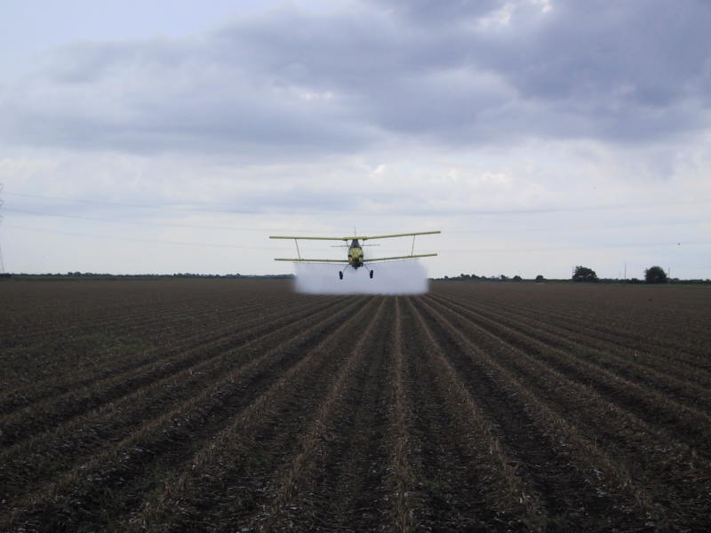
Optimizing Aerial Application
More modern solutions
Notes:
More modern solutions have moved the boom forward to allow the pattern to drop quickly by creating larger droplets before being affected by the rotor wash. In agricultural settings, getting low to reduce height to target. Note the crisp edge of the pattern.

Slide 46
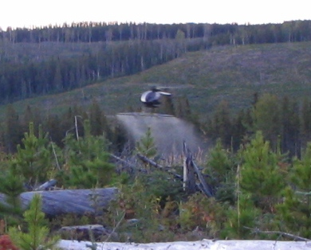
Optimizing Aerial Application
Lowest possible drop height to reduce K_{e}
Raindrop nozzles produce uniform moderate droplets
Boom position and width minimize turbulent wake effects
Moderate airspeed ensures uniformity
Notes:
We want to lower the drop height as best as possible to reduce the kenetic energy of the droplets. We need to keep in mind however that we must maintain calibration height. The use of nozzles that produce uniform droplets in the moderate size range is best. The boom position and width should be chosen as to minimize turbulence and wake affects on the spray pattern. Flying at a moderate airspeed will ensure uniformity.

Slide 47
Role of Calibration
Independent, empirical assessment of effectiveness of aircraft configuration
  Aircraft (specific machine)
  Nozzle
    Type(s)
    #’s X rotor width
    Position and orientation
  Pressure and flow
  Aircraft speed
  Drop height
Notes:
The role of calibration in aerial application is to provide an independent, empirical assessment of the effectiveness of the aircraft confiquration. The assessment includes the specific aircraft to be used on spray. The nozzle type (or types), the number of nozzles relative to the rotor width as well as their position and orientation. Determination of pressure and flow as well as flying speed and drop height.

Slide 48
Role of Calibration
Ready translation from spray technology to forest management
  “Swath Kit” spells out aircraft, nozzles, number of nozzles, nozzle orientation, boom width, boom position, pressure, flow, air speed, drop height
  Forest spray manager can readily assure aircraft is spraying as calibrated
Notes:
A ‘swath kit’ spells out the parameters determined during calibration for the optimized application system. Forest managers can readily assess if the aircraft is spraying as calibrated.

Slide 49
Conclusion
Consistent application can assure achievement of nominal application
Consistency results from integration and adhering to calibration of:
  Nozzles
  Placement
  Orientation, pressure
  Air speed and trim
  Drop height
Notes:
To conclude, consistent application can achieve nominal rate if we integrate the adherence to calibration with respect to nozzles, placement of nozzles and boom, pressure, flying speed and trim, as well as drop height.

Slide 50
Thank you!
Daniel Chicoine
daniel@iftech.ca
www.iftech.ca
Notes:
Thank you for your time and the opportunity to share my experiences with you.

