Slide 1

Oil & Gas Lease Site Management
Notes:
Thank you for the introduction
We are changing our name from West Country Oilfield Services to West Country Energy Services to better reflect our customer bases and services we offer. For those who are not familiar with West Country we work primarily out of Alberta and Saskatchewan but work throughout Western Canada providing vegetation management services as well as gas leak detection services. Today, my presentation will focus on vegetation management on oil and gas leases.
In 2014, we completed work on over 20,000 oil and gas sites ranging from 100m2 to 100Ha. These sites were mainly operational sites such as well, pads, batteries, compressor stations, and plant sites. We work on conventional oil facilities and oil sands mining sites. Some sites are new construction sites as well as pipeline rights-of ways.
We also control vegetation on abandonments and work on a significant number of reclaimed sites working for a number of various environmental reclamation companies. In 2014, we had over 100 seasonal employees help us complete our projects and in 2013, I had a lot more hair……
Welcome to my world…..

Slide 2
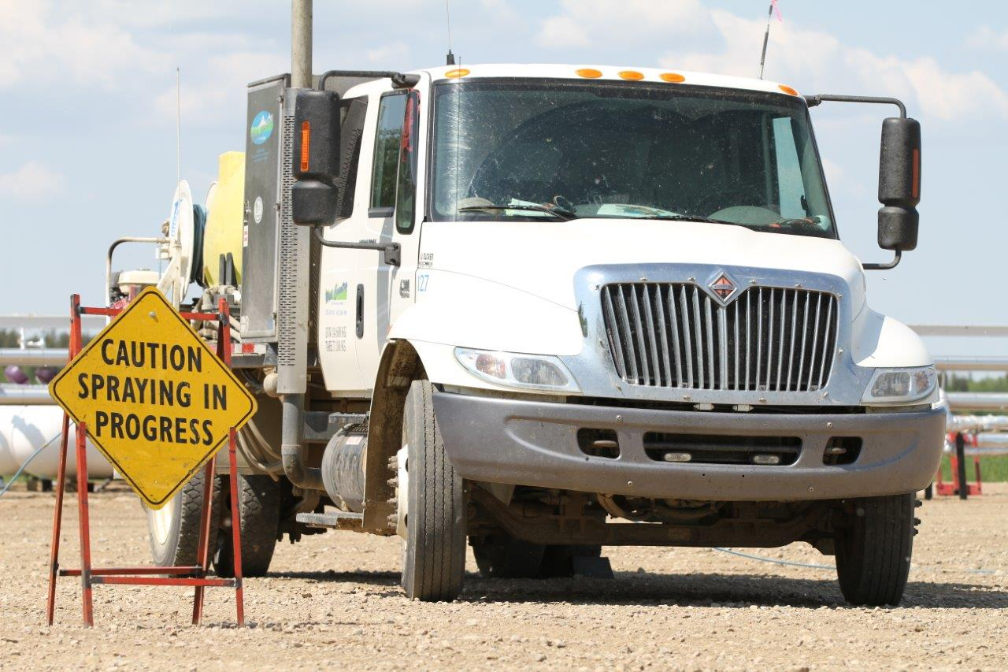

Slide 3
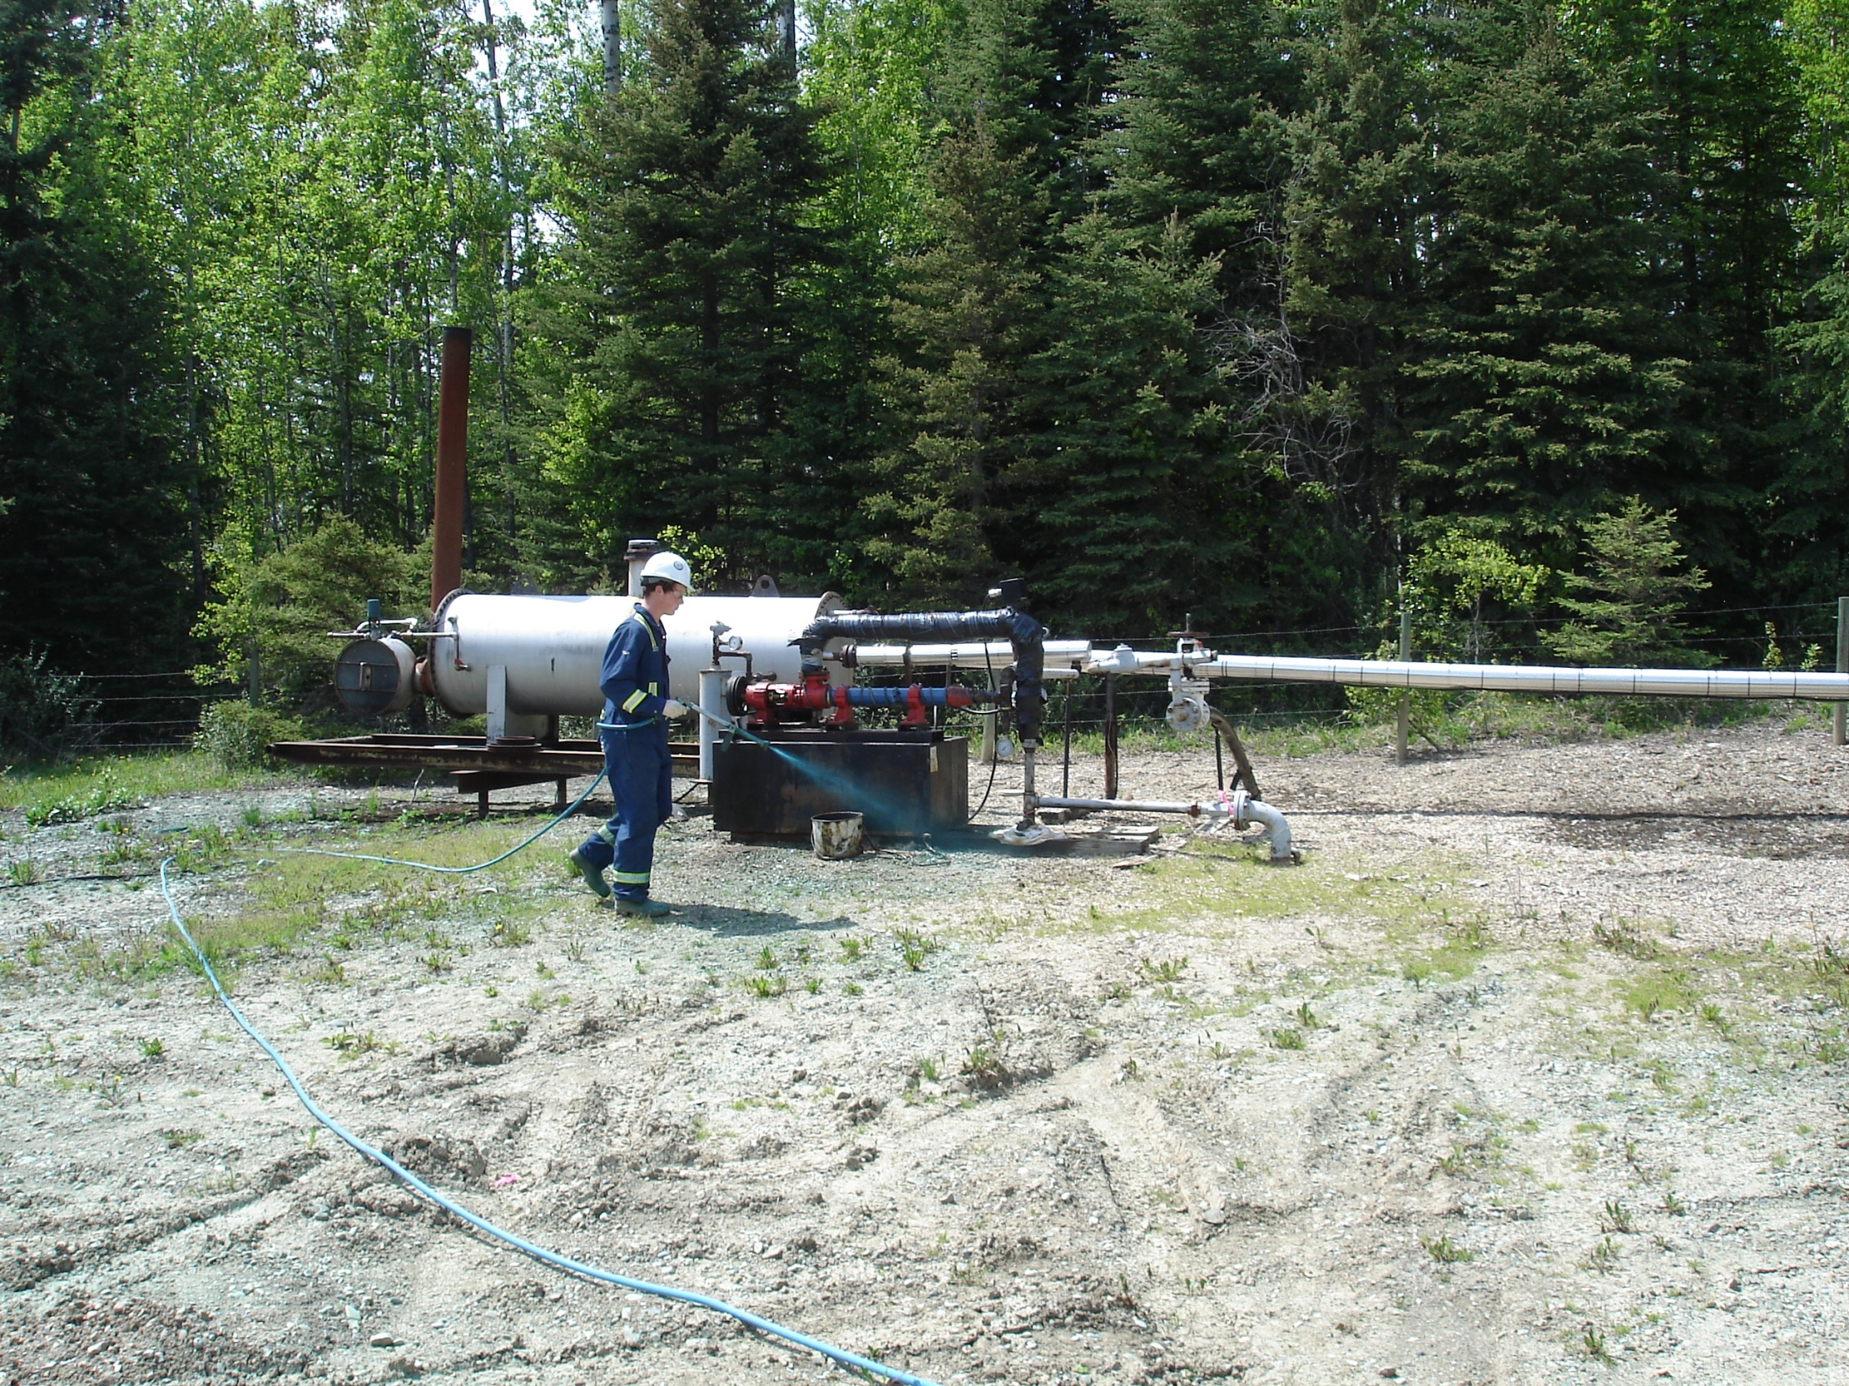

Slide 4
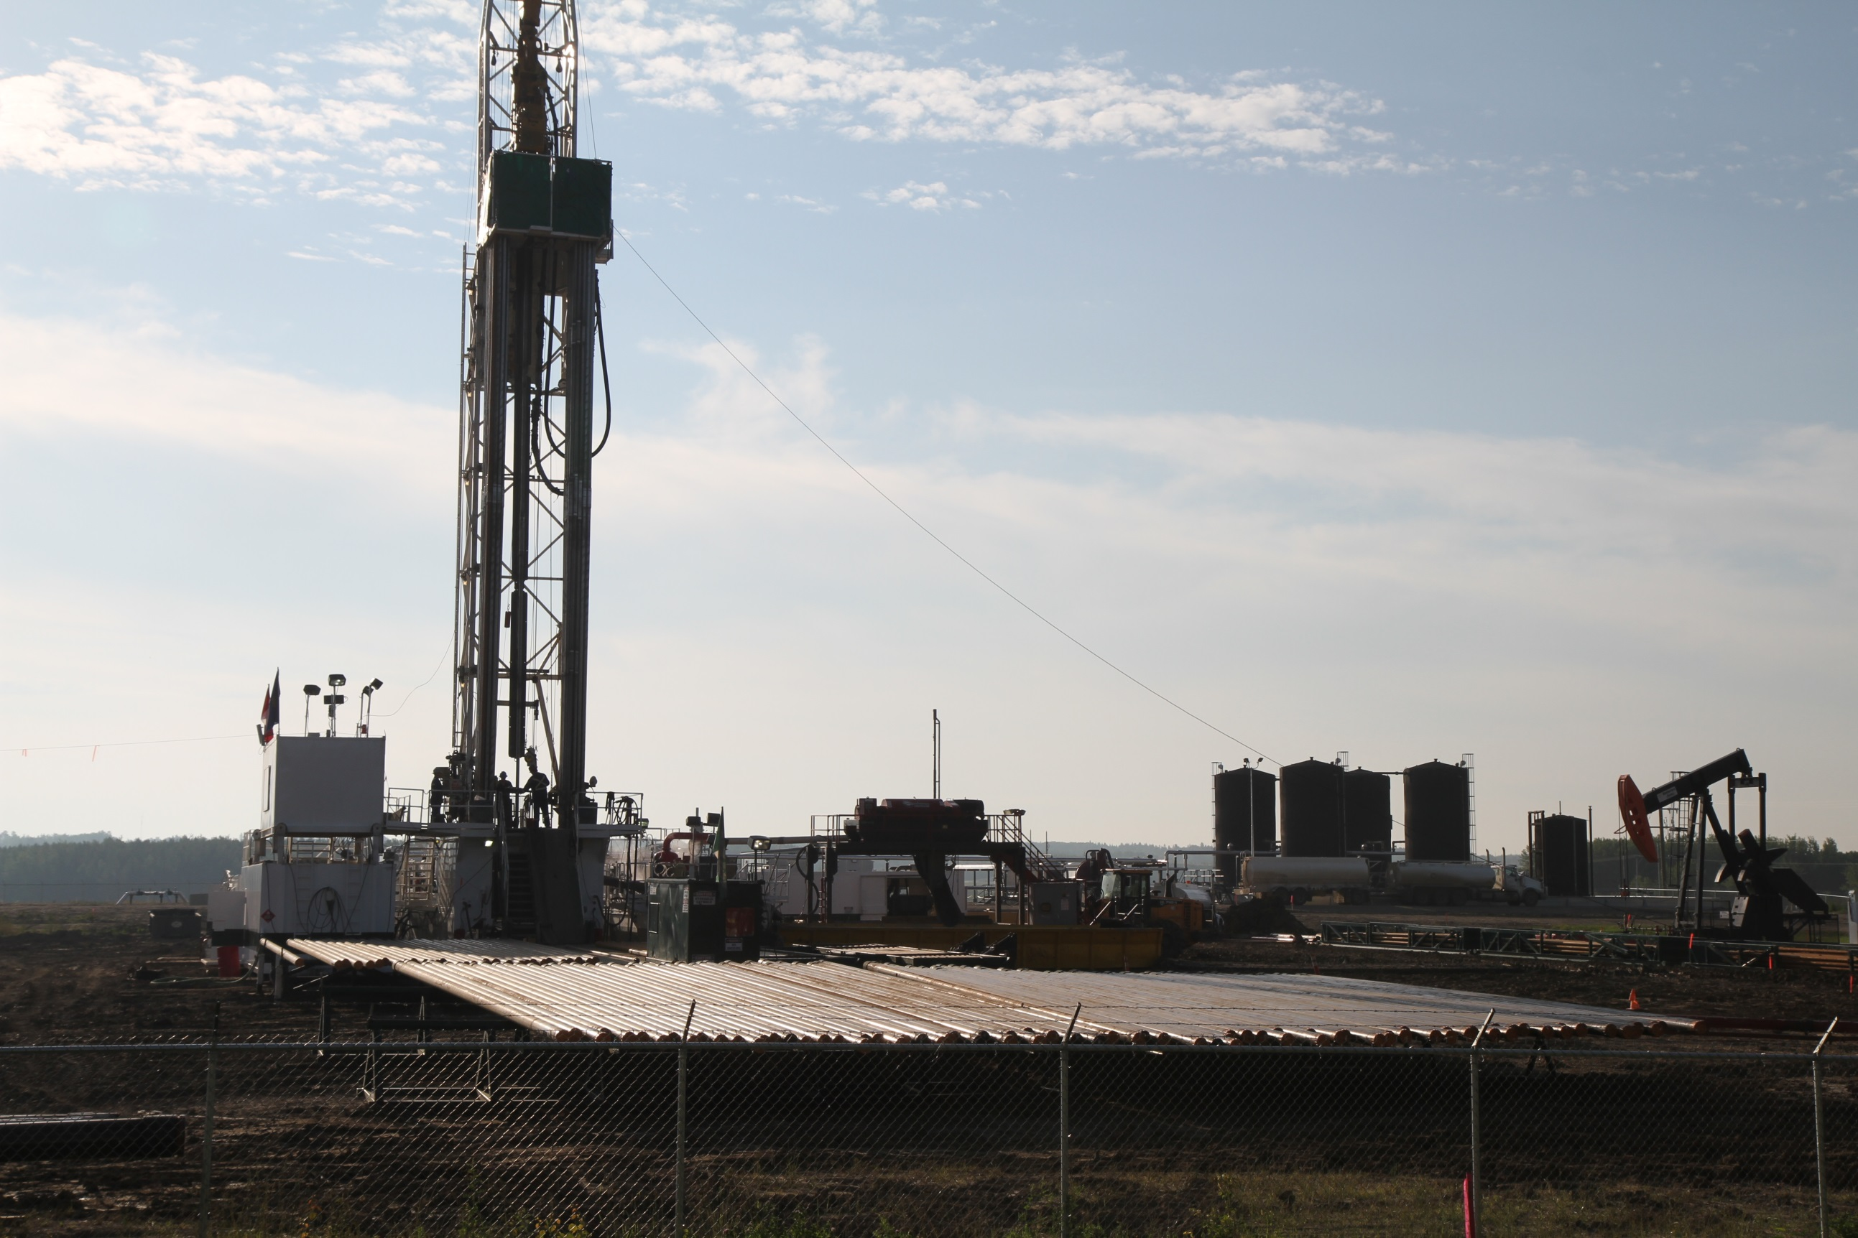

Slide 5
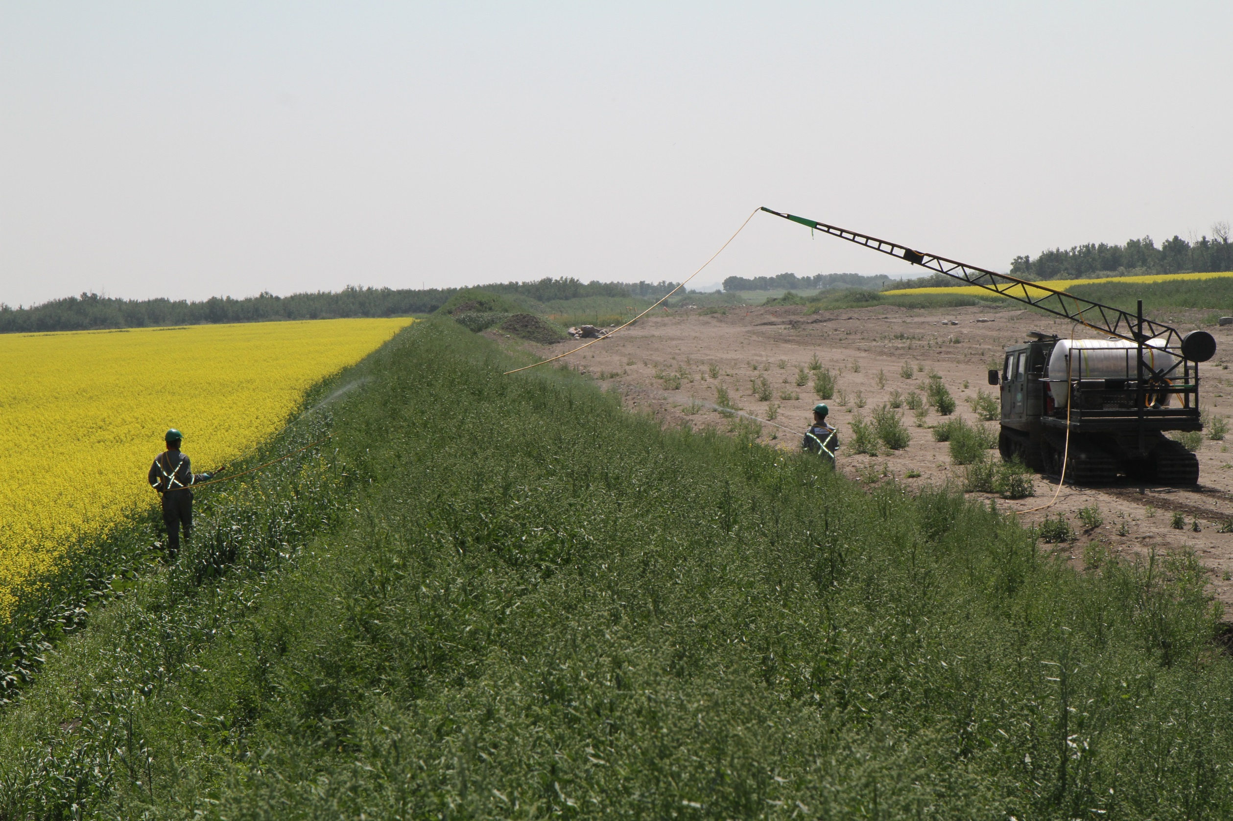

Slide 6
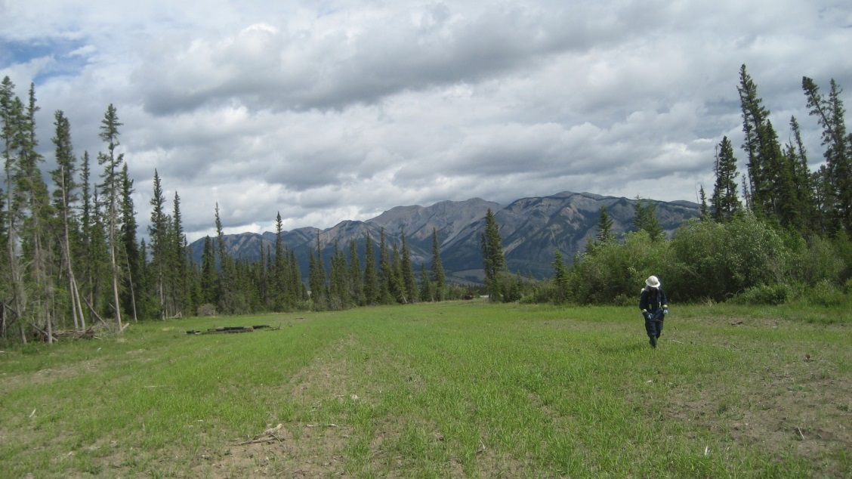
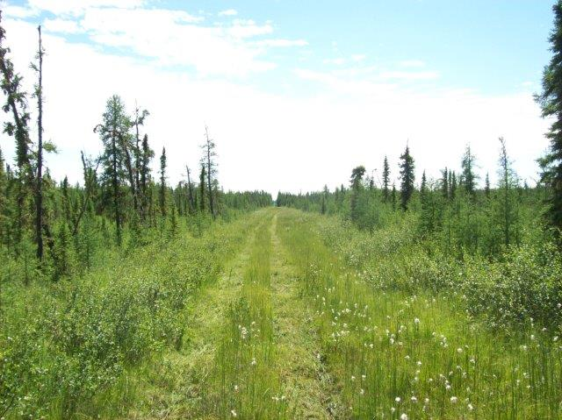
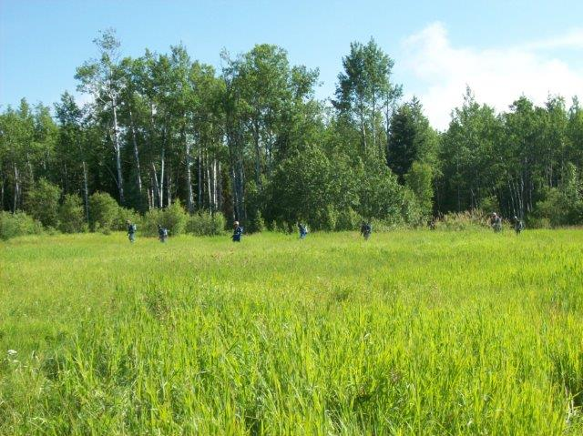

Slide 7
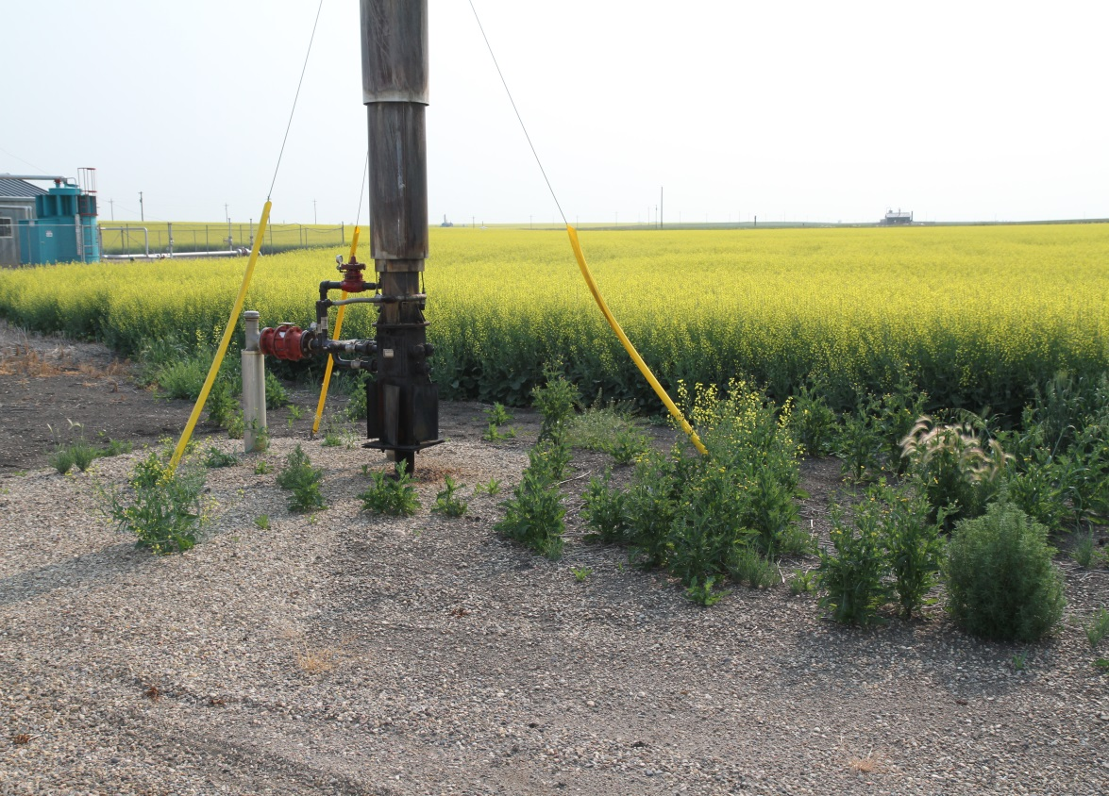
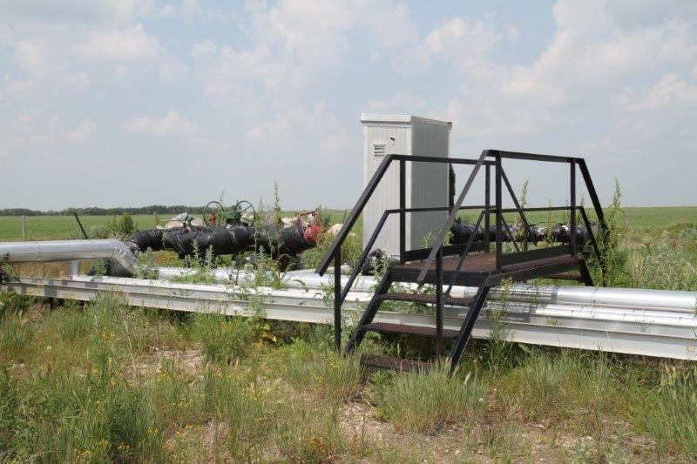
Why we control vegetation on Oil and Gas leases
Notes:
Where does one start? Let’s look at why we are controlling vegetation on the sites. First of all the reason we are out on these sites is to make sure that we have the sites clean enough to reduce the impact of a fire and at the very least prevent being the fuel or combustibles for a fire if there was a fire on site.
Secondly, to prevent the establishment or harbouring and spread of invasive plant species or prohibited noxious weeds on to our sites or off them.
There are a number of integrated tools to help us control vegetation on oil and gas sites. We use weed whipping, hand-pulling, and mowing as well as herbicide applications. By far herbicides applications is the largest component of what we do and rightly so as it is the most effective tool we have and provides our customers with the most cost effective program.

Slide 8
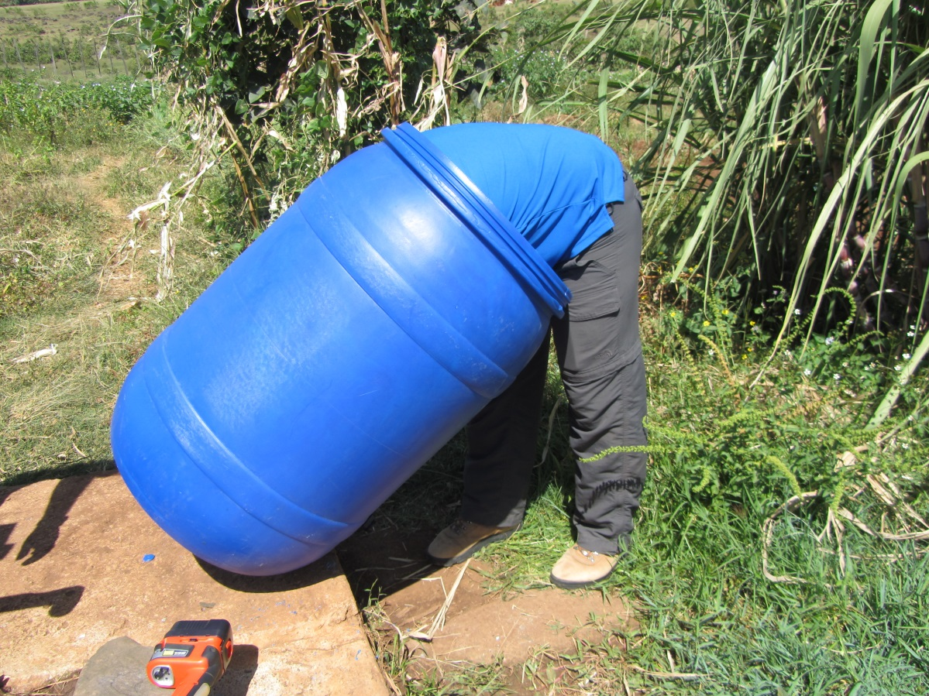
Challenges Short List
Program Planning
Weather
Weed Management
Equipment & Staffing
Notes:
To itemize some of the challenges we face there are a number but I have taken the liberty to short list into a few categories
Weed Management –resistance and problem weeds
Equipment and Staffing
Program Planning
Weather

Slide 9
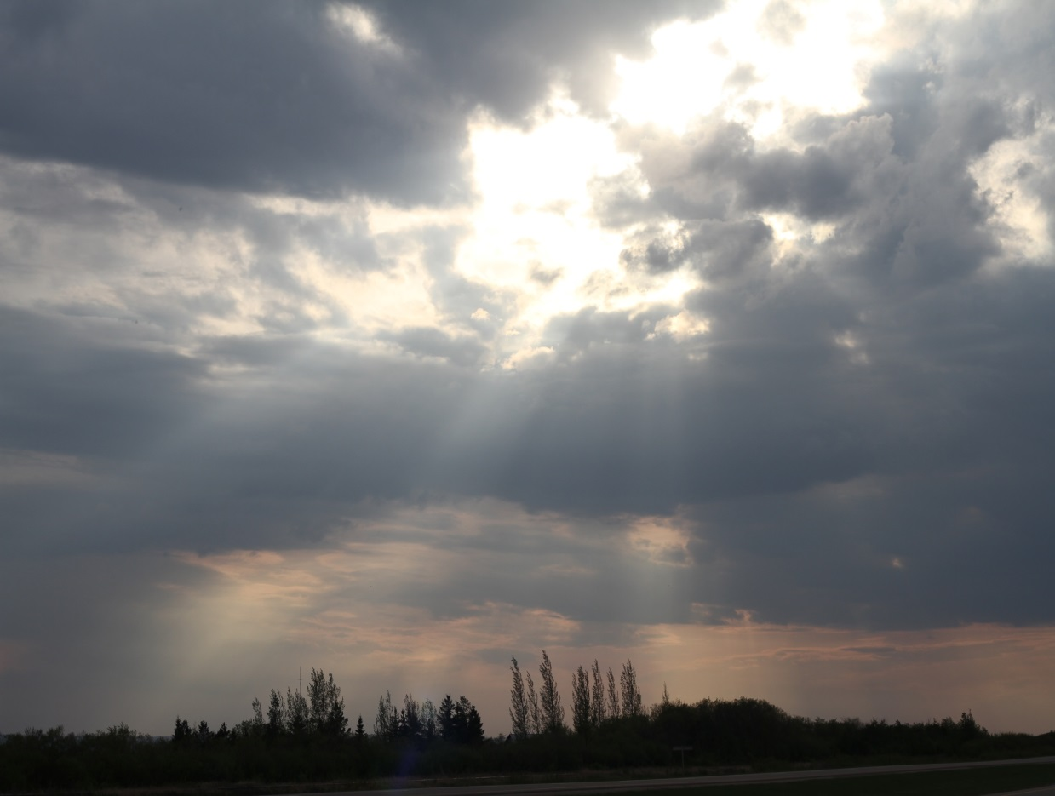
Weather
Wind and Rain
Our managers and crews use Apps for local weather and radar information
Notes:
Wind and rain are a constant battle for oil and gas lease management, mother nature will always be a challenge. We are not able to control the wind or rain but are getting better at working around it.
Our managers and crews use aps for local weather and radar information to help monitor storm systems. Weather forecasts change and storms don’t always move at the speed or intensity that they are predicted to do but we seem to be able to move around them. We also have the luxury of moving crews and fleet around to drier areas get work done for the most part.

Slide 10

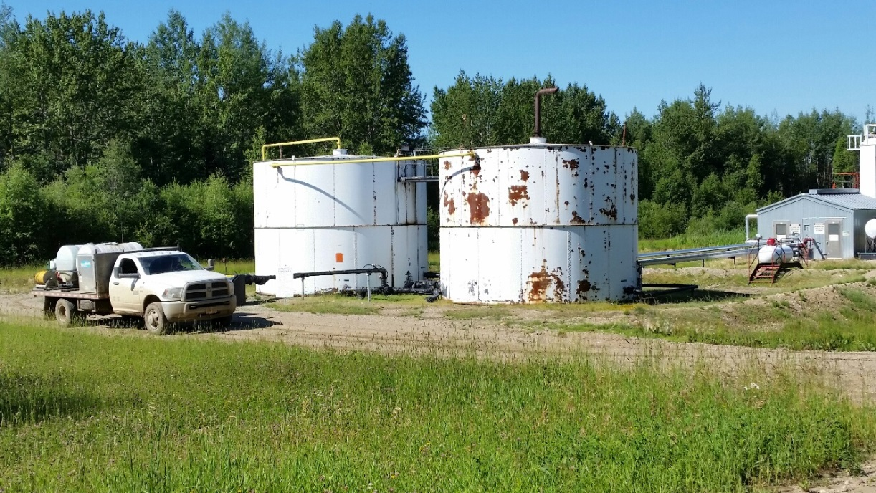
Weather
We use On-site in all our applications to aid in deposition control, minimize off target movement, and increase rainfastness
Notes:
We also use On-Site in all our applications to aid in deposition control, staying where the product is applied on the lease and increase our overall rainfastness.

Slide 11
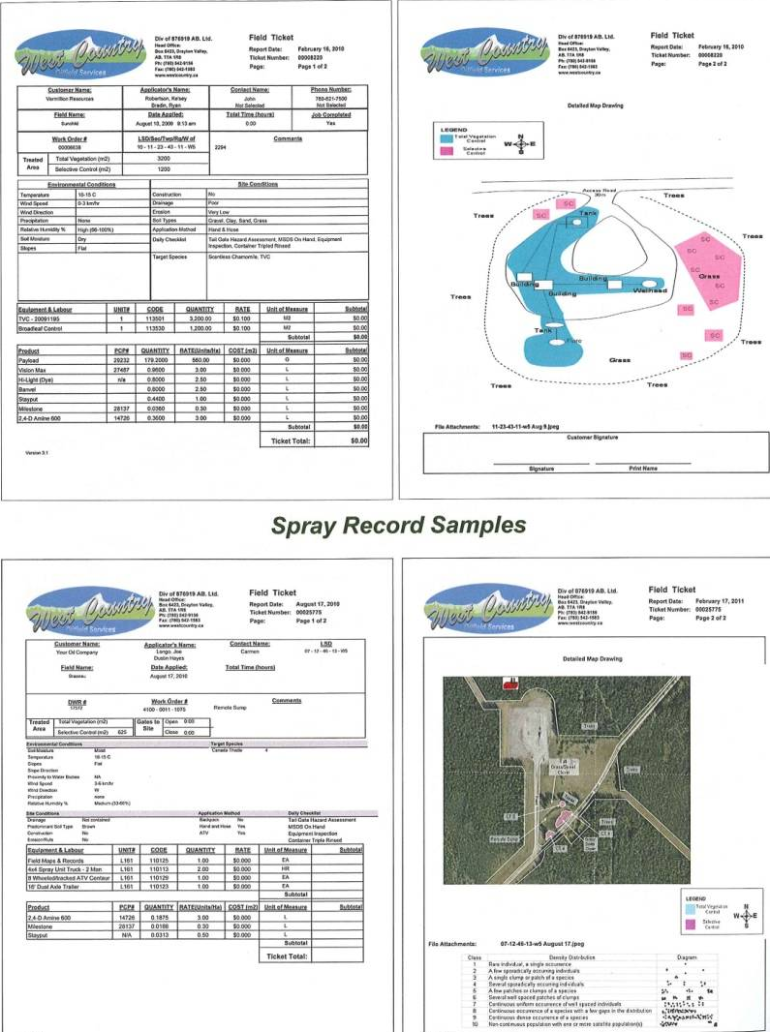
Program Planning
Site Lists and Site navigation
Utilize a custom database to store digital records
Site assessment data, environmental conditions, product used and rates, dimensions, weed densities
Notes:
Planning programs is key to any successful program. The more time spent off season combing over and preparing the necessary details to turn into good operational plans the better.
Site Lists and Site Navigation
We use a custom database to store digital record of all the work we carry out each year. Site information such as site assessment data, environmental conditions, product used and rates, dimensions, etc along with digital maps of the treatments are stored in the database. Although this database helps us with what was done on site and what we treated and also provides us a snapshot of number of locations etc it is still difficult with the every changing assets of our customers when it comes to list management. New sites added, sites going to abandonments, properties sold, are a challenge in itself as our customers still struggle with providing us with the needed current information for the new season. We are fortunate that we have mostly longer term customers who we can help prompt if it looks like there are missing sites on lists that they provide us.

Slide 12
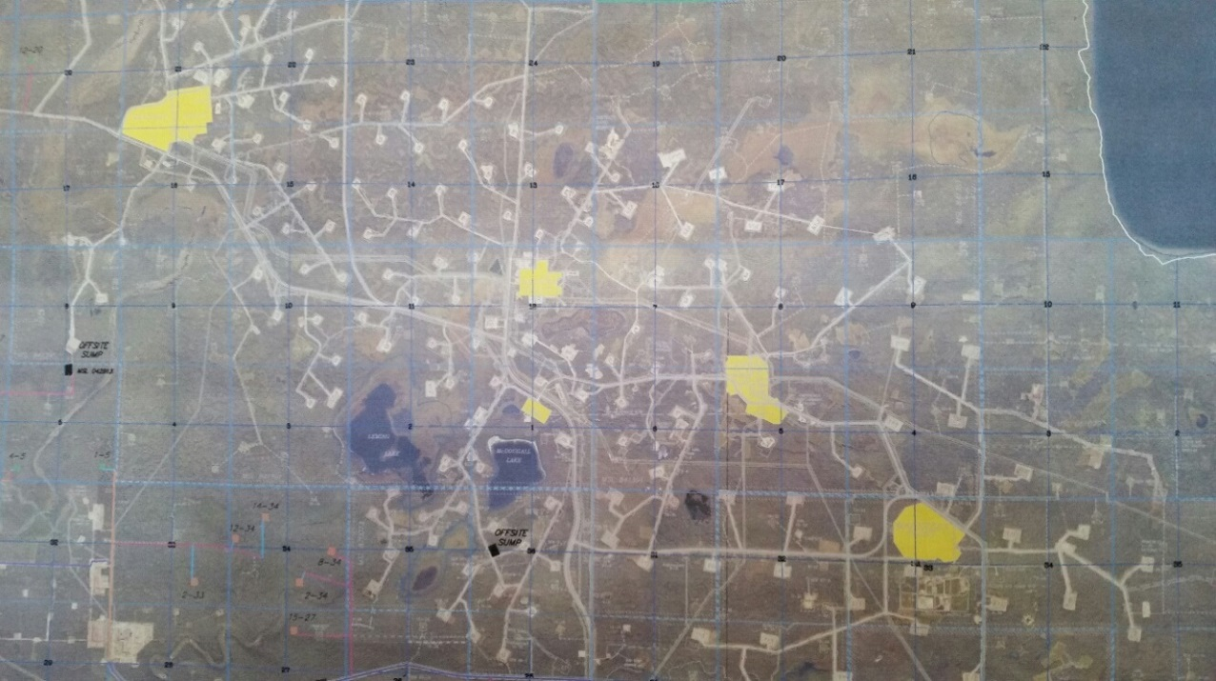
Site List Management
One of the largest challenges to a successful program
Constantly changing, assigned to new field, sold, abandoned, new construction
Notes:
List management is critical to a successful oil and gas lease vegetation management program. Sites are constantly being added or deleted. Some change ownership, are abandoned or reclaimed, others may be no spray or organic sites and need special attention. Keeping track of the sites has been a difficult challenge for our clients as some of the companies we work for are so large and have difficulty determining what assets they own as it is a moving target.
Our database helps us manage what was done on sites and also provides us a snapshot of number of locations etc it is still difficult with the every changing assets of our customers when it comes to list management. We are fortunate that the majority of our customers are long term and we can help cross reference sites that we have worked on.

Slide 13
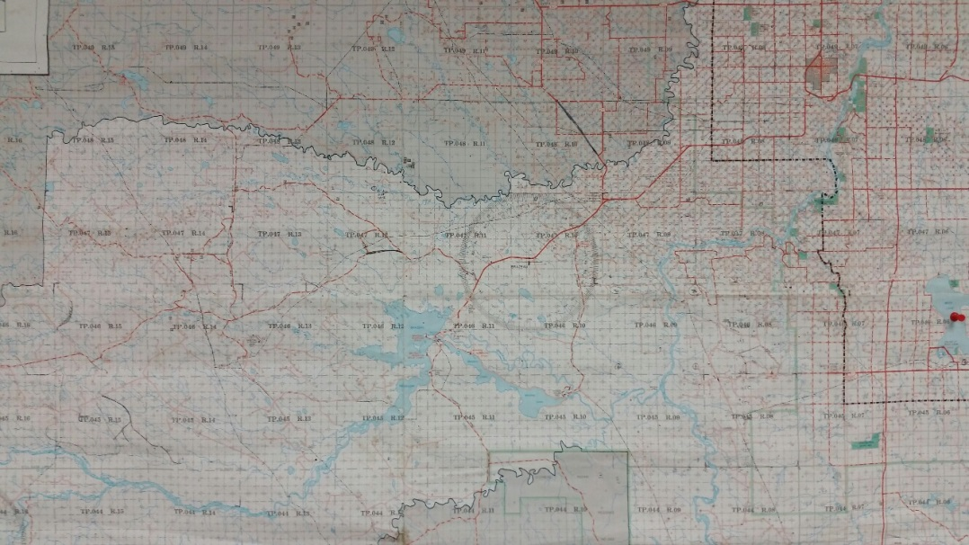
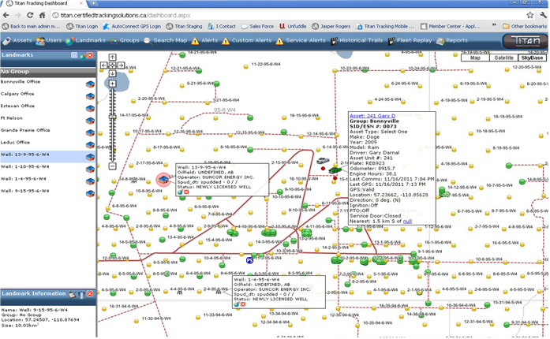
Site Navigation
Finding and getting to sites is another large challenge
In the past we relied heavily on field maps
For the most part use GPS now
Notes:
We utilize a number of programs right now that we preload for the crews into tablets that allow them to navigate to the GPS coordinates for the sites. Using GPS in the trucks to navigate to the sites does help reduce windshield time spent getting to sites. With some of the mapping software we are able to see what sites are on the way which allows us to coordinate work on multiple sites as well as multiple customers in some cases.

Slide 14
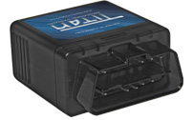
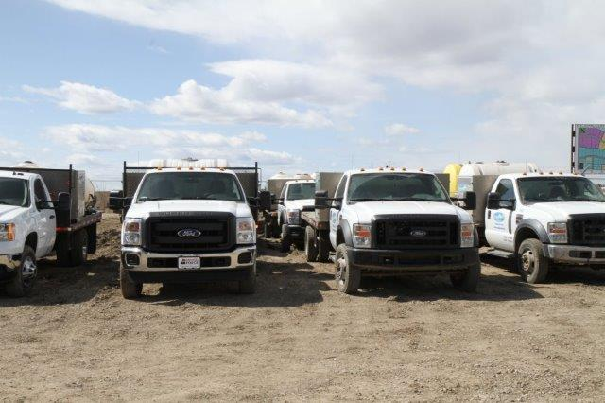
Equipment management -GPS
Used for truck monitoring
  Speeds
  Idling times
  Location
  Seatbelt use
  Aggressive driving parameters (acceleration and deceleration)
Notes:
We also use GPS in all our trucks to monitor, speeds, idling time, location, seatbelt use, aggressive driving parameters such as excessive acceleration and deceleration.

Slide 15
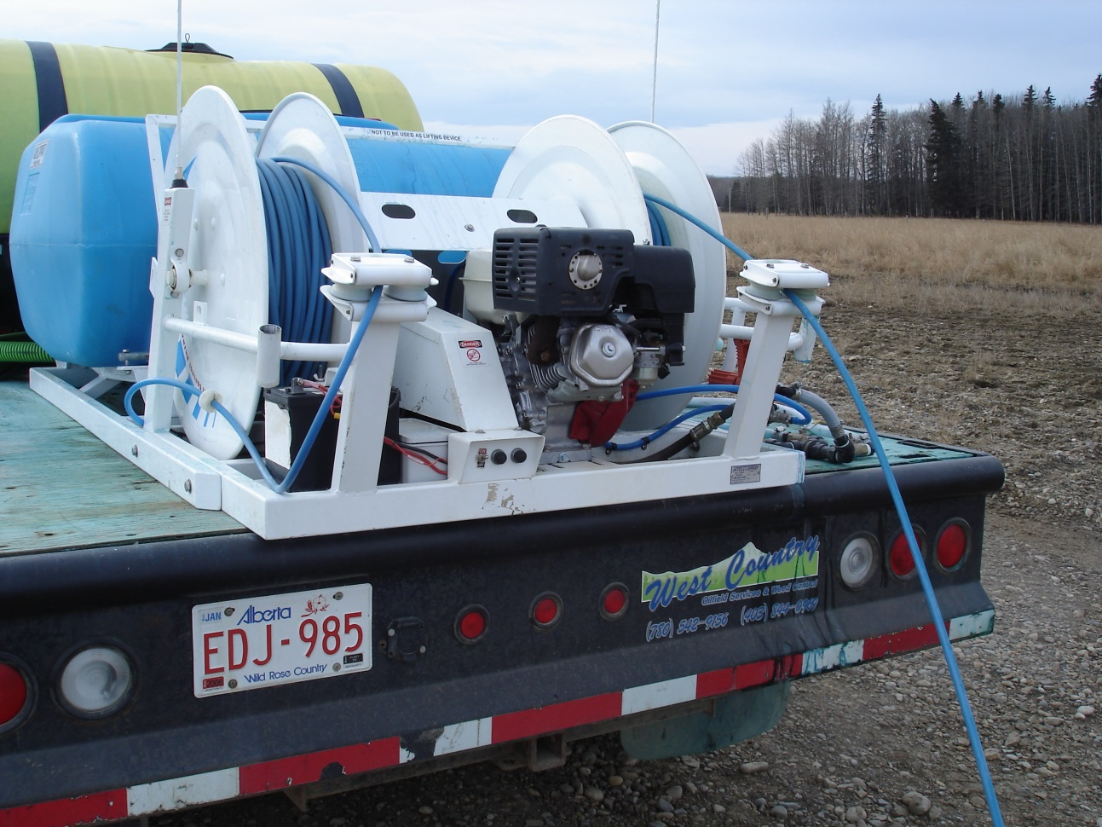
Equipment & Staffing
A number of advances in equipment
Biggest advancement for us has been the Intelli- Spray system
Notes:
Equipment – there have been a lot of advances in equipment with all kinds of boom less nozzle and spraying configurations but for us probably the biggest advancement has been the Intelli spray system. I say this because it is the uniqueness of the hose that is much more light weight and durable than conventional hose as well the smaller size allowing more hose to be strung on a reel increasing the distance one can be from the spray unit. For us this means we are able to park our trucks on site with less moving around and able to get to the weed problem. The light weight allows us to string out hose for 150 meters and we do not need two people to help carry the hose.
Hand and hose operations typically had weeds near the corners of the leases as applicators either could not reach, or did not want to spend the time to don a backpack and walk out to the edges. This is not a problem with applicators using intelli spray systems.
Another benefit is that one can do more spot applications with the hand and hose applications reducing the amount of product needed by reducing the amount of area treated when it comes to broadleaf control.
The powered windup reel is a blessing at the end of a day. Year- end surveys with crews this always comes to the top as a positive. The one negative thing about the intelli spray system is that it requires more maintenance than most other systems.
There has been a number of advancements in equipment to map and record treatments using boom or boomless applications mounted on equipment and there is work going on to develop hand and hose mapping by using GPS technology on the spray gun. Currently, we are using Aps like map measure pro to capture this information.

Slide 16
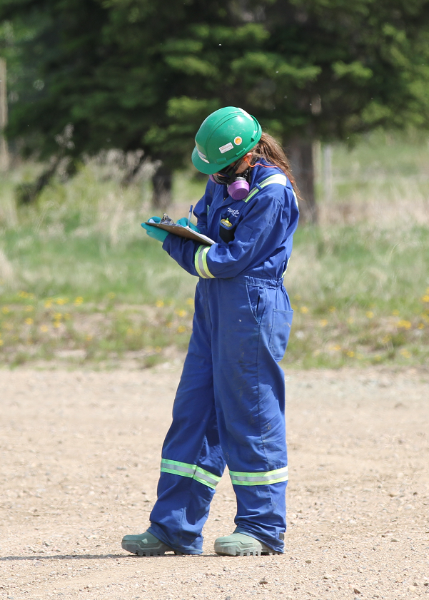
Staffing
On going Challenge for most organizations
We have not found a new technology to help us but have used new techniques
Notes:
Not a new problem for anyone just an on-going one with new challenges. When I first started hiring crews years ago we would have two people in our trucks and they would work a 14 to 16 hour day. If you told them they had to take time off they would go look for work with someone else. This really has not changed much, just that now a days employee can only work up to a 12 hour day with us and if we do not give them all the time off they want they will go look for work with someone else.
We have to hire more people than the seats in the trucks to ensure that the assets aren’t parked in the yard. This is not a new technology rather a new technique for our business.

Slide 17
Staffing – What we look for in hiring
  Good communication skills
  Safety Minded
  Self-motivated
  Able to drive various equipment
  Physically fit
  Work well with others
  Willing to travel and Be away long hours or days
  Organized and pays attention to detail
  Plant ID skills, good math comprehension
  Book smart, streetwise
  No time off unless rain or wind
  Mechanically inclined
  Computer literate
  Non smoker
  Can stay away from texting during the day for long periods of time
Notes:
How many of you meet all of these requirements????
That’s why we have two person crews

Slide 18
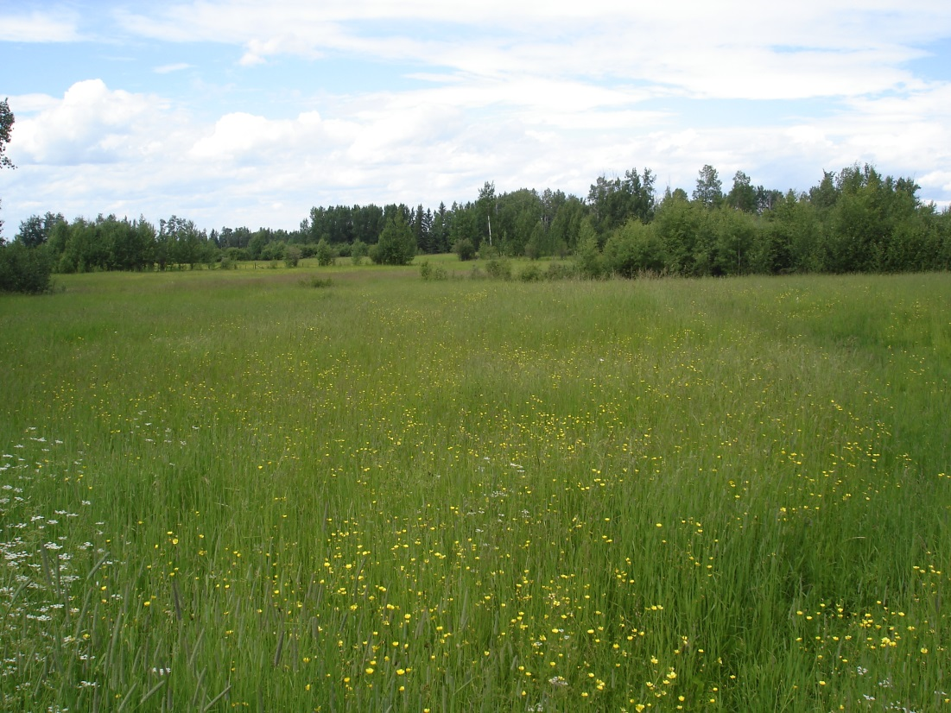
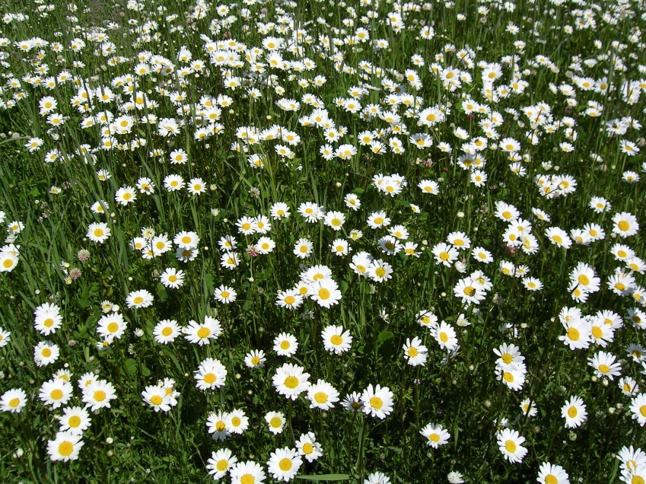
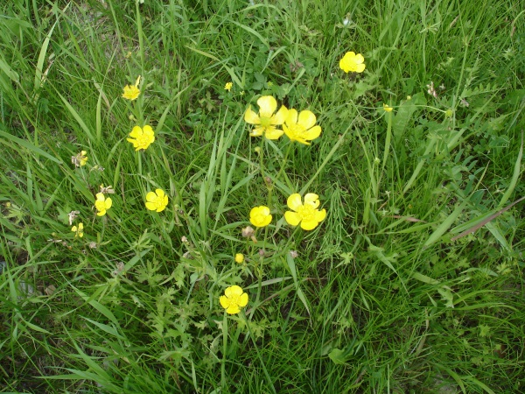
Weed Management
Weed challenges we deal with are
  kochia, Russian thistle, scentless chamomile, ox eye daisy, tall buttercup, Canada thistle, perennial sow thistle, cow cockle, foxtail barley

Slide 19
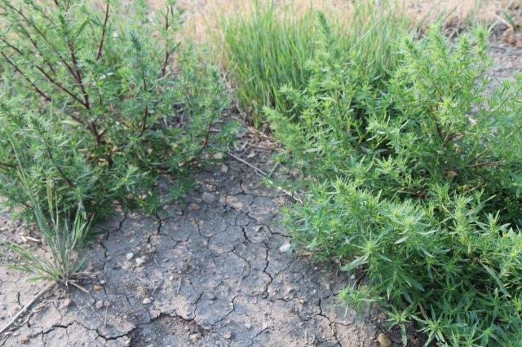
Weed Management
Herbicide Resistance Challenge
  Concern for clients introducing resistant weeds on to landowners property
Herbicide Selection & Rates
  Trend to reduced rates
  Loss of some products
Notes:
Herbicide Resistance– Is a real concern and needs to be planned into your program. Introducing resistant weeds on to a landowners property due to our programs is not acceptable.
Herbicide Selection – reduced rates of older products and removal of some was becoming a serious challenge but of late we have been fortunate to have a number of new herbicides added to our tool box with different resistance management groups. The two that have made the biggest impact for us has been Esplanade and Navius.

Slide 20
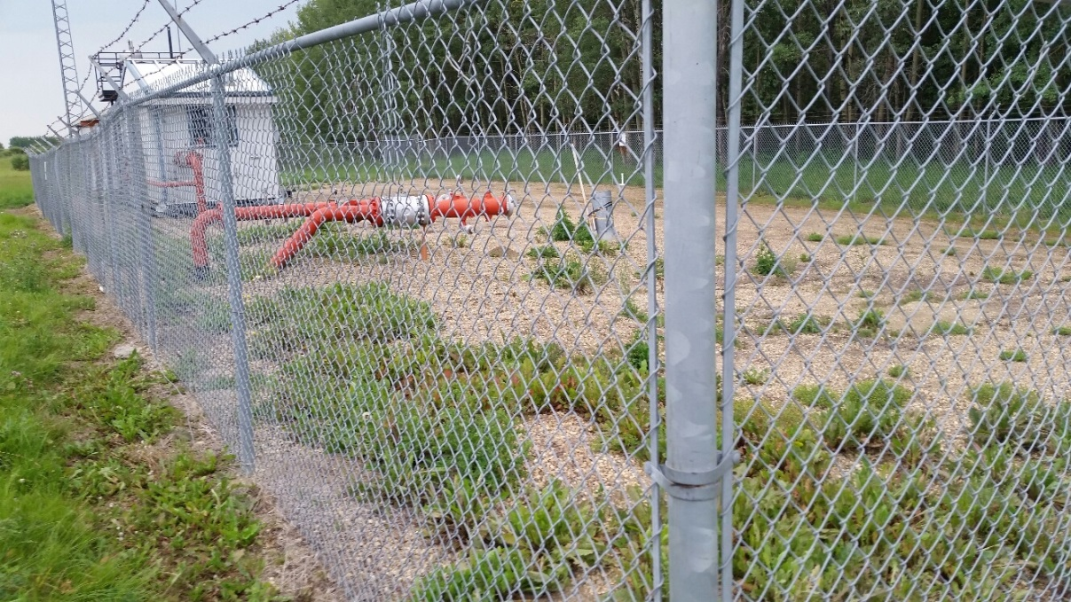
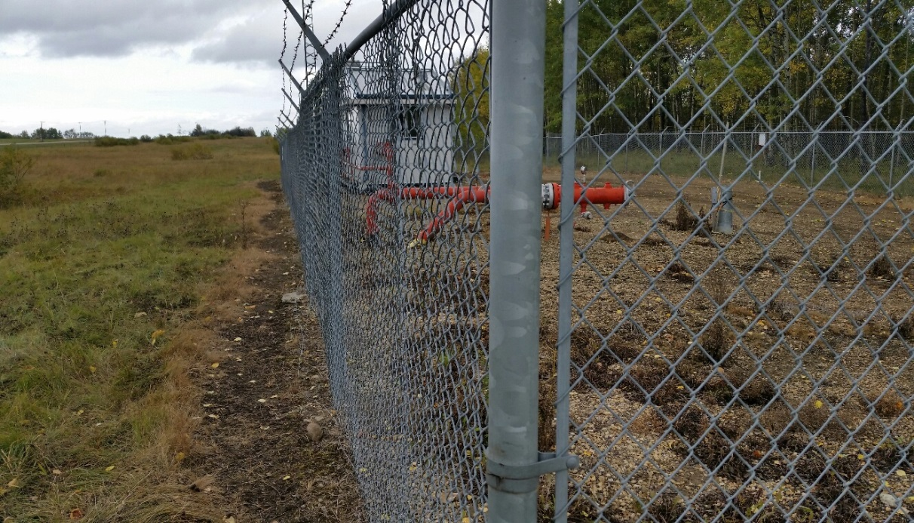
Weed Management
For our TVC programs we rely heavily on Arsenal
Have used Payload and Amitrole 480 as substitutes for Arsenal in resistance management
Notes:
For total vegetation control programs we rely heavily on Arsenal tank mixed with VisionMax and a broadleaf component such as Banvel VM and Milestone. Arsenal has a season long residual which provides our clients with the most successful total vegetation control.
We have rotated products such as Payload or Amitrole to add a different herbicide group into our mixes to substitute Arsenal out. We have for years, used, a minimum of three different actives in our TVC mixes to reduce the risk of resistance selection.

Slide 21
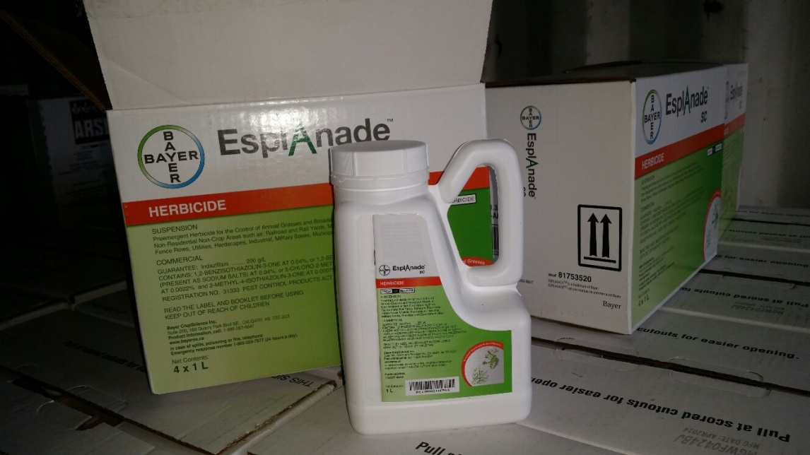
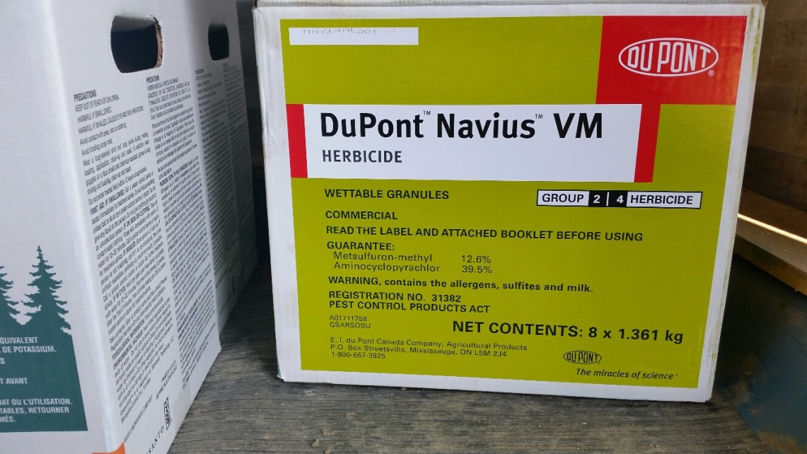
Weed Management
Two new break though products for our business have been Esplanade and Navius
Esplanade as a TVC product
Navius – broadleaf control for kochia as well as TVC tank mix partner
Notes:
When Amitrole was available in the marketplace we used it as a resistance breaker as well. But having to use 375ml/Ha of Esplanade versus 20,000ml/Ha of Amitrole is a logistic dream.
In 2014, we introduced Esplanade into our programs and had excellent success. In our heavy kochia areas adding Navius into the tank mix and found we had next to no break though of late kochia and Russian thistle. We look forward to integrating more Esplanade into out 2015 programs and by doing so with extend the life our Arsenal with our clients.

Slide 22
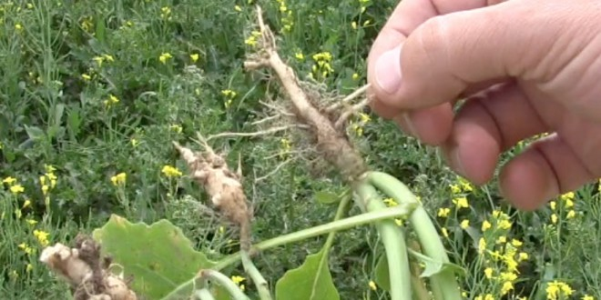
Weed Management
Clubroot – not a weed but a soil borne disease of canola crops
Becoming a larger challenge with landowners
Cleaning and disinfecting stations
Resistant canola varieties
Notes:
There is a lot of canola grown throughout the provinces and clubroot management is a challenge. A number of oil and gas customers do have wash/air stations setup to clean equipment before moving onto a landowners property. Clubroot is soil borne and spreads by soil brought in or by dust blowing infected soil. There are resistant canola varieties which will help however again you don’t want to be the one blamed for introducing the disease.

Slide 23
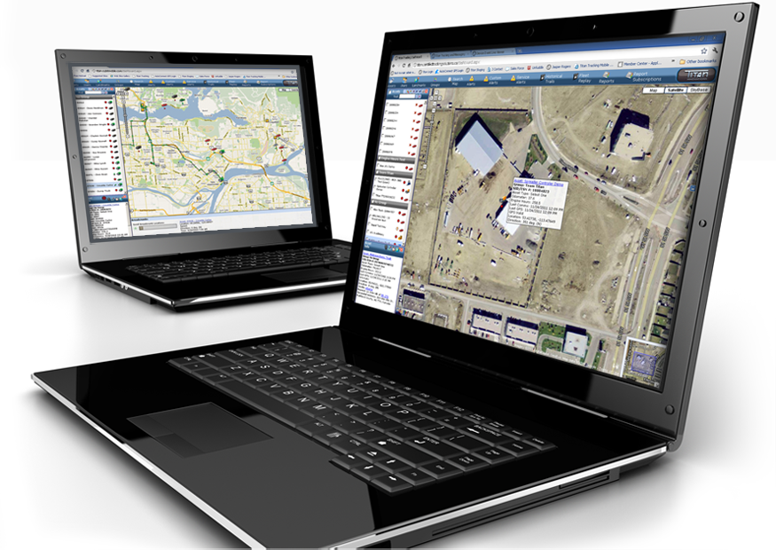
Challenges 2015 & Beyond
Real time reporting
  Testing software and hardware system to allow us to navigate to site, record data, report back to manager and invoice client as soon as completed
Simultaneous list & site management with multiple crews
Notes:
With Every one of our customers we are accountable for the $ spent and this puts increased pressure on our customers and ourselves as clients want the information as fast as possible. We all want data as fast as possible. This year will be testing an upgraded database program that will allow us to enter the site data in the field and send in real time reports as work is completed or when in cell service. This will allow us to get faster turnaround to our customers.
List management is also a challenging when using multiple crews in an area so that work is not overlapped or missed. We will be testing a system this year which will allow our crews to work digitally off the same site lists in the field and for us to be able to track in real time as sites are being completed.
Ultimately, technology has come a long way and every business has to embrace technology that is going to make your programs run smoother.

