Slide 1
The Professional Governance Act and Practice Rights Framework
Presentation to the Integrated Vegetation Management Association of BC Forum November 9, 2023

Slide 2
Learning objectives
What is the Professional Governance Act (PGA)?
OSPG responsibilities
Regulated and reserved practice
Duty to report
Notes:
This presentation will provide a brief overview of the origins and intent of the Professional Governance Act, the Office of the Superintendent of Professional Governance, distinguish areas of responsibility for the OSPG and regulatory bodies, examine regulated and reserved practice frameworks used by professions under the PGA, and discuss the Duty to Report for registrants under the PGA.

Slide 3
Professional Governance Act and the Office of the Superintendent of Professional Governance

Slide 4
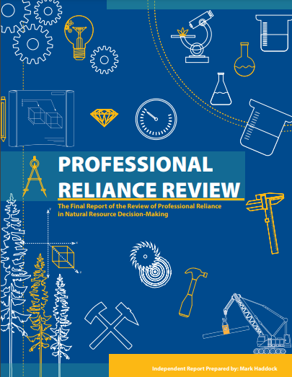
Professional Governance Act
2018 Professional Reliance Review
121 recommendations
Two governance recommendations:
  Establish an oversight office
  Standardize key elements of professional governance through an “umbrella” statute to govern professions
PGA provides common governance framework for six regulatory bodies; ability to add more
PGA fully in force February 2021
Key principles: public interest; protection of environment, health and safety of the public

Slide 5

OSPG duties and responsibilities
OSPG functions include…
Audits, investigations into systemic and general matters
Guidance, monitoring to ensure PGA regulatory bodies act in the public interest
Central point-of-contact for PGA regulatory bodies & gov’t ministries
OSPG does not…
Oversee individual registrants or professionals
Carry out the duties or functions of regulatory bodies
Conduct appeals or reconsiderations of regulatory body decisions

Slide 6
Practice Rights Framework

Slide 7
Regulated and reserved practice
PGA definitions:
  "regulated practice" means the carrying on of a profession by a registrant of a regulatory body
  "reserved practice" means a regulated practice for which the right to practice is reserved for registrants of a regulatory body

Slide 8
PGA practice rights model - summary
Areas of practice where regulatory body can regulate registrants
Provision of advice and services
based on discipline(s)
Regulated Practice
Regulated practice may exclude reserved practice of another regulatory body
Areas of practice reserved for registrants of a particular regulatory body;
s. 55 allows for authorized practice via PGA, regs, or another enactment
Reserved Practice
Requiring the experience and technical knowledge of a professional in those specific discipline(s), as it relates to the protective purposes of the PGA
Notes:
Task to determine those areas of the profession that are important to reserve for registrants for the protective purposes of the act – the things that non-registrants should not be doing.
Formula for reserved practice definition may not necessarily follow what’s been created for other professions.
Requires working closely with other reg bodies to determine reserved practice.

Slide 9
Regulated practice
Regulated practices
  prescribed areas of practice describing where regulatory bodies can regulate registrants – set standards and hold registrants to account
  includes advice or services that are ancillary to the described practices of the profession
The regulated practice may specify limits, such as ‘does not include areas of practice that are reserved for registrants of another regulatory body’

Slide 10
Reserved practice
Reserved practices may be a subset of the regulated practice or may be the entire regulated practice
A person working in the regulated practice (but not the reserved practice): not required to register with the regulatory body. Must not use any reserved titles
A person working in the reserved practice: must register with the regulatory body - the regulatory body has oversight of their practice regardless of whether in regulated or reserved. May use reserved titles if registered
PGA s. 54 prohibitions:
A person not registered with a regulatory body must not provide a service within a reserved practice or recover a fee or renumeration in respect of the provision of service; must not carry out work within the reserved practice of a profession unless under supervision of a registrant
S. 55 allows for exceptions to these prohibitions if provided for in the Act, regulations or another enactment

Slide 11
Overlap vs. Alignment vs. Intersection
Multi-disciplinary work, such for contaminated sites, can result in:
  Overlap of practice: same task, same competence (knowledge, skills, ability) to perform the task, different regulator
  Alignment of practice: different tasks, similar technical knowledge, different regulator
  Intersecting practice: different tasks, different competence (knowledge, skills, ability), different regulator
 | Task | Competence | Regulator
Overlap | ✓ | ✓ | ✗
Alignment | ✗ | ✓ | ✗
Intersection | ✗ | ✗ | ✗
Notes:
- may be that the CSAP process to become an AP and how APs are relied on showcases all three – because this falls within the exception to a prohibition on reserved practice, there is no need for the reserved practice definitions under the PGA to address it.

Slide 12
Duty to Report

Slide 13
Duty to Report
Statutory duty on a registrant to promptly report another registrant to a regulatory body when certain (s. 58) conditions met
Duty extends to employers or partners of registrants
Focus on significant harm to the environment or to the health or safety of the public
Reprisal protection
Duty to report guidance available: Duty to Report to Regulatory Bodies | Office of Professional Governance (professionalgovernancebc.ca)
Notes:
Problems Identified:
Professional Reliance Review identified barriers to professionals reporting based on the Code of Ethics responsibility.
General perception that professionals are in the best place to observe other professionals’ misconduct.
Regulatory bodies need to be more aware of misconduct/incompetence within the profession
58(2) If a registrant has reasonable and probable grounds to believe that an identified registrant is engaged in the regulated practice in a manner that may pose a risk of significant harm to the environment or to the health or safety of the public or a group of people, the registrant must promptly report this to the registrar of the identified registrant's regulatory body.
(4) If a person
(a) terminates the employment of an identified registrant,
(b) revokes, suspends or imposes restrictions on the privileges of the identified registrant, or
(c) dissolves a partnership or association with the identified registrant,
based on a belief described in subsection (2), the person must promptly report this in writing to the registrar of the identified registrant's regulatory body.

Slide 14
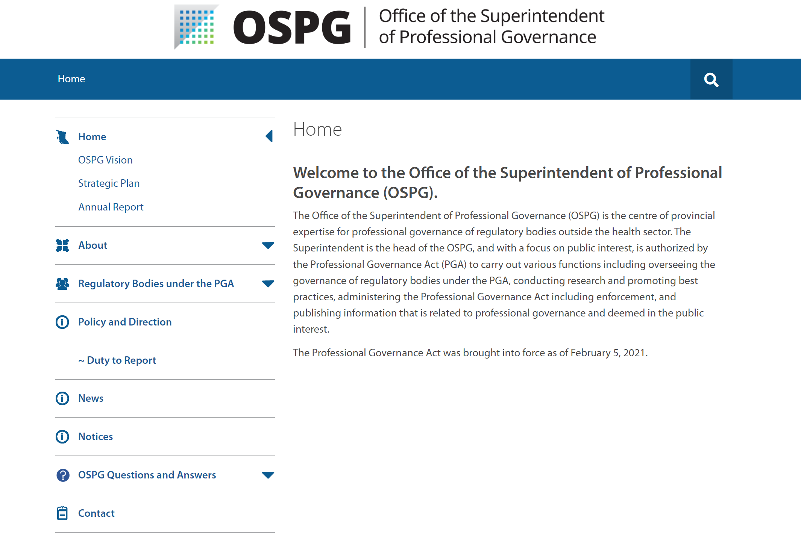

Slide 15
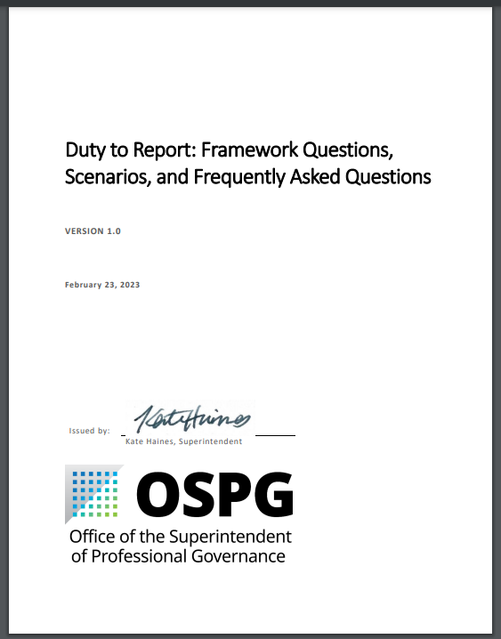
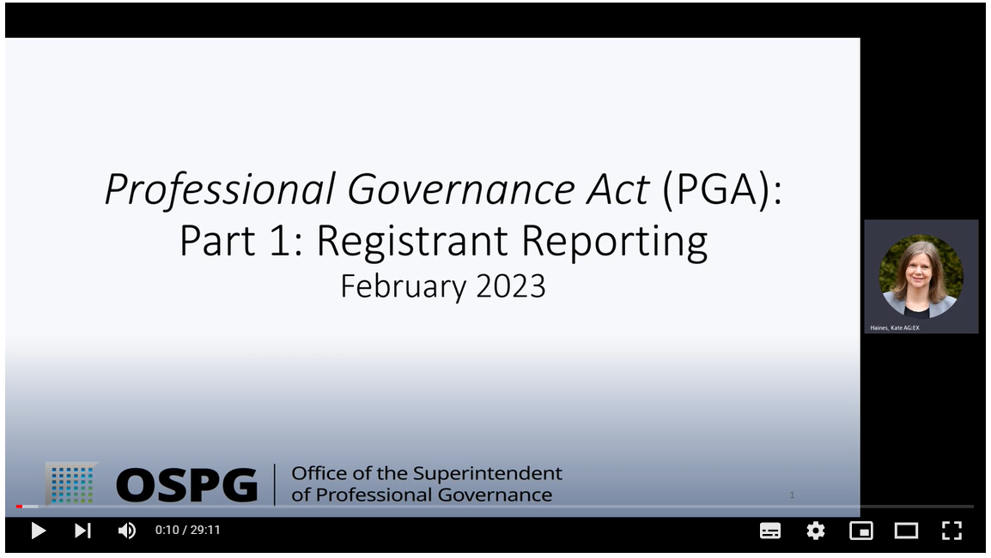
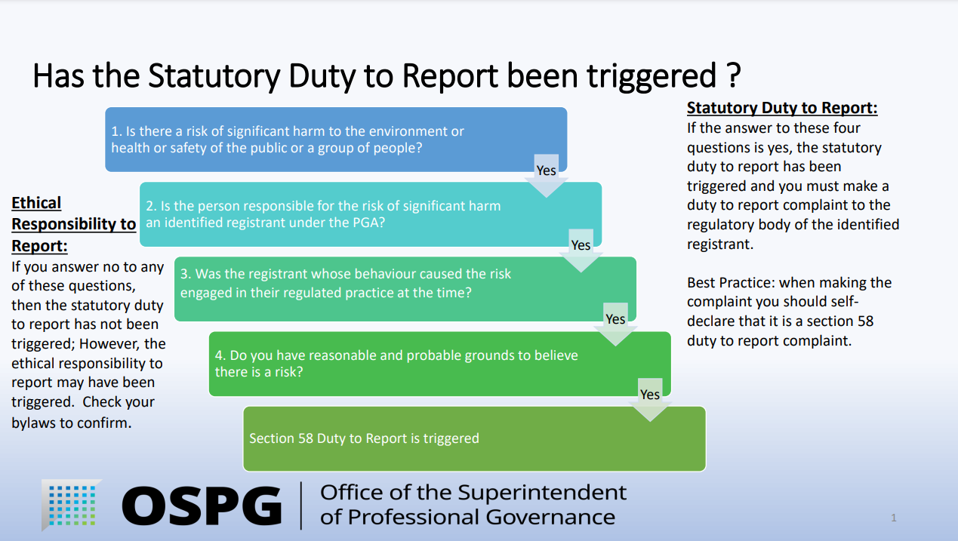
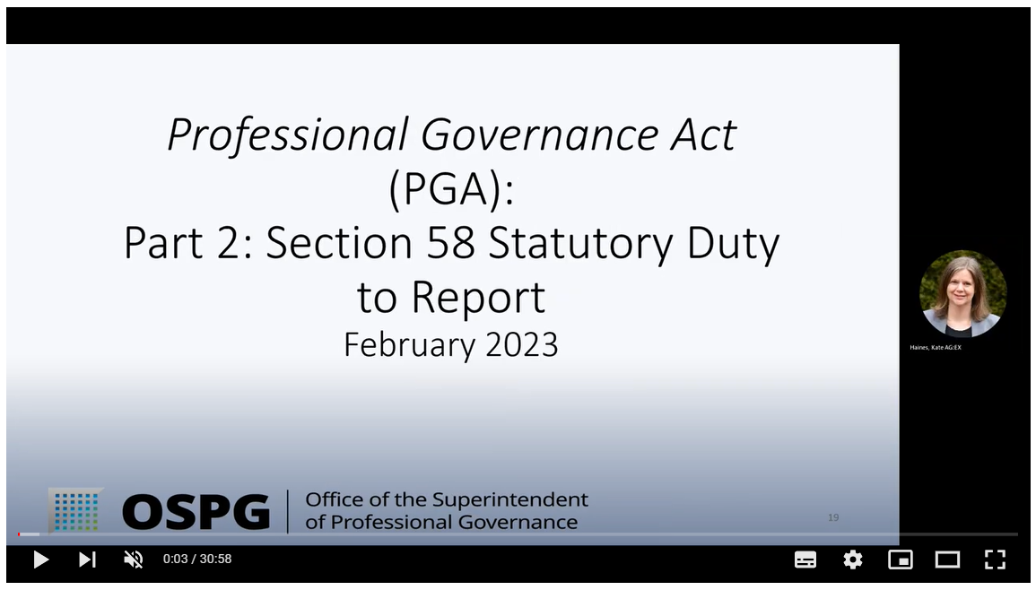
Notes:
Two 30 minute video modules Registrant reporting
S 58 reporting including 3 scenarios
Slide with question framework of assessing whether reporting duty has been triggered
Document with detailed question framework, additional scenarios, and frequently asked questions
FAQs informed by those questions asked during the live sessions

Slide 16
Questions?

Slide 17
Contact
Website: https://professionalgovernancebc.ca/
Phone number: 1 (236) 478 1940
Email: OSPGEnquiries@gov.bc.ca
Notes:
R

