Slide 1
Vegetation dynamics and vegetation management under uncertain climate futures:
Where and when are changes most likely to occur?
Ché Elkin
University of Northern British Columbia
FRBC/Slocan Mixedwood Ecology Chair
Notes:
Projected future changes in temperature, and the timing and amount of precipitation, have the potential to substantially alter the growth and distribution of pants in B.C. However, the impact of climate change on vegetation communities is expected to be heterogeneous with some areas experiencing large shifts, and other projected to exhibit minimal or no change. One of the key challenges facing vegetation managers is identifying where on their landscapes changes are likely to occur, and when these changes will likely take place. Using case studies from western Canada and central Europe I’ll present research evaluating how climate change is projected to impact a range of different vegetation communities. Based on this research I’ll discuss the general factors that will influence how sensitive vegetation communities are to climate shifts, and what this mean for efficient and effective management plans

Slide 2
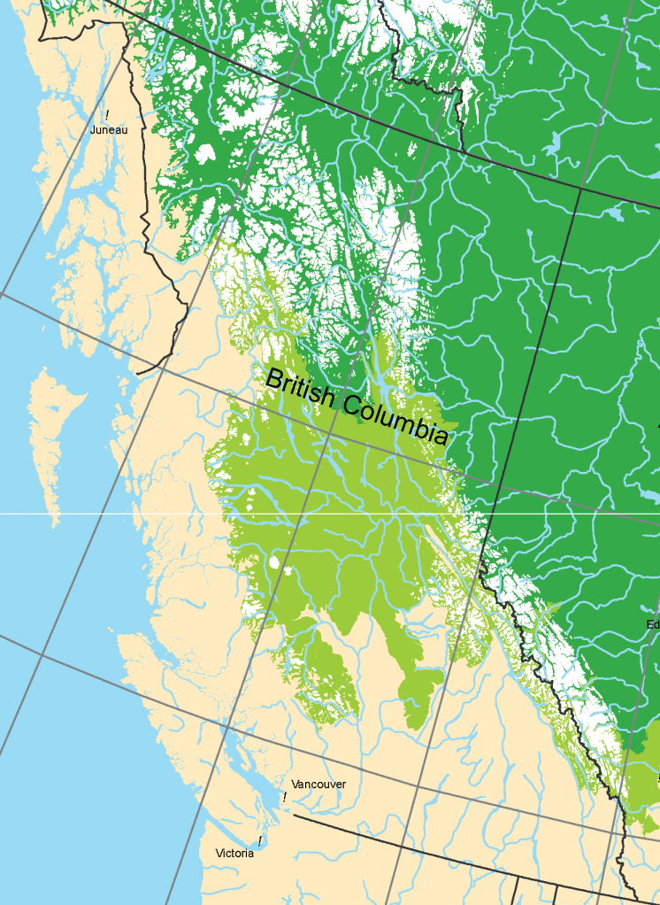
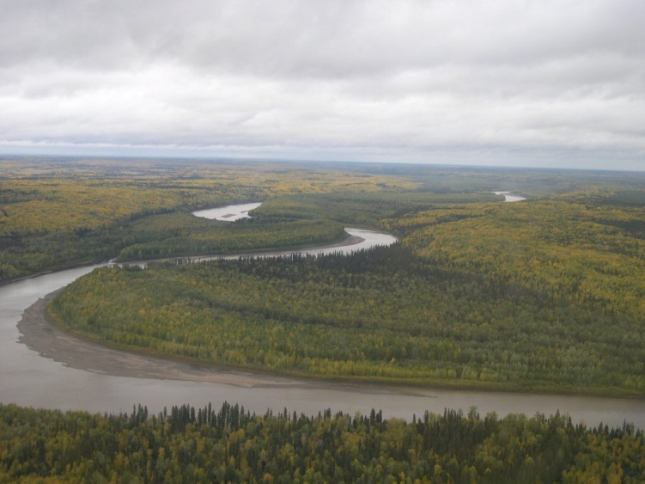
Baldwin 2012 CBVM
BC Forest and Range, Fort Nelson FD
Sub-boreal, boreal mixed forests
How will climate change influence forest dynamics?
What impact will future changes have on forest ecosystem services?
Can adaptive management be used to maintain forests and forest ES?
Notes:
My current focus is on trees

Slide 3
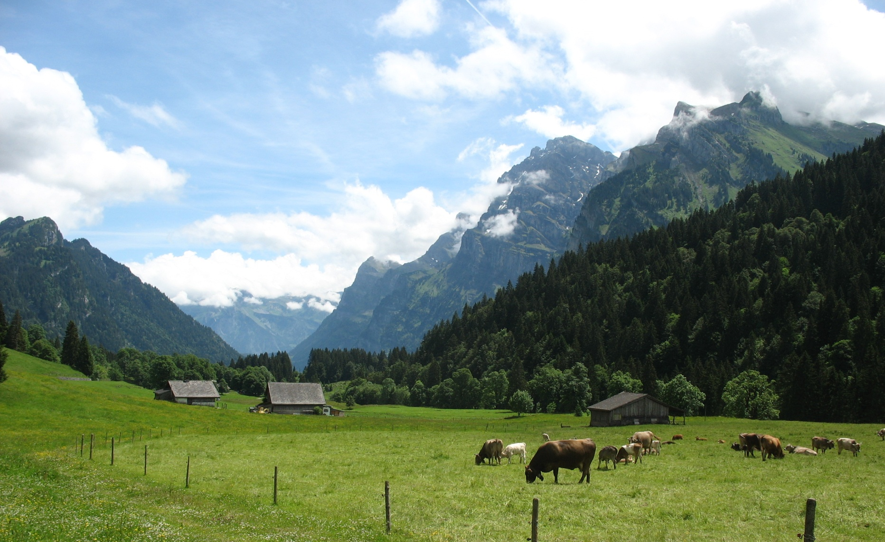
Vegetation management under climate uncertainty
Notes:
Broader background

Slide 4
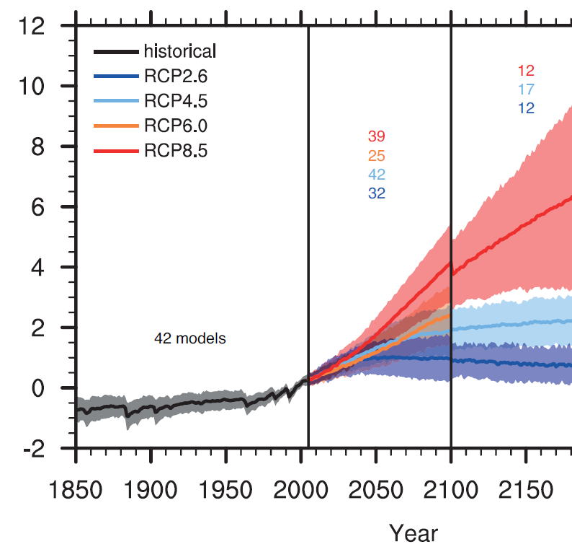
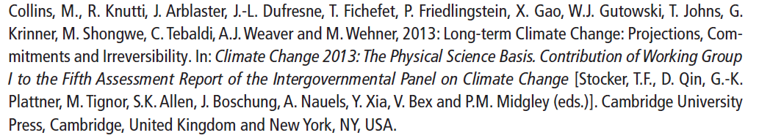
Future climate
What does this mean for vegetation in BC?
IPCC AR5
Notes:
Input climate futures scenario

Slide 5
BC’s climate future (2050)
Omineca
Climate Variable | Season | Projected Change from 1961-1990 Baseline
 |  | Ensemble Median | Range (10th to 90th percentile)
Mean Temperature (°C) | Annual | +1.8 °C | +1.3 °C to +2.7 °C
Precipitation (%) | Annual Summer Winter | +8% +1% +9% | +2% to +15% -8% to +9% -2% to +18%
Snowfall* (%) | Winter Spring | +2% -54% | -7% to +10% -71% to -10%
Growing Degree Days* (degree days) | Annual | +223 degree days | +136 to +379 degree days
Frost-Free Days* (days) | Annual | +19 days | +11 to +30 days
2012 Pacific Climate Impacts Consortium, Plan2Adapt
http://www.plan2adapt.ca

Slide 6
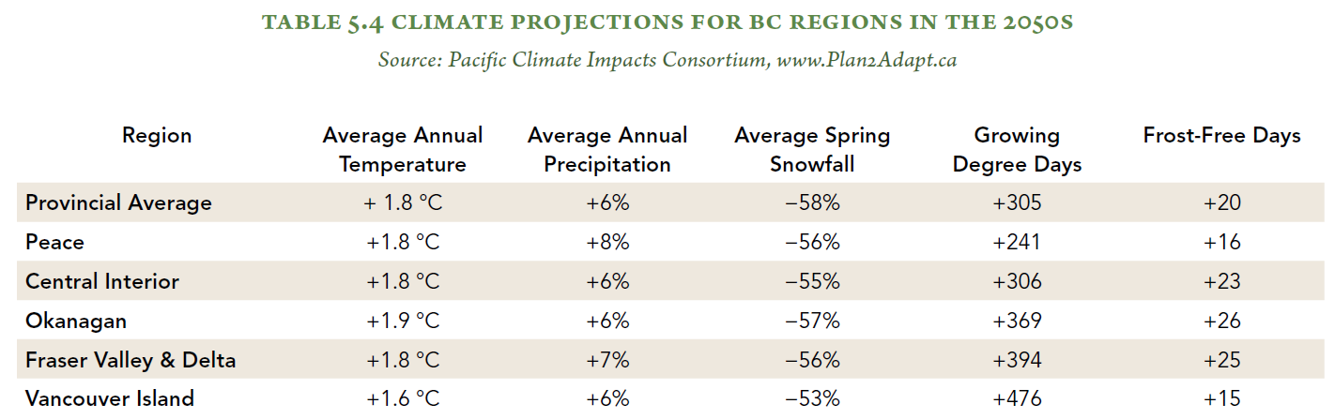
Climate impact on vegetation management

Slide 7
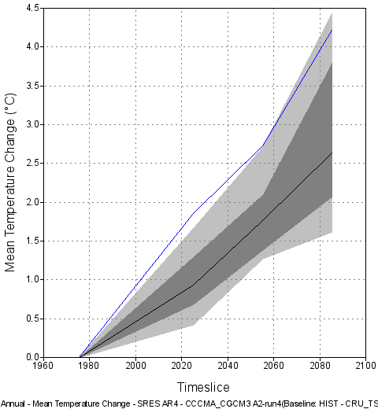
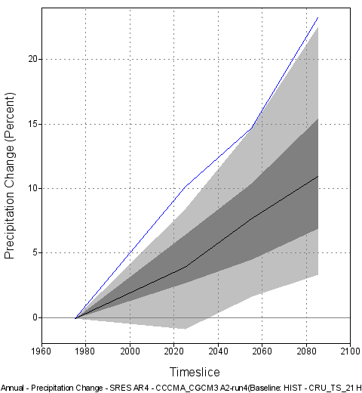
Future climate range
2012 Pacific Climate Impacts Consortium, Plan2Adapt
http://www.plan2adapt.ca
Notes:
Variation from ensemble GCM and RCM models

Slide 8
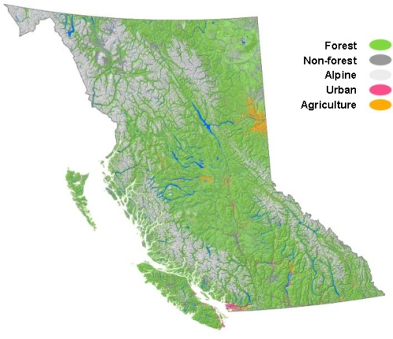
The central interior is projected to have approximately the same number of growing degree days in 2050s as Salmon Arm
Dawson et al 2008
Preliminary analysis of climate change in the Cariboo-Chilcotin Area of British Columbia.
Pacific Climate Impacts Consortium
Notes:
Dawson et al 2008
Preliminary analysis of climate change in the Cariboo-Chilcotin Area of British Columbia
Use latitudinal shifts to inform projected challenges
Should not assume a 1 to 1 mapping.
Species movement
Residual of historic differences in management
Different objectives

Slide 9
Vegetation management in the future
Is this a challenge?
Can we evaluate how the system respond?
Can we evaluate when the system will respond?
Uncertainty?

Slide 10
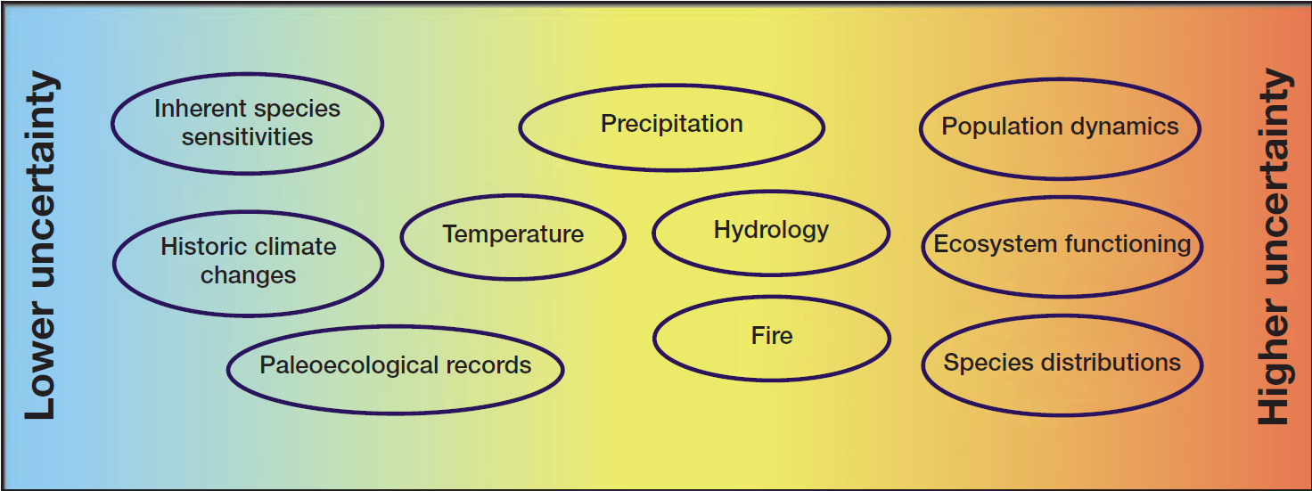
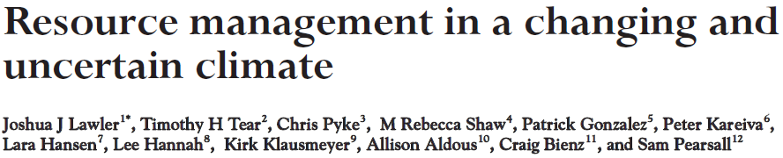
Management uncertainty

Slide 11
Vegetation changes under future climates
Where
When
What
How
How can we evaluate if future climate shifts will be important?
Notes:
General findings from a range of different work that have done on
Where
Spatial, ecotone
Value of climate data
When
Climate change
Species tolerance levels
Need to think about response of system (what is being looked at), and the rate at which management can influence changes.
How
Direct
Indirect
Not included disturbance,
Overview of my research that has addressed where, when and how vegetation may be altered.

Slide 12
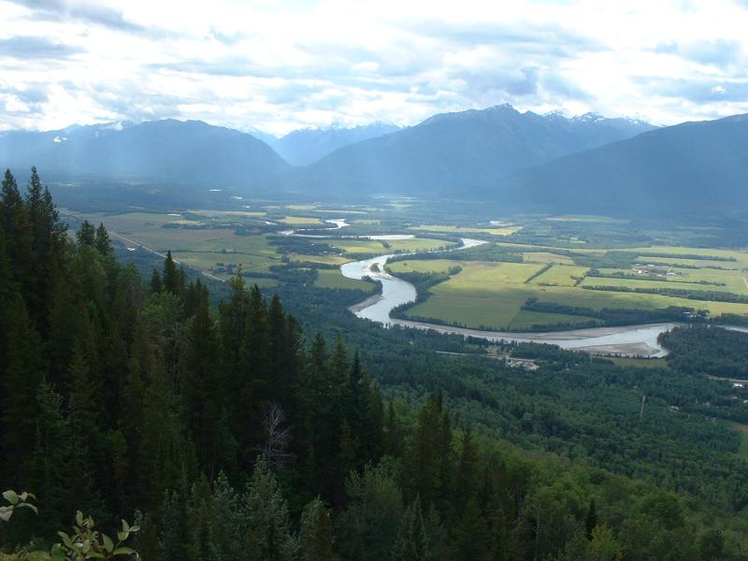
Evaluating along elevation gradients
Notes:
Good way to evaluate

Slide 13
Where?
Where on the landscape are we most likely to see changes in vegetation?
Notes:
Where
Spatial, ecotone
Value of climate data
When
Climate change
Species tolerance levels
Need to think about response of system (what is being looked at), and the rate at which management can influence changes.
How
Direct
Indirect
Not included disturbance,
Overview of my research that has addressed where, when and how vegetation may be altered.

Slide 14
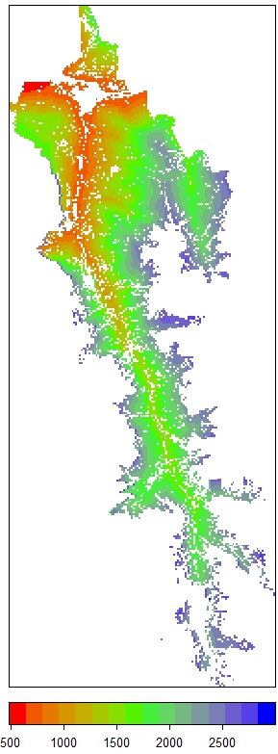
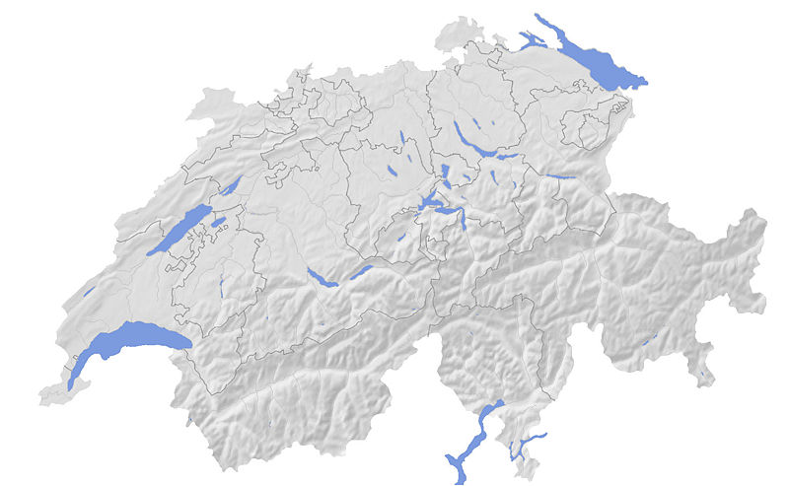
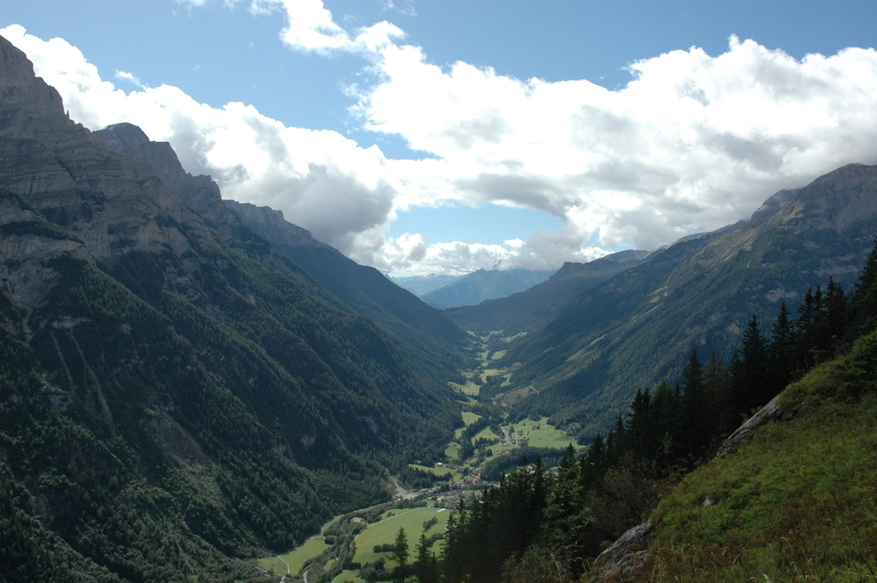
Climate sensitivity?
Saas Valley

Slide 15
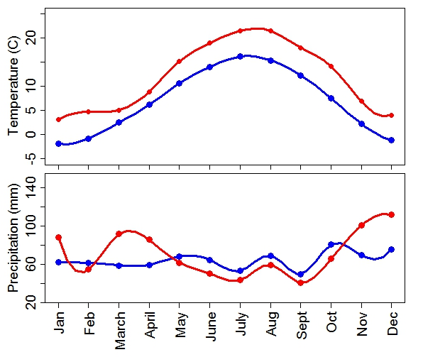
Saas valley
Climate scenario
IPCC 4: a1b
future climate
(2100)
current climate
Notes:
Predicted climate change in each region (A1b from IPCC4).
Valais, warmer drier summers, warmer wetter winters.
Davos, warmer wetter summer, warmer drier winters.

Slide 16
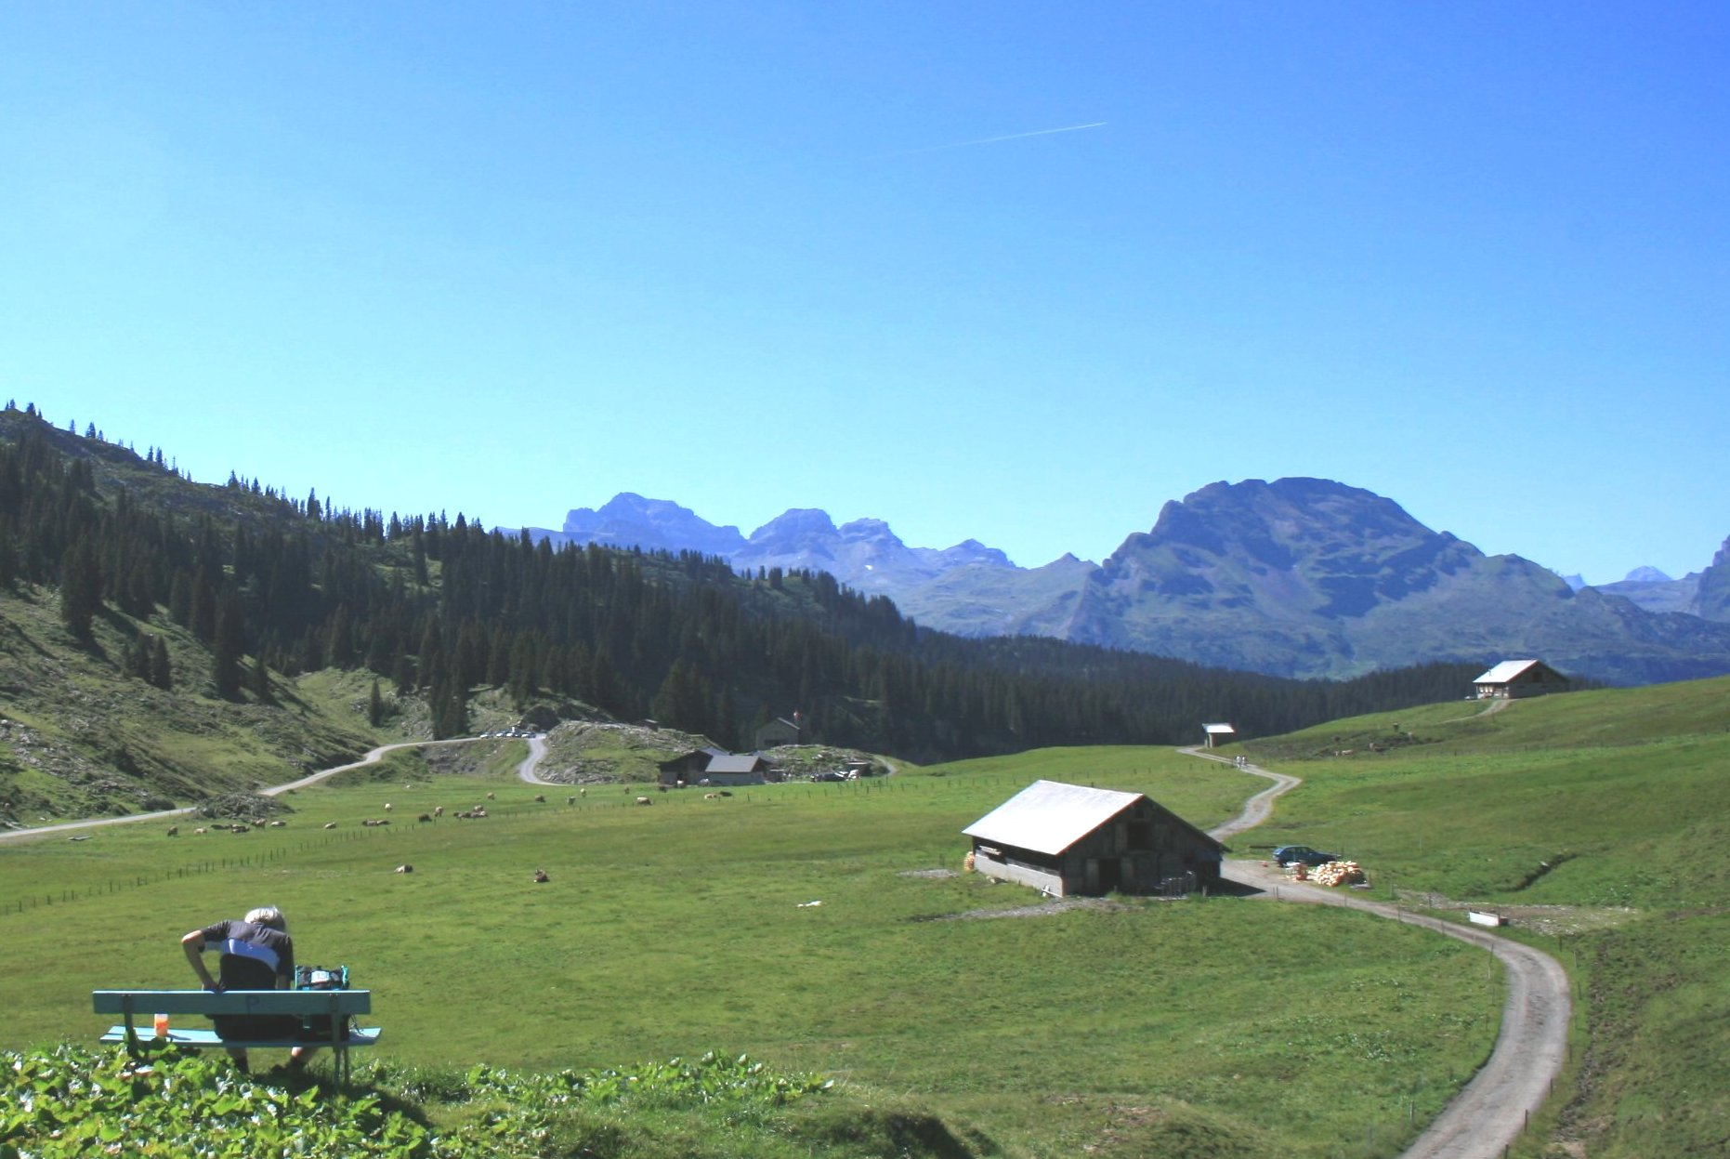

Drivers of vegetation dynamics
Climate
impact

Slide 17
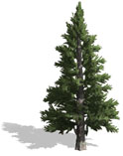

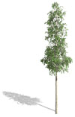



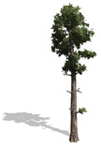
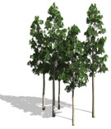


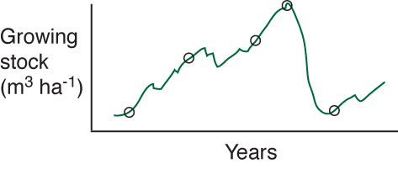
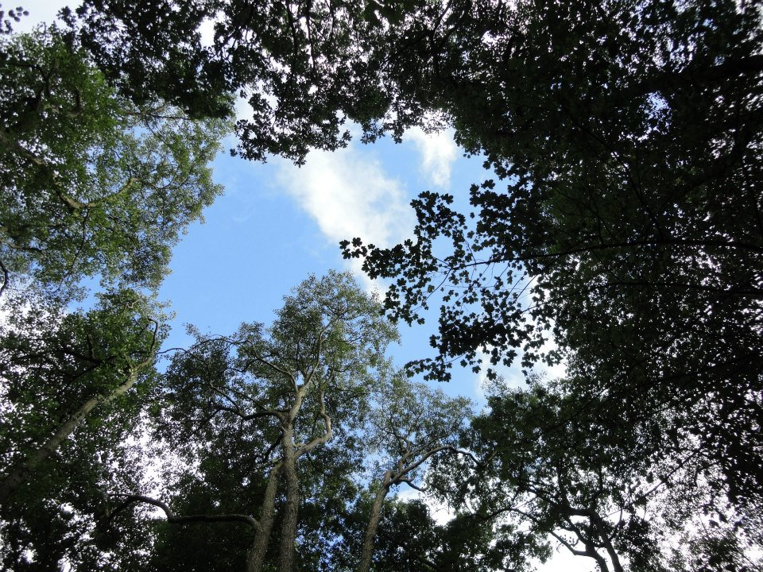



Dynamic vegetation models
Forest gap
Individual processes
Population processes
Community processes
Recruitment
Growth
Competition
Mortality
Light availability
Moisture availability
Temperature
Nutrients
Notes:
Highlight the fact that these models need a large amount of empirical data to operate correctly, but they are a powerful tool for testing assumptions regarding forest growth and dynamics.
- models are only as good as the empirical data they are built on, and the empirical data that they are validated against.
Model faillure can be just as valuable as success (represents where our data or knowledge of process is poor).

Slide 18
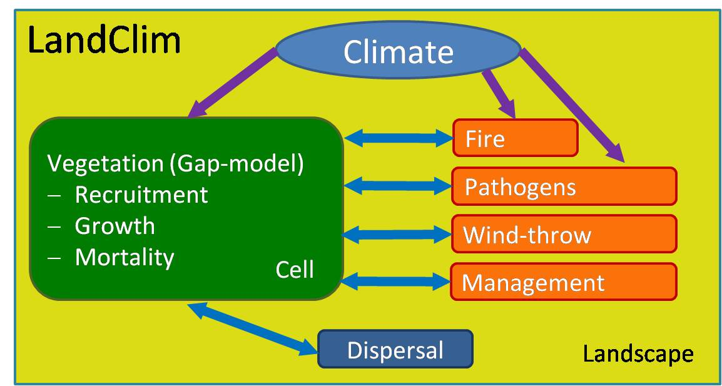
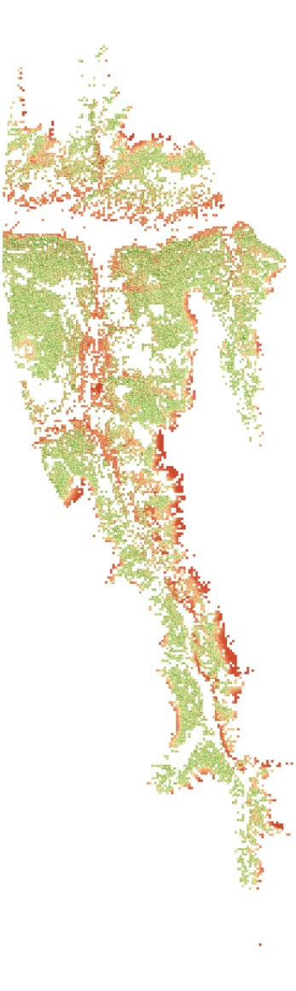
Landscape model
cell
Notes:
Forest state simulated, and used to evaluate forest derived ecosystem services.

Slide 19

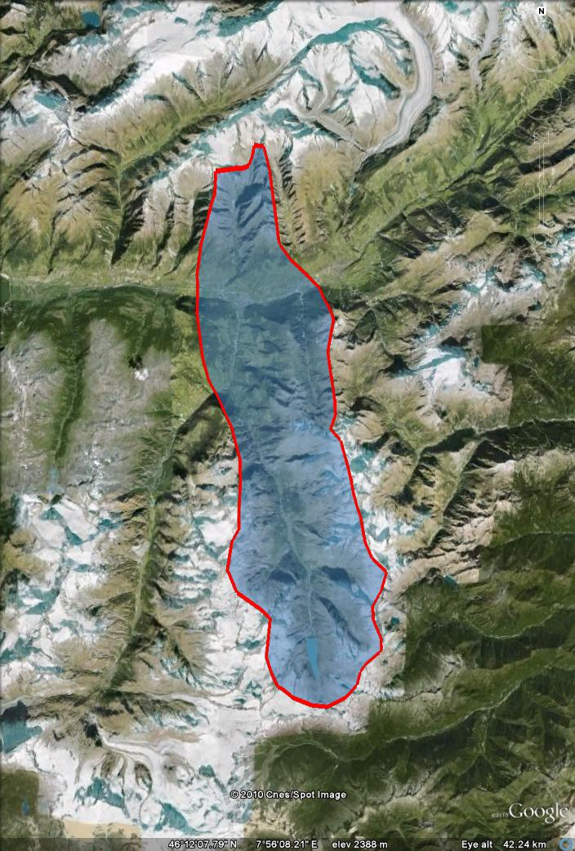
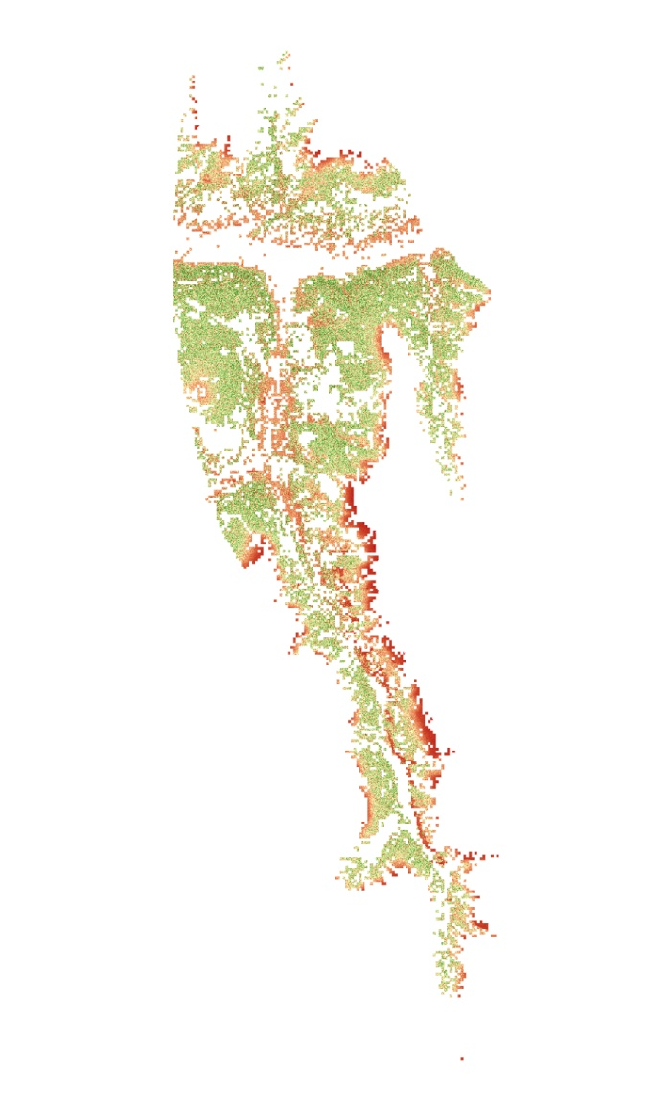
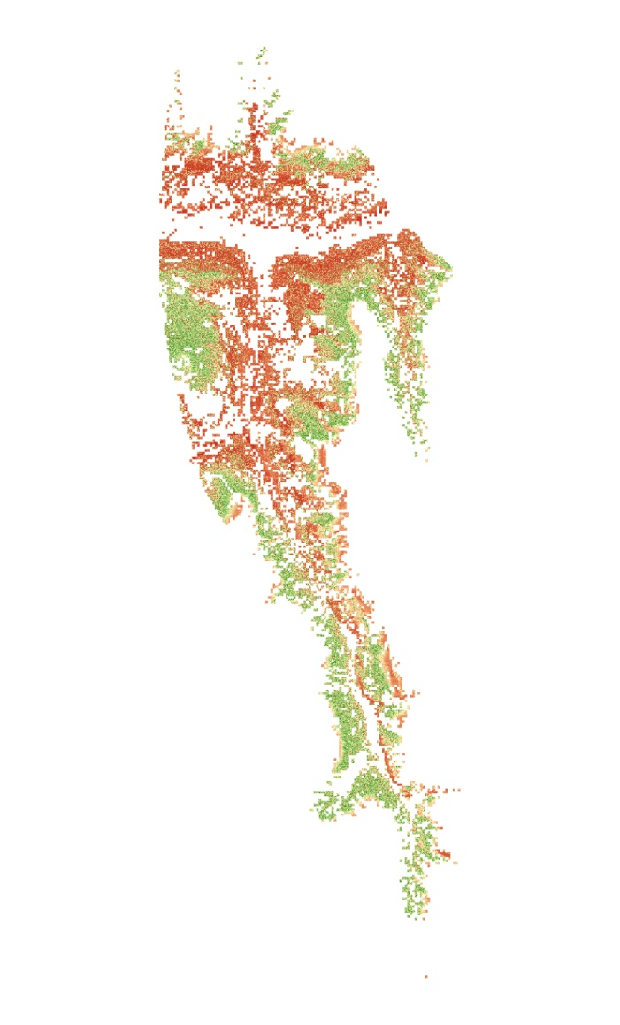
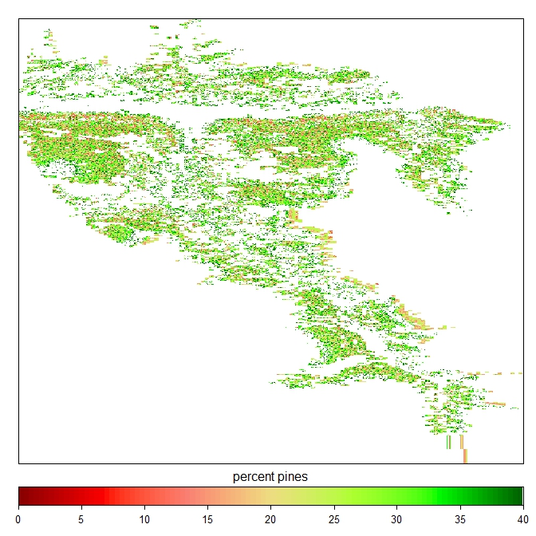
Climate impacts on forest dynamics
Forest biomass
2000 2050 2100
Visp
t/ha
80 240 400 560
Elkin & Bugmann. 2010. EEA
Notes:
Results: climate impacts predicted to have strong elevation dependent impacts on forest (exemplified by change in forest biomass).

Slide 20
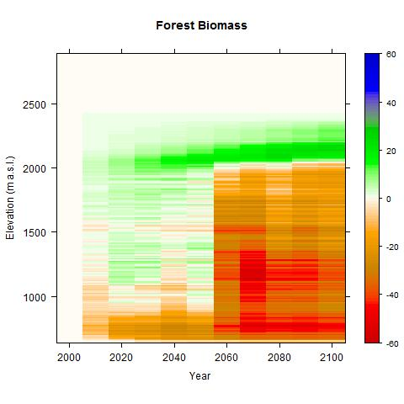
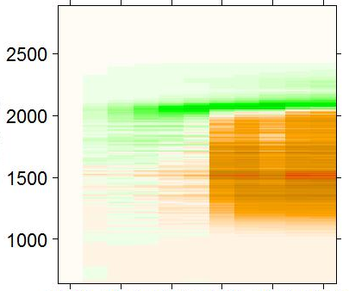
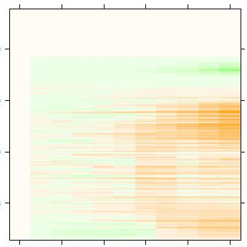
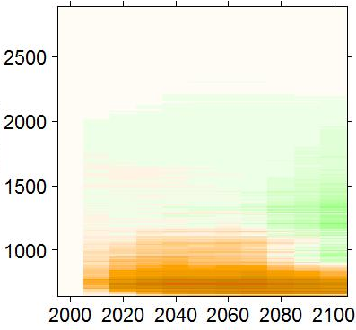
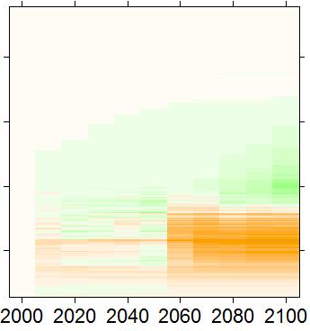
Climate impact on forest composition
Year
Forest biomass (t/ha)
Picea abies
Larix decidua
Elevation (m a.s.l.)
Pinus sylvestris
Quercus sp.
Year
Elkin & Bugmann. 2010. EEA
Notes:
Changes in forest composition as well as forest biomass.
Climate large impact on forest state
Elevation dependent, severe at low elevations
Non-linear change through time

Slide 21
Where is important
Notes:
Good way to evaluate

Slide 22
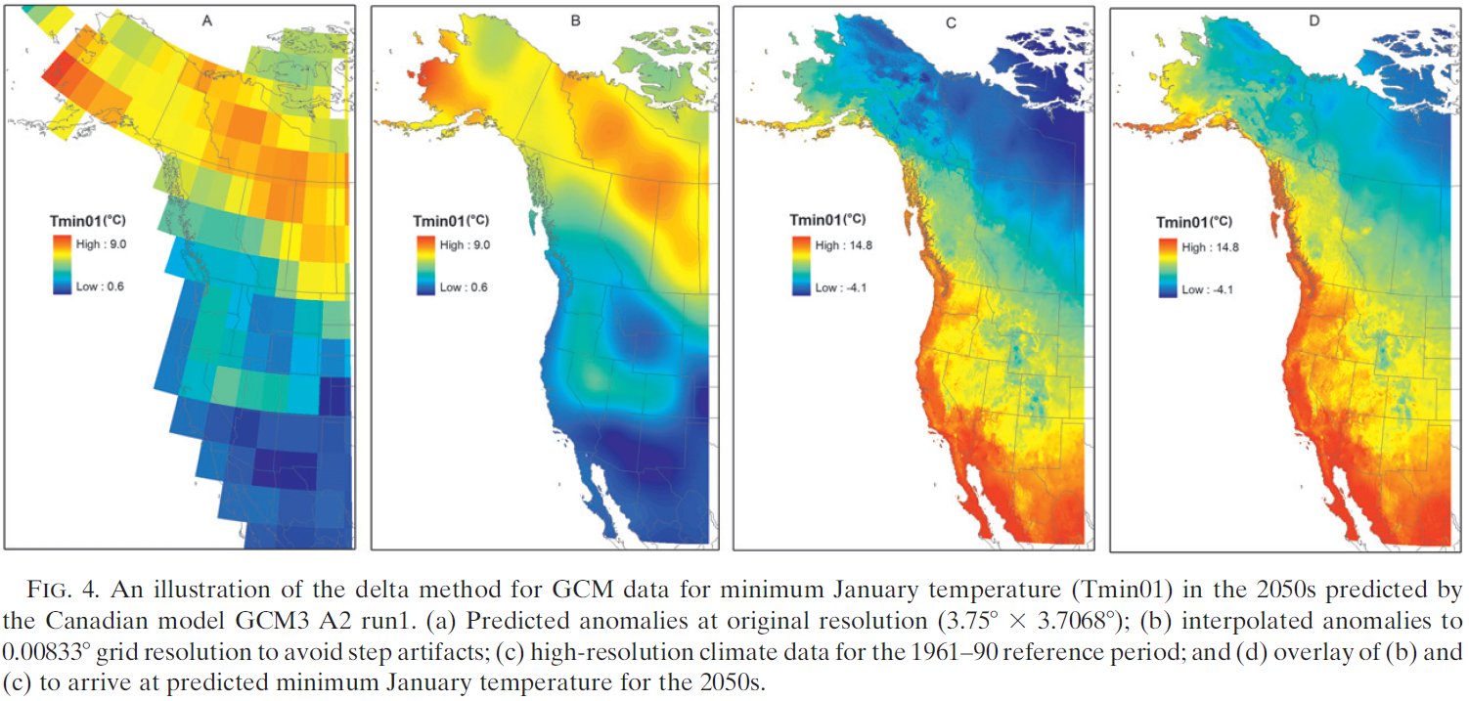
Downscaling climate data
2012
Notes:
Downscaling data allows much more accurate data, but still need to be concerned with microtopography (as well as variation between the GCM).

Slide 23
When?
When are important changes projected to occur?

Slide 24
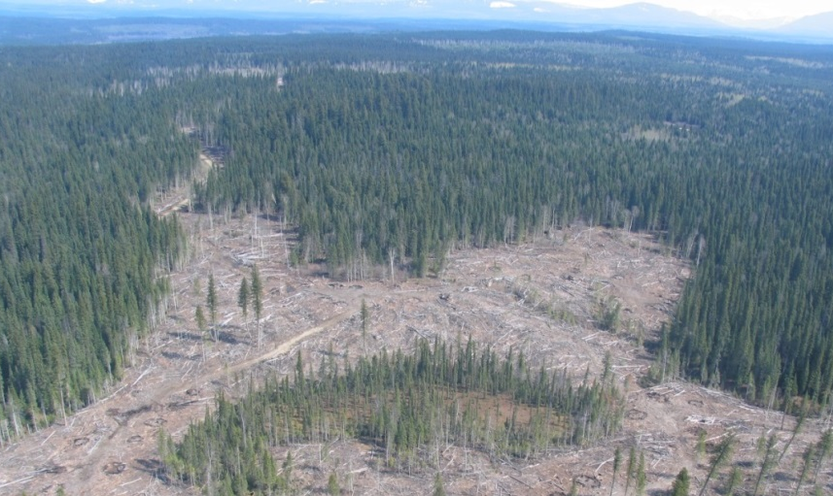
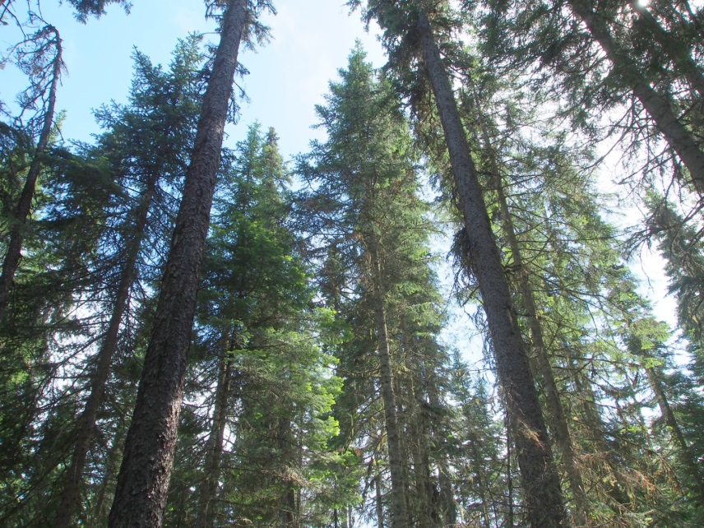
When?
Vegetation distance to climate thresholds?

Slide 25
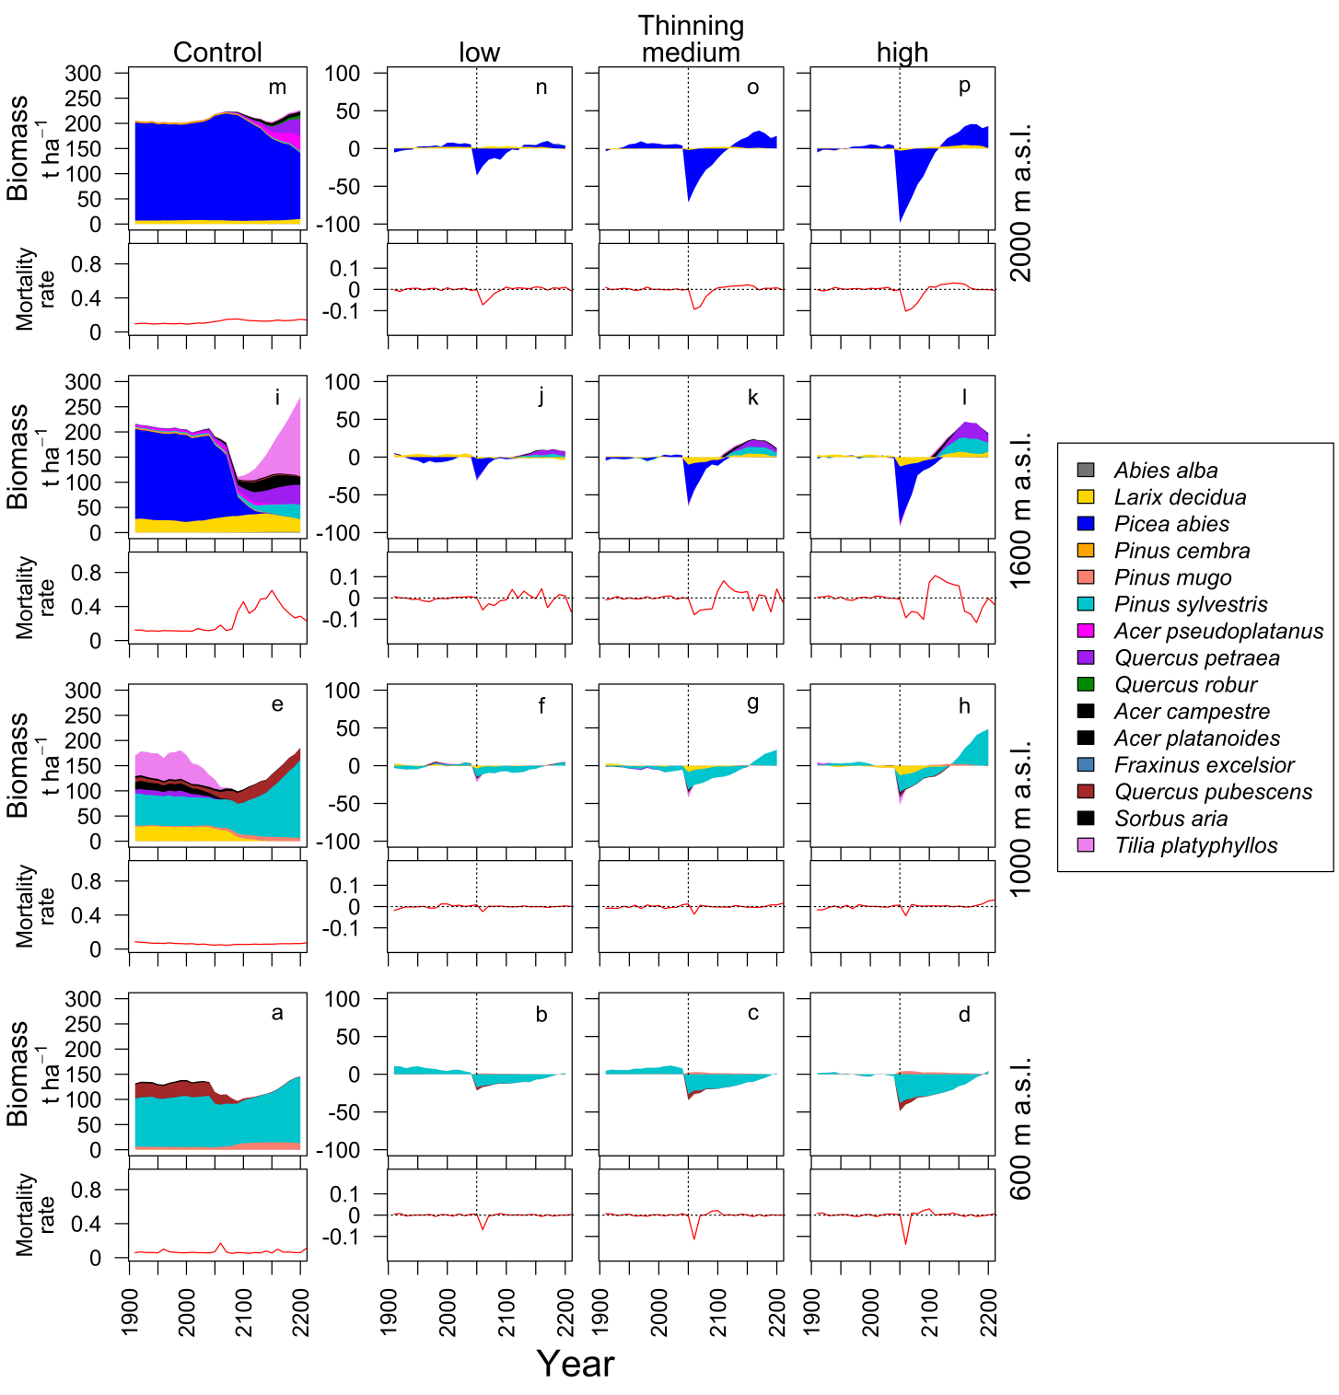
Elkin et al. 2015. Ecological Applications

Slide 26


Slide 27
What?
What is projected to be impacted?

Slide 28
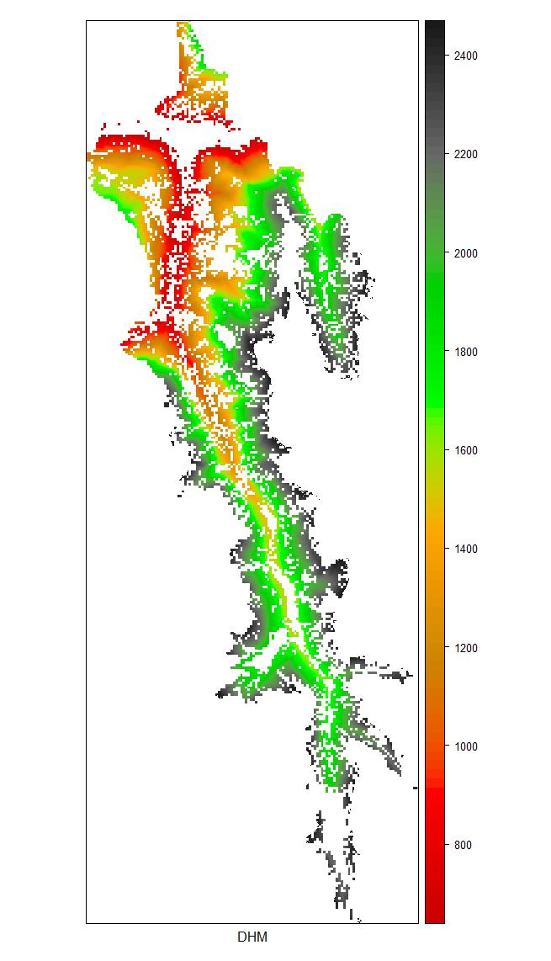
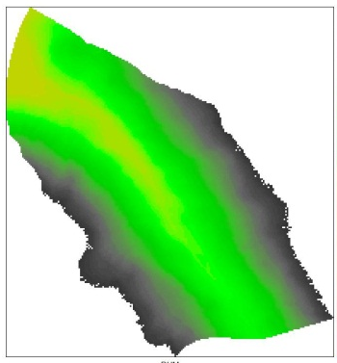
Climate sensitivity?
Saas Valley
2400
2200
2000
1800
1600
1400
1200
1000
800
m a.s.l.
Dischma Valley
Ecosystem services
Biodiversity
Carbon storage
Timber
Protection
Bio-fuel

Slide 29
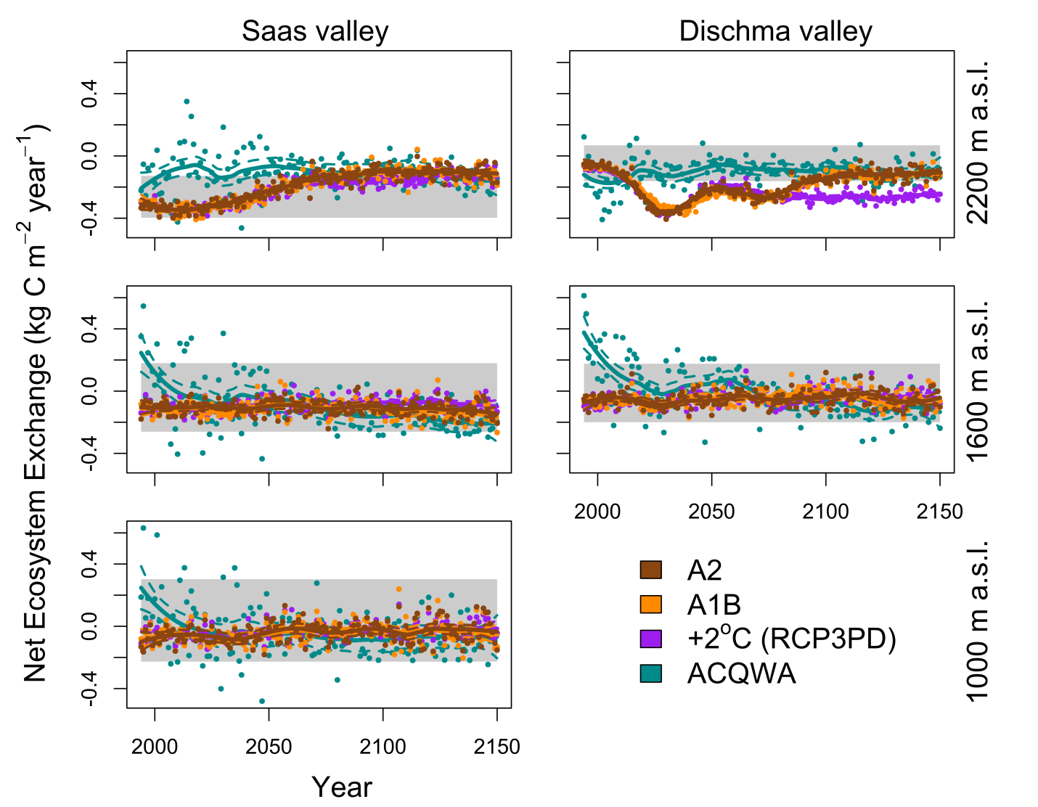
Carbon
Elkin et al. 2013. Global Change Biology

Slide 30
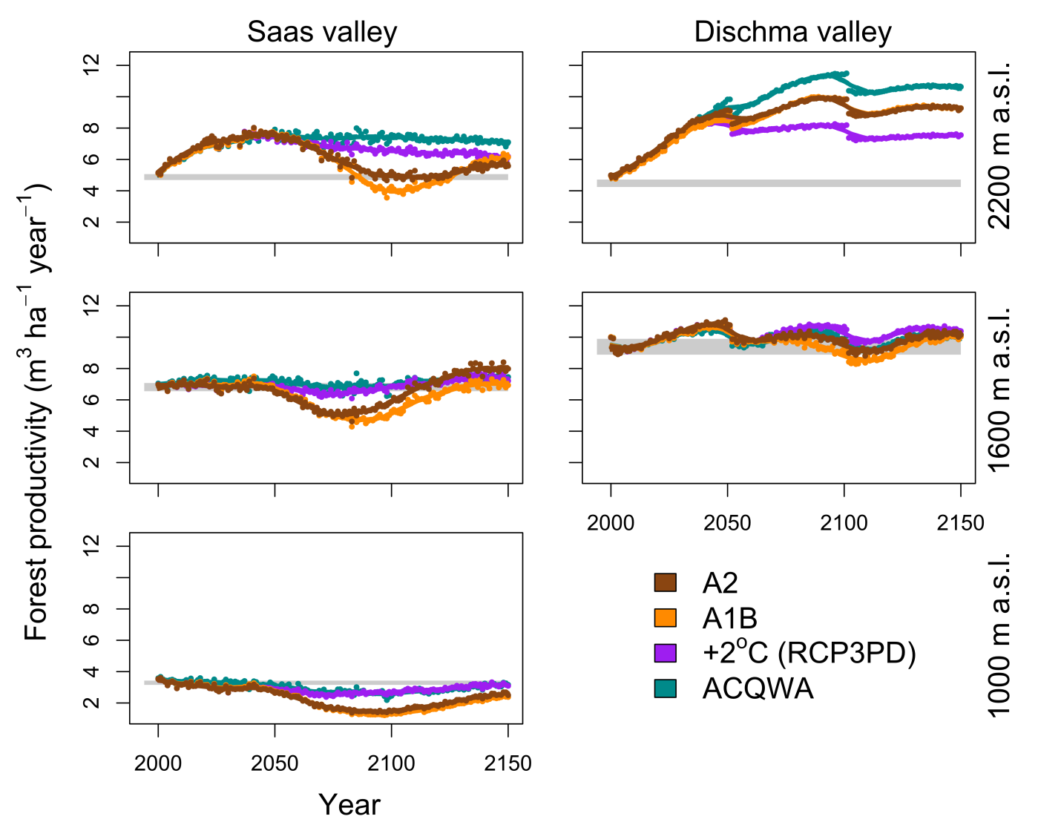
Potential forest productivity (timber)
Elkin et al. 2013. Global Change Biology

Slide 31
What
Ecosystem services
Biodiversity
Protection
Timber
Bio-fuel
Carbon storage

Slide 32
How?
What are the main drivers of future vegetation impacts?

Slide 33
Is climate or land use change most important for future vegetation shifts?
Climate
impact
Land use change
Economic Social Ecological

Slide 34
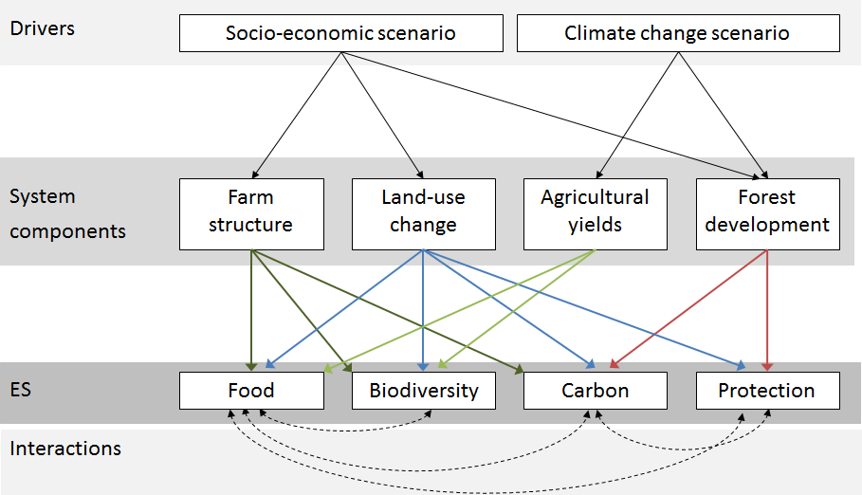
Briner, S., Bebi, P., Elkin, C., Schmatz, D., Gret-Regamey, A. (2013) Trade-offs between ecosystem services in mountainous regions. Ecology and Society. 13(3):35.

Slide 35
Coupled ecological and economic framework
Feedback loop
Step 3
LandClim
Forest state, dynamics
Forest Ecosystem services
ALUAM
Economically optimal land use
Agricultural ecosystem services
Climate
scenarios
b1, a1b
Crop model
Climate dependent crop yields
Policy and market scenarios
Step 1
Step 2
Briner, S., C. Elkin, R. Huber, and A. Gret-Regamey. (2012) Assessing the impacts of economic and climate changes on land-use in mountain regions: A spatial dynamic modeling approach. Agriculture Ecosystems & Environment

Slide 36
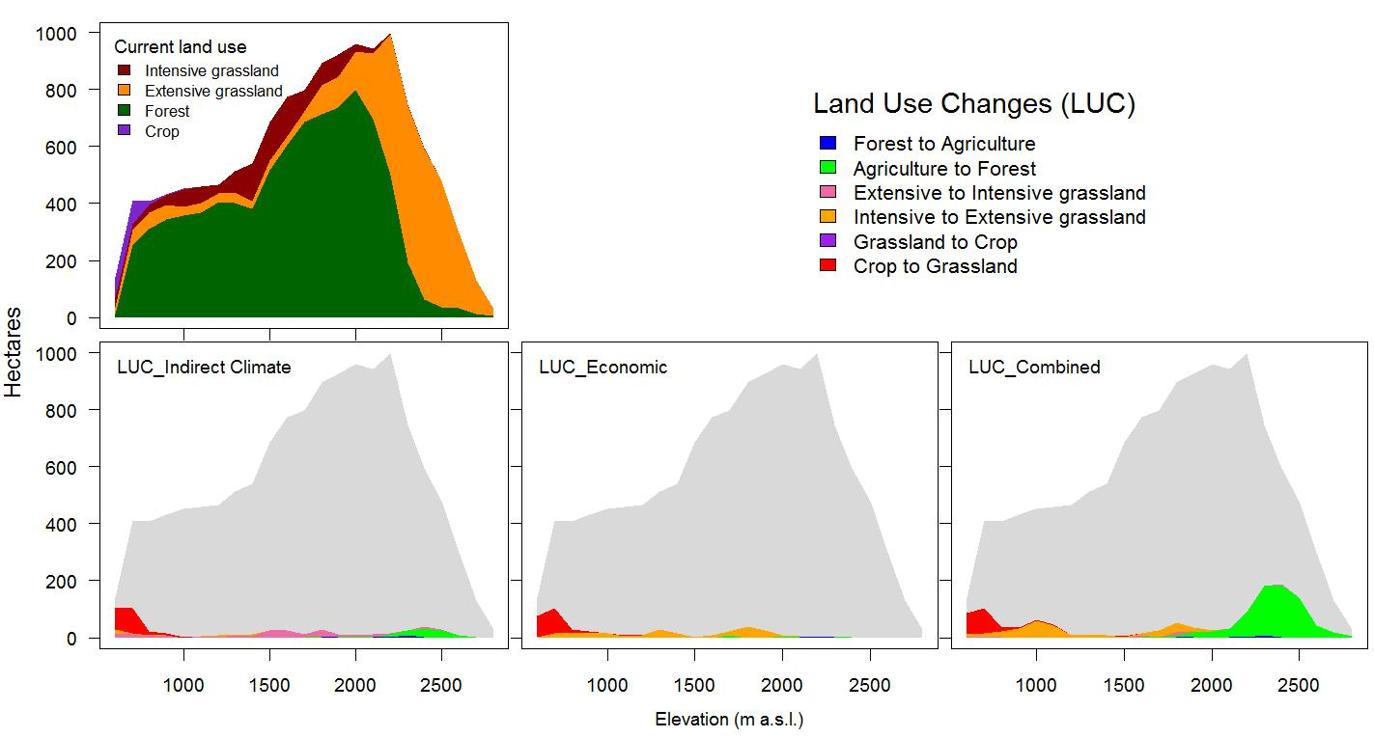
Projected land use changes (A1B, 2080)
Area
Elevation
Briner, S., Elkin, C., Huber, R., Evaluating the relative impact of climate and economic changes on forest and agricultural ecosystem services in mountain regions.
J of Environmental Management (in review)

Slide 37
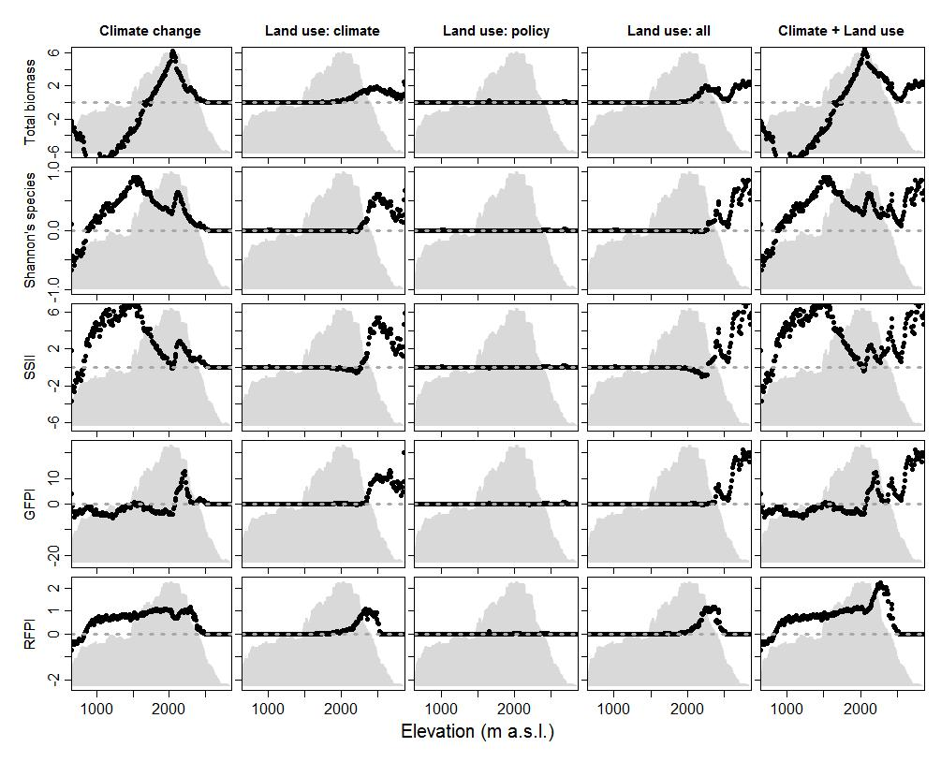
Forest ecosystem service impacts (2080)
Briner, S., Elkin, C., Huber, R., Evaluating the relative impact of climate and economic changes on forest and agricultural ecosystem services in mountain regions. J of Environmental Management (in review)
Elevation (m.a.s.l.)
Notes:
Need to consider the joint impact of land use shifts (mangemetn shifts) in conjunction with the direct ecological shifts in order to understand how these systems will change, and where management will be most effective.

Slide 38
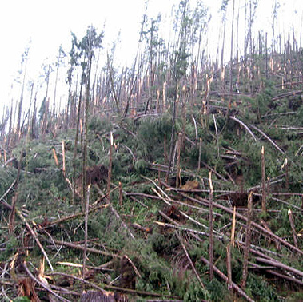
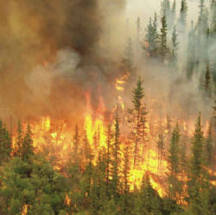
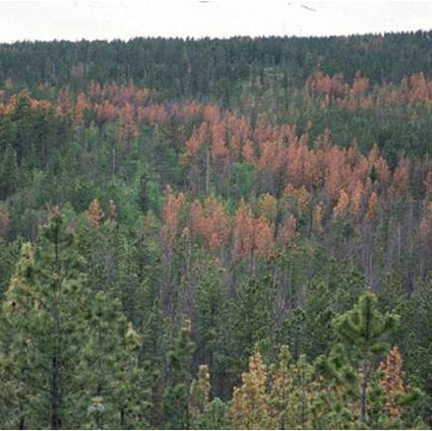
Climate and disturbances
Wind throw
Fire
Disease

Slide 39
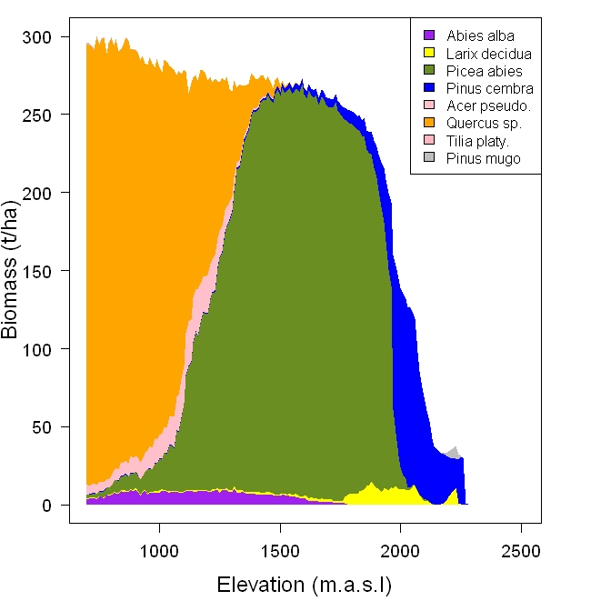
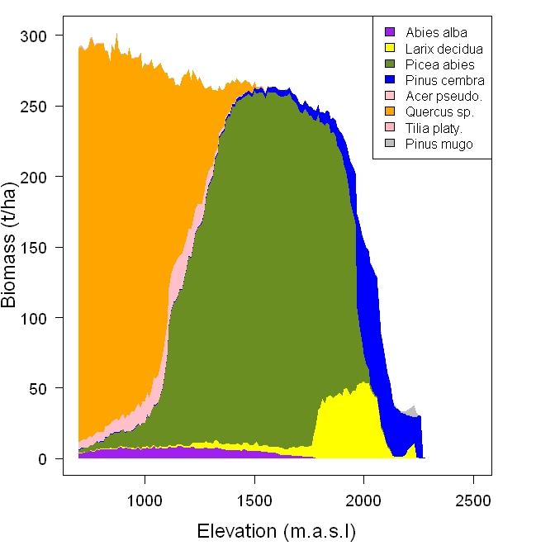
Separating direct and indirect effects of climate change
Current disturbance
regime
Future increased
disturbance regime
Direct (climate) Indirect (fire) Direct + Indirect

Slide 40

Disturbance intensity ≠ vegetation impacts
Increased disturbances had the largest influence on forest composition at high elevations (even though the size and frequency of fires increased more at low elevations).
While changes in total forest biomass were relatively small, there were large changes in species specific biomass (i.e. forest composition)
Total biomass difference
Species specific Biomass gains
Species specific biomass difference
Species specific biomass losses
Notes:
- Increased disturbances had the largest influence on forest composition at high elevations (even though the size and frequency of fires increased more at low elevations).
- Increased disturbances (in the absence of direct climate change effects) produced an increase in total forest biomass at high elevations, and a small decrease in biomass at lower elevations.
- While changes in total forest biomass were relatively small, there were large changes in species specific biomass (i.e. forest composition).

Slide 41



Future vegetation management?
Rules of thumb?

Slide 42
Rules of thumb
Where
When
What
How
Ecotones
Not necessarily current state

Slide 43
Rules of thumb
Where
When
What
How
Distance from climate dependent thresholds
Location dependent

Slide 44
Rules of thumb
Where
When
What
How
Goals of management
  System response (forest vs. field)
  Management duration
  Flexibility in management interventions
Integrated vegetation management
  Appropriate method, at the appropriate time in the correct place

Slide 45
Rules of thumb
Where
When
What
How
Climate can influence:
  Economic drivers
  Social drivers
  Ecological drivers
Disturbances
  Direct sensitivity does not equal indirect senility

Slide 46

Questions

