Slide 1
An Indigenous Perspective on Managing Invasive Species
Integrated Vegetation Management Association of BC
2023 Biennial Forum, Sun Peaks
November 8, 2023, by David Walkem, MBA, BScF, RPF (Ret)
Sr Mgr Strategic Relationships, the Invasive Species Council of BC

Slide 2



David Walkem, MBA, BScF, RFP(ret)
Cooks Ferry Band Council for over 30 years (Past Chief)
Registered Professional Forester (retired)
Mining Association of Canada - Community Interest Advisory Panel
Canadian Council on Invasive Species – Board
Sustainable Forestry Initiative – Past Board member
Invasive Species Council of BC - Senior Manager, Strategic Partnerships

Slide 3
Outline of Presentation
Current state of Invasive Species Management and Engagement within Indigenous Organizations
Why Invasive Species are Important to Indigenous People
Why Engage
  Truth and Reconciliation Committee Calls to Action
  UNDRIP/ DRIPA Framework Becoming a Reality
  Ministerial Mandate Letters
How to Engage Indigenous People
Recommendations

Slide 4
Current State of Invasive Species Management and Engagement within Indigenous Organizations
Ad hoc, Localized, project based
Nothing at a policy level for invasive species – such as with forestry and wildlife **Changing **
Beyond government:
Canadian Council on Invasive Species completed a survey in 2022 to identify local, regional, and national Indigenous Organizations that have an interest in invasive species
ISCBC Indigenous Invasive Species Network- to link Indigenous groups

Slide 5
Why Invasive Species are Important to Indigenous People
Invasive species negatively impact the land and use of the land by Indigenous people for medicines, food, and spirituality – Aboriginal and Treaty Rights depend on access to Healthy lands and water
Connection to the land is key to Indigenous languages and identity
Connection to the land is key to successful Reconciliation
Protecting lands and water meets United Nations Declaration on the Rights of Indigenous Peoples (UNDRIP)
Notes:
Spell out DRIPA

Slide 6
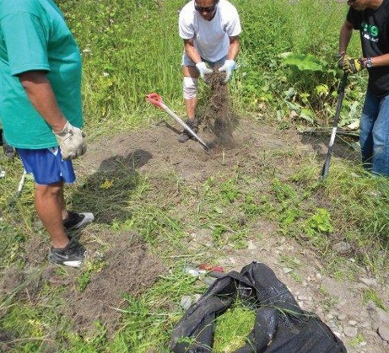
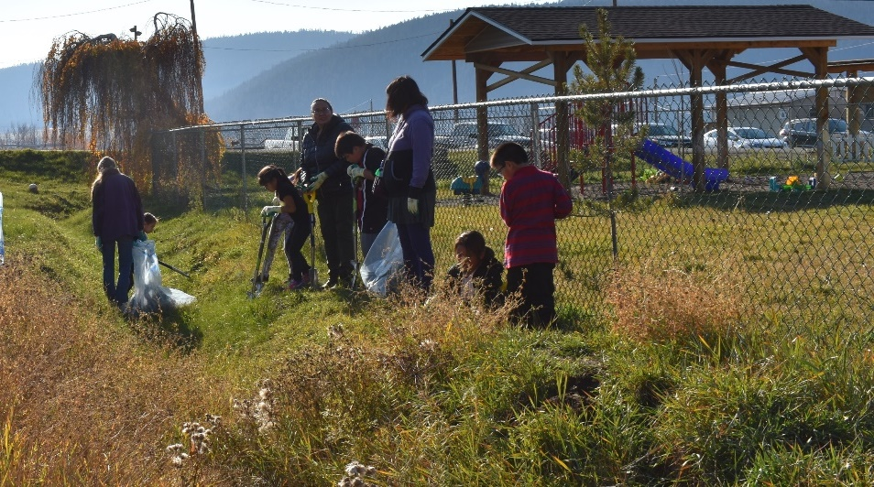
Why Invasive Species are Important to Indigenous People
Growing Concerns of Indigenous Peoples
Increased development, recreation, and access increases spread across traditional lands
Policy Development, Management Decisions, and Response Implementation have typically not included Indigenous Peoples”
Cultural sites and practices need to be considered before actions
Kispiox Community Weed Pull
Williams Lake Youth Weed Pull

Slide 7
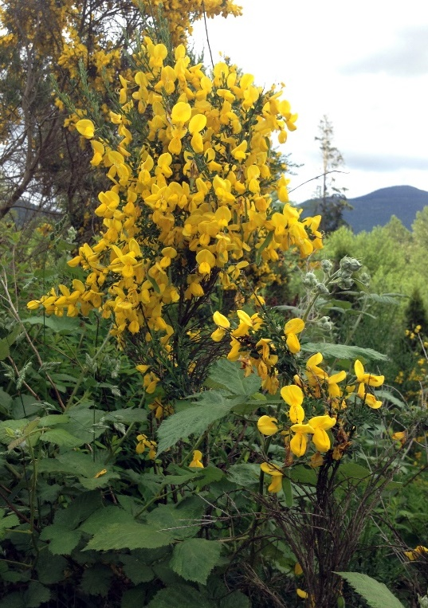
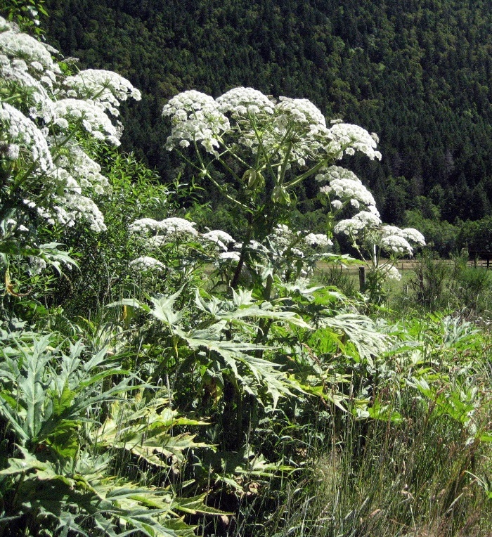
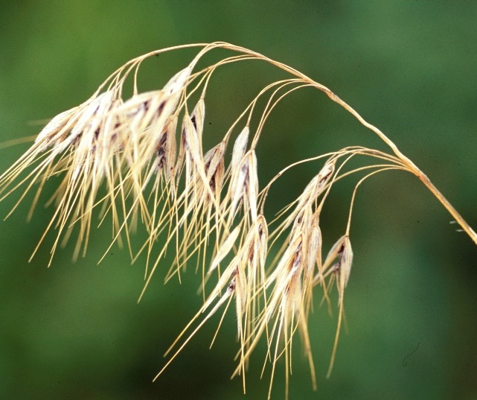
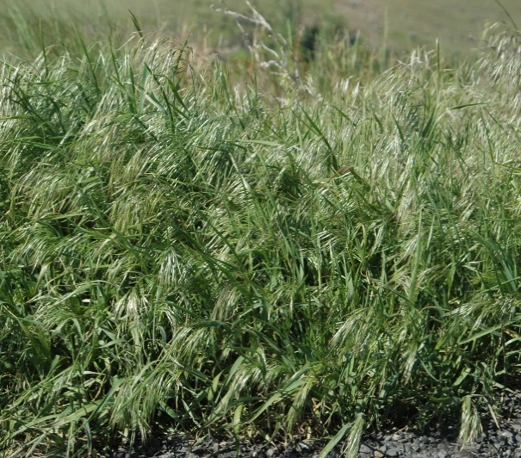
Why Invasive Species are Important to Indigenous People
Invasive Species and Weather Events
Flood how did invasive species increase risk?
Fires how can management reduce risk of fires and infestations?
Changing Climates which species will greatly impact traditional practices?
Credit: J Leekie
Credit: B Brown
Scotch broom
Giant hogweed
Cheatgrass
Credit: S Dewey
Credit: C Evans, University of Illinois, Bugwood

Slide 8
Why Engage
United Nations Declaration of the Rights of Indigenous Peoples
Article 32(3) –States shall provide effective mechanisms for just and fair redress for any such activities and appropriate measures shall be taken to mitigate adverse environmental, social, cultural, and spiritual impacts
Invasive species negatively impact Indigenous peoples use of the land

Slide 9
Truth and Reconciliation Commission Principles & Calls to Action
Call to Action #6 All Canadians share responsibility for establishing and maintaining mutually respectful relationships; and
Call to Action #8 Supporting aboriginal peoples cultural revitalization and integrating knowledge … and connections to the land into reconciliations processes are essential
Call to Action #43 All levels of Government adopt and implement UNDRIP as a framework for reconciliation
Call to Action # 57 Public Servants for Federal, Provincial, Territorial, and Municipal governments to provide education on the history (and cultures) of Aboriginal peoples …
Why Engage

Slide 10
Why Engage
Declaration on the Rights of Indigenous Peoples Act 2019 and Action Plan 2022 – 2027
“ ..Indigenous Peoples have meaningful and sufficient access to abundant and healthy traditional foods"
Theme 1 – Self Determination and Inherent Right of Self-Government
  1.2 Shift from short-term transactional arrangements to
  co-development of long-term agreements
Theme 2 - Title and Rights of Indigenous Peoples
  2.6 Co-develop strategic-level policies, programs and initiatives to advance collaborative stewardship of the environment
  2.8 Collaborate with Indigenous partners on issues related to conservation and biodiversity in B.C

Slide 11
Why Engage
Minister Mandate letters “ creating opportunities for Indigenous peoples to be full partners in our economies…”
Provincial plans
  Together for Wildlife, Climate Change, etc
  Interface Fire
  Fire Strategy

Slide 12
How to Engage
Principles identified by Paul Robitaille in Keynote address BC Invasive Species Council Annual forum February 2023 to improve Success in engaging with Indigenous Peoples:
#1 Respect Indigenous Peoples RIGHTS
Acknowledge Indigenous Peoples as Rights-holders
#2 Respect Indigenous Peoples SOVEREIGNTY
Co-develop priorities, programs and processes
#3 Respect Indigenous Peoples GOVERNANCE​
Do your homework & ask questions
#4 Respect Indigenous Peoples LAWS ​
Ask what their law says about…​
#5​ Respect Indigenous Peoples KNOWLEDGE​
Invest in OCAP training
#6 Respect Indigenous Peoples TIME
Practice radical transparency!​

Slide 13
How to Engage
Ensure government to government partnerships from policy development and management decision making to on the ground implementation actions
Review current plans (such as EDRR)- where is Indigenous engagement?
Provide Indigenous History and Cultural Education at all levels of the organization and/or public service decision making levels
Establish space on any Working Group for Indigenous participation

Slide 14
How to Engage
1. Improve Leadership and Collaboration with Indigenous People
  Where have Indigenous organizations been involved in policy frameworks?
  How have policy and decision-making frameworks involved Indigenous organizations?
2. Expand field operations to include Collaboration with Indigenous People
  What Indigenous input is sought on priority invasive species?
  How are Indigenous people involved in plans before implementation?
3. Build partnerships and communicate
  How are you engaging Indigenous people in planning and priorities?
  How are you prioritizing partnerships for planning and operations?

Slide 15
Involve Indigenous participation at all levels from policy development, management decision-making, to implementation of projects
Ensure all initiatives support Indigenous engagement
Encourage and promote local involvement in projects
Expand science and management to include traditional knowledge
Identify potential partners such as Guardians, Invasive Species Council of BC, others
Considerations for the Scope of Indigenous Engagement

Slide 16
Recommendations on How to engage with Indigenous
People within your organization
Look to ensure your mandate accommodates Indigenous Representatives
Provide Indigenous History and Cultural education at all levels of decision making (Board of Directors, Management, Staff)
Look at how to adopt the Truth and Reconciliation Calls to Action and the UNDRIP Framework and the DRIPA Action Plan into your organization's actions

Slide 17
Together we can protect the lands, waters and traditional rights within British Columbia
Invasive Species are a concern for all federal, provincial, territorial, and Indigenous governments - managing them requires us to work together.

Slide 18
Kʷukʷstem
Thank You
Questions?
Contact: dwalkem@bcinvasives.ca
Resources:
Invasive Species That Affect Indigenous Communities
Indigenous Community Toolkit for Managing Invasive Species
Indigenous Video Series on YouTube

