Slide 1
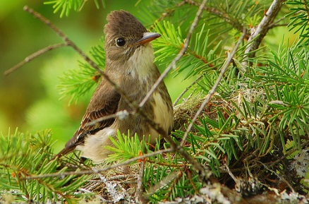
Forest Management and the Migratory Bird Convention Act
Integrated Vegetation Management Association of BC
Kari Stuart-Smith, PhD., RPBio.
Senior Forest Scientist, Canfor
November 8, 2016

Slide 2
History of the Migratory Bird Convention Act In Canada
In the early 1900s concerns were raised that over-hunting and lead poisoning were leading to extinction of many migratory birds, primarily waterfowl.
In 1916 Canada signed the Convention on the Protection of Migratory Birds with the U.S., and the Migratory Bird Convention Act (MBCA) was enacted in Canada in 1917 (updated in 1994).
The MBCA protects migratory birds through:
  Establishment of migratory bird sanctuaries
  Hunting bag limits and regulations and seasons
  Prohibitions against activities that may be harmful to birds, including the taking of feathers (for hats), pollution, and incidental take.

Slide 3
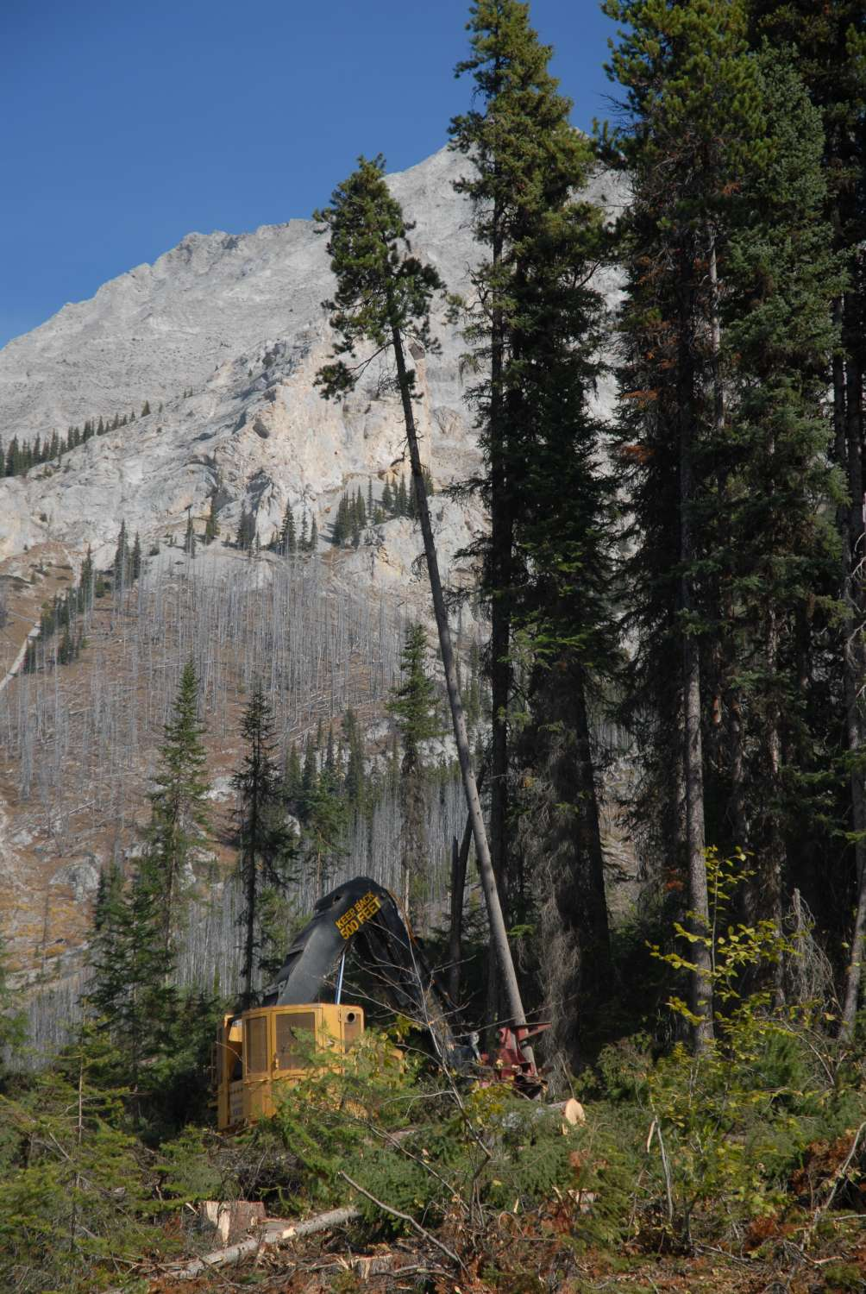
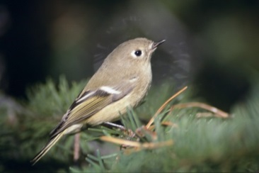
What is Incidental Take?
Refers to the inadvertent killing, harming, disturbance, or destruction of migratory birds, their eggs, or nests that is more or less foreseeable.
The MBCA was amended to allow regulations to be made to permit incidental take, but these have not been developed yet.
Without regulations, there are no permits or authorizations for circumstances of incidental take.

Slide 4
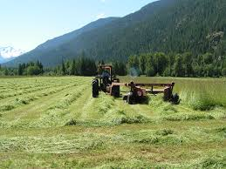
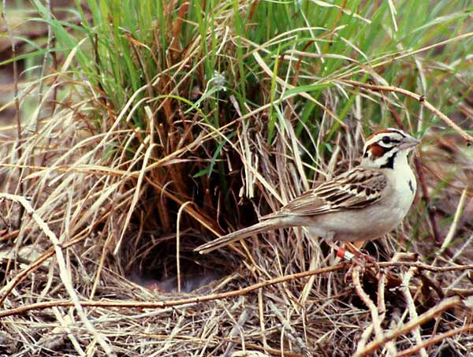
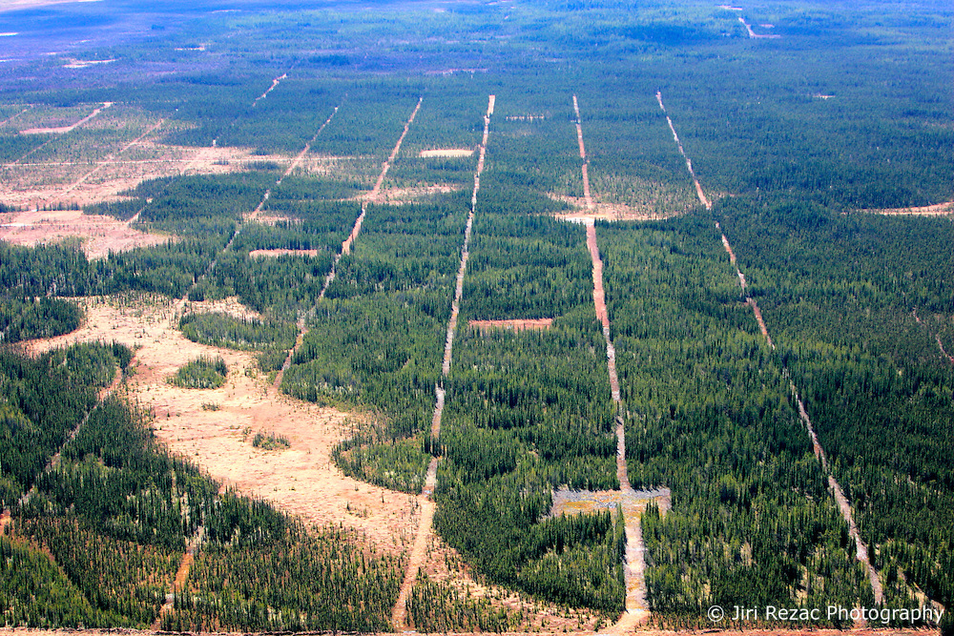
A A Massive Problem
The MBCA impacts all industries; agriculture, oil and gas, hydro, urban and rural development, fishing, etc.
Difficult to find an equitable and effective approach to regulation for all these different industries.
CWS working on regulations until 2010, but stopped due to complexity of issue and concerns of various sectors.
Photos: Kari Stuart-Smith, Chris Wood

Slide 5

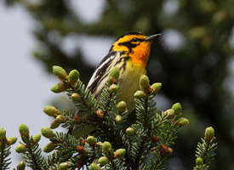
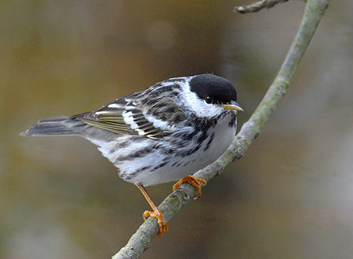
Legal Concerns
Destruction of any migratory bird nest is illegal, on crown or private land.
Federal enforcement officers can convict without concrete evidence of a bird or eggs being destroyed – a high likelihood is enough (i.e., logging during the peak nesting season).
Fines up to $ 1,000,000 and 3 years prison, or $ 300,000 per nest or bird on summary conviction.
Photos: Kari Stuart-Smith, Chris Wood

Slide 6
Case Law Examples
Land developer
  cleared land in Langley for a commercial development which caused disturbance to a robin’s nest
  Had to make a $10,000 payment to Environmental Damages Fund
Point de Chêne Yacht Club
  repairs to a breakwater caused destruction of bank swallows nests
  Resulted in a $13,000 penalty
J.D. Irving Ltd (only forestry company convicted to date)
  destroyed eight heron’s nests in a great blue heron rookery while road-building
  company unsuccessfully challenged the law on a constitutional basis
  Resulted in a $60,000 penalty

Slide 7
Social License and Certification
Increasing questions and requests regarding migratory birds:
BC Trappers Association
Naturalist groups,
ENGOs,
General public
Issue also being raised during our Certification audits

Slide 8
Provincial Legislation - BC Wildlife Act
S. 34 A person commits an offence if the person, except as provided by regulation, possesses, takes, injures, molests or destroys
(a) a bird or its egg,
(b) the nest of an eagle, peregrine falcon, gyrfalcon, osprey, heron or burrowing owl, or
(c) the nest of a bird not referred to in paragraph (b) when the nest is occupied by a bird or its egg.

Slide 9
How do we deal with this Issue?
Migratory bird nests occur in virtually every stand logged during the nesting season, which runs from late March through mid-August.
Shutting down logging operations during this period would have huge implications:
  Cost and logistics of holding that much inventory for 5 months
  Contractor viability – large monthly payments on equipment
  Keeping the workforce in forestry
Cannot avoid planting or brushing during the nesting season
Forest industry employs 145,000 people, contributes $12 billion annually to the GDP, and $2.5 billion to government revenue.
So what to do?????

Slide 10
Provincial Working Group – Interior BC
In June 2015, major licencees in interior BC agreed to start working together to address the issue.
Canadian Wildlife Service and MOE/MFLNRO providing technical assistance.
The provincial group worked collaboratively to develop the products described in this presentation.
With input from practitioners and scientific testing from CWS, the products will be refined and improved over the next 2-3 years.

Slide 11
The Migratory Bird Strategy
A risk reduction approach, with 3 main components:
Risk Rating Matrix for Forest Stands
Best Management Practices to avoid or reduce the risk
Training for Field Workers
The specific BMPs which are applied to each stand and the training developed for field workers are company specific.

Slide 12
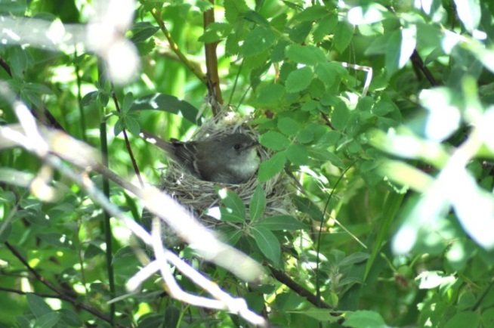
1. The Risk Rating Matrix
Ranks forest stands from very low to very high, based on the relative density of birds thought to nest within them.
Based on qualitative relationships taken from the literature and expert opinion; not quantitative.
Rank | Nest Density = Risk
1 | Very Low
2 | Low
3 | Moderate
4 | Moderately High
5 | High
6 | Very High

Slide 13
Stands categorized for ranking
Objectives :
To categorize the habitat that stands provide for nesting birds as accurately as possible, using as few VRI variables as possible.
To use VRI variables familiar to and commonly used by foresters.
To prefer directly measured variables over calculated or projected ones.
To use the most accurate variables.
Categories based on 4 variables:
BEC zone (8 zones)
Dominant Tree Species (19 groups)
Age Class (5 classes)
Height Class (4 classes)

Slide 14
Example: Montane Spruce BEC
 | Age 3-30 years |  |  |  | Age 30-80 years |  |  |  | Age 80-120 years |  |  |  | Age 121-250 |  |  |  | Age 250+
Leading Species | Height (m) |  |  |  | Height (m) |  |  |  | Height (m) |  |  |  | Height (m) |  |  |  | Height (m)
 | <10.4 | 10.5-19.4 | 19.5-28.4 | 28.5+ | <10.4 | 10.5-19.4 | 19.5-28.4 | 28.5+ | <10.4 | 10.5-19.4 | 19.5-28.4 | 28.5+ | <10.4 | 10.5-19.4 | 19.5-28.4 | 28.5+ | <10.4 | 10.5-19.4 | 19.5-28.4 | 28.5+
PyFd | 2 | 1 | . | . | 2 | 1 | 3 | . | 1 | 2 | 3 | 4 | . | 2 | 4 | 4 | . | . | 4 | 5
PyFd_Decid | 3 | 2 | . | . | 3 | 2 | 3 | . | 1 | 3 | 4 | 5 | . | 3 | 5 | 5 | . | . | 5 | 6
Fd>75% | 2 | 1 | . | . | 2 | 1 | 2 | 4 | 1 | 2 | 3 | 4 | . | 2 | 3 | 4 | . | . | 4 | 4
FL | 2 | 1 | . | 3 | 2 | 1 | 3 | 4 | 2 | 3 | 4 | 4 | 2 | 3 | 4 | 5 | . | . | 5 | 5
FL_Decid | 3 | 2 | . | . | 3 | 2 | 3 | 4 | . | 3 | 4 | 5 | 2 | 3 | 5 | 5 | . | . | 5 | 6
Pl | 2 | 1 | 2 | . | 2 | 1 | 2 | 3 | 1 | 2 | 3 | 3 | . | 2 | 3 | 3 | . | 2 | 3 | .
Pl_Mix | 2 | 1 | . | . | 2 | 1 | 3 | 3 | 1 | 3 | 4 | 4 | . | 3 | 4 | 4 | . | 3 | 4 | 5
Pl_Decid | 3 | 2 | . | . | 3 | 2 | 3 | 4 | 1 | 3 | 4 | 5 | . | 3 | 4 | 5 | . | . | 5 | 5
SB | 2 | 1 | . | . | 2 | 1 | 2 | 3 | 1 | 3 | 4 | 4 | 2 | 3 | 4 | 5 | 2 | 4 | 5 | 5
SB_Decid | 3 | 2 | . | . | 3 | 2 | 3 | 4 | 2 | 3 | 5 | 5 | . | 3 | 5 | 5 | 3 | 4 | 5 | 6
CH | 2 | 1 | . | . | 2 | 1 | 3 | 3 | 1 | 3 | 3 | 4 | 2 | 3 | 4 | 4 | 2 | 3 | 4 | 5
CH_Decid | 3 | 2 | . | . | 3 | 2 | 3 | . | 1 | 3 | 4 | 4 | 3 | 3 | 5 | 5 | 2 | 3 | 4 | 6
Other | 2 | 1 | . | . | 2 | 1 | 3 | . | 2 | 3 | 3 | 3 | . | 3 | 4 | 5 | . | . | 4 | 5
Other_D | 3 | 1 | . | . | 3 | 2 | 3 | . | . | 3 | 4 | 4 | . | 4 | 5 | 5 | . | . | 5 | 6
Decid | 3 | 2 | . | . | 3 | 2 | 3 | 4 | . | 4 | 5 | 5 | 3 | 4 | 5 | 5 | . | 5 | 5 | 6
At_Con | 3 | 2 | 3 | . | 3 | 2 | 3 | 4 | 2 | 4 | 5 | 5 | 3 | 4 | 5 | 6 | . | 5 | 6 | 6
Act | 3 | 3 | 4 | . | 3 | 3 | 3 | 4 | 2 | 4 | 5 | 5 | 3 | 4 | 5 | 6 | . | . | 6 | 6
Stand Ranks are in black; dots mean that height class did not exist for that age class

Slide 15
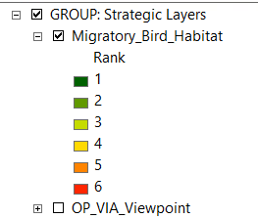
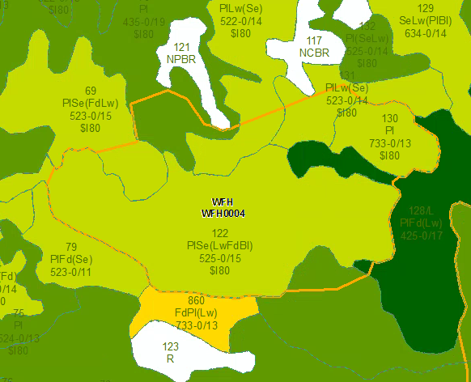
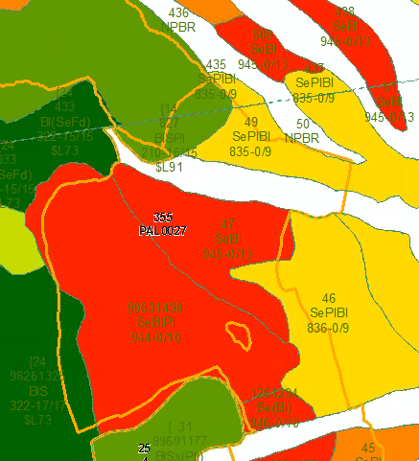
Matrix turned into a GIS layer
Proposed cutblocks can be overlaid
on this layer to determine ranking of
stands within them

Slide 16
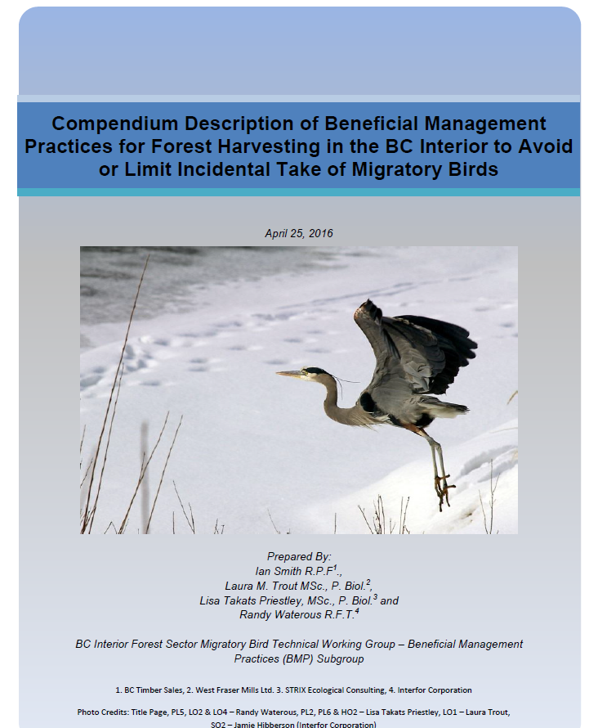
2. Application of BMPs
  The provincial working group developed a Compendium of BMPs to avoid or reduce the risk of incidental take.
  BMPs were categorized by their likelihood of avoidance of incidental take and the degree of protection they provide nesting birds.
  They were also given an efficiency rating.

Slide 17
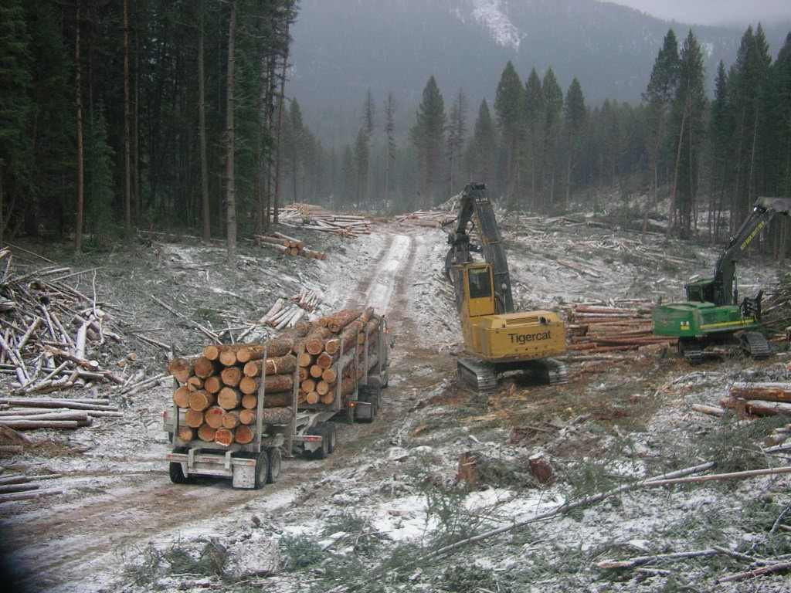
TRUE Avoidance BMPs
  These BMPs deal with timing of the activity (harvest, brushing, etc).
  Only conducting the activity outside the nesting season will eliminate all of the incidental take risk associated with that block.

Slide 18
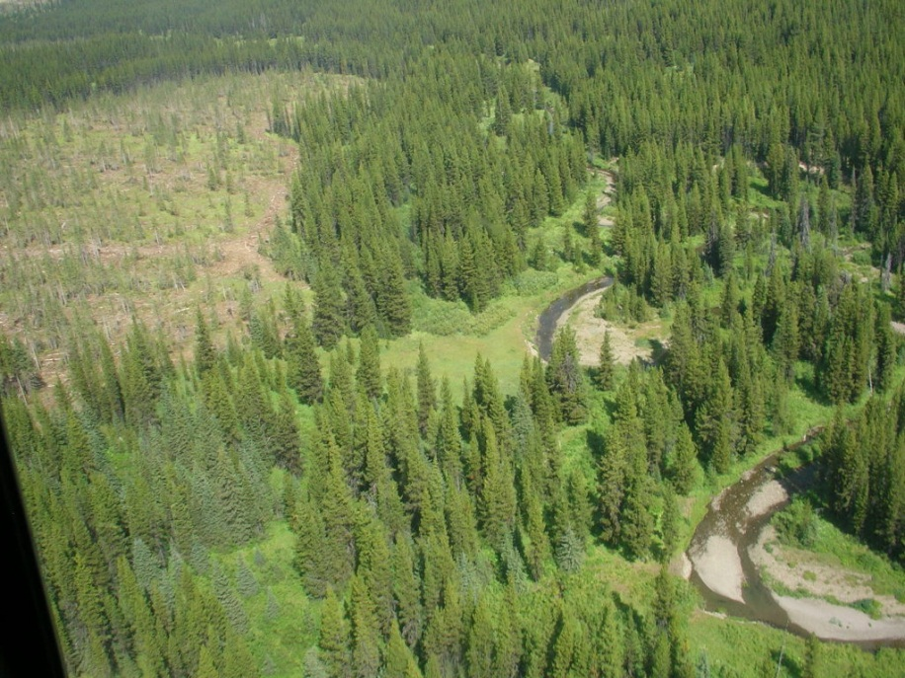
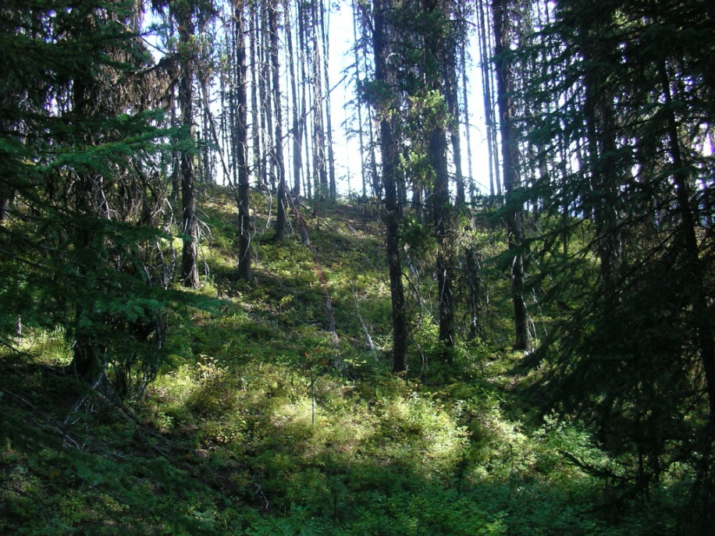
PARTIAL Avoidance BMPs – more effective
  These involve various kinds of retention.
  E.g., Retain riparian ecosystems within Riparian Reserve Zones (RRZ)
  Capture the full extent of the riparian ecosystem – not just linear strips based on minimum requirements.

Slide 19
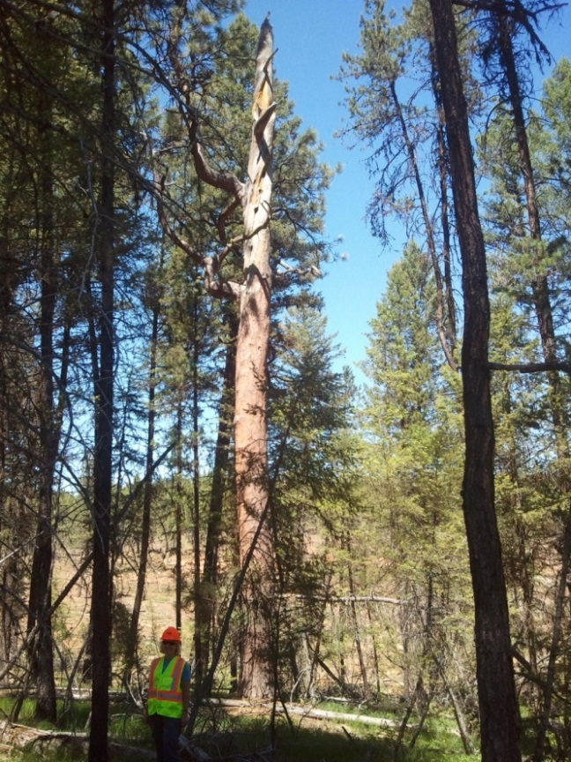
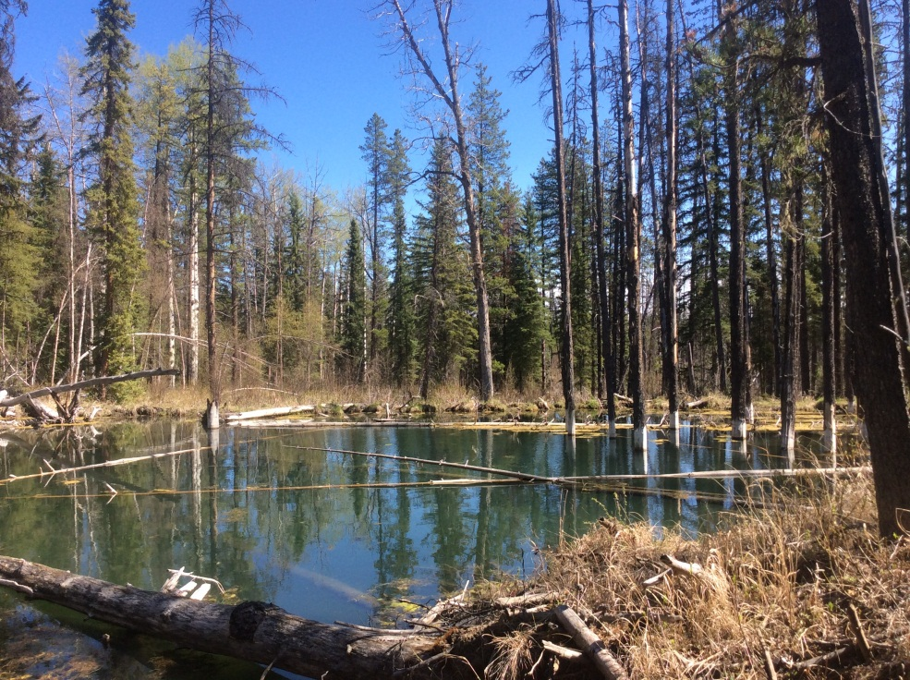
Partial Avoidance BMPs – more effective
Retention of high value wildlife trees (snags with cavities) in WorkSafe BC reserves where required.
Wildlife Tree Patches – anchored around important habitat including wet shrubby areas, multi-layered stands, mixedwood stands, old growth, wetlands, etc.

Slide 20
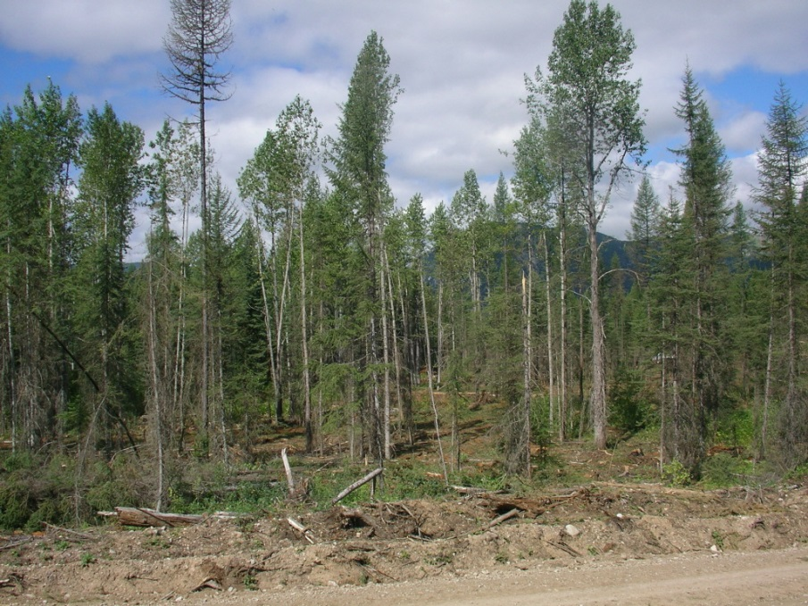
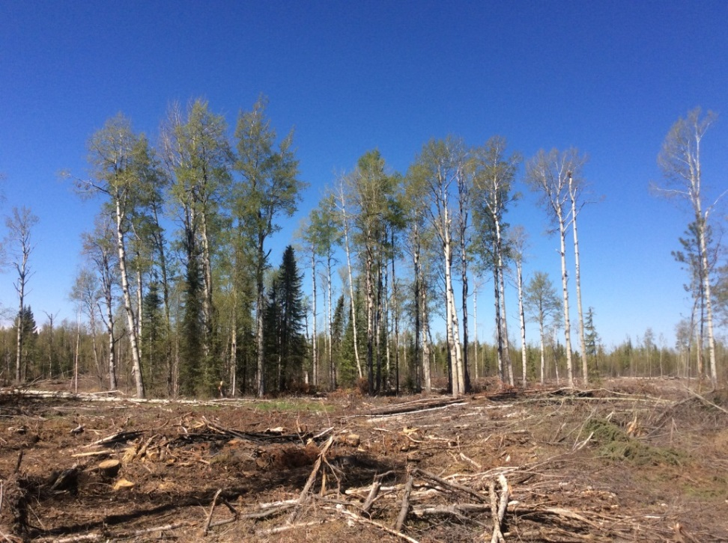
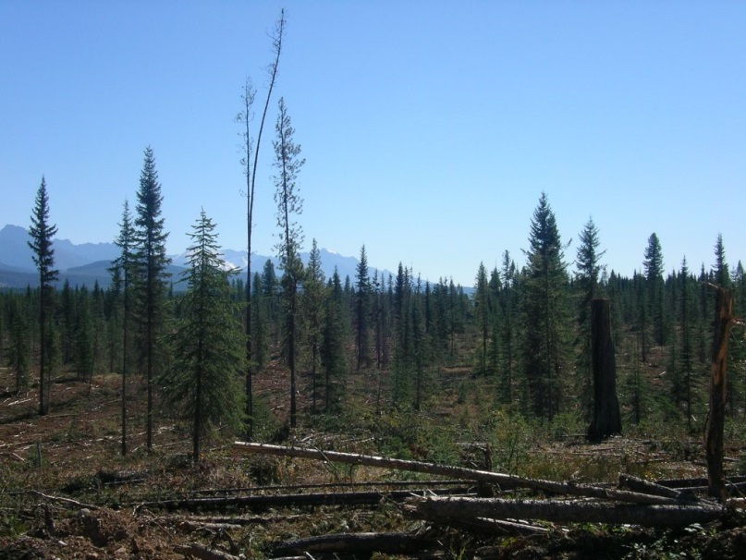
Partial Avoidance BMPs – less effective
  Partial cut or high retention,
  Retention of clumps built around snags and conifer understory
  Retention of conifer understory

Slide 21
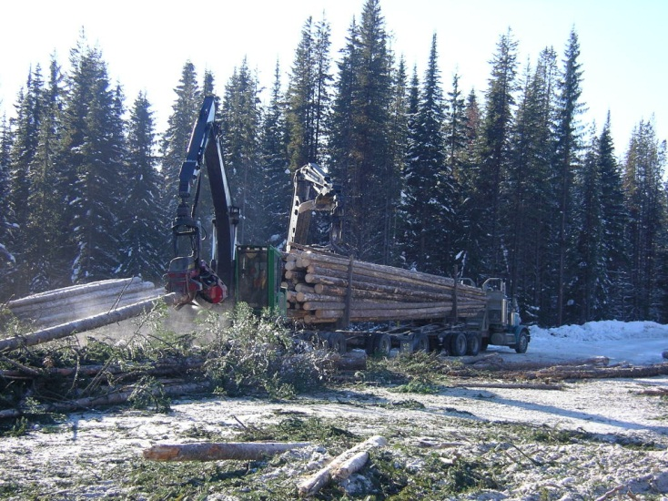
Relating BMPs to Ranks:
Rank 6 example – Highest Risk
This block contains primarily Rank 6 stands.
Harvesting and hauling should be deferred outside the nesting season in most cases.
  Consider felling, skidding, and decking at roadside or satellite yards during winter for hauling in spring and summer.

Slide 22
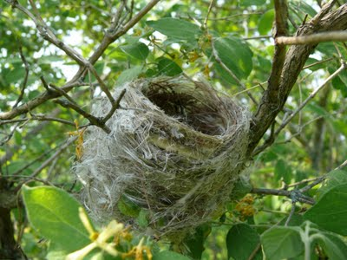
Rank 6 blocks – Option 2
If harvesting cannot be deferred outside the nesting season period, bird surveys may be conducted by qualified person(s) during the peak nesting period (June).
Reserves must be placed around detections of listed species (Endangered and threatened, warblers-of-concern)
All nests found must be placed in reserves, permanent (listed species) or temporary (others).

Slide 23
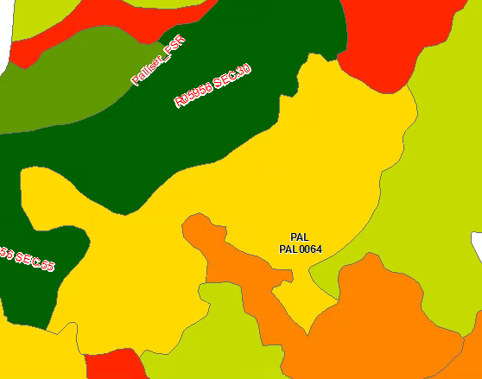
Rank 4 and 5 Cutblock example
Option 1 – Defer harvest until after nesting season
Option 2 - Place a reserve on the portion of the block that is in the Rank 5 polygon, then apply a BMP such as understory retention or retention of high value snags to the Rank 4 portion of the block.

Slide 24
Summary – Harvest Scheduling and BMPs
Block/ Stand Rank | Harvest Scheduling | BMPs
1 | n/a | Training
2 | n/a | Training
3 | n/a | Training
4 | Outside Nesting season (Restricted Period 2), unless BMPs applied to reduce risk. | 1 or more BMPs
5 | Outside Nesting Sesason (Restricted Period 1), unless BMPs applied to reduce risk. | 2 or more
6 | Outside Restricted Period 1 unless absolutely necessary, then either conduct bird surveys and apply reserves prior to harvest, or layout at least 20% reserves prior to harvest.

Slide 25
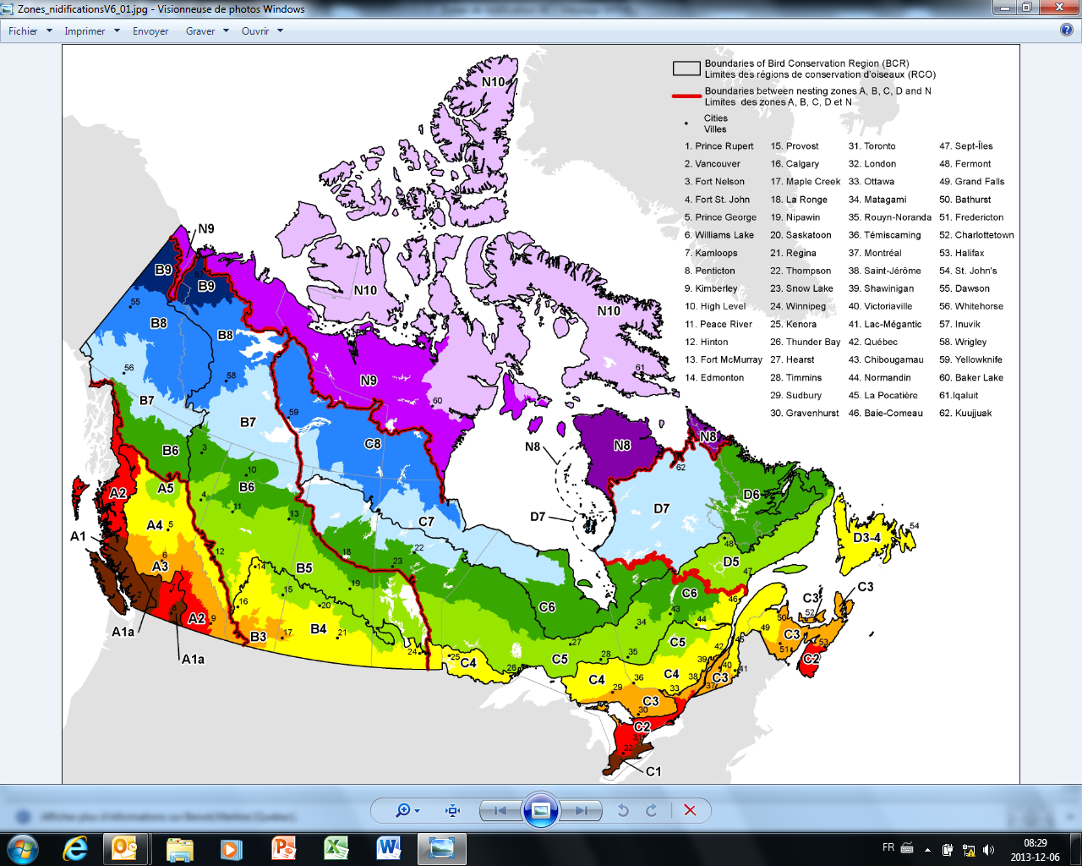
How Restrictive Periods were identified
Nesting calendars provided on the Environment Canada website for Incidental Take.
Two main Restricted periods were identified:
  Period 1 – Covers full nesting period for almost 80% of the species nesting in forested habitats
  Period 2 – Covers full nesting period for about 60% of the species
Nesting calendars need local and elevational verification

Slide 26
3. Training for Field Workers
Training was company-specific
In Canfor, training presentations were developed specifically for:
  Block Layout / Cruising,
  Harvesting / Road-building / Mechanical Site-Prep,
  Silviculture (Planting/Brushing/Spacing),
These presentations are short and specific to the job, and focus on what to do if an active bird nest or stick nest is found during work.
They are intended to be given at annual pre-works at the start of the season in early spring.

Slide 27
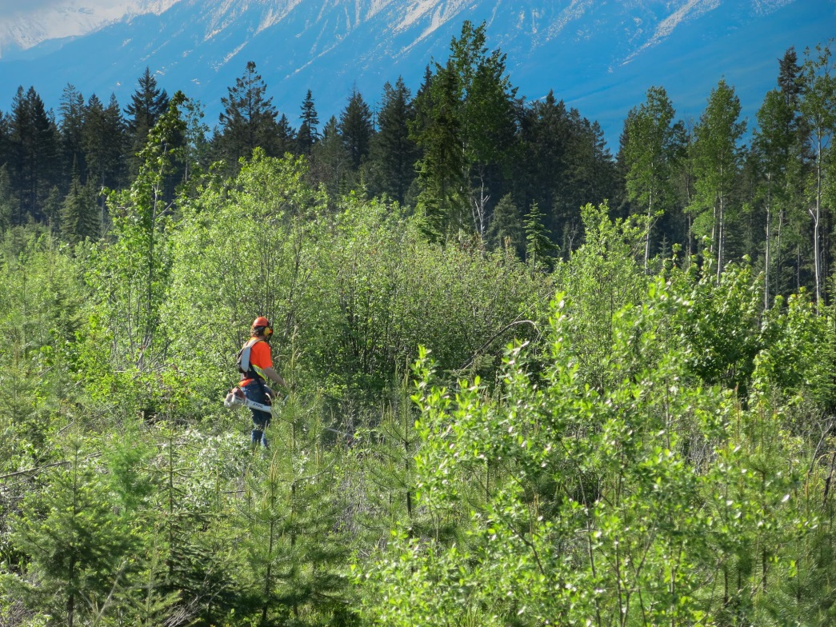
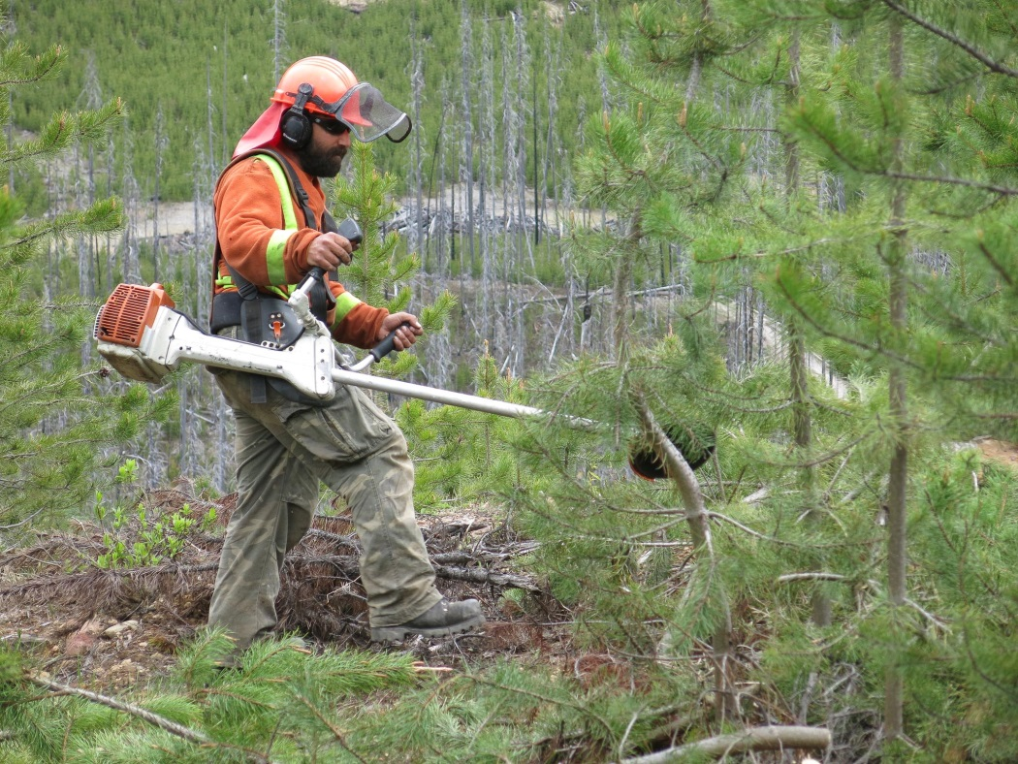
Brushing
Typically occurs in stands ranked 1-3, but due to nature of work brushers often come across bird nests.

Slide 28
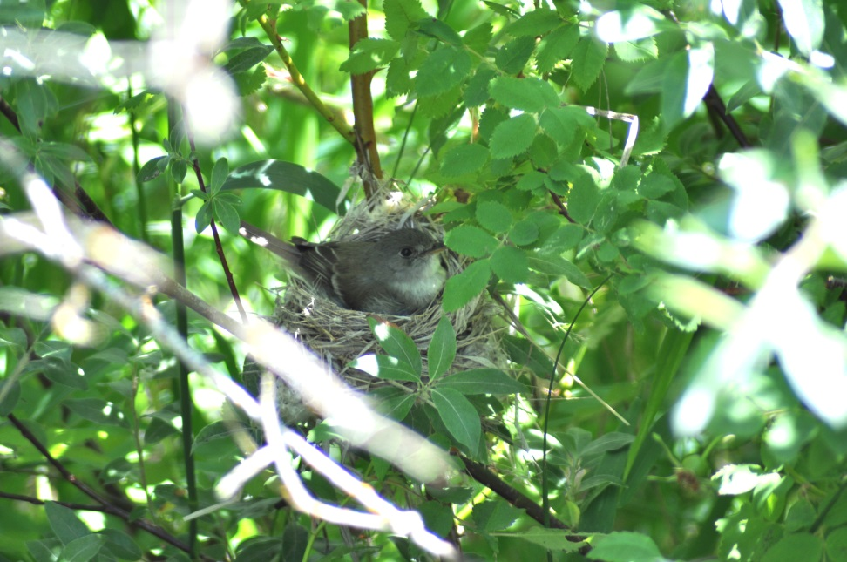
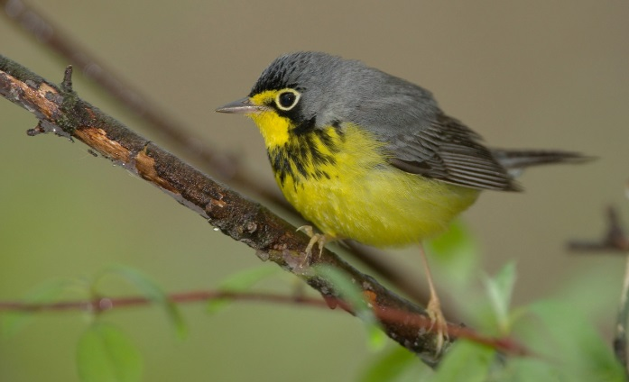
If you find an active bird nest in a Small Tree or Shrub.…
Do NOT cut the tree/shrub containing the nest or the trees/shrubs directly beside the tree containing the nest (to the extent that you can, given that sometimes a cut is made before a nest is discovered).
Vegetation directly adjacent to the nest tree/shrub is sometimes involved in supporting the nest, and helps provide cover to it.
Complete your work in the vicinity of the nest as quickly as possible and move on.
If others need to work in the area, flag a 10m no-work zone around the nest so they are aware it is there and don’t disturb it.
Photo: Ian Adams

Slide 29
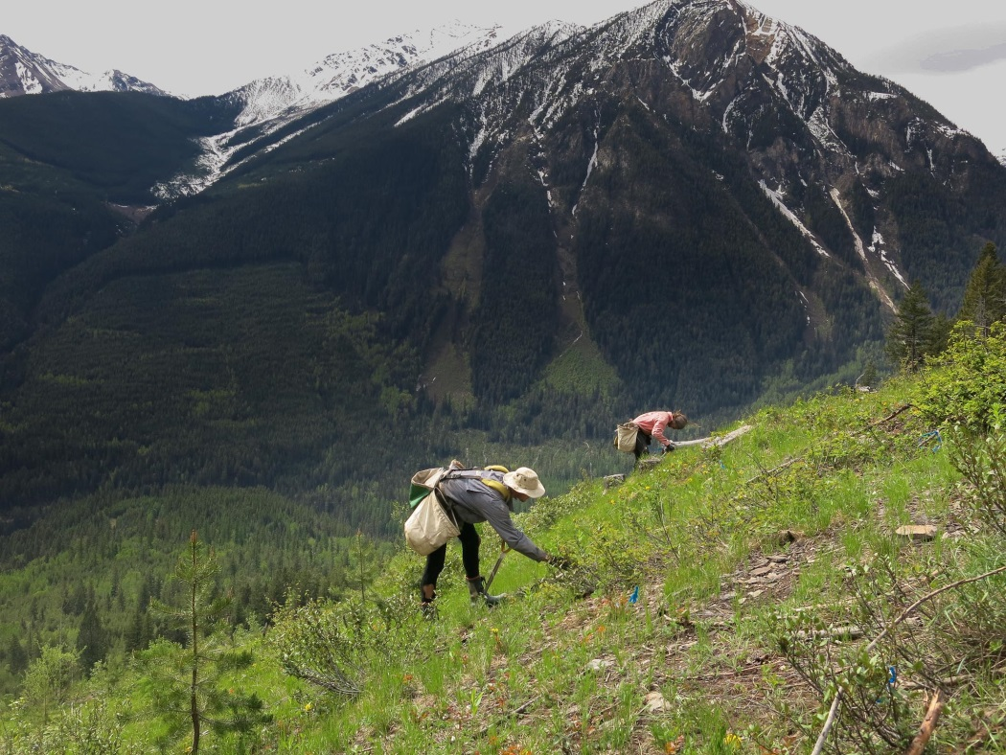
Planting
Blocks usually planted 1-2 yrs following harvest; very few nests present at that time.
Rated 1 or 0 if < 1 post-harvest.

Slide 30
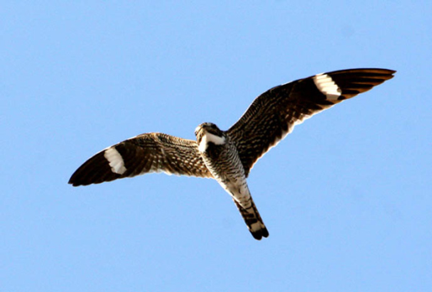
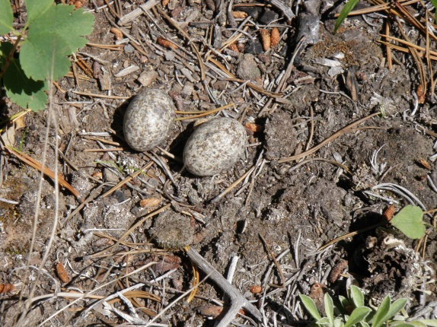
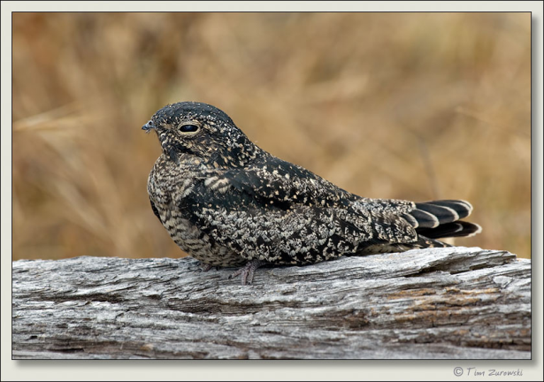
If you find an active bird nest on the ground.…
Manage an ‘ocular’ (no ribbon required) 5m radius no-work zone (NWZ) around the nest and do not fell any trees or shrubs within this zone. Avoid trampling the nest.
Ensure you directionally fall any trees or shrubs away from this zone, so as not to damage the nest or harm the bird.
If the nest is on a road or landing, flag a 10 m, highly-visible NWZ around the nest. Advise others working in the area of the nest location, so the nest does not get driven over.
Common
Nighthawk –
threatened
species

Slide 31
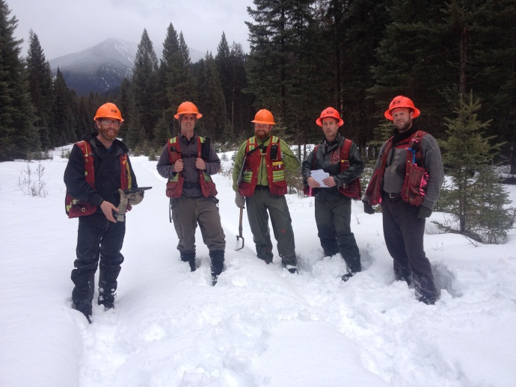
Role of Field Operations/Layout
Field Ops play a key role in determining what habitat for birds remains post-logging.
Can identify important habitat and placing this in reserves where practicable.
By knowing when they have found an active nest and how to manage it, they can reduce incidental take.

Slide 32
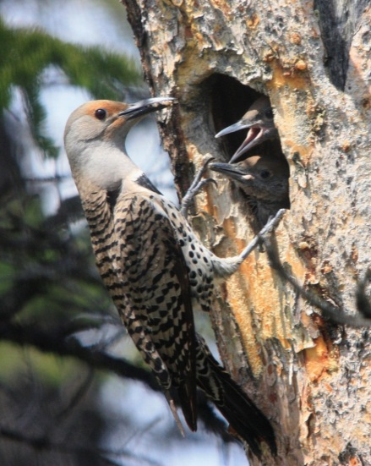
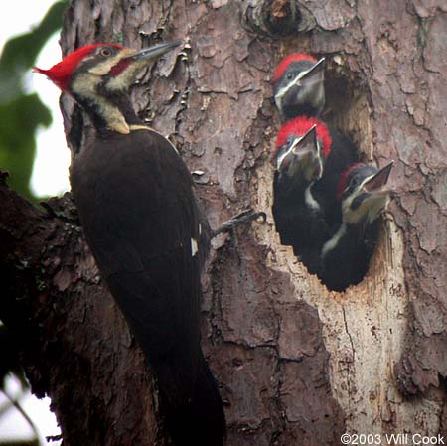
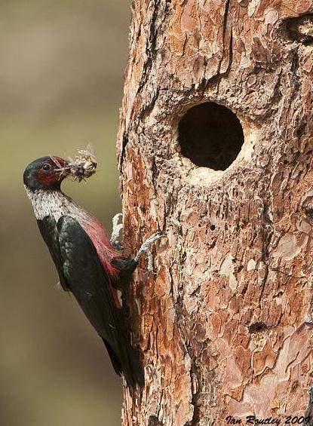
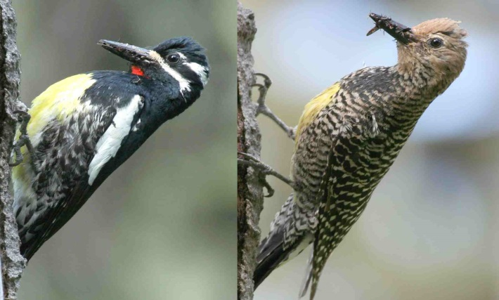
If you find an active nest in a Dead or Dying tree (Snag).…
Ribbon a reserve around the snag where practicable, of WorkSafe BC radius minimum > 1.5 times the height of the snag.
If a PIWO nest; aim for > 100 m radius WTP, connected to adjacent forest, where practicable.
If a LEWO or WISA, report to supervisor and Forest Scientist immediately, must reserve and report to MFLNRO
Photo: Matthew Sim (web)
Female WISA

Slide 33

Active nests in shrubs, trees, or on the ground…..
Birds that nest in shrubs, trees, and on the ground typically build new nests each year in different locations, so an active nest does not need to be protected if found during layout/cruising, UNLESS….
If the block will be logged between May and early August of the year the nest is found, ribbon a 50 m diameter temporary No-Harvest Buffer around the nest. DO NOT ribbon the nest itself! (this will attract predators).
GPS this buffer (and give the file to your Canfor supervisor, who will make sure it is put on the Logging Plan map and communicated to the loggers.
Or Common Nighthawk or …
Photo: Ian Adams

Slide 34
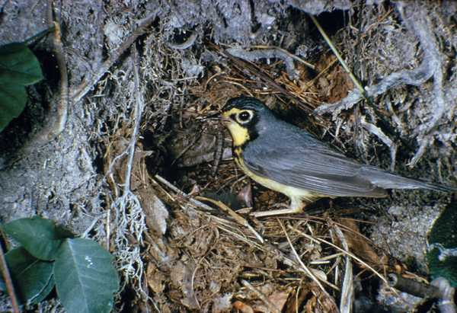
Species-at-Risk Profile:
Canada Warbler – Threatened
Grande Prairie/Ft. St. John/Ft. Nelson Regions
Most abundant in wet, mixed deciduous/coniferous forest with an abundant shrub layer.
Nests on or near the ground, often in dense ferns or fallen logs.
Report to your Canfor Supervisor immediately if you see this bird or its nest.
Reserve needs to be developed by a qualified person.

Slide 35
Testing and Adaptive Management
Two test of the matrix being performed this winter
  1. CWS using point count data collected around the province to test the matrix with data
  2. Expert ornithologist hired to review matrix based on his expert opinion
Feedback from practitioners around the province will permit improvement of Standard Work Procedures and BMPs over next few years.
Full implementation by 2018.

Slide 36

Thank you

