Slide 1

Introducing new DuPont™ Truvist™ and Navius™ VM
Herbicides
DuPont
Land Management
Herbicides in Canada

Slide 2
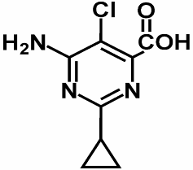
Proprietary Active Ingredient
Both DuPont™ Truvist™ and Navius™ VM* are blends containing aminocyclopyrachlor (“MAT 28”), a proprietary active ingredient from DuPont.
Pyrimidine carboxylic acid class
New generation of synthetic auxin herbicides
Unique properties at molecular and whole-plant levels deliver more potent herbicidal activity than other active ingredients, enabling
  Faster action
  Control of wider spectrum of
  broadleaf weeds and brush
Notes:
The most exciting thing about Truvist and Navius VM is that they both contain BRAND NEW chemistry

Slide 3


Launched in Canada in 2014:
Aminocyclopyrachlor 39.5%
Chlorsulfuron 15.8%
(DuPont™ Telar®)
GROUP 2 and 4 herbicide
Aminocyclopyrachlor 39.5 %
Metsulfuron methyl 12.6 %
(DuPont™ Escort®)
GROUP 2 and 4 herbicide
*
Notes:
Resistance management

Slide 4
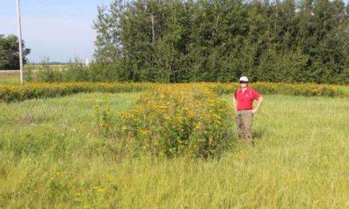
New Chemistry Delivers:
Excellent post-emergence control of many broadleaf and brush** species
Excellent residual control of many difficult-to-control broadleaf weeds
Two modes of action for effective resistance management
Dry, concentrated formulation for less handling
Low use rates per hectare for a favorable environmental profile
Low toxicity to mammals, birds
and insects for low impact on
wildlife and the environment
** DuPont™ Navius™ VM*
Common Tansy 3 YAA
Notes:
Note to trainer: we are talking about the features of the new chemistry- aminocyclopyrachlor. This plot is Rejuvra™ XL which also contains this new chemistry

Slide 5
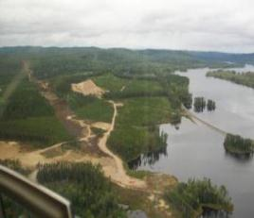
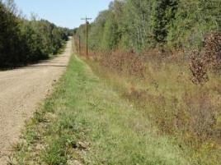
Development highlights and experience:
Demonstrated results with commercial equipment, on commercial scale, in “real life” environments:
With the help of industry co-operators and professional applicators
  50+ co-operators including: AAAF, MWS, CN, CP, Fortis, Hydro One, BC Hydro, and many others
  120+ field research permits across Canada in 2011, 2012, and 2013 with DuPont™ Navius™ VM* and Truvist™
  Thank You to our field permit co-operators!
North American experience:
Three seasons of commercial experience with DuPont™ Perspective® (Truvist™) and Streamline® (Navius™ VM*)
2200+ total research trials in North America with the active aminocyclopyrachlor, since 2005
Hydro Quebec
Drayton Valley AB
Notes:
Opportunity for recognition of co-operators in the room

Slide 6


Count on New DuPont™ Truvist™ herbicide to help you keep roads safer at every turn and to help you ensure bareground sites stay safe, clean and clear.

Slide 7

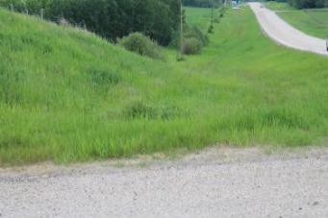
Key Features
Controls difficult species, such as leafy spurge
Selective to most perennial and native grasses
Provides broad spectrum weed control
Low use rate, dry formulation
Low toxicity to mammals, birds and insects
Lac Ste Anne AB, 1YAA.
Notes:
RE: “Selective to most perennial and native grasses”:
Any damage that we have seen is on more southern grass species such as bentgrass and C-4 grasses. The MAT alone has not shown issues on any of the cool season grasses that we have further north. When we see injury it is typically caused by the SU, and MSM (Escort) in particular, not by the MAT. The grasses to watch are timothy and orchard grass. We've also seen issues with bromegrass and wheatgrass if they are already stressed. Blue grasses have not had any issues.

Slide 8
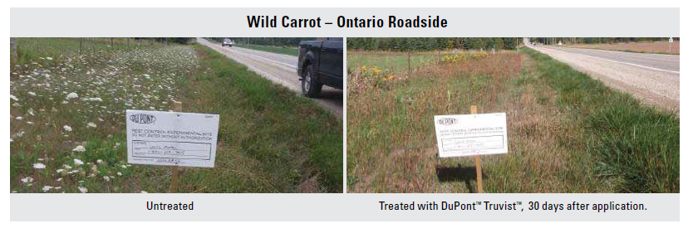
Benefit: Selective Application
New DuPont™ Truvist™ herbicide helps you keep motorists and road crews out of harm’s way
Provides long-lasting control of a broad range of obstructive annual and perennial weeds
Allows natural grasses to thrive
Helps you manage invasive and noxious species for clean, natural roadsides

Slide 9
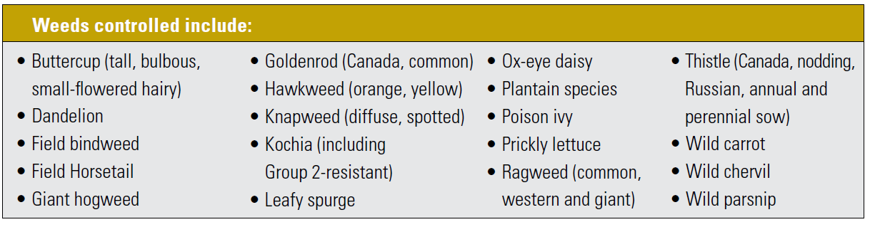
Over 50 species controlled, including:
Notes:
Trainer- see label for full list, plus training aid for species under consideration

Slide 10
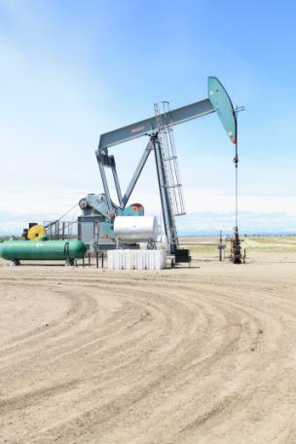
Benefit: Bareground Tank mixes
New DuPont™ Truvist™ herbicide helps you keep your sites safe, clean and clear
Provides effective resistance management including control of Group 2 resistant kochia
Low use rate helps you raise the standard on productivity and environmental responsibility.
Notes:
Hidden for Ontario weed inspectors

Slide 11
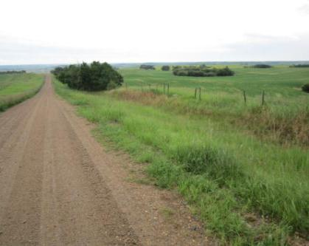
Application-rates
Always read and follow label instructions carefully.
SITES: Industrial Non-Crop Areas
TIMING: For best results, apply to young, actively growing weeds. Thorough coverage of target weeds is essential.
APPLICATION RATE:
DuPontTM TruvistTM Herbicide | 168 grams/hectare
Adjuvants: Non-Ionic surfactant OR | 0.25% v/v
Merge or Crop Oil Concentrate | 1% v/v
Wainwright AB 1YAA

Slide 12
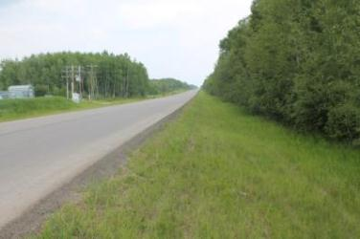
Application
Always read and follow label instructions carefully.
DuPontTM TruvistTM is not registered for aerial application.
No respirator is required for mixing or application of DuPont™ Truvist™ Herbicide
Wear chemical resistant gloves, long-sleeved shirt, long pants, shoes and socks during mixing/loading, application, clean-up and repair activities (gloves are not required for ground boom sprayers)
Rain-fast at 4 hours after application.
Worker re-entry: once sprays have dried.
No daily application limit.
A maximum of one application of
DuPontTM TruvistTM Herbicide may be made per year.
Bonnyville AB, 21 DAA
Notes:
PPE per your company policy

Slide 13
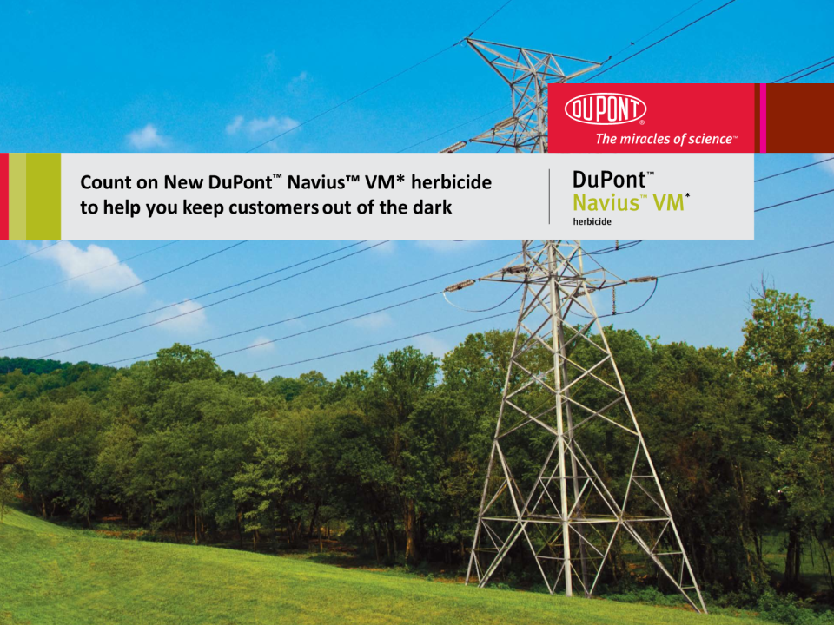
*This product is not registered for this use. It is a violation of the Pest Control Products Act to use a product in a non-registered application.
Notes:
Brush and broadleaf weed control

Slide 14

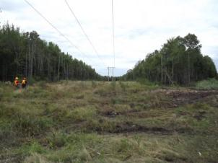
Key Features
*
Controls challenging brush species such as maple, pine, spruce and poplar
Selective to many perennial and native grasses
Multiple, low use rates, dry formulation
Low toxicity to mammals, birds and insects
NS Power, 2YAA

Slide 15
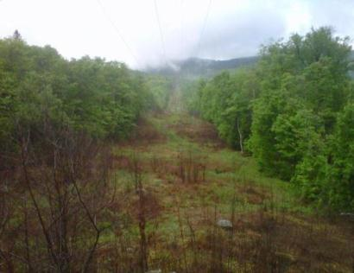
Benefit:
Navius™ VM* helps you provide uninterrupted power to your customers and allows safe access to pipeline, rail, road and other rights of way.
Selective control- promotes the grass understory
Effective control of broadleaf weeds and brush with a single herbicide
Easy to use – low-odour, dry formulation mixes easily
Low use rate: easier to transport, takes less storage space and Helps you get more done in a day
Algoma Power
306 Days after Application

Slide 16
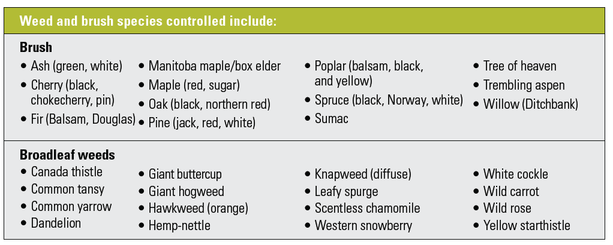
Over 40 species controlled, including:
*
Notes:
Sumac under BLW on label
Trainer- see training aid for full list and species under consideration

Slide 17
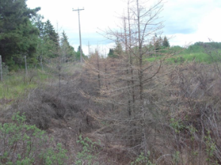
Application- Rates
*
Always read and follow label instructions carefully.
Application Rate | Species controlled include:
167 grams/hectare | Broadleaf weeds
334 grams/hectare | Ash, Cherry, Maples. Poplar, Willow, Fir and Spruce. Maximum height varies. Refer to label.
499 grams/hectare | Oak, Hickory
668 grams/hectare | Pine, Fir, Spruce
Adjuvant | Rate
Non-ionic surfactant or | 0.25% v/v
Merge or crop oil | 1% v/v
MB Hydro 1YAA
Notes:
Photo shows site with Spruce control at all 3 rates, depending on height.

Slide 18
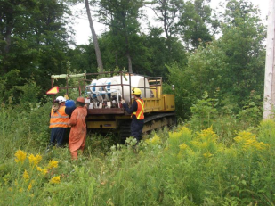
Brush Application
*
Always read and follow label instructions carefully.
DuPontTM NaviusTM VM* Herbicide may be applied using ground spray equipment, fixed wing aircraft or by helicopter.
No respirator is required for mixing or application of DuPont™ Navius™ VM* Herbicide.
Wear chemical resistant gloves, long-sleeved shirt, long pants, shoes and socks during mixing/loading, application, clean-up and repair activities (gloves are not required for ground boom sprayers).
Rain-fast at 4 hours after application.
Worker re-entry: once sprays have dried.
No daily application limit.
Apply a maximum of 668 g/ha of Navius™ VM* Herbicide per year.
Algoma Power

Slide 19
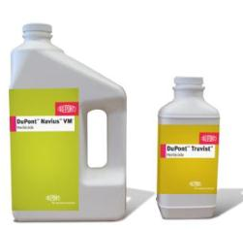
Package
 | DuPont™ Truvist™ |  | DuPont™ Navius™ VM*
formulation | Wettable granule (dry)
bottle | 567 gram |  | 1.36 kg
Bottles per case | 12 |  | 8
Hectares per case | 40 |  | 64 (weed rate)
Final product packaging may not be exactly as shown above.
Always read and follow label instructions carefully.

Slide 20

Count on New………….
For:
Effective brush control
Flexibility
Productivity
For:
Control of tough weeds
Grass that thrives
Enhanced bareground control

Slide 21


DuPont Land Management
Websites:
  www. landmanagement. dupont.ca
  www.truvist.dupont.ca
  www.navius.dupont.ca
DuPont Land Management Support Centre: 1-800-667-3925
www.engageagro.com
Notes:
As for all DuPont vegetation management products, DuPont Truvist™ and Navius™ VM can be ordered from TrueNorth Specialty Products, now known as Univar Environmental Sciences.

Slide 22

THANK YOU!

