Slide 1



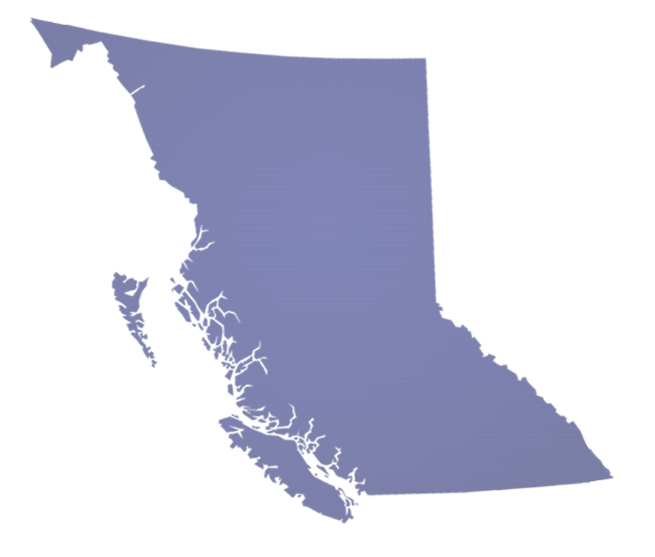
Managing Invasive Species in a Changing Province
Climate, Habitat and Site Type Modeling
to Forecast Risk & Prioritize Resources
Presented by: Becky Brown, P.Ag
Invasive Plant Specialist Provincial Early Detection Rapid Response Coordinator
B.C. Ministry of Forests
November 8, 2023

Slide 2
Overview
WHY do climate modelling?
HOW? – Our model development process
What? – The outputs

Slide 3
Why do climate modelling?
New incursions faster than natural adaptation
Increasing frequency & severity of climate related disturbances
Predict the risk and adapt before impacts realized
Fluid world travel & trade
Increasing urbanization
Introduction & spread of invasive species at an all-time high
Wildfires
Floods

Slide 4


Invasive Species
Climate, Habitat & Site Type Modeling
Background
(2008-2012) Manual potential range mapping, based on:
  Current BC and global distributions and literature
(2012-2020) Semi-manual climate, BEC and Plant Hardiness Zone potential range mapping, based on:
  Global species distributions (GBIF)
  Koppen-Geiger Climate Classification System correlated to BC BEC System (ClimateBC)
  Global Plant Hardiness Zones (NAPPFAST) correlated to CAN and US Plant Hardiness Zones (for plants only)
https://www2.gov.bc.ca/gov/content/environment/plants-animals-ecosystems/invasive-species/edrr

Slide 5
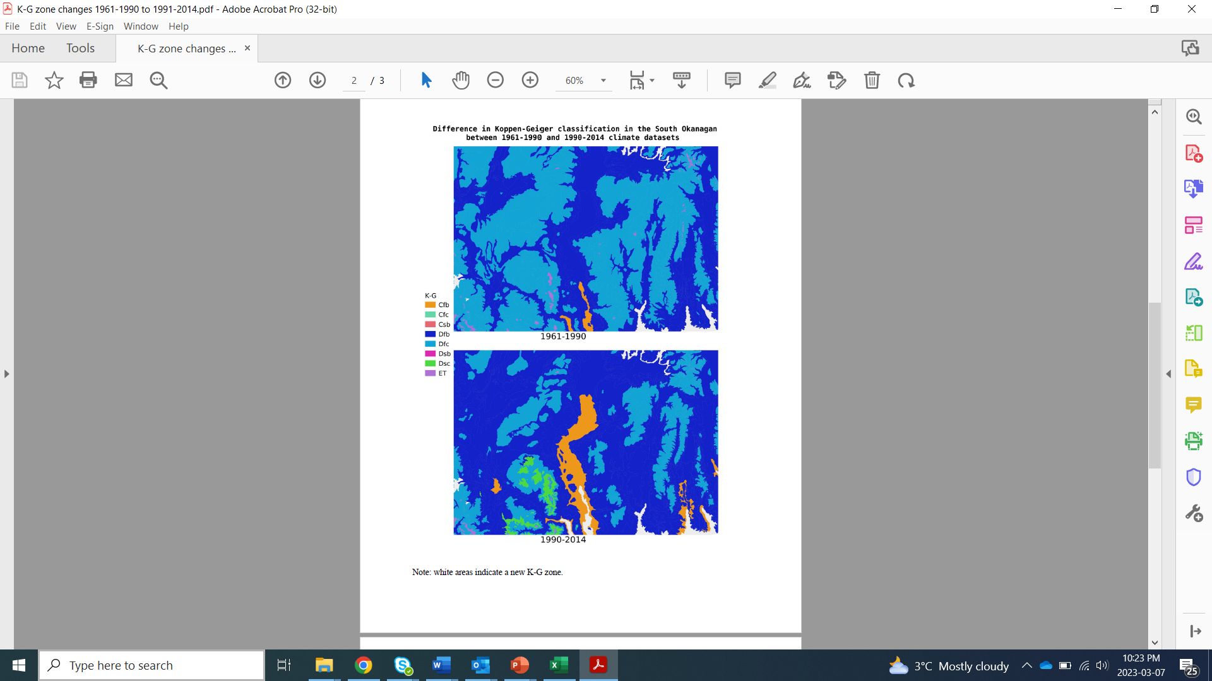
Climate Change
Difference in Koppen-Geiger Classification data sets 1961-1990 to 1990-2014, South OK.
Note: White areas indicate new K-G climate zone.
(Winter 2019/20) K-G Climate Classification System time range shift (1961-1990 to 1991-2014) = 30 noticeable shifts in classification zone extents
(Winter 2020/21) Update to global-BC climate correlation tables = ClimateBC data updated and significant shift in species suitable climate zones in BC

Slide 6
Invasive Species
Climate, Habitat & Site Type Modeling
Project Development (Winter 2021/22)
Goal: To more accurately quantify and prepare for current and potential risks to the province.
Objectives:
  Identify potential species range in B.C. based on climate, habitat and/or site type requirements.
  Select accurate and current global and provincial datasets.
  Identify a robust global climate model platform.
  Model outputs consistent with on-ground observations of subject matter experts
https://www2.gov.bc.ca/gov/content/environment/plants-animals-ecosystems/invasive-species/edrr

Slide 7
Invasive Species
Climate, Habitat & Site Type Modeling
Project Development
Methods:
  Critically assessed current and potential datasets.
  Consulted provincial and international climate specialists
  Tested two model approaches for priority invasive plants, animals and insects
    GBIF-WorldClim2-ClimateBC *preferred*
    GBIF-Koppen-Geiger-Gayton Script-BC BEC
Results: 3-tier modeling:
  Climate
  Habitat
  Site Type
https://www2.gov.bc.ca/gov/content/environment/plants-animals-ecosystems/invasive-species/edrr

Slide 8
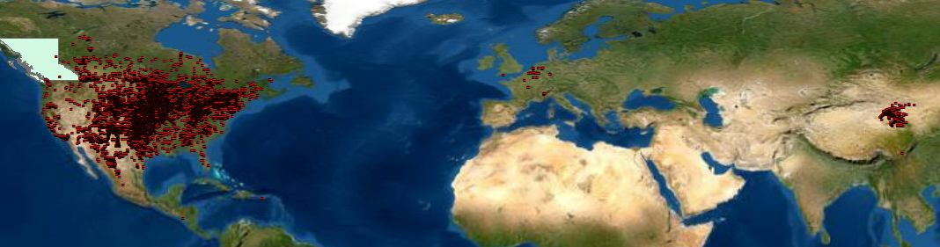
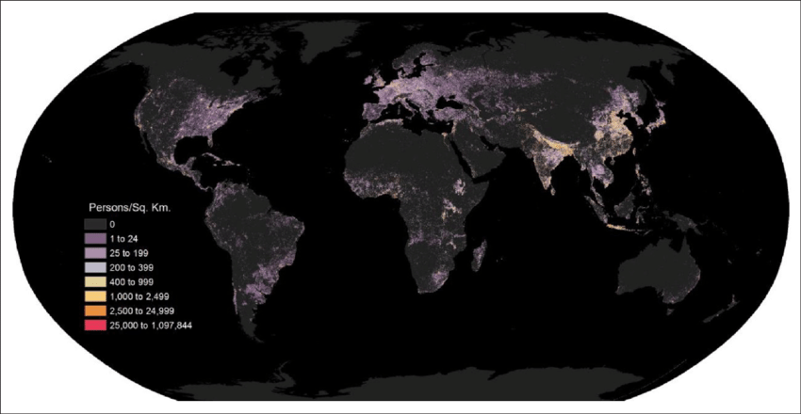
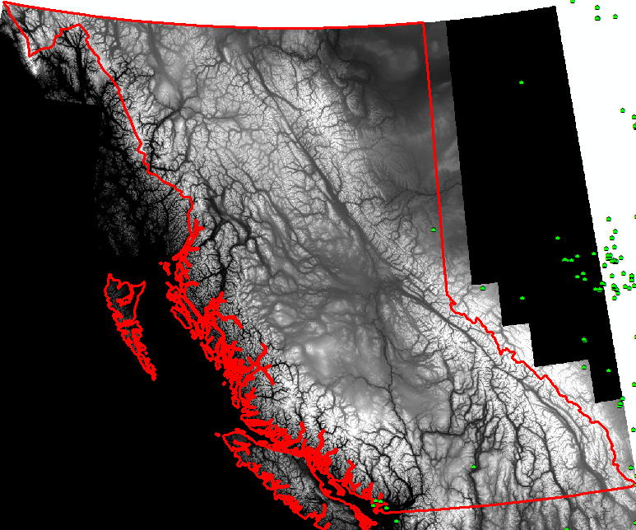
Invasive Species
Tier 1: Climate Modeling Process
1. GBIF known occurrence records for selected species
2. Append WorldClim2 data to BC Digital Elevation Model (high-res) to establish Max/Min climate ranges
Imported data into ArcMap 10.8
WorldClim 1km Res
BC DEM 50m Res

Slide 9
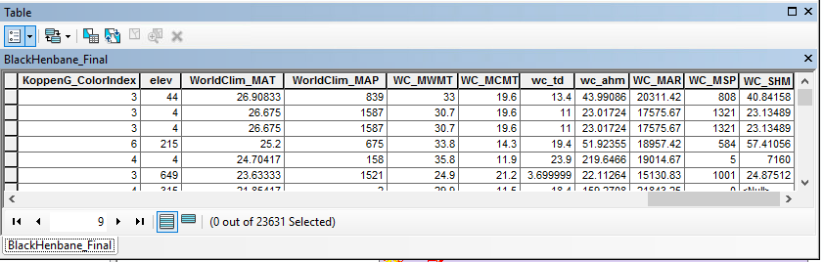

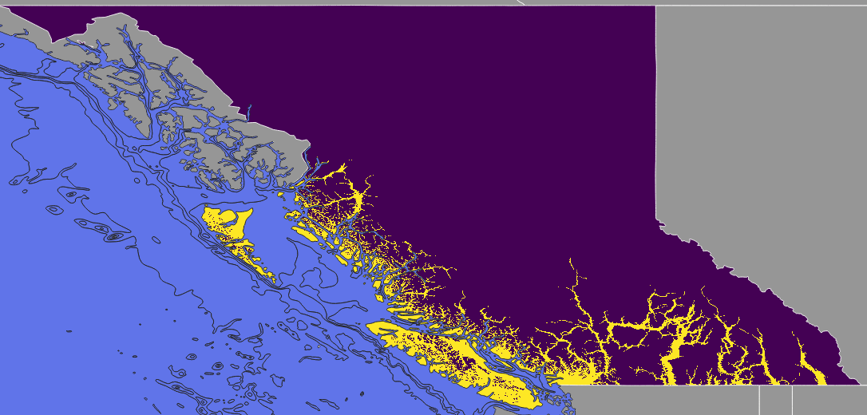
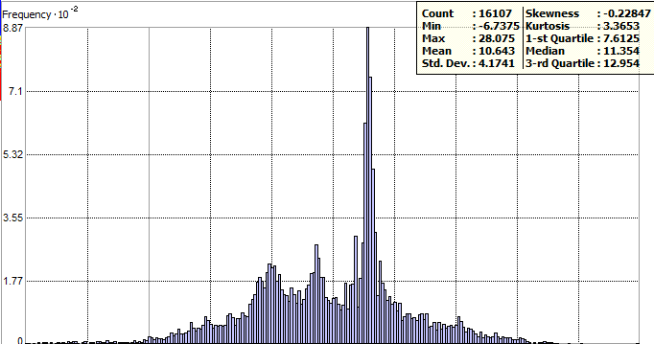
Invasive Species
Tier 1: Climate Modeling Process
3. Append WorldClim2 (1km) & BC DEM (50m) Max/Min climate range data based on location to GBIF known species occurrence records. Complete raster analysis to establish Max/Min high res. (50m) climate ranges in B.C. by species.
4. ArcMap Geostatistical analysis was run to obtain Max/Min climate projections for current, 30’s, 50’s and 90’s.
Example: Mean Annual Temperature Range
Raster Reclass done in QGIS with Grass r.reclass

Slide 10
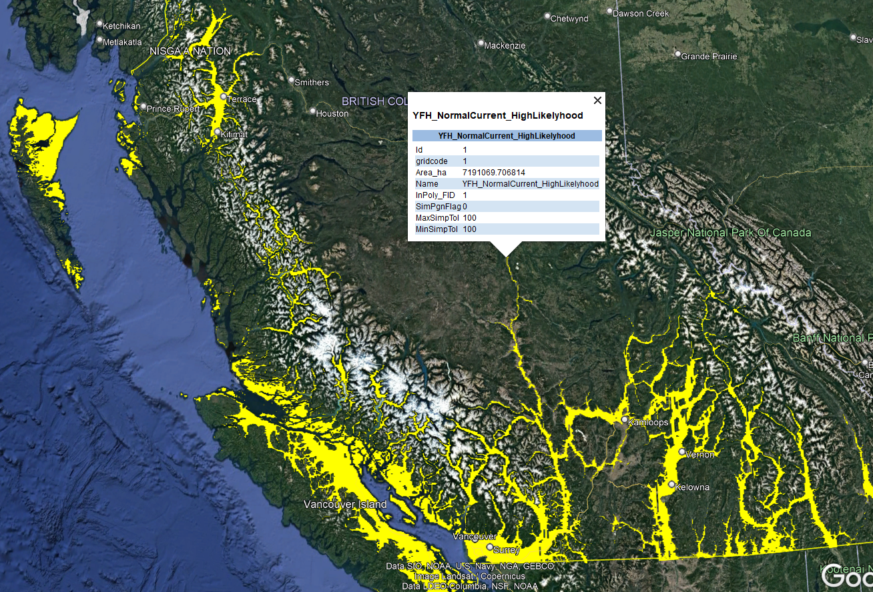
Invasive Species
Tier 1: Climate Modeling Process
Outputs:
10+ climate variables
Equal weight given to each variable
Establish areas of potential range based on known range Max/Min values
Using ‘current’ data of the same range globally then translated to BC
Climate projections for current, 30’s, 50’s and 90’s.
**Targeted Management for Isolated Areas of Concern**
Yellow Floating Heart Current (1971 - 2000) High Risk Areas

Slide 11
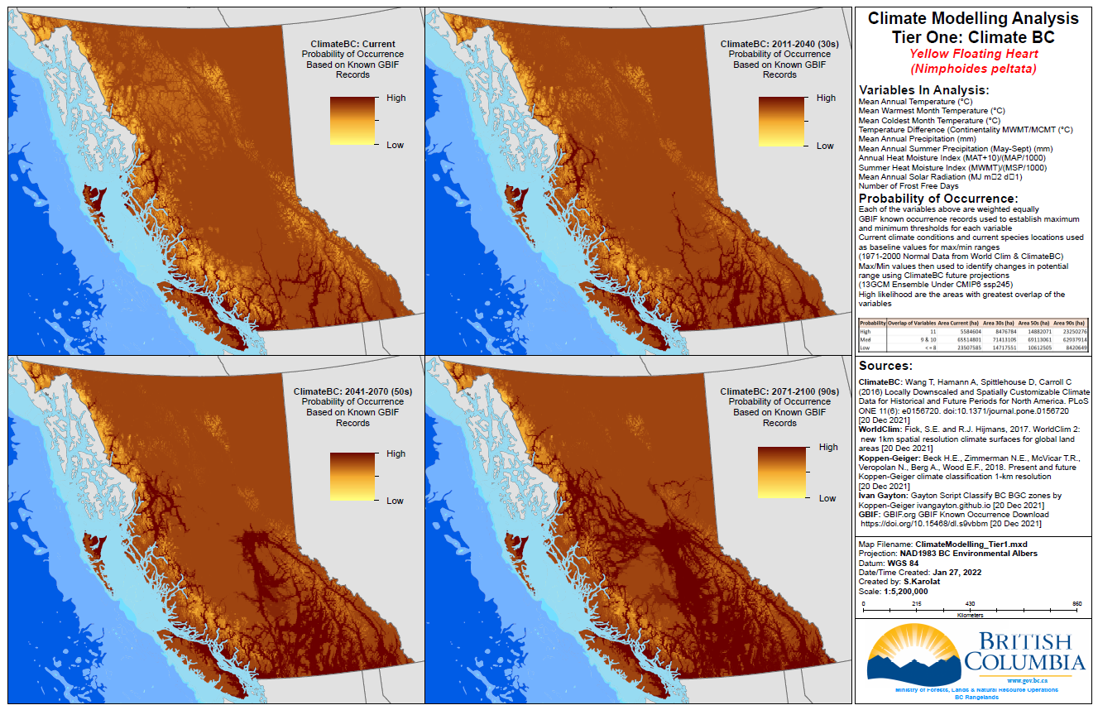
Invasive Species
Current & Predictive Climate Range Modeling
30 Year Projection
Current
50 Year Projection
90 Year Projection

Slide 12
Invasive Species
Current & Predictive Climate Range Modeling
COMPLETED TO DATE
Invasive Plants | Invasive Animals
Black Henbane | Eastern Newt
Cheatgrass | Feral Pig
Common Tansy | Nutria
Eggleaf Spurge | Oriental weather loach
European Common Reed | Quagga Mussels
Flowering Rush | Rosy Red Minnow/Fathead minnow
Garlic Mustard | Zebra Mussels
Giant Hogweed
Marsh Plume Thistle | Invasive Insects
Perennial Pepperweed | Japanese Beetle
Poison Hemlock | Spongy Moth
Shiny Geranium | Spotted Lantern Fly
Spurge Flax
Water Hyacinth
Wild Chervil
Yellow Floating Heart
26 species climate range models based on 10+ climate variables for current, 2011-2040, 2041-2070, and 2071-2100
Raster based suitability analysis using climate variables & future projections
Current & predicted range incorporated into all risk assessments and species prioritization decision making

Slide 13
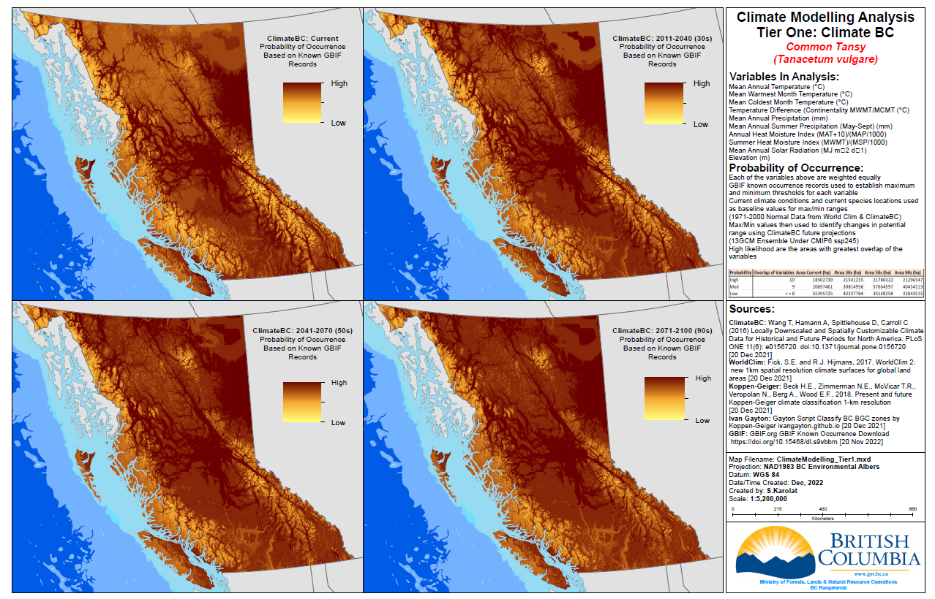
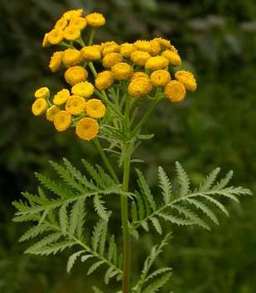
Using
the Models
30 Year Projection
Current
50 Year Projection
90 Year Projection

Slide 14

Invasive Species
Tier 2: Current & Predictive Habitat Modeling
Habitat modeling will further increase species range map accuracy
  Climatic requirements
  +
  2. Growth limiting factors:
Right Management → Right Place!
Terrestrial vs aquatic
Water depth, temp. pH, salinity
Soil type, pH, nutrients
Canopy cover
Aspect
Latitude
Elevation
Getty Images

Slide 15
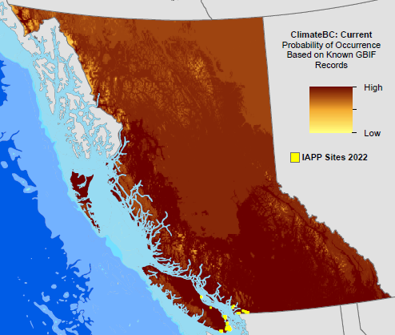
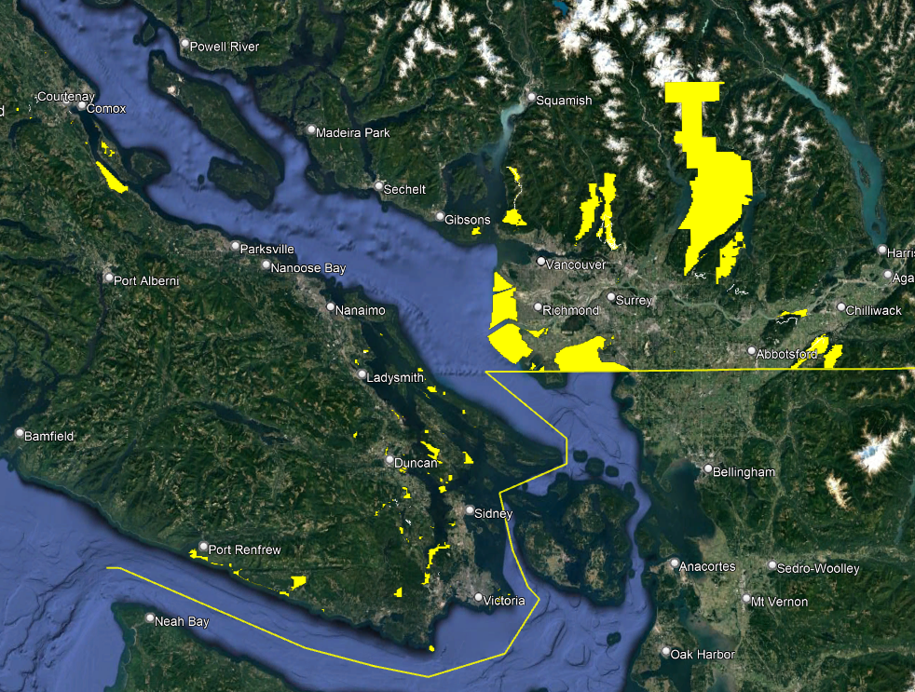
Invasive Species
Tier 3: Site Type Modeling for Targeted Surveillance
Site type modeling makes priority setting easier
Species-Specific Climate Modeling
Shiny geranium
High-Risk Site Type Modeling
https://www2.gov.bc.ca/gov/content/environment/plants-animals-ecosystems/invasive-species/edrr

Slide 16
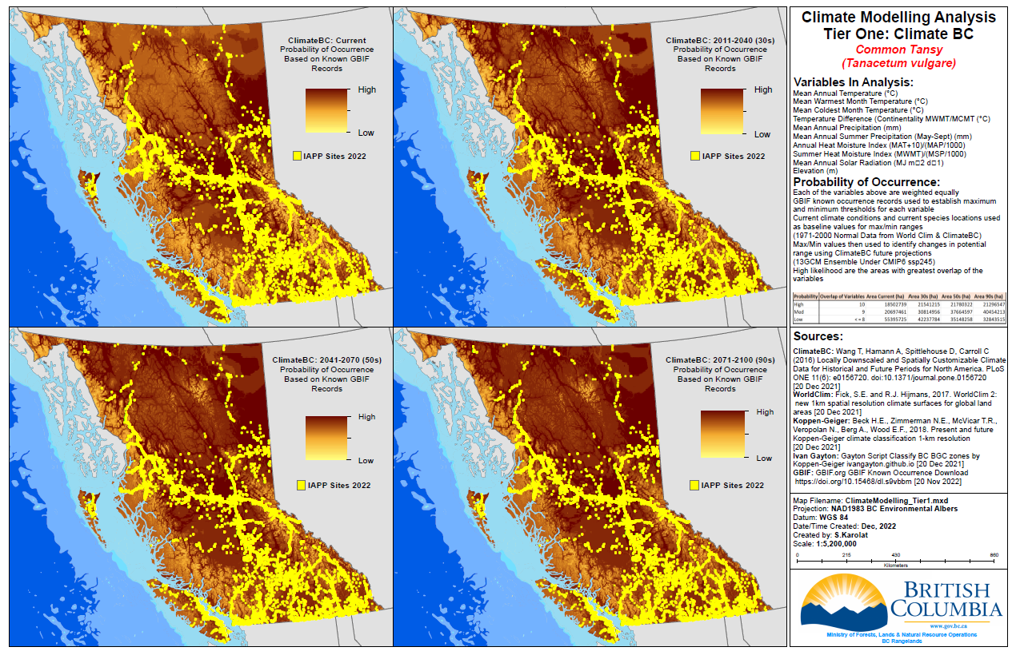
Using
the Models
*Species Occurrence Data
*Identifying Opportunity
30 Year Projection
Current
50 Year Projection
90 Year Projection
Common tansy

Slide 17
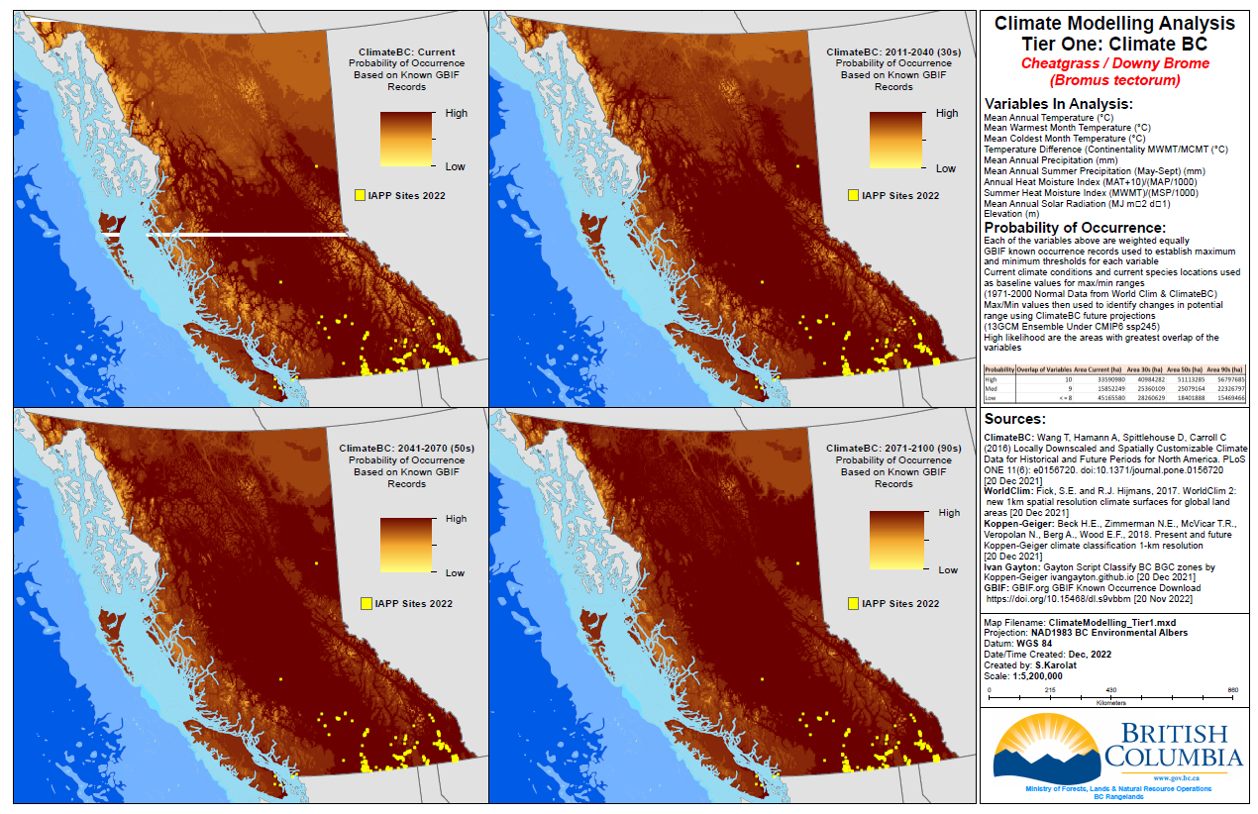

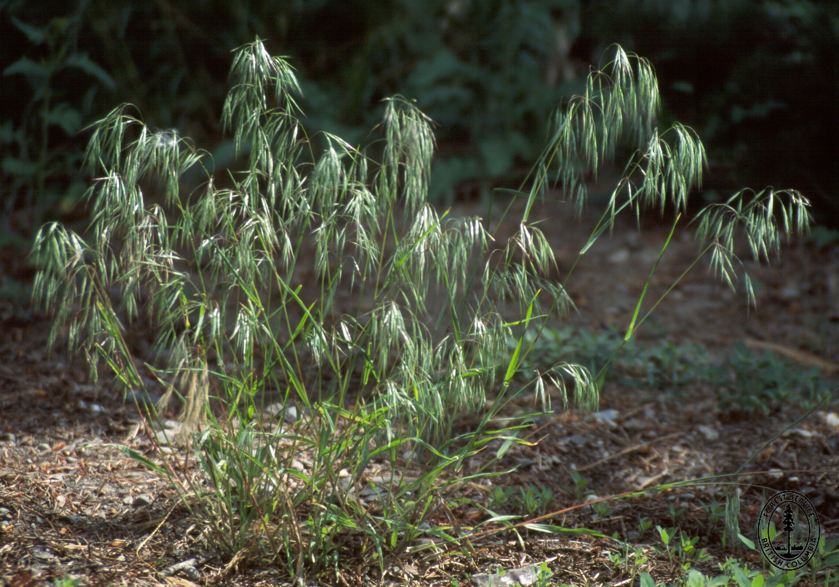
Climate Change Adaptation & Predictive Mapping
Cheatgrass
30 Year Projection
Current
50 Year Projection
90 Year Projection

Slide 18
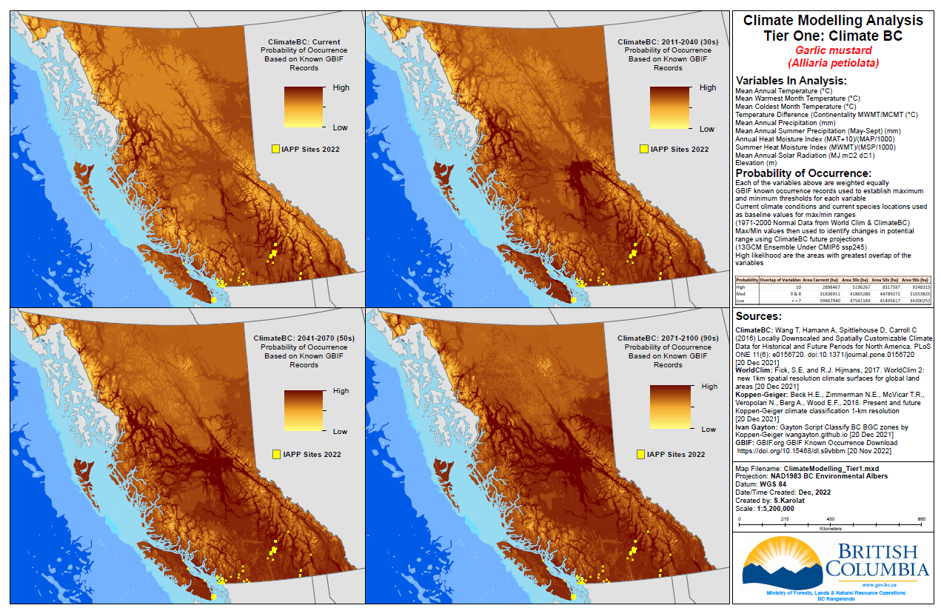
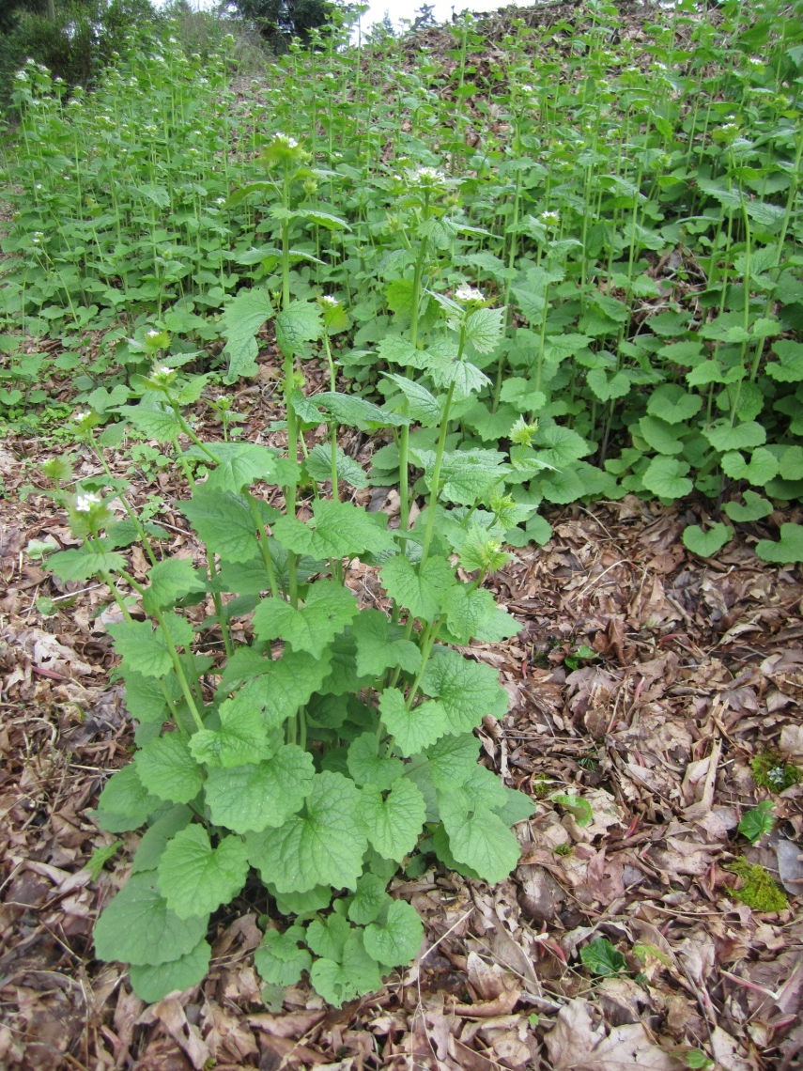
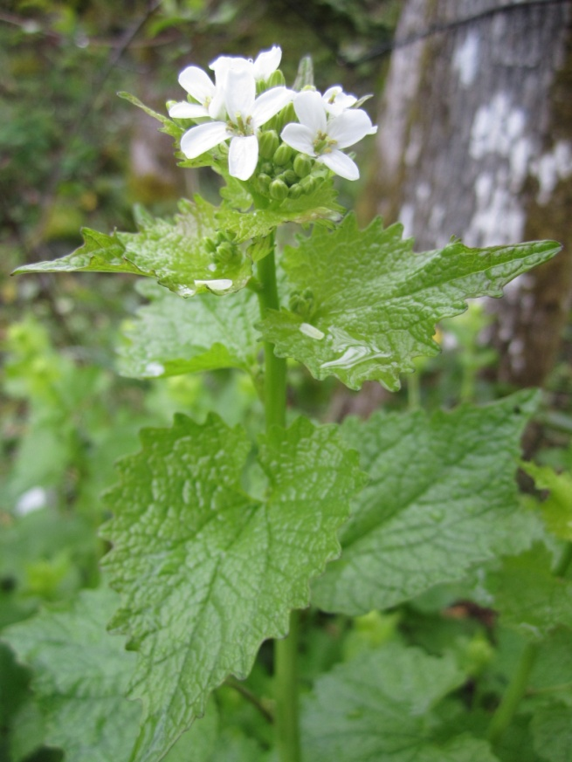
Climate Change Adaptation & Predictive Mapping
Garlic Mustard
30 Year Projection
Current
50 Year Projection
90 Year Projection

Slide 19
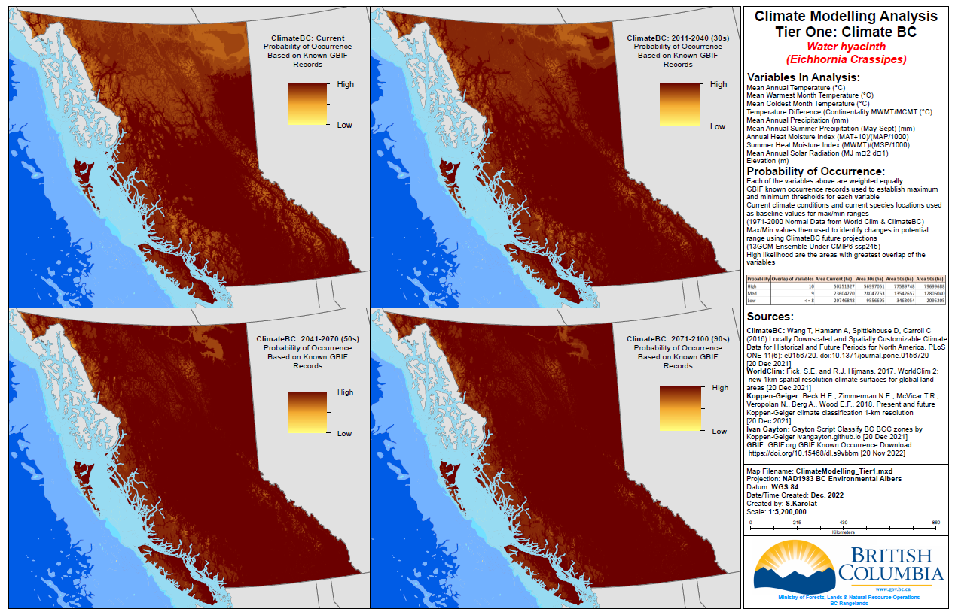
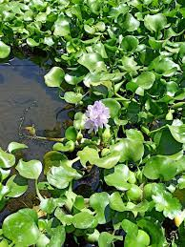
Climate Change Adaptation & Predictive Mapping
Water hyacinth
*Aquatic plant
*Habitat modeling important = accurate range & risk projection
30 Year Projection
Current
50 Year Projection
90 Year Projection

Slide 20
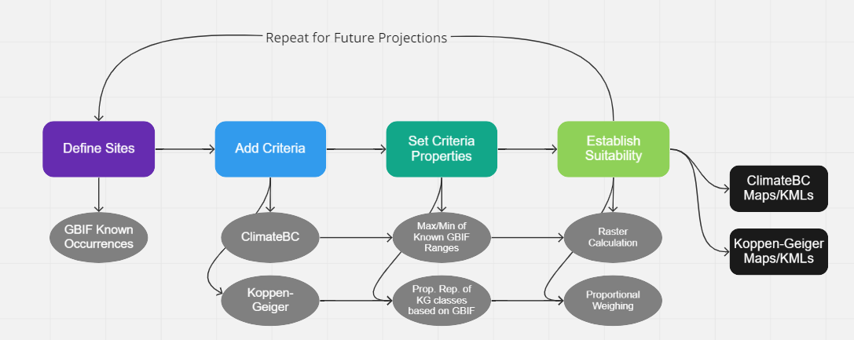
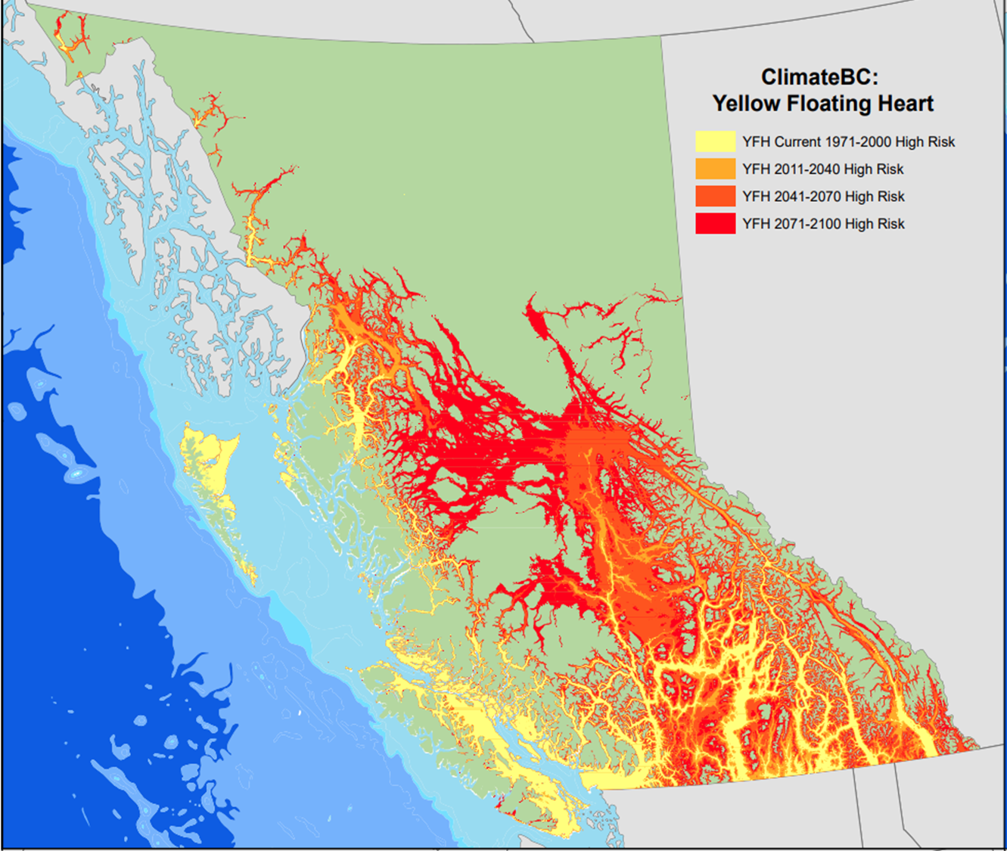
Invasive Species – Current & Predictive Climate Change Modeling
Conclusion
Two climate modeling approaches explored:
  GBIF-WorldClim2-ClimateBC
  GBIF-Koppen-Geiger-Gayton Script-BC BEC
Purpose
  Accurately map current and future potential range of high-risk invasive species that are present or absent with a high likelihood of introduction in B.C.
Rationale
  Changing climate requires the use of time projected climate data to accurately predict potential ranges for invasive species in B.C.
Suitability Analysis Workflow
Next Steps
  Tier 1 More Climate Modeling
  Tier 2 Habitat Modeling
  Tier 3 More Site Type Modeling

Slide 21
Current & Predictive Climate Range Modeling
Why?

Slide 22
Thank you!
Becky Brown, P.Ag.
Invasive Plant Specialist – Provincial EDRR Coordinator
B.C. Ministry of Forests
Becky.N.Brown@gov.bc.ca
250-739-8206

