Slide 1
Integrated Pest Management Program
Turning the Page and Starting the Next Chapter
Jon Mullan, P.Ag., M.P.M.
Pesticides Officer – Large Industry Specialist
Ministry of Environment
Industrial Vegetation Management Association
November 10, 2016

Slide 2
Outline
Better Communication: clear & consistent routes
Key Messages: issues & updates
Avoiding the Potholes: lessons learned from 2016 PMPs
Changing landscape: FN consultation & protocol agreements
What’s coming down the pipe: IPMP work plan

Slide 3

Improving Communications
Information Management Act
Call out for your email addresses!
New IPM Program email boxes
New Victoria physical address (coming soon)

Slide 4

Improving Communications
Information Management Act (May 2015)
Requires government organizations to adopt:
  digital records creation
  information management practices
  Shift from paper to digital
  2-3 year timeline but we are starting now

Slide 5
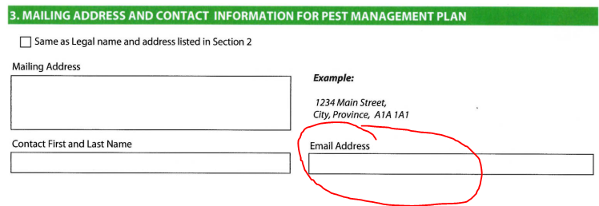

Improving Communications
Please provide your email address! (and keep it current)

Slide 6

Improving Communications
On Hold
New email boxes:
Report Submission = IPMReporting@gov.bc.ca
  Notices of Intent to Treat (NIT)
  Annual Use Submissions (AUS)
  Complaints = IPMComplaints@gov.bc.ca
  Includes self-reporting
  Risk based response

Slide 7

Improving Communications
New Victoria physical address coming soon:
ENV offices moving into one building
Capital Park = behind the legislature
Anticipated Summer/Fall 2017
Mailing address update will be sent out

Slide 8
IPMP Messages
Annual Use Summaries
  PFZs and permits
Stem injection of knotweed with glyphosate

Slide 9

Annual Use Summaries
Increased focus on data management & analysis
January 31 is the deadline!
IPMReporting@gov
  Good time to confirm a.i.s in PMP
  Will be stopping annual reminders!

Slide 10
Pesticide Free Zones & Pesticide Use Permits (PUP)
Lots of interest with PFZ reduction
IPMR S.18(3) allows for exemption to requirements (e.g., PFZ)
Can request any pesticide, any application method, any buffer
PUP requires $1000 plus consultation; max. 3 years
PUP is a statutory decision & conditions can be appealed
Guidance document to understand process coming soon

Slide 11
Stem Injection of Knotweed with Glyphosate
IPMP received request for label interpretation (end of 2014)
Response - application method not on label
Clarified not compliant & PMRA HQ confirmed
Engaged in discussions with proponents & manufacturers
Understand there is interest in label amendment within 1-2 years
IPM Regulation does not restrict this application if on label
IPMP supports selective application of pesticides

Slide 12
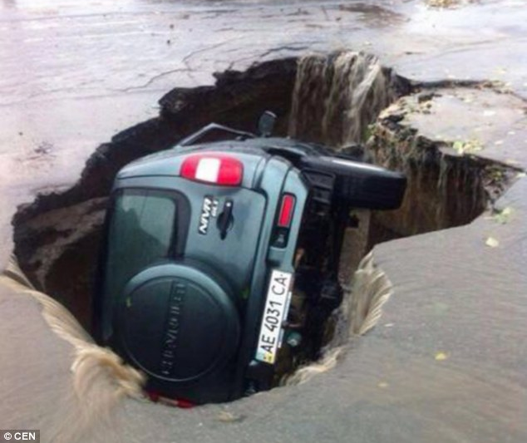
PMP Issues in 2016
Coming up on 12th anniversary (IPMR)
3rd go around for many of you
Increasing government attention in registration process
Issues:
  Process
  Submission

Slide 13


PMP Issues in 2016
Process:
FN consultation
Submission:
FN consultation summary
PMP
  Wildlife protection
  IPM Adoption
Explanatory Notes

Slide 14

FN Consultation & Protocol Agreements
SEAs
Protocol agreements
Tools
Must dos
Tips
NITs

Slide 15
Strategic Engagement Agreements (SEAs)
New agreements with FNs are being developed (current=7)
Establishes new procedures on how to engage
Supersede draft FN Consultation Guidelines
  MUST follow
May include new requirements on:
  timing
  process
  notifications (NITs)

Slide 16
FN Protocol Agreements
New kid on the block
Various names:
  “protocol agreement”,
  “new relationship & reconciliation agreement (NRRA)”, etc.
Mandatory
Usual structure by authorization type and sector-specific activity

Slide 17
FN Consultation - Tools
Draft Guidelines for Consulting with First Nations
  updated version coming soon (avail on IPMP website)
  sets standard, can be different but not lower*
CAD Public Map Service (http://maps.gov.bc.ca/ess/sv/cadb/)
  identify which FNs have overlapping asserted territory with PMP
MARR`s First Nations Negotiations website
  www2.gov.bc.ca/gov/content/environment/natural-resource-stewardship/consulting-with-first-nations/first-nations-negotiations

Slide 18
FN Consultation – “Must Dos”
Every time you are registering a PMP, you must:
confirm overlap with PMP boundaries & asserted\proven territory
check for agreements in place
  don't assume - may have changed
  several in development
ensure FNs have a response
summarize detailed communication log

Slide 19
FN Consultation – Tips
Ensure access to information
Clarify scope
  not discussing PMRA`s decision to register the pesticide or general use of pesticides
Request site-specific concern if possible
  if not available, attempt to build solution into PMP standards
Connect concern to asserted\proven right

Slide 20
FN Consultation – NITs
Deferred PMP consultation
  different from NIT as notification only!
  only occur if FN requests site specific /timing related info
  attempt to handle concerns within PMP to avoid need
  shared decision - not unilaterally imposed by proponent
  If necessary, must meet IPMR AND provide necessary info to FN
  timelines for NIT consultation either draft guidelines or SEAs/etc

Slide 21

What will the IPMP be working on?
Planned:
Data management & analysis
  AUS submission verification
  sales & use data
  a.i. risk ranking
PMP assessment (e.g., IPM adoption)
Explanatory Notes Phase 2
Policy prioritization
Schedule 2 review

Slide 22

What will the IPMP be working on?
Regional Operations Update:
Verifying compliance with PFZ requirements on industrial ROWs
Manny Mariotto (PG) leading
No significant noncompliance in 2016
Work to continue into 2017

Slide 23

For More Information:
Jon Mullan (Victoria)
Jonathan.Mullan@gov.bc.ca
(250) 387-9416
Explanatory Notes available on website.
If you want to prosper for a year, grow rice.
If you want to prosper for a decade, plant trees.
If you want to prosper for a century, grow people.

