Slide 1
Current Challenges & What’s New in VM
IVMA BC – Nov 7, 2023

Slide 2
Overview
Veseris Overview
Markets
Kochia – The Challenge
NEW Trico Repellent

Slide 3
Veseris means impact. for your business | for your team | for you
Established as standalone business in 2020, divested by Univar Solutions.
Owned by AEA Investments, a business building private equity firm.
Headquartered in Austin TX with operations in USA, Canada, Mexico.
Distribution company offering value added services to professional clients.
Leader in pest management market segments, growth focused.
Notes:
Growth focused, fuel for business.
Ways we grow: New customers, product lines, grow your business. Our sales team is here to drive this growth.
M&A is part of our future, platform is built to add on to. Aim will be to add more product lines, expertise and locations.

Slide 4




Our History
2000
Acquired TrueNorth Specialty Products from Midland Vegetation
2005
Range and Pasture Market Expansion
2010
Golf & Greenhouse Markets Expansion
2011
Expand Structural Pest Control Business to Canada.
2013
Change Name to Univar ES and launch ProVMWeb
2017
Amalgamate divisions as one Operation, re-launch Pestweb.ca with ProTraining.
2020
Carved out of Univar and purchased by AEA Investors, become Veseris.
2021
New ERP, Online Store and Corporate Office.
2023
Best is yet to Come.
Notes:
History means nothing other than to give us experiences and lessons to learn from in the future. It is how we apply that in the present, each and every day that matters, that will build our future success together.
We have a long history in the industries we serve together with our customers and supplier partners, and we aim to continue to build success stories together for a long time to come.

Slide 5
One of the largest chemical distributors in North America…
We simply do more to impact their businesses:
More than 10,000 products
from 800 supplier partners
400+ employees and 70+ locations
Coverage across the United States,
Canada, and Mexico
Over 40 years of specialty success
…and an independent partner working to support customers — not to compete with them.
Notes:
Who is Veseris? Simply put, we’re one of the largest specialty chemical distributors in North America. In fact, more businesses make Veseris their distributor of choice than our next four competitors combined. Why? Because, thanks to our commitment to customer success, we support them in ways no one else can.

Slide 6
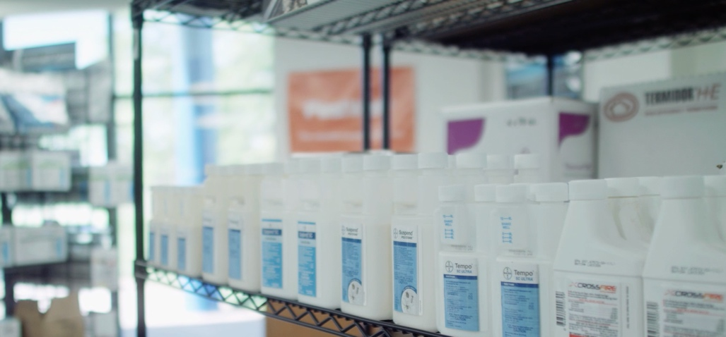
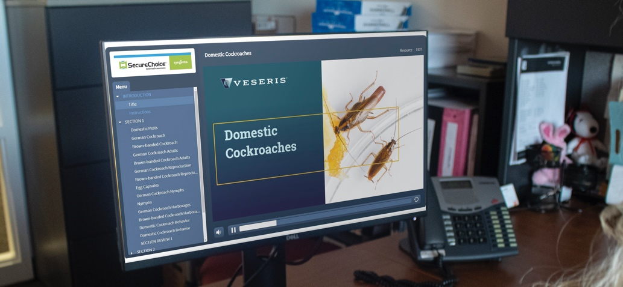
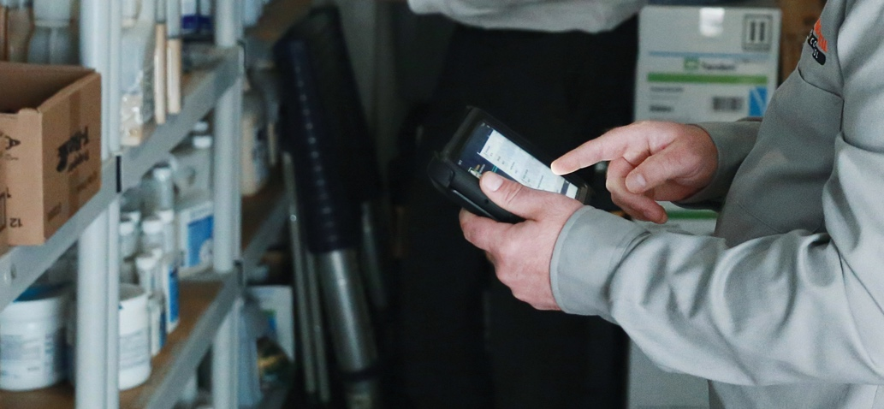
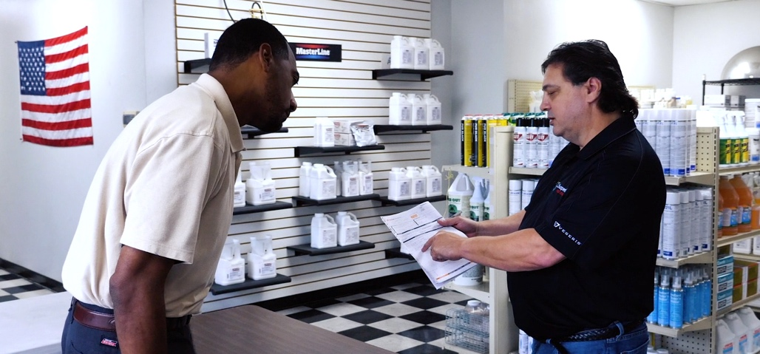
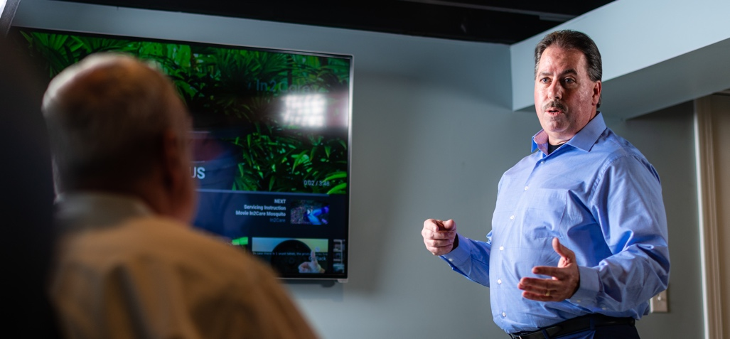
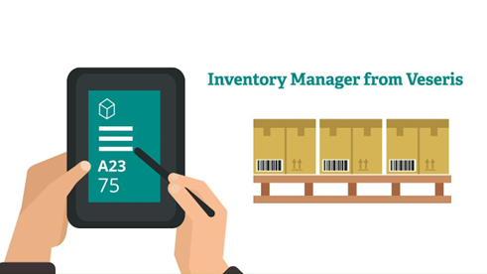
The Veseris Edge
Products
& Logistics
Training &
Education
Technology &
Digital Tools
Far-Reaching,
Local & Independent
Experts &
Strategic Support
Inventory Management

Slide 7
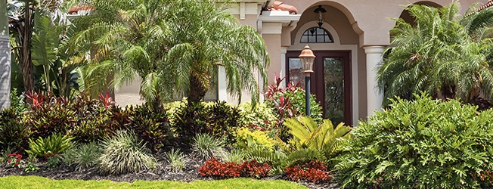

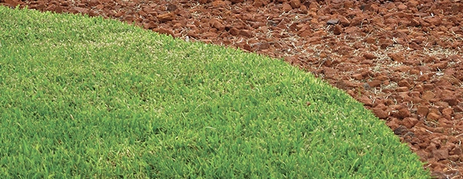
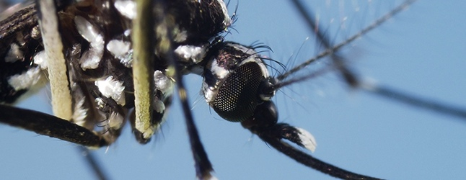
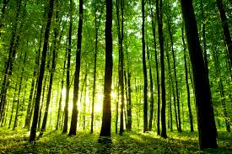
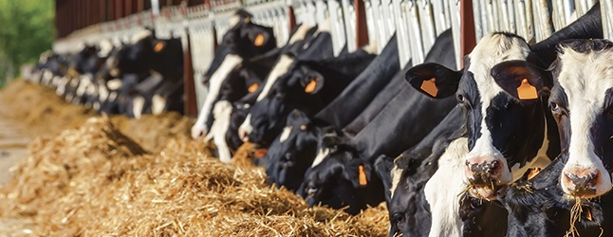


We’ll help you grow into (or across) service areas.
Structural Pest
Wildlife
Turf & Ornamental
Public Health
Forestry
Animal Health
Vegetation Management
Sanitization
Products | Equipment | Supplies | Training | Expertise
Notes:
With more products, equipment, and supplies available, we have the capability to help you grow in your current service area. We can also help you identify, train into, and successfully sell services in any of these eight areas. We bring expertise, support, and professional training to the table that can stand your business up and help you see greater returns and higher customer satisfaction.

Slide 8
Kochia – The Challenge

Slide 9
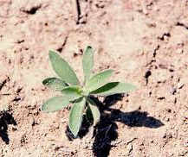
Let’s Talk Kochia or Bassia Scoparia….
Kochia is one of the most prolific weeds in western Canada
Herbicide resistant biotypes of kochia are developing rapidly
It is spreading to non-traditional kochia areas
It requires an integrated approach to management so that we can limit its spread

Slide 10
Common names for Bassia Scoparia
Kochia
Burningbush
Fireweed
Mexican fireweed
Belvedere
Summer cypress
Mock cypress
Common red sage
Poor man’s alfalfa

Slide 11
Biology of Kochia
First weed to emerge in spring
Genetically diverse
Phenotypic plasticity
Up to 100,000 seeds plant
Tumbleweed
Protogynous flowering
High seedbank turnover – longevity in soil 1-2 yrs
Heat, drought, saline tolerant

Slide 12
Morphology
Alternate linear to narrowly ovate-shaped leaves with fringed hairs on margins
  Lime-green to grayish-green color, turning brown at maturity
  About 5-6x longer than wide
Conical shaped plants with many branched stems
  Typically ~1 m high
  Up to 2.25 m high

Slide 13
Rooted for success
Kochia roots typically extend 1.8-2.5 m deep; ~3 times as deep as tall
Lateral roots ~ 10cm below the soil surface extended up to 2.4 m
Kochia without competition has been found with root diameters of 6.7m

Slide 14
Kochia Weediness and Impact
Highly invasive/noxious
May displace desirable vegetation
High forage value when young but can be toxic to livestock & wildlife
Seed valuable for upland game birds

Slide 15
Genetic Diversity
Genetic diversity and morphological characteristics vary widely
Greater diversity within population (90%) than between populations
High genetic diversity is maintained through substantial gene flow, aided by cross pollination and seed dispersal over long distances

Slide 16
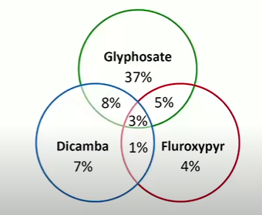
Herbicide Resistance
Resistance found to 4 herbicide families.
  Photosystem II inhibitors, e.g. triazines – Group 5
  ALS inhibitors, e.g. sulfonylureas – Group 2
  EPSPS inhibitors, e.g. glyphosate – Group 9
  Synthetic auxins, e.g. dicamba & fluroxypyr – Group 4
Multiple resistance: 2 or more SOA
2017 studies across kochia populations in AB & SK

Slide 17
What Herbicide options do we have?

Slide 18
Herbicide Options
Sightline
Sightline B – Fluroxypyr
Group 2 & 4
2-8 leaf stage of kochia
0.42L/ha – suppression
0.84L/ha – control
Detail
Saflufenacil – Group 14
Post Emergent Control – 145ml-290ml/ha
Post-emergence and residual pre-emergence control 435 ml/ha
Non-Ionic Surfactant required at 0.5% v/v

Slide 19
Herbicide Options
Octtain XL – Group 4
Fluroxypyr & 2,4-D
1.6 L/ha – suppression up to 50cm tall
3.1L/ha – control up to 50cm tall
Overdrive – Group 4 &19
Diflufenzopyr & Dicamba
285 g/ha
Requires Non-ionic surfactant @ 0.25% v/v
Apply at 15cm or less height

Slide 20
Herbicide Options – Pre-Emergent
Esplanade SC
Indaziflam – Group 29
375 ml/ha
Suppression of Kochia
Pre-emergent application with moisture needed for activation
No contact absorption properties
Torpedo EZ – Group 14 & 15
Flumioxazin & Pyroxasulfone
880ml to 1215ml/ha
Pre-emergent control - thorough cover ground coverage required. Moisture required for activation
Post emergent add a non-ionic surfactant @ 0.25% v.v.
Weeds emerged up to 5cm

Slide 21
What else we can do?
Plan
Develop an IPM Plan with site goals & realistic customer expectations of control
Single application or multiple applications per growing season. Apply at appropriate timing and growing conditions
Monitor
Monitor, treat, monitor
Any plants not controlled, hand pick plants to stop seed re-production and cross pollination of possible resistant biotypes
Rotate
Use herbicide rotation with multiple modes of actions
Rotate herbicide groups during season where possible
Tank mix with different herbicide options
Scout after treatments to ensure control and monitor if any possible resistant plants are present
Use full labelled rates

Slide 22
Two critical components to any successful, vegetation management program are.
Selecting the correct Herbicide(s) and proper rate for your use pattern and target species.
Applying the herbicide prescription with precision, with minimal environmental and applicator impact.

Slide 23
What’s New?

Slide 24

TRICO®
Deer, Elk and Moose Repellent
Protection against Browsing, Rubbing and Debarking

Slide 25
TRICO® PRO is a scent and taste repellent that protects against deer, elk and moose that browse, rub or debark seedlings, trees and shrubs TRICO® provides effective control of deer damage to vulnerable, deer attractive agricultural plants.
The TRICO® brands offer long-lasting protection and are effective in all seasons. A proven track record in Europe has been achieved thanks to the residual repellency, the fact they start working immediately and the dual action provides protection in a range of plants from forestry to vineyards, orchards to field crops.

Slide 26

Discourages browsing damage with dual modes of action as both a smell and taste barrier.
Long lasting protection with a single application (up to 6 month’s).
Suitable for all terrains.
Begins working upon applications while also being water resistant and odorless to humans.
Proven track record. More then 200 million trees are treated annually in Europe.
Only 4 liters is required to treat up to 1000 plants.
Suitable for all trees and provides protection from seedling to maturity.
Residential Label use coming.

Slide 27

Double mode of action
Repels by scent and taste
Ease of use
Ready-to-use product with weather resistant formula
Apply year-round
Get long-lasting protection with a single application. Lasts up to 6 months
Plant Compatibility
For use on all tree species – coniferous and deciduous
Multiple use product
Prevents deer, elk or moose damage in forestry and agriculture

Slide 28
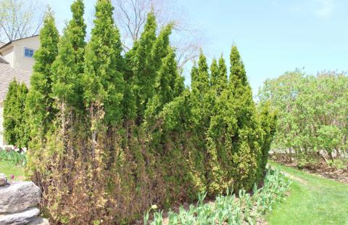
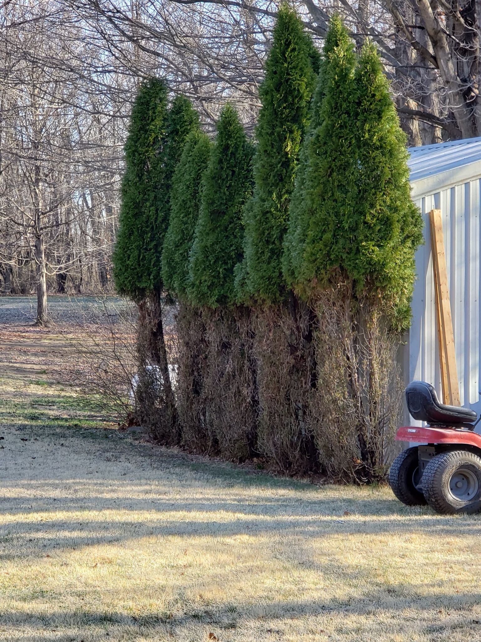
Damage on Tree Farms and Private Property

Slide 29
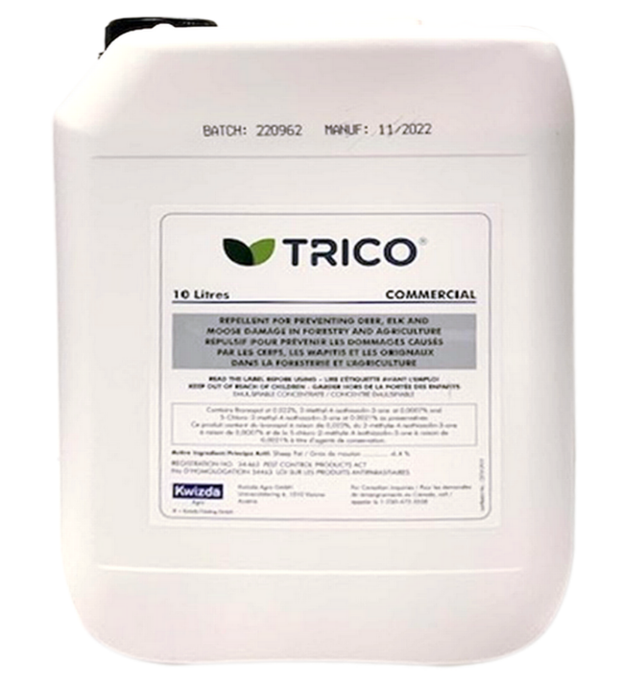

New Tool for Foresters and Growers!
TRICO® is a scent and taste repellent that protects against deer, elk and moose that browse, rub or debark seedlings, trees and shrubs. Offers long-lasting protection and is effective in all seasons.

Slide 30
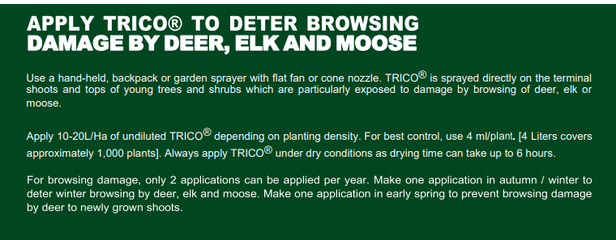
Application Info

Slide 31
Thank you for your time.
Aaron Foster
780-870-1078
aaron.foster@veseris.com
www.PestWeb.ca
www.Veseris.com

