Slide 1




Overview of Continuing Education Credits & New Assistant Applicator Requirements
Rob Au, M.Sc., A.Ag.
Integrated Pest Management Program
Ministry of Environment
IVMA, Prince George, BC
November 10, 2016

Slide 2
Certification Categories
Aerial
Agriculture
Forestry
Fumigation
Industrial Vegetation Management
Landscape
Mosquito Management
Pesticide Dispenser
Structural

Slide 3
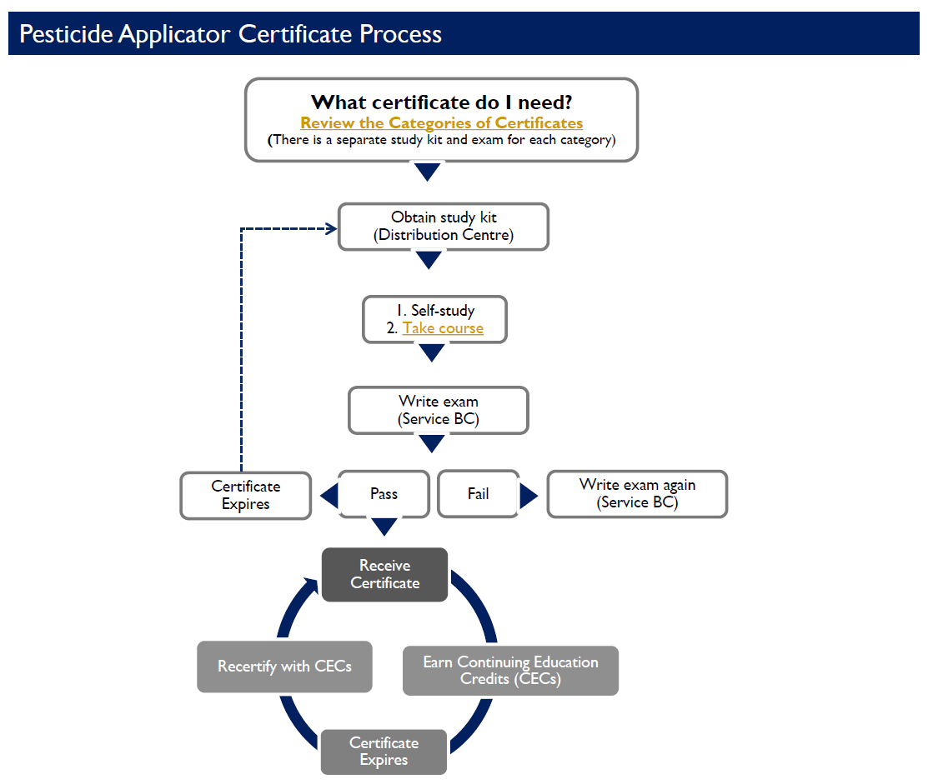

Slide 4

Recertification
A pesticide applicator can recertify by either:
  Rewriting the exam, or
  Collecting 20 continuing education credits (CECs) through an approved association

Slide 5
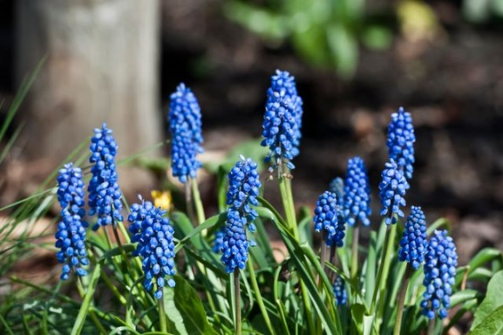
Continuing Education Credits
Industrial Vegetation Management Association tracks CECs
  Sectors covered: Ind. Veg., Forestry, Aerial
  Credit Coordinator: reception@ivma.com

Slide 6
Continuing Education Credits
IVMA
  ensures adequate number of suitable courses
  recommends number of CECs that each course merits
  records credits earned by each member
  requests certificate renewal for members with sufficient credits
Ministry of Environment
  approves courses that meet training requirements
  1 credit = 1 hour of relevant training
  audits training courses
  issues certificates

Slide 7

Continuing Education Credits
A. Integrated Pest Management
pest identification and biology
pest prevention
monitoring methods
action and injury levels
management methods, including pesticide alternatives and decision making
evaluation of results

Slide 8
Continuing Education Credits
B. Safety and Environmental Protection
pesticide labels and label comprehension
legislation
toxicity
emergency response (first aid, spills, fires)
protective clothing and equipment
effects of pesticides on the environment
safe procedures for storage, transport, mixing, application, cleanup and disposal
C. Application Technology
equipment selection
proper equipment set-up, use and maintenance
equipment calibration and pesticide use calculations
pesticide products and factors affecting their use and performance

Slide 9
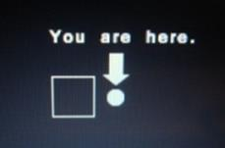
Continuing Education Credits
Courses not recognized for recertification:
  business aspects of farm or pest management
  the mechanics of crop fertilization and irrigation
  production varieties
  storage or marketing of commodities

Slide 10

Assistant Applicator
  IPM Regulation changes came into force July 1, 2016
  A certified applicator can still supervise up to 4 uncertified applicators
  Uncertified applicators now need to complete online training
  Training course is offered free of charge
  Requires about 4 hours
  Course must be completed annually
  Passing the exam results in a statement of completion

Slide 11
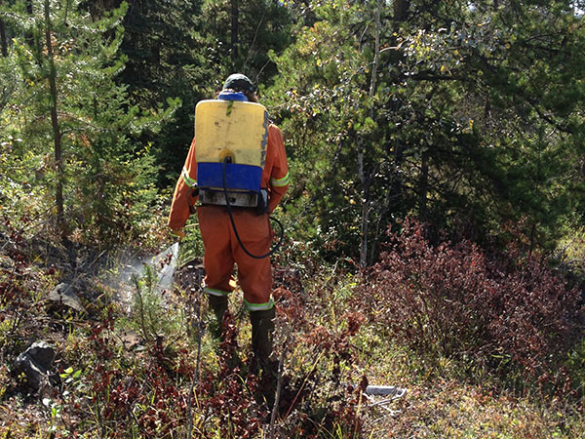
Assistant Applicator
Workers are trained in the safe use of pesticides
Reduced requirements for understanding IPM, pesticide selection and equipment calibration
May perform some, but not all, of the duties of a certified applicator

Slide 12
Restricted Activities for Assistant Applicators
Select the pesticides to be used in a treatment area;
Determine the method or rate of pesticide application in a treatment area;
Determine injury thresholds for pests for the purpose of deciding when to use a pesticide;
Mix pesticide concentrates;
Calibrate pesticide application equipment;
Handle or use fumigants;
Use permit-restricted or restricted class pesticides;
Use pesticides that have a label indicating that the pesticide must be used only by a certificate holder; and
Conduct pre or post-treatment evaluations.

Slide 13
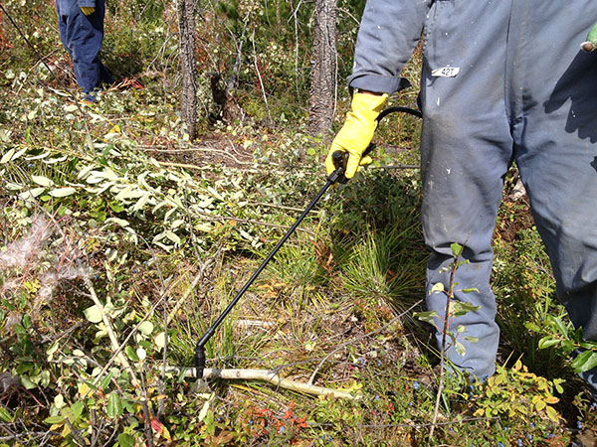
Role of an Assistant Applicator
Applying pesticides to a treatment area under the supervision of a certified pesticide applicator;
Safely transporting pesticides to the work site;
Taking pesticides in and out of storage; and
Ensuring security of mobile, temporary and permanent storage facilities

Slide 14
Supervisors of Assistant Applicators
Must not be more than 500m from each assistant applicator;
Must maintain continuous visual or auditory contact with each assistant applicator;
Must review the record kept by the authorization holder for each assistant applicator; and
Must not permit an assistant applicator to apply a pesticide unless satisfied that the assistant applicator has completed the course required by the Ministry of Environment.

Slide 15
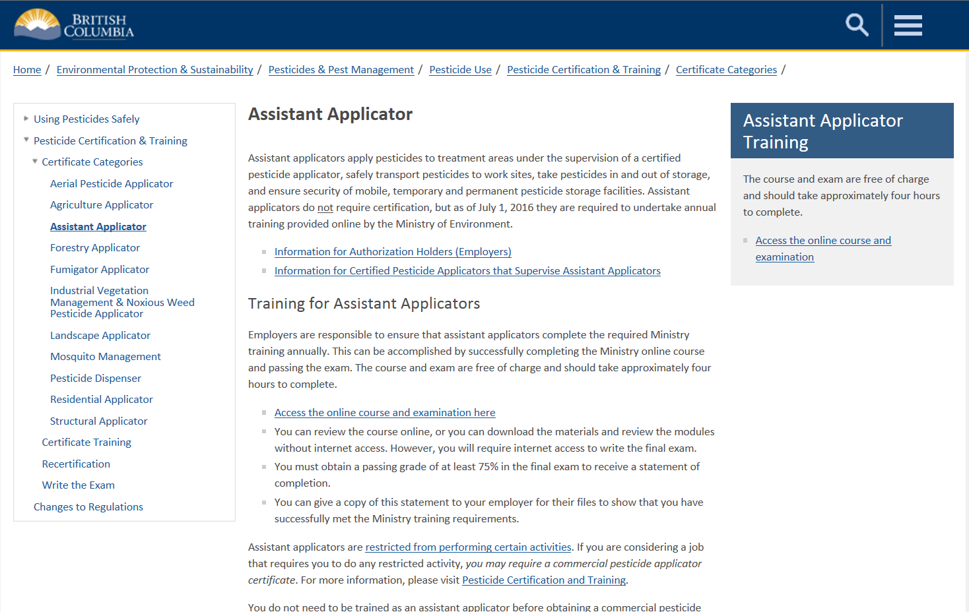
http://mytrainingbc.ca/assistantapplicator/

Slide 16
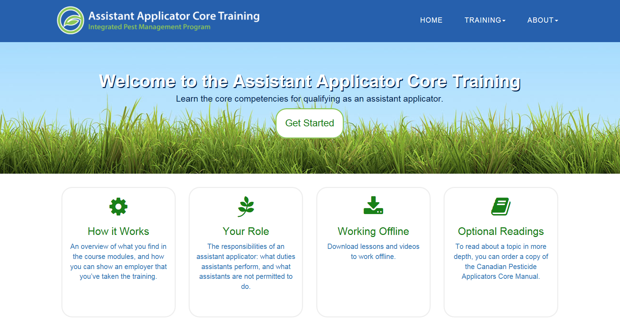

Slide 17
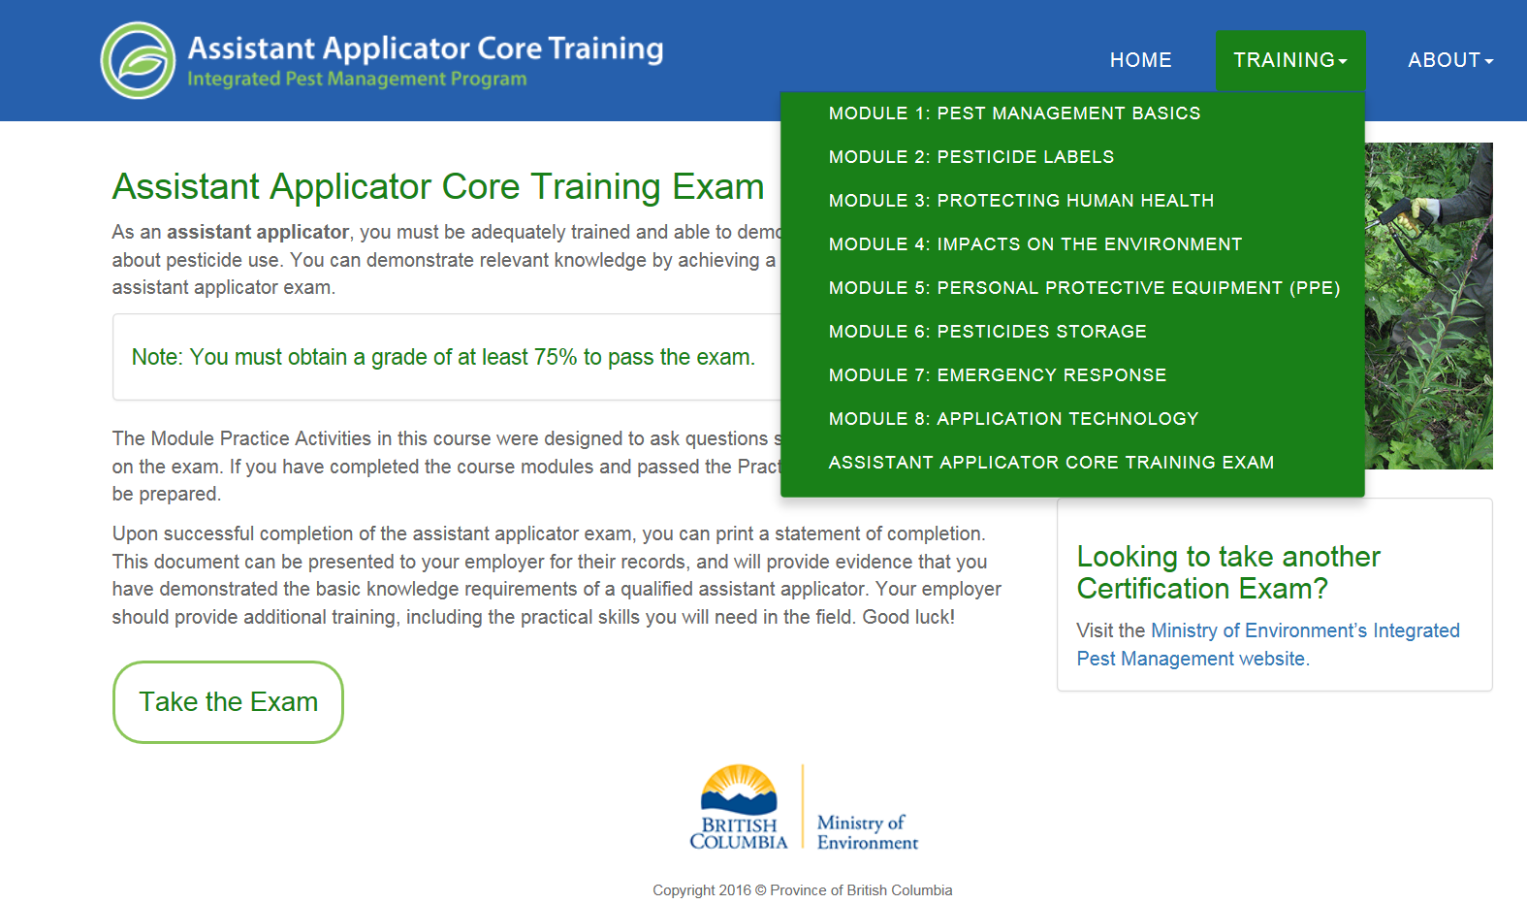

Slide 18
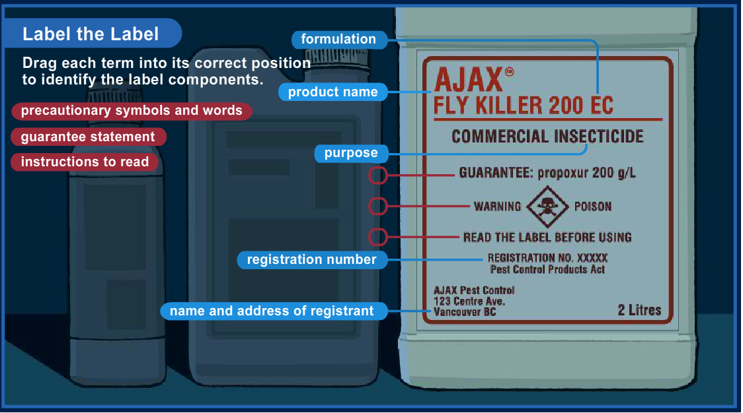
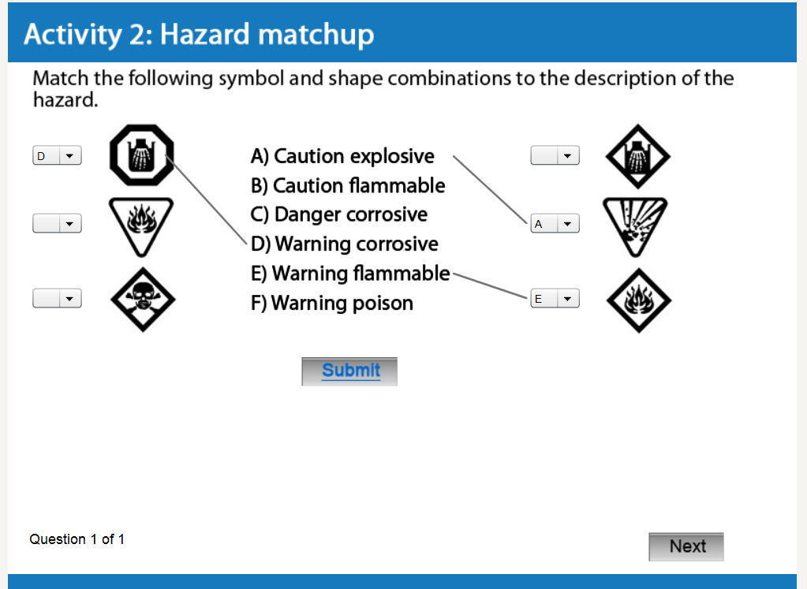
Lesson 2: Pesticide Labels

Slide 19
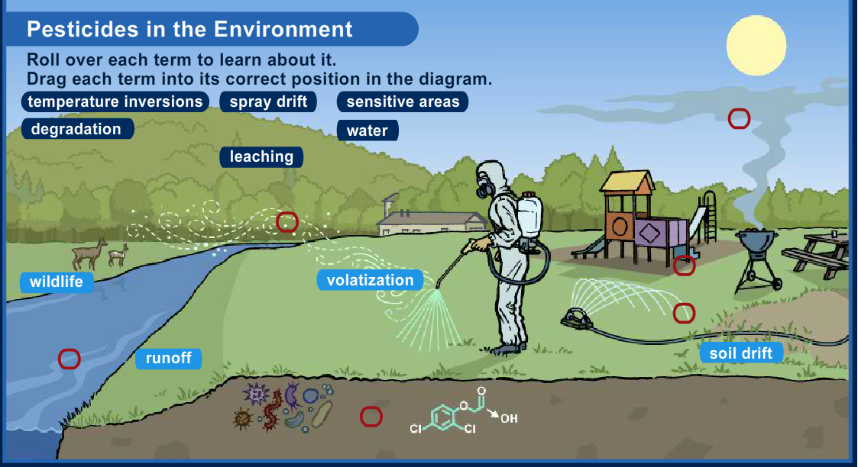
Lesson 4: Impacts to the Environment

Slide 20
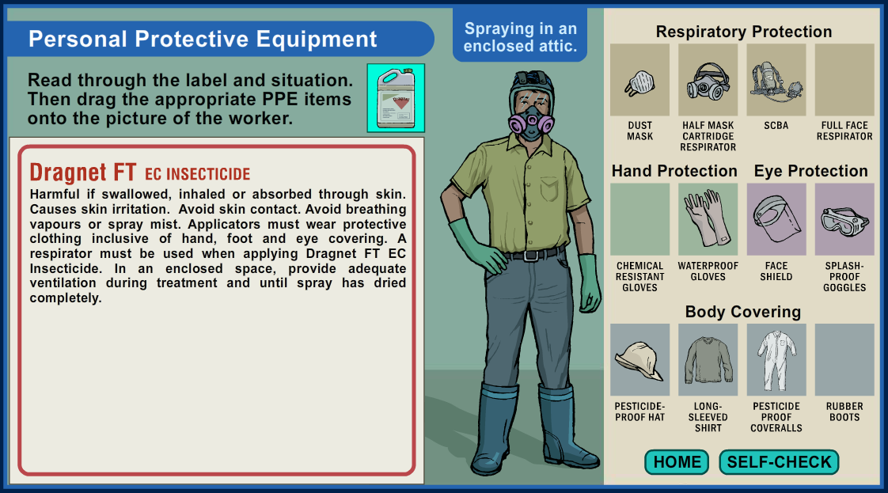
Lesson 5: PPE

Slide 21
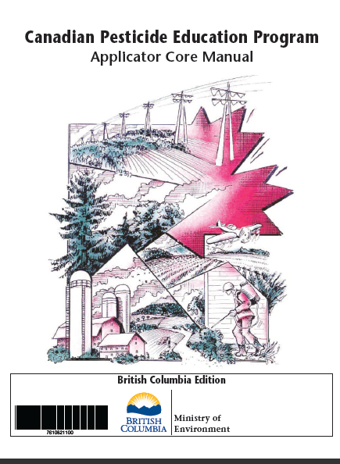
Online Training Resources
Open School BC online training
  www.openschool.bc.ca/info/pesticides/index.html
CORE Manual
Online Course
Assistant Applicator
http://mytrainingbc.ca/assistantapplicator

Slide 22

Questions and Discussion

Slide 23
Contact Information
Rob Au
IPM Licence Officer
250-356-0475
Robert.Au@gov.bc.ca
Ministry of Environment – IPM: www.gov.bc.ca/PestManagement

