Slide 1
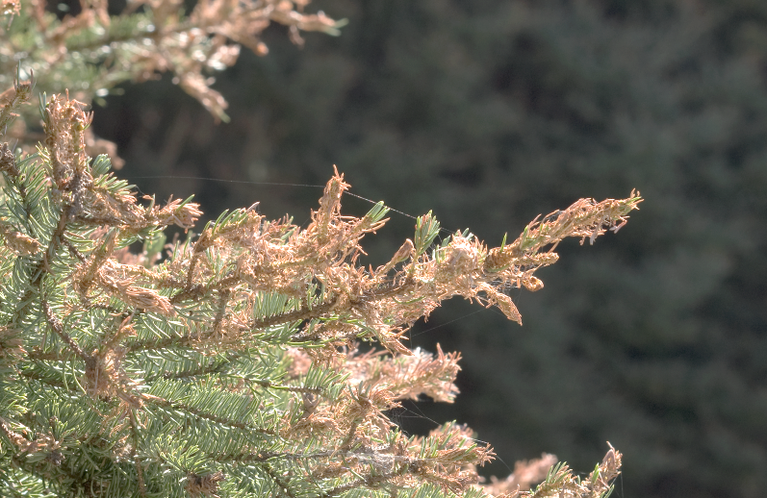
Dry-belt Douglas-fir and Western Spruce Budworm Management in the Cariboo Region
Jodi Axelson
Forest Entomologist
BC Ministry of Forests, Lands and Natural Resource Operations
Cariboo Region

Slide 2
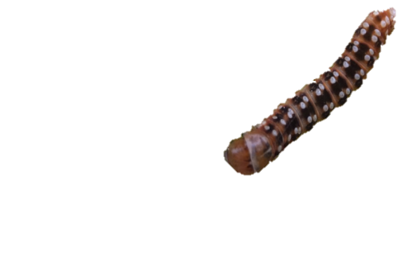
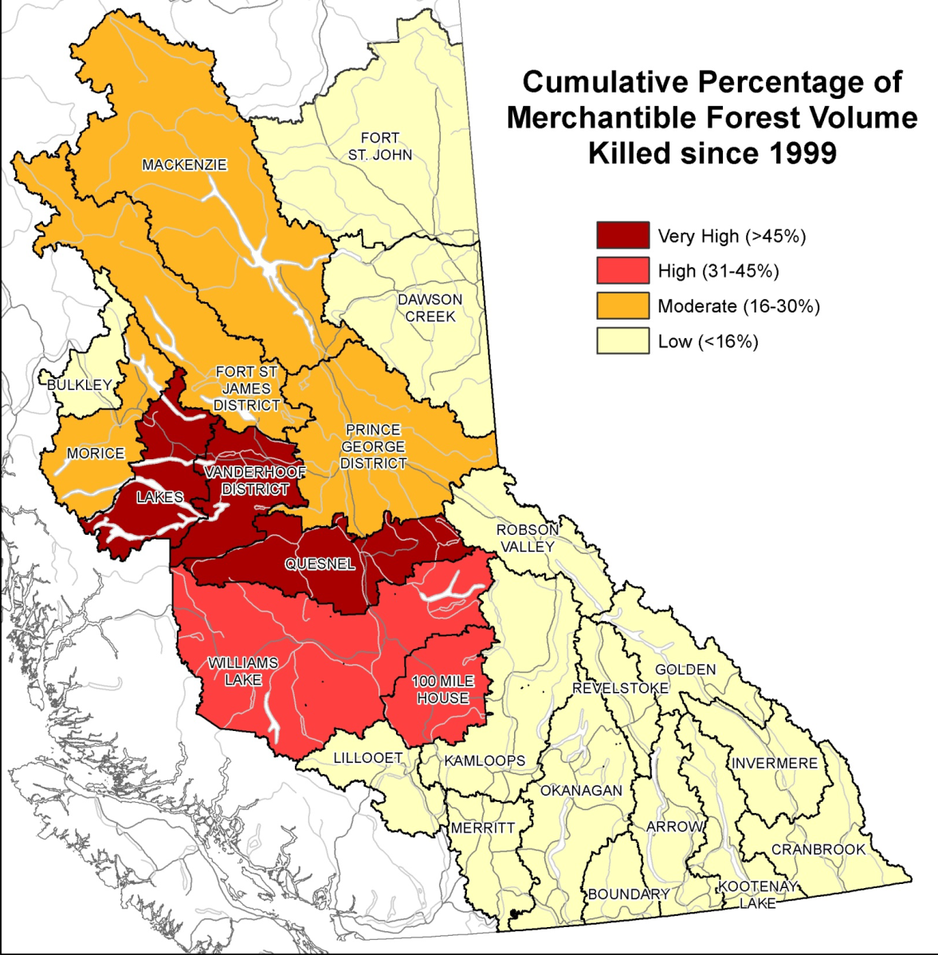
Forest Management in the
Cariboo
In a post-mountain pine beetle world there is renewed emphasis on the management of Douglas-fir for short and mid-term timber supply.
http://www.for.gov.bc.ca/hfp/mountain_pine_beetle/mid-term-timber-supply-project/MPB-Committee-Presentation.pdf

Slide 3
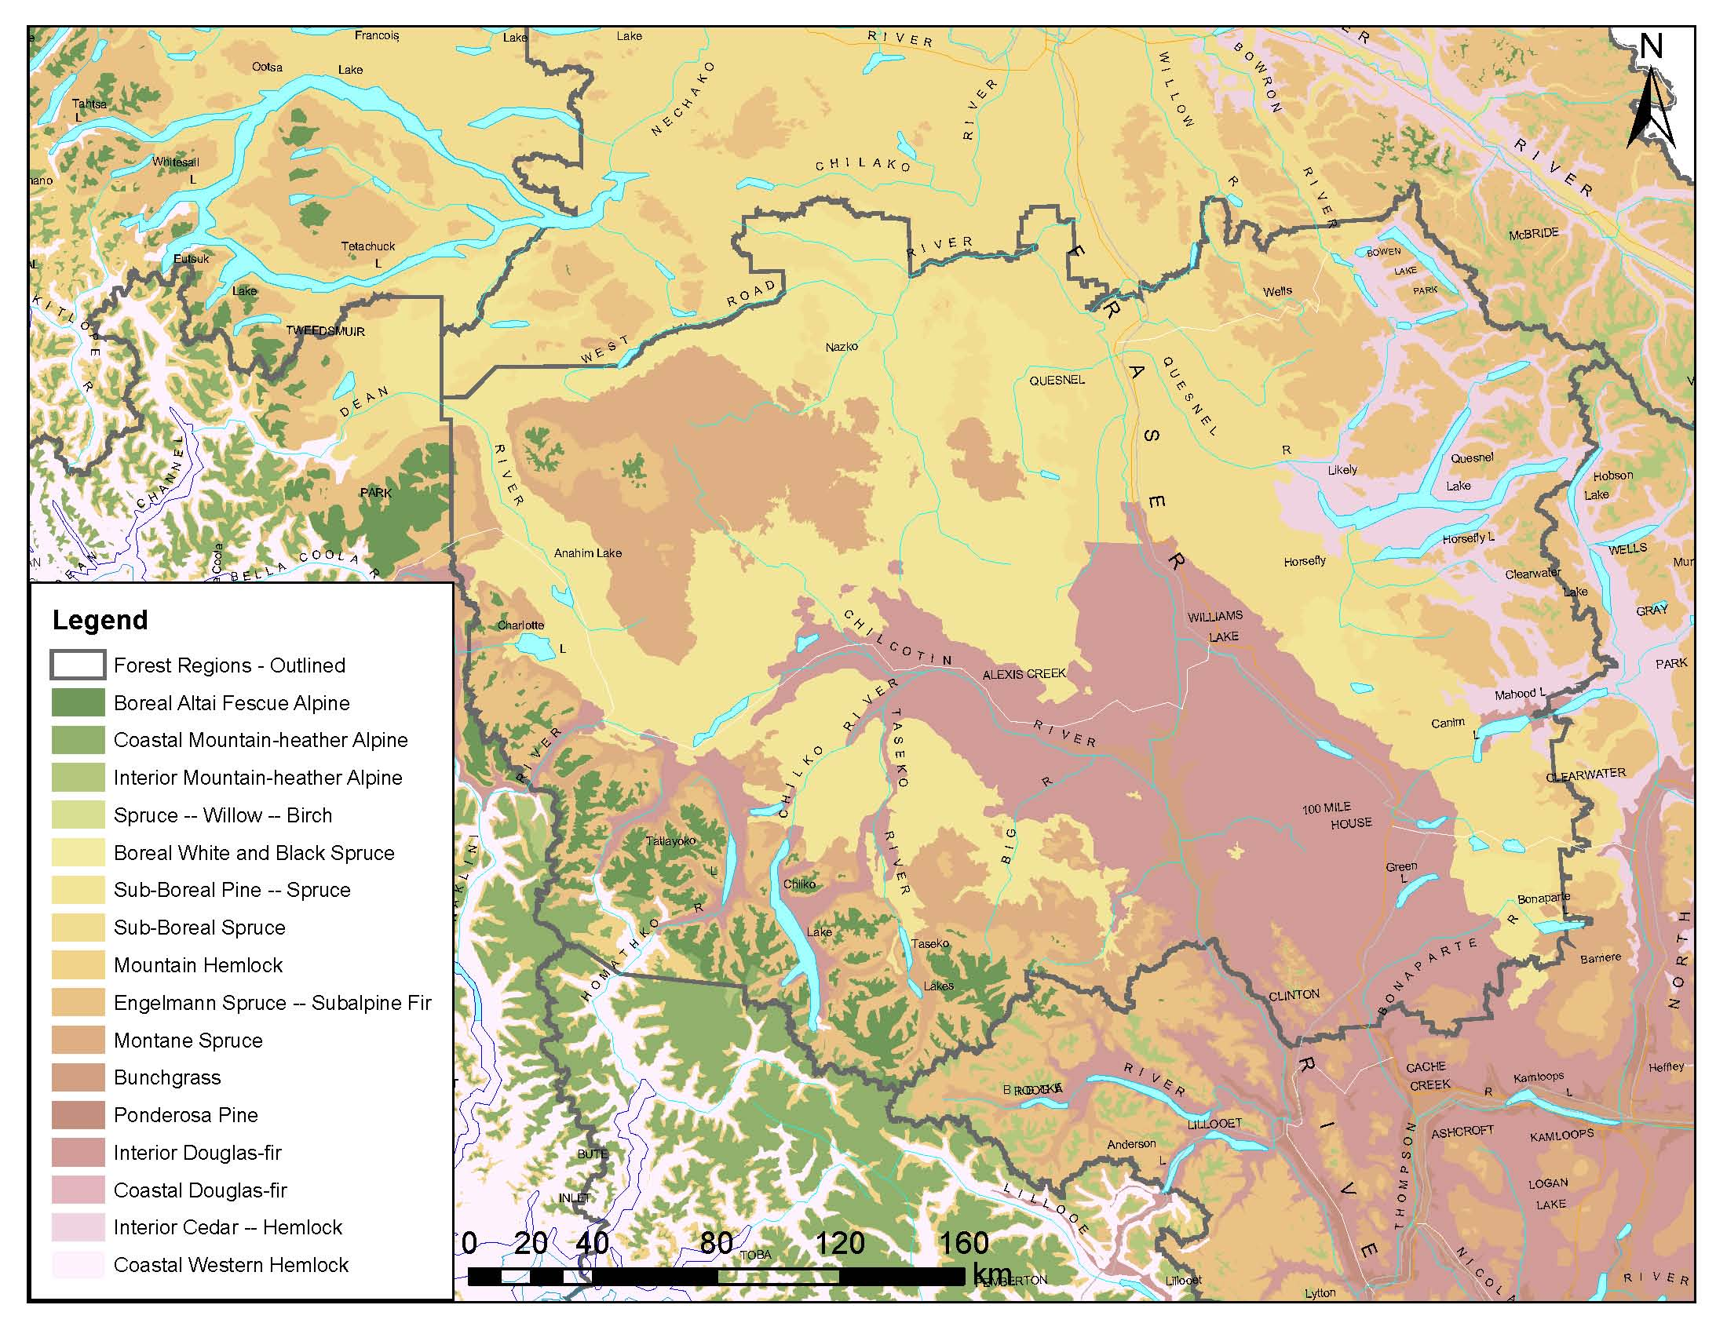
Western Spruce Budworm
45% of Cariboo Region is
Interior Douglas-fir (IDF) BEC Zone
76% of western spruce
budworm defoliation occurs
in the IDF
Notes:
Within the IDF with 2 primary zones – IDFdk3 and IDFxm

Slide 4
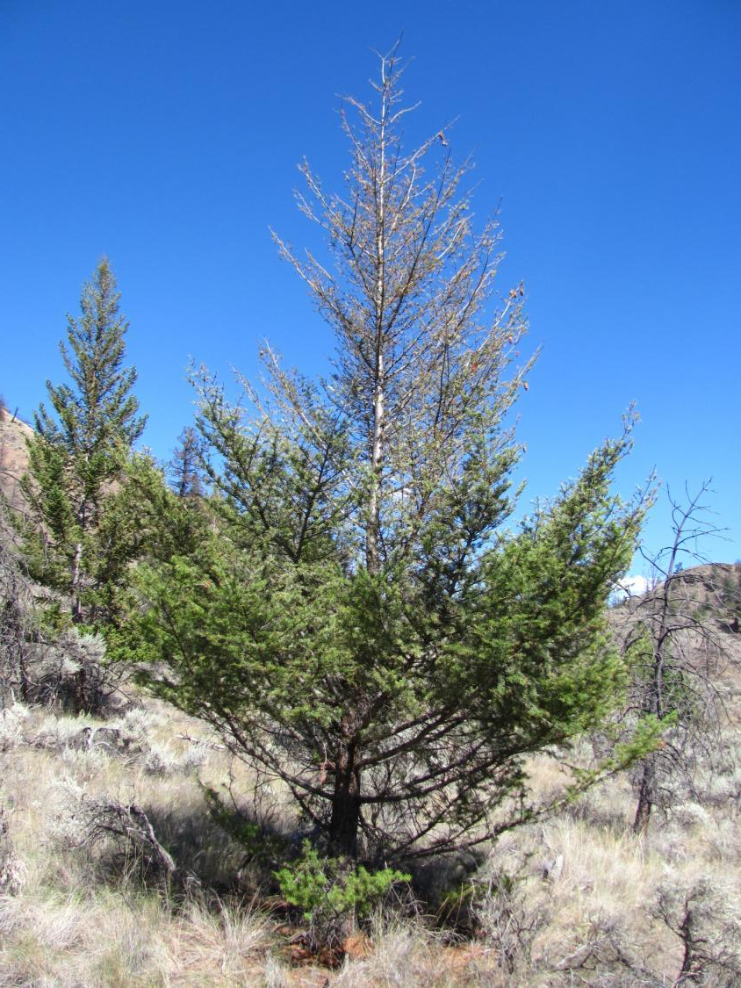
Western Spruce Budworm
Order: Lepidoptera, Family: Tortricidae
Scientific Name: Chorisotnuera Occidentalis (Freeman)
Host: Primarily Douglas-fir, spruce and western larch may also be attacked
Damage:
All ages of trees are susceptible
Tree mortality can occur after several successive years of severe defoliation, particularly on immature or suppressed trees
Top-kill - resulting in stem defects
Height and volume loss
Reduced seed production - damaged cones

Slide 5
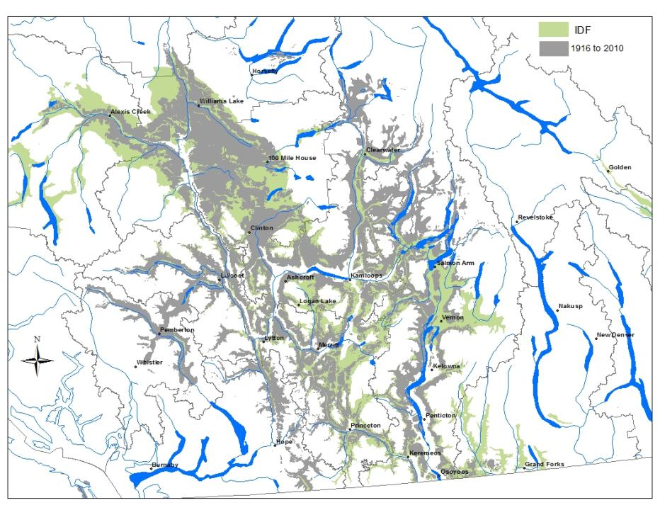
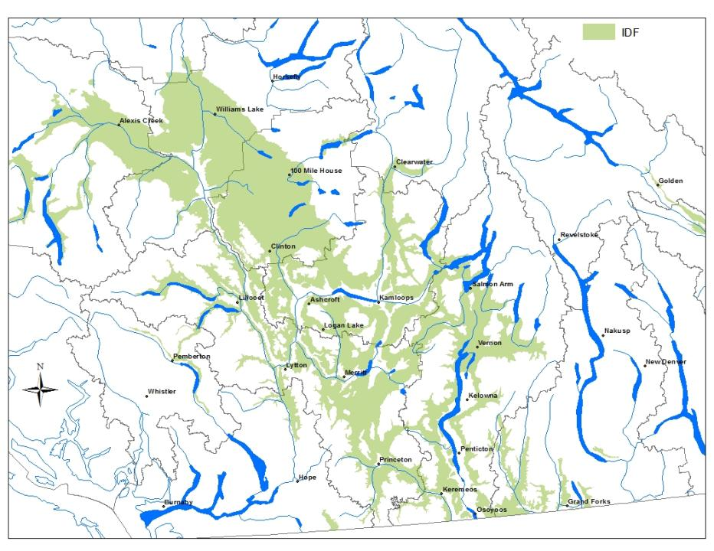
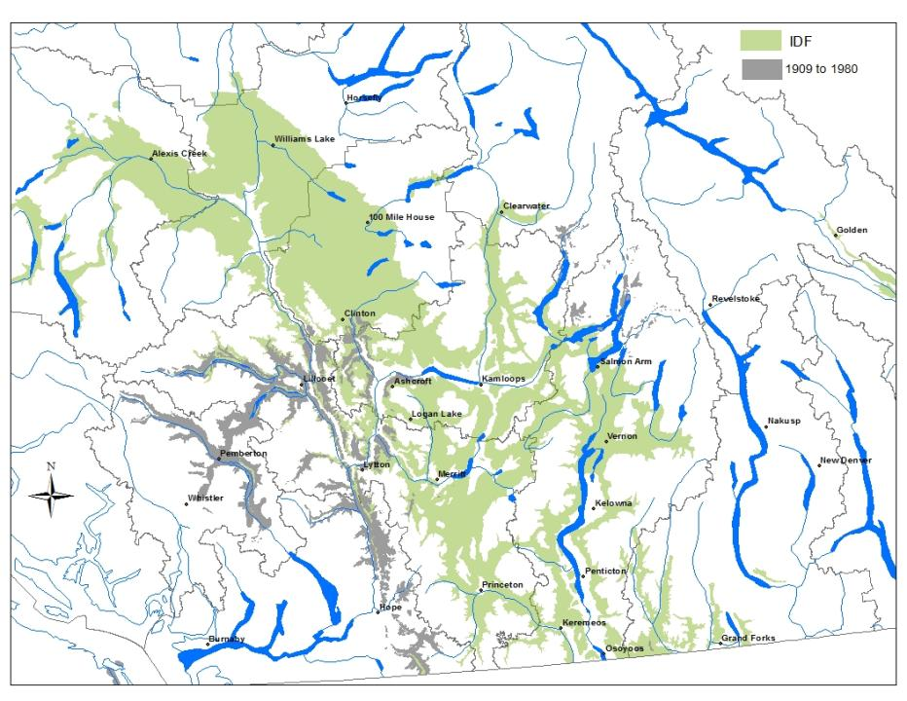
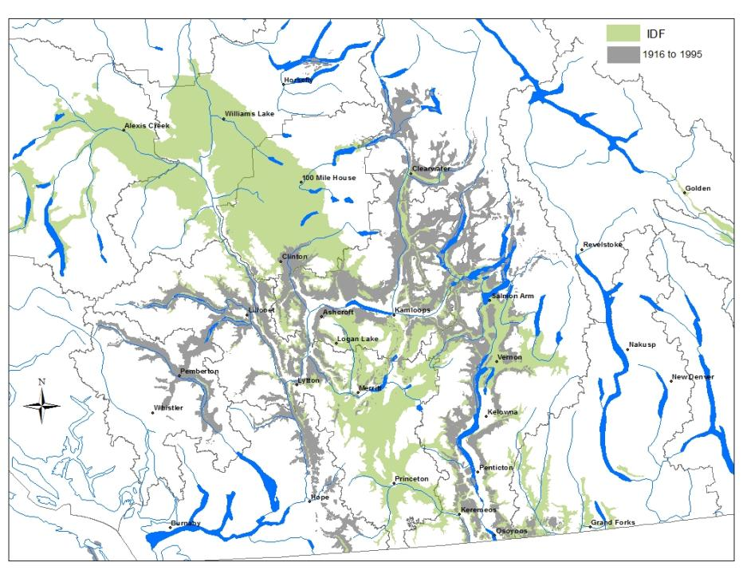
Western Spruce Budworm History
1909-2010
Notes:
IDF is the predominant ecosystem (biogeoclimatic zone) in which Df is found – although not the only one. Other biogeoclimatic zones also contain Df but at lower proportions and in mixes with other species (e.g. ICH, PP)

Slide 6


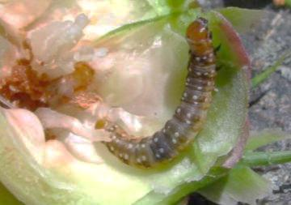
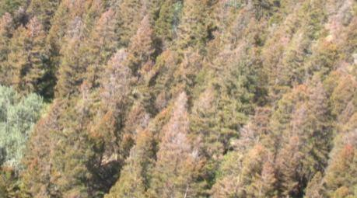
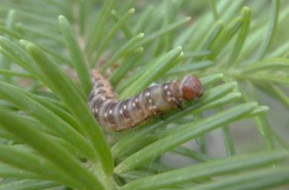
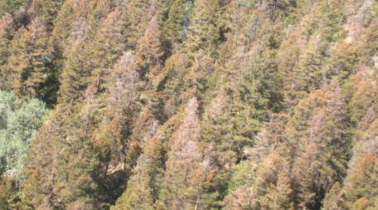
Western Spruce Budworm Spray Decision Matrix
Douglas-fir leading stands – IDF dk & xh
Stands containing intermediate stand structure (e.g. multi-layered)
Single-age young stands (with scattered mature)
Harvest or stand tending scheduled within 5 years
Notes:
-Next part of this presentation is to highlight the process by which we prioritize stands for treatment
-multi-layered multi-age stands
-even ages = YOUNG stands
- existing silvicultural investment

Slide 7
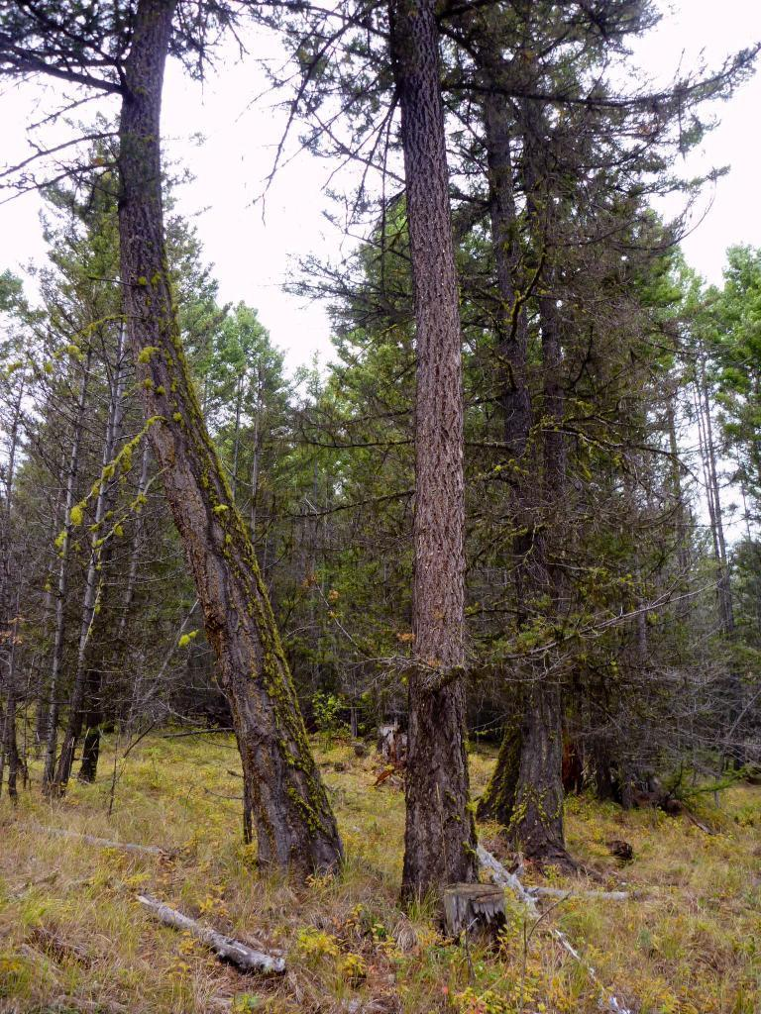
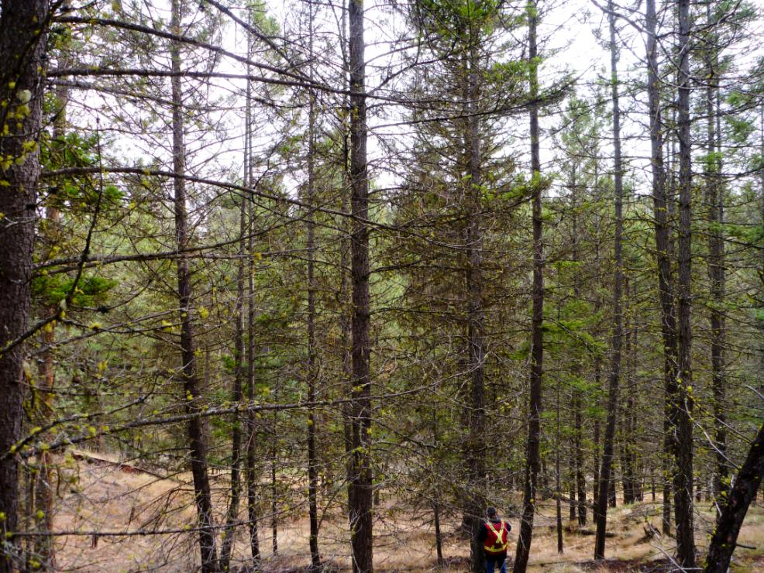
Notes:
-Range of conditions in the IDF is highly variable
-residual affect of past harvest regimes (i.e. Diameter limited cutting)
-common to have larger dominant trees at lower density then L2 and L3

Slide 8
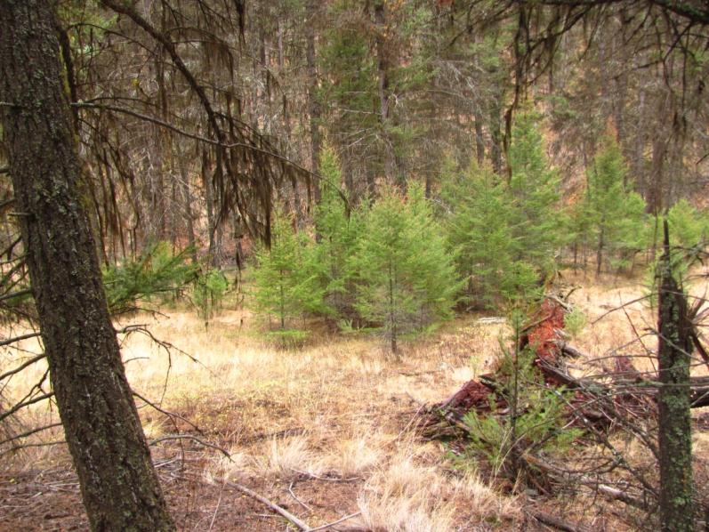
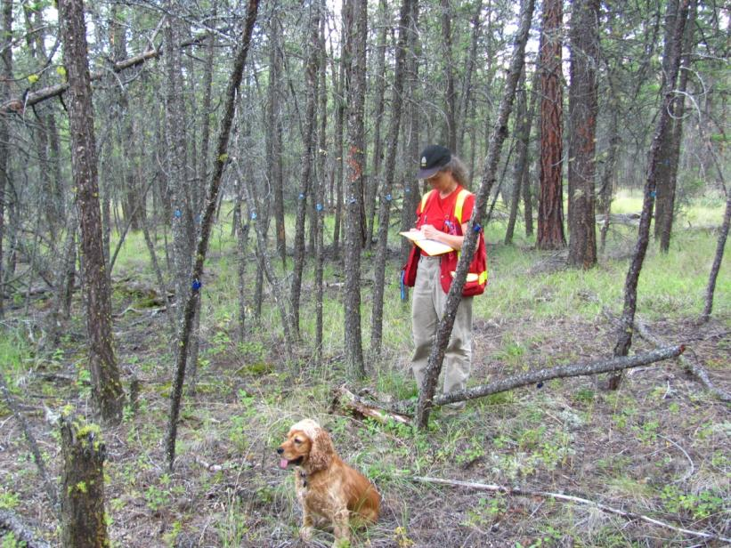
Notes:
-intermediate aged stands with very little volume, mostly even-aged with few exceptions

Slide 9
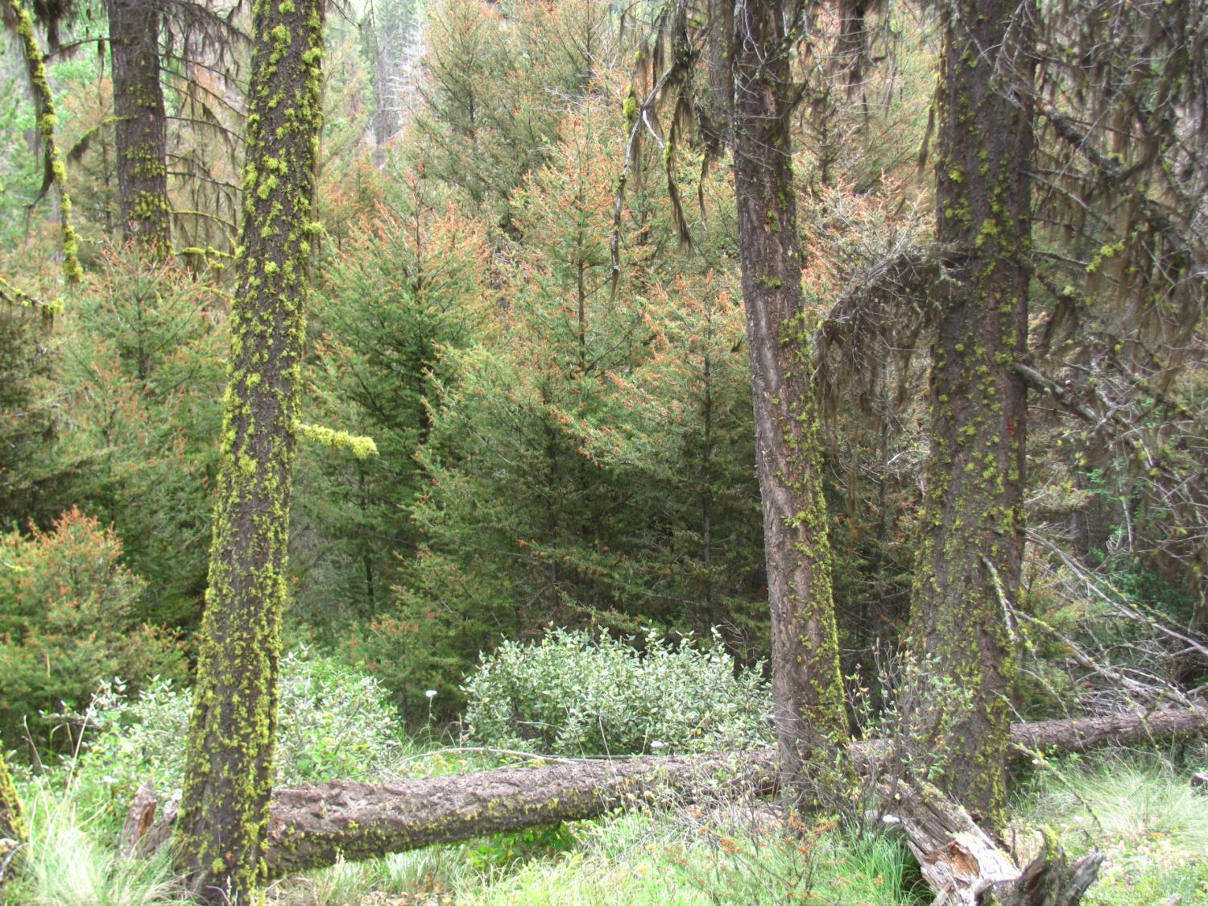
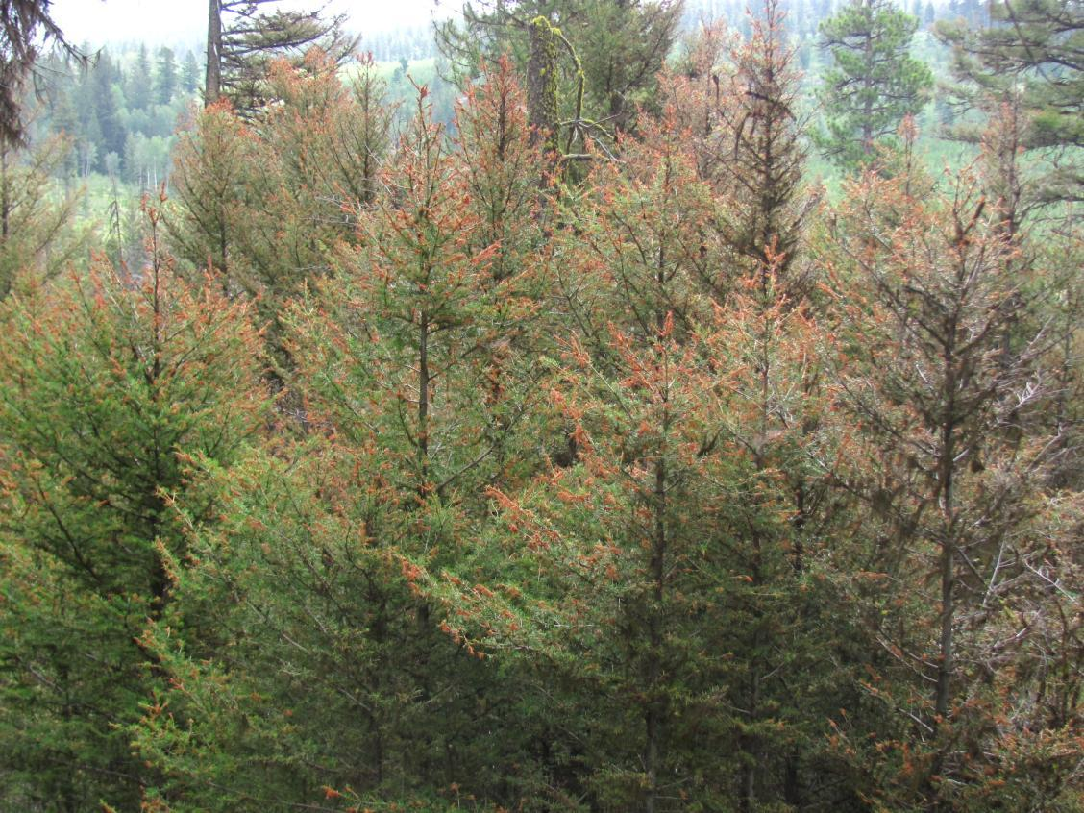
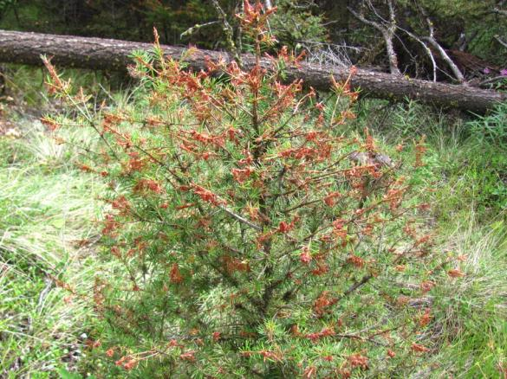
Notes:
-Damage in the understory layers tends to be severe – topkill and mortality are result of cumulative feeding

Slide 10
Western Spruce Budworm Spray Decision Matrix
Douglas-fir leading stands – IDF dk & xh
Stands containing an intermediate stand structure (e.g. multi-layered)
Single-age young stands (with scattered mature)
Harvest or stand tending scheduled within 5 years
Current or past damage (growth suppression, top-kill, imminent mortality, current defoliation)
Historic defoliation records show areas with highest consecutive years of defoliation and total years of defoliation (equates to in-stand damage)
Dendrochronology identifies duration and interval between outbreaks
Notes:
-going from stand level criteria to broader longer-term perspective using different data sources
-for example using tree-rings we can identify return interval between outbreaks – has some predictive value

Slide 11
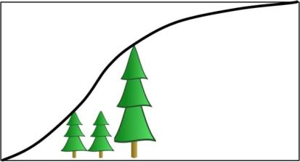
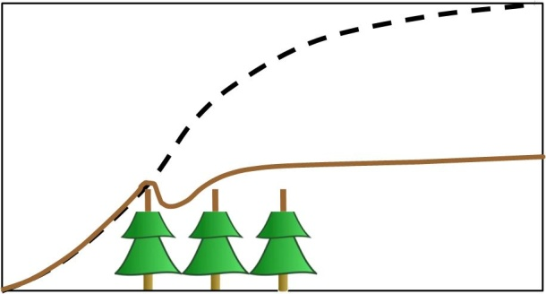
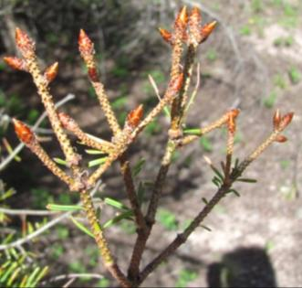
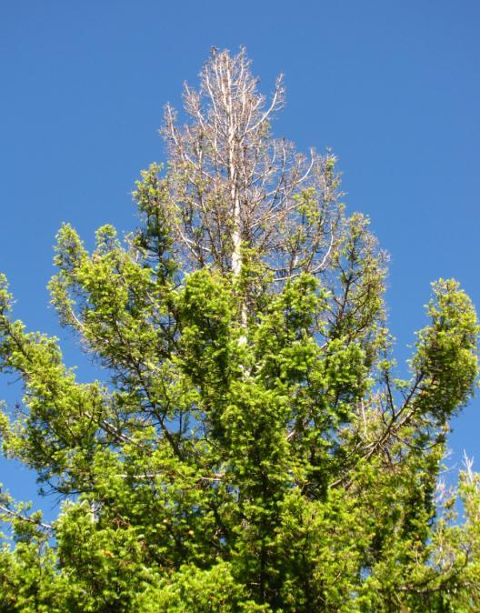
Expected growth
Budworm top-kill growth
Top-kill
Shoot defoliation results in immediate growth cessation
Notes:
As soon as there is defoliation (red line) there is nearly immediate decrease or cessation of radial growth – incremental growth starts to recover in absence of feeding but quickly drops again with beginning of next feeding cycle
Top-kill particularly problematic in the young age classes as the amount of resources required to repair crown not only keeps growth and recovery suppressed longer but leads to stem defects

Slide 12
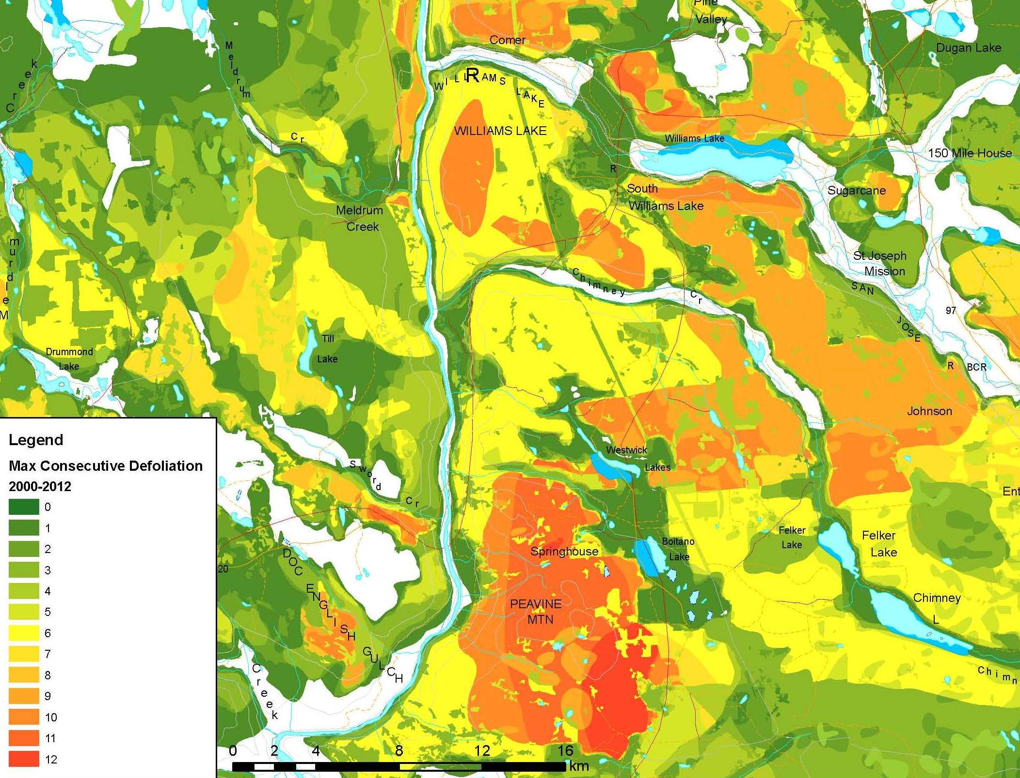
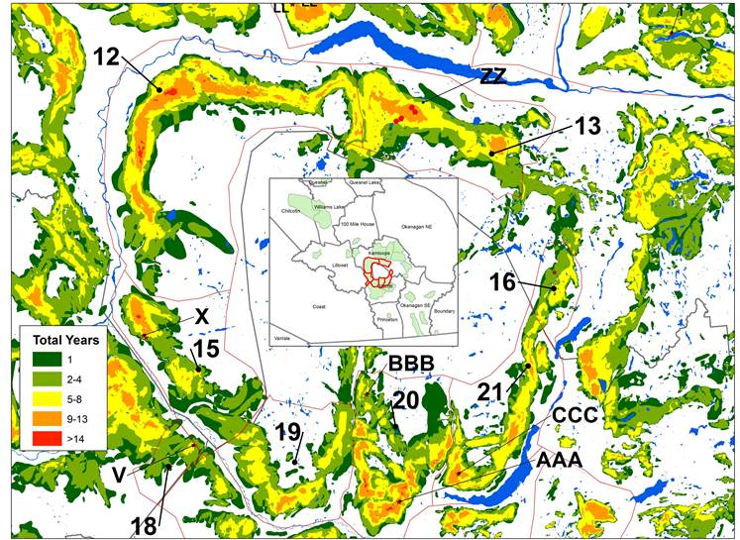
Existing Site Impact
Overlay: Maximum consecutive years defoliation
Notes:
GIS data based on our AOS:
Overlay shows cumulative (successive) years of defoliation – greater impacts due to chronic feeding (WL and SW of WL)

Slide 13
Western Spruce Budworm Spray Decision Matrix
Aerial Overview Survey identifies active populations (severity/extent)
Predictive sampling to locate highest budworm populations
Egg mass surveys in affected stands and adjacent high priority stands
Egg mass surveys in areas where outbreaks are imminent
(early intervention)
Moderate to severe defoliation predicted – prioritize for B.t.k. treatment
Notes:
Landscape level tools:
- AOS provides an annual survey of where the damage is and how severe
- Target those areas with eggmass surveys which is the predictive too we use to target areas for treatment
- “light” eggmass prediction with treatment = EARLY INTERVENTION – stop damage from happening before it does in younger age classes

Slide 14
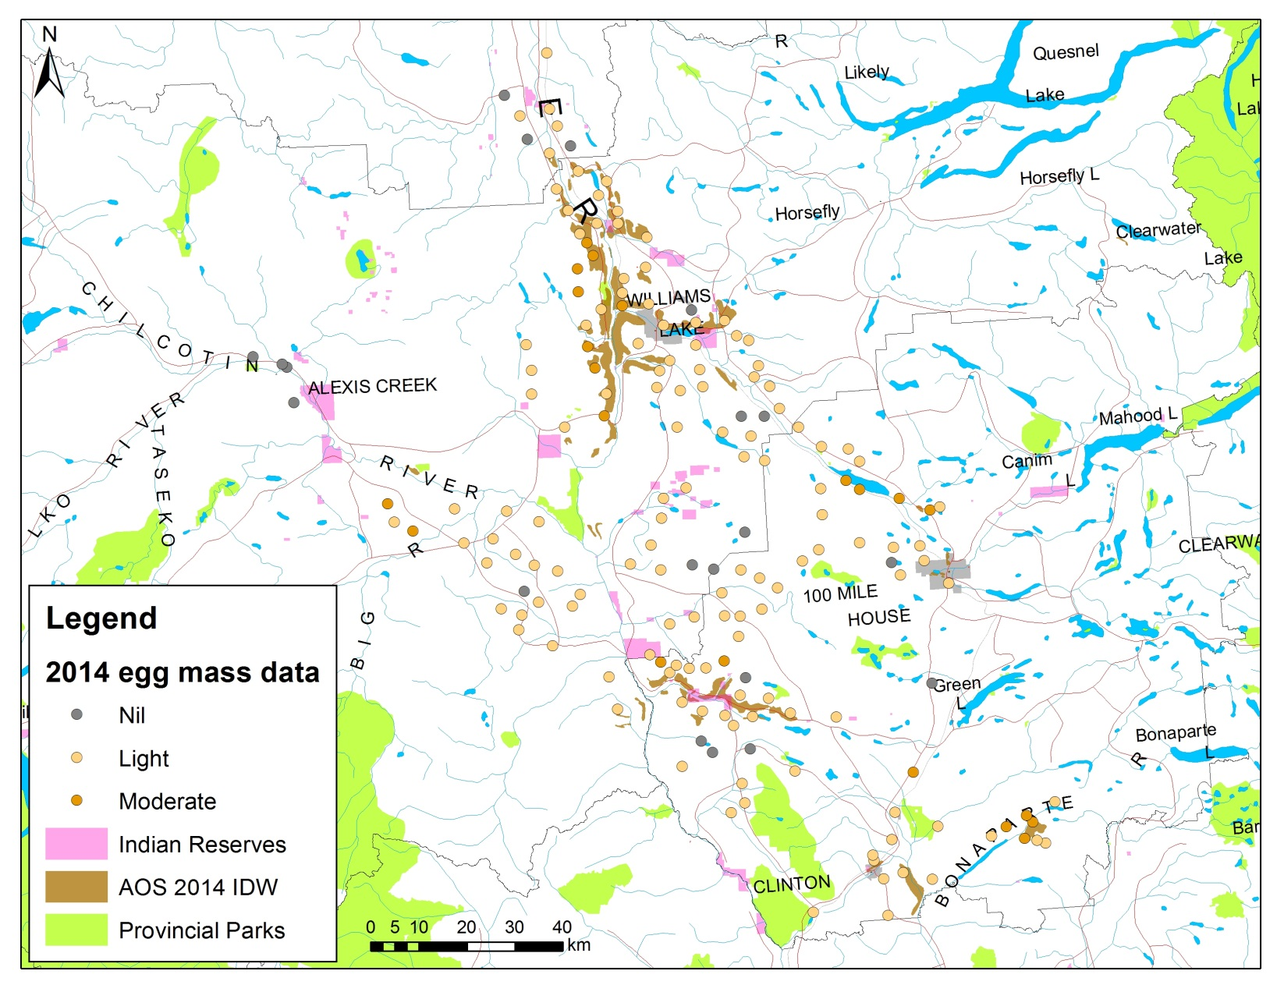
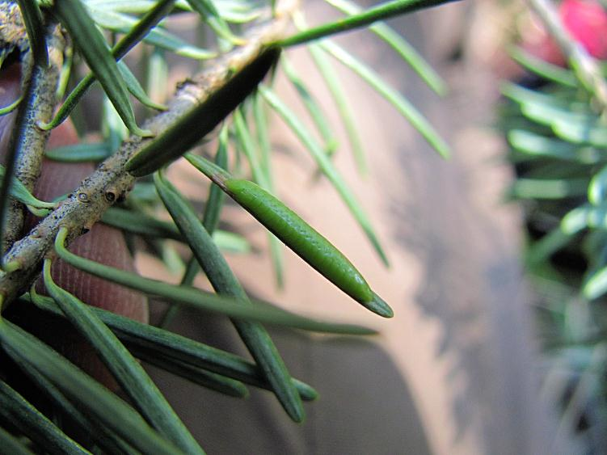
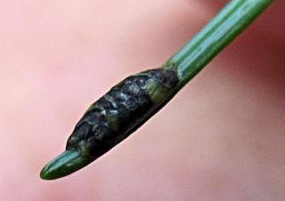
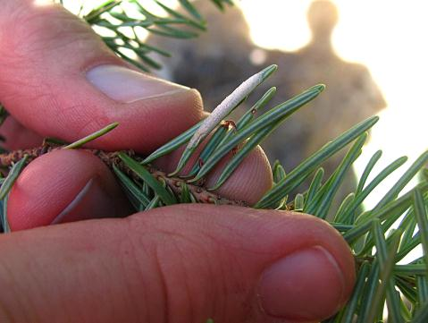
Western Spruce Budworm
Population Prediction
new
parasitized
hatched
Notes:
-Eggmass predictions are generally down with exception in 100 Mile and Kamloops TSAs
-Hectares for 2014 ~61,000 ha (down from 78,000 in 2013) in areas with highest predicted populations

Slide 15
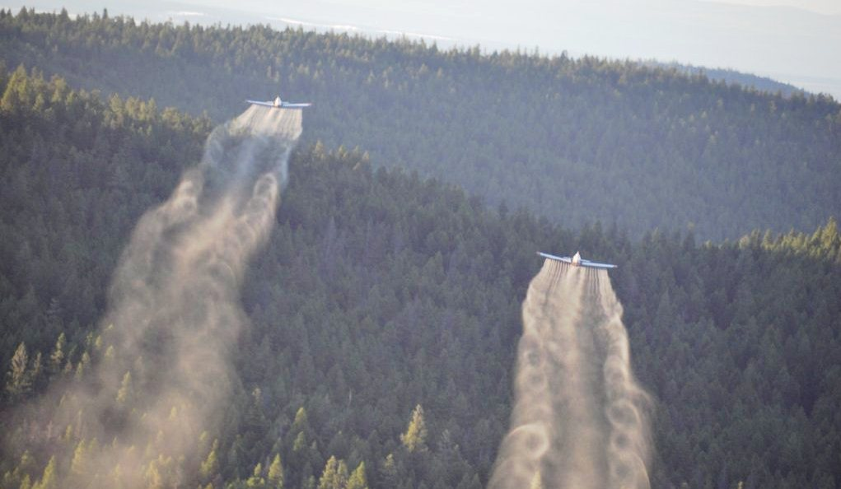
Western Spruce Budworm
Area and Design
Maximize spray block size or design aggregate blocks
Blocks will contain a mix of stand structure types; age classes; density
By default, larger areas will contain a continuum of WSB population density (light-severe)
Treat with B.t.k.
early in outbreak
cycle to prevent
top-kill and
dramatic growth
suppression

Slide 16
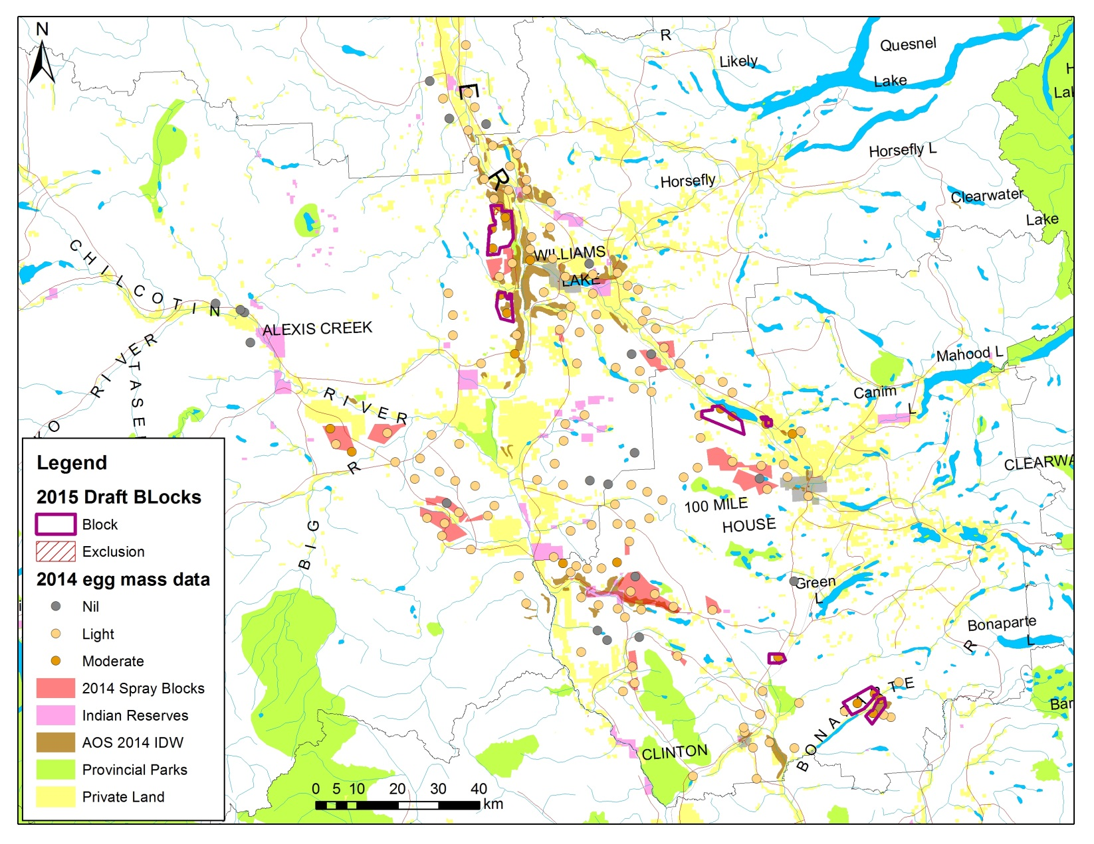
Notes:
-Eggmass predictions are generally down with exception in 100 Mile and Kamloops TSAs
-Hectares for 2014 ~61,000 ha (down from 78,000 in 2013) in areas with highest predicted populations

Slide 17
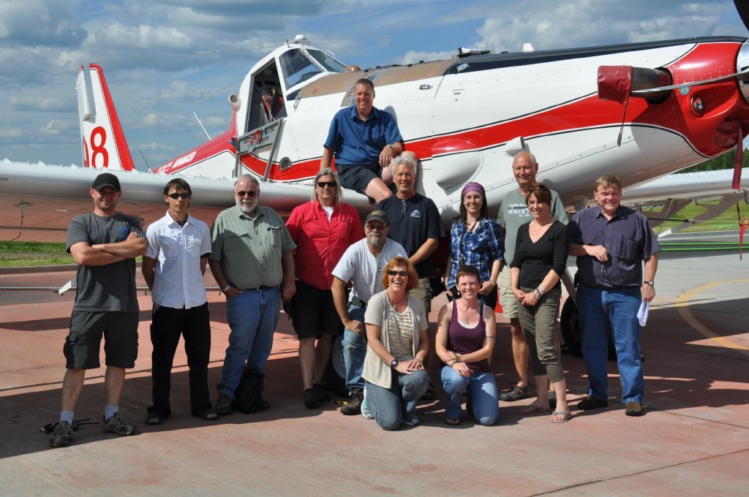
Western Spruce Budworm
Treatment
  Planning - communications:
    Consultation – First Nations
    Intent to Spray – Public Notice
    Coordination with Provincial Forest Health Coordinator
    Media
  Planning – Logistics:
    Purchasing and
    staging product
    Timing treatment
    and larval
    development
    Team
Notes:
Team – TOR and CAR fire centre, Conair, ground crews, helicopter support, weather crew and monitoring, engineers

Slide 18
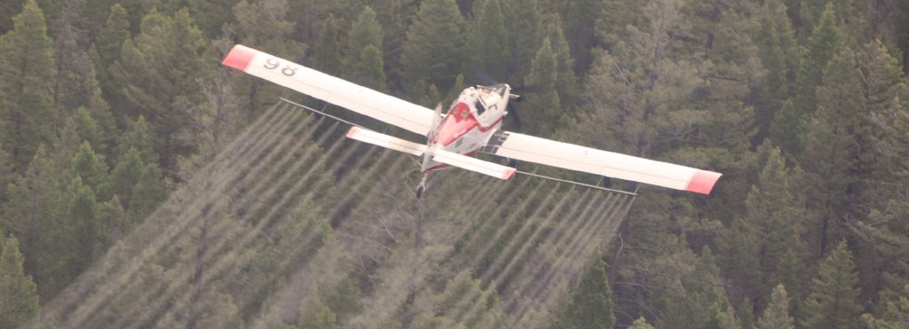
Western Spruce Budworm
Treatment
  Aerial treatment of larval populations using Bacillus thuringiensis var. kurstaki (B.t.k.):
    Formulation = Foray 48B
    Application rate = 2.4 litres/hectare
    Spray boom 63 m long and delivers B.t.k. droplets 100-120 micron diameter
  Aerial treatment costs + $30/ha and stands normally only need single spray
Notes:
(B.t.k.) is a bacterium that occurs naturally on dead or decaying matter in the soil. It is not a synthetic chemical and is only activated when eaten by a susceptible species of insect. B.t. is the most widely used naturally occurring pest control product in the world. B.t.k. is specific to the Lepidoptera (moths and butterflies)

Slide 19
Western Spruce Budworm Spray Program - Provincial
Kootenay-Boundary
Chilliwack
Notes:
-Treatment history since 1997. 2012 largest spray year and first time treatment in Kootenay

Slide 20
Western Spruce Budworm Spray Program - Cariboo
5%
8%
5%
6%
8%
6%
5%
8%
11%
37%
31%
84%
Notes:
-Next part of this presentation is to highlight the process by which we prioritize stands for treatment
-multi-layered multi-age stands
-even ages = YOUNG stands
- existing silvicultural investment

Slide 21
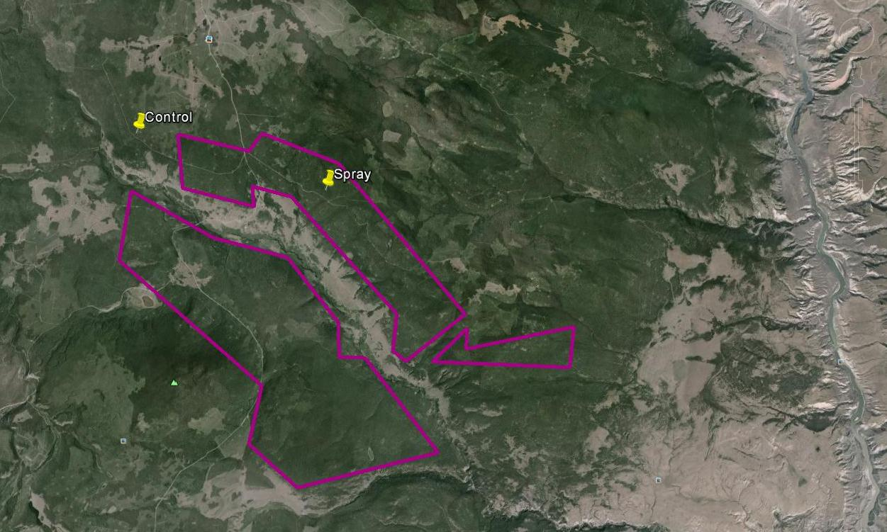
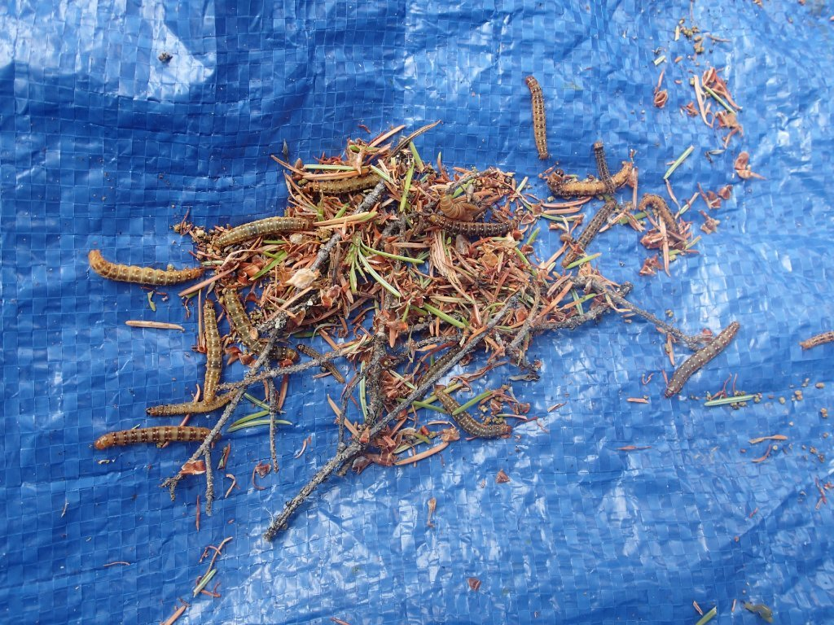
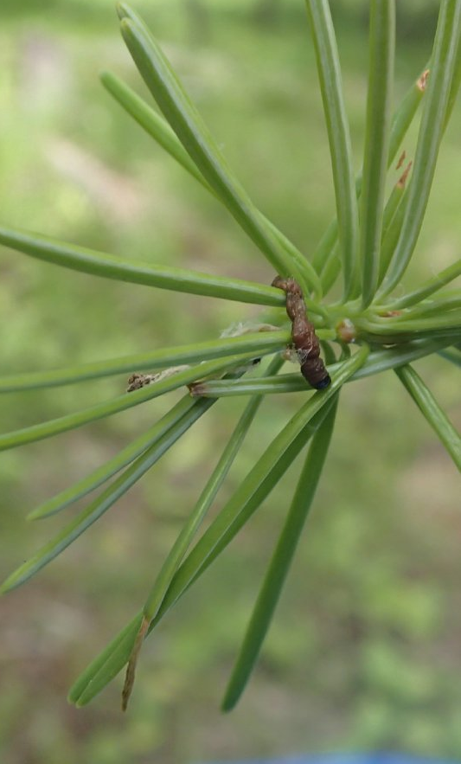
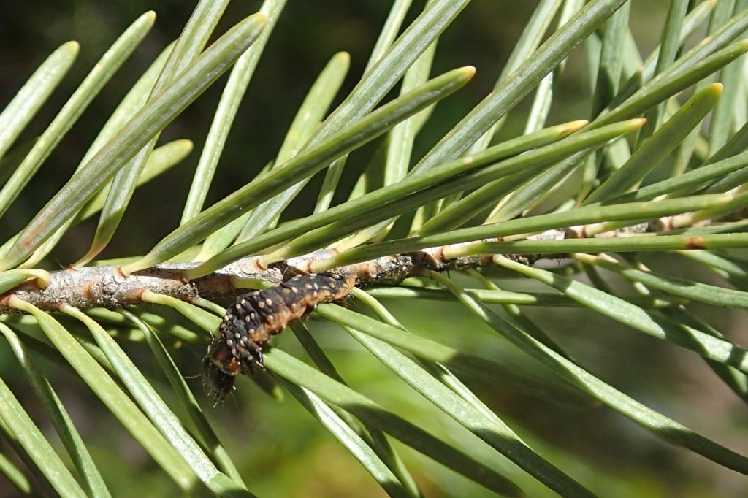
Western Spruce Budworm
Post-Spray

Slide 22
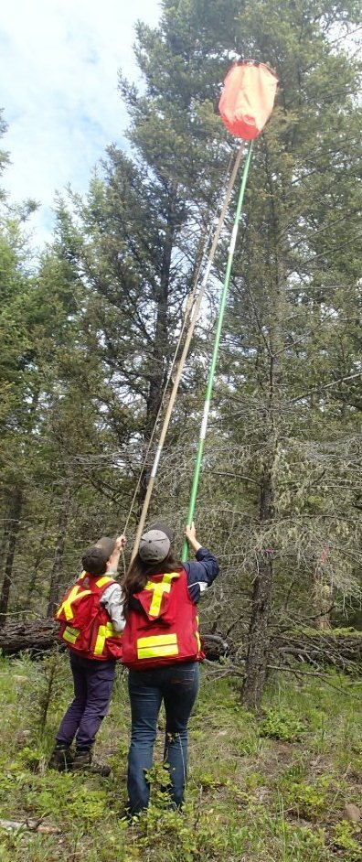
Western Spruce Budworm
Efficacy
B.t.k. treatment
Untreated control
Notes:
-To determine how effective the spray was conduct population density surveying
-Blue bars are the pre-treatment populations – literally 100s of larval 1 m2 of branch
-Get abrupt drop in density after the spray – curtail damage – foliage and bud loss, growth reductions
-non-treated stands get expected natural morality but much less significant reductions in insect populations

Slide 23
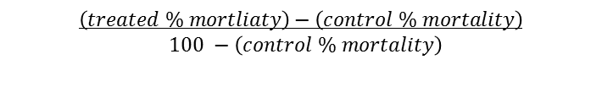
Western Spruce Budworm
Efficacy
Abbott’s Corrected Mortality =
(%)
$$\left(treated \% mortliaty\right)−\left(control \% mortality\right)$$
$100 −\left(control \% mortality\right)$
Notes:
-To determine how effective the spray was conduct population density surveying
-Blue bars are the pre-treatment populations – literally 100s of larval 1 m2 of branch
-Get abrupt drop in density after the spray – curtail damage – foliage and bud loss, growth reductions
-non-treated stands get expected natural morality but much less significant reductions in insect populations

Slide 24
Western Spruce Budworm
Wrap-Up
Western spruce budworm treatment program involves:
  Iterative and science based planning
  Multiple sources of data – landscape to stand-level
Consultation with local stakeholders
Follow-up
Continual development and adjustment

Slide 25
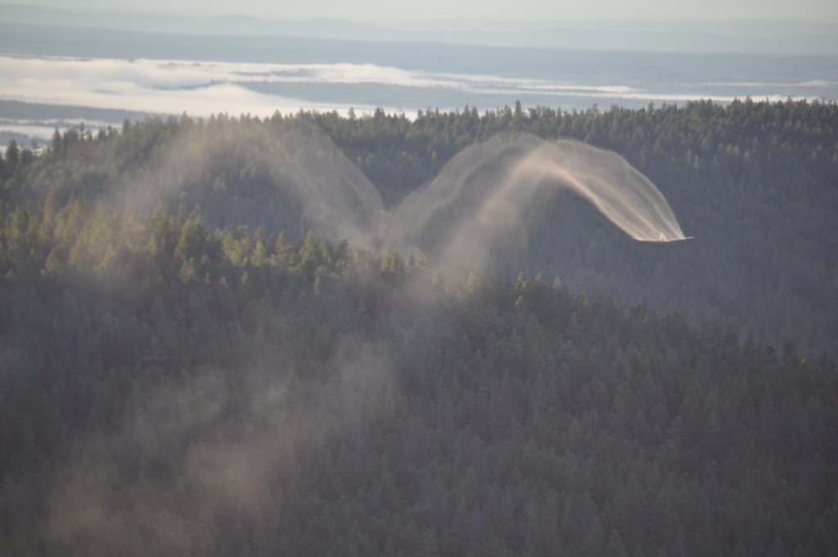
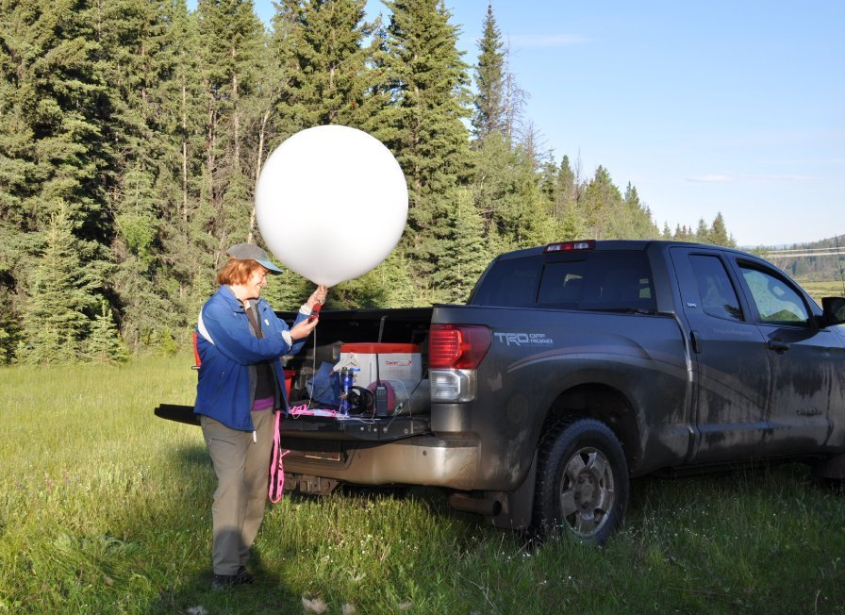
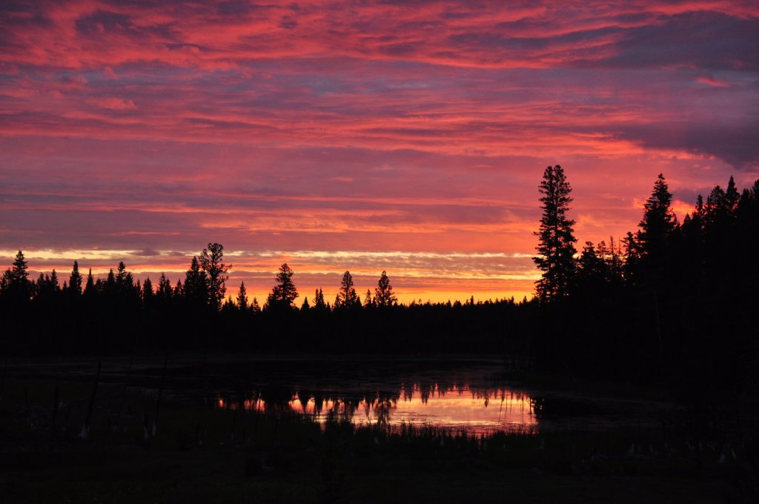
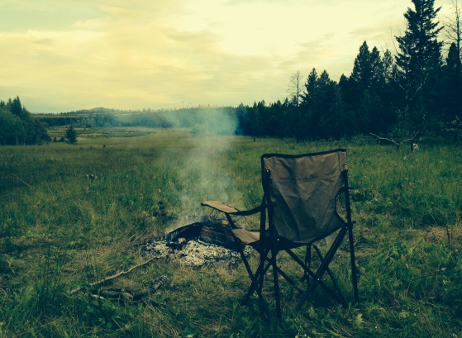
Questions?

