Slide 1
The Development and Management of Herbicide Resistant Weeds in IVM
Don Hare
Senior Research Scientist
30 October 2014

Slide 2
Overview
Current Global Status – update of herbicide resistance
Understanding herbicide mode of action (MOA)
What is herbicide resistance?
What factors lead to selection for herbicide resistance?
The Group 4 Synthetic Auxins – what makes them unique?
How do you manage herbicide resistant weeds?
  Herbicide MOA , Multi – Mode of Action
  Best management practices for DAS products
  Best practices in IVM and Range and pasture.
Notes:
This module is designed to be a general overview on the topic of herbicide resistance. While it does not give an in-depth explanation of the biochemistry and genetic alterations involved with resistance, it should provide a basic understanding of the above topics. For a more detailed understanding of herbicide resistance, consult local university publications and/or other scientific sources for additional information.
In addition there are other internal Dow AgroSciences R&D resources such as Weed Resistance Grids and SWOT analyses by crop which can supplement this training module. You will note a slide listing internal DAS contacts for weed resistance info and training toward the end of the presentation.
.

Slide 3
Global Status Update - Herbicide Resistance
How are WE doing?
Herbicides were introduced in ~ 1945-1950’s
~70 years of herbicide use (50 years of Picloram)
~45 years ago (1975) significant appearance of herbicide resistance (HR)
Currently there are 437 unique cases (species X site of action) with HR
238 species (138 dicot + 100 monocot) ~60 %/40%
154 annual + 34 a-p vs 38 perennial (84%/16%)
22 of 25 known herbicide sites of action have HR weeds
155 different herbicides in 84 crops in 64 countries have HR
Notes:
The next three slides will discuss factors which can increase the selection pressure for herbicide resistant biotypes.

Slide 4
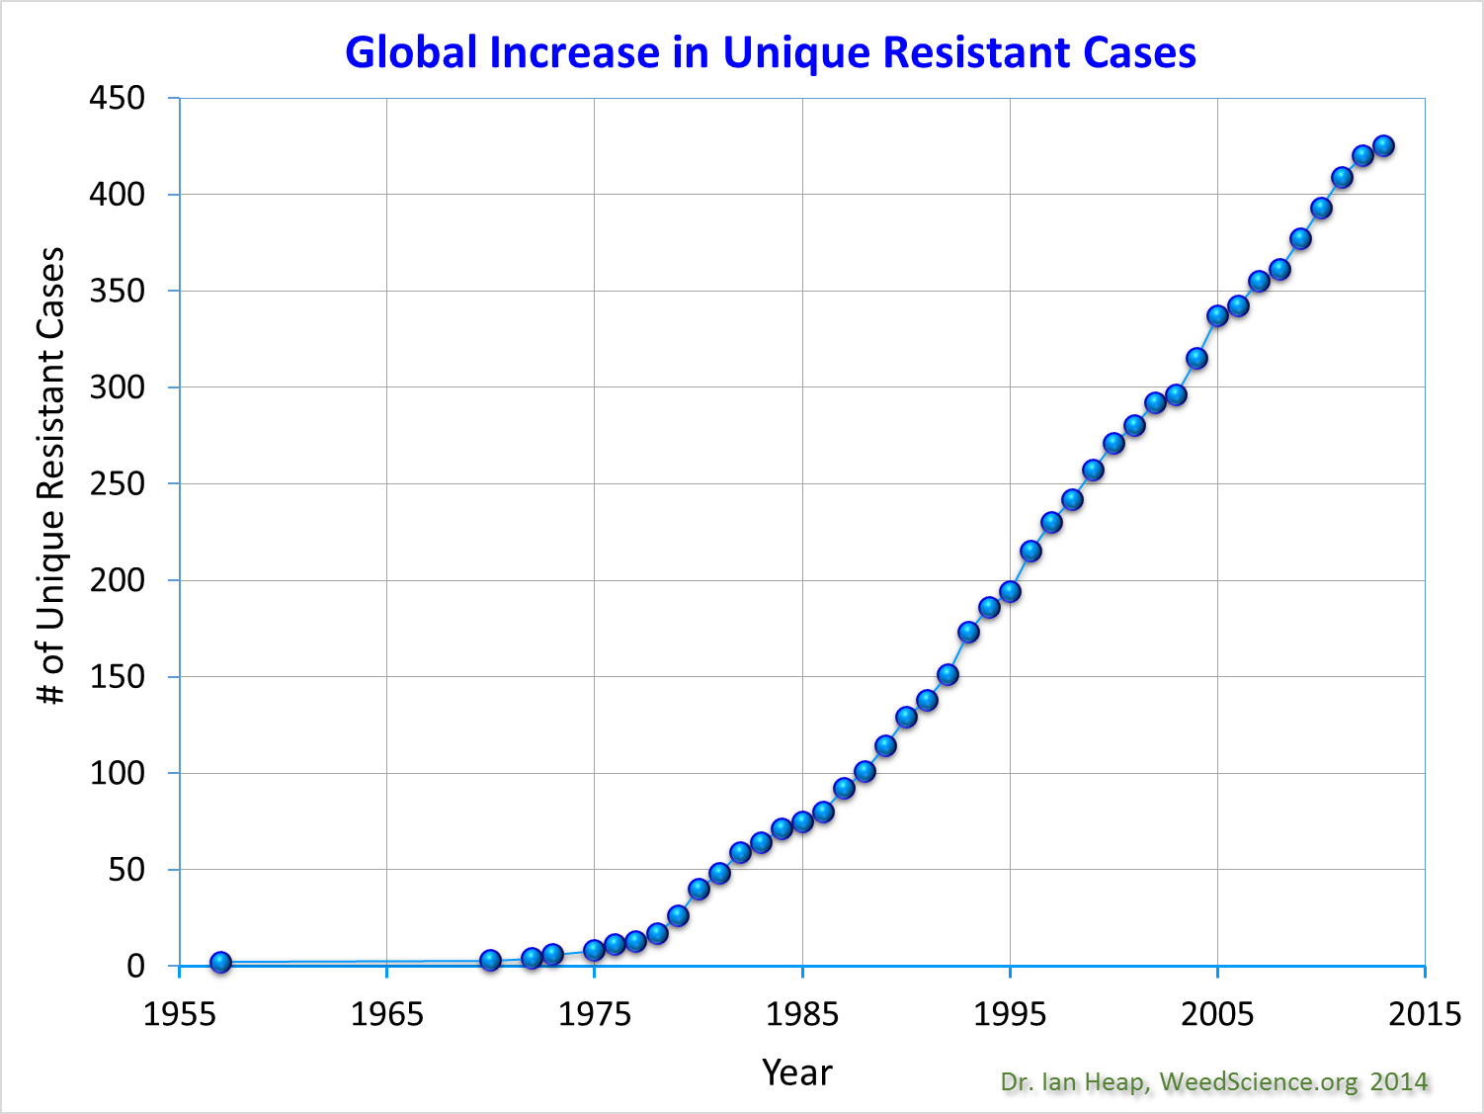

Slide 5
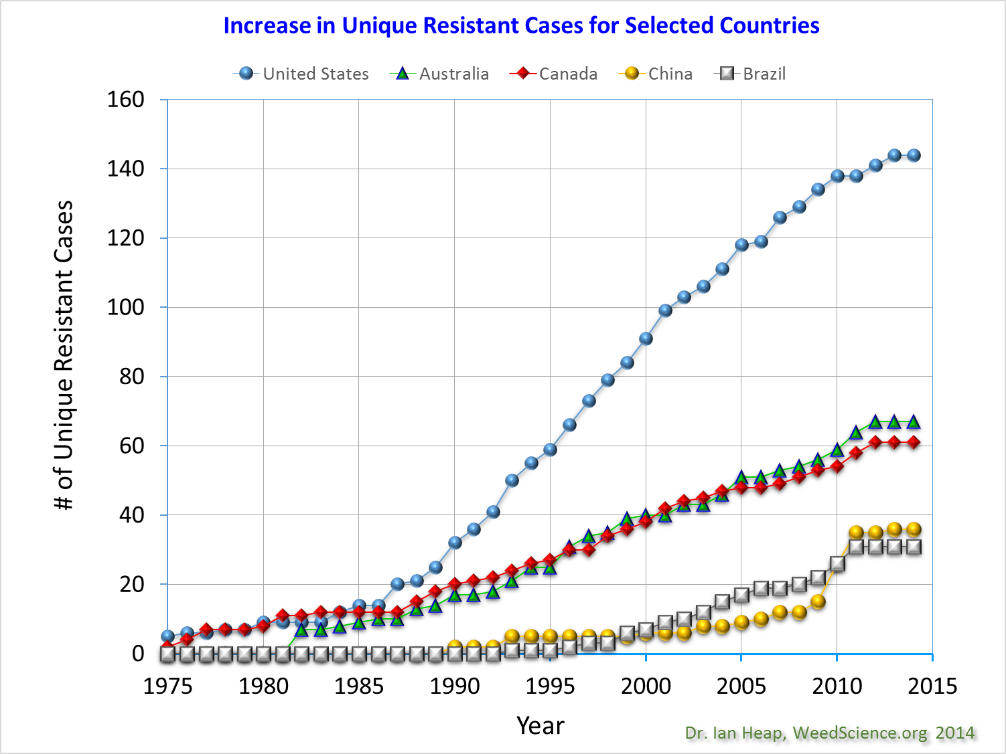

Slide 6
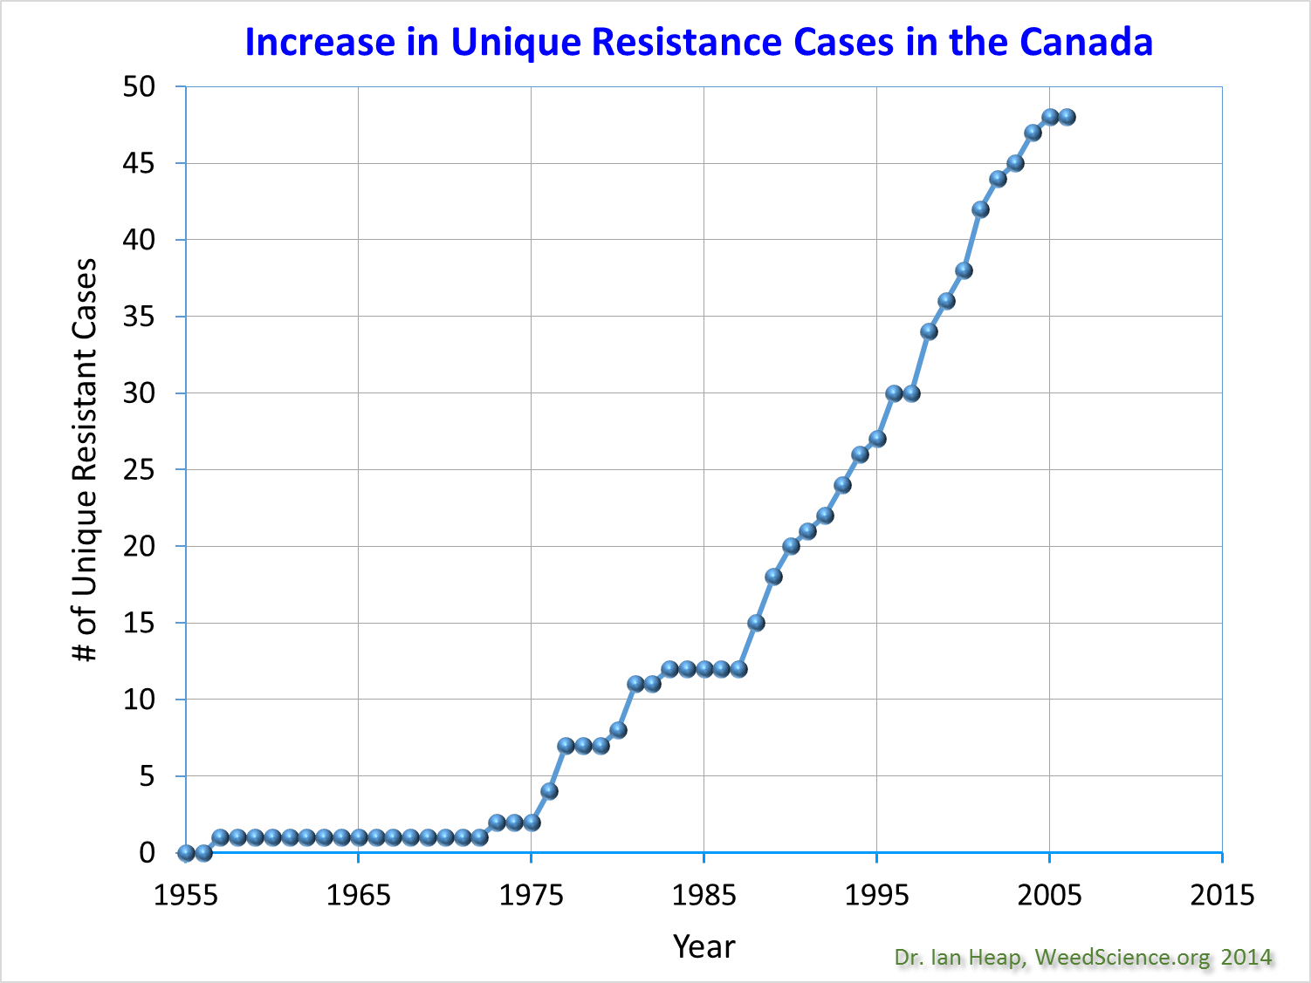

Slide 7
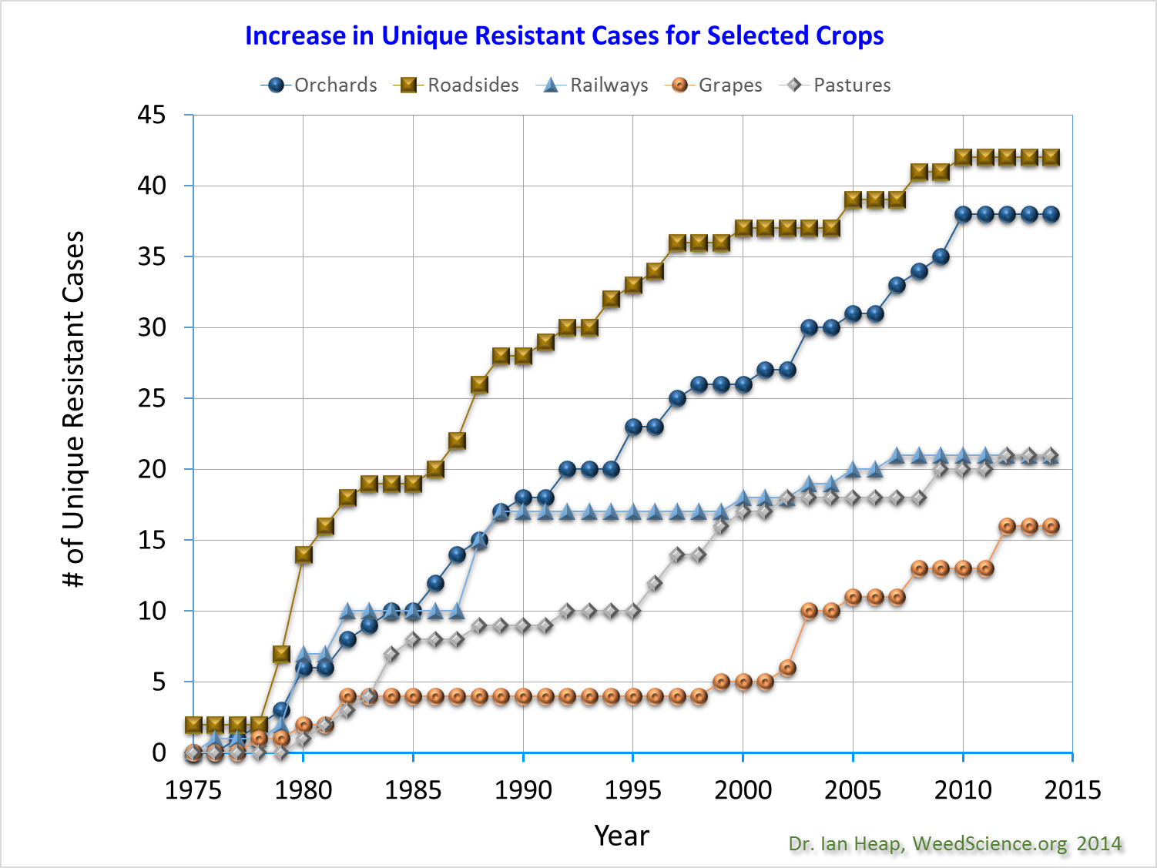

Slide 8
What Are Modes of Action?
Herbicides are classified by the method they affect the plant (292)
There are three major methods that herbicides affect plants:
Light processes (105) - 36%
Cell metabolism (102) - 35%
Growth or cell division (67) - 23%
Unknown (18) - 6%
Herbicides are grouped together by similar mode of action (25)
There are two main types of mechanisms for control (site of Action)
Target site – single or multiple enzyme
Non target site – system disruption ie Photosynthesis

Slide 9
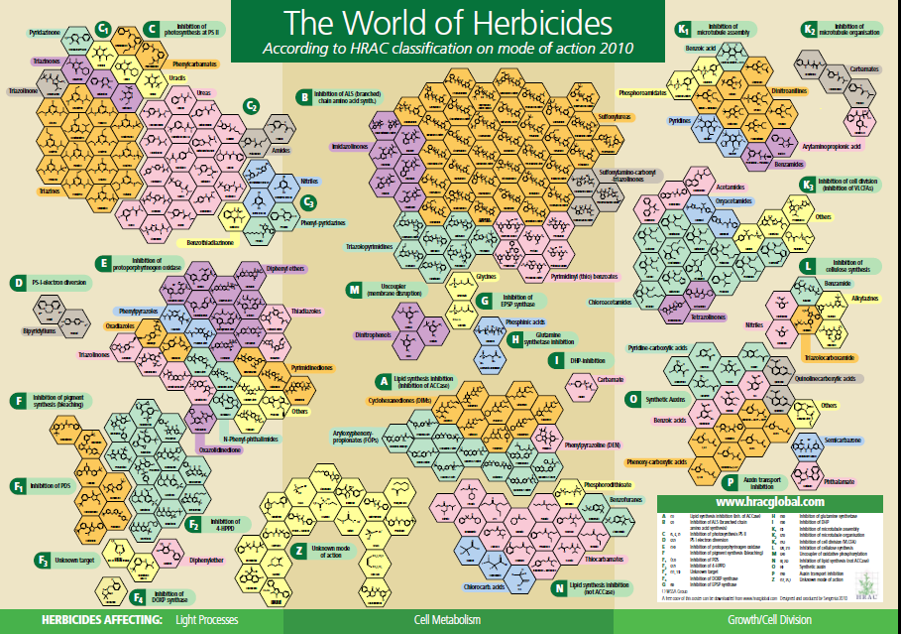

Slide 10
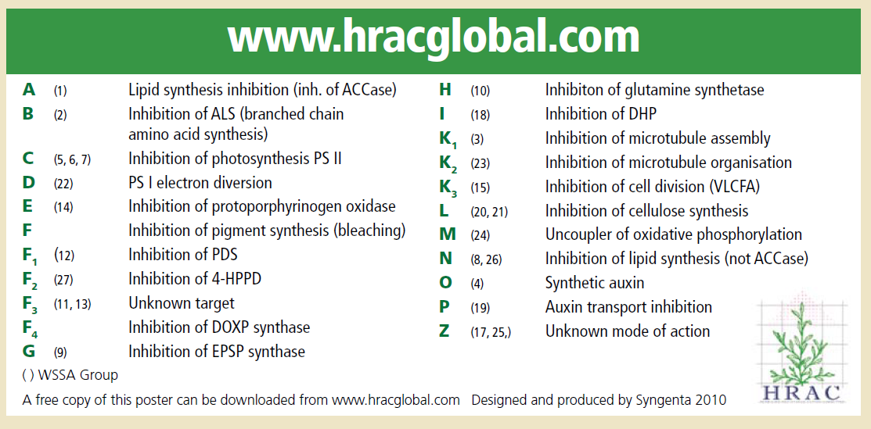
Herbicide - Mode of Action

Slide 11
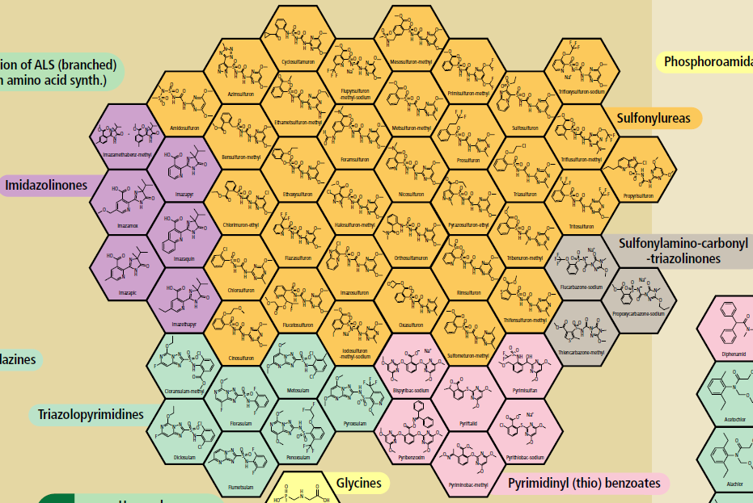
2- Inhibition of ALS
(Branched Chain Amino
Acid Synthesis)
Cell Metabolism

Slide 12
Group 2 – Inhibition of ALS
(Branched Chain Amino Acid Synthesis)
ALS Subgroups (5)
Sulfonylurea Imidazolinones Triazolopyrimidines Sulfonylamino - carbonyl-triazolinones
Primidinyl thio Benzoates (6)
(34)
Chlorsulfuron
Metsulfuron-M
Tribenuron-M
Thifensulfuron
Ethametsulfuron-M
(6)
Imazapyr
Imazamox
Imazethapyr
Imazapic
(7)
Florasulam
Pyroxsulam
Flumetsulam
Diclosulam
Penoxsulam
Cloransulam-M
Metosulam
(3)
Flucarbazone –sodium
Thiencarbazone-M Proproxycarbazone -sodium
56 GRP 2 Unique Active Ingredients

Slide 13
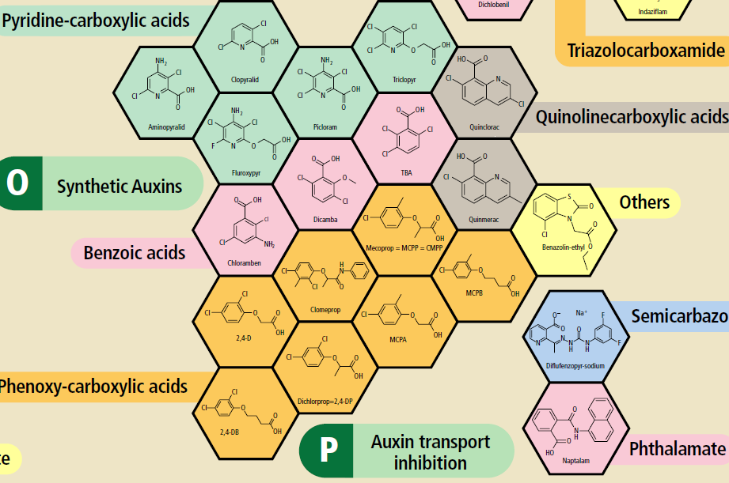

Slide 14
Group 4 - Synthetic AUXIN
AUXIN Subgroups
Quinoline CA
Pyridine CA Benzoic A Phenoxy CA Arylpicolinate
Quinclorac
Quinmerac
Aminopyralid
Clopyralid
Picloram
Fluroxypyr
Triclopyr
ACP ??
Dicamba
TBA
Chloramben
2,4-D
MCPA
Dichlorprop
Mecoprop
Arylex
20 Unique Actives
5 subgroups

Slide 15
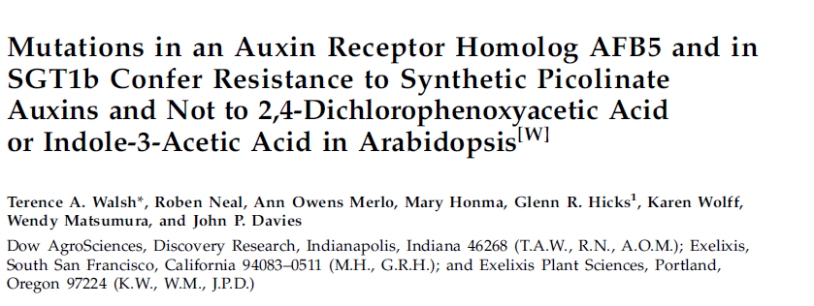
Cross Resistance Within a Single MOA Group-??
Different Site of Action for each MOA Subgroup
ie unique active can have difference resistance response
Phenoxy vs Pyridine

Slide 16
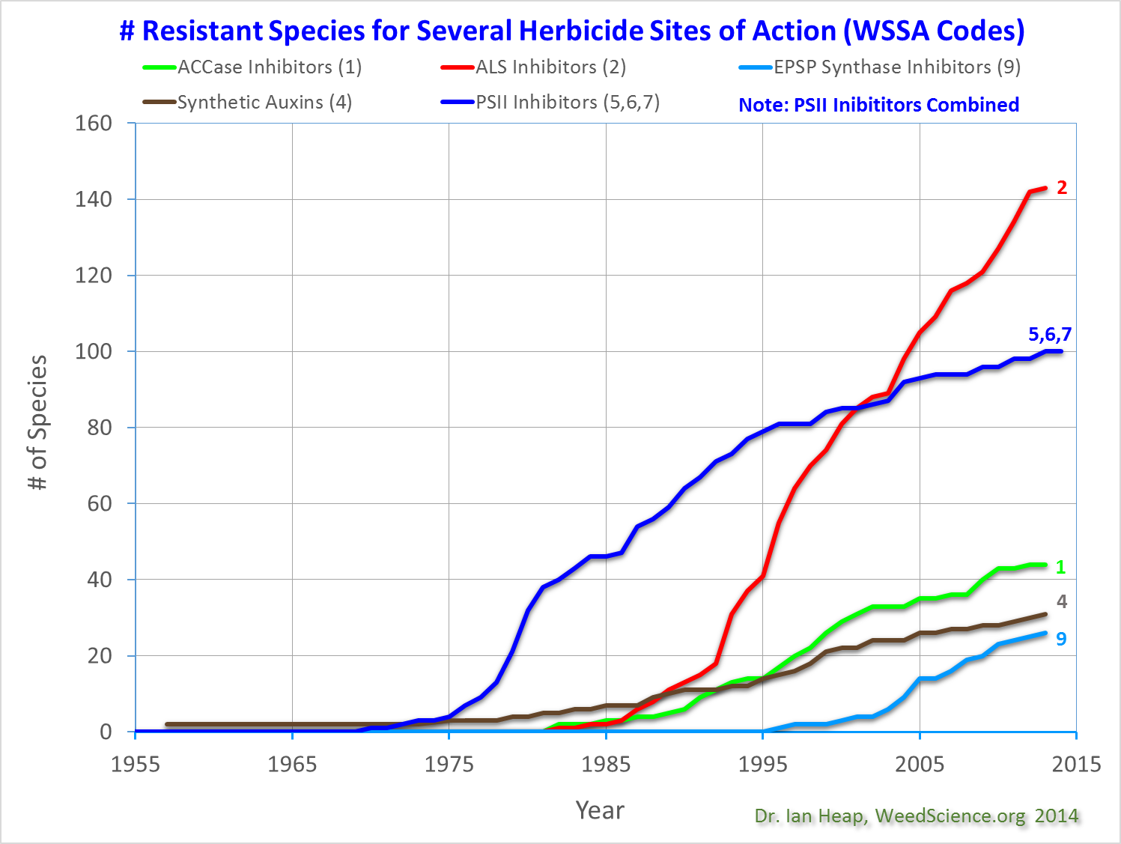

Slide 17
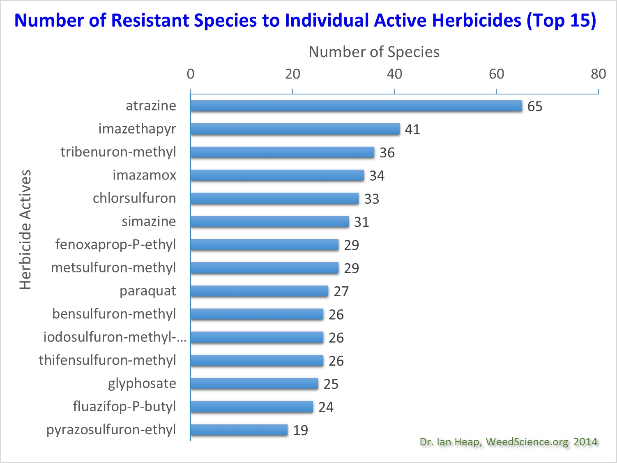
5
2
2
2
2
2
5
1
2
22
2
2
2
9
1
2

Slide 18
Herbicide Resistance vs. Tolerance?
Resistance – Weed that was once controlled by a herbicide now survives a herbicide application at normal rates and complete it’s life cycle.
versus
Tolerance - ability of a plant to survive a herbicide treatment at a normal use rate. It is naturally tolerant.
Notes:
To understand this topic one must first differentiate between two terms that are often confused.
Resistance - this is an inherited ability of a plant to survive a herbicide treatment following exposure to a dose that would normally kill that plant. Resistance can be naturally occurring (most common) or induced by such techniques as genetic engineering.
Tolerance, is when a labeled rate of a herbicide, applied for the first time, does not control the target species.
Keep in mind that in this presentation, we are focusing on resistance (ie, where you once achieved control with a 1X rate of a herbicide, but now there are control failures).

Slide 19
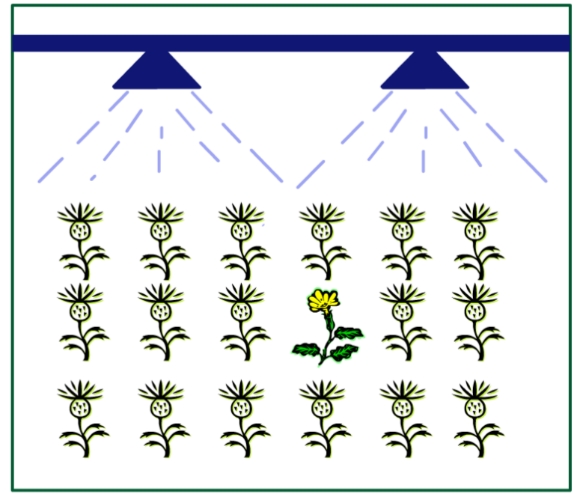
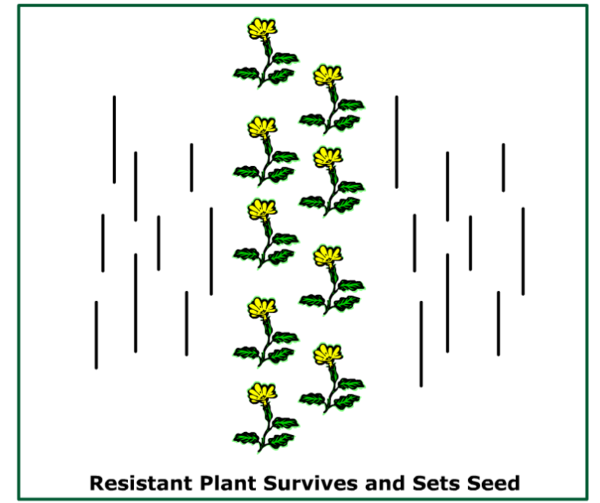
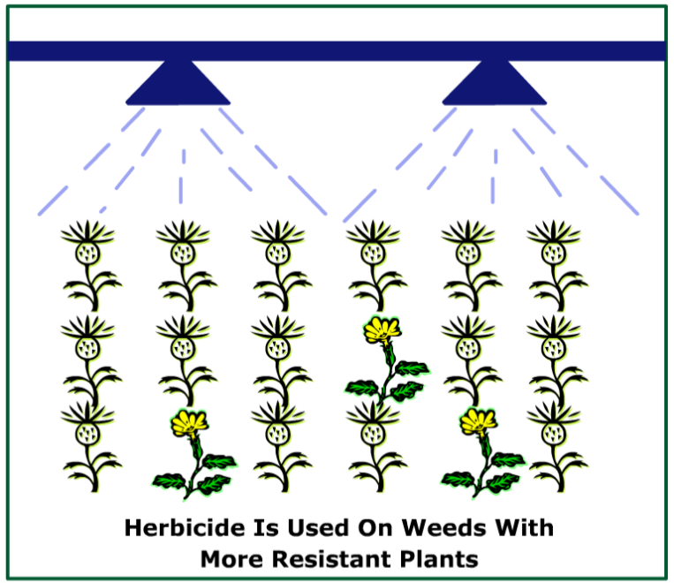
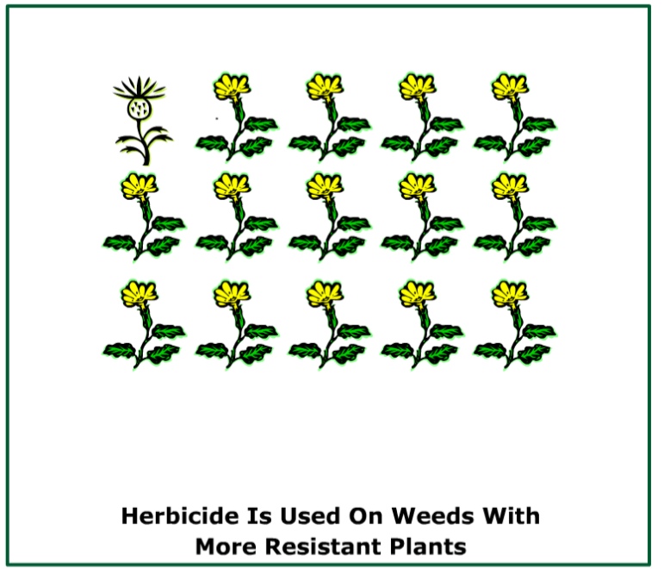

How do we Select for Resistant Weeds?
http://www.soygrower.org/WRM/wrm/htmls/lesson1/media/ncgawrm_l01t01p07.swf
Notes:
This slide visually illustrates how an application of a herbicide will select for resistant biotypes.
First, one should understand the definition of “biotype”. It is a genetic or morphological difference between one plant and another within the same species.
So. . . How do we select for resistance?
The first box simply shows that at the time of a herbicide application there may be some percentage of plants within that population that are resistant to a given herbicide. These resistance plants naturally occur in nature at very low frequencies.
The second box explains that the resistant plant will survive and subsequently produce offspring which also are resistant.
Thus in box three, you now have a larger number of resistant plants present.
Box four shows that as you continue this application process over time you will eventually select for a population where the majority are resistant to that particular herbicide.
Take-home message: Resistant weeds are FOUND (selected for), not created.

Slide 20
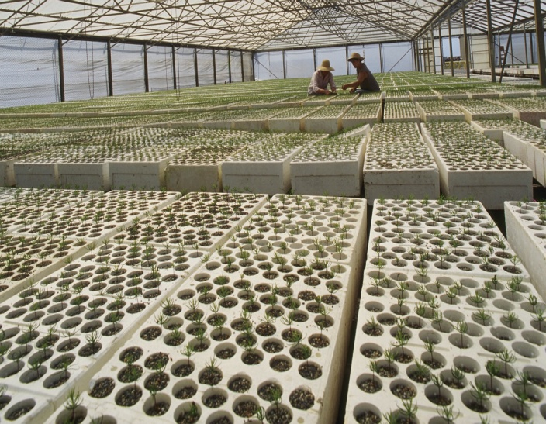

Slide 21
What Factors Increase Risk for
Herbicide Resistance?
Herbicide selection pressure and use patterns
  MOA, site of action
Weed characteristics and species
Vegetation management practices- crops, vegetation cover crop vs bare ground, rotations, weed control timing, mechanical control, stewardship.
Notes:
The next three slides will discuss factors which can increase the selection pressure for herbicide resistant biotypes.

Slide 22
Weed Characteristics and Herbicide Resistance Development
Annual growth habit vs Perennial growth
  growth from seed or vegetative propagation
  emergence duration and timing
High seed production and High weed density
  Higher density = Higher chance for resistant individuals
Relatively rapid turnover of the seed bank
  result of short lived seed dormancy
High susceptibility to a particular herbicide
Naturally high frequency of resistant gene(s) within the weed population (e.g. Kochia)
Notes:
We’ll first discuss weed characteristics.
Of the major weeds developing resistance to herbicides, all are annuals (perennials which reproduce from vegetative structures would be much less prone to evolve resistance). These weeds typically have high seed production with most seed germinating within a year. Also, if a weed species is particularly sensitive to a given herbicide, then this increases the potential to develop resistance since this also intensifies selection pressure. Finally, weeds which have a high level of genetic variation or a high frequency of resistant genes (such as that known to exist in plants like rigid ryegrass and lambsquarters) are some of the more problematic species.

Slide 23
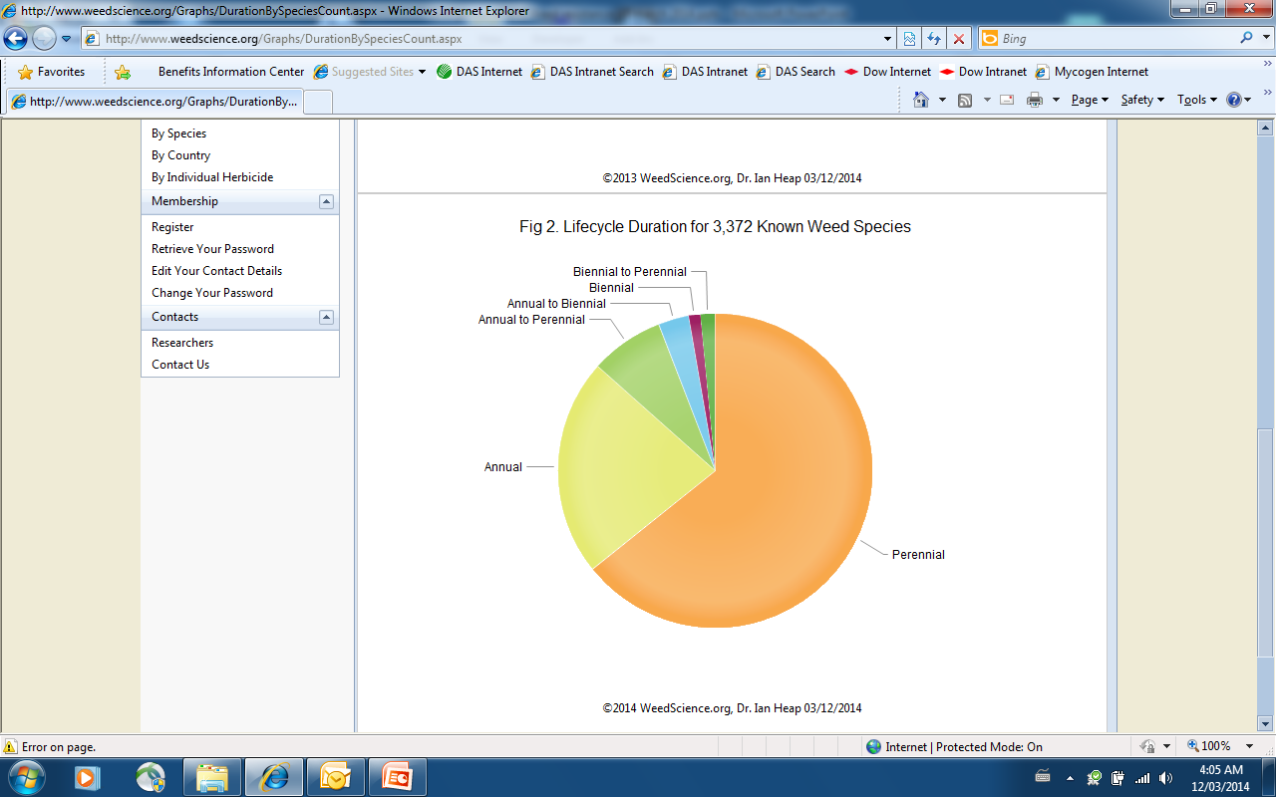
16%
62%/38%
22%
62%

Slide 24
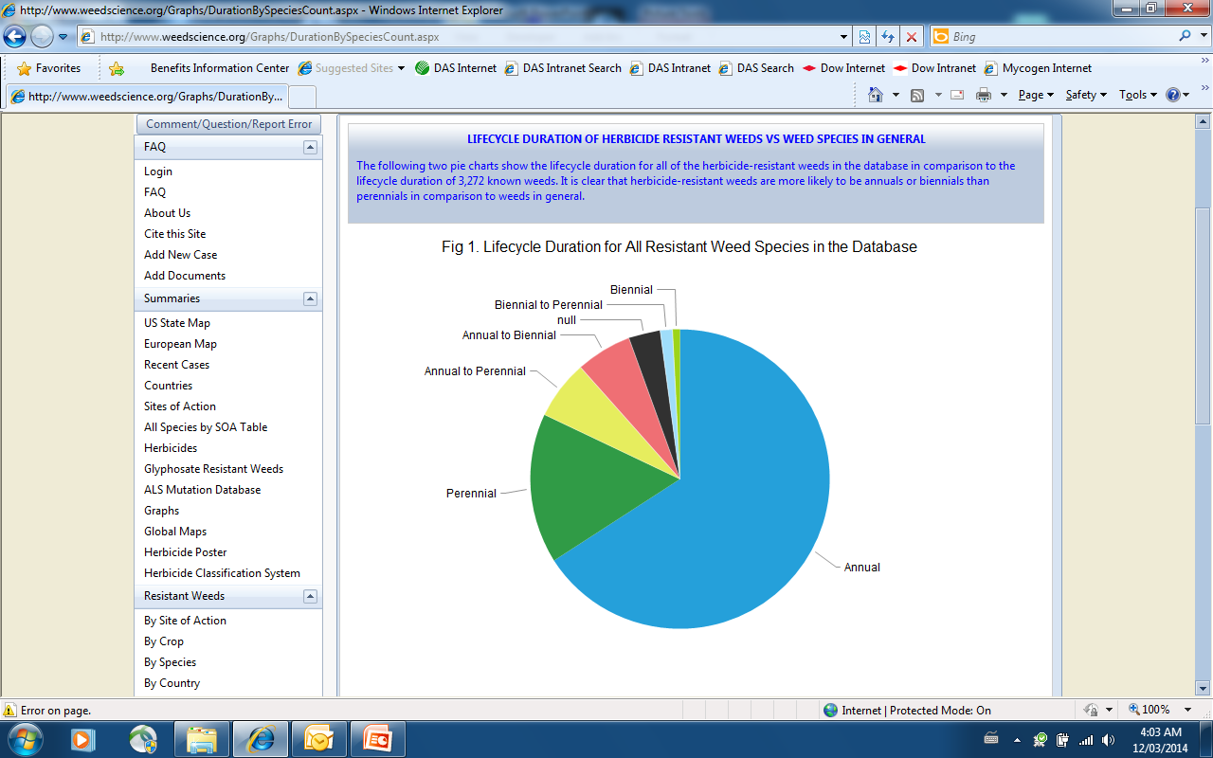
19%
84%/16%
16%
65%

Slide 25
Seed Production of Western Weeds
300,000
250,000
200
250
400
2800
3500

Slide 26
Kochia-Annual, high seed producer, high seed bank, genetics, highly susceptible
Assumes an initial weed seed population of 100,000/m2 with a 1 in 10,000,000 occurrence of resistant biotypes in the initial population and 90% weed control from Chlorsulfuron (Glean, Telar)
Simulated Progression of Resistant Kochia Exposed to Repeated Annual Applications of a Group 2 herbicide
Notes:
This chart is a very simple example of a model where kochia resistance to chlorsulfuron (Glean herbicide) was predicted. (Chlorsulfuron, an ALS inhibitor, would represent target-site resistance.) First, you will note that a starting point for all models is some key assumptions. In this case, assumptions were:
initial seed population of 100,000/m2
frequency of resistant biotypes (1 in 10,000,000)
a steady efficacy rating for the herbicide (90% weed control - thus a very effective herbicide)
The graph shows that if chlorsulfuron was applied repeatedly as an annual application in ceral crops, roughly 10% of the kochia population would be predicted to be resistant in a period of 5 years. A grower at this point might file a herbicide nonperformance complaint, but it could indeed go unnoticed or simply be misdiagnosed as a less-than-desired performance due to other factors (ie, poor application or environment at time of treatment). Note however, what happens in the next couple of years. In Year 6 - approximately 40-50% of the population becomes resistant, and in Year 7 the number escalates to ~90 percent . Typically it is thought that resistant biotypes are “detectable” when they comprise ~30% of the population. At Years 6/7 a problem would obviously be noticeable to the grower, and the situation would force him to change management practices on that particular field.
This graph illustrates one very important point regarding visual detection of target-site resistance: it is very common to go from excellent control of a particular weed to very poor control within one growing season.
In contrast, a more subtle decline in performance would likely be noted with resistance due to non-target site mechanisms such as enhanced metabolism. For example, in Europe where blackgrass shows metabolic resistance to several herbicides, control is often ~70 percent versus 0 percent or a complete failure. This latter type of resistance is much more difficult to recognize in a field situation or to predict via modeling..
(As for accuracy of the above model. . . in real field situations, resistance to sulfonylurea herbicides like Glean has been reported to occur after 3 to 5 years of repeated use).

Slide 27
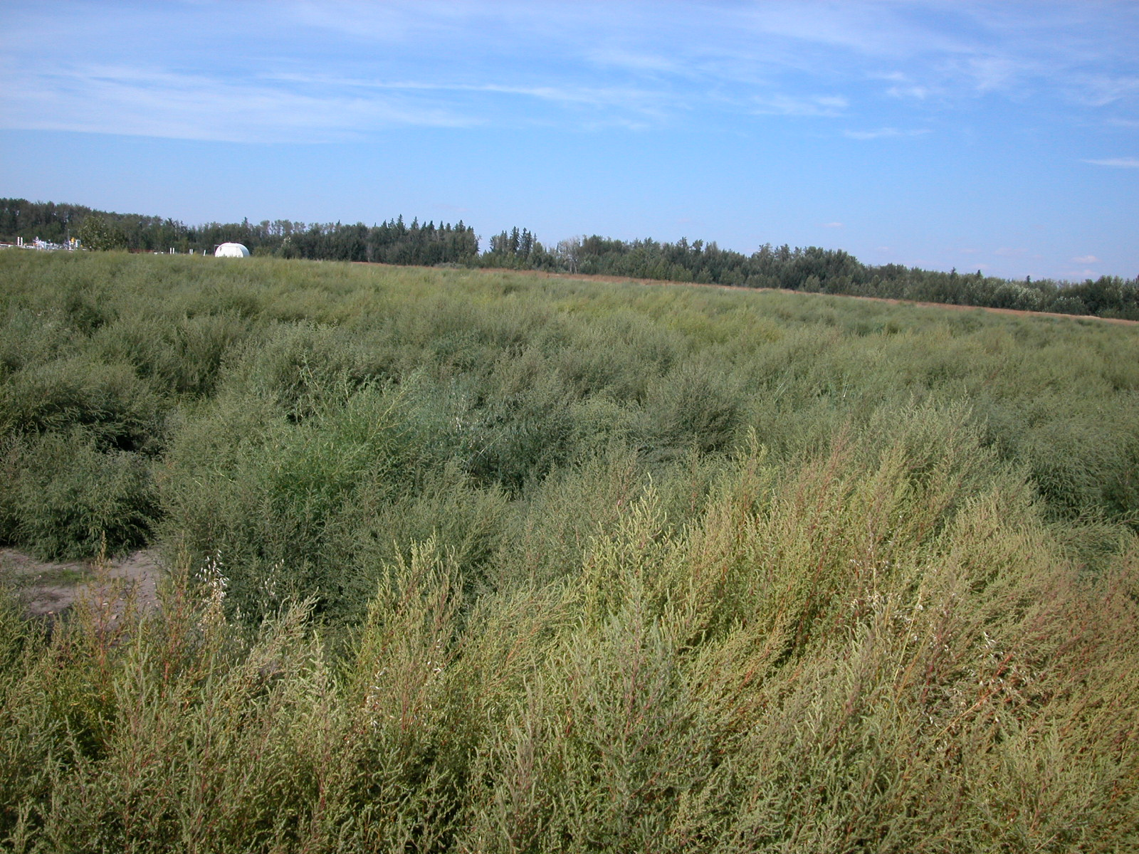
Kochia Invasion - Now ALS and Glyphosate Resistant!!
This field took 4 years to go from “very few” kochia to this
Group 2 ALS resistant Population @ Ft. Saskatchewan, Alberta- 2011

Slide 28
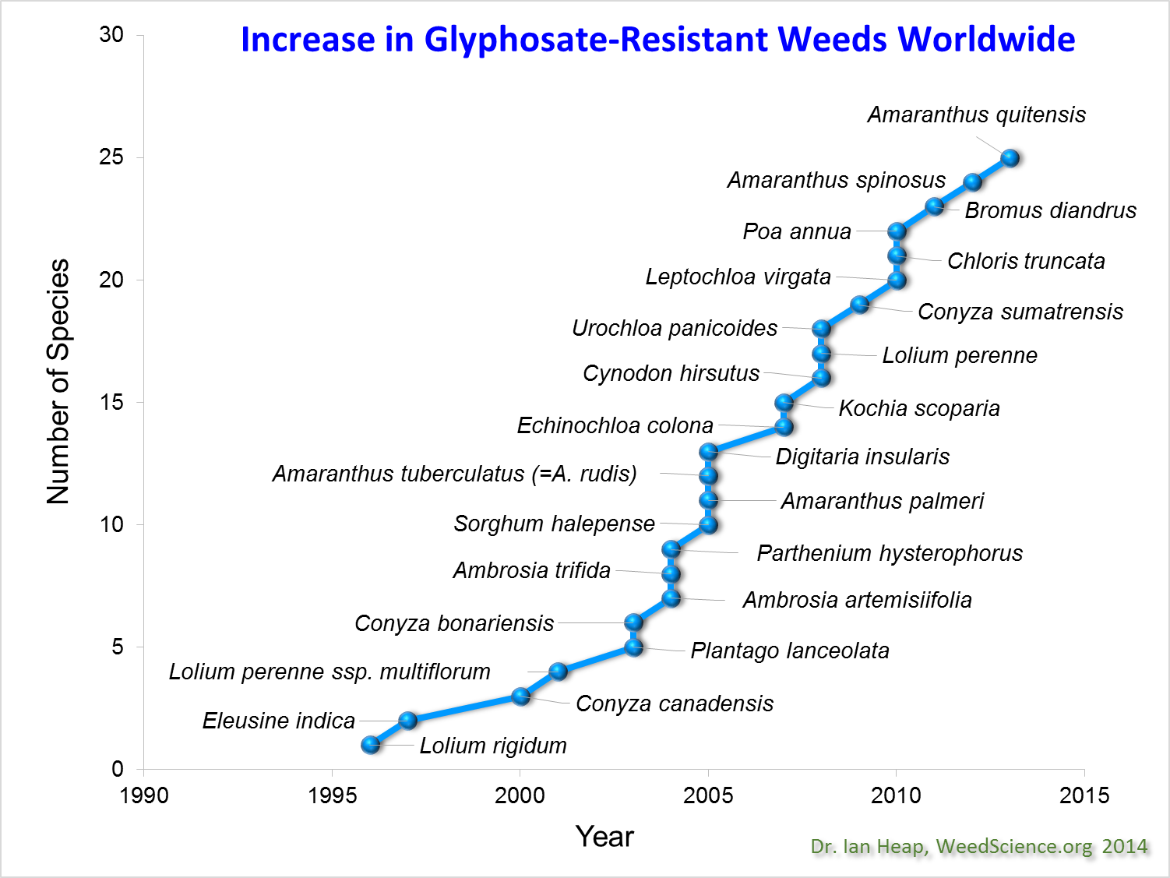
25 years of use
25 HR Species Already

Slide 29
Herbicide Factors that Increase Risk for Resistance
Two primary types of HR:
  target-site and non target-site (enhanced metab.)
Herbicides that act at a single site of action and are broken down in the plant with a common metabolic pathway increases risk of resistance.
  Group1, ACCase, Group 2,ALS Group 9 (glyphosate)
Herbicides that have a long residual in the soil.
  Group 2 – SU Telar, Metsulfuron, IMI Arsenal,
  Group 5,6,7 – Diuron, Atrazine,triazines
High performance on a wide range of growth stages.
Notes:
Herbicide factors can also influence selection intensity.
We’ll explain this a bit more later in the presentation, but herbicides with a single site of action (ALS, ACCase inhibitors) or a “common detoxification pathway” (like cytochrome P450 monooxygenase or glutathione-S-transferase) are characteristics that lead to rapid development of resistance.
Also, herbicides with prolonged soil residual allow a longer time to select for the resistance trait. Highly effective kill is also a factor since it depletes susceptible genes from the population quickly.

Slide 30
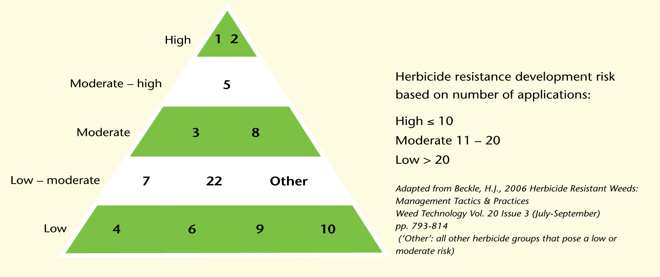
Understand Herbicide Mode Of Action
Herbicide Rotation and Management

Slide 31
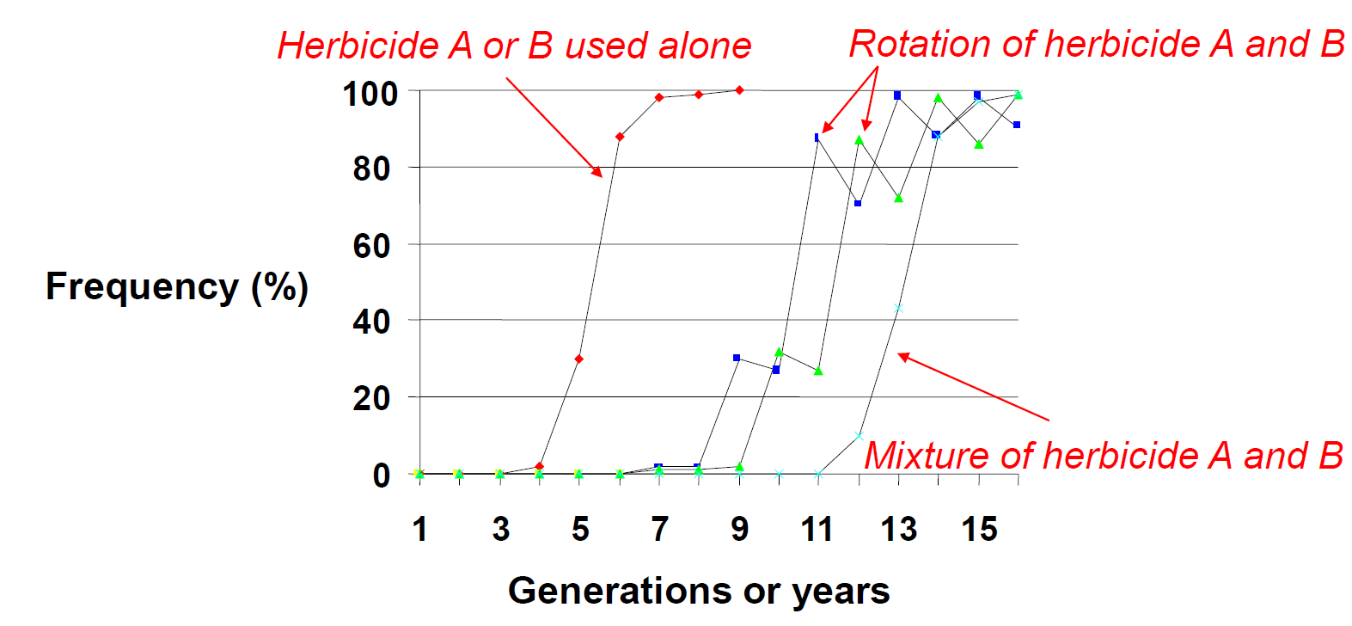
Predicted Increase of HR Over Time
Slide courtesy of Dr. Hugh Beckie

Slide 32
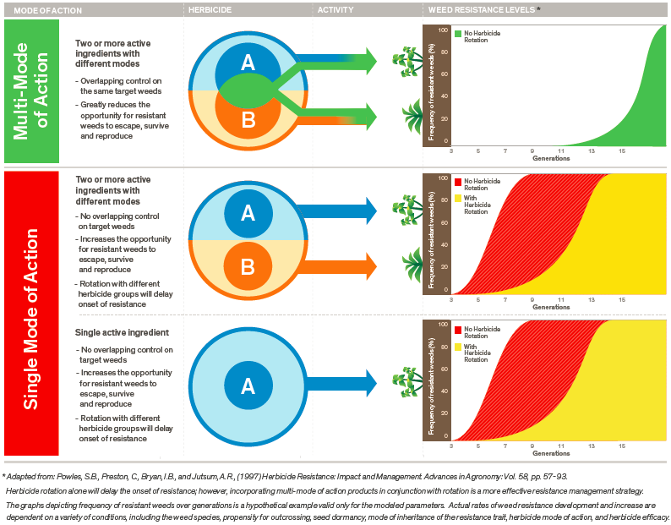
Herbicide Resistance Management

Slide 33
What Factors Increase Risk for
Herbicide Resistance?
Herbicide selection pressure and use patterns
  MOA, site of action
Weed characteristics and species
Vegetation management practices- crops, vegetation cover crop vs bare ground, rotations, weed control timing, mechanical control, stewardship.
Notes:
The next three slides will discuss factors which can increase the selection pressure for herbicide resistant biotypes.

Slide 34
Understand IVM Herbicide Mode Of Action
Herbicides grouped based on their mode of action.
Active | Product | Group
 | (example)
Chlorosulfuron | Telar,Glean | 2
Metsulfuron | Escort, Ally | 2
Imazapyr | Arsenal | 2
Glyphosate | Roundup | 9
Diuron | Karmex | 5
Atrazine | AATREX | 5,6,7,
Flumioxazin | Payload | 14
2,4D | 24D | 4
Dicamba | Vanquish | 4
Picloram | Tordon | 4
Fluroxypyr | Starane | 4
Clopyralid | Lontrel | 4
Triclopyr | Garlon | 4
Aminopyralid | Milestone | 4
Notes:
We’ve already learned that target-site resistance is one of the primary “mechanisms” of weed resistance. If we have some understanding of how individual herbicides work within the plant to provide control, we can better choose herbicide programs to prevent or manage resistance. If you choose to look at herbicide MOA in more detail, use the link on the bottom of the slide. Otherwise, the following slides will simply give an overview of which herbicide classes are most prone to resistance.
Note: It is important to understand that MOA is not always the key criterion in prevention of resistance. Where a non target-site resistance mechanism (like enhanced metabolism) has been identified, the mechanism of degradation is of greater importance. However, at present there is no classification of herbicides relating to degradation.
(If link is chosen)
These slides discuss various herbicide classes as sorted by mode of action. The WSSA (Weed Science Society of America), HRAC (Herbicide Resistance Action Committee) and Australian classification codes are utilized for discussion - each are used in various parts of the world.
This training segment allows one to learn more about these all of these herbicide MOA classes, find out which herbicides are included in each, and get a general picture of frequency/identification of resistant species .

Slide 35
Canadian IVM Products- HR Weeds
Active | Product | Group | HR Weeds |  | HR Weeds
 | (example) |  | Global |  | Canada
Chlorosulfuron | Telar,Glean | 2 | 33 |  | 25
Metsulfuron | Escort, Ally | 2 | 29 |  | 25
Imazapyr | Arsenal | 2 | 19 |  | 6
Glyphosate | Roundup | 9 | 25 |  | 4
Diuron | Karmex | 5 | 5 |  | 5
Atrazine | AATREX | 5,6,7, | 12 |  | 12
Flumioxazin | Payload | 14 | 1
2,4D | 24D | 4 | 29 |  | 4
Dicamba | Vanquish | 4 | 6 |  | 4
Picloram | Tordon | 4 | 3 |  | 1
Fluroxypyr | Starane | 4 | 3 |  | 2
Clopyralid | Lontrel | 4 | 1 |  | 0
Triclopyr | Garlon | 4 | 0 |  | 0
Aminopyralid | Milestone | 4 | 0 |  | 0

Slide 36
Canadian HR Weeds – 60 species
Annual Grasses Broadleaf PSII/Glyphosate
Wild Oats Kochia Kochia
Green foxtail Ragweeds Ragweed
Giant Foxtail Russian Thistle Marestail
Persian Darnel Annual S. Sow Thistle Tall Waterhemp
Barnyard Grass N. L. H Beard P. Amaranth
Crab Grass Mustards C. Groundsel
RR.Pigweeds
Cleavers
P. Amaranth
Lamb’squarters
Hempnettle

Slide 37
Canadian HR weeds by MOA
 | A | B | b | C1 | C2 | C | G | 0
 | 1 | 2 | 2 | 5 | 7 | 6 | 9 | 4
 | ACCase | ALS | Imazapyr | Photo Sys II | PSII(Urea) | PS(II)(Nitrile) | EPSP | S auxin
 | 4 | 25 |  | 12 | 3 | 2 | 4 | 2
1 | Wild Oat | Wild Oat |  |  |  |  |  | W. Mustard
2 | G. Foxtail | G. Foxtail |  | BarnyardGrass |  |  |  | W. Carrot
3 | Persian Darnel | Giant Foxtail
4 | Crab Grass | Horseweed | Horseweed |  |  |  | Horseweed
5 |  | Kochia | Kochia |  |  |  | kochia
6 |  | C. Ragweed | C. Ragweed | C. Ragweed | C. Ragweed |  | C. Ragweed
7 |  | Giant Ragweed |  |  |  |  | Giant Ragweed
8 |  | Spiny SowT
9 |  | L. Quarters |  | L. Quarters
10 |  | Russian T
11 |  | NLHBeard |  | Bird Mustard |  | Smooth Pigweed
12 |  | RR Pigweed |  |  | RR Pigweed | RR Pigweed
13 |  | W. Mustard | Mustard
14 |  | B. Mustard |  | C Grounsel
15 |  | Cleavers
16 |  | Shepards Purse | Shepards Purse
17 |  | Cow Cockle
18 |  | P Amaranth |  | P Amaranth | P Amaranth
19 |  | tall Waterhemp | tall Waterhemp | tall Waterhemp
20 |  | Smartweed
21 |  | Chickweed
22 |  | W.Buckwheat
23 |  | Black Nightshade
24 |  | Pennycress
25 |  | C. Hempnettle
26 |  |  | Catchfly

Slide 38
DAS Pyridine Chemistry Family
Global Registrations
Cost of New Active - $250 M*
Registration time – 9.1 years*
139,400 molecules screened for 1 new active
Aminopyralid
Fluroxypyr
Clopyralid
Triclopyr
Picloram
* Phillips McDougall Report, (Croplife America and European Crop Protection Association)

Slide 39
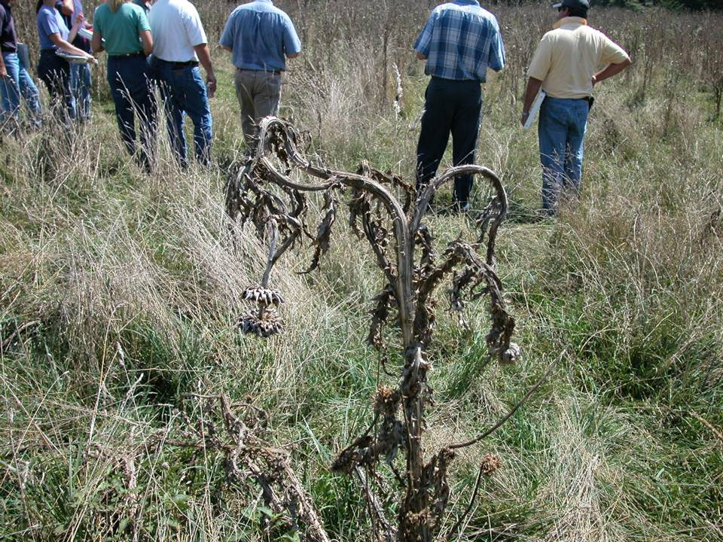
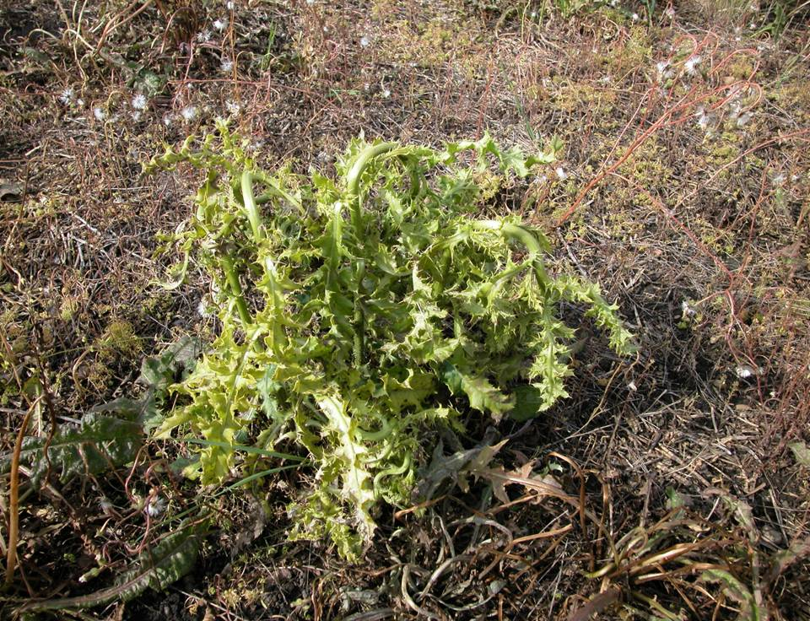
Auxins – Unique MOA for IVM
Group 4 “growth regulator” herbicide.
Absorbed by leaves and roots
Systemic, phloem and xylem mobile herbicide in plants.
Turn on system, all other turn off/block
Deregulation of cell growth, resulting in uncontrolled cell division of new growing tissue, resulting in epinasty and death
Globally –only 7 cases of HR in 60 years of use in Pyridine subgroup

Slide 40
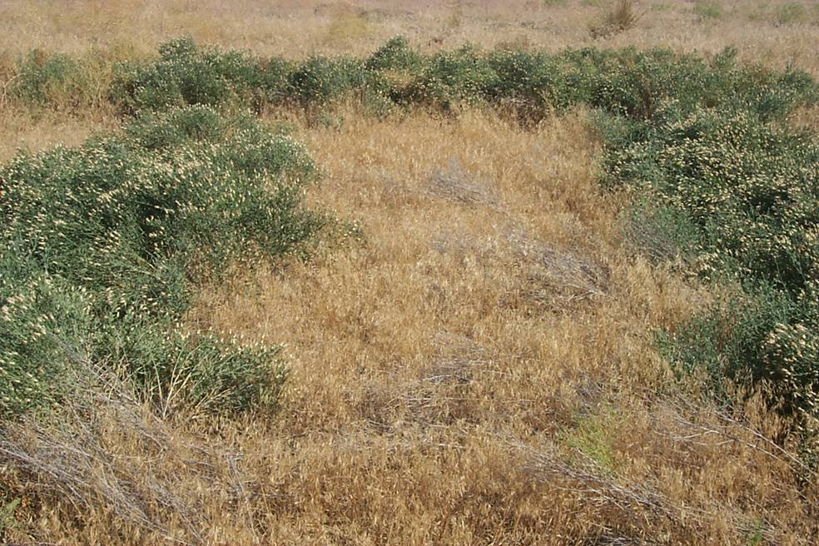
Russian Knapweed control with Aminopyralid at 60 g ae/ha (780 days after application)

Slide 41
Dow AgroSciences IVM Herbicides
Herbicide Resistance Management - Built in
Starts with a strong Mode of Action
  Group 4 Auxin - Pyridine
Pre-built in Multi-Mode Action or Multi-Site of Action in many co-formulated products
3 way combinations for MMA
Tank Mix with other MOA for bare-ground grass control and increased resistance management
  Vantage XRT, Arsenal, Karmex, EsplAnade

Slide 42
IVM Products - Mode of Action
Group 4 - Synthetic Auxins : Pyridine foundation
Aminopyralid Milestone, ClearView
Picloram Tordon 101, Tordon 22K
Triclopyr Garlon XRT, Garlon RTU
Fluroxypyr Sightline
Clopyralid Lontrel

Slide 43
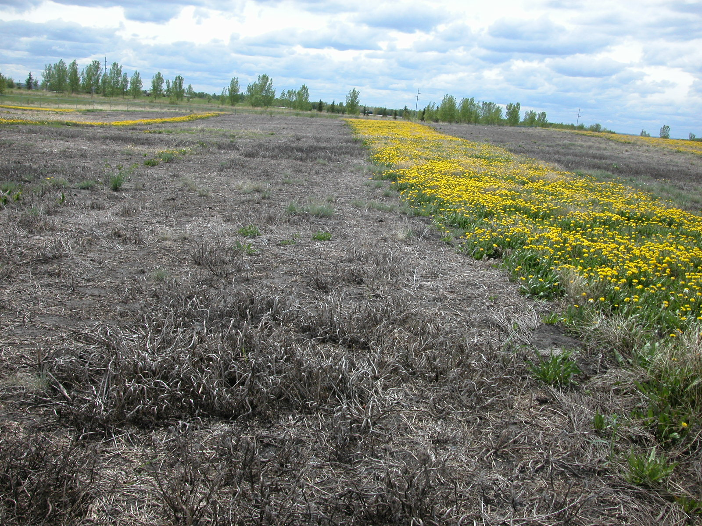
Bare ground MMA
ClearView + Glyphosate 60 DAA - (Ft. Saskatchewan)

Slide 44
Summary
Selection pressure caused by herbicide overuse/misuse generally leads to a resistance issue.
Two primary types of resistance:
  target-site
  non target-site
Herbicide Mode of Action are not the same
Rate and frequency of herbicide resistance occurrence and spread are influenced by:
  Weed characteristics
  Herbicide MOA selection pressure and use patterns
  Vegetation type, Management practices
Notes:
So. . . We’ve talked about a lot of things related to herbicide resistance today. Here are some key points to remember:
Resistant weeds are found, not created!!! Selection pressure caused by continued use of a particular herbicide or herbicide group generally leads to a resistance issue.
Two primary types of resistance:
target-site - This is the most common resistance mechanism. It occurs when the herbicide can no longer bind or interact within the plant to negatively impact plant metabolism or growth
non target-site - due to mechanisms other than target-site modifications (ie, enhanced metabolism, reduced herbicide translocation, or sequestration)
Weed traits such as annual growth habit, high seed production, little seed dormancy, several reproductive generations/season, high frequency of resistant genes are key factors in selection for resistance. The herbicide MOA and use pattern also play a large role in selection for resistance.
To prevent and or manage resistant weeds:
learn how to distinguish between nonperformance vs. resistance
understand herbicide MOA
know best management practices defined for your geography - understand that herbicides are just one component of Integrated Weed Management

Slide 45
Integrated Weed Management Practices
Chemical Practices:
Use herbicides prudently
  Consider economic thresholds and weed seed bank
Rotate to herbicides with different mode of action or site of action yearly OR
Apply herbicide combinations with different modes of action (tank-mixes, prepackaged or sequential applications).
Follow label directions for recommended use rates and application timings to ensure best efficacy.
Maintain detailed field records of cropping & herbicide history.
Notes:
Remember, the key to prevention of herbicide resistance is to reduce selection intensity and utilize herbicides with restraint within an overall Integrated Weed Management strategy. Management is the key!
Let’s first look at cultural practices which can be incorporated as part of an integrated approach:
Crop rotation - This factor alone can have a large impact. Since crops have different life cycles, one would likely be addressing different weeds in each crop. Consequently, tillage/herbicide options would be varied.
There are several ways to incorporate non-chemical weed control. Keep in mind how important non-chemical weed control has been shown to be (ie developing countries typically have few resistance problems because weed control methods other than herbicides are often a large component of the management plan).
Field scouting is always critical. It’s important to respond to changes in weed populations and prevent weed escapes from setting seed - this is how resistant biotypes multiply quickly in the seed bank.
And last - prevent spread of weed seeds. Selection for resistance is more important than spread of resistance, but still one should be careful not to disseminate resistant weed seed.

Slide 46
Integrated Weed Management Practices
Cultural Practices (Cont.):
Scout fields regularly to identify potential issues and eliminate weed escapes, and stop seed production. Keep good records of weed populations.
Control the Survivors – re-spray, cut, mow, pull
Prevent spread of resistant weeds by thoroughly cleaning equipment as it moves from field to field.
Also do not allow resistant weeds from total vegetation control areas (ie. fence rows, railroads, public utilities, etc) to spread to cropland, and vise-versa (mixing different systems of rotation, herbicide MOA and cultural practices.
Notes:
Remember, the key to prevention of herbicide resistance is to reduce selection intensity and utilize herbicides with restraint within an overall Integrated Weed Management strategy. Management is the key!
Let’s first look at cultural practices which can be incorporated as part of an integrated approach:
Crop rotation - This factor alone can have a large impact. Since crops have different life cycles, one would likely be addressing different weeds in each crop. Consequently, tillage/herbicide options would be varied.
There are several ways to incorporate non-chemical weed control. Keep in mind how important non-chemical weed control has been shown to be (ie developing countries typically have few resistance problems because weed control methods other than herbicides are often a large component of the management plan).
Field scouting is always critical. It’s important to respond to changes in weed populations and prevent weed escapes from setting seed - this is how resistant biotypes multiply quickly in the seed bank.
And last - prevent spread of weed seeds. Selection for resistance is more important than spread of resistance, but still one should be careful not to disseminate resistant weed seed.

Slide 47
Summary (cont.)
Use multi-mode of action herbicide groupings or rotate with different herbicide Groups
    Don’t rely solely on one group
Embrace and develop a multi-year and multi-crop strategy maintaining good records
Throw weeds off balance
    Change timing, cropping, fertilizer placement, tillage, etc.
Scout & Assess – are there surviving weed patches after herbicide application?
Test for resistance

Slide 48
Practices that Increase
Risk for Resistance
Use of the same herbicide or mode of action over an extended period.
Rotations that rely on the same herbicide grouping.
Weed control programs relying solely on herbicides - no integrated weed management.
Notes:
In general, whenever you rely completely on herbicides for weed control, this will greatly enhance the occurrence of resistant weeds. The advantage of non-chemical methods is that these do not select between susceptible and resistant plants.
Other things to keep in mind are:
Continuous planting of the same crop year after year will reduce options for rotating to herbicides with a different target site.
Any weeds that escape control by the herbicide should be eliminated in order to prevent seed production from this potentially resistant plant. Also, if seed is produced, one should be careful not to spread this seed from field to field as you may be “spreading the problem”
Typically one should always apply the 1X rate of a herbicide labeled for control of various species, since a higher rate will again increase selection pressure.
Many researchers believe modeling is an effective tool to predict the occurrence of herbicide resistant weeds given the weed, herbicide and cultural practices we just described.

Slide 49
Understand Herbicide Mode Of Action
Rotate herbicides groups (not brands) to delay selection for herbicide resistance.
Select herbicides with multiple modes of action or that have different mechanisms of action – each with activity on the target weed
(e.g. Sightline on Kochia).
Herbicide mixtures containing different Herbicide Groups are more effective than rotating herbicides.
Notes:
We’ve already learned that target-site resistance is one of the primary “mechanisms” of weed resistance. If we have some understanding of how individual herbicides work within the plant to provide control, we can better choose herbicide programs to prevent or manage resistance. If you choose to look at herbicide MOA in more detail, use the link on the bottom of the slide. Note: It is important to understand that MOA is not always the key criterion in prevention of resistance. Where a non target-site resistance mechanism (like enhanced metabolism) has been identified, the mechanism of degradation is of greater importance. However, at present there is no classification of herbicides relating to degradation.

Slide 50
Managing Herbicide Resistance
Assessment of the Risk of Resistance
(Herbicide Resistance Action Committee - HRAC)
Notes:
So. . .
Now that we’ve learned:
to distinguish resistant weeds from ones not properly controlled due to other factors
and we now have some basic understanding of herbicide MOA and the fact that the occurrence of herbicide resistance varies greatly by class
We can now focus on management concepts.
This matrix is a visual depiction of how one might go about assessing risk of herbicide resistance. Each of these components has been discussed previously, but this gives a good visual of how factors interact to influence risk.

Slide 51
Summary
“Current herbicides should be regarded as a non-renewable resource”
“sole and complete reliance on herbicides for weed control is not a long-term, sustainable practice”
Karlowsky et al., 2006. Can. J. Plant Science 86

Slide 52
Questions?
Thank you for your time!

