Slide 1
Integrated Pest Management Program
Authorizations Update
Nov. 7, 2023
IVMA of BC Forum
Chelsea Eby
IPM Officer
Regional Operations Branch

Slide 2
Overview
Staff update
New/updated guidance documents
  Interim guidance for Public Consultation on PMPs
  Indigenous Engagement Guidance
Blueberry River First Nations Implementation Agreement

Slide 3

Who is who for the IPM Authorizations Team?
Director
Communities IPM & AgriFood
Cassandra Caunce
Senior IPM Officer
(Scott Bennett base)
Andreas Wins-Purdy
IPM Officer
Chelsea Eby
Section Head
IPM & AgriFood
Sajid Barlas

Slide 4
Public Consultation Requirements for PMPs
IPMR Section 61 amended February 2022
Newspaper notices no longer specifically required
Now states that the two notices must be published “in the manner specified by the administrator”
No change to what is required in the notice

Slide 5
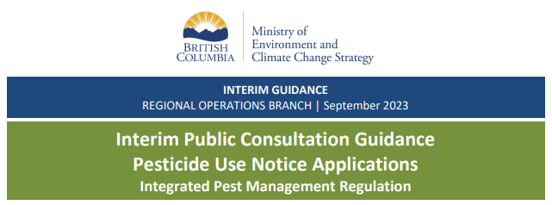
Interim Guidance for Public Consultation on PMPs
Intent is to have a comprehensive digital option for public consultation
  Not developed yet
After amendment, had applicants submit a public consultation plan for approval before beginning public consultation
Now have interim guidance of what is pre-approved
Available on the ENV website
www2.gov.bc.ca/gov/content/environment/pesticides-pest-management/business-industry/authorization-to-sell-or-use-pesticides

Slide 6
Interim Guidance for Public Consultation on PMPs
Option 1 – Newspaper advertisements
Follow the old requirements
Notice (40 cm²) placed twice in a two-week period
Option 2 – Digital advertisements
Notice placed in digital news media for a minimum of 3 days/week for 2 consecutive weeks
Digital news media does not include social media or social networking sites
Notice must include a link to a website where the PMP can be accessed
Option 3 – Public consultation plan approval
Send your public consultation plan to IPMPBC@gov.bc.ca for approval
Must have approval before publishing your first notice

Slide 7
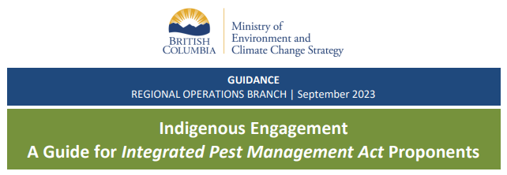
Indigenous Engagement – A Guide for IPMA Proponents
www2.gov.bc.ca/gov/content/environment/pesticides-pest-management/business-industry/authorization-to-sell-or-use-pesticides

Slide 8
Indigenous Engagement – A Guide for IPMA Proponents
Replaces 2011 Draft Guidelines for IPM Proponents Conducting Consultation with First Nations
Developed based on foundation of engagement with First Nations in draft guidelines and current best practices
Consistent with other ministry policies
Developed with recognition & observation of the UN Declaration on the Rights of Indigenous Peoples

Slide 9
Indigenous Engagement – A Guide for IPMA Proponents
Written for proponents who are:
Preparing a Pest Management Plan (PMP) to register with the Ministry through the confirmation of Pesticide Use Notice (PUN) process
Pesticide Use Permit (PUP) applicants
Updated language
Proponents engage with First Nations while performing the procedural aspects of consultation
Ministry consults with First Nations based on the proponent's engagement report

Slide 10
Indigenous Engagement – A Guide for IPMA Proponents
Proponents are encouraged to:
Understand and follow individual First Nation’s referral processes
Provide meaningful detail in plain language
Outline if the planned activities are for an ongoing pest management program or a completely new program
Provide spatial files (e.g. KMZ/KML)
Offer to share the annual Notice of Intent to Treat (NIT), including maps as spatial files for ongoing engagement and accommodation on PMPs
Contact IPMPBC@gov.bc.ca to confirm the list of First Nations to engage with before starting the engagement process

Slide 11
Indigenous Engagement – A Guide for IPMA Proponents
Examples of accommodation for impacts to interests of Indigenous people:
Sharing annual NITs and annual use reports
Changing pesticide use timing to avoid sensitive biological stages or food gathering areas
Reducing treatment area size
Changing pesticide application method
Using a different product in a specified area
Avoiding pesticide use in a specified area

Slide 12
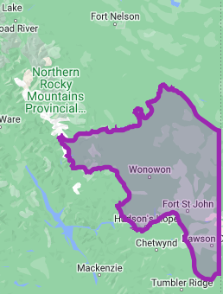
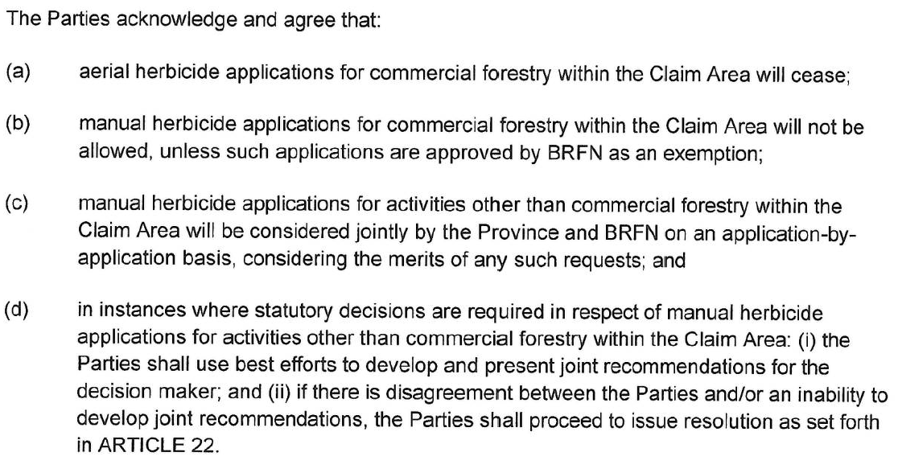
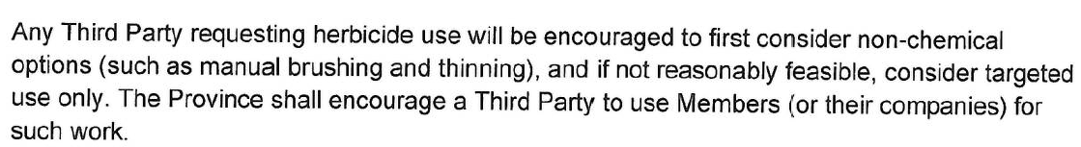
Blueberry River First Nations Implementation Agreement
Article 6.3 speaks to herbicide applications within the Claim Area
Province and BRFN are still working on implementation of the agreement

Slide 13

Questions?
Chelsea Eby
Chelsea.Eby@gov.bc.ca
236-468-2249

