Slide 1



BC Ministry of Environment
Integrated Pest Management Program Update
Christine Woodhouse, A/Director, IPM Section
BC Ministry of Environment
IVMA of BC Biennial Conference
November, 2016

Slide 2

Outline
Staff updates
IPM Regulation amendments

Slide 3
Staff Updates – since 2014
Retired: Jeff Fournier (Surrey)
Moved on: Colleen Loguisto and Gwen Lohbrunner
New to IPM Regional Operations:
  Conrad Bérubé, Senior Environmental Protection Officer (Nanaimo)
  Chelsea Eby, IPM Officer (Surrey)
  Andreas Wins-Purdy, IPM Section Head (Penticton)
  Cassandra Caunce, Director (Surrey)
  New to IPM Victoria:
  Rob Au, IPM Licence Officer
  Christine Woodhouse, Acting Director + Administrator
New: Kris Ord, Executive Director, Environmental Standards Branch
New: Mark Zacharias, Assistant Deputy Minister, Environmental Protection Division

Slide 4

IPM Regulation Amendments
Integrated Pest Management Regulation amended in December, 2015
New requirements came into force on July 1, 2016
Objectives
Pesticides will be used:
  By people with knowledge and training
  As part of an Integrated Pest Management process
Public interaction with pesticide dispensers will increase at the point of sale

Slide 5
IPM Regulation Amendments
New rules for pesticide use on landscaped areas of private land
  Certification (Residents)
  Licensing (Commercial property owners)
  OR: hire a licensed company / use an exempted product
  (some exemptions apply)
Municipal bylaws must still be followed

Slide 6
IPM Regulation Amendments
Schedules 2 and 5
Minor changes to Schedule 2 – Excluded Pesticides
New Schedule 5
  Domestic products that require no licence or certificate for use
New training required for Assistant Applicators
  Relevant to IVMA members
  Rob to provide more detail
New training for Residents
  Residential Applicator Certificate
  gov.bc.ca/homepesticideuse

Slide 7
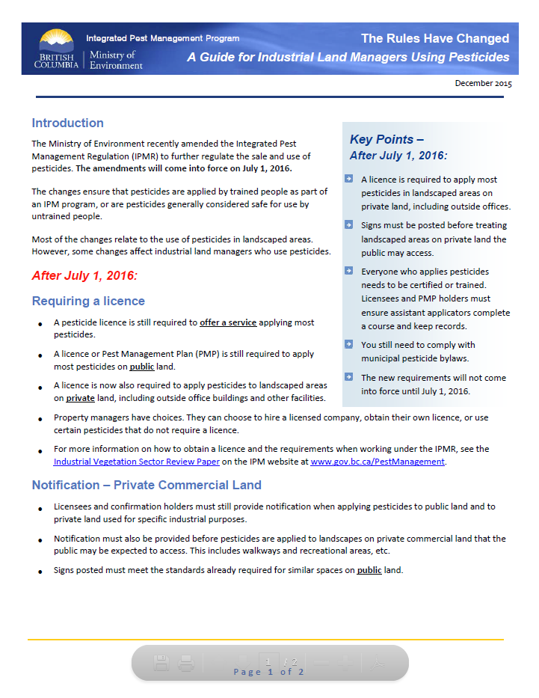
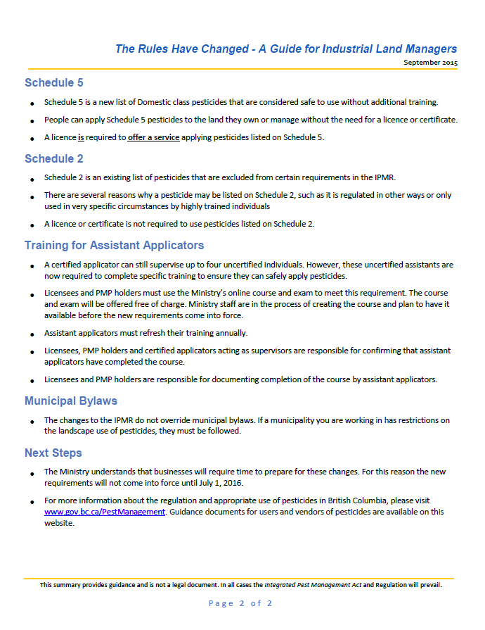
Guidance
The Rules Have Changed – A Guide for Industrial Land Managers Using Pesticides (PDF)

Slide 8

Thank you
Christine Woodhouse, MASc, PEng
Christine.Woodhouse@gov.bc.ca
250-356-5274
  gov.bc.ca/pestmanagement

