Slide 1
Integrated Pest Management Program
Policy Update
Nov. 7, 2023
IVMA of BC Forum
Emily Carmichael
Acting Large Industry Specialist
Environmental Standards Branch

Slide 2

Overview
ENV IPM Program Updates
Policy Updates
  Drones
Treaty 8 G2G agreements
Certification & training
Regulatory updates
  Adjuvants
  License year
  Rodenticide amendments

Slide 3
IPM Program Structure
ENVIRONMENTAL STANDARDS BRANCH (ESB)
Responsible for legislation, policy, certification, and training materials
COMPLIANCE & ENFORCEMENT BRANCH (CEEB)
Responsible compliance inspections, enforcement, complaint response, and compliance promotion
REGIONAL OPERATIONS BRANCH (ROB)
Responsible for authorization issuance
Joint responsibilities
Protection of human health and the environment from pesticides; industry and public outreach and promotion

Slide 4





Who is who for the IPM Policy Team?
Director /
IPM Act Administrator
Christa Zacharias-Homer
A/IPM Unit Head
Lauren Hall
(Jon Mullan Base)
A/Large Industry Specialist Emily Carmichael
(Lauren Hall Base)
A/Senior Policy Analyst
Rana Sarfraz
(Emily Carmichael Base)
Licence Officer
Sima Mpofu

Slide 5


Policy Update: Drones
Products registered for application by drone will have "Remotely Piloted Aircraft Systems" and/ or "RPAS" on the label
  3 product labels for mosquito larvicides
Policy Work (2023/2024)
Jurisdictional scan
GAP analysis

Slide 6
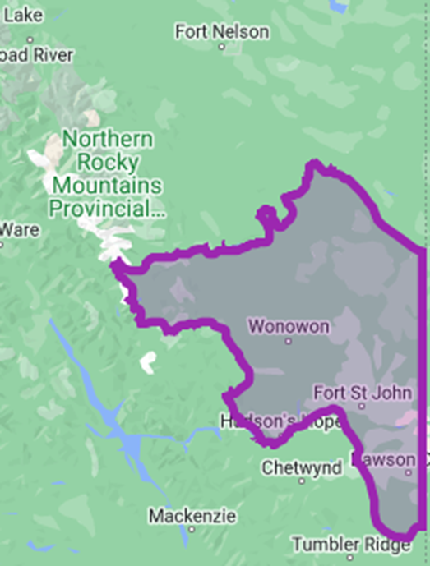
Treaty 8 G2G Agreements
2021 Supreme Court decision
  Province infringed upon Blueberry River First Nations’ (BRFN) Treaty 8 rights due to cumulative effects of industrial development
Jan. 18, 2023: Province and BRFN signed Implementation Agreement (collaborative decision making and land use planning)
Consensus agreement and letters of agreement reached with other Treaty 8 Nations

Slide 7

Certification & Training Improvements
Manuals
  Rodent Management in Agriculture Manual (2022) NEW
  Industrial Vegetation Manual (in progress – 2023/2024)
  Soil fumigation (2024)
  New Drone Manual (2024-2025)
Other
  Invigilator guidelines

Slide 8

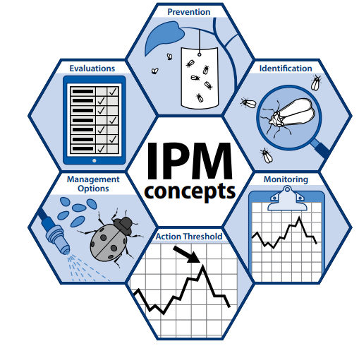

Regulation Update: SGARs
New regulations came into effect January 2023
  Sale and use of second -generation anticoagulant rodenticides
Only Essential Services
  (includes companies providing service)
Certificate to purchase and use
Licence to purchase and use
Enhanced IPM requirements
Restrictions on baiting periods
Disposal (unused bait & dead rodents)
No SGARs in critical wildlife habitats
Increased record keeping

Slide 9
Essential Services: who is included?
Schedule 6
  Health Services
  Emergency response services, emergency management services and national defence
  Electricity, water, oil and gas and similar services
  Agriculture and food
  Transportation
  Sanitation, waste and recycling services
  Communications
  Coroner, mortuary and similar services
  Environmental protection

Slide 10
Regulation Update: Adjuvants
IPMR Schedule 2: “surfactants”
Are all adjuvants excluded? YES
Status: amendment completed January 2023.
What does this mean?
1) don't need to add these when advertising
2) do not need to include/report in list of pesticides used
3) don't need to include in PMP

Slide 11
Regulation Update: Licence year
Amended definition of a “licence year”
  Previously, a licence year began on April 1
  NEW: a licence year is one year from the date of issuance
Avoids administrative processing bottlenecks
PLEASE CHECK YOUR LICENCE EXPIRY DATE!

Slide 12
For more information
Web page: www.gov.bc.ca/PestManagement
Subscribe to our IPM News & Updates: https://www2.gov.bc.ca/gov/content/environment/pesticides-pest-management/ipm-news-updates
Emily.Carmichael@gov.bc.ca
(778) 405-1935
Integrated Pest Management Program HQ/Victoria

Slide 13
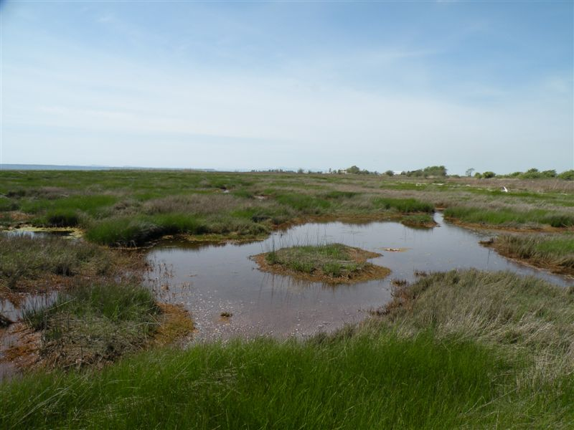
Policy Update: Pesticides Near Water
Explanatory Note: Using Pesticides Near Water – Work Plan 2024
  Defining a “body of water” and regulatory requirements when working near water

Slide 14
Essential Services: who is included?
Schedule 6: Electricity, water, oil and gas and similar services
Electricity
  Infrastructure and facilities associated with the generation, transmission or distribution of electricity
  Does not include car charging stations
Drinking water
  Water filtration facilities and water distribution facilities
Wastewater
  processing facilities
Petroleum, natural gas and propane gas production, processing, transmission, distribution and storage
  Does not including gasoline stations

Slide 15

Essential Services: who is included?
Schedule 6: Transportation
Commercial or industrial shipping
  Commercial ports, passenger terminals and commercial terminals and shipyards
Airplane hangars
Rail
  Infrastructure and facilities associated with the transportation of passengers and goods by rail

Slide 16

Essential Services: who is included?
Schedule 6: Communications
Radio
Cable television
Telecommunications systems and services
  Cellular towers, broadcasting structures, and internet exchange points
  Does not include offices and call centres

