Slide 1
WILD BOARS in
Lac Ste. Anne County
IVMABC
Richmond 2014

Slide 2
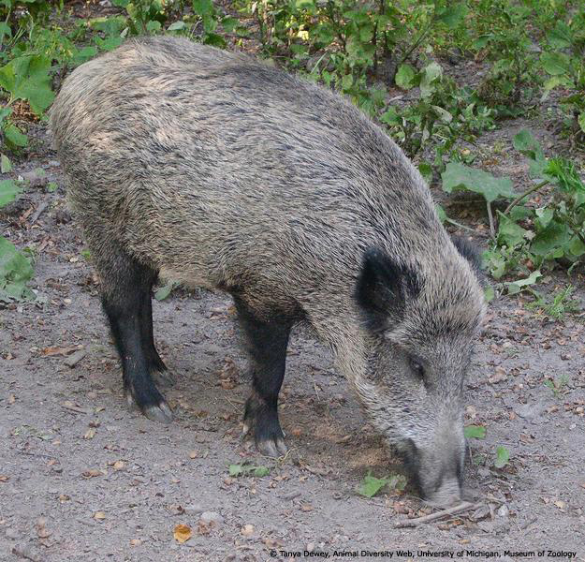

Slide 3
Employed with Lac Ste. Anne County for the past 20 years as the Agricultural Fieldman
Appointed by the Provincial Gov’t as a Pest Inspector under the Pest Control Act

Slide 4
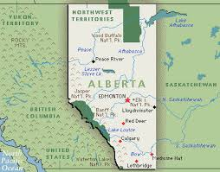

Slide 5
Wild boar were imported into Alberta in the early 1990’s from Europe as meat production animals and for hunt farms. There are no current regulations or restrictions on raising them in captivity.

Slide 6
Diversification of Alberta Farms
People started importing Wild Boars in conjunction with Alberta Agricultures push for Diversification of Farming to help with profitability.
Other animals were being raised domestically such as Bison, Emus, Alpacas and Ostriches.

Slide 7
Background
In the mid -1990’s, the Alberta Wild Boar Association successfully lobbied the Alberta government to include wild boar under the Stray Animals Act.
The Brand Inspectors responsible for enforcing this Act were powerless to capture these animals and gave permission to landholders to destroy any wild boar that strayed onto their property.
Very few were captured or destroyed because of their evasiveness.
As hunting pressure starts to build wild boars will change their habits. For example, in Lac Ste. Anne County the wild boar population now is largely nocturnal.

Slide 8
Background in Lac Ste. Anne
Problems reported first in late 1990’s.
Another Local producer had been raising Wild Boars for meat production in the area since about 1990.
In 1991 we actually made this location a stop on our local ASB Summer Tour as a stop to showcase Agriculture diversity.

Slide 9
“The Furrow” –Magazine excerpt
This producer was even given some press on his operation and highlighted as a entrepreneur.

Slide 10
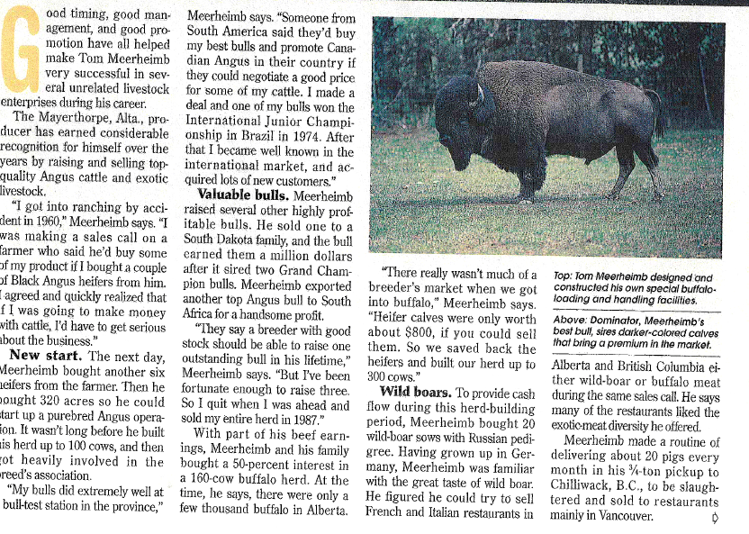

Slide 12
At one time this farm had 300-700 animals on site, currently there are approximately 60 wild boar.
This location was a stop on the Provincial ASB Summer Tour in 1997 to showcase agricultural diversity.

Slide 15
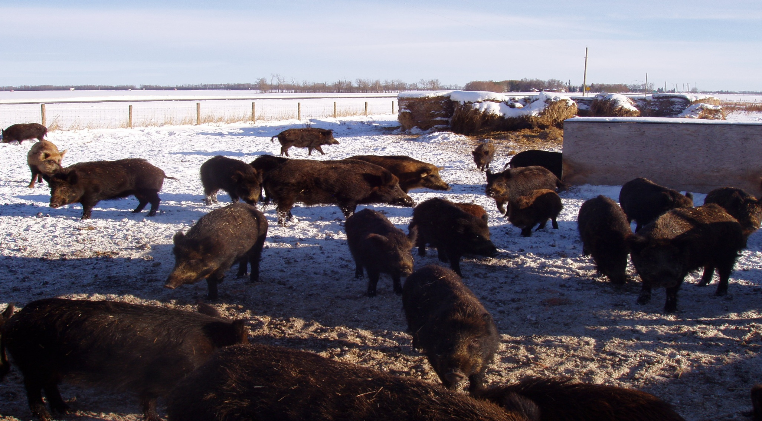
Hunt farm

Slide 16
Wild Boar Hunt Farm
Meat from this operation is also served as at high end restaurants such as the Westin Hotel in Edmonton, and Resorts in Banff Alberta.

Slide 17
Miconseption
Common misconception - Internet article - Wild Boars in Pennsylvania weren’t expected to survive their winter
This was not the case. Many wild boar that escaped reproduced in the wild. The numbers grew at an alarming rate.
May of 2003 - estimated to be close to 500 at large.
.

Slide 18
Difficulties
Wild Boars - deemed to be livestock under the Stray Animals Act
Legally a landowner is not allowed to destroy a wild boar on his property unless he contacts an inspector, the inspector is satisfied that the animal is “dangerous” and the inspector authorizes the landowner or some other person to destroy the animal.
Because of these regulations, control of wild boars was next to impossible since even if wild boars were at large on your property any immediate control was not possible.

Slide 19
Its now political…..
In the late 1990’s the County office, Elected Officials and the Agricultural Service Board began receiving complaints about Wild Boars from producers in an area adjacent to where the Wild Boars had escaped.
In 2000 complaints about wild boar at large and causing damage to crops, field and stacked and baled hay were numerous and complaints were made directly to the local MLA, local RCMP and Fish and Wildlife.

Slide 20
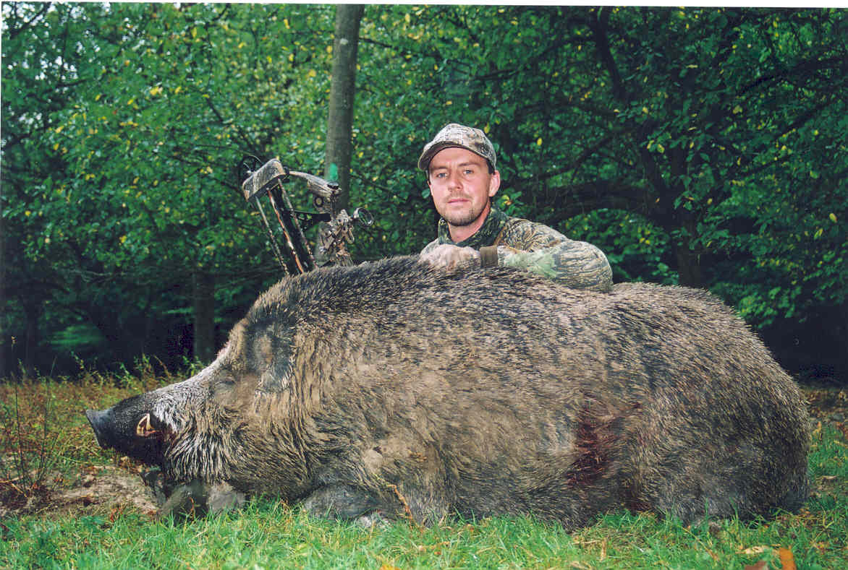

Slide 21
Problems
Most common complaints were: damage to standing crops - boars would flatten the crop and root up pits in the field; damage to stacked bales - boars would burrow into them, break them apart and their manure would make them unfit for cattle feed.
Wild Boars are aggressive and posed a potential danger to people as well as livestock.

Slide 22
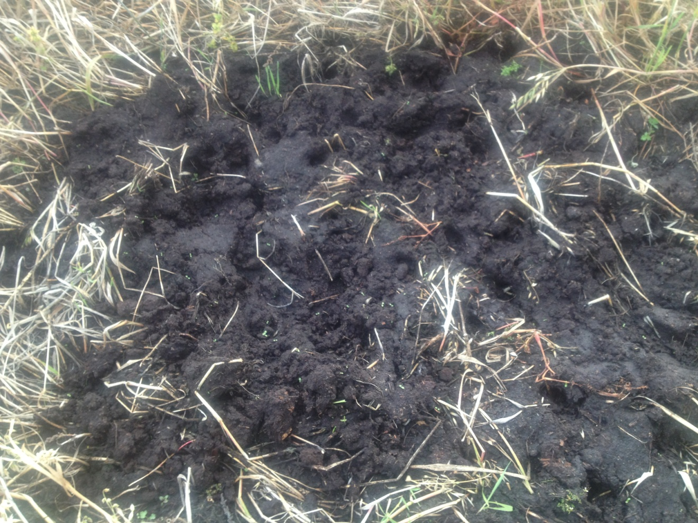
Damages to Crop Areas

Slide 23
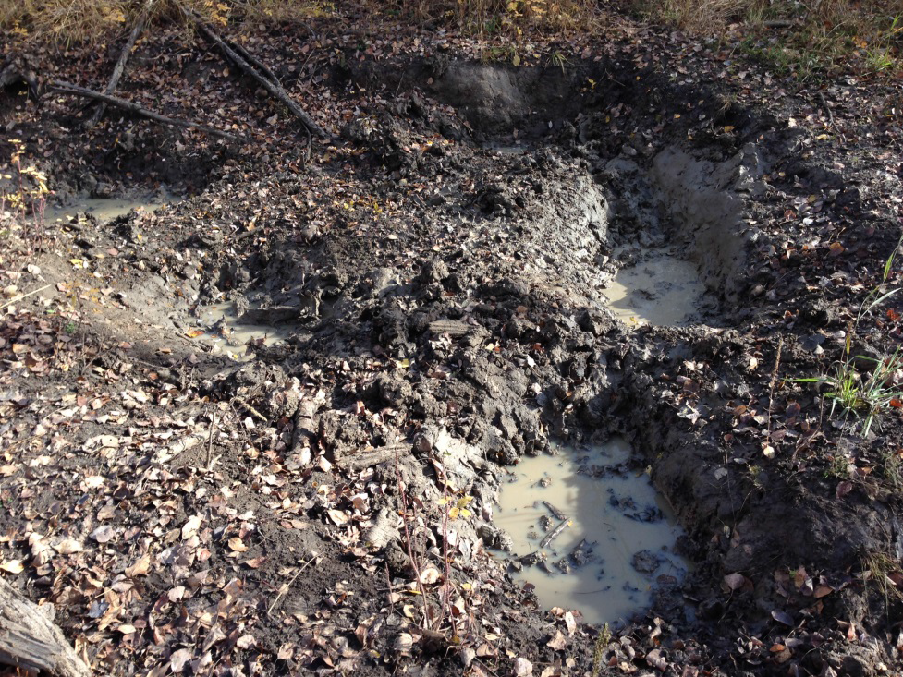
Damages to Crop Areas

Slide 24
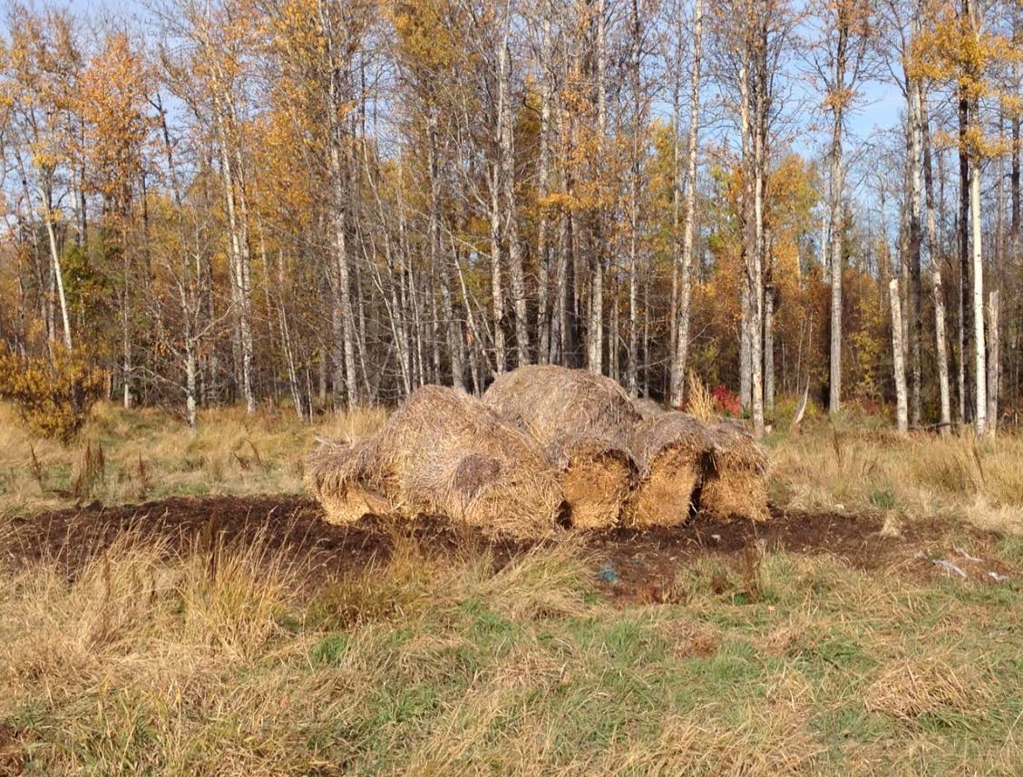

Slide 25
Attempts at ASB resolution
In 2001 a resolution was brought to the Provincial Agricultural Service Board Conference
Therefore be it resolved: That Alberta Agriculture Food & Rural Development take responsibility to remove the Wild Boars that are running at large in Alberta

Slide 26
Resolution
Therefore be it resolved: That Alberta Agriculture Food & Rural Development take responsibility to remove the Wild Boars that are running at large in Alberta

Slide 27
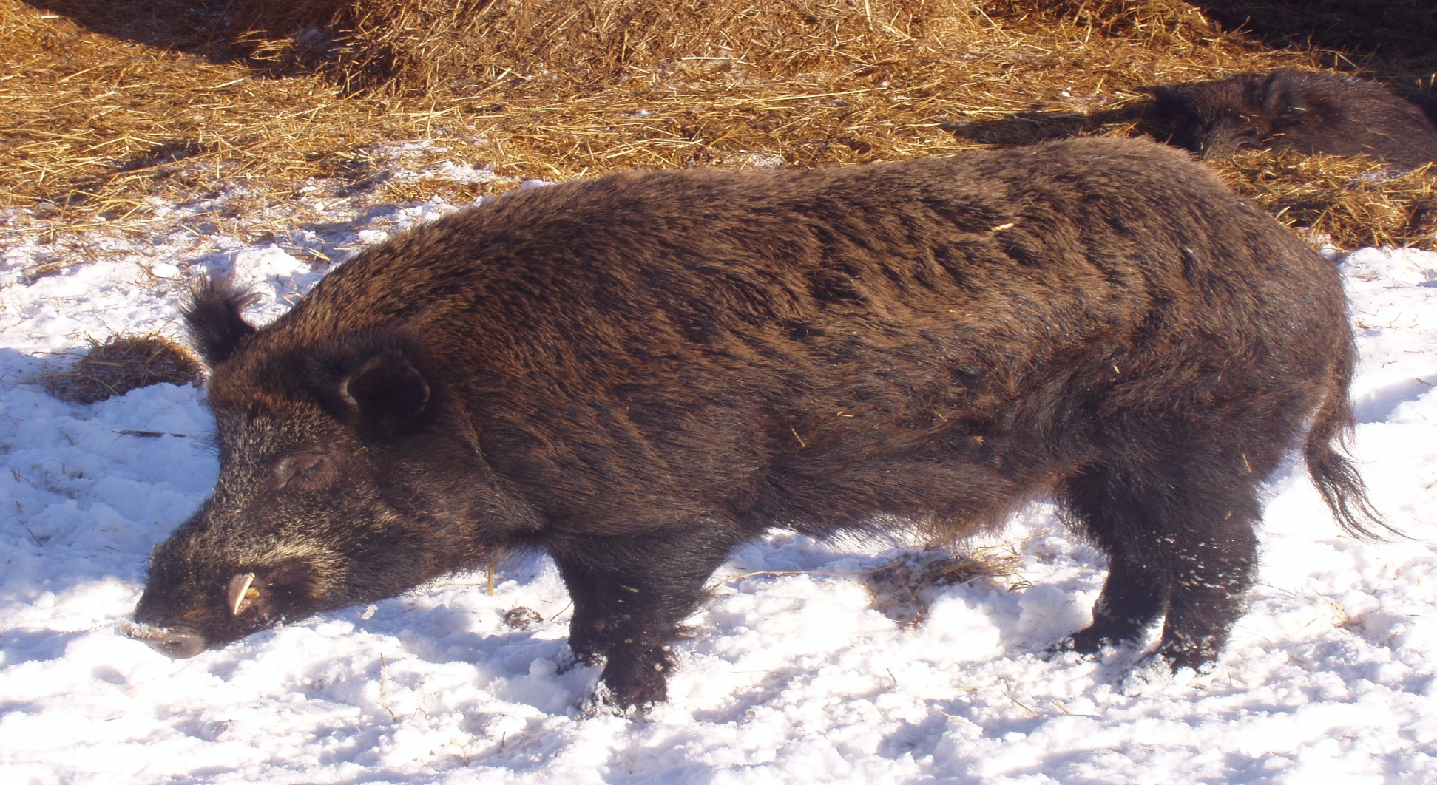

Slide 28
Plan
In early 2003, AAFRD was requested to assist in the development of an eradication plan for Lac Ste. Anne County.
Pilot project initiated - wild boar at large in Lac Ste. Anne County added to the Agricultural Pests Act.

Slide 29
Original Pilot Program
$20,000 to set up, advertise and payout on bounty
Manufactured a wild boar trap for local producers to try and live trap wild boars.

Slide 30
Bounty information
Bounty consisted of $50 per pair of boar’s ears and written permission from the landowner must be obtained.
Wild Boar was declared a “Pest” in LSAC

Slide 31
PEST ACT
Act States
“An animal, Bird, Insect, Plant, or Disease is destroying or harming or likely to harm any land, livestock or property may be declared a Pest or a Nuisance.”
Wild Boar (Sus scrofa) is declared to be a pest where it is at large in Alberta

Slide 32
Under the ACT it states
DUTY OF INDIVIDUAL
5(2) An owner or occupant of land or property or the owner or person in control of livestock shall take active measures to
  a) Prevent the establishment of pests on or in land, property or livestock unless otherwise authorized by the minister

Slide 33
Program
The program was successful to the point of motivating landowners to hunt wild boars which they may or may not have done otherwise.
Has it eradicated the Pest …..? Nope

Slide 34
The Press
Globe & Mail, Financial Post, MacLeans Magazine, Western Producer, Alberta Outdoorsman, Edmonton Journal, Alberta Farmer Express, Edmonton Sun, 630 CHED, CBC Radio, Global TV, CTV, and WILD TV.
Online hunting blogs with Alberta Outdoorsman

Slide 35
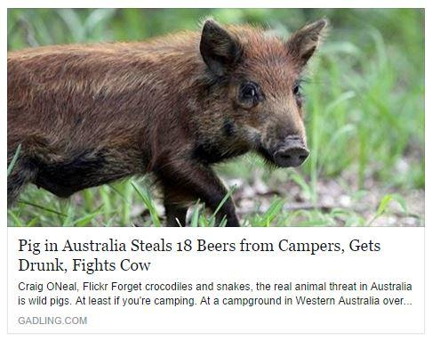

Slide 36
RING THOSE PHONES
Every media event that occurs we get inundated with calls from expert hunters wanting to come in to Lac Ste. Anne County and “fix our problem”
Information posted on our County Website to help alleviate the calls from hunters inquiring about hunting wild boars in Lac Ste. Anne County

Slide 37
No, we do not maintain a list of landowners with wild boar problems. It is the responsibility of the hunter to contact the landowner

Slide 38
Challenges with Hunters
List of farmers who were having problems with wild boar
Snaring – group hunting – leaving gates open…..
Farmers getting fed up with the calls and hunters not obeying rules set out.

Slide 39
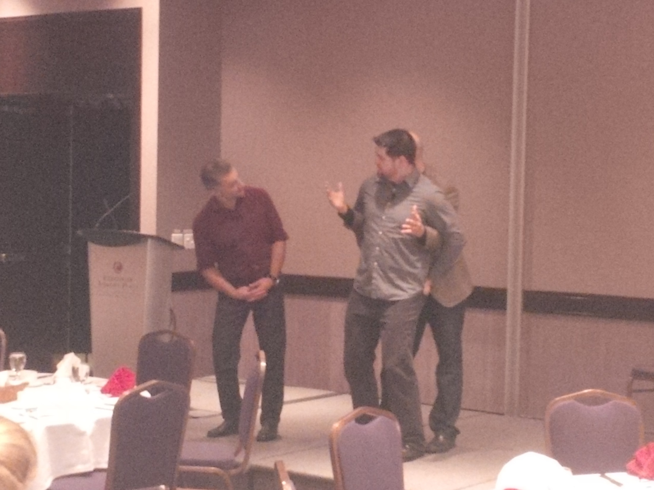

Slide 40
Wild boar Canada mapping
http://wildboarcanada.ca/#sthash.quNwLKDj.dpbs
http://wildboarcanada.ca/#sthash.quNwLKDj.dpbs

Slide 41
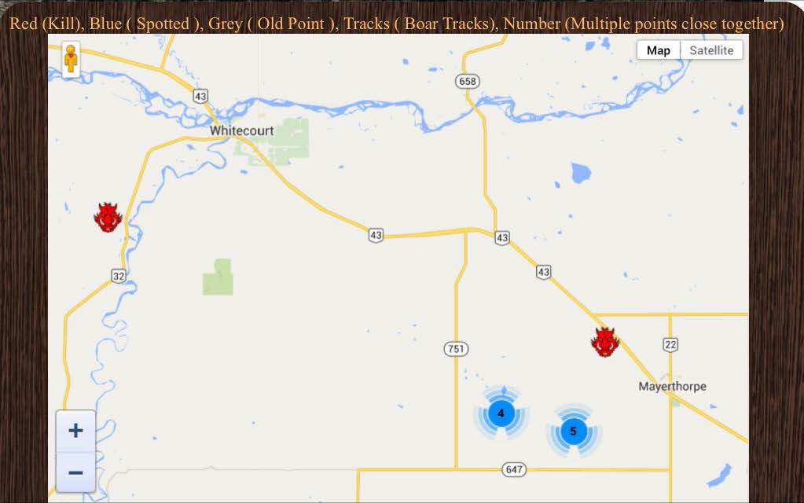
http://wildboarcanada.ca/#sthash.quNwLKDj.dpbs
http://wildboarcanada.ca/#sthash.quNwLKDj.dpbs

Slide 42
Program Statistics
To Date 460 sets of Wild Boar ears have been collected under the Lac Ste. Anne County program.
  This Equates to $23,000

Slide 43
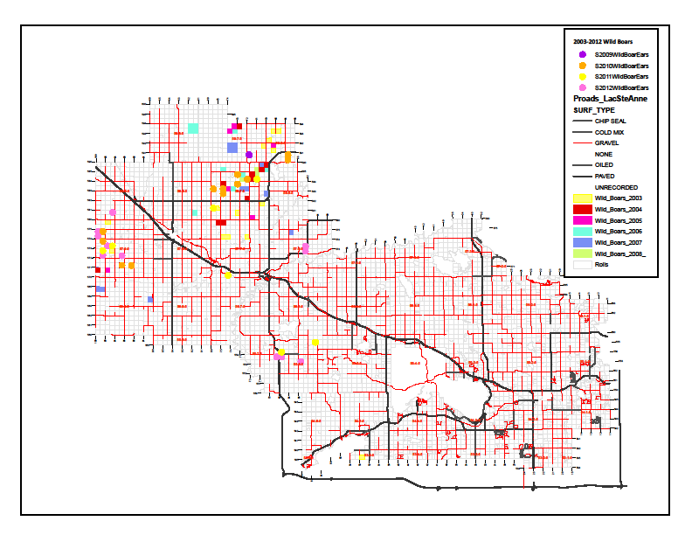

Slide 44
Program Statistics
NOT including the bounty submitted thus far in 2014
Parkland County - 4
Yellowhead - 0
LSAC - 13
Brazeau - 0
Woodlands - 38

Slide 45
Program Statistics
To date (since 2009) 222 sets of Wild Boar ears have been collected under the Woodlands County program. ($11,100 in payments)
In the NW Region, 534 ear pairs collected as of last March between 2008 and 2014 ($26,700 in payments)
Provincially approximately 942 sets have been collected from 2008-2014 ($47,100 in payments)

Slide 46
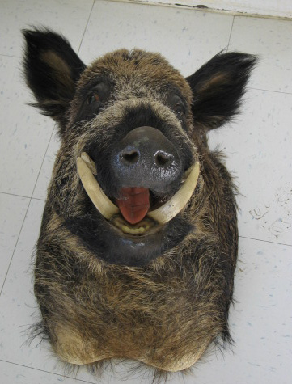

Slide 47
Building Trust with the Landowners
Most people who are hunting the wild boar personally know the landowners or have built up a rapport.
Good communication is key – notify where & when you are hunting
One hunter has been particularly successful in building that realtionship

Slide 48
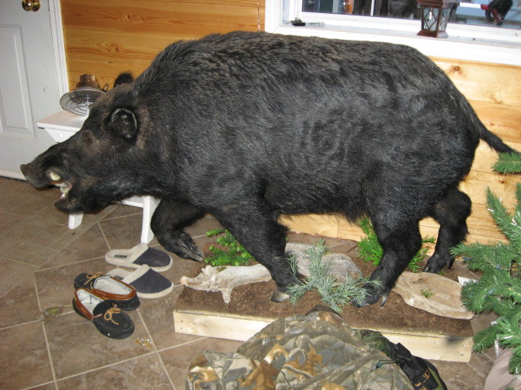
Live Mount of Wild Boar Hunted

Slide 49
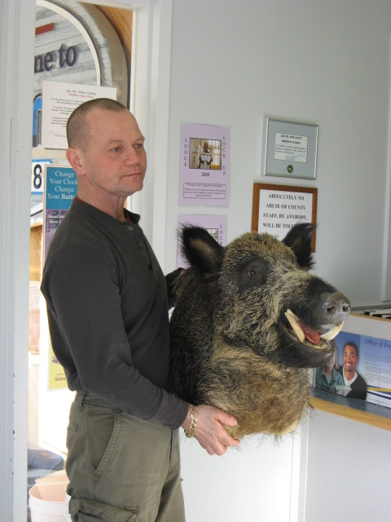
Local Hunter with Victim

Slide 50
Pest VS Domestic????
When is a Wild Boar a Pest?
Once it gets out of a fence

Slide 51
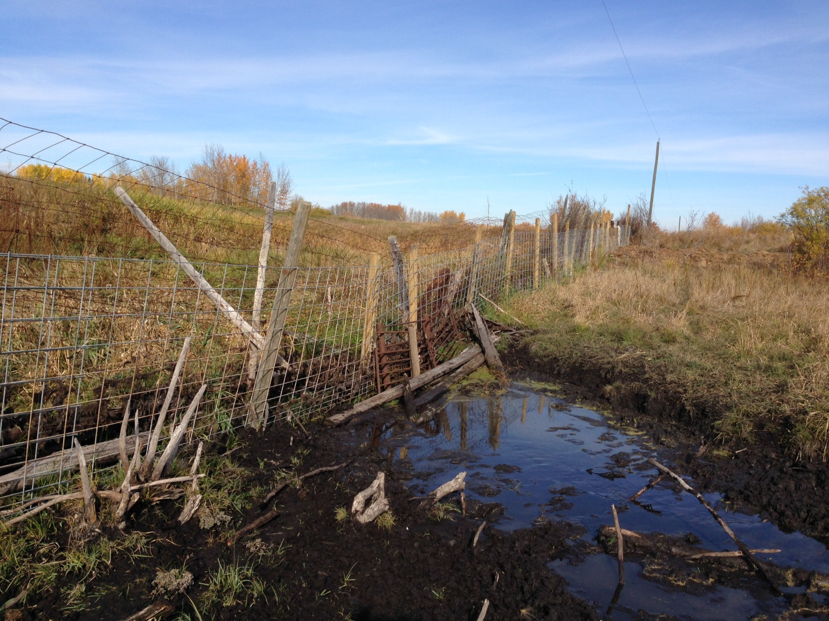

Slide 52
Fencing Requirements
All existing wild boar fencing systems will be required to conform to the Containment Standards no later than Dec 31, 2018.
Actual fact – they’ve already had over 20 years to provide adequate fencing

Slide 53
Fencing Standards
Standard 1
Buried fence with an electric wire.
Standard 2
Double fencing system with an electric wire.

Slide 54
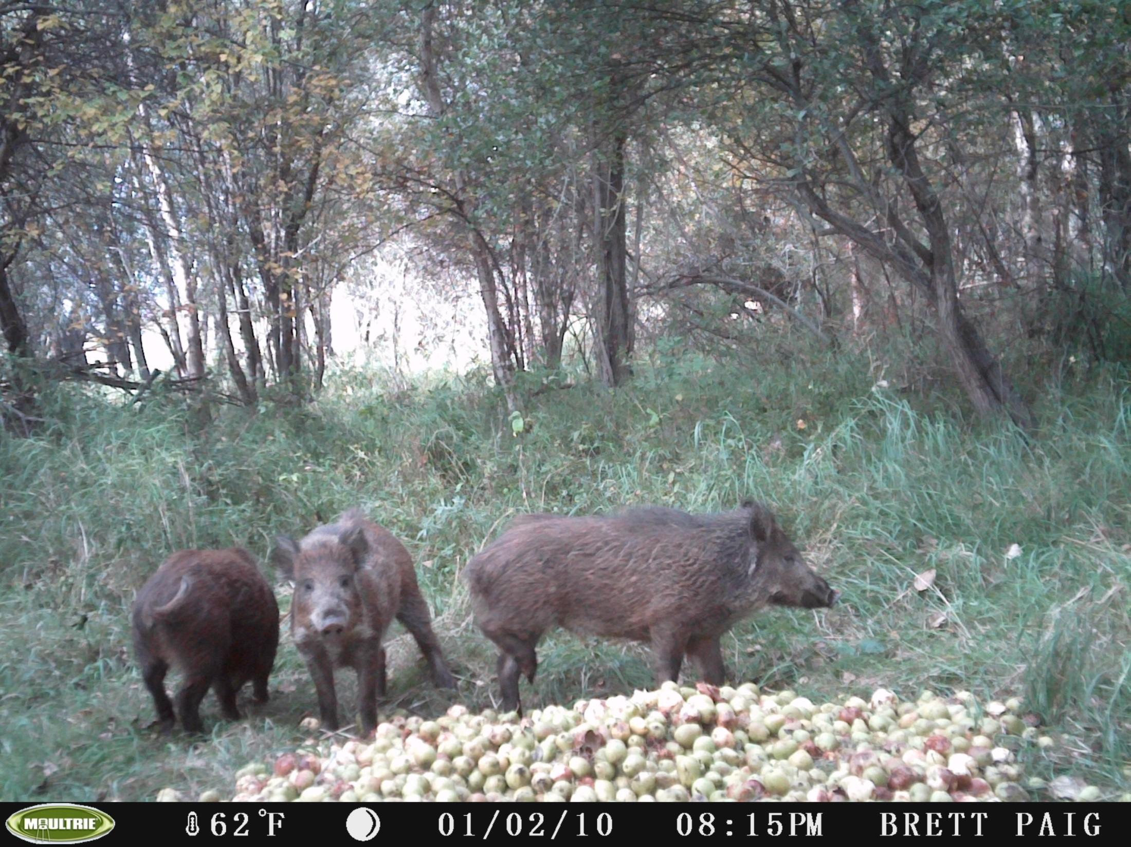

Slide 55
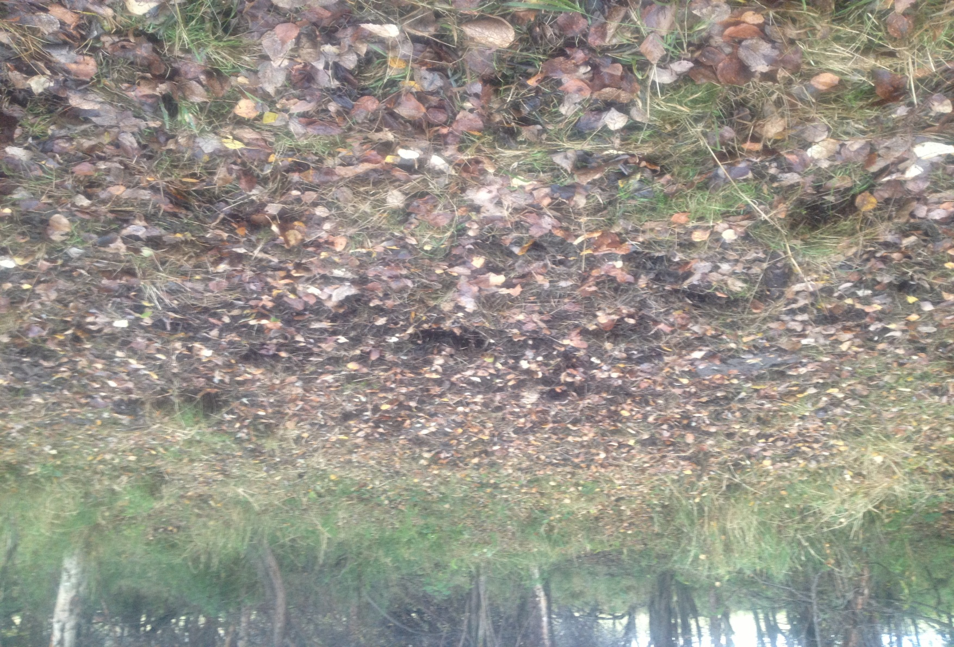

Slide 56
Discussion on the PEST ACT
b) control or destroy all pests on or in the land, property or livestock unless otherwise authorized by the Minister

Slide 57
Responsibilities of Owners
Where do the responsibilities of the Owners of these animals come in to play?
- Sufficient containment standards
- Livestock identification
- Accountability
They are in fact self-governed in their operations of owning a potential Pest.

Slide 58
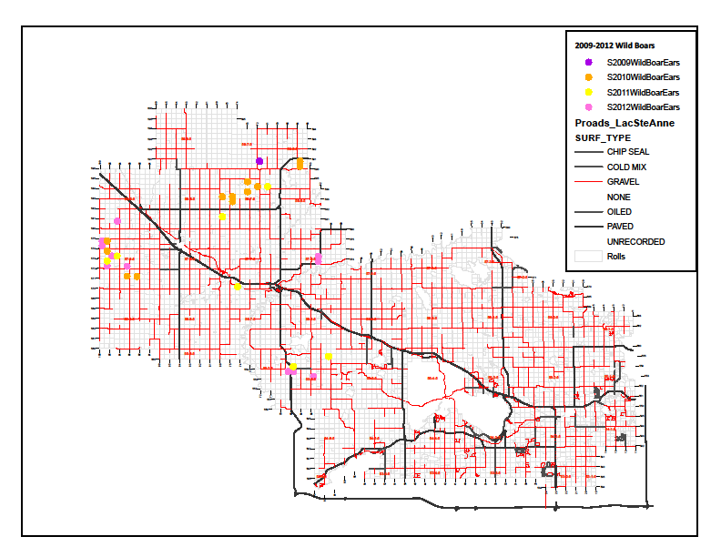

Slide 59
Ag. Service Boards
Get to deal with the issue now after Province allowed farmers to raise a “Pest”
Appointed Pest Inspector – Ag. Fieldman
Local ASB’s put forward resolutions to lobby the government.

Slide 60
Latest ASB resolution
That Alberta Agriculture and Rural Development outlaw the raising of wild boar in Alberta and eradicate all remaining wild boar in captivity in Alberta, compensating current owners for their losses both in the value of the wild boar, and the value of their capital investments.

Slide 61
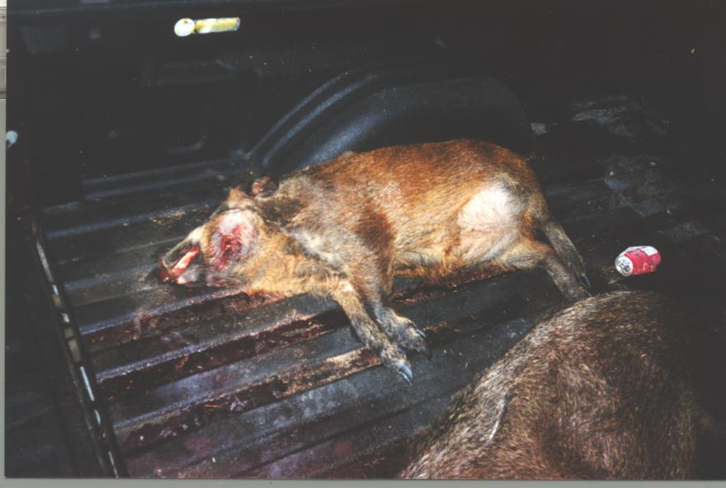

Slide 62
Keys to Pest Control
Start ‘em EARLY!

Slide 63
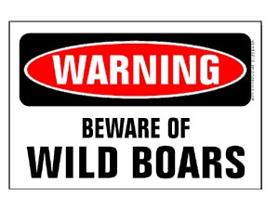

Slide 64
Questions??
Geoff Thompson
Vegetation Management Specialist
ENGAGE AGRO
Cell: 780.305.1176
Fax: 780.785.2864
www.engageagro.com

Slide 65
Questions??
Geoff Thompson
Agricultural Fieldman
Lac Ste. Anne County
1-866-880-5722
gthompson@gov.lacsteanne.ab.ca

