Slide 1
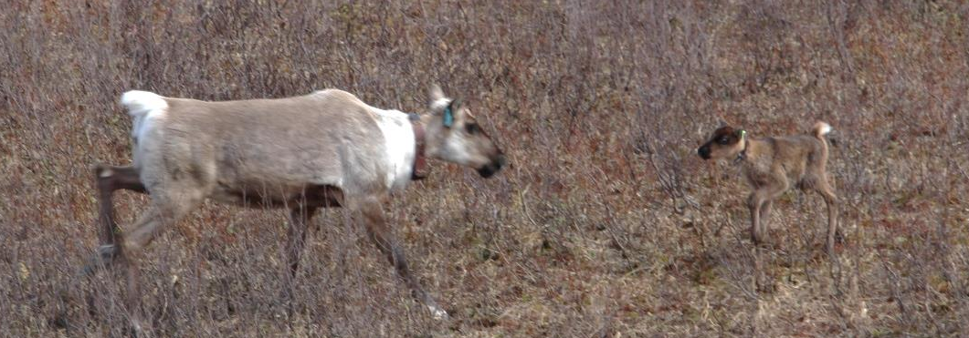












South Peace Caribou Recovery

Slide 2
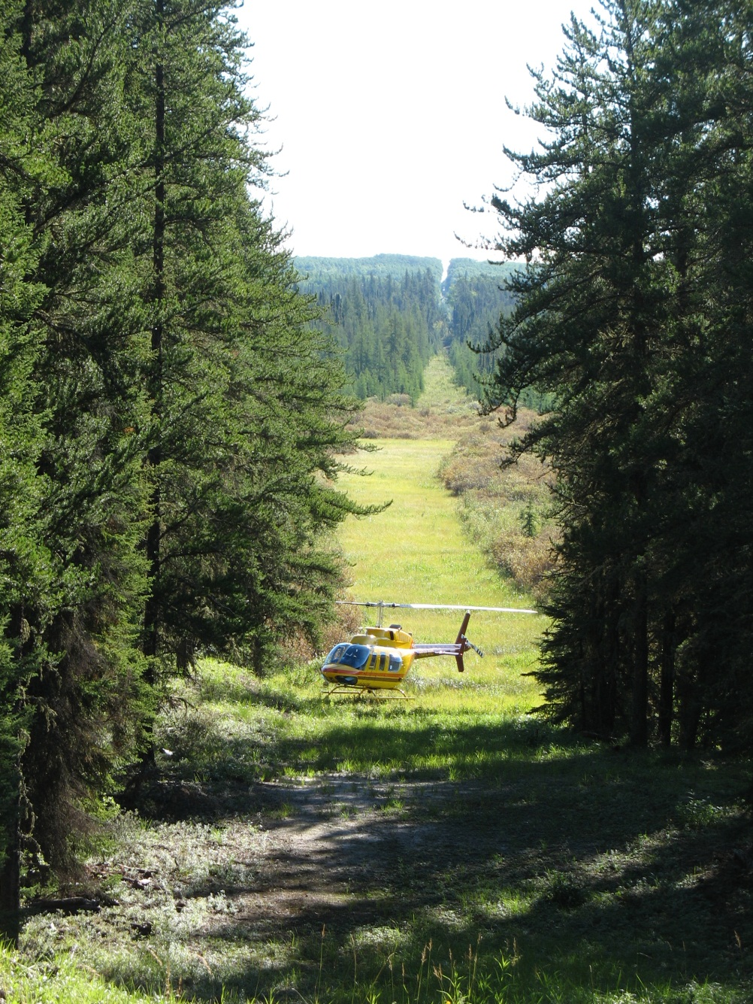
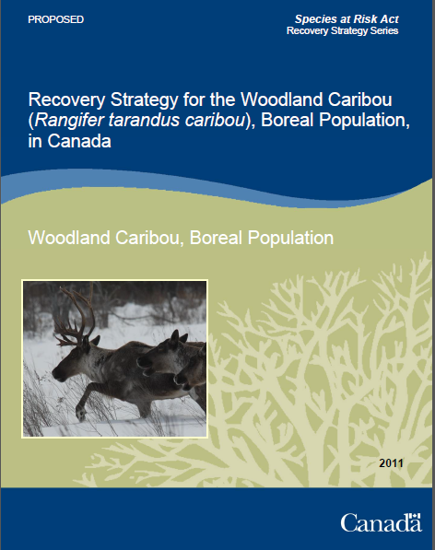
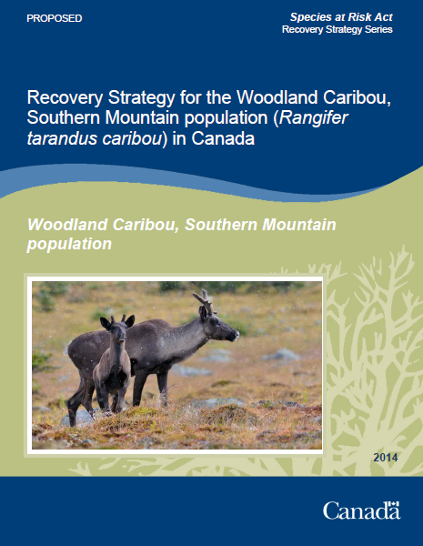
Caribou Population Decline
The disturbance threshold adopted as a caribou recovery strategy is for <35% disturbance
500m

Slide 3
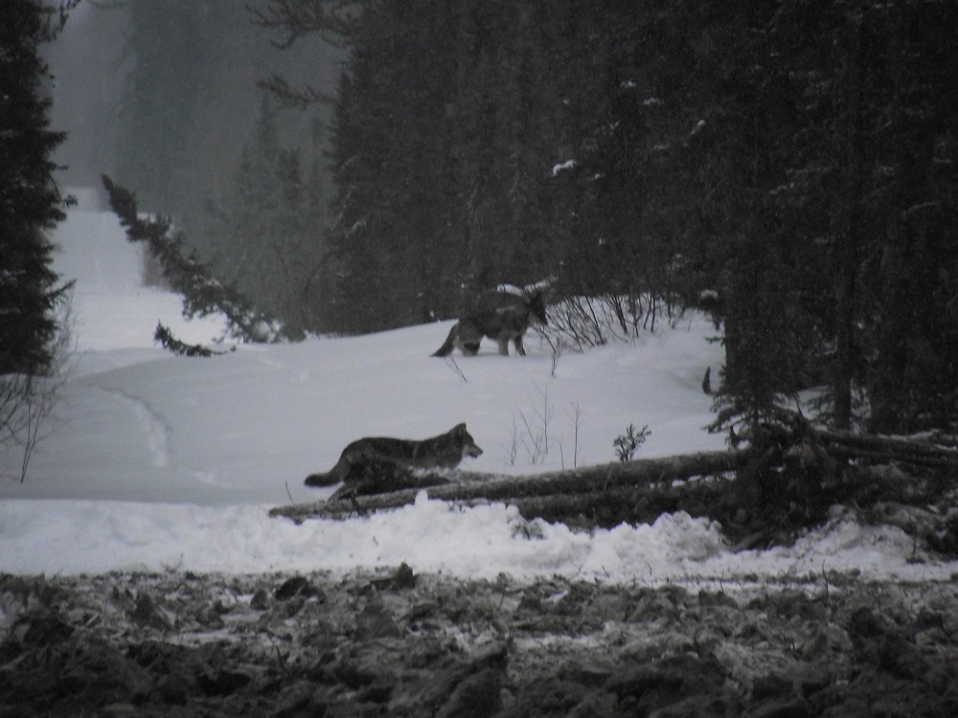
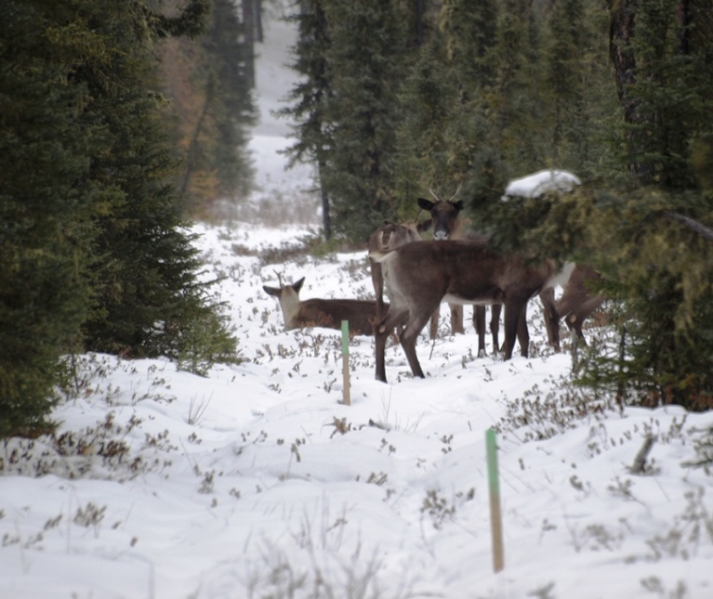
Ecological Context
Wolf population
Moose population
Young vegetation community
Vegetation disturbance
Caribou population
How would one go about resolving this problem?

Slide 4
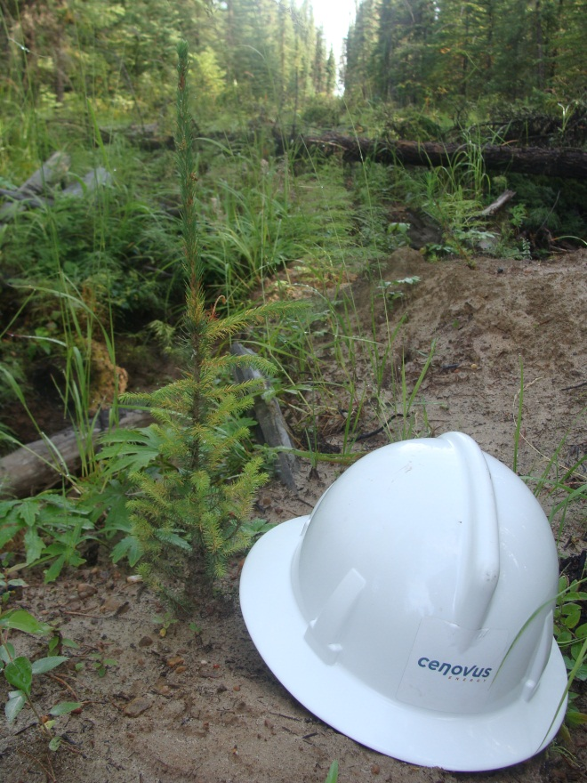
Habitat Restoration
Site-specific silviculture prescriptions
Wolf population
Moose population
Young vegetation community
Vegetation disturbance
Caribou population

Slide 5
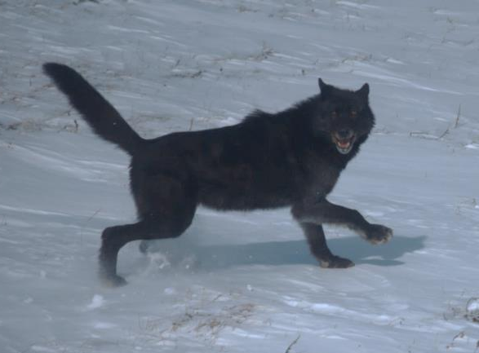
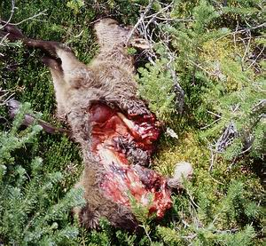
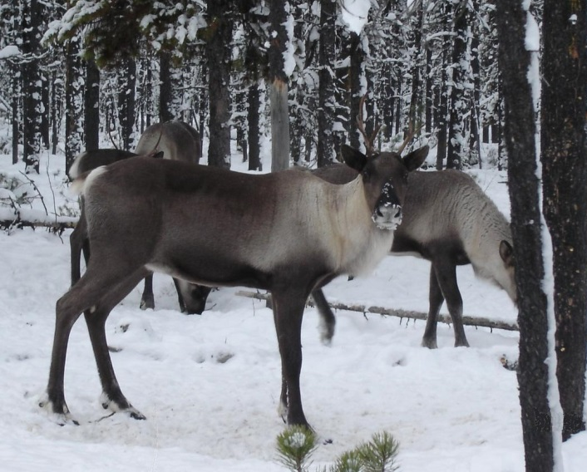
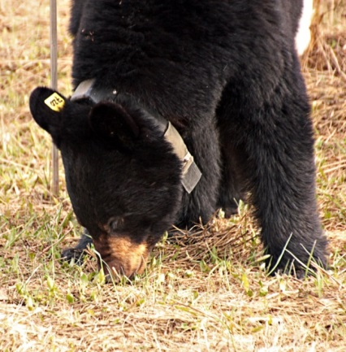
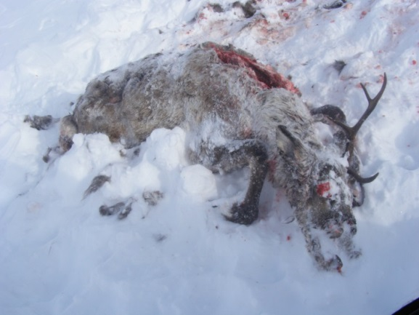
The More Immediate Concern

Slide 6
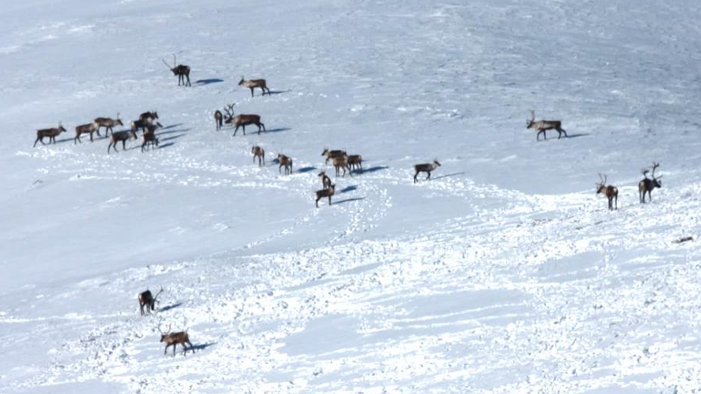
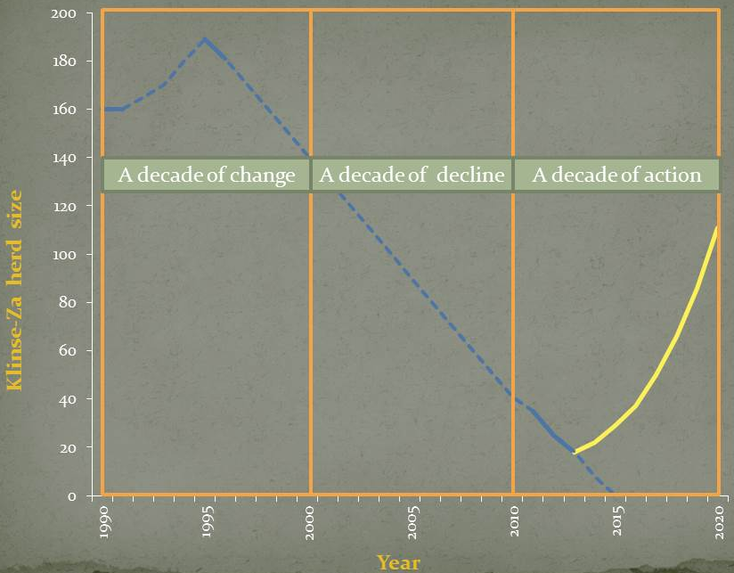
The Klinse-Za Caribou Herd
Population was close to 200 in 1995
Recent inventories begin 2011
Estimated recovery trend
Extirpation was expected by 2015

Slide 7

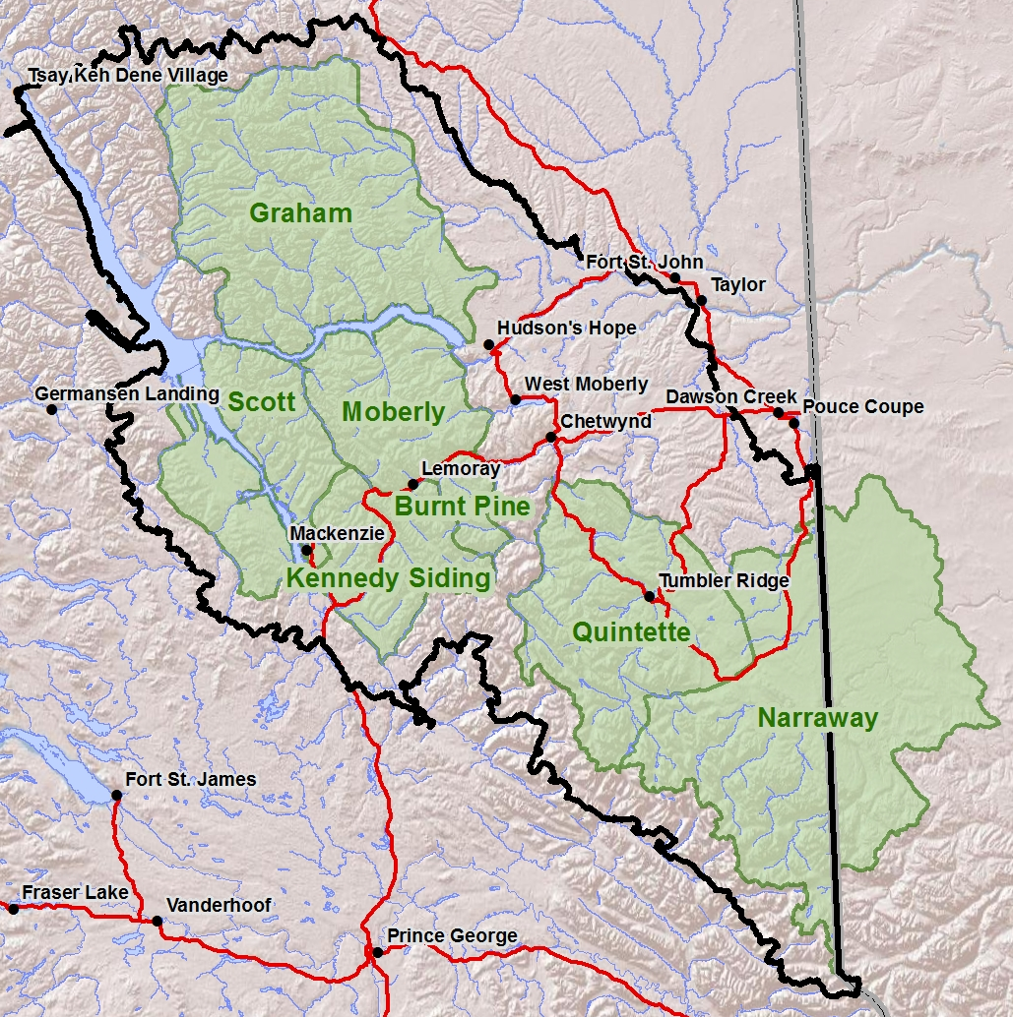

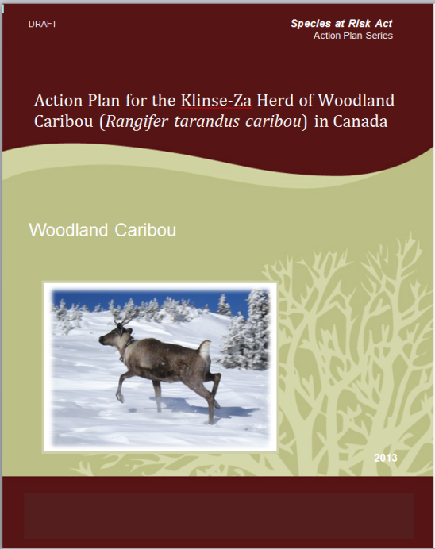
Initiative for Action
Recovery Action Plan
Peace Northern Caribou Committee

Slide 8
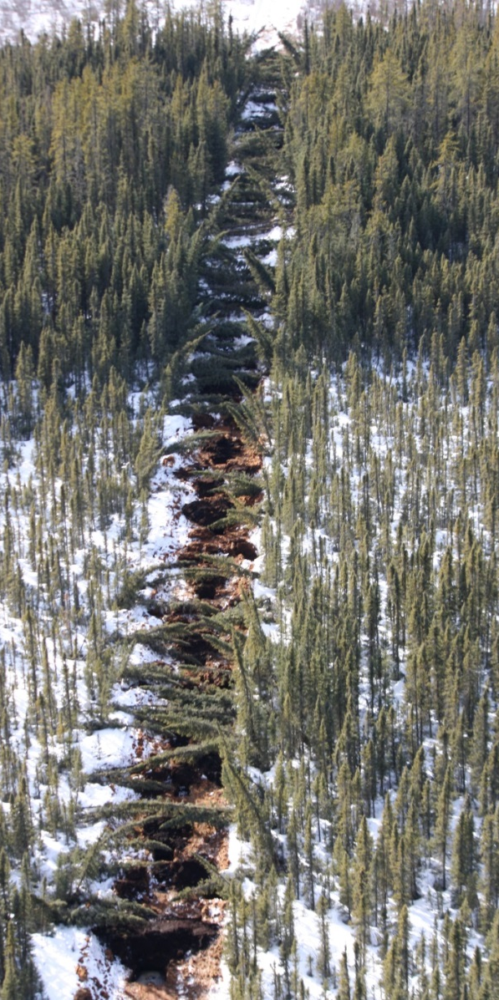
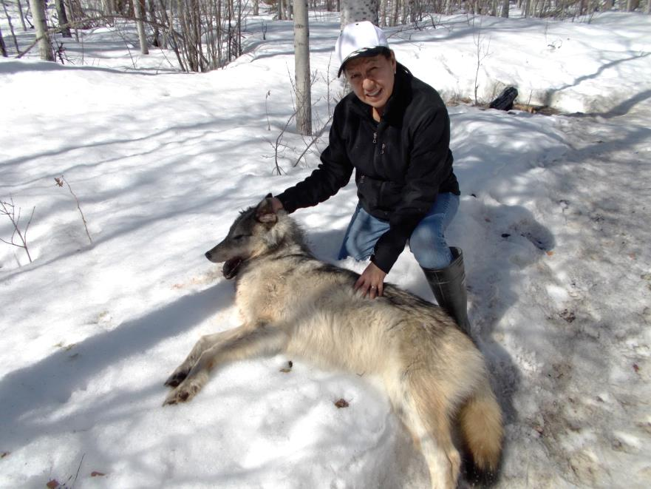
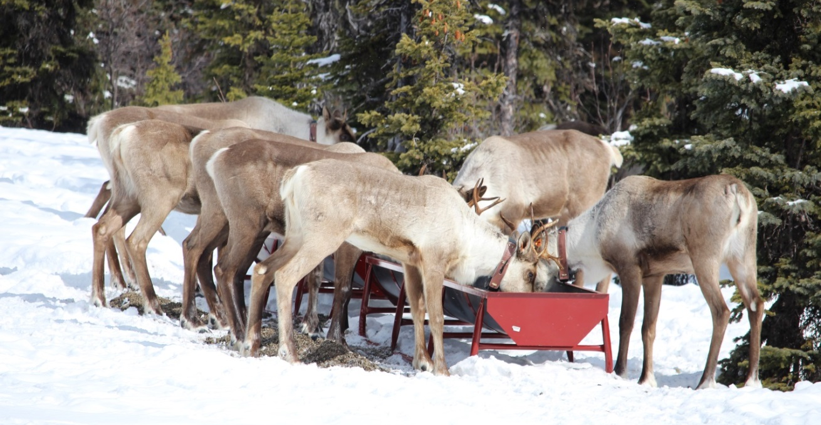
Recovery Actions
22 removed in 2012-13
20 removed in 2013-14
10 penned in 2014
Planning to start 2015

Slide 9
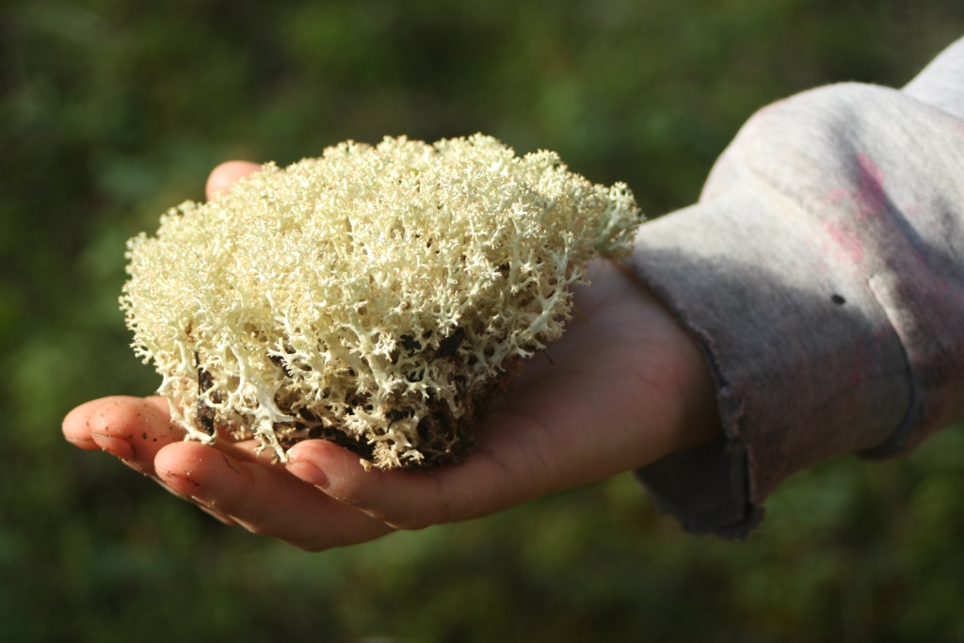
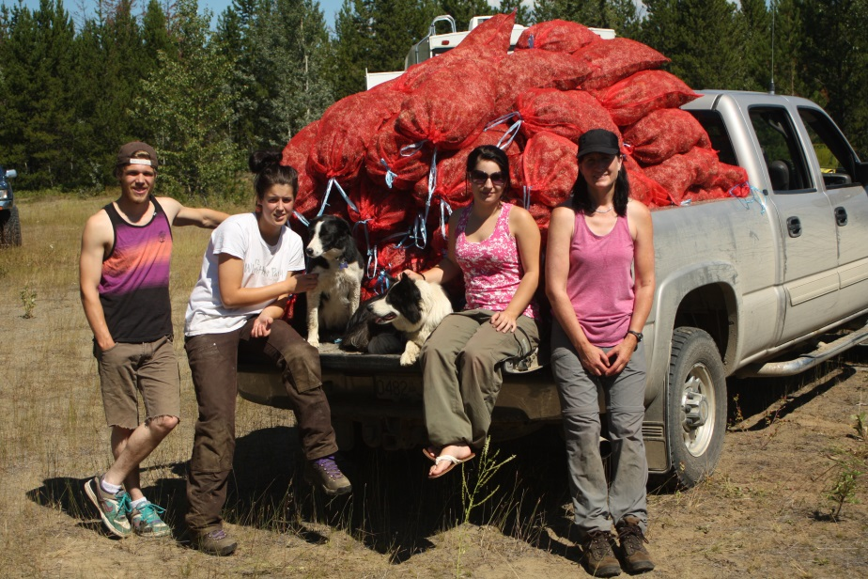
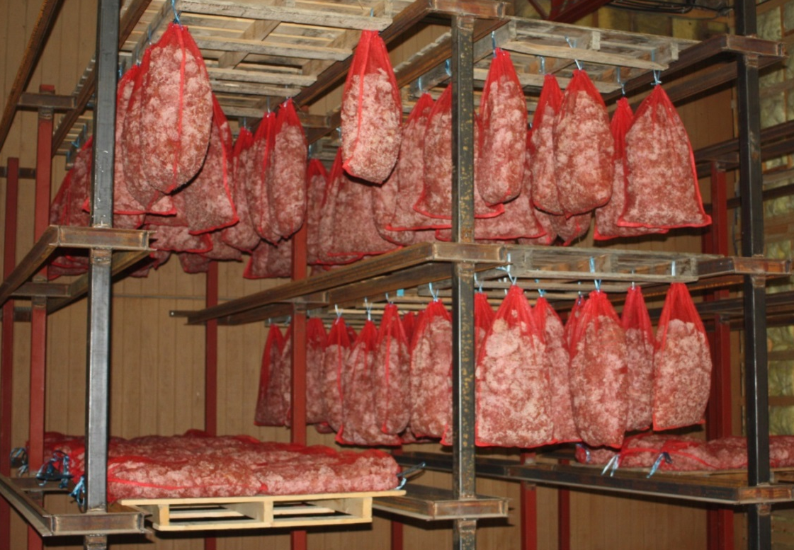
Lichen Collection August 2013
180 bags collected in 2013 & stored for later use

Slide 10
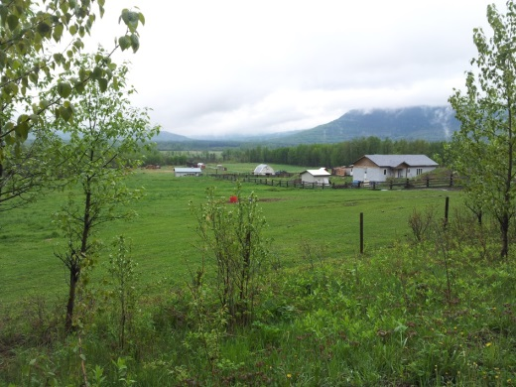
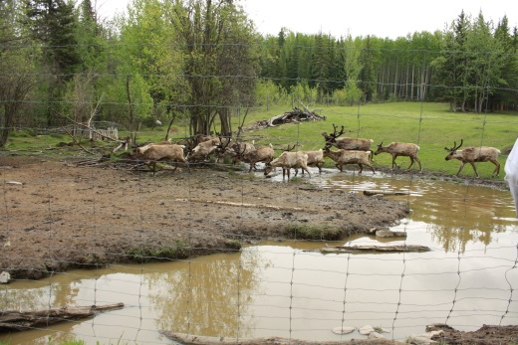
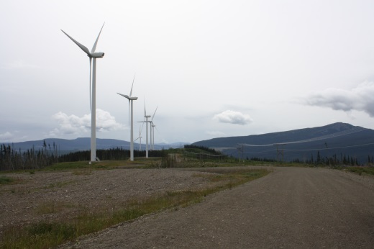
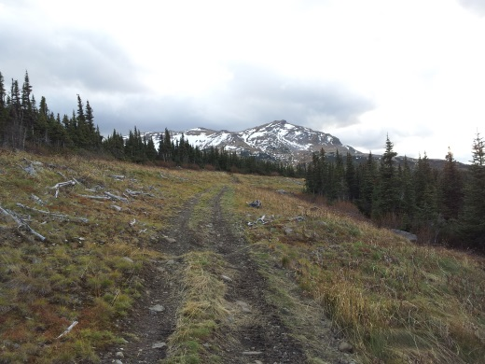
Site Selection September 2013
Criteria | Weight
In calving range? | 5
Is habituation a problem? | 13
Is there a disease risk? | 14
Is there natural forage? | 4
Rating for ease of release. | 11
Rating for shepherd's abilities. | 12
Rating for snow >1m. | 6
Rating for access. | 10
Rating for distance. | 4
Rating for level of logistics . | 9
Rating for ease of communication. | 5
Rating for safety. | 10
Mt. Bickford chosen as the site

Slide 11
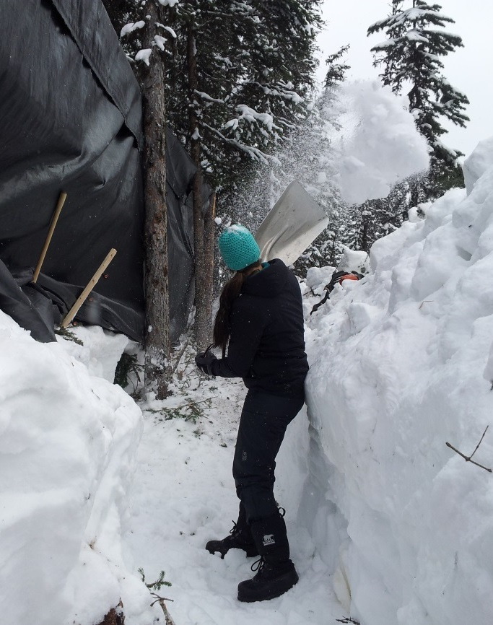
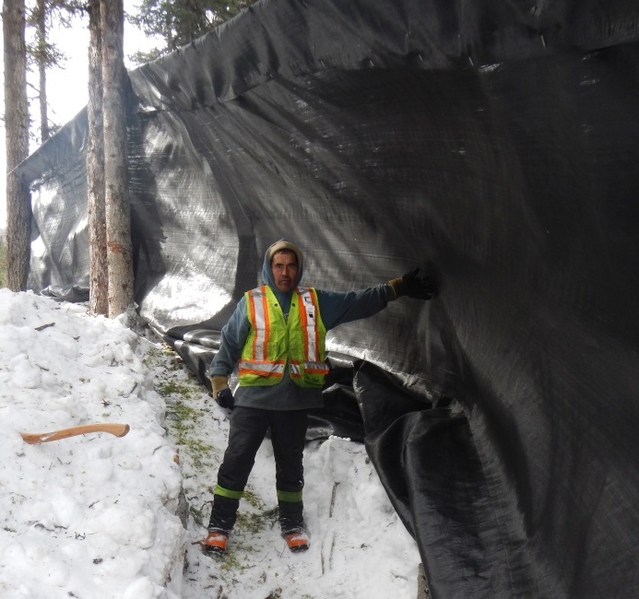
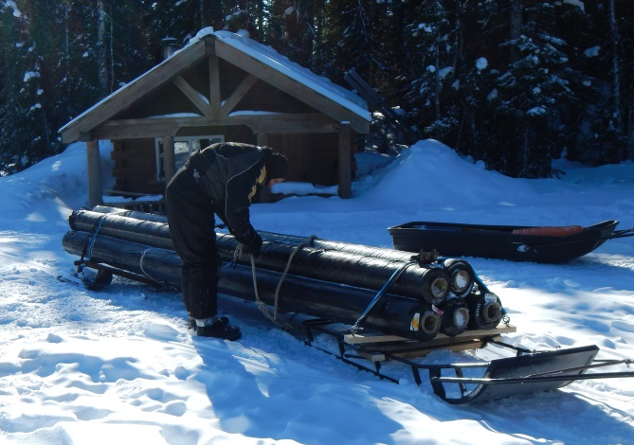
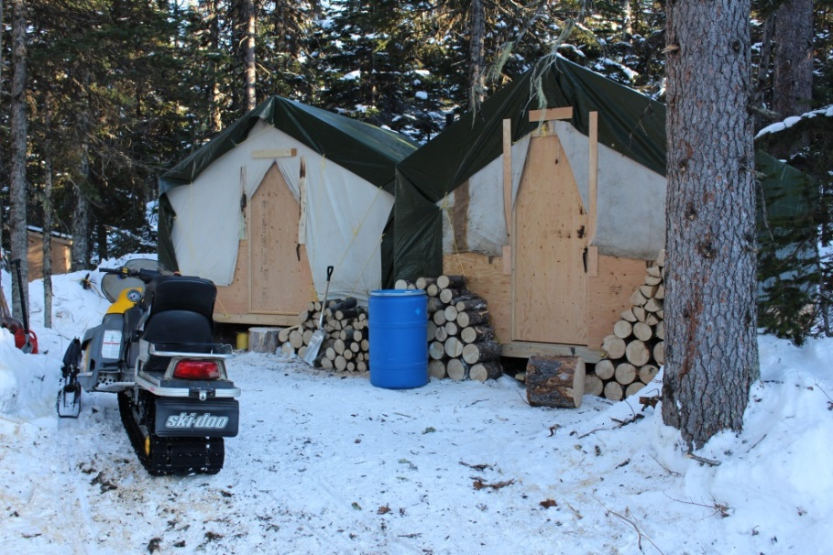
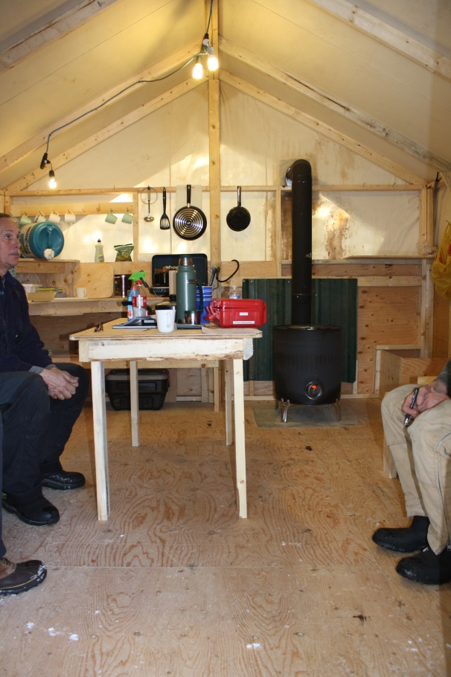
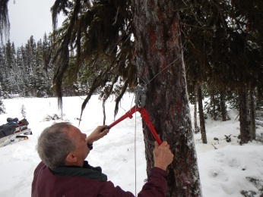
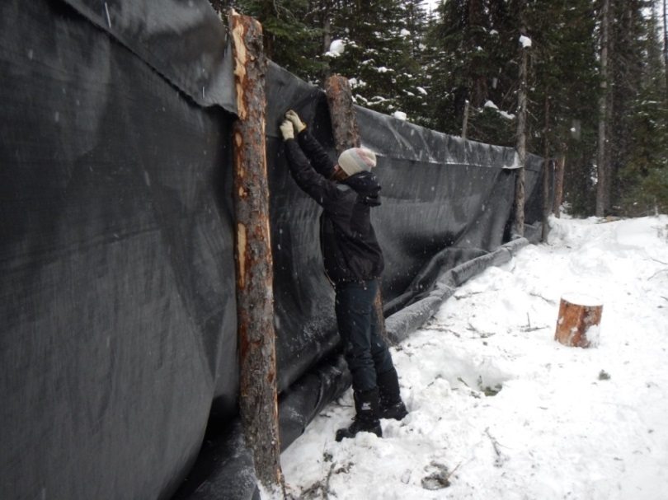
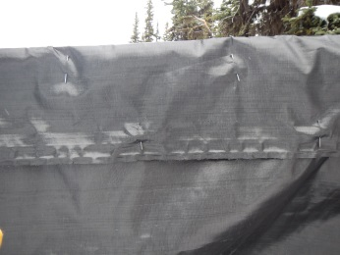
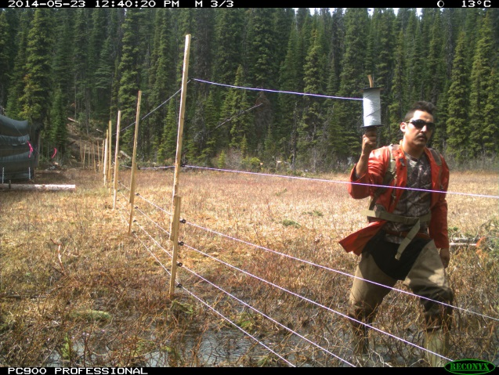
Construction February 2014

Slide 12
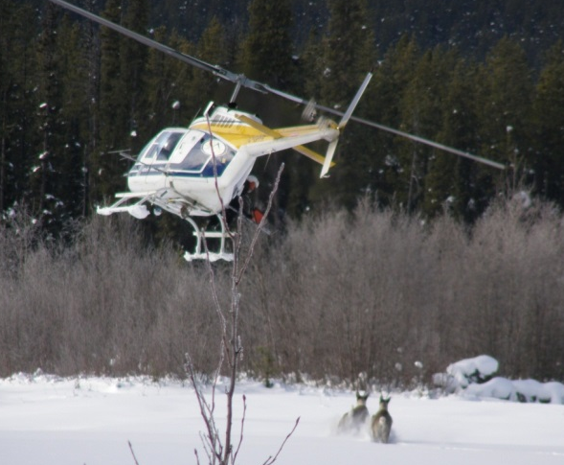
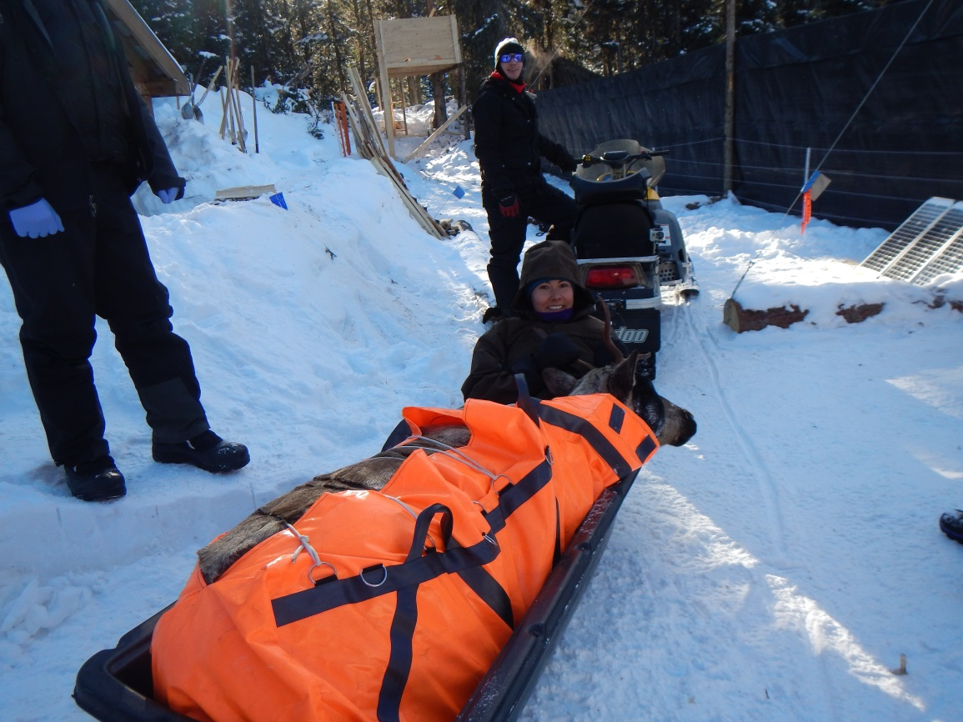
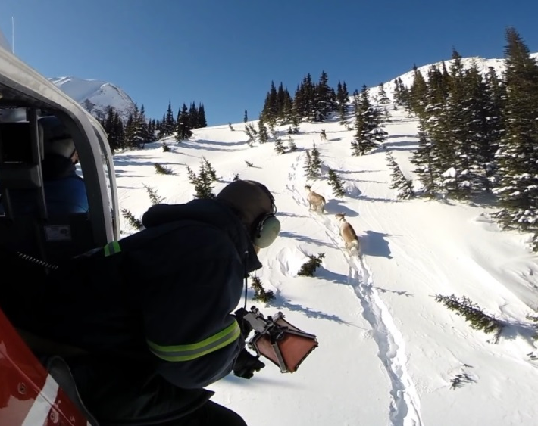
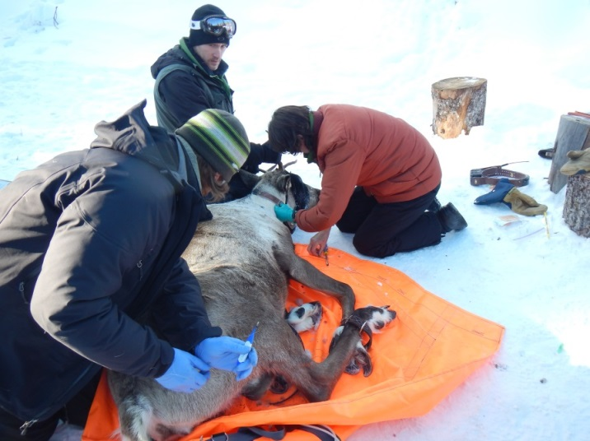
Capture & Collaring March 2014
10 cows captured March 2014
5 from Klinse-Za & 5 from Scott
2 transport heli & 2 capture heli
25 people including 4 vets

Slide 13
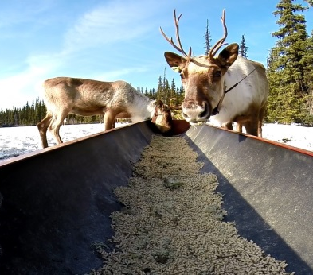
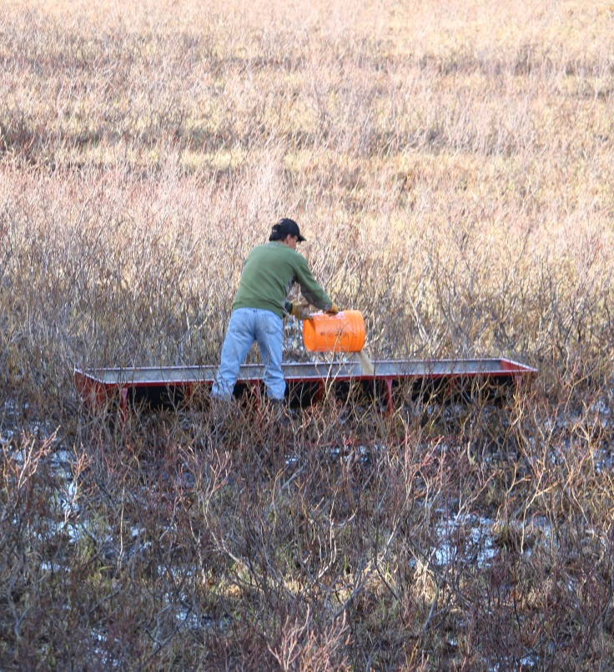
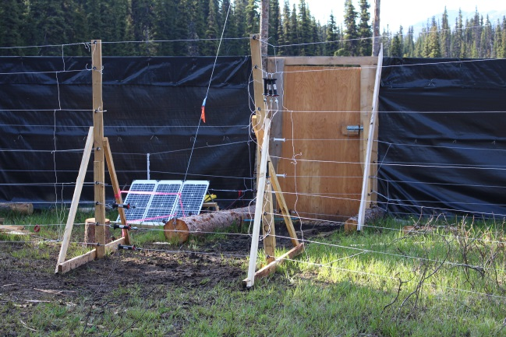
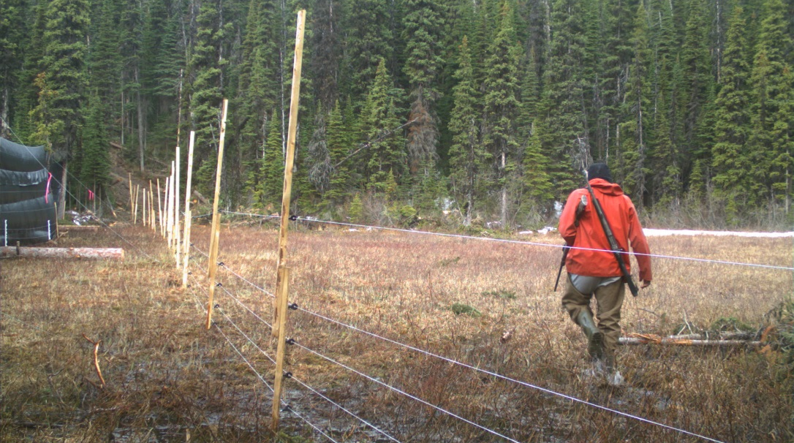
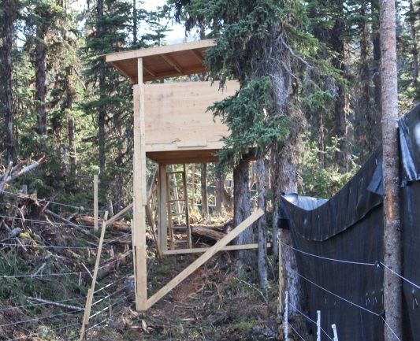
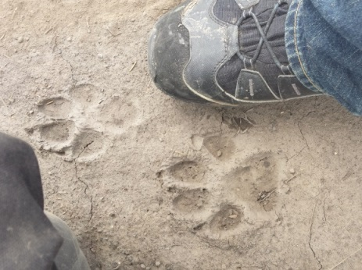
Shepherding April-July 2014

Slide 14
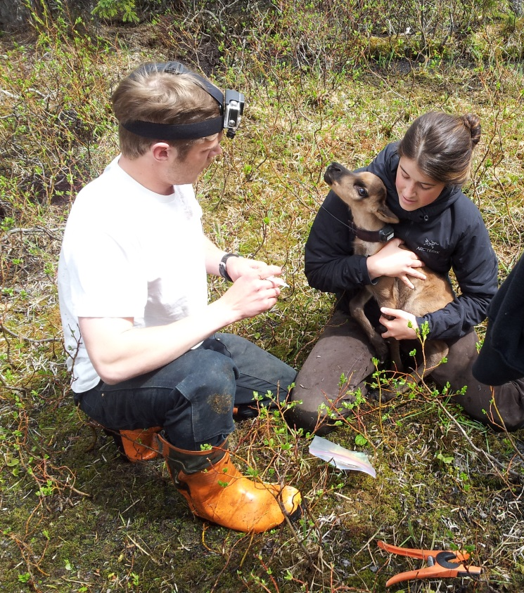
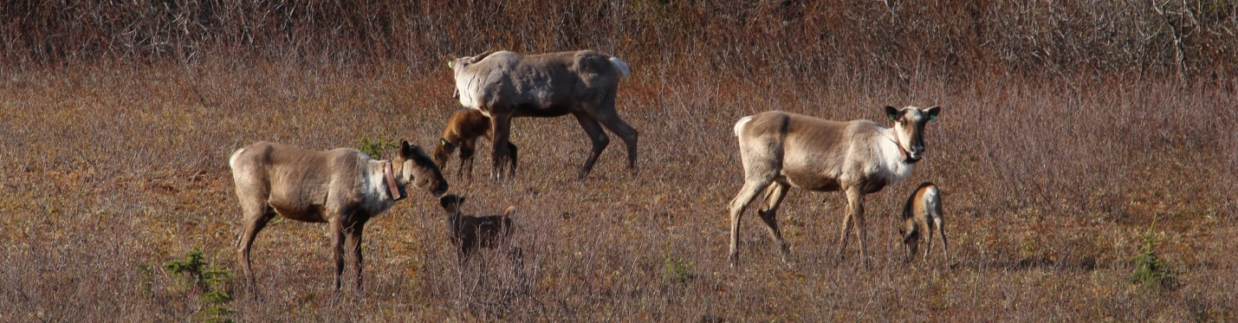
Calving May-June 2014
K
K
K
S
S
S
S
K
K
S
Date in May/June
First cohort mostly males, second mostly females

Slide 15
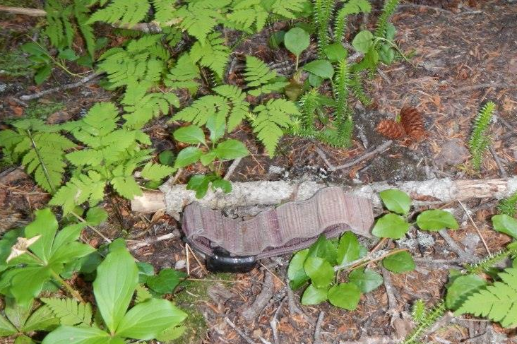
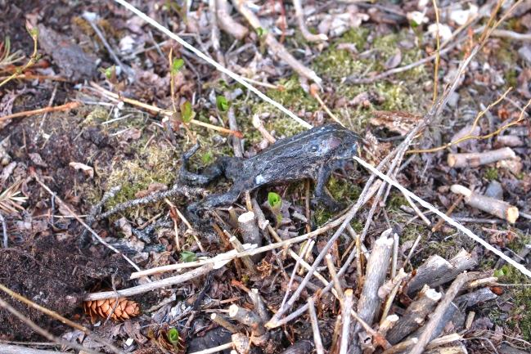
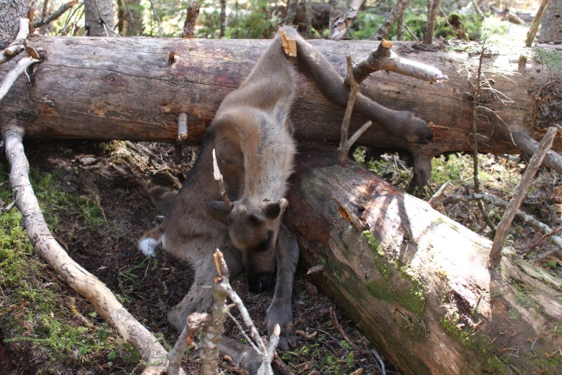


Pen Incidents
1 calf dropped collar
Bears tested the fence twice
1 calf died
2 cows escaped
1 calf injured

Slide 16



Release 140707
1
3
5
4
5
6
4
Pen
Scott
Klinse-Za
Order released
3
2
2
1

Slide 17



Predation Event 140710
2 of the calf mortalities were the youngest calves & the third had a bad leg (injured in pen)
Cow ~ 2pm-10pm
Calf ~10pm
4am next day
6pm next day
Calf ~ 7am
Calf ~next day

Slide 18



Vehicle Collision 140823
a - Escaped predation 140710
b – Escaped predation 140817
c – Calf was hit on highway 97 140823
a
b
c

Slide 19


Current Status
Healthy
Healthy
Healthy
Healthy
Injured leg, wolf
Died in pen
Wolf
Healthy
Vehicle
Wolf (cow/calf)
K
K
K
S
S
S
S
K
K
S
Date in May/June
3 males and 2 females remaining
Older animals survived better

Slide 20


Current Status
1 dead from the Scott
5 in the Klinse-Za (2KC, 1KN, & 2SN)
2 in the Scott (1SC and 1KC)
1 in the Kennedy (1KC)
1 in the Quintette (1SN)
9 road crossings (3 cows)

Slide 21

Current Status
Average distance moved since release is 360kms
Scott
Klinse-Za
Burnt Pine
Kennedy
Km moved
Quintette
Animal Id

Slide 22





Improvements
Brush understory in pen
More diligent during calving
Later release = older & healthier calves
Extend shepherding to end of August
Enforce current vehicle closure
Expand pen / protect more cows
Bring cost down

Slide 23
Component Costs
Cost cuts
Less planning (e.g., locating site)
No snow shoveling
No recapturing escaped animals
No bulldozer
Don’t need second fence
½ of capture & transport
We have left--ver materials for pen
Need only maintenance on camp
Total = $530,735 → $106,147/calf
New forecast = $350,000 → $23,333/calf

Slide 24


3-yr Business Plan
Activities addressed:
  Maternal pen
  Wolf removal
  Habitat restoration
  Securing funds
Used to :
  Establish Goals
  Provide priorities on actions
  Canvass private sources
2014 – 2017 Business Plan

Slide 25

A Case for Vegetation Management?

Slide 26

A Case for Vegetation Management?

Slide 27

A Case for Vegetation Management?

Slide 28

A Case for Vegetation Management?

Slide 29

Opportunity
Cooperative Land Management Award from Resources North Association
National as well as local media coverage both at time of capture and release

Slide 30


Early Indications of Success
85% “disturbed” → 35% threshold
246 km treated in 4 townships
5.6% of range potentially “restored”
Plan to double the treated area

Slide 31




Treatment: mounding and planting

Slide 32


Treatment: stand modification

