Slide 1
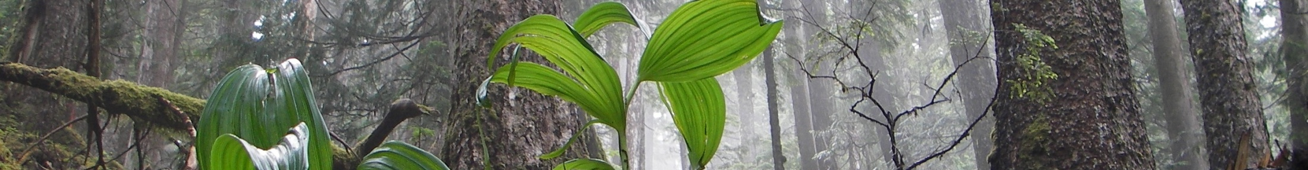

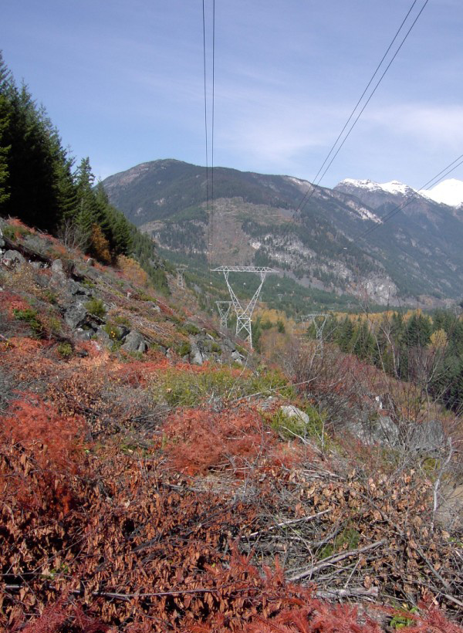
Bc hydro forest health risk assessment
B.A. Blackwell & Associates Ltd.
Babita Bains Gwen Shrimpton Bruce Blackwell Avram Sandor

Slide 2
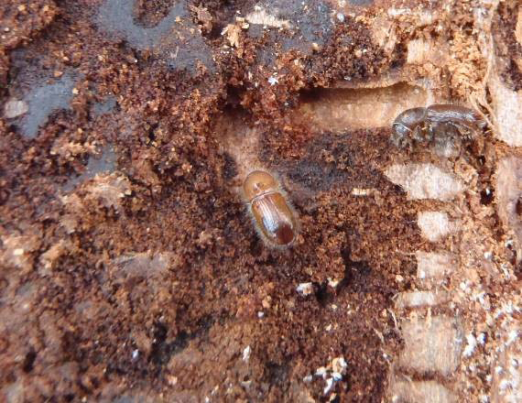
INTRODUCTION
B.A. Blackwell & Associates Ltd.
Blackwell completed a forest health risk assessment for BC Hydro infrastructure
The diverse landscape of BC supports a variety of forest health factors (insects and diseases)
  Bark beetles
  Defoliators
  Fungal pathogens
Notes:
B.A. Blackwell & Associates Ltd. were contracted by BC Hydro to determine the potential impact of forest insects and diseases on BC Hydro infrastructure. Considering the diverse landscape of BC, there are many tree species which support a variety of insects and diseases, and these include bark beetles, defoliators and pathogens.

Slide 3
INTRODUCTION
B.A. Blackwell & Associates Ltd.
BC Hydro transmission, distribution and communication systems are extensively located in areas impacted by forest pest damage
Attacked trees contribute to dead, dying and leaning trees adjacent to Hydro infrastructure
  Trees are one of the major causes of power outages to the distribution and transmission systems
  Dead and dying trees also become a significant fire risk
Notes:
As identified through this project, Hydro transmission, distribution and communication systems are extensively located in areas impacted by forest pest damage and as trees come under attack from insects and diseases there is an increase in the number of dead, dying and leaning trees adjacent to the transmission and distribution systems; hence the potential for these affected trees to fall onto powerlines is significantly increased.
Trees were identified as one of the major causes of power outages to the distribution and transmission systems and they can also cause damage to microwave sites and substations by falling into the site and damaging equipment such as transformers. Additionally, these dead and dying trees pose another threat to the system because dead trees can become a significant fire risk.

Slide 4
INTRODUCTION
B.A. Blackwell & Associates Ltd.
Results of tree death include:
  Reduction in moisture content
  Increase in downed woody fuels (coarse and fine fuels)
  Increase in laddering of fuels (stratification)
Rates of fire spread increase in stands of dead trees and suppression can also become more challenging
Notes:
Results of tree death include reduction in moisture content, increase in downed woody fuels, and increase in laddering of fuels, all of which can create a potentially dangerous situation for BC Hydro infrastructure. An increase in fuels can increase the wildfire threat and fire behaviour, and lead to challenges with fire suppression.
Additionally, this can also increase costs for the removal of hazard trees adjacent to the Hydro system.

Slide 5
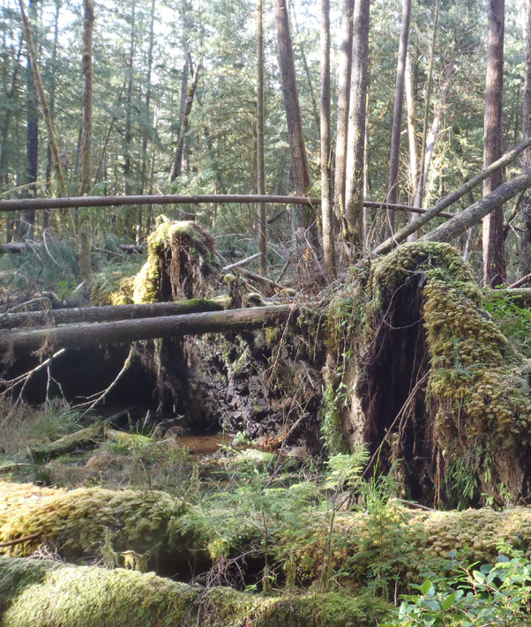
INTRODUCTION
B.A. Blackwell & Associates Ltd.
An important objective for Hydro is to target areas that pose the highest forest health risk to their system
Targeting areas requires an understanding of:
  Hazards
  Location of hazards
  Anticipated mortality of impacted trees
Notes:
Given the magnitude of current and past forest health problems it is important for Hydro to target areas which pose the highest risk to the system – both from a safety and economic perspective. This requires an understanding of the hazards, location of these hazards and anticipated mortality of impacted trees. Ultimately, the desire is to focus tree removal efforts in areas that will offer the greatest line of security while keeping costs low.

Slide 6
DELIVERABLES / OBJECTIVES
B.A. Blackwell & Associates Ltd.
The deliverables of this project included:
  Identification of the most detrimental forest health factors to BC Hydro infrastructure and the development of extension materials
  A review of transmission and distribution corridors across the Province including
    Development of maps to identify areas of risk
    Maps designed to assist operations and field staff in the ID of forest health factor incidence and the level of associated risk to Hydro infrastructure
Notes:
There were two deliverables for this project. The first included identification of forest health factors most detrimental to Hydro infrastructure and the second included development of extension materials. These extension materials/information sheets were designed to provide Hydro staff and contractors (e.g., hazard tree assessors) with practical information that can be utilized to identify forest health factors in the field.

Slide 7
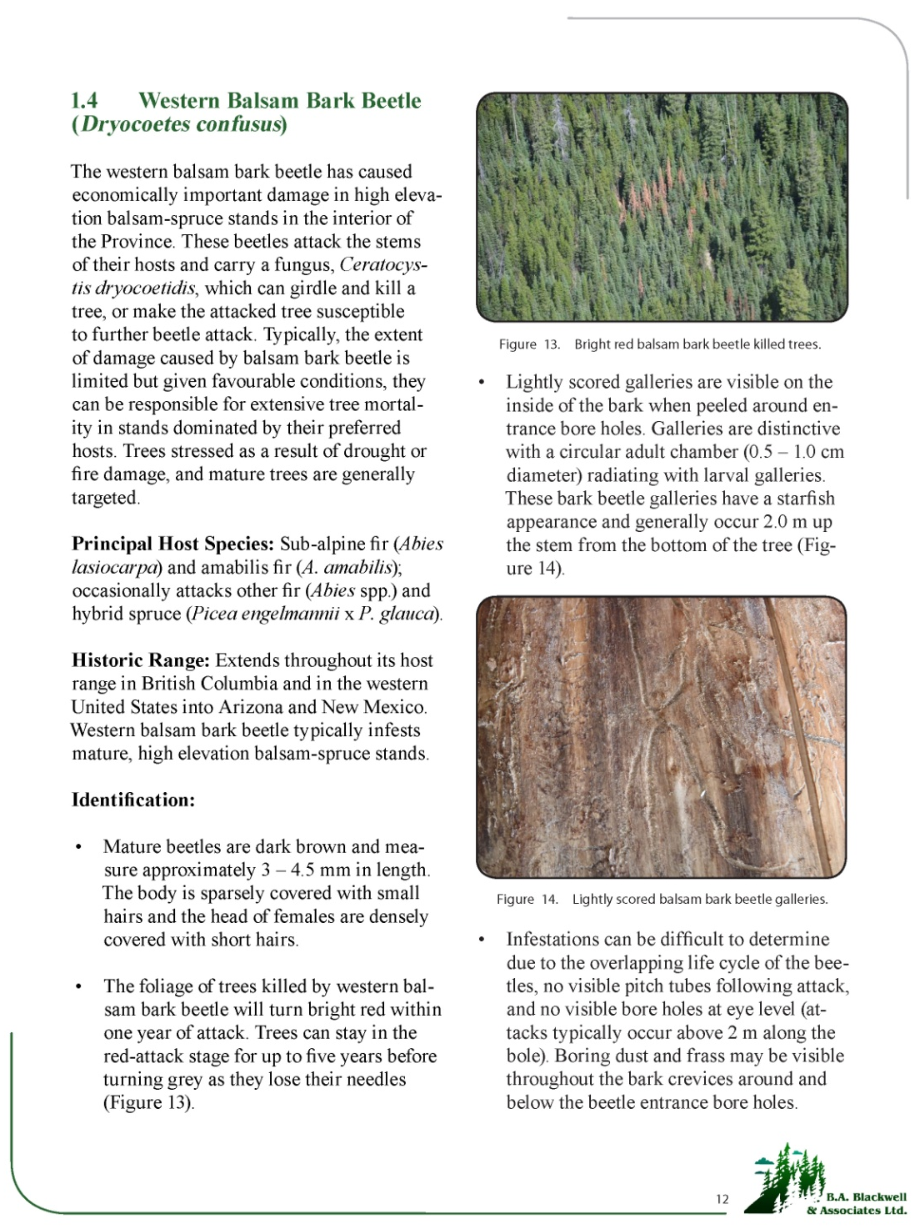
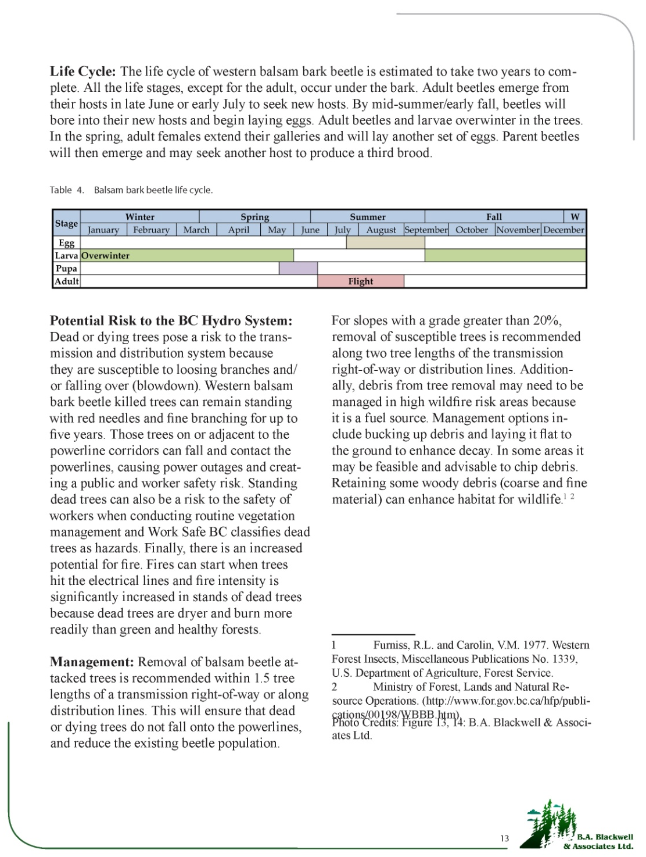
Notes:
Information sheets included descriptions and photos of the key signs and symptoms for pest and damage identification, including host species, historic range, life history and information on the potential risk to the Hydro System and Management recommendations.

Slide 8
DELIVERABLES / OBJECTIVES
B.A. Blackwell & Associates Ltd.
The deliverables of this project included:
  Identification of the most detrimental forest health factors to BC Hydro infrastructure and the development of information sheets
  A review of transmission and distribution corridors across the Province including
    Development of maps to identify areas of risk
    Maps designed to assist operations and field staff in the ID of forest health factor incidence and the level of associated risk to Hydro infrastructure
Notes:
The second deliverable, and what is the main focus of my presentation, was the completion of a review of transmission and distribution corridors across the Province and the development of interactive maps that illustrate forest health related risk. Specifically, these maps were designed to assist operations and field staff in the identification of forest health factor incidence and the level of associated risk to Hydro infrastructure.

Slide 9
METHODS
B.A. Blackwell & Associates Ltd.
A spatial analysis was completed to identify the location of forest health infestations adjacent to Hydro infrastructure
  50 m buffer on each side of the ROW / powerline corridor
  Spatial data
    Hydro distribution and transmission systems
    Vegetation Resource Inventory (LRDW)
    Annual MFLNRO forest health data (2001 – 2013)
Notes:
A spatial analysis was completed to identify the location of insect and disease infestations adjacent to transmission and distribution lines using a 50 m buffer on each side of the right-of-way or powerline corridor.
Spatial data on the location of the distribution and transmission systems was provided by BC Hydro.
VRI data was used to identify forested and non-forested areas, and used to determine species composition.
Annual forest health data was obtained from MFLNRO. The spatial analysis included 12 years of annual forest health conditions. The main source of this data is aerial overview surveying.

Slide 10
METHODS
B.A. Blackwell & Associates Ltd.
Bark beetle intensity classes from the annual data are classified as trace, light, moderate, severe and very severe
For this analysis…
  Trace class remove for bark beetles
  All other bark beetle intensity classes merged into a single class
  All defoliator intensity classes merged into a single class
Notes:
Intensity classes for bark beetles are generally classified as trace, light, moderate, severe and very severe. In this analysis the trace class was removed. All other bark beetle intensity classes were merged into a single class and included in the analysis. Defoliators are generally classified as light, moderate, severe and grey. Again, all intensity classes were merged into a single class and included in the analysis.

Slide 11
METHODS
B.A. Blackwell & Associates Ltd.
The study area was classified as red, orange, yellow and green:
Class | Indication
Red | Area has been/is currently under attack and the pest is present at any level of intensity
Orange | Area is moderately susceptible to attack because the host tree(s) is present and comprises more than 30% of the forest
Yellow | Area has low susceptibility to attack because the host tree(s) comprises less than 30% of the forested area.
Green | Host species is not present in the forest or the area is not forested
Notes:
With the compiled forest health data, VRI and right-of-ways and powerline corridors, interactive maps supporting each of the identified leading forest health factors were generated. These maps illustrated classes of forest health or forest health ratings.
Red: area has been or is currently under attack and the forest health factor is present at any level of intensity
Orange: The area is moderately susceptible to attack because the host trees are present and comprise more than 30% of the forest
Yellow: The area has low susceptibility to attack because the host trees are not present or it is present but comprises less than 30% of the forested area.
Green: Host species is not present in the forest or the area is not forested

Slide 12
INTERACTIVE MAPS
B.A. Blackwell & Associates Ltd.
Maps supporting each of the identified leading forest health factors were generated, enabling BC Hydro to look-up information on each pest
Additionally, an overview map of the Province was created with a risk rating for all the pests combined
  To develop a map to capture the cumulative impact of all FH factors, a separate coding system was created
Notes:
In addition to the interactive maps, an overview map of the Province was created and contains the risk rating for all of the pests combined. To develop a map to capture the cumulative impact of all the forest health factors, a separate coding system was created. Forest health factors were based on extent and ability to cause tree mortality and assigned a rating between 1 and 10 with a 10 rating implying a high extent and ability to cause tree mortality – the higher rating pests were typically bark beetles

Slide 13
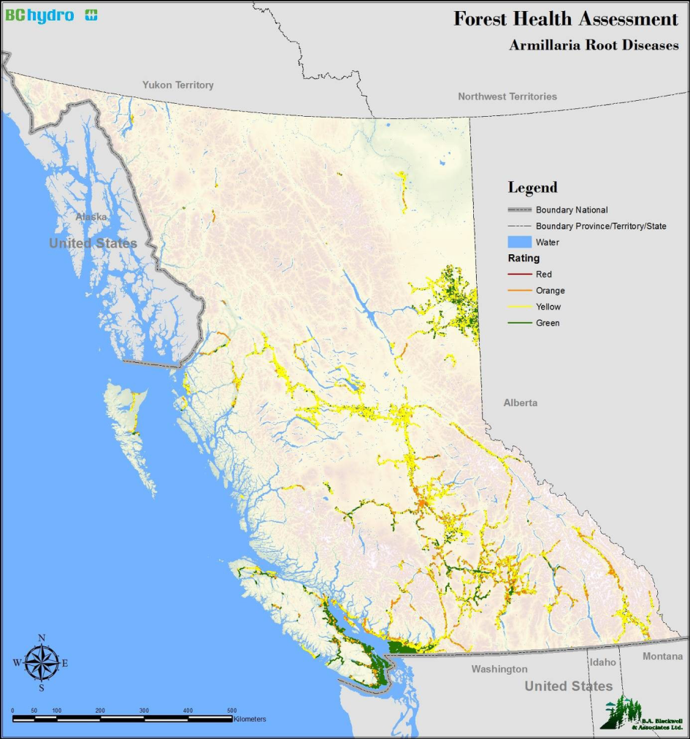
INTERACTIVE MAPS
B.A. Blackwell & Associates Ltd.
Risk assessments/interactive maps were developed for 14 forest health factors
Maps illustrate the threat rating for each forest health factor
Red = areas of concern
Orange = potential risk
Notes:
Individual risk assessments were completed for 14 forest health factors – these pests included major bark beetles, defoliators and pathogens that pose the greatest risk to Hydro infrastructure. The maps illustrate the threat ratings (red, orange, yellow and green) for each pest – where areas rated red are areas of concern and areas rated orange are areas of potential risk.

Slide 14

Mountain
Pine Beetle
B.A. Blackwell & Associates Ltd.
Low susceptibility considering pine composition
Isolated areas where beetle activity is present
Orange and red rated areas will require monitoring or treatment
Green areas indicate host species not present/area not forested
Notes:
The mountain pine beetle map identifies isolated areas where beetle activity is present (rated orange and red). It is worthy to note that there is still unattacked pine left in southern BC and the beetle is spreading in pockets, specifically in the Lillooet and Kelowna areas. There is also a continued concern over the increased risk of wildfire in areas with standing dead trees as well as the potential for windthrow. And to reiterate, areas classed green indicate the host species is not present in the forest or the area is not forested.

Slide 15


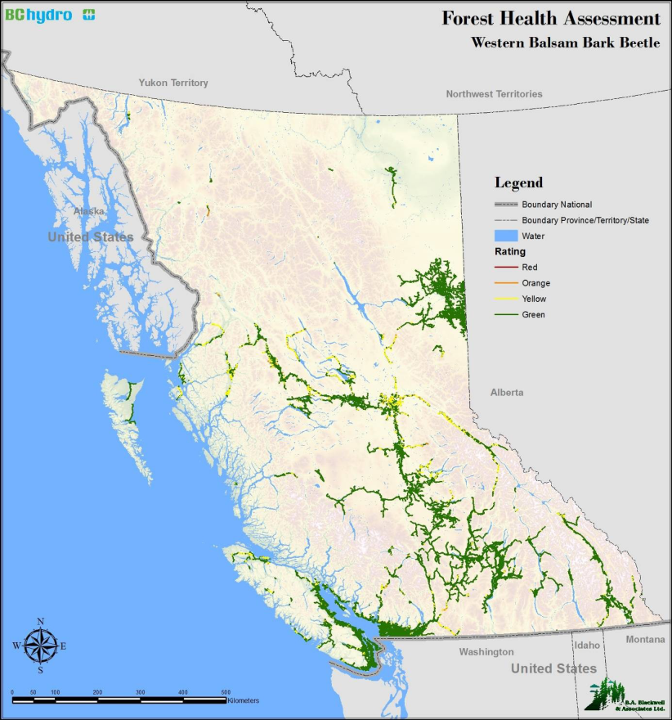
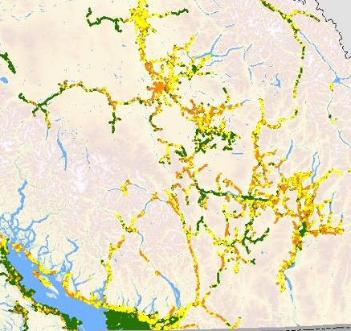
B.A. Blackwell & Associates Ltd.
Notes:
The Douglas-fir bark beetle, spruce bark beetle and western balsam bark beetle assessments illustrated a relatively low – moderate risk associated with BC Hydro infrastructure with predominantly yellow and green risk ratings throughout. There are select areas that are moderately susceptible to Douglas-fir bark beetle attack considering there is a substantial Douglas-fir component. These areas appear orange on the map and are predominantly within the Sunshine Coast, Cariboo, Interior and Kootenay regions.
Spruce bark beetle threat is low with some isolated areas identified as moderately susceptible due to host tree presence and composition along Hydro infrastructure. These moderately susceptible areas are generally concentrated in the North East, Omineca, Cariboo and East Kootenay regions.
The western balsam bark beetle risk is low due to the limited host range distribution along Hydro infrastructure as indicated by the green areas.

Slide 16
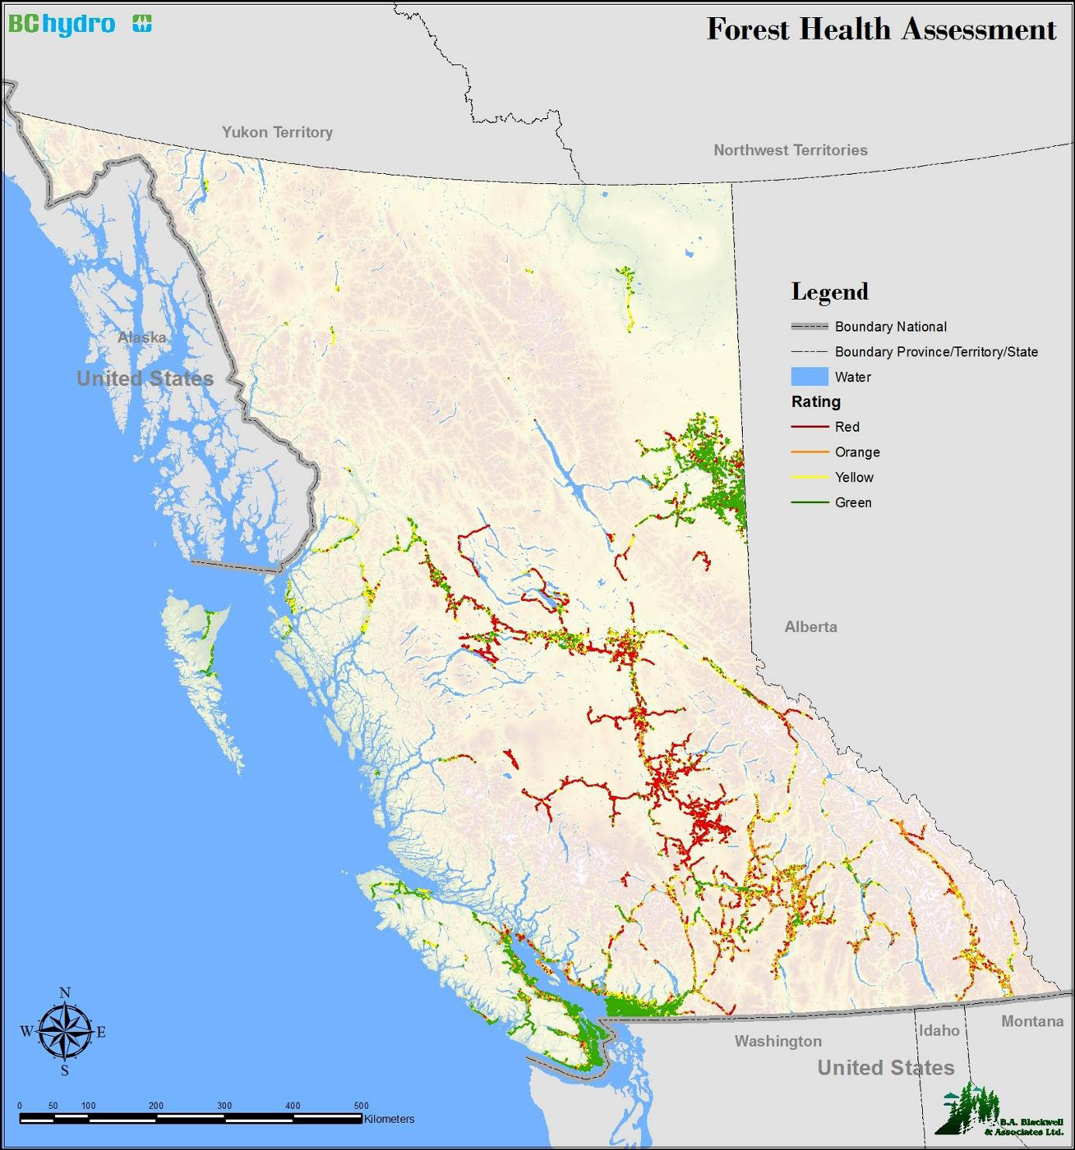
Cumulative
Effects
B.A. Blackwell & Associates Ltd.
Cumulative effects of all forest health factors
Cariboo and Southern Omineca Forest Regions have the greatest forest health associated risk to Hydro infrastructure
Notes:
This is the interactive map of the Province illustrating the cumulative effects of all forest health factors and the associated threat rating along Hydro infrastructure. The cumulative forest health assessment identifies the Cariboo and Southern Omineca Forest Regions with the greatest forest health associated risk to BC Hydro infrastructure. Red = areas of concern; orange = areas with potential risk

Slide 17

SUMMARY
B.A. Blackwell & Associates Ltd.
Maps are a useful tool to predict and manage potential forest health impacts on Hydro infrastructure
Products (maps and extension materials) were designed to provide Hydro managers with current management information
Notes:
The development of the maps, which summarize current forest health threats, will be a useful tool to predict and manage potential forest health impacts on Hydro infrastructure and the products are designed to provide Hydro managers with current management information.

Slide 18
SUMMARY
B.A. Blackwell & Associates Ltd.
The interactive maps were designed to assist Hydro with:
  Prioritize monitoring
  Manage their infrastructure
  Minimize the impact of dead or dying trees adjacent to the transmission and systems
  Identify areas of concern (rated red) and potential risk (rated orange)
  Developed extension materials that outlined management options for each FH factor (hazard tree removal and debris management)
Notes:
Specifically, these maps are designed to assist BC Hydro in prioritizing monitoring and managing their infrastructure, and to minimize the impact of dead or dying trees adjacent to the transmission and distribution system. In addition to identification of areas of concern (rated red) or potential risk (rated orange), extension materials have outlined management options for each forest health factor which includes the removal of identified hazard trees as well as debris management.

Slide 19
SUMMARY
B.A. Blackwell & Associates Ltd.
Considering the impacts of global warming across our Province, it is highly probable that the risk associated with the identified FH factors will increase
  Additional FH factors
  Change in host ranges and populations
As the climate continues to change there is the likelihood that trees become more stressed and relatively innocuous insects and diseases acting together could become significant
Notes:
Considering the impacts of global warming across our Province, it is highly probably that the risk associated with the identified forest health factors, and likely additional forest pests, will increase. This could include an increase or change in pest host range and pest populations. As the climate continues to change and trees become more stressed, relatively innocuous insects and diseases acting together could become significant

Slide 20
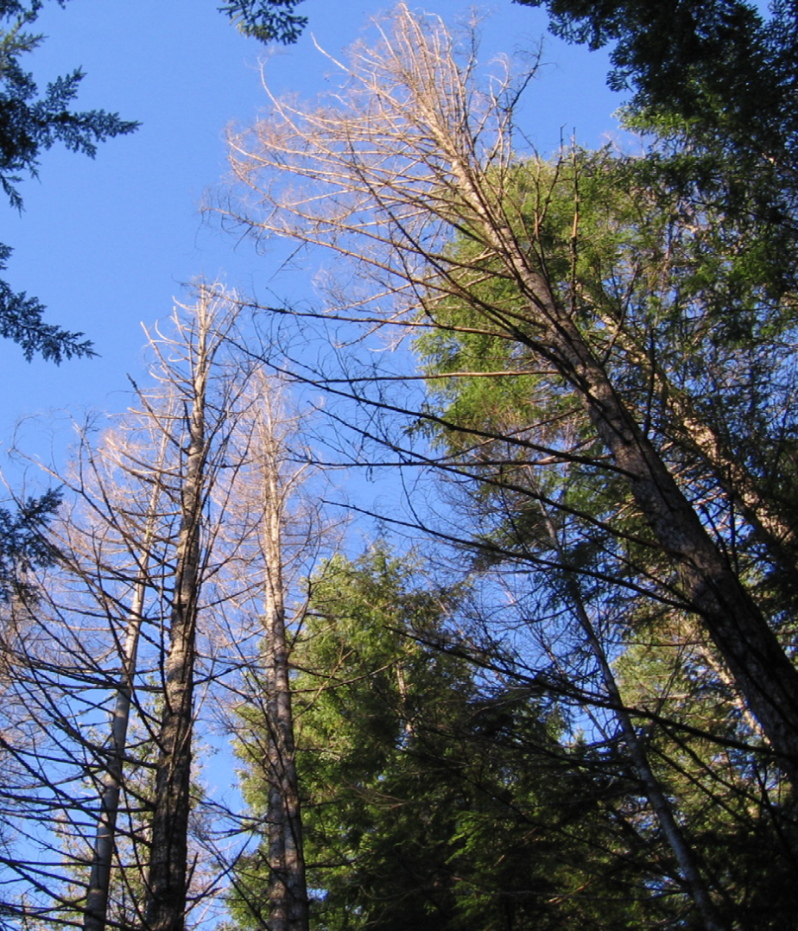
SUMMARY
B.A. Blackwell & Associates Ltd.
To maintain system reliability, and public and worker safety, BC Hydro will need to maintain or improve funding and program execution for the hazard tree and edge tree programs
Notes:
It is anticipated that the forest health factors assessed in this project will continue to cause damage or mortality to trees adjacent to the transmission and distribution system throughout the Province. Additionally, new pests may become more significant over time. In order to maintain system reliability and public and worker safety, Hydro will need to maintain or improve funding and program execution for the hazard tree and edge tree programs. Finally, considering these pest complexes can change significantly in intensity and size, it is recommended that Hydro continue to monitor forest health factors throughout the Province.

Slide 21

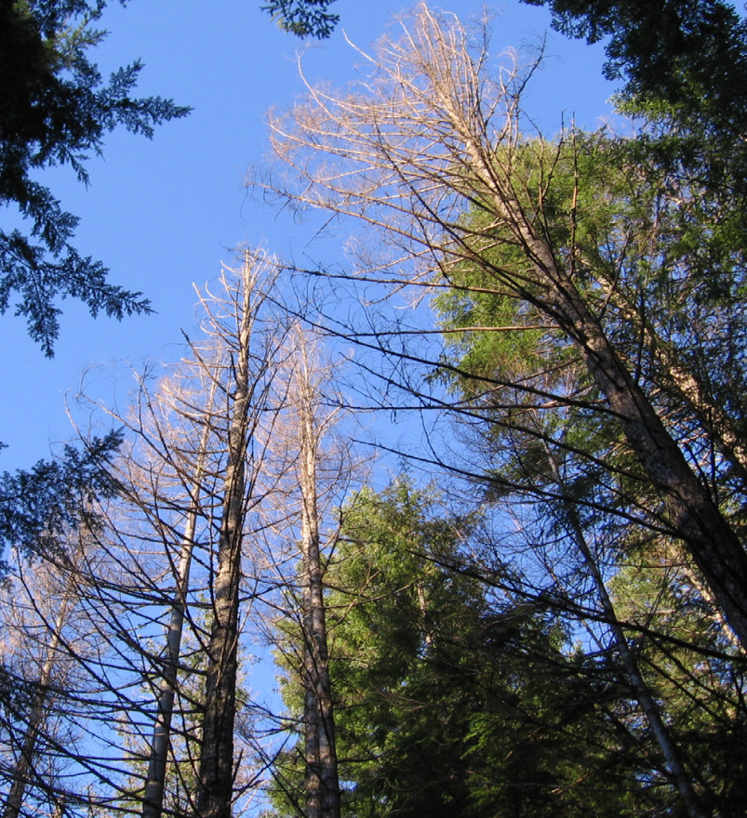
QUESTIONS
B.A. Blackwell & Associates Ltd.

