Slide 1
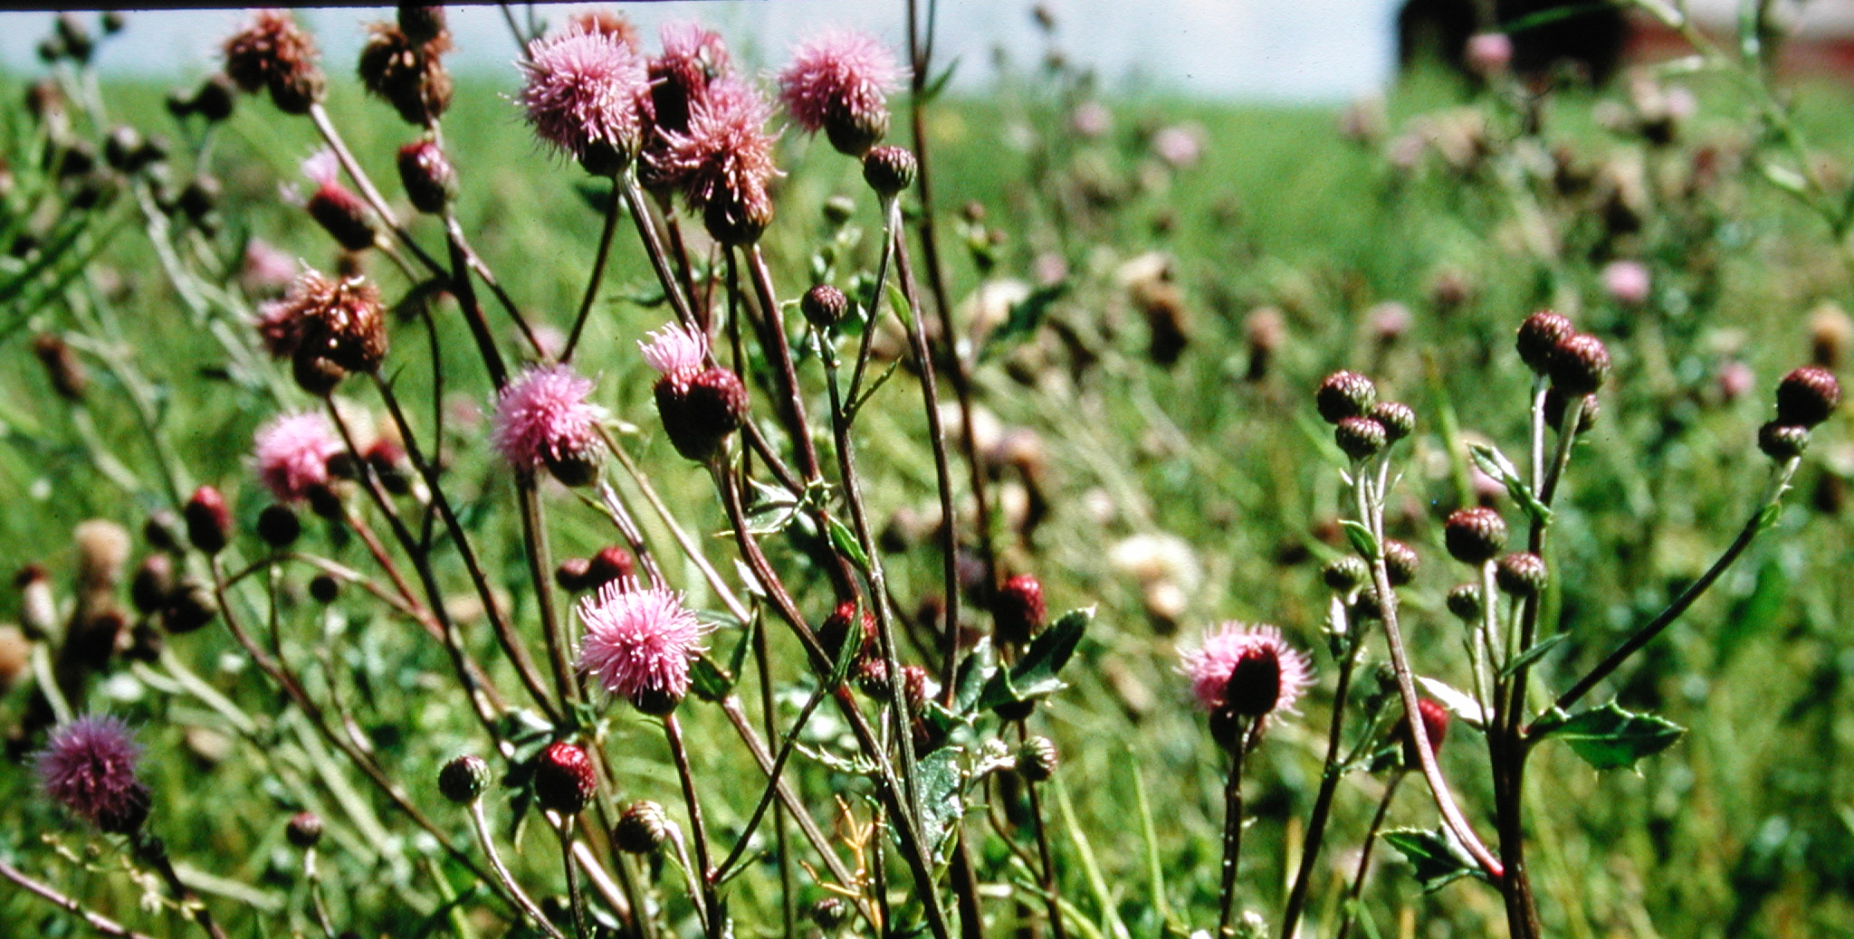
Improving Herbicide Efficacy and Reducing Herbicide Resistance
Ken Sapsford P.Ag.
Pesticide Specialist, BC Ministry of Ag

Slide 2
How Herbicides Work
Understanding the different ways herbicides affects a plant helps to know the best time and conditions to apply a pesticide
Not all pesticides kill the plants in the same fashion
There are 28 modes of action (MOA) that herbicides will control a plant
Only 14 MOA are registered in Canada
Only 7 MOA are listed as herbicides commonly used for Industrial/Noxious weed management

Slide 3
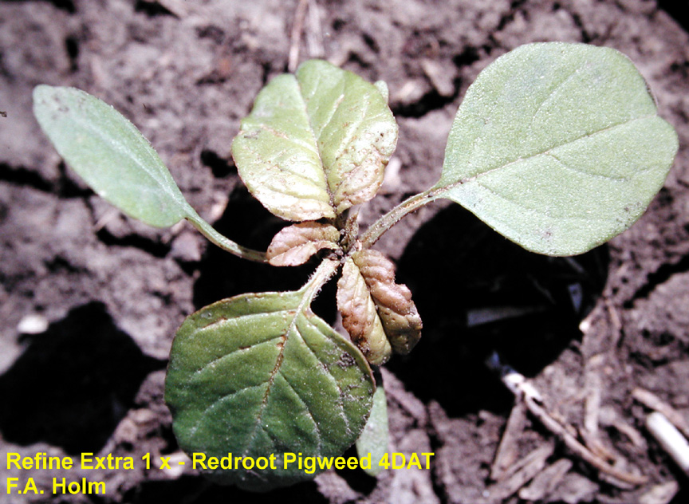
Group 2
Selective herbicides, both broadleaf and grassy weeds
Soil active and persistent
Moves readily throughout the plant
Plant death is slow
Non toxic to mammals
Example
  Arsenal

Slide 4
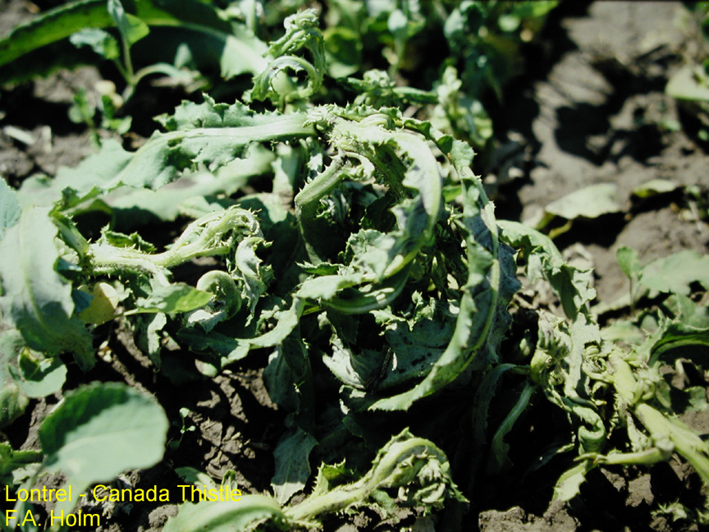
Group 4
Available as esters, amines or salt formulation
Formulation affects uptake by plant and rainfastness
Translocate through the plant
Symptoms include abnormal and rapid growth
Some soil activity
Example
  2,4-D, Milstone, Lontrel,
  Banvel, Dichloroprop,
  Aspect, Tordon & Garlon

Slide 5
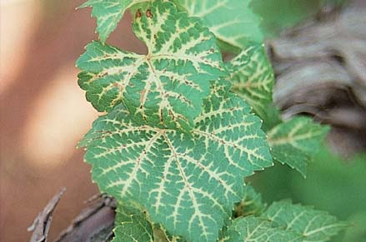
Group 5 & 7
Some are selective and some are non-selective
Move upward in plant mostly (poor at moving downward)
May be subject to leaching into ground water
Work best under sunny conditions
Are soil residual
Examples
  Group 5 – Hyvar X-L & Simanex
  Group 7 – Karmex & Diurex

Slide 6
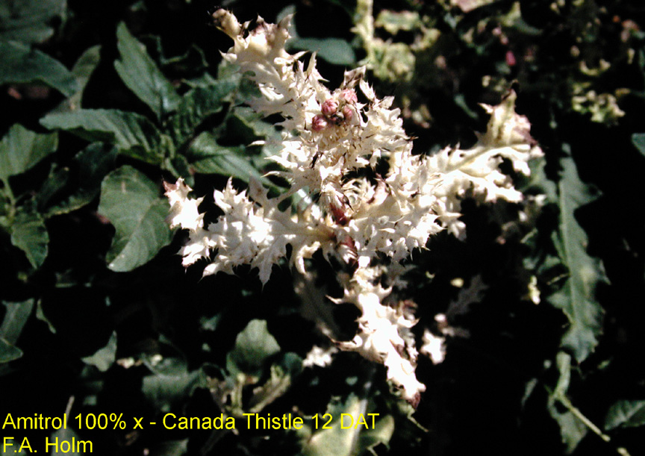
Group 11
Absorbed by foliage and roots
Translocates both up and down the plant
Best on small, actively growing plants
Short term soil residual
Example
  Amitrol

Slide 7
Group 29
Pre-emergent Herbicide for the Control of Annual Grasses and Broadleaf Weeds in Non-Residential Non-Crop Areas
Soil active and persistent
Reduces emergence of seedling
Example
  Esplanade

Slide 8
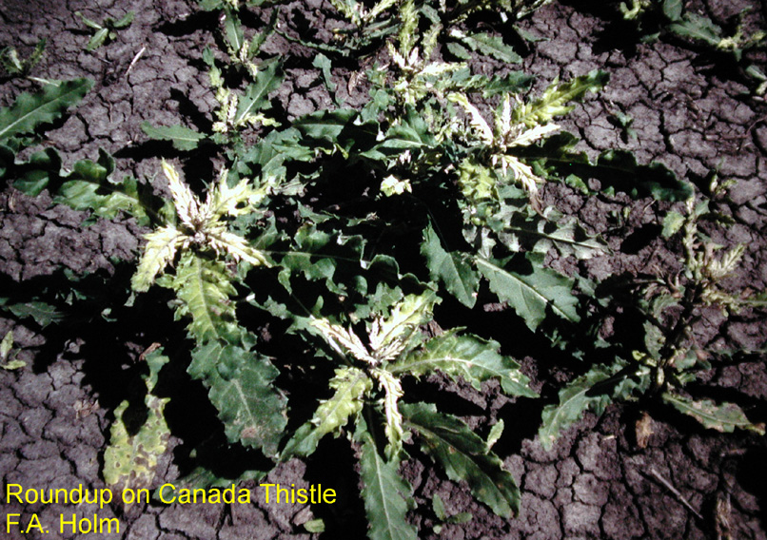
Group 9
Non-selective herbicide
Effective on most broadleaf and grassy plants
Translocates readily through the plant
No soil activity because it binds tightly to soil and is inactivated
Perennial weed control
Very low mammalian toxicity
Only product in this group
  glyphosate

Slide 9
Improve Efficacy
Soil residual herbicides:
  Usually require rainfall to move product into soil
  Need to contact soil to be effective
Foliar applied herbicides work best:
  Plants are clean of dust or dew
  Actively growing
  Annual plants are small
Glyphosate:
  Larger perennial plants able to capture more herbicide to move to roots
  Best applied after flowering or in fall rosette as plant is moving more sugars to the roots
  Multiple applications at proper rate are more effective than one very large application

Slide 10
Proper Application
Soil residual herbicides:
  Too high of application rate will increase length of residual control and may injure tolerant plants
  Some products require herbicide to reach the ground and not be intercepted by foliage
Foliar applied herbicides:
  Too high of application rate may injure tolerant plants
  Too high application rate may destroy cells in leaves before herbicide can translocate to the roots (glyphosate)
Faster dieback of plants does not mean better control

Slide 11
Herbicide Resistance and
Herbicide Tolerance Definitions
Herbicide resistance: the inherited ability of a plant to survive and reproduce following exposure to a dose of herbicide normally lethal to the wild type.
Herbicide tolerance: the inherent ability of a species to survive and reproduce after herbicide treatment. This implies that there was no selection or genetic manipulation to make the plant tolerant; it is naturally tolerant.
Source: Weed Technology Volume 12, Issue 4 (October-December) 1998. p. 789.

Slide 12
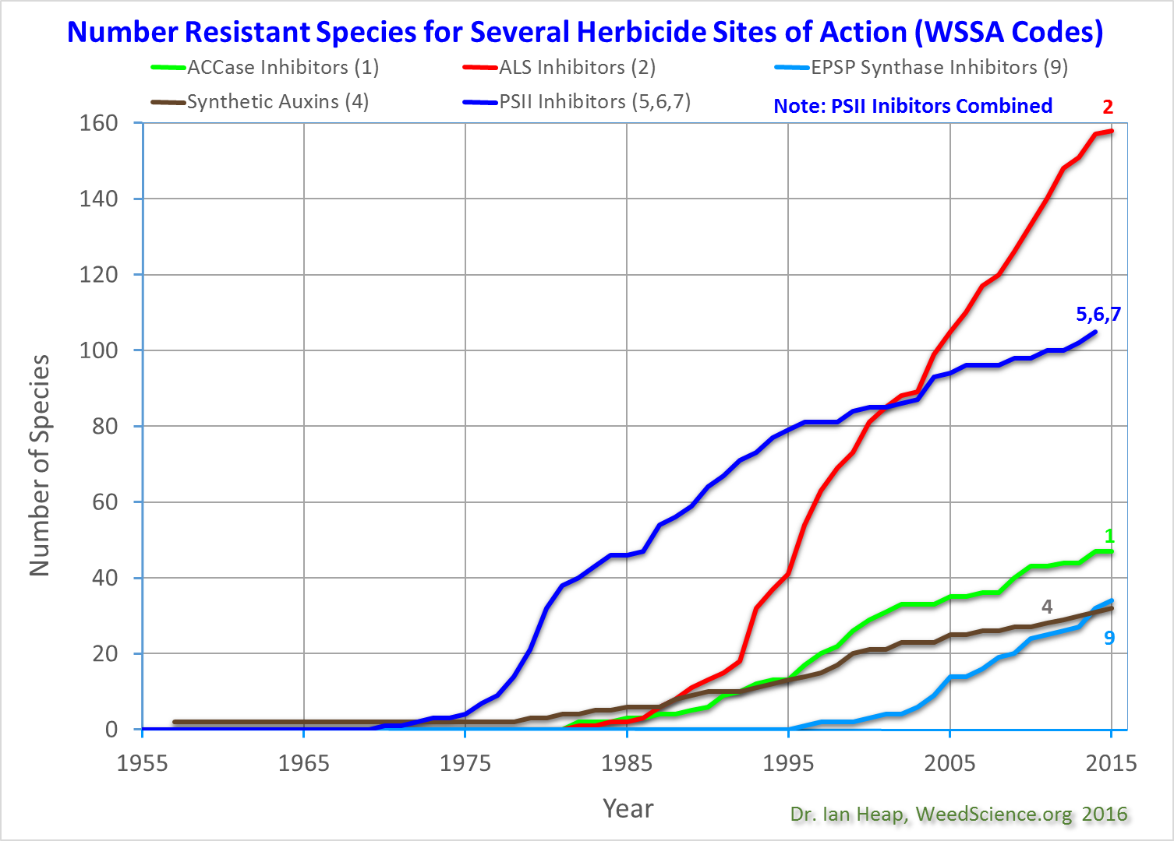
Notes:
This graph presents the chronological increase in resistance to 5 herbicide sites of action. The letters refer to the Weed Science Society of America code (WSSA) to identify herbicide sites of action. Different herbicide sites of action have different propensities to select resistance. PSII inhibitor (Group 5, 6, 7) herbicides, primarily atrazine resistant weeds in corn, dominated in the USA and Europe in the 1970’s and 80’s. ALS inhibitor (Group 2) herbicides are the most prone to resistance. Note that the Y axis is the number of species (because a species is only plotted once per site of action).

Slide 13
First report: spotted knapweed resistance to auxinic herbicides (group 4)
Spotted knapweed is a prohibited noxious weed that is primarily controlled with auxinic herbicides. A population collected from a managed rangeland in East Kootenay, BC, was highly resistant to both clopyralid (Lontrel) and picloram (Tordon). This is the first report of resistance in spotted knapweed.
Canadian Journal of Plant Science, 10.1139/cjps-2016-0008

Slide 14
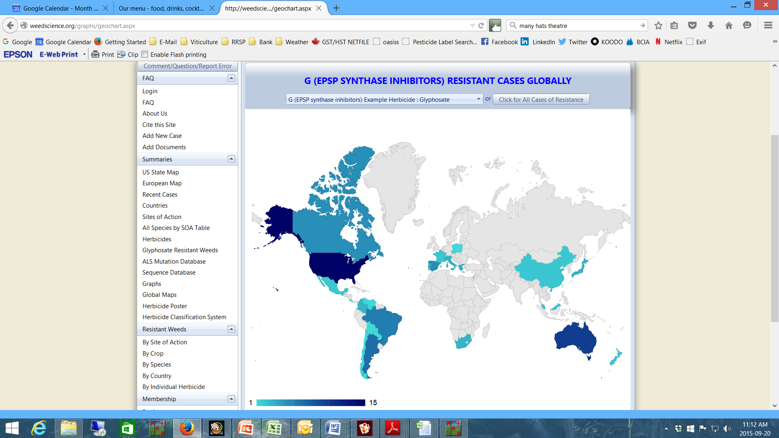
Glyphosate Resistance

Slide 15
23 Trade Names for glyphosate
Cheminova Glyphosate
ClearOut 41 plus
Credit 45
Crush’R Plus
Glyfos
Knockout Extra
Lajj Plus
Matrix
Maverick
Mpower
NuGlo
Roundup Transorb
Roundup Ultra 2
Roundup Weathermax
R/T 540
Sharpshooter
Sharpshooter Plus
StartUp
Touchdown
Traxion
Vantage Plus Max II
Vector
Wise-up

Slide 16
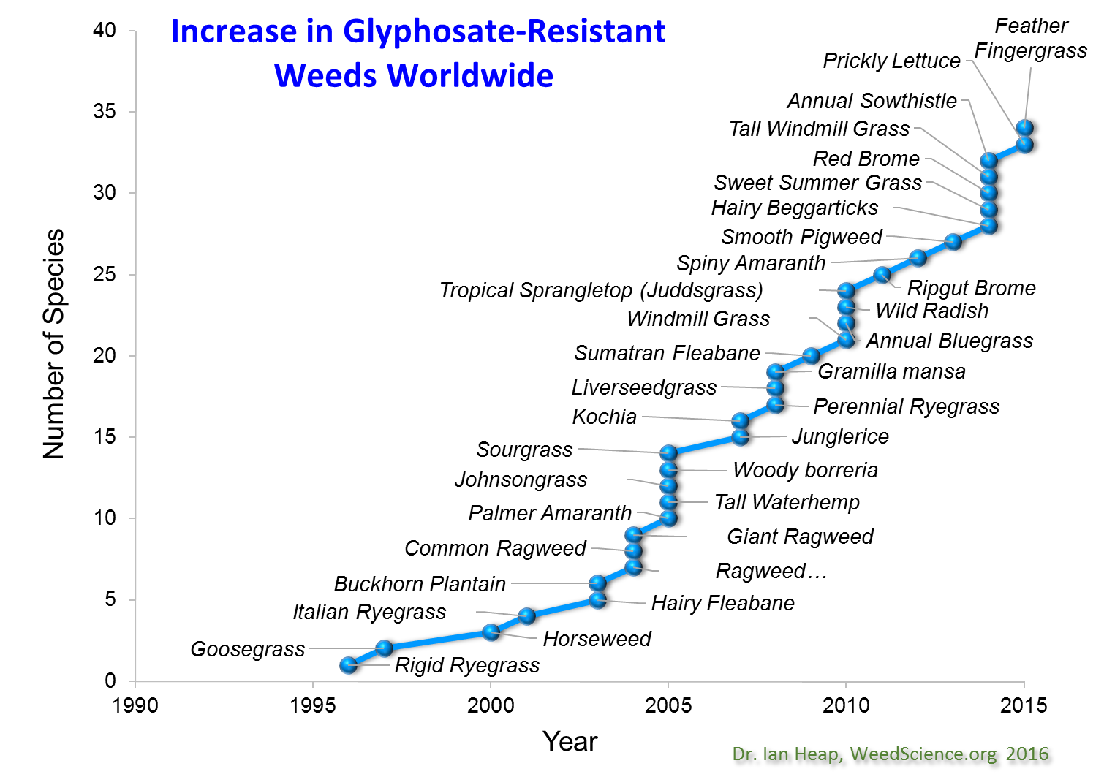
Canada Fleabain

Slide 17
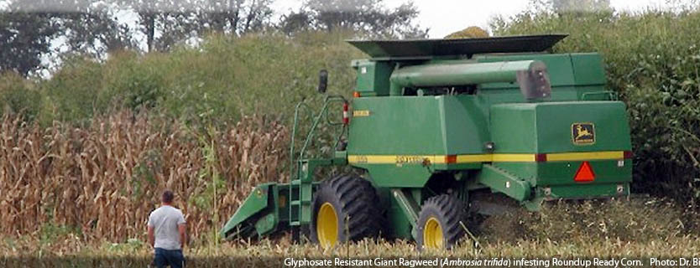
Glyphosate Resistant Giant Ragweed in Corn

Slide 18
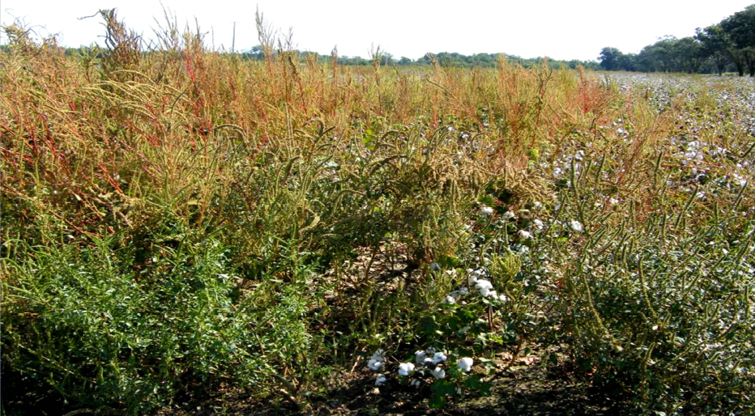
Cotton Crop?

Slide 19
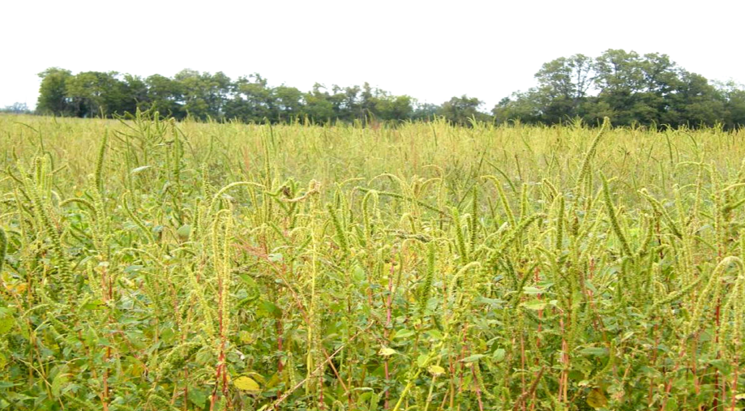
Soybean Crop?

Slide 20
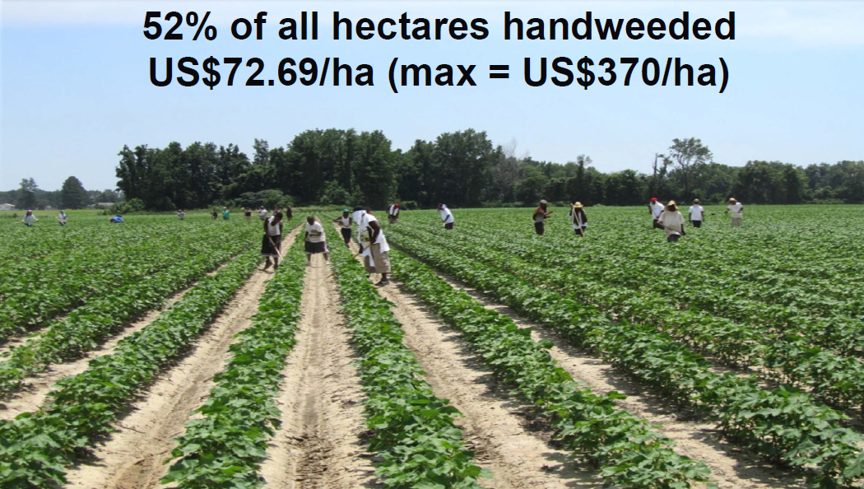
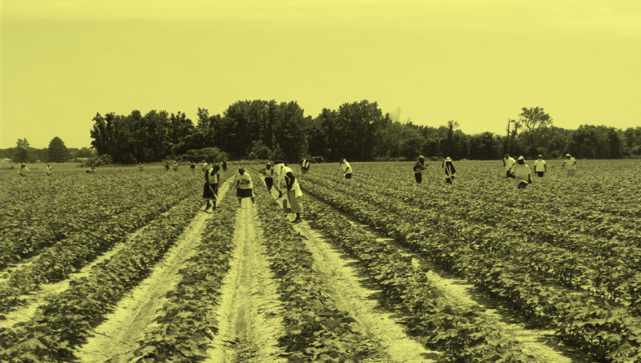
Southern USA Cotton Production
2011 Photo: Jason Norsworthy
University of Arkansas

Slide 21
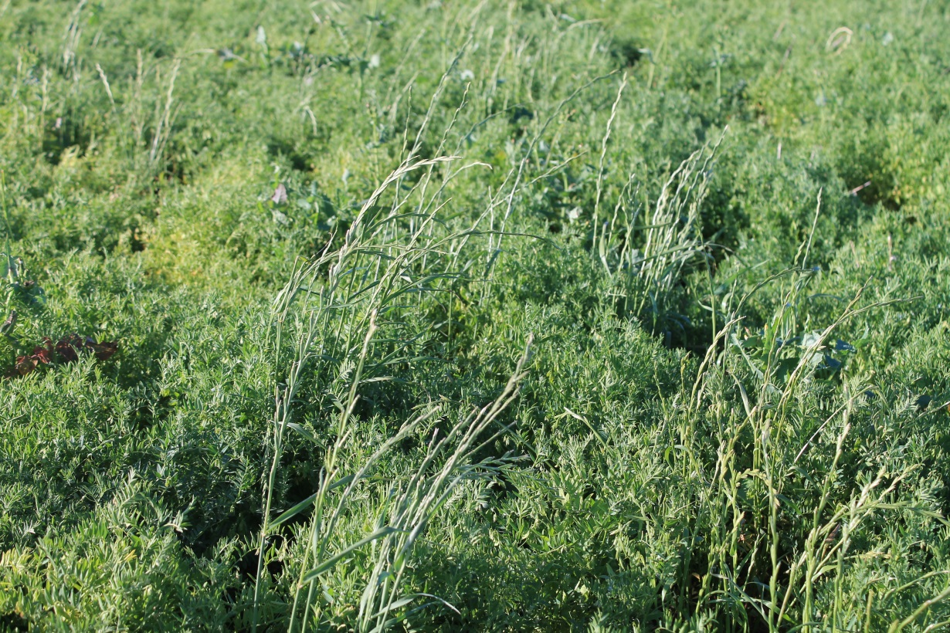
Australia
Annual Ryegrass
(Lolium rigidum)
Biotypes with resistance to Groups 1, 2, 3, 5, 9, 11, 15
Some biotypes with multiple resistance (up to 7 modes of action)
“Ryegrass control drives our cropping decisions”

Slide 22
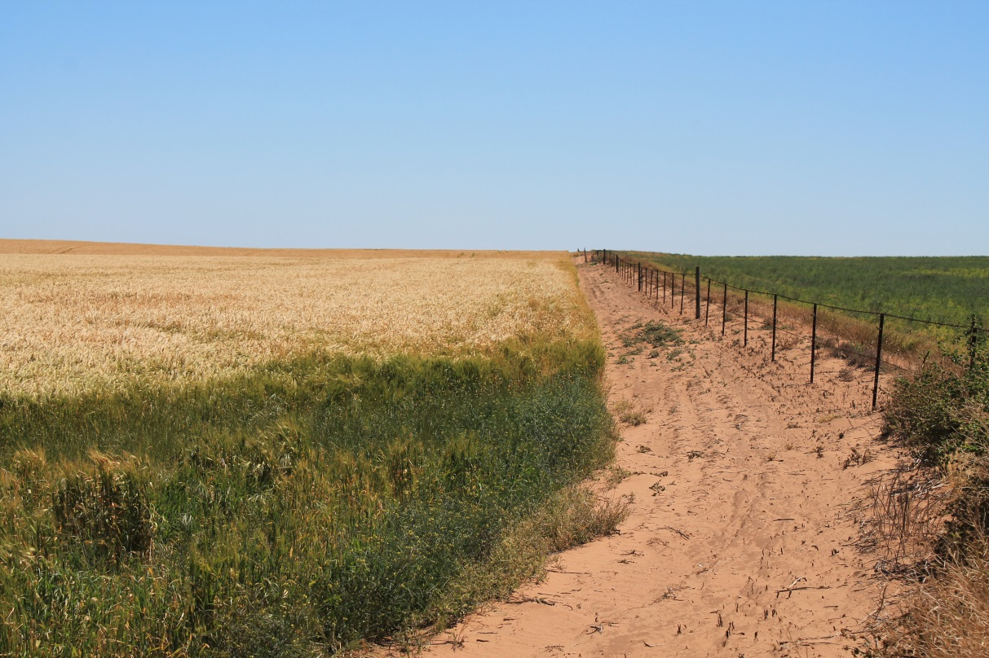
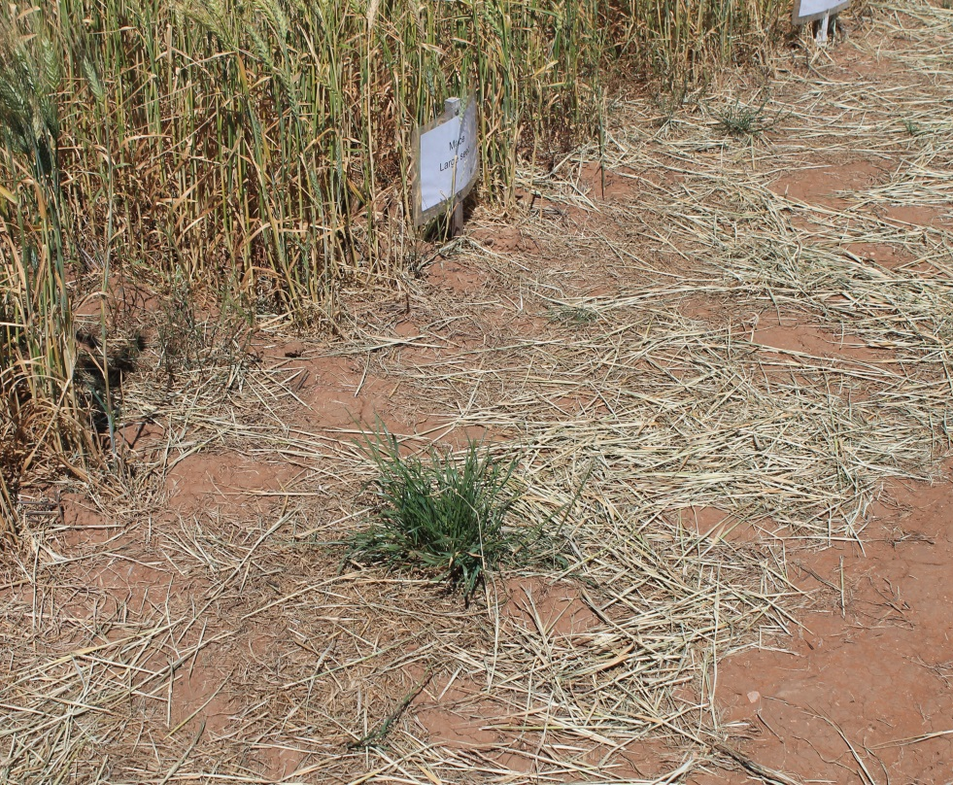
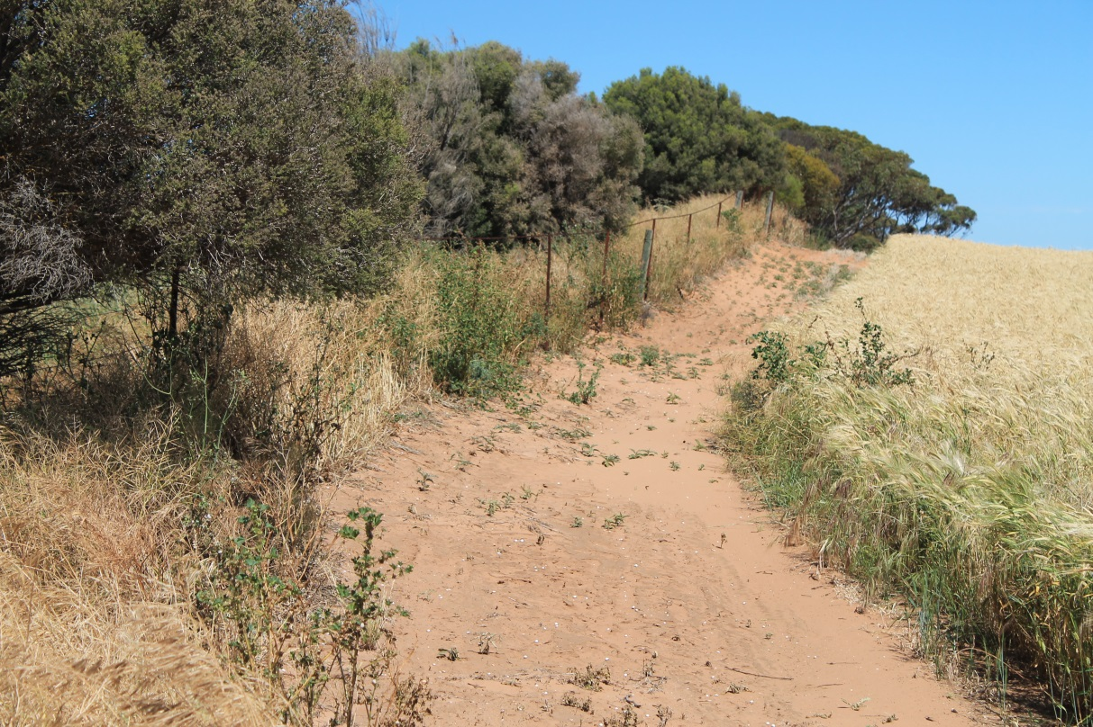
Glyphosate resistant ryegrass in South Australia

Slide 23
10 Ways Australian Farmers can fight Herbicide Resistance
  Act now to stop weed seed set
  Capture weed seeds at harvest
  Rotate crops and herbicide mode of action
  Test for resistance
  Aim for 100% control and monitor every spray event
  Don’t automatically reach for glyphosate
  Never cut on-label herbicide rate
  Plant clean seed into clean fields
  Use the double knock technique
  Employ crop competitiveness to combat weeds

Slide 24
How We can fight Herbicide Resistance
  Act now to stop weed seed set
  Capture weed seeds at harvest
  Rotate crops and herbicide mode of action
  Test for resistance
  Aim for 100% control and monitor every spray event
  Don’t automatically reach for glyphosate
  Never cut on-label herbicide rate
  Plant clean seed into clean fields
  Use the double knock technique
  Employ crop competitiveness to combat weeds

Slide 25
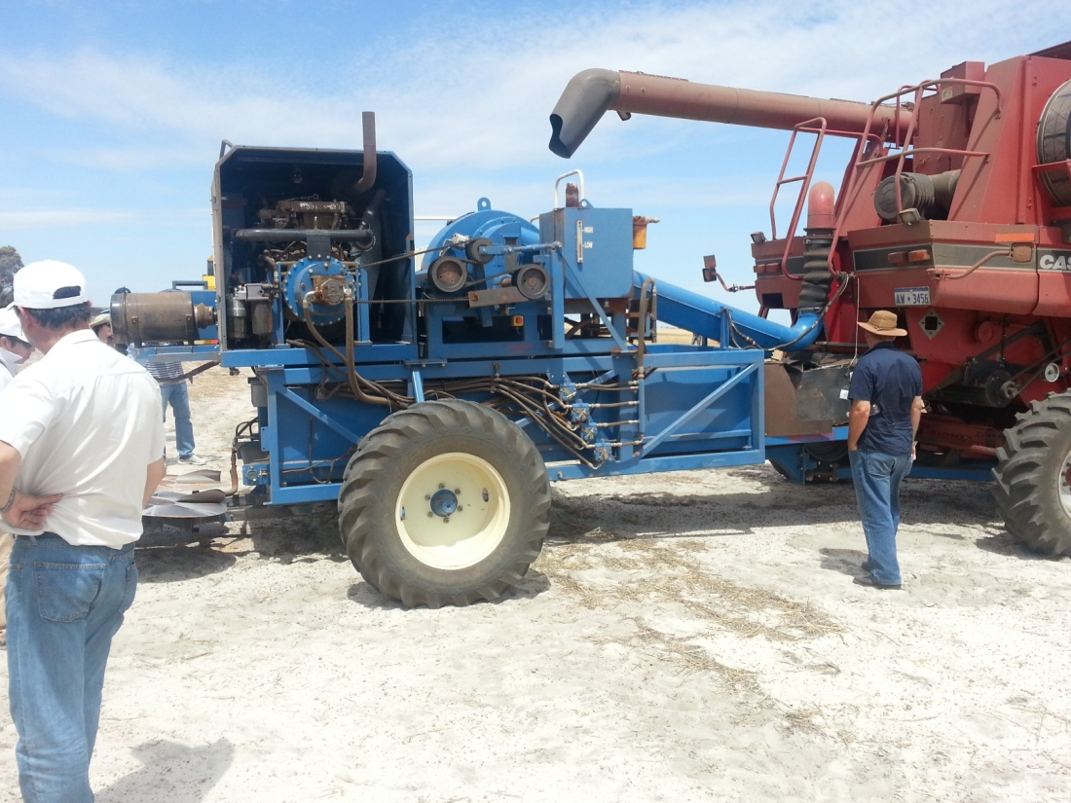
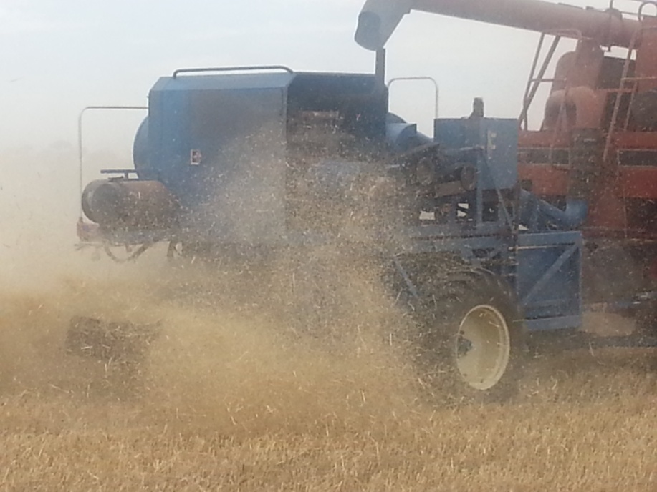
Harrington Seed Destructor

Slide 26
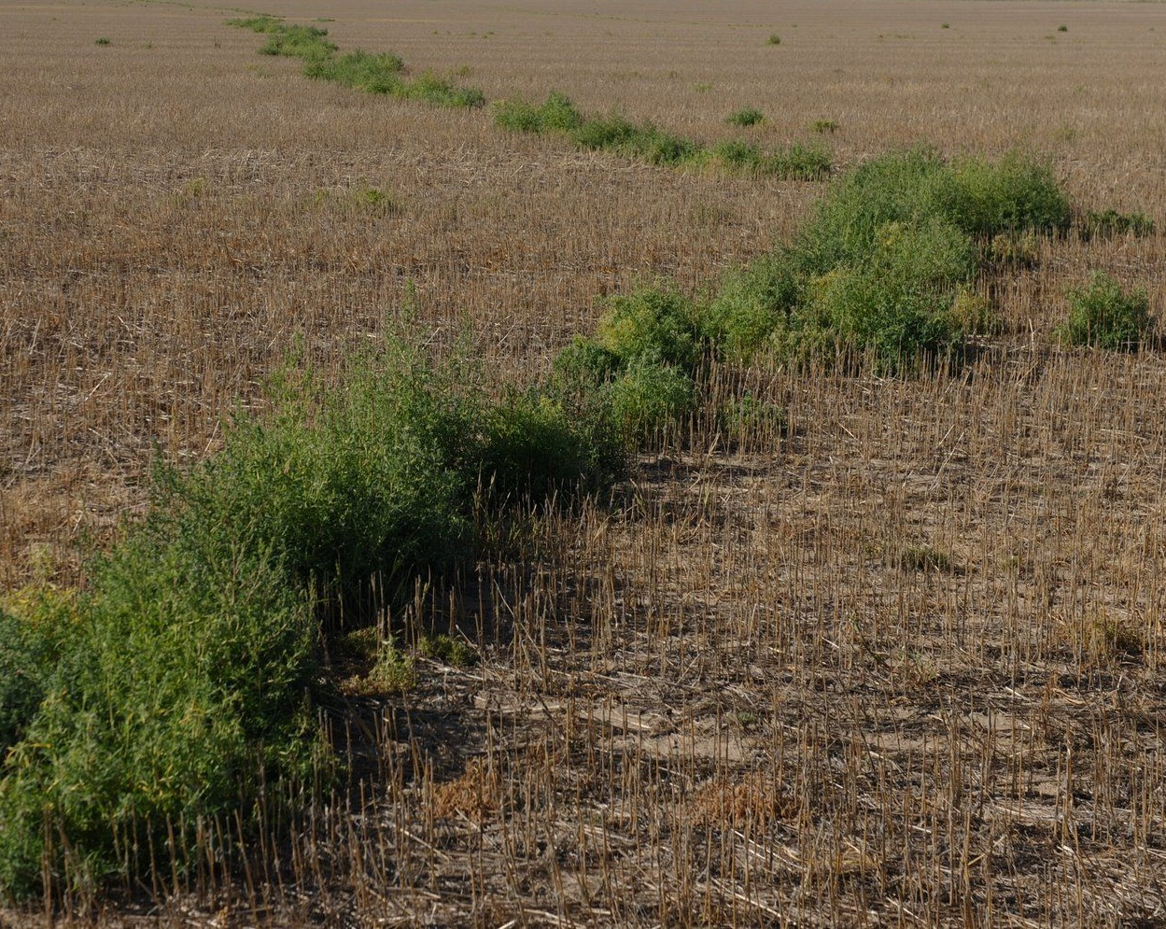
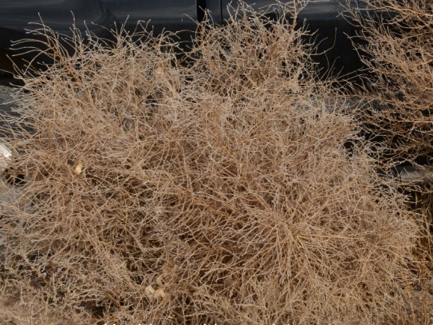
Cotton Acres in Arkansas
Kansas: Confirmed Glyphosate resistance in kochia in 2007.
Source: Dr. Phil Stalhman, Kansas State University; Dr. Phil Westra, Colorado State University

Slide 27
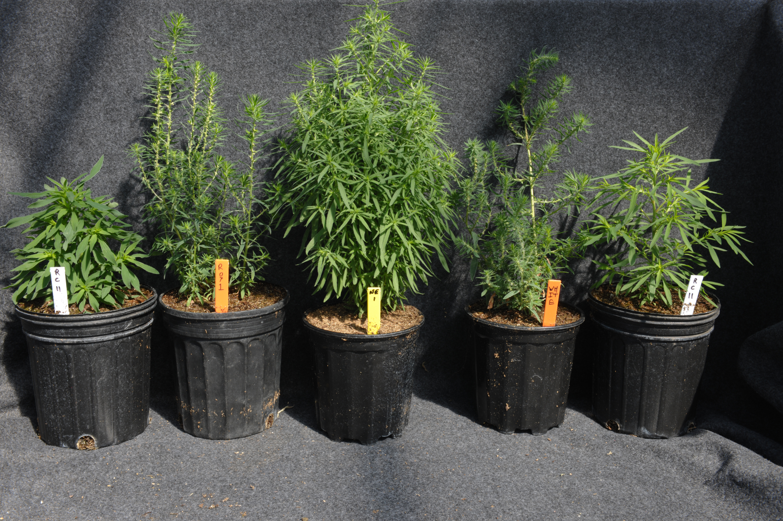

Slide 28
Mechanisms of Glyphosate Resistance
Target Site Mutation (Proline 106)
Translocation
Gene Amplification
Sequestration

Slide 29
Target Site Mutation
Herbicide
Herbicide
Enzyme
Enzyme
Susceptible
Resistant

Slide 30
Mechanisms of
Glyphosate
Resistance
Ryegrass
Canada Fleabane
Reduced
Translocation /
Sequestration
Susceptible
Resistant
Susceptible
Resistant

Slide 31
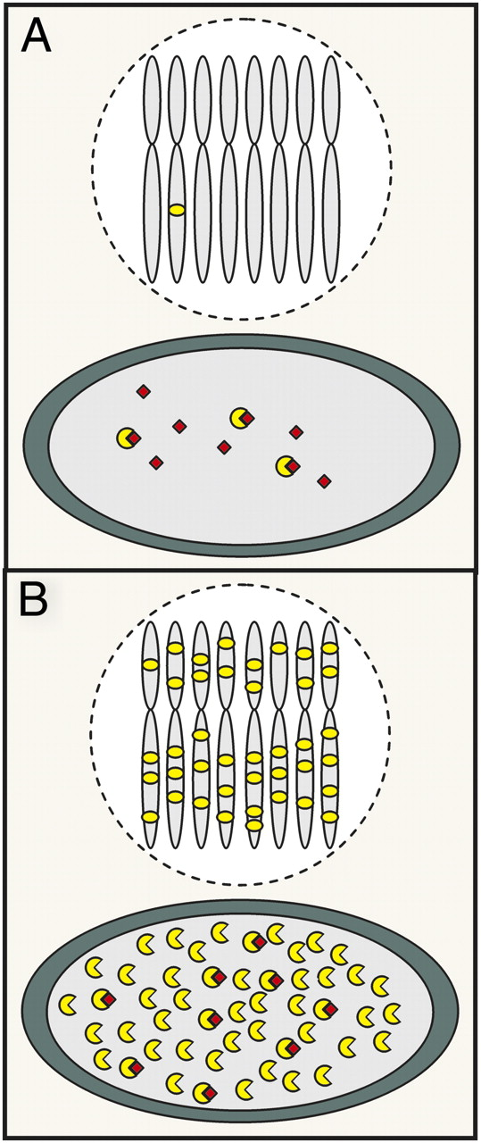
EPSPS gene amplification confers glyphosate resistance in A. palmeri
In 2010, CSU researchers characterized glyphosate resistance in A. palmeri
Susceptible
Gaines, et al. (2010) PNAS 107:1029-1034
Resistant
Powles S B PNAS 2010;107:955-956

Slide 32
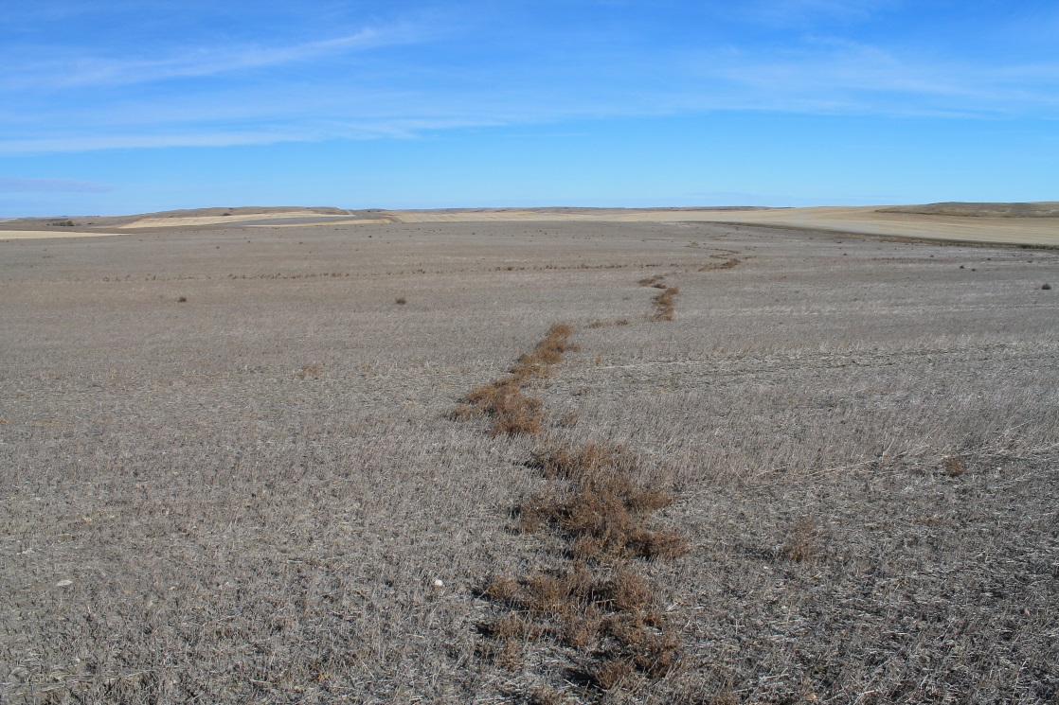
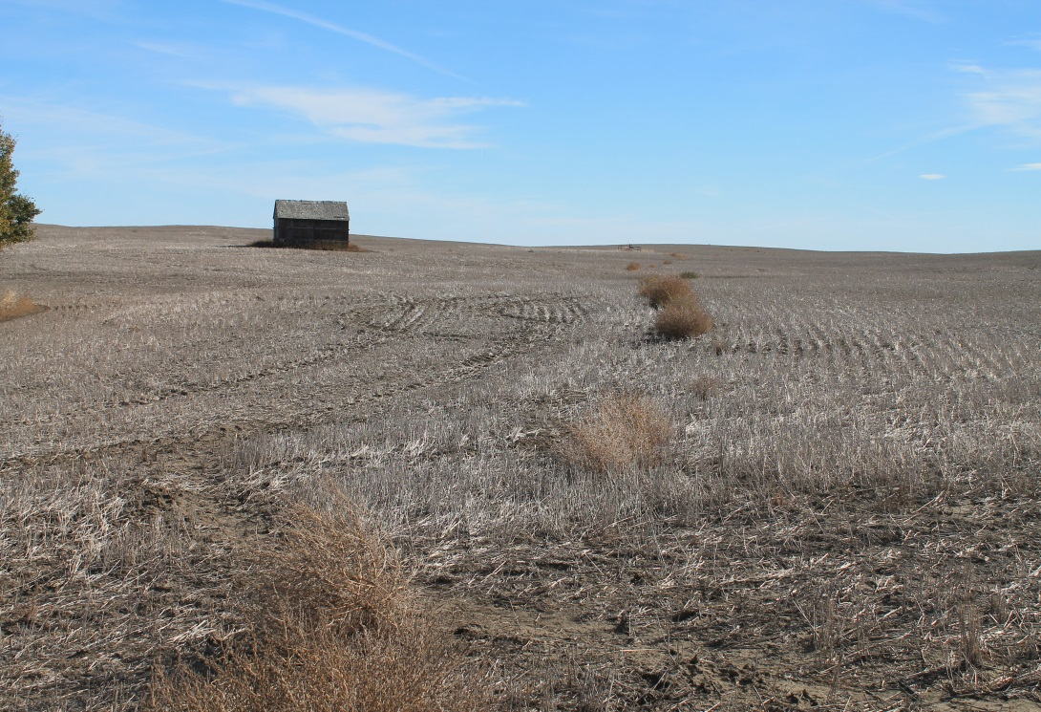
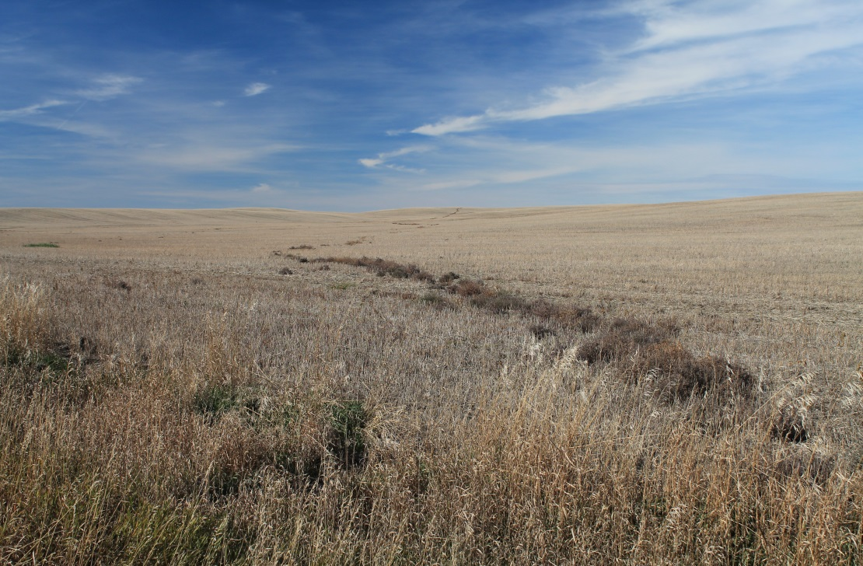
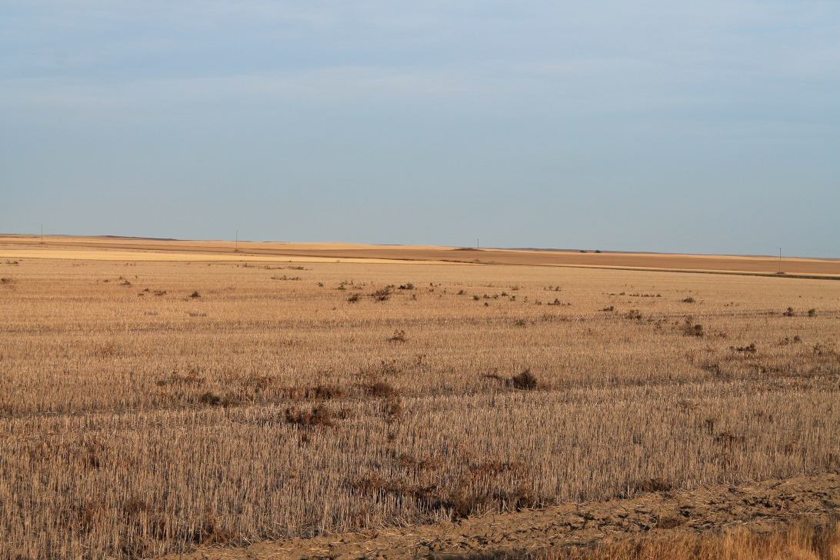
Alberta 2011

Slide 33
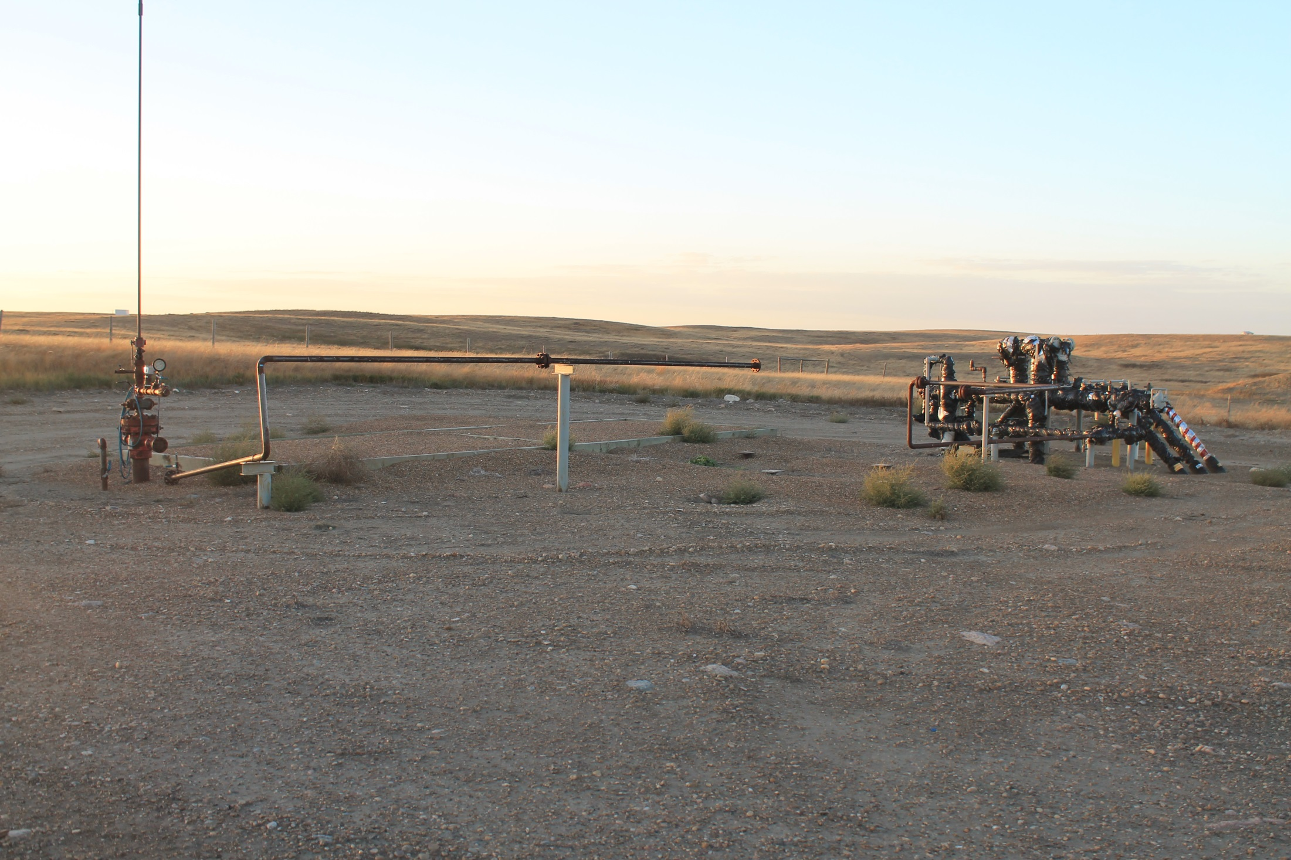

Slide 34
Agricultural and non-agricultural land uses reporting glyphosate-resistant L. rigidum in Australia. From Preston (2009).
Source Situation No. of sites
Grain Production Chemical fallow 28
Winter grain Production 19
Horticulture Tree crops 4
Vine crops 15
Other Driveway 1
Fence line & crop margin 25
Irrigation channel 8
Airstrip 1
Railway right-of-way 1
Roadside 1
80% - Bare Ground
Managing glyphosate resistant weeds in Australia
Christopher Preston
School of Agriculture, Food and Wine, University of Adelaide

Slide 35
Frequency of Resistant Individuals (%)
Herbicide A or B used alone
Herbicide A and B rotated
100
80
60
40
Tank-mix of Herbicide
A and B
20
0
0
2
4
6
8
10
12
14
16
Generations

Slide 36
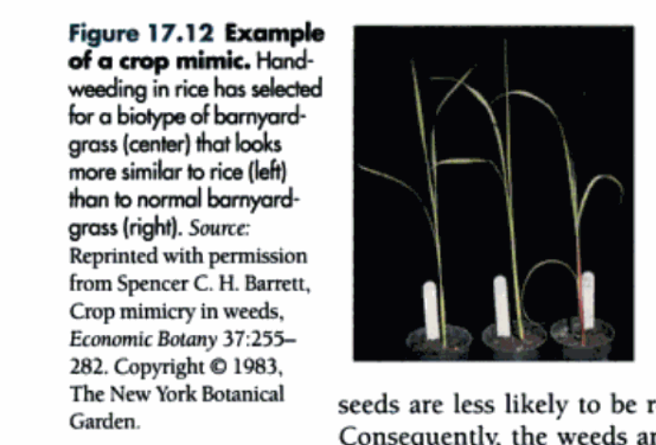
Barnyard Grass is Resistant to
Hand Weeding in Rice fields in Asia

Slide 37
Glyphosate Resistant Weeds
34 resistant species world wide
5 known resistant species in Canada
There will be more
Glyphosate should never be applied alone
  It is too valuable of a tool to lose

Slide 38
Resistant Management
Use multiple modes of action
Use the proper rate
Monitor weeds after application
Do not allow any escapes to shed seed
Use IPM that includes non chemical control

Slide 39
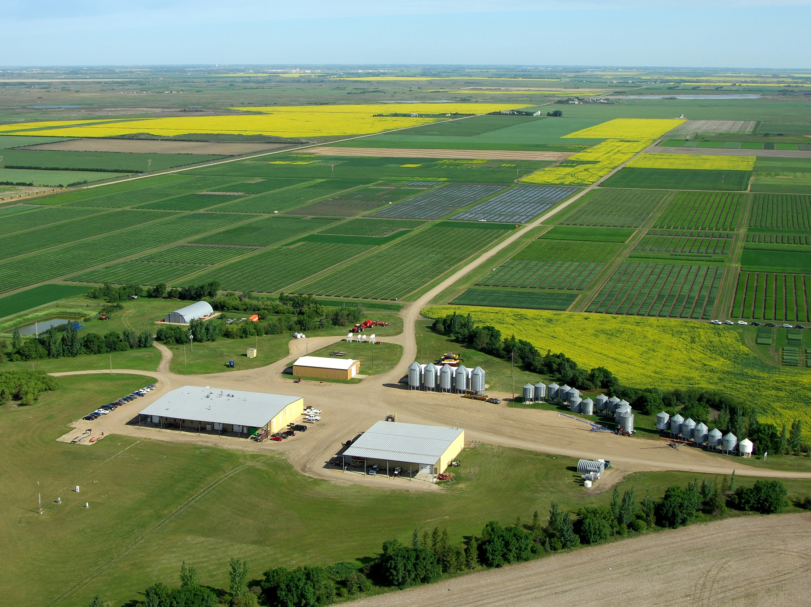
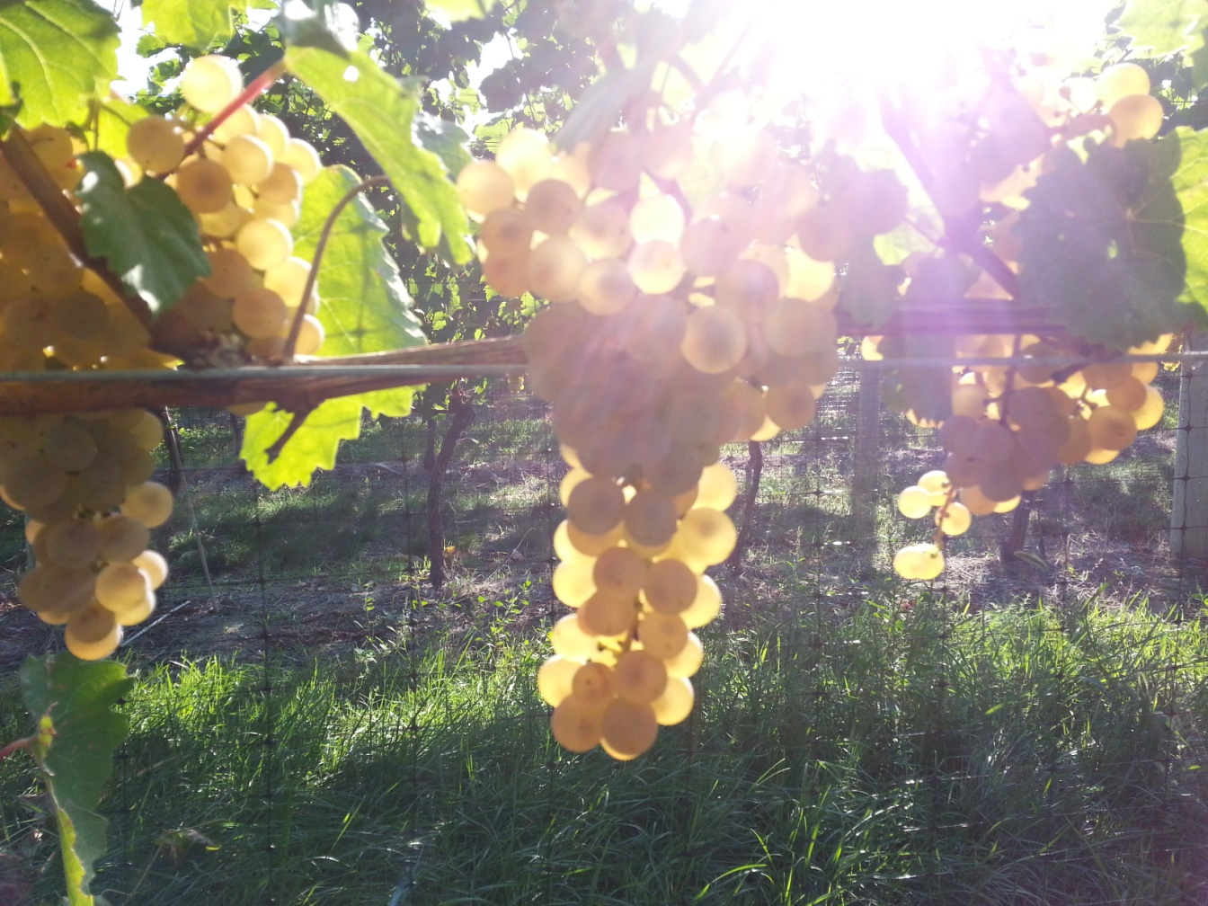
Questions
Ken Sapsford P.Ag.
Pesticide Specialist

