Slide 1

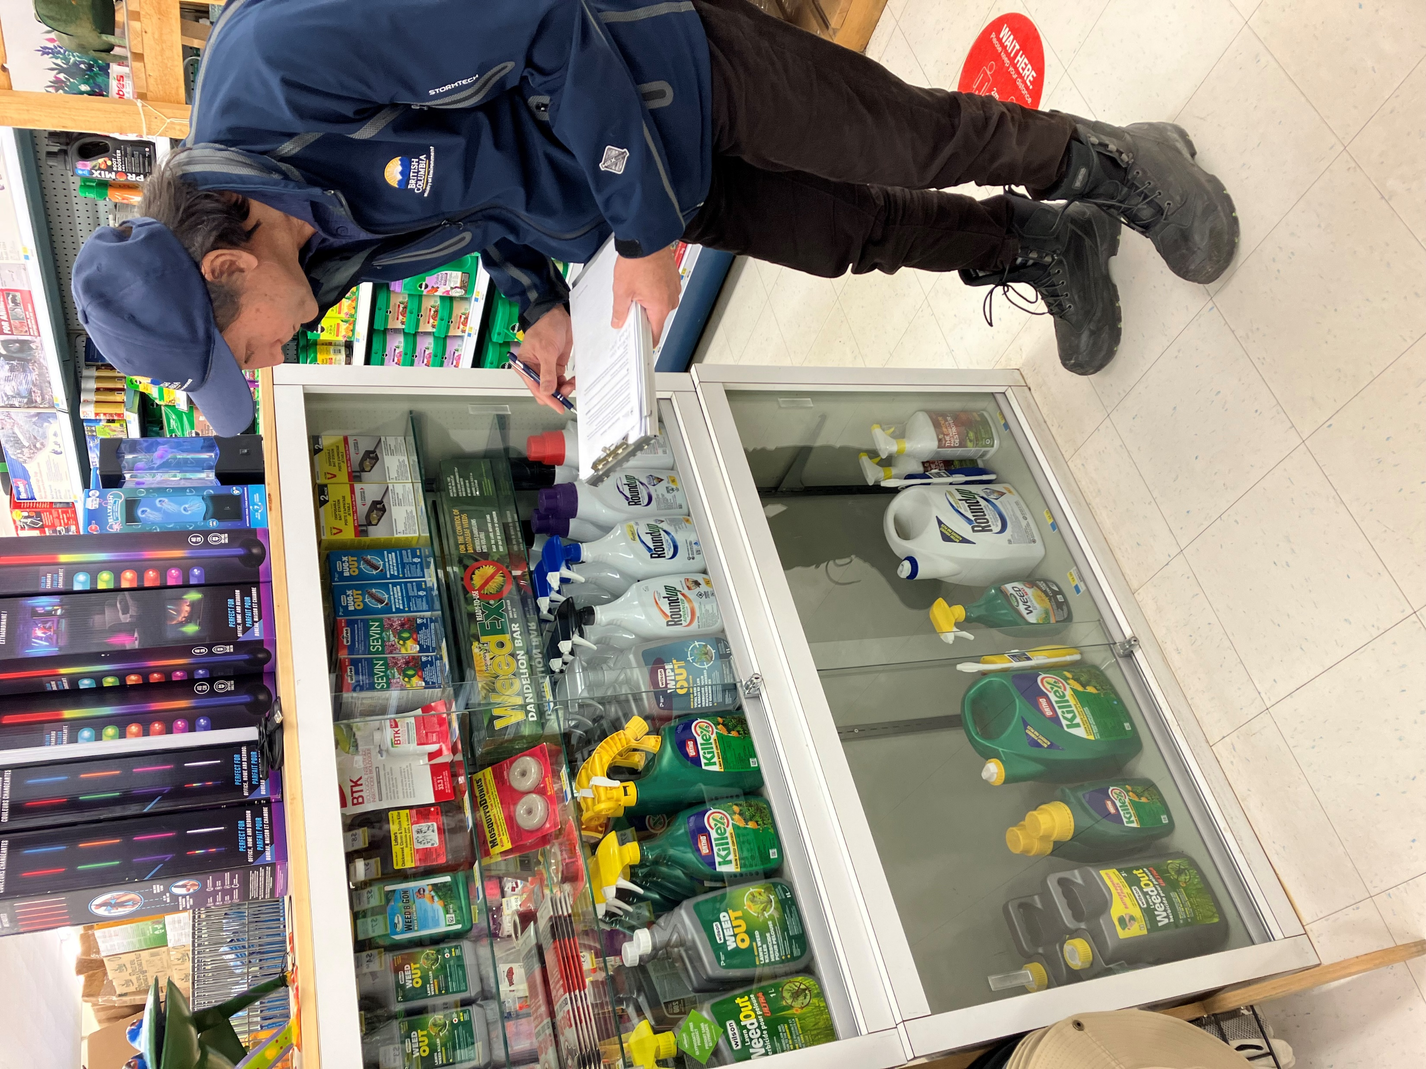
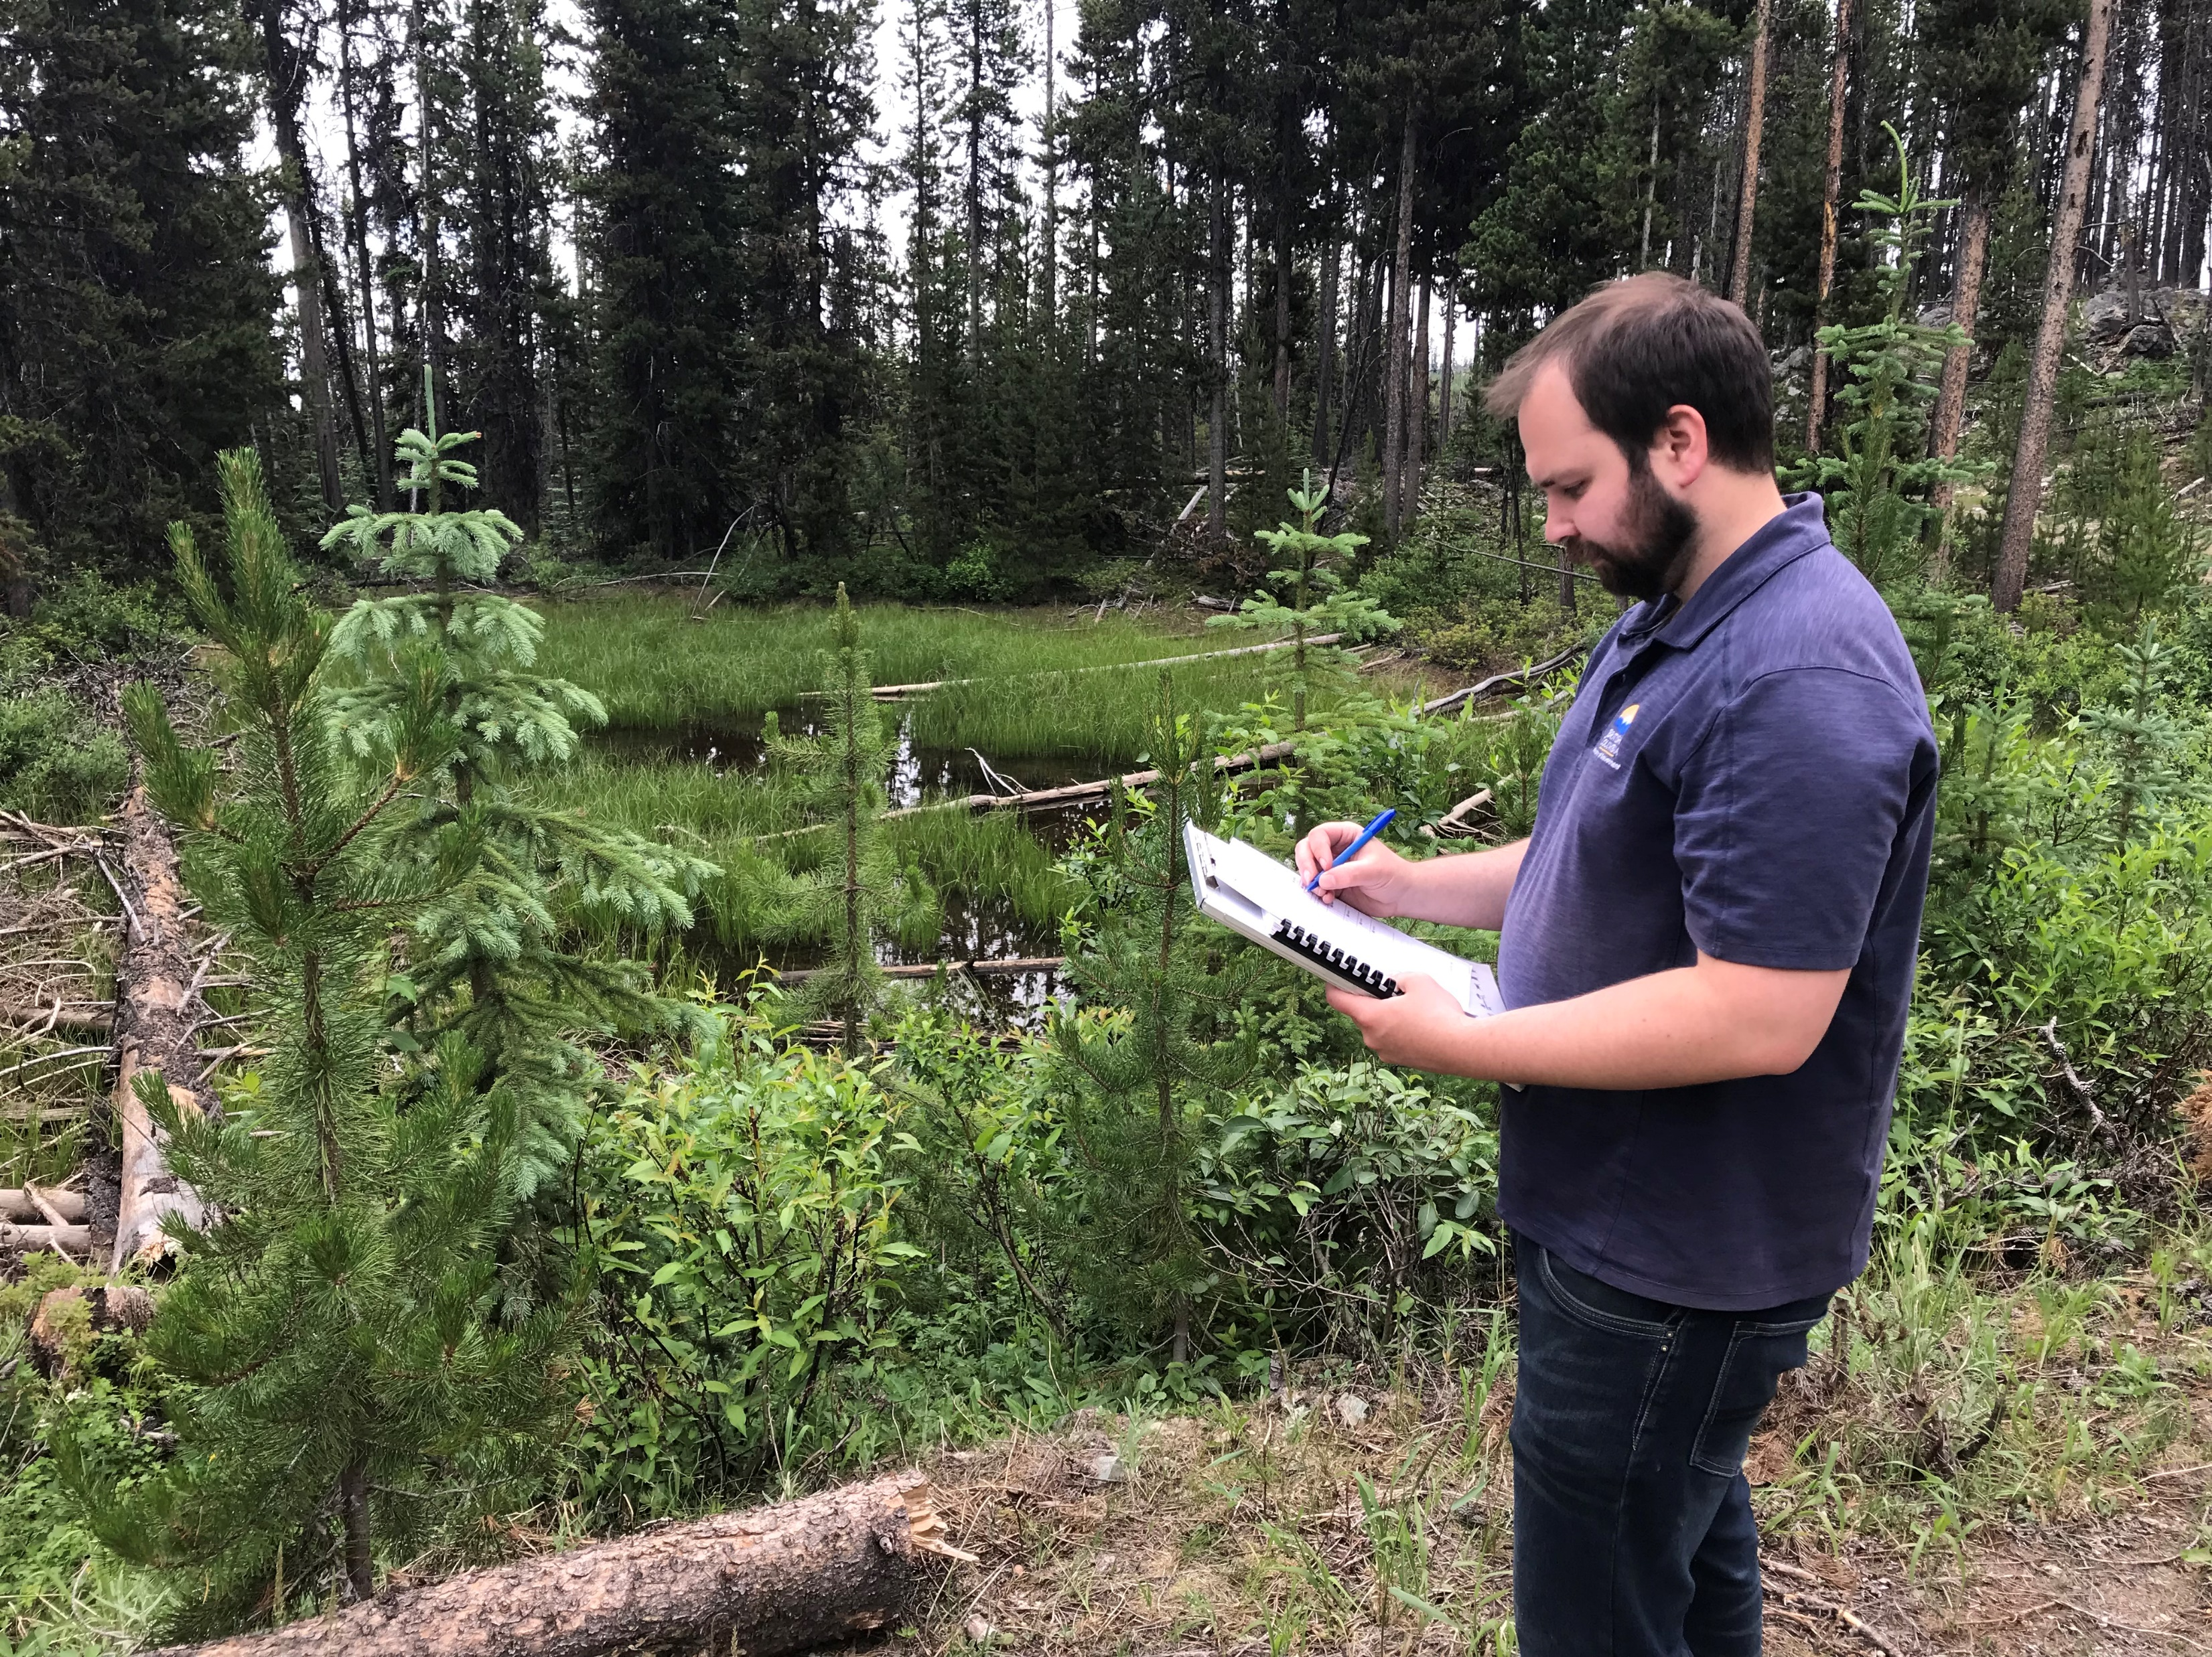
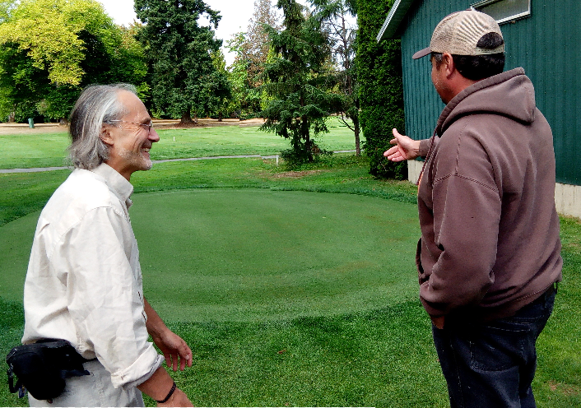
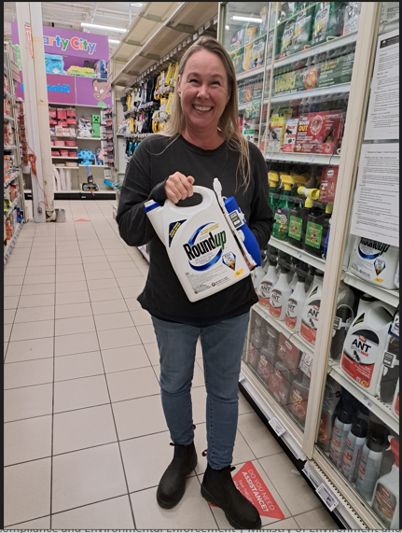
Compliance & Environmental Enforcement Branch – IPM Team News and Updates
IVMA, Conference
November 7th, 2023
Michael Lapham– Compliance Section Head - IPM
Compliance and Environmental Enforcement Branch
Notes:
Introduction

Slide 2
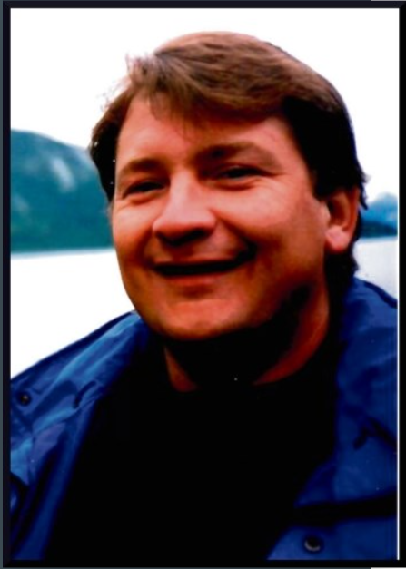
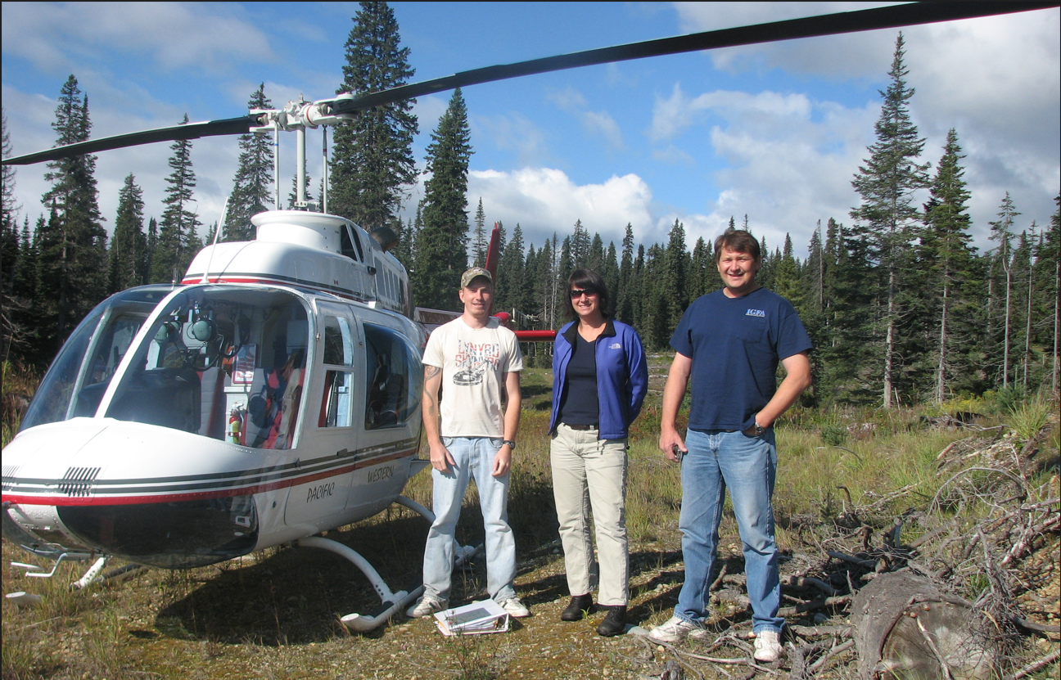
Remembering Manny Mariotto
March 31, 1963 - April 29, 2023
https://www.legacy.com/ca/obituaries/princegeorgecitizen/name/emanuele-mariotto-obituary?id=51799324

Slide 3
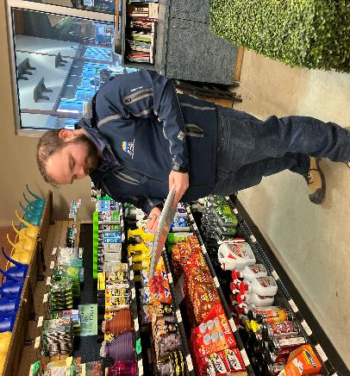
Presentation Outline
Compliance Team Updates
Risk-based Planning Approach
2022 Aerial Pesticide Audit
Online Implementation of Annual Use Reports for Licence Holders Submissions
Complaints Management – Industrial Vegetation/Noxious Weed Sector
IPM Section Head Michael Lapham conducting an onsite compliance inspection

Slide 4
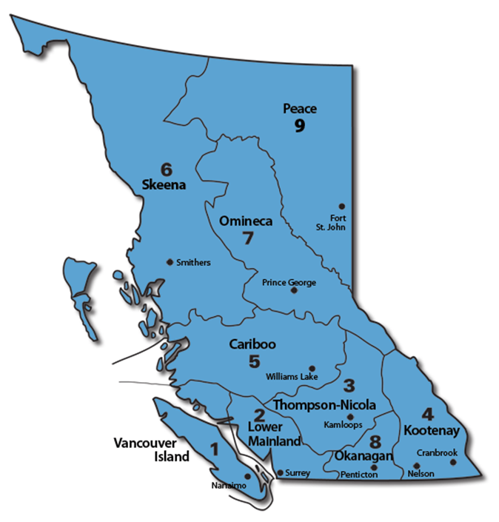
Compliance and Environmental Enforcement Branch - IPM
Currently four staff including a Section Head and three IPM Officers:
Kamloops – Michael Lapham (Section Head)
Nanaimo – Conrad Berube (Senior IPM Officer)
Penticton – Alexis Friesen (IPM Officer)
Williams Lake – Rafiullah Sahibzada (IPM Officer)
Surrey – Vacant (TA, April 31st)
Director:
Nelson – Jennifer Mayberry
Notes:
Mention that I have been in role close to 2 years now and that Conrad is planning on retiring next year.

Slide 5
Compliance and Environmental Enforcement Branch (CEEB)
CEEB is split into of two separate business areas that are each lead by a director including: Compliance and Enforcement and Administrative Monetary Penalties (AMP)
Vision
British Columbians are motivated to always follow environmental protection laws.
Mission
We are inspired to protect the environment by holding individuals and businesses accountable. We verify compliance with environmental protection laws and take timely enforcement action where required. We focus on the highest-priority areas and choose the best tools to achieve compliance.

Slide 6
Risk-based Approach in a Snapshot
Inherent Risk
Modifiers
Cumulative Risk Score
Behavioral Risk
Quantity of Pesticides Used
Quantity of Pesticides Sold
Authorization Type
Compliance history
Level
Category
Outcome
New authorizations
Time since last inspection

Slide 7
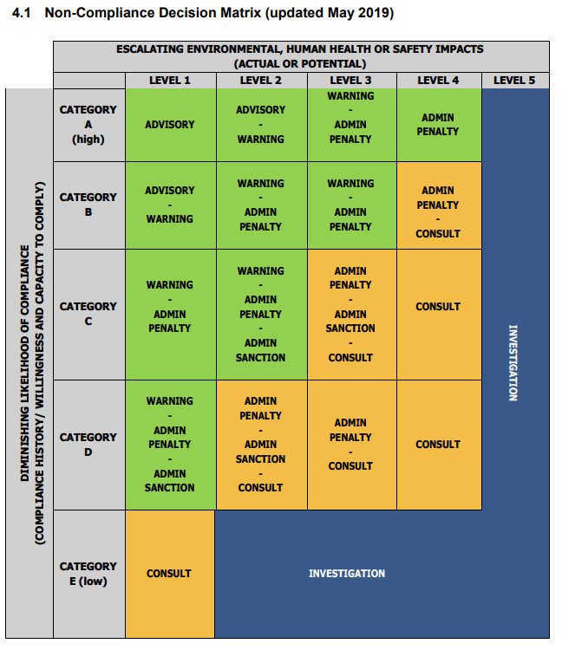
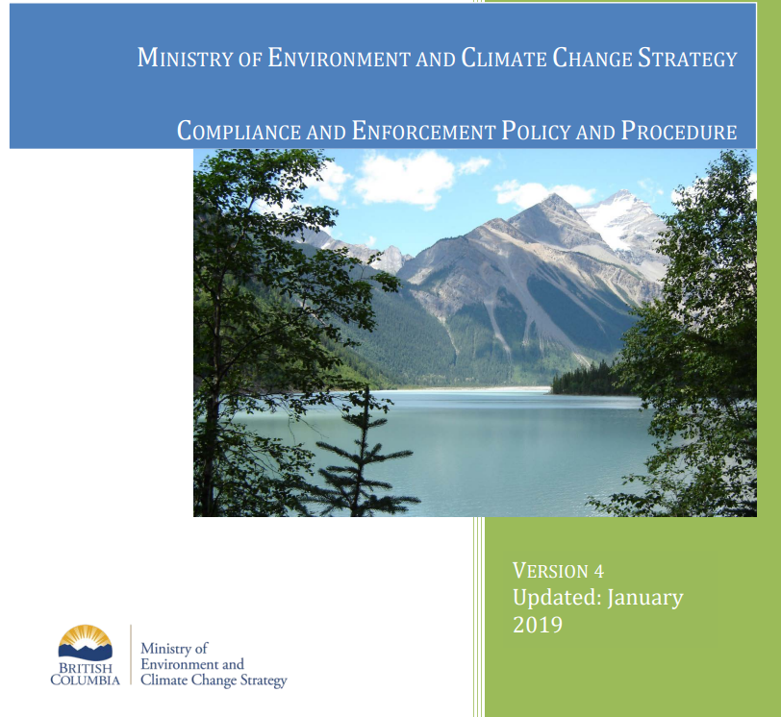
Compliance – Verification and Enforcement
Compliance and Enforcement Policy and Procedure
Notes:
Matrix Calibration sessions and group discussions on larger more complex files.

Slide 8
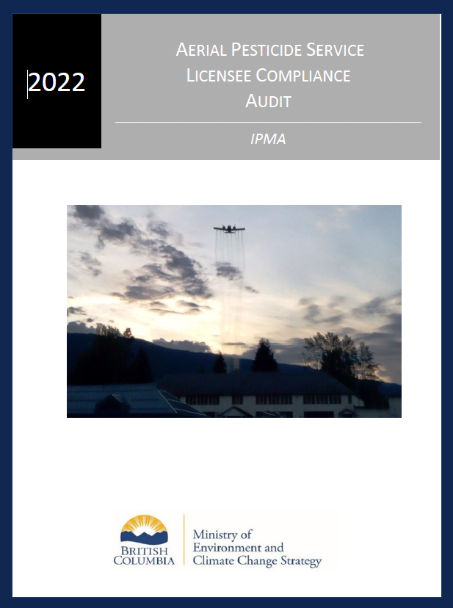
2022 Aerial Pesticide Audit
What is considered an Aerial Pesticide Application?
Application of pesticides from helicopters or fixed-wing aircraft to manage mosquitoes, vegetation along rights-of-way, and pests associated with agricultural or forestry production
Why complete an audit?
A recent AMP was issued for an aerial application on crown land without a permit.
Internal and external interest in aerial pesticide use
Few inspections had been done recently as there are a small amount of authorization holders (only 11 licenced aerial operators identified in the province).

Slide 9
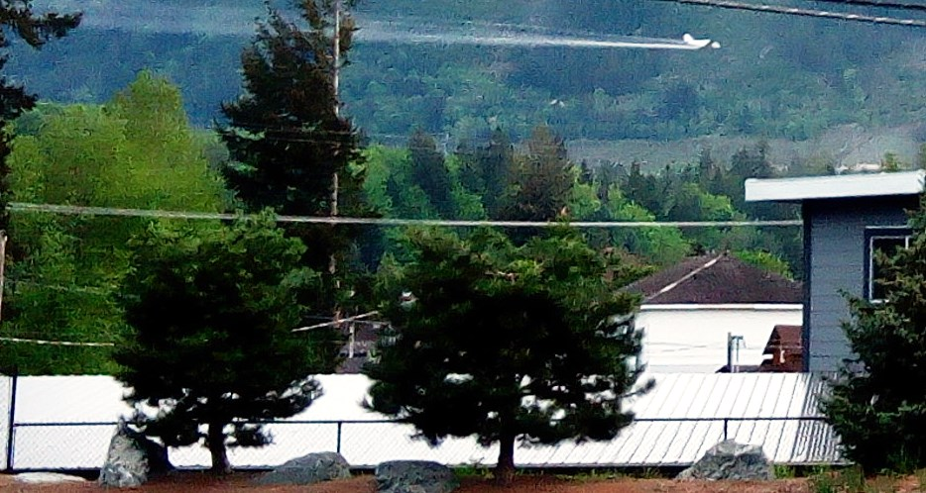
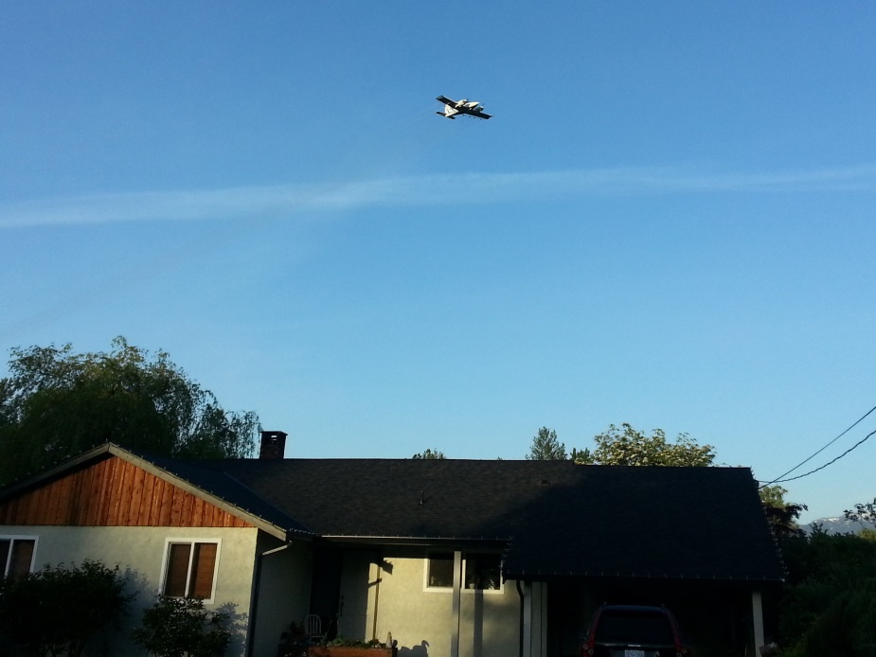
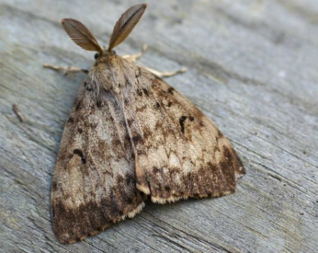
2022 Aerial Pesticide Audit
Key Audit Findings:
1. Exceptions from licensing requirement (IPMR)
6 (1) A licence under Section 4 of the Act is not required by a person who
(b) uses or sells a pesticide only as an employee or contractor of a licensee,
What does this exemption mean?
Some Aerial licensees only did applications as a contractor of a licensee and therefore did not require a licence.
2. Rate of Compliance
No major non-compliances found.
A total of 11 inspections were conducted with a compliance rate of 9% (all advisories, lowest level of non-compliance).
Failed to submit Annual Use Summaries on Time and Pesticide use Records were missing key information.
Notes:
In many cases, aerial pesticide operators were using pesticides as a contractor of a licensee and did not actually require a licence. All they needed was an aerial pesticide applicator certificate. However, many company still wanted to have a licence to have the option to be hired by an independent client.
Example: If you are an industrial vegetation licensee that wants to contract an aerial applicator, technically the aerial operator only requires a certificate. However, if that is the case, the licence is responsible for the pesticide application and is required to keep records of the application.

Slide 10
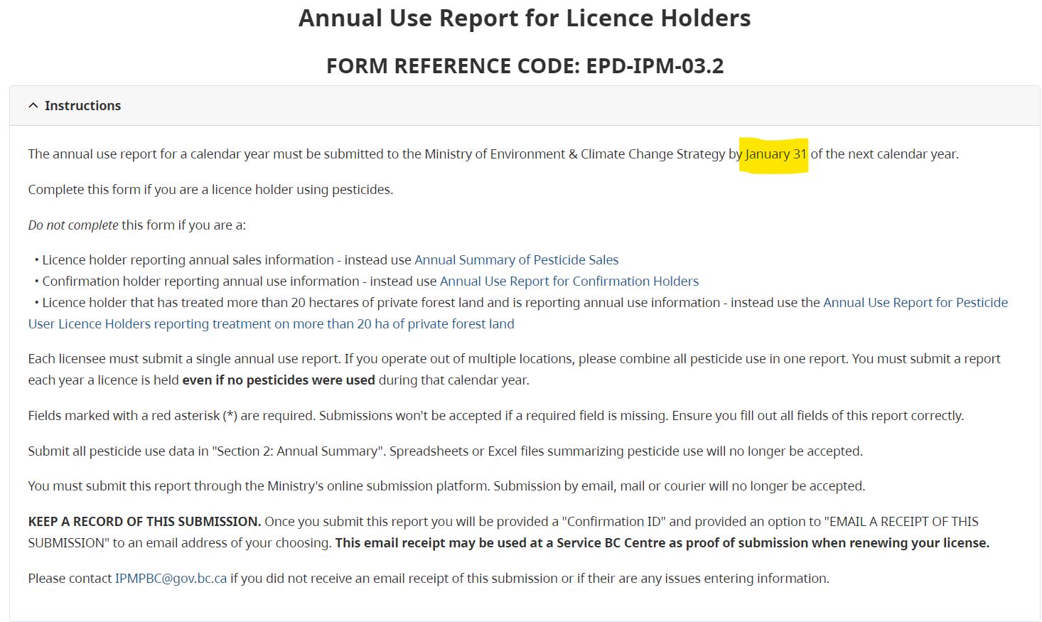
Annual Use Report for Licence Holders
DUE JANUARY 31ST IN THE FOLLOWING CALENDAR YEAR
Notes:
First part of the online submission platform for Annual Use Reports lists instructions.
As a reminder, the annual use report is due on January 31st, even if no pesticides were used. Submitting your Annual Use Report after January 31st is a non-compliance and could result in issuance of an advisory, warning, or high depending on your compliance history.

Slide 11
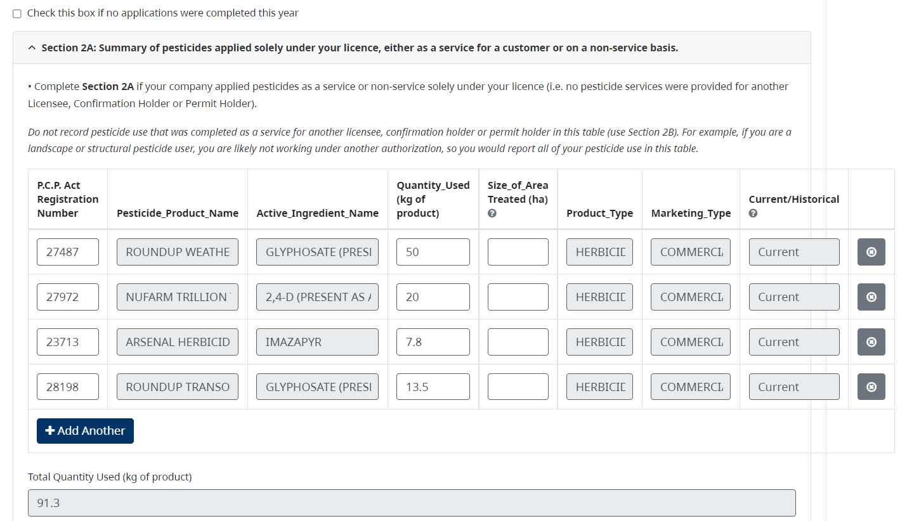
Annual Use Report for Licence Holders
Notes:
This slide shows what it looks like to input your pesticide use. You simply enter your P.C.P Act Registration Number for the pesticide you used and the pesticide product name, active ingredient name, product type, marketing type, and where it is still registered will population from Health Canada Pesticide Database.
You then simply enter the Quantity used for each pesticide in Kg. The size of area treated is currently not required to be recorded for landscapers. Talk about the difference between section 2a and 2b

Slide 12
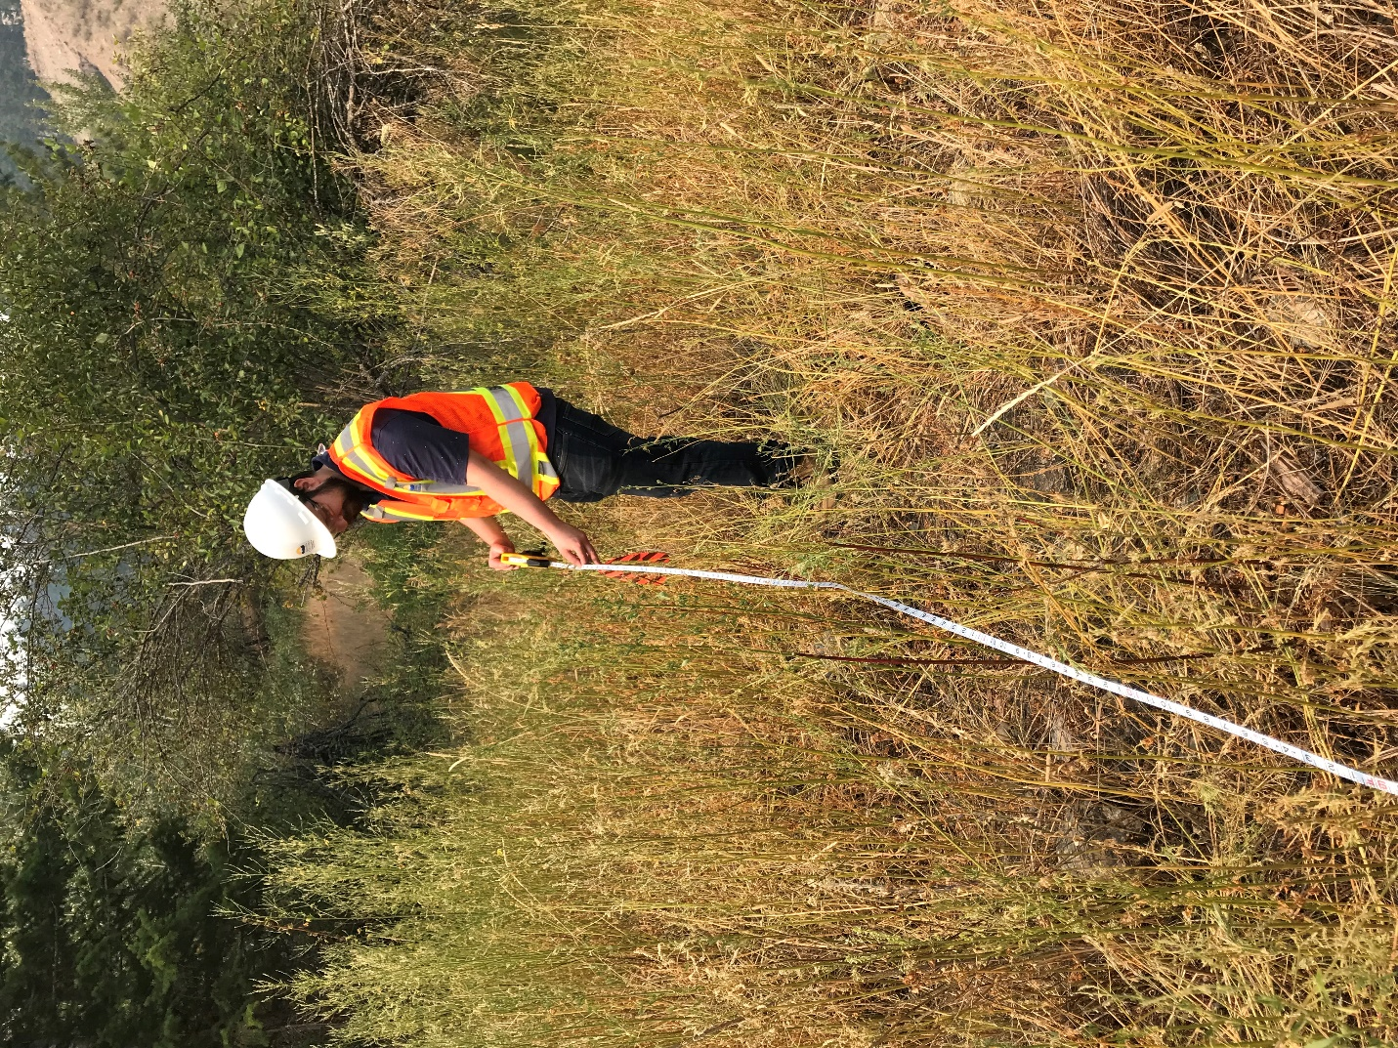
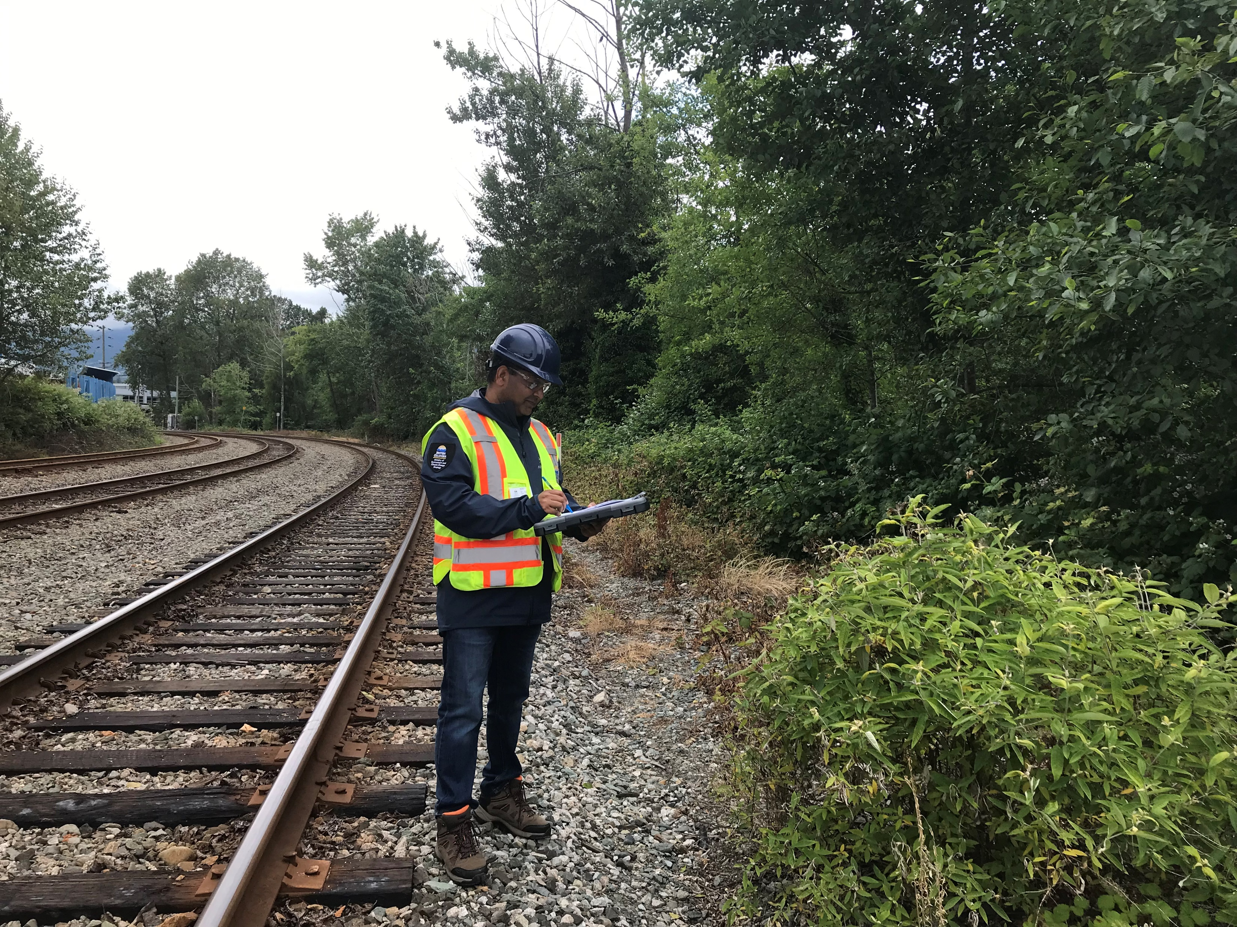
Complaints Management - 2023
Complaints Summary
About 90 complaints were received by CEEB so far.
5 or so complaints were related to industrial vegetation and noxious weeds.
Common complaints this year have been regarding rodenticide use, agricultural sector, and neighbor to neighbor issues.
Types of complaints regarding Industrial Vegetation/ Noxious Weed Sector
Use of pesticides near residential property (signs hard to find, pesticide drift, worried about impacts to pets, children, plants).
Other non-compliances – either reported or self-reported (i.e. spraying pesticides in PFZs, near wells, spills, using pesticides not on PMP, spills, etc).

Slide 13

IPM Complaints
Where to Self-Report Non-Compliances
The RAPP hotline is the best method for reporting complaints regarding the sale and use of pesticides.
EnvironmentalCompliance@gov.bc.ca
Compliance Report Email Template (PDF, 272KB)
The non-compliance report must include the following:
Authorization number
Legal name of the authorization holder, including ‘doing business as’ names
Date of the event
Description of the non-compliance
If available:
  Test results
  Remedial action
  Explanation of most probable cause
https://www2.gov.bc.ca/gov/content/environment/natural-resource-stewardship/natural-resource-law-enforcement/conservation-officer-service/cos-rapp
If a spill is occurring, please contact the 24-Hour Spill or Environmental Emergency Reporting line at 1-800-663-3456.
More information can be found at Report a Spill.

Slide 14
Questions?
Compliance Section Head – IPM: Michael Lapham
Contact: Michael.Lapham@gov.bc.ca
Phone: 778-974-2376

