Slide 1



Overview of Current Invasive Plant Program Structure, Initiatives and Projects in BC
Integrated Vegetation Management Association of BC
Oct 28, 2014
Dave Ralph
Invasive Plant program
Range Branch
Ministry of Forests, Lands and Natural Resource Operations

Slide 2
Presentation Overview
British Columbia’s Challenges
Solutions for Invasive Plant Management
  Getting on the Same Page
  Collaborating Locally
  Ensuring a Scientific Base in Decision Making
  Strengthening Legislative Framework
  Spartina Project
Notes:
Let’s review the areas I am going to touch on today. [click]
First – brief overview of the complexity that is inherent in British Columbia and challenges it creates for invasive plant management. [click]
Next – talk about some solutions we have put in place and are working on to improve invasive plant management in the province.
Solutions I will cover today are: [click]
Getting on the same page – as the vast majority of BC is Crown land, the provincial government is a substantive land manager. I’ll discuss how government has made significant strides at breaking down the traditional government silos and the positive results this has created. The Invasive Species Council of BC is also a key player in bringing a multitude of perspectives together to unite on common objectives.
Collaborating Locally – land and resource managers, stakeholder groups, First Nations, and the public have a vested interest in the invasive plant challenges in their local areas. I will present to you how our Regional multi-stakeholder Invasive Plant committees and Local Government weed programs are working to improve on-ground actions.
With expanding recognition of the threats posed and impacts realized from the broad range of invasive plants in the province, the provincial government is prioritizing actions and funding based on scientific review and analysis. Historically, this was not always the case...
And finally, we are currently finalizing a proposed amendment to regulation.
So, what is this BC Complexity anyway?

Slide 3
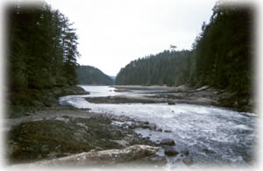
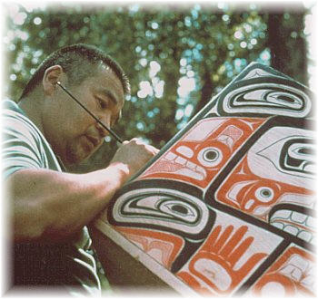
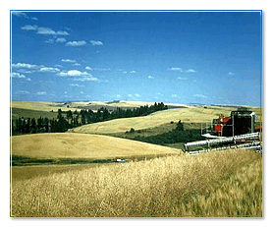

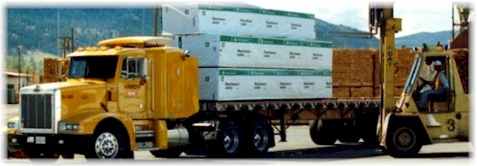

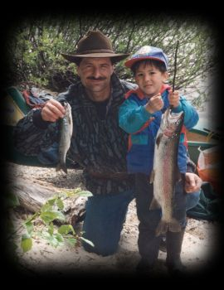

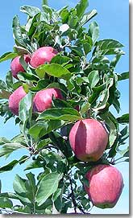
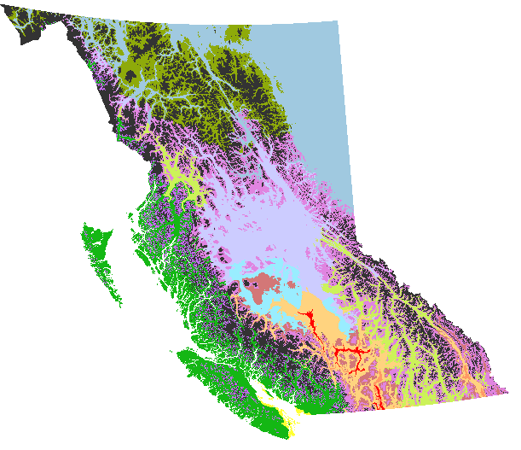
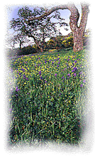
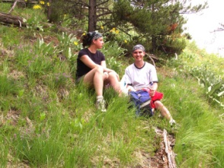

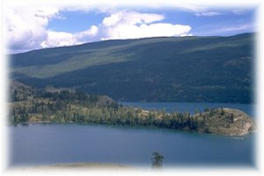
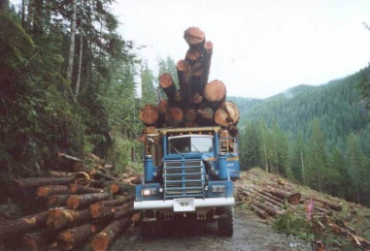
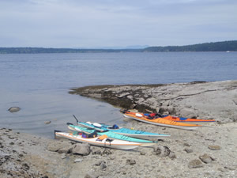

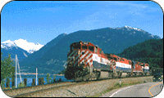

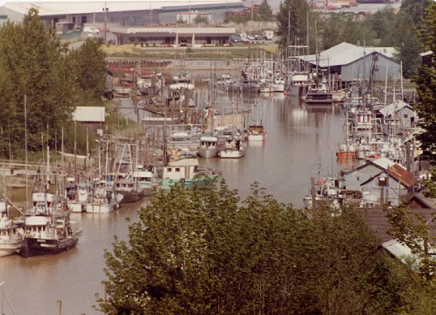
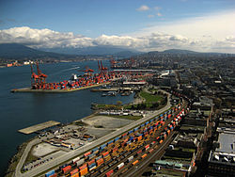
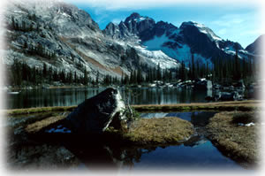
The Challenge…
Notes:
Challenge: how to determine those existing invasive plant species that should be regulated in all or specific areas of BC?
Approximately 94% of BC’s 95 million ha is Crown land. 94,780,000 ha (95% is Crown land)
80% provincial forest and range land
14% parks/protected areas
5% agriculture capability
14 Biogeoclimatic zones
All Canadian Growing Zones ( 8 ) are found here
Over 4.6 million people (2011); 75% live in the Fraser Valley / Metro Vancouver and Vancouver Island areas (less than 8 percent of the province)
Busiest port in Canada
So what did we do? The WCA Regulation Project team completed a North American scan of regulated invasive plant species, then refocused and reviewed PNW and Canadian fed and provincial invasive plant legislation and species listed.
Available risk assessments were looked at with a BC lens.
A risk analysis protocol was developed and completed for over 300 species.
All three categories contain terrestrial and aquatic plant species.

Slide 4
BC’s Solutions:
Getting on the Same Page
Inter-Ministry Invasive Species Working Group
  Established in 2004
  Broad membership across government (Forests & Lands, Environment, Agriculture, Energy & Mines, Recreation, BC Parks, Health, etc.)
  Report to Assistant Deputy Minister’s Committee for invasive species
Notes:
So let’s talk about some of the solutions British Columbia has put in place to help address the invasive plant issues that result from our multi-faceted complexity.
First item – we needed to be on the same page in BC – or in other words, having common overarching goals, strategies and key messaging. The provincial government was a good place start.
The Inter-Ministry Invasive Species Working Group was established in 2004 as an invasive plant cross-government committee to improve efficiencies and on-ground effectiveness of invasive plant work across government agencies, and provide oversight to testing a pilot program on partnership delivery models.
In 2008 the mandate expanded to include all invasive species. The WG Terms of reference was confirmed and a strong connection between the IMISWG and member ministries’ executive established.
Various ministries and Crown agencies are members of the working group, including: Ministries of Forests, Lands and Natural Resource Operations; Environment; Transportation; Agriculture; Energy and Mines; Community, Sport and Cultural Development; Aboriginal Relations and Reconciliation; and Health; BC Parks; and the Oil and Gas Commission.
Reporting to the Assistant Deputy Minister’s committee provides overall guidance to the working group, and enables significant issues to be elevated to Cabinet.

Slide 5
Inter-Ministry Invasive Species Working Group
PURPOSE:
To ensure coordinated, collaborative, and cost-effective delivery of provincial government invasive species programs through science-based strategic planning, harmonized robust legislation, acquisition of resources, and reporting.
Notes:
The Purpose of the working group is :
To ensure coordinated, collaborative, and cost-effective delivery of provincial government invasive species programs through science-based strategic planning, harmonized robust legislation, acquisition of resources, and reporting.
The structure and governance of the working group is covered in their Terms of Reference.

Slide 6
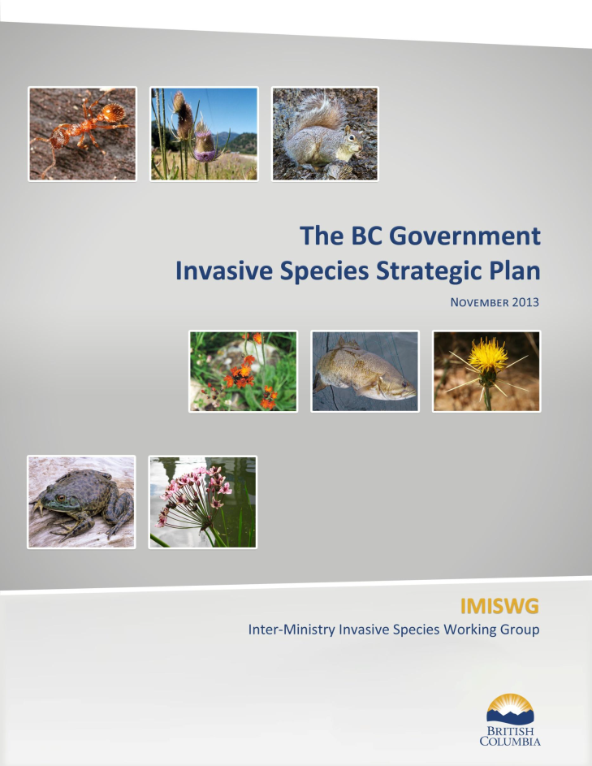
Inter-Ministry Invasive Species Working Group
RESULTS TO DATE:
Invasive Plant Strategic Plan (2011)
Invasive Species Strategic Plan (2013)
BC Invasive Species Early Detection & Rapid Response Plan (2013 final draft)
Notes:
So is the working group fulfilling it’s purpose? The members would likely state a resounding YES.
The management of invasive plants on Crown land in British Columbia – remember that is 95% of the land base – is a lot more cohesive than it used to be. Crown land managers have common visions and are working under the same goals and objectives.
In 2008 a Strategic Plan for Invasive Plant management for BC Government was developed and published in 2011. Recently, the IMISWG has developed a replacement document to reflect their expanded mandate for all invasive species. The purpose of the plan is to guide the coordination, integration and delivery of the provincial government invasive species program. The plan has three over-arching goals :
Goal 1: To prevent the establishment of new invasive species in British Columbia.
Goal 2: To reduce the socio-economic and environmental impacts of existing invasive species in British Columbia.
Goal 3: To provide the framework and capacity for ongoing management of invasive species.
The IMISWG has also developed an Early Detection and Rapid Response plan to address new incursions of invasive species, including plants. The plan was drafted in 2011 and has been field tested and adjusted based on those results. The 2013 draft is in final preparation for ADM committee review and approval in 2014. The development of the EDRR plan resulted in a dedicated program lead and the implementation of the provincial EDRR program.

Slide 7
Inter-Ministry Invasive Species Working Group
RESULTS TO DATE:
- Cross Ministry resource sharing (staff & $)
  - Establishment of common invasive plant priorities
  Collaborative projects ongoing (FN, industry, ISCBC, etc)
  Invasive species Policy established
  Legislative GAP analysis completed
  Google – ‘IMISWG’ for other projects and initiatives
Notes:
Planning and delivery of on-ground programs is improving with the “breaking down of ministry silos”. Ministries with land management responsibilities now share resources wherever possible, and duplication of effort by individual agencies has been significantly reduced. Establishing common priorities for highest threat species is now occurring. Instead of ministry by ministry policies on invasive plants, government-wide policies are being established. The IMISWG has also completed a GAP analysis of the current legislative framework on invasive species in BC and is working to address the gaps identified during this process.
There are numerous other projects and benefits being realized from the hard work of this group, that will be showcased on their website in 2014. Just google “IMISWG” and you will find it!

Slide 8
BC’s Solutions:
Getting on the Same Page
Invasive Species Council of BC
  Established in 2005, charitable Society
  Board of Directors has broad representation from 13 perspectives
  Works collaboratively with IMISWG and Regional Invasive Species Organizations
Notes:
Also helping the province be more unified in province-wide programs and broad messaging is the Invasive Species Council of BC.
Established in 2005, this registered charitable society with a Board of Directors that represent various perspectives including federal, provincial and local governments, First Nations, forest industry, mining, agriculture, utilities, transportation, regional committees, conservation and wildlife, recreation and tourism, and horticulture.
The Council has the six standing committees, and works to establish and support province-wide programs, support cross-Canada collaborations and elevate awareness of invasive species issues.
The ISCBC works collaboratively with the Inter-Ministry Invasive Species Working Group and various regional invasive species organizations, stakeholder groups and industry organizations.

Slide 9
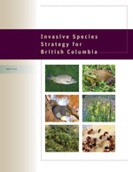
Invasive Species Council of BC
RESULTS TO DATE:
Legislative Guidebook (2007)
Local Government Toolkit (2011)
- Aboriginal Toolkit (2011)
BC Invasive Species Strategy (2012)
- Annual Forum & Workshops
- Invasive Species Toolkit for local
Government (2014)
Notes:
The Invasive Species Council is the secretariat for BC’s Invasive Species Strategy. This umbrella document provides a solid framework for land and resource managers, regional organizations and partner agencies to develop and implement operational plans in their respective areas.
Since its inception, the Council has held an annual 1.5 day forum and pre and post forum workshops on all things invasive. It has worked with all levels of governments to produce a Local Government Toolkit and a Legislative Guidebook. An Aboriginal Toolkit has also been completed through the work of the Council’s Aboriginal Working Group, and a Legislative Guidebook.

Slide 10
Invasive Species Council of BC
RESULTS TO DATE:
- Social behavior change programs targeting key pathways of introduction
- Grow Me Instead / Plant Wise
- Clean, Drain , Dry (aquatic)
- Best Management Practices Guidebooks;
Transportation, Utilities, Forestry
- Spotters Network; TIPS,
Notes:
Since the establishment of the Invasive Species Council of BC, there have been numerous provincial scope education and awareness focussed projects completed, new programs developed and implemented, and general awareness of the issues enhanced across BC and beyond.
Examples include these listed on the screen.
Moving on to our second solution -

Slide 11
BC’s Solutions:
Collaborating Locally
Regional Weed Committees &
Local Government Weed Programs
13 regional weed / invasive species committees
14 local government weed programs
Notes:
Establishing regional weed committees and engaging in local government weed programs has helped us tackle the inherent complexity of our landscape, distribution of invasive plants, and regional stakeholder priorities. Beginning in the 1980’s with the initiation by and support of local livestock associations whose members were experience first hand the impacts of invasive plants on forage supply, Regional Weed Committees began expanding to other regions of the province over the next 20 years, with a large component forming after 2002. These committees are registered societies with broad stakeholder membership, similar to the ISCBC.
Some local governments have established noxious weed programs or specific bylaws to address identified threats and concerns within their jurisdiction. Several of the regional district weed programs are quite extensive and accomplish similar activities as regional weed committees – education & awareness; collaborative planning tables with land managers. Today the province provides support to 14 local government programs.

Slide 12
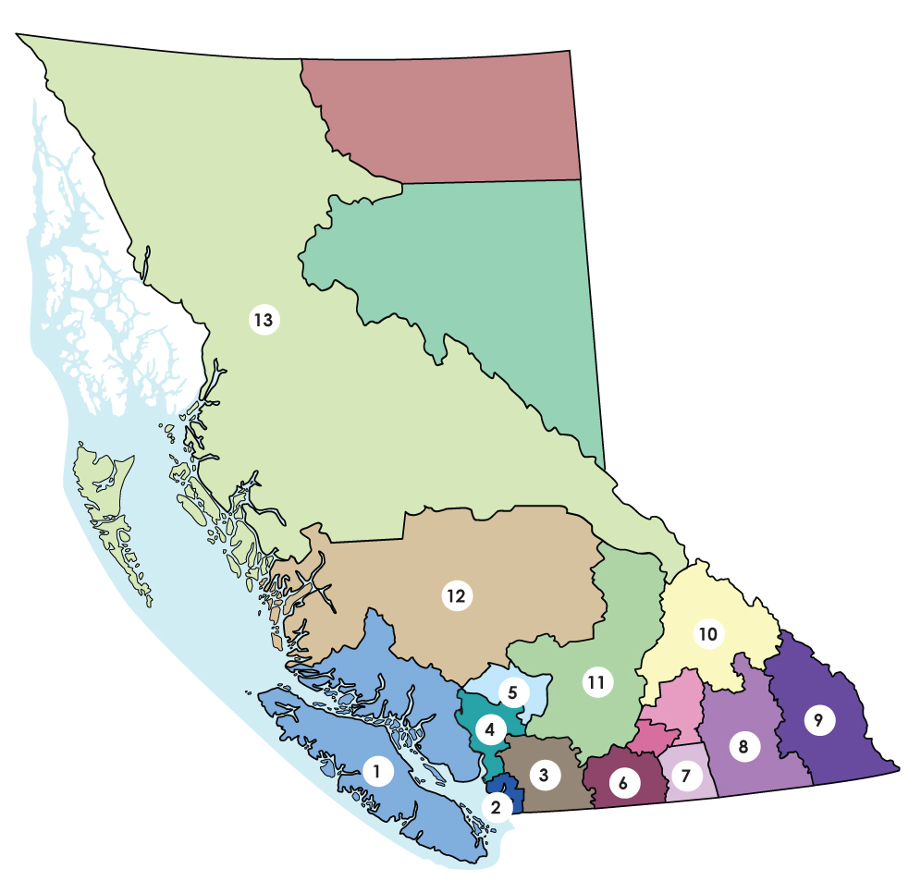
Regional Invasive Species Organizations
RESULTS TO DATE:
Insert weed committee map here
Regional based IP planning tables
Identification of opportunities for improved collaboration
Education & Awareness
Partnership delivery (in some areas)
Notes:
Today there are Regional Invasive Species Organizations (Weed Committees and RD Programs) across the entire province.
These provide a valuable local table for operational planning, regional priority setting, and in some areas, implementation of management actions. These organizations provide a lot of education and awareness activities in their areas, from having booths at local farmer’s markets to school programs and presentations with local officials.
In some areas of the province, the organizations are engaged in a Partnership Delivery approach to management. This is where land managers not only collaboratively plan species and areas to control, but they pool their resources so that one treatment contractor operates on all jurisdictions within a defined geographic area. Cost efficiencies are realized from minimizing contract management and travel costs.
This approach has also facilitated the establishment of First Nations Invasive Plant Partnerships.

Slide 13
BC’s Solutions:
Ensuring a Scientific Base in Decision Making
  Detailed risk assessments completed for all proposed prohibited species
  Risk analysis completed for current and future regulated species
Notes:
As I said at the beginning, historically science has not always been the foundation for weed management decisions in BC. Weed related Problems, Perceptions, Politics, and Passion – and the “ I hate this weed” were also components in decisions. With expanding recognition of the threats posed and impacts realized from the broad range of invasive plants in the province, the provincial government is prioritizing actions and funding based on scientific review and analysis. Invasive plant species are being prioritized for control on Crown land through a risk analysis procedure which closely follows the federal government approach, but with some adjustments to help address the complexity of the issue in our province.

Slide 14
Ensuring a Scientific Base in
Decision Making
Factors reviewed:
  Presence/absence in the province
  Potential/actual impacts
  Likelihood of spread (vectors)
  Potential & current distribution
  Confidence in current inventory data
Notes:
The protocol or procedure the IMISWG is using and using right now to finalize a new list of species for regulating as noxious weeds, includes examination of several factors:
Presence/absence in the province
Potential/actual impacts
Likelihood of spread (vectors)
Potential & current distribution
Confidence in current inventory data

Slide 15
Ensuring a Scientific Base in
Decision Making
Factors reviewed:
  Threat to special values (e.g. rare & endangered species; seed industry)
  Threat to human health
  Longevity of the problem in BC
  Difficulty to control
  Invasiveness - disturbance Y/N
Notes:
The protocol or procedure the IMISWG is using and using right now to finalize a new list of species for regulating as noxious weeds, includes examination of several factors:
We considered if the specific invasive plant species was a particular threat to special values (e.g. rare & endangered species; seed industry).
We also looked at the Threat to human health – toxicity, likelihood of exposure
Longevity of the problem in BC
Difficulty to control – are tools available and can they be successfully applied?
And we considered each species invasiveness. Does it invade and expand in undisturbed habitats or does it need disturbance to establish and disturbance or no disturbance to spread?

Slide 16
Determining Priorities Provincially
(Partnership Delivery/Contracts)
Crown lands (MoTI, FLNRO, Parks, Utilities)
Prohibited IP species determined by the IMISWG
highest provincial priority (EDRR). No variation
Provincial top 25 species
Provincial Weed Control Act Regulations category lists

Slide 17
Top 25 Provincial Priority Invasive Plants
Bohemian Knotweed | Garlic Mustard | Wild Chervil | Leafy Spurge
Giant Knotweed | Tansy Ragwort | Scotch Broom | Purple Loosestrife
Japanese Knotweed | Field Scabious | Blueweed | Hoary Cress
Himalayan Knotweed | Common Bugloss | Hoary Alyssum | Orange Hawkweed
Marsh Plume Thistle | Puncturevine | Himalayan Balsam | Invasive Yellow Hawkweeds
Rush Skeletonweed | Common Tansy | Himalayan Blackberry
Yellow Flag Iris | Spotted Knapweed | Teasel
April 2014

Slide 18
Determining Priorities Regionally
Provincial Prohibited (EDRR)- prevent/treat new incursions
Regional Prohibited prevent/treat new incursions
Top 25, if occur in region
Additional regional priority species not included in above
Strategic planning identifies species/sites for management
  Identify these sites/species based on values (ecological,
  producer investment on private, vectors, other impacts)
  Input - land managers, stakeholders, partners, tenure holders
  This input and collaboration helps identify new species, sites,
  impacts to values and local concerns
Notes:
Establishing regional weed committees and engaging in local government weed programs has helped us tackle the inherent complexity of our landscape, distribution of invasive plants, and regional stakeholder priorities. Beginning in the 1980’s with the initiation by and support of local livestock associations whose members were experience first hand the impacts of invasive plants on forage supply, Regional Weed Committees began expanding to other regions of the province over the next 20 years, with a large component forming after 2002. These committees are registered societies with broad stakeholder membership, similar to the ISCBC.
Some local governments have established noxious weed programs or specific bylaws to address identified threats and concerns within their jurisdiction. Several of the regional district weed programs are quite extensive and accomplish similar activities as regional weed committees – education & awareness; collaborative planning tables with land managers. Today the province provides support to 14 local government programs.

Slide 19
BC’s Solutions:
Strengthening Legislation
- BC Weed Control Act Regulation review began in 2009
- Drivers for change :
  Need to include more noxious weeds
  (regional variability)
  Limited ability to address new incursions
  Unregulated pathways of introduction & spread
Notes:
Last solution, but certainly not least, is strengthening our legislative framework in BC and for invasive plants, our current opportunity on this solution is an amendment to the Weed Control Act Regulation.

Slide 20
WCA Regulation Amendment
  Address pathways & vectors of spread (e.g. Sale, Movement/Transport, Storage, Disposal)
  Provide a solid foundation for Early Detection and Rapid Response actions
    Prohibited Noxious Weed List
  Create Restricted Noxious Weed lists – to address species of provincial concern, regional concern, and that are a threat to specific values
Notes:
It is our intention to amend the WCA Regulation to address specific gaps that have been identified by staff, land managers, and stakeholders.
1. Stopping the sale, movement, improper storage of infested material/goods, and improper disposal are proposed additions to the regulation. Explicitly addressing these areas will help close these pathways and vectors of introduction and spread of noxious weeds.
Created a prohibited noxious weed list will provide the regulatory foundation needed for provincial Early Detection and Rapid Response actions under the BC Invasive Species EDRR Plan.
Three Restricted noxious weed lists are proposed, replacing the current provincial and regional noxious lists. Restricted A will be provincially noxious weeds, Restricted B will include noxious weeds of specific concern within specified regional districts, and Restricted C will include species that are a threat to specific values.

Slide 21
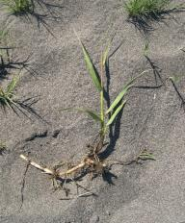
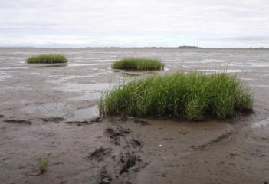
Spartina (Cordgrass) Project Overview
Invasive Intertidal plant
In: California, Oregon, Washington, BC
3 species
  S. anglica (Fraser Delta)
  S. patens (Burrard Inlet, Courtenay)
  S. densiflora (Baynes Sound)

Slide 22
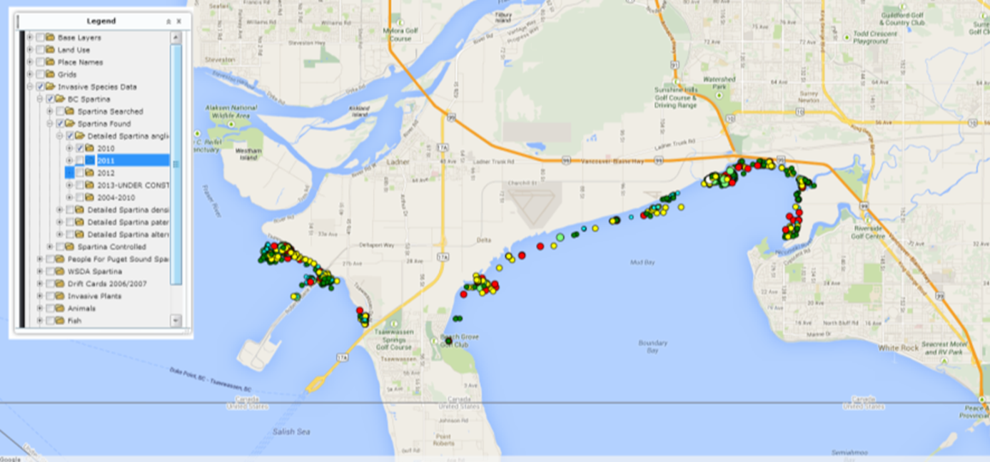
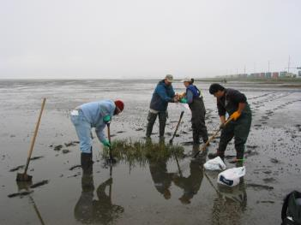
BC Spartina Working Group
2004 partnership
  Industry, Gov’t, NGO, local stewardship groups
  Limited $$, but significant in-kind & volunteers
  Linkages across the border
Tasks: map, mechanical control, outreach
  S. anglica as the priority species
Notes:
Began with small partnership
We had committed individuals but not committed organizations
Funding was limited, piecemeal and limited commitment
Therefore linkages with Washington State for expertise was crucial in our early years
Over time we expanded members in our Working Group
Annual meetings between BC and Washington State were extremely useful
We did not have herbicide option (no approvals in canada for herbicide in marine environment) and so agree to focus on mechancial control until we determined it was not sufficient

Slide 23
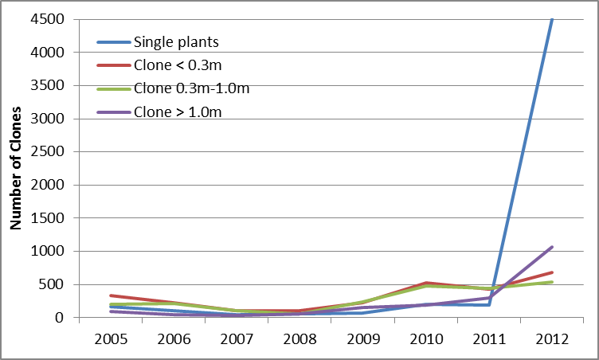
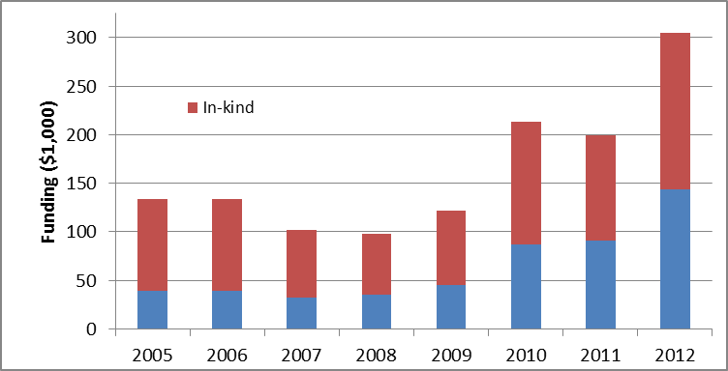
Spartina anglica Trend
Reduced Funding
= Lost containment
Notes:
With our annual mapping we could look at the trend (and initially it was looking good)
Had similar mapping effort beginning in 2005 +
However, we weren’t able to get as much cash funding in 2007 & 2008 and were not able to remove the large clones >1m.
Appears in doing so this created a cascading effect were we couldn’t keep up to the large clones as well as the smaller clones
Therefore this was a wake up call by 2010 that we either had to find significant funding or move towards herbicide

Slide 24
Process to Chemical Control (2010 - 2014)
Began in 2010 to determine logistics to apply for federal herbicide registration with PMRA
Significant jurisdiction and regulatory uncertainty
Technical support from WA, OR, CA (West Coast Agreement)
Emergency Registration (ER) granted Feb 2013 (1 yr.) for Rodeo (glyphosate) and Habitat (imazapyr)
Pesticide Use Permit granted July 2013 (3 yr.)
1st year of Spartina treatment 2013 (Roberts Bank/Boundary Bay)
ER for Habitat only granted Feb for 2014
2nd year of Spartina treatment 2014 (Roberts Bank/Boundary Bay)
Planning for 2015
Notes:
With our annual mapping we could look at the trend (and initially it was looking good)
Had similar mapping effort beginning in 2005 +
However, we weren’t able to get as much cash funding in 2007 & 2008 and were not able to remove the large clones >1m.
Appears in doing so this created a cascading effect were we couldn’t keep up to the large clones as well as the smaller clones
Therefore this was a wake up call by 2010 that we either had to find significant funding or move towards herbicide

Slide 25
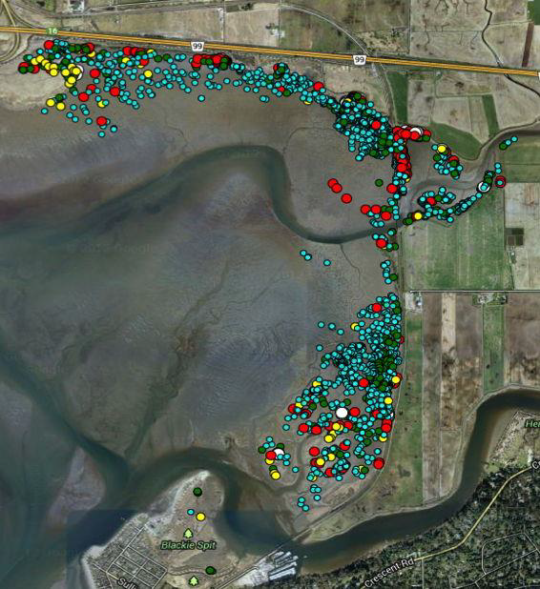
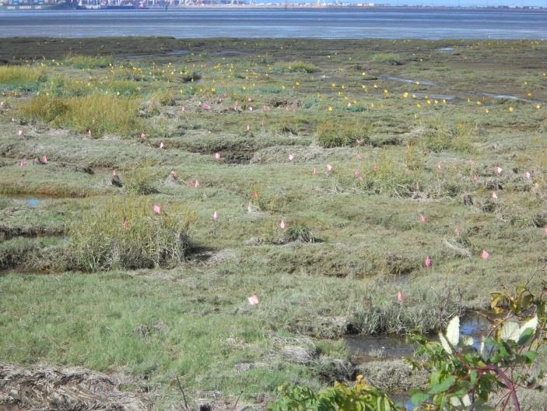
Boundary Bay – Spartina Treatment

Slide 26
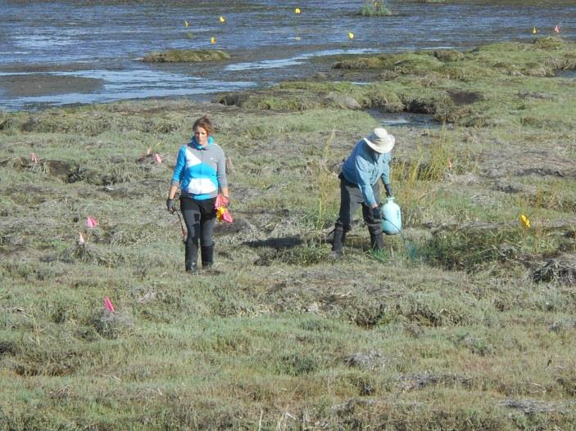
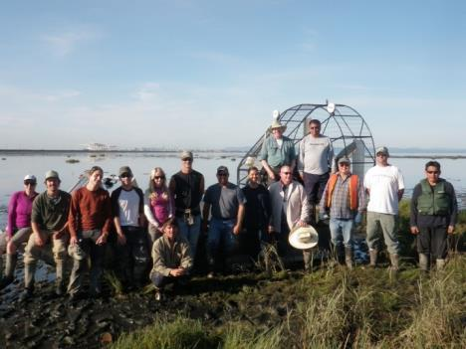
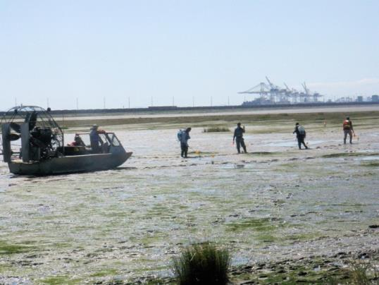
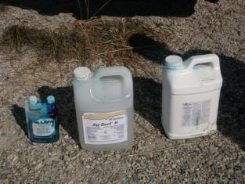



Slide 27
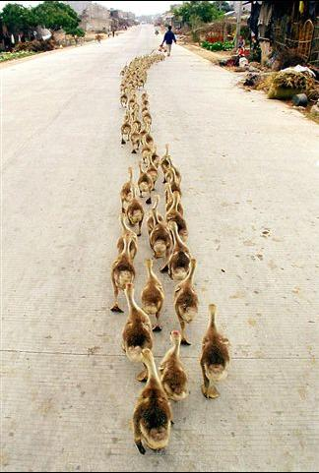
BC Invasive Plant Programs:
On the Same Page, Communicating and Collaborating, Using Science and Developing Strong Regulations
Special Projects
Moving in the right direction!
Thank you
Notes:
Bit by bit, we are getting our ducks all lined up for long term success in invasive plant/noxious weed control and management in BC.
Thank you.

