Slide 1
Right Tree, Right Place
A good thing, but is it IVM?

Slide 2
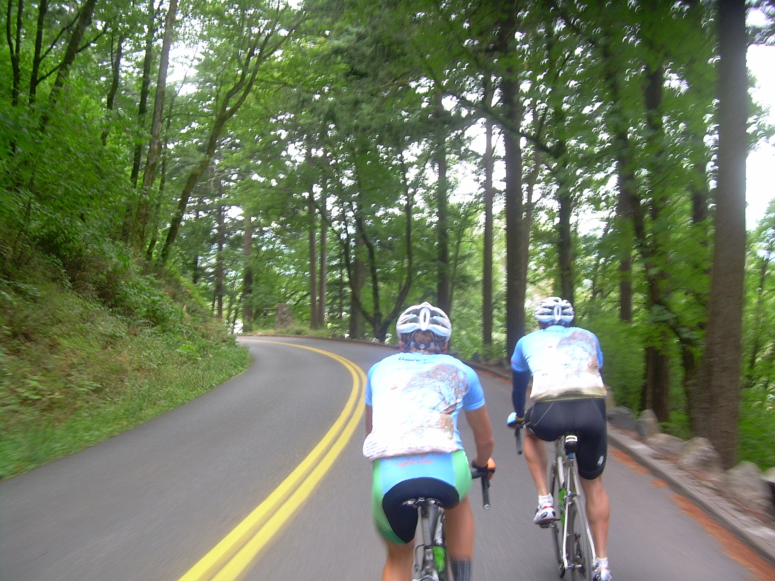
Life is a Journey…
Notes:
Life is a journey, I think there is no better way to experience a journey than by bike, and today I'll share my journey of coming to the conclusion that Right Tree, Right Place IS Integrated Vegetation Management - or at least one of the tools in the IVM toolbox, and it is a whole lot more.

Slide 3
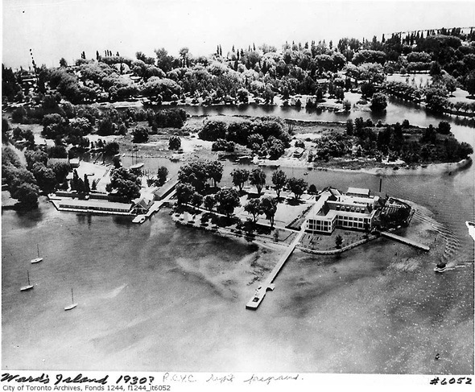
Way back …
Would Toronto’s Islands be here today without tree planting?
Notes:
I could start this journey way back, around the turn of the last century, when according to family history my great-grandfather went to the City of Toronto's council and warned them that the beautiful Toronto Islands would be lost to erosion unless they acted to save them. He convinced them to plant willows to reinforce the beaches. Maybe he was right, and maybe they were the right tree for the right place, long before anybody had coined the term.

Slide 4

Still here…
Photo: Nick Harris
Notes:
My buddy Warren lives with that decision - he's the Parks Manager for the Islands, and he remembers as a climber, having to maintain those scraggily old willows, or their descendants. But the willows are still there, and so are the Islands. So my great grandfather must have been right. Don't forget about Warren, he might show up again later along this journey...

Slide 5
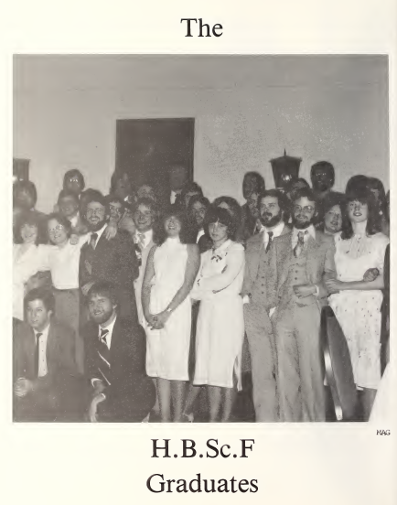

From here to there.
Notes:
My part of the Journey began way back in 1982 when I graduated from Forestry and found myself working for, of all things, a UTILITY! Heck, it wasn't until third year in school I think, that I realized that utilities actually hired foresters. Anyway, I became a utility forester and learned a lot of things they never taught me in school. One thing I learned quickly was the right tree, right place concept and how it made perfect sense from a line clearance point of view.

Slide 6
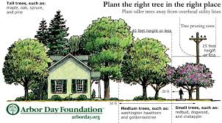
Notes:
It's simple, folks. The bigger a tree will grow at maturity, the further away it should be from the power lines. It ain't rocket science.

Slide 7
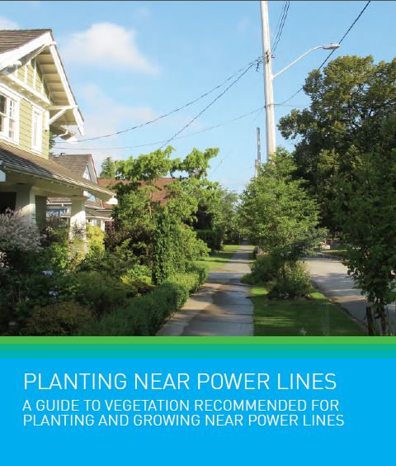
Notes:
A lot of utilities even help their customers out with pretty pictures, they recommend trees for the different zones, and maybe even provide some outdated planting and maintenance advice...

Slide 8
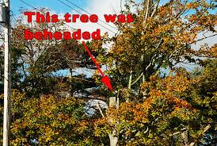
The Wall of Shame
Notes:
We could clearly see the benefits of the concept from our utility lens. You only have to look at what happens to some of the "wrong tree, wrong place" victims. Rhonda is a great collector of these examples, contributions to her "wall of shame“, and the Internet is an endless source of bad pruning pictures.

Slide 9
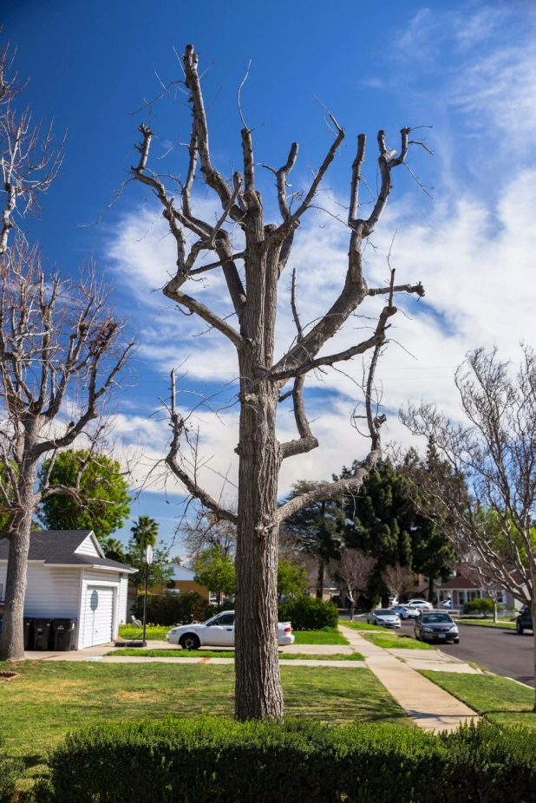
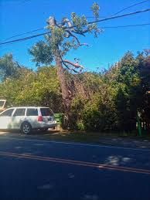
Notes:
Sometimes it is easy to point to the utility as the bad guy behind the butchered trees. Other times it seems voluntary on the part of homeowners. Maybe they see what the utilities do and figure it must be right. Any way you look at it, could either of these be called the right tree for the right place?

Slide 10
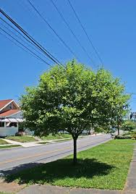
Notes:
And, you can see where they've done it right, where the right tree in the right place is not a threat to the lines, and is allowed to develop naturally. The Internet is not such a great source of pictures of good pruning, or of the right tree in the right place, as I discovered in building this presentation.

Slide 11
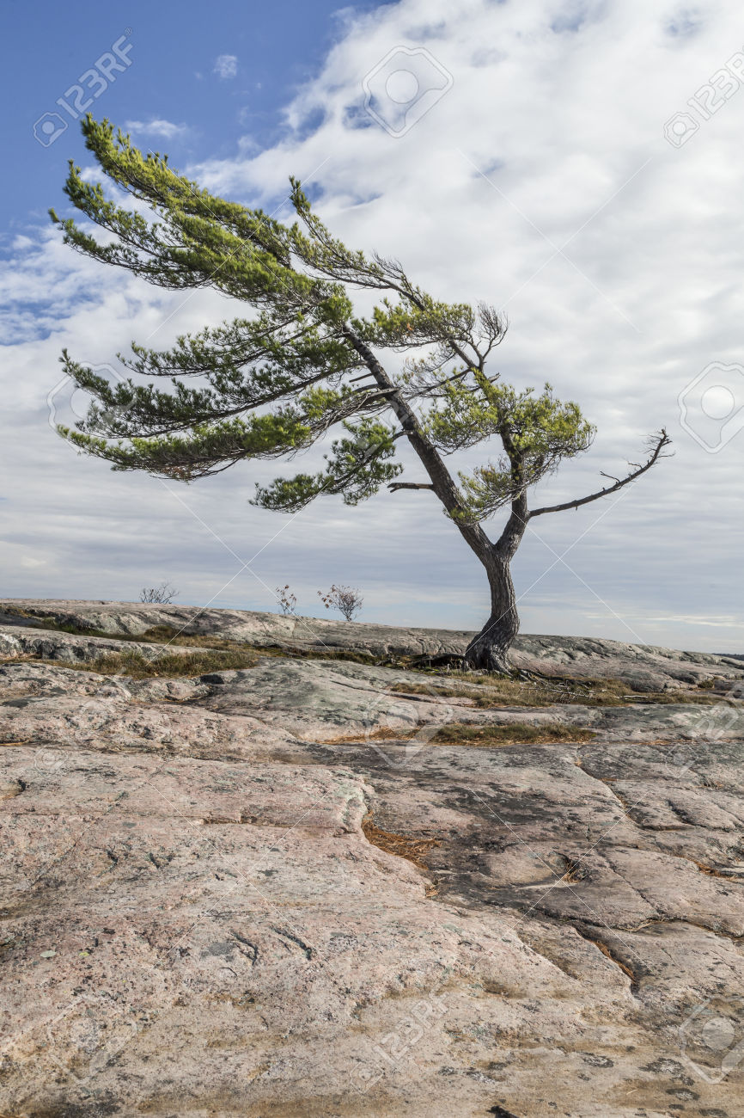
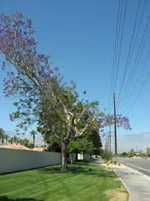
Notes:
But we wouldn’t have to give those trees that trademark windswept look if they were the right trees in the first place.

Slide 12
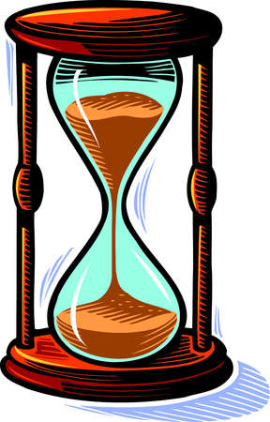
Notes:
Well, time marches on like it always does, 20 years or so passed, and Right Tree Right Place and its value to the utility industry stood the test of time.

Slide 13
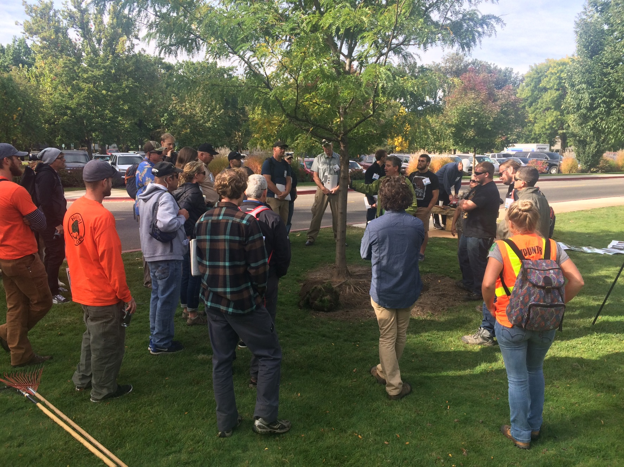
Notes:
But over that same 20 years, I think I changed a bit. The world of arboriculture opened up to me, and I became way more interested in the trees, their biology, and the impact they had in the landscape and to the well-being of our cities. And through experience I learned a lot more about the connections people feel with trees.

Slide 14
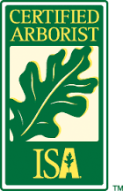
Notes:
Somewhere along the way, I stopped thinking of myself as a Forester. I was an arborist.

Slide 15
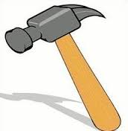
Notes:
I think as my understanding of arboriculture evolved, I began to realize that right tree, right place applied to so much more than just as a tool to keep trees away from utility lines.

Slide 16
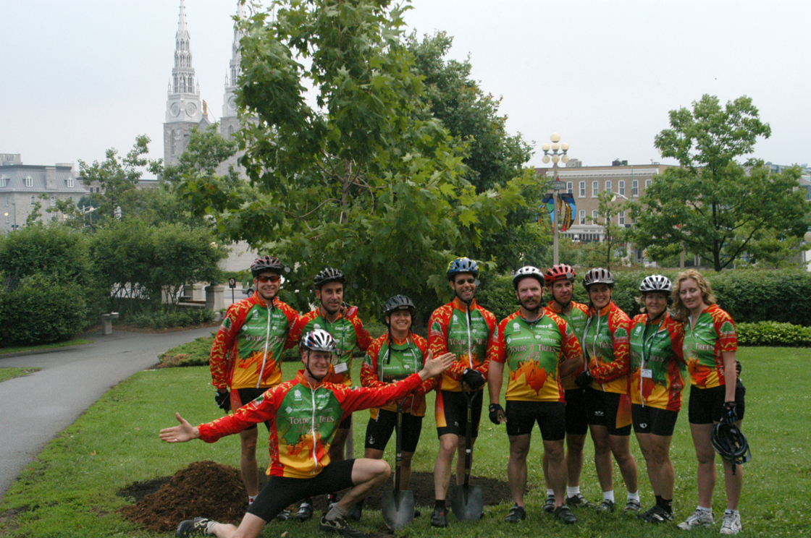
Notes:
At arboriculture conferences, I started seeing this amazing group of riders roll in to the conference field day after a week on their bikes, and I thought "Cool, trees and bikes - how perfect!” It was called the Tour des Trees, and it was a fundraiser for tree research and education. I loved to ride, and this could be a penance for a career of removing way more trees than I plant. I signed up for my first Tour in 2003, since it started on Parliament Hill, and wound up 600 miles later in Montreal, where I was born. Don't worry; this is all relevant to my presentation, as most of what I've seen on my journey has been from the saddle of my bike.
This was the Canadian contingent that year, part of a group of about 80 riders. That’s a younger me on the left, and beside me is that guy named Warren, who became a great friend and a big part of this journey.

Slide 17
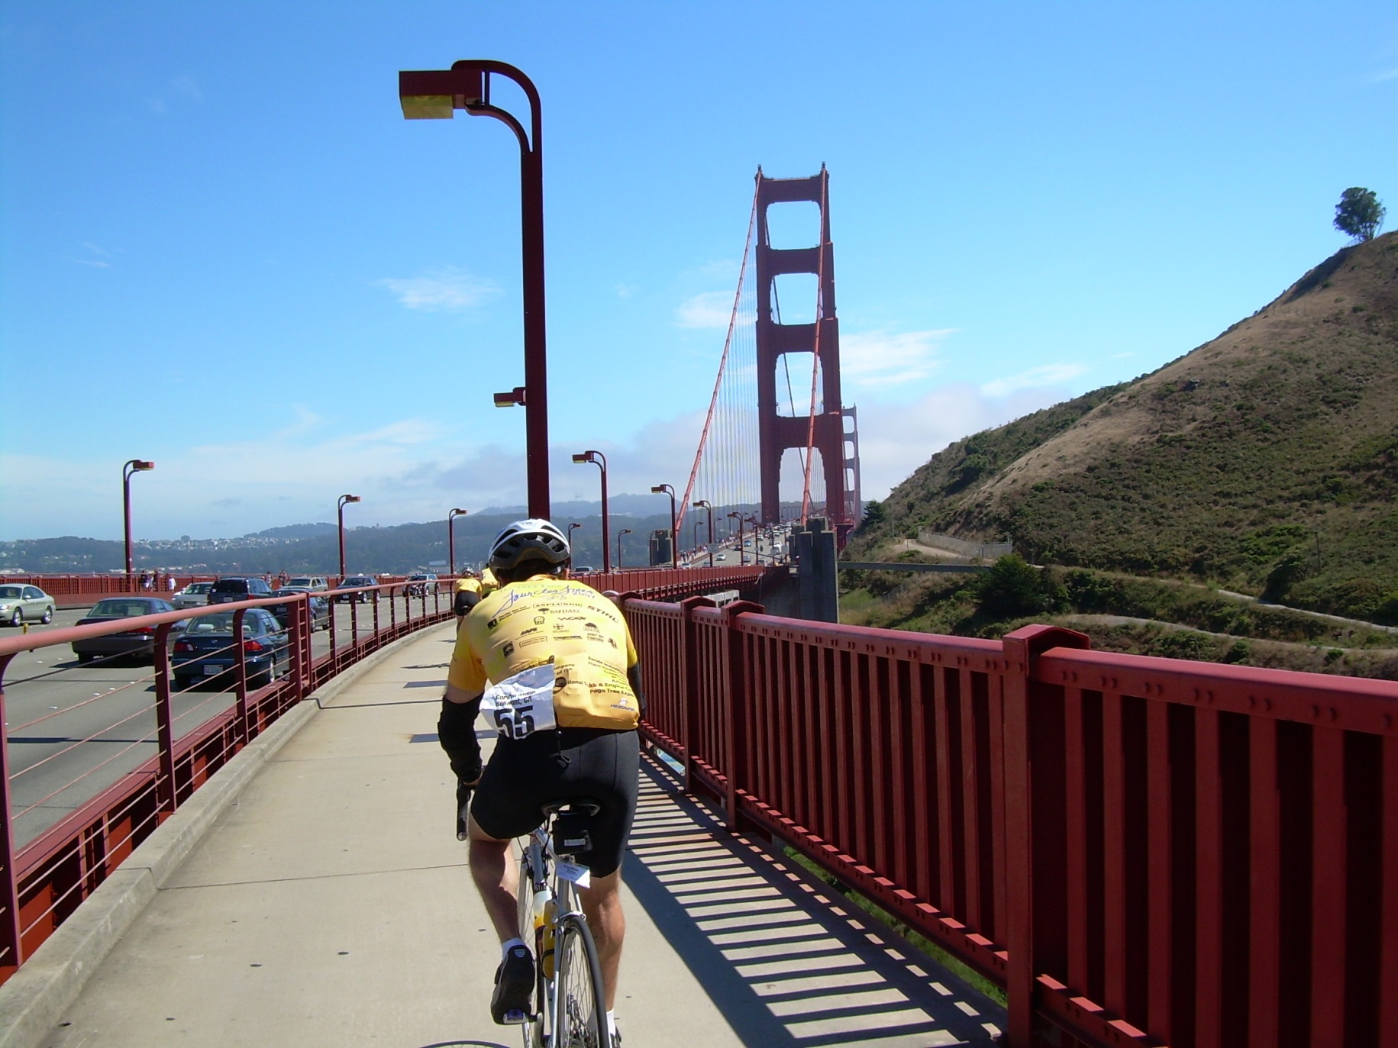
Notes:
Fast forward to 2007, our California Tour. Wine country, Redwoods, and beaches.

Slide 18
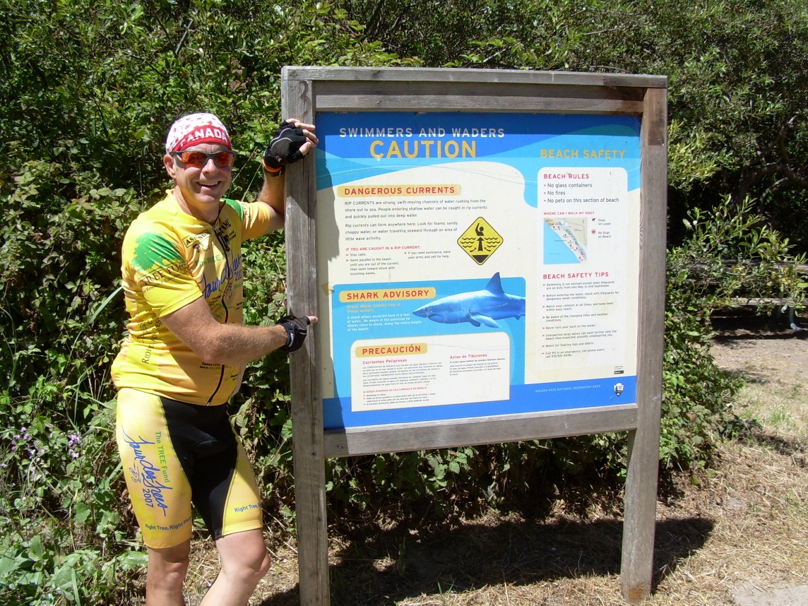
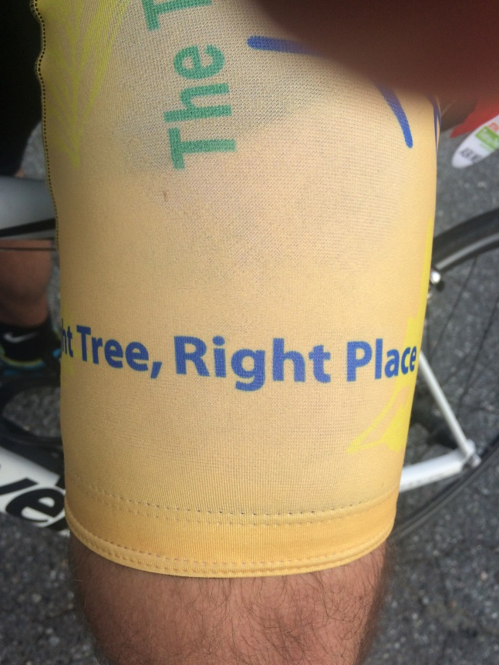
Notes:
This particular Tour had Pacific Gas & Electric as a major sponsor. And the Right Tree Right Place message was such a part of their culture that it was prominently displayed on the kit.

Slide 19
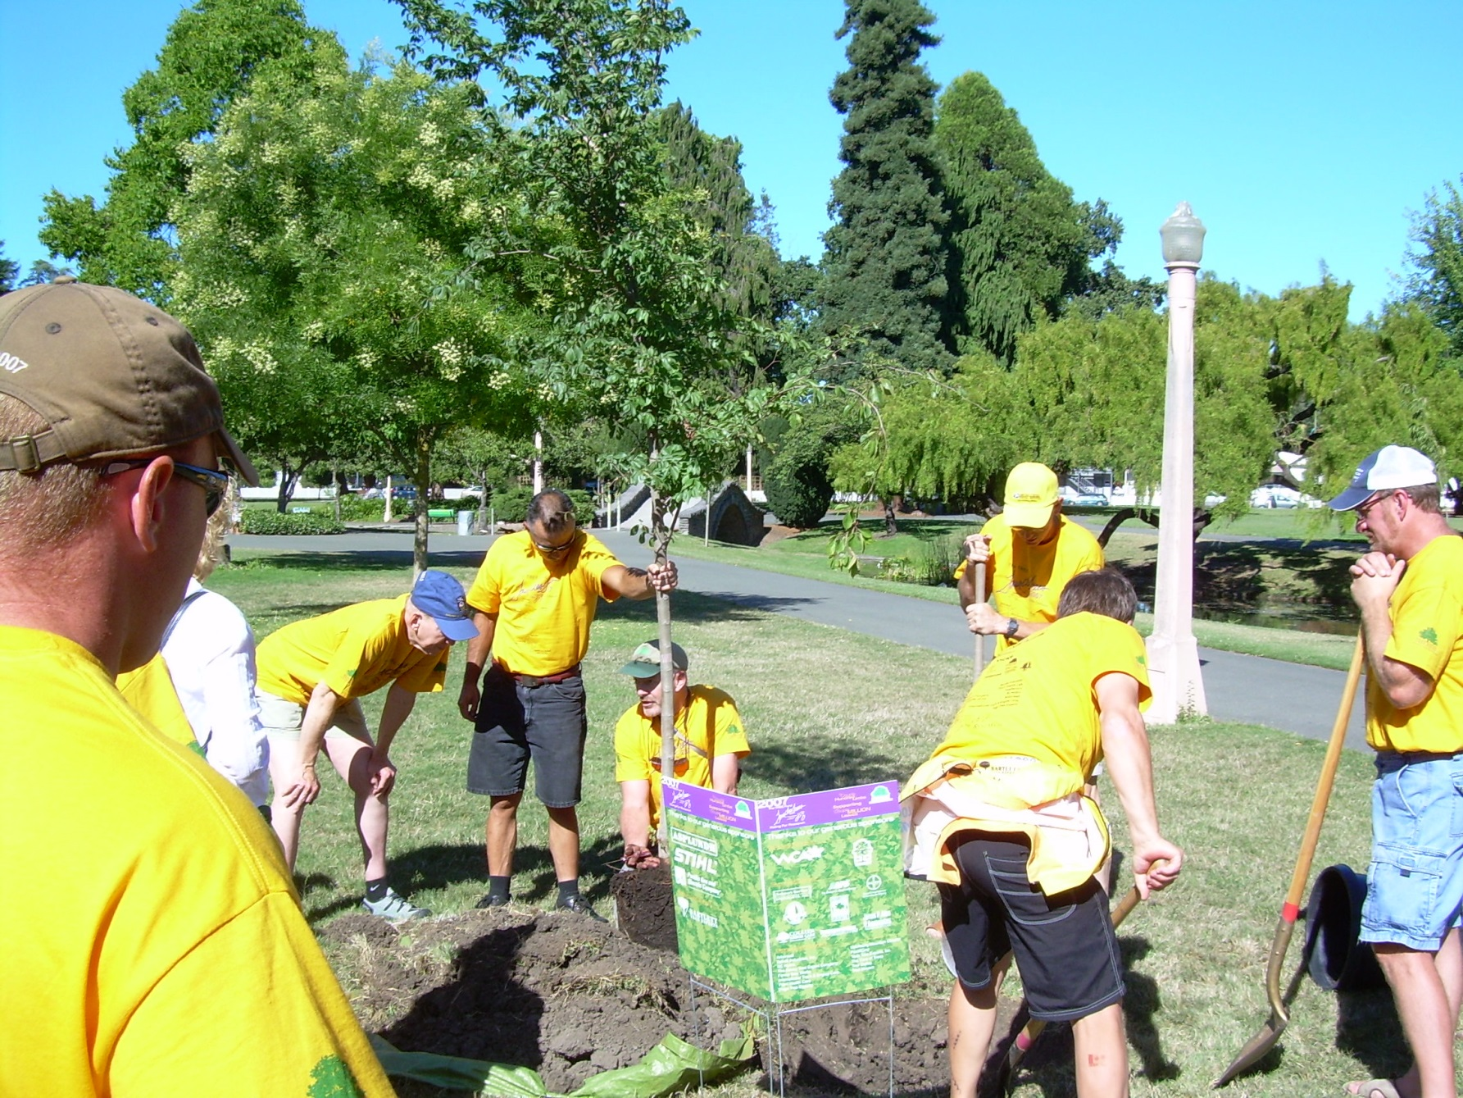
Notes:
I kind of took it for granted, as right tree right place was also a part of my culture. My "aha" moment came at one of our events when our sponsor was speaking and of course mentioning Right tree, Right place. I was completely surprised when a municipal arborist behind me started grumbling about how it was just a hammer the utilities use to get their way. It had never occurred to me as a negative thing; I guess I'd always had a more holistic and inclusive view of the concept.

Slide 20
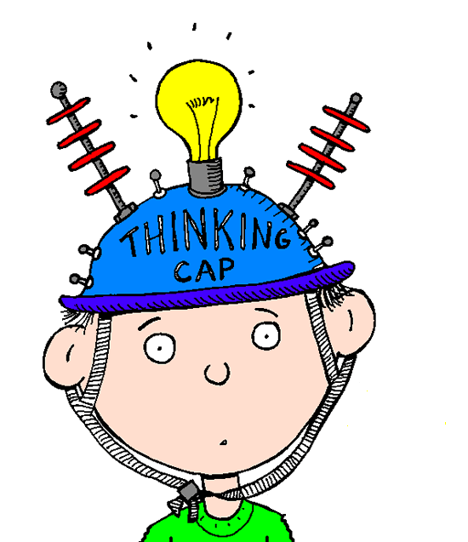
Hmmm…
Notes:
That set me to thinking - not all the way ahead to integrated vegetation management at that point, but about all the ways beyond the traditional utility Right Tree, Right Place message that the concept really applies.

Slide 21
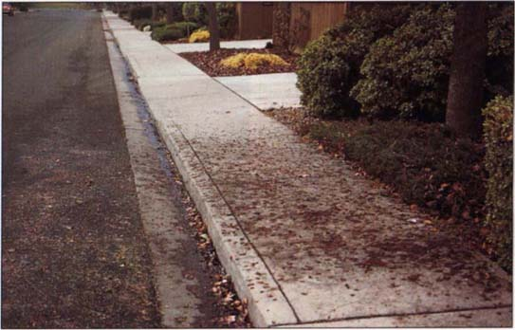
Notes:
That same municipal arborist who was grumbling about the utilities would never think of planting a messy, fruit dropping tree over a busy pedestrian area. Isn't that a Right Tree, Right Place decision at its very core?

Slide 22
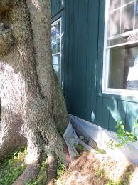
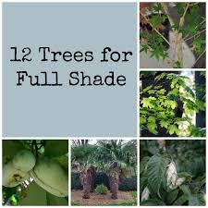
Notes:
When you go to the nursery to buy a tree there are so many choices, and so many things to consider - does the tree favour open sunlight or partial shade, well-drained soil or will it tolerate poor drainage, just how big will it get in relation to structures, other trees, and yes, utility lines?

Slide 23
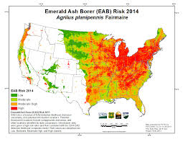
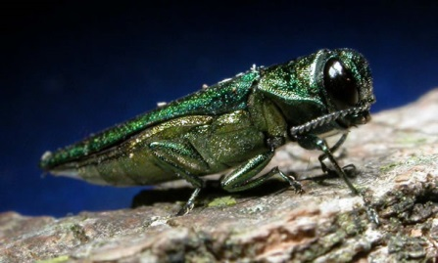
Notes:
Sometimes the wrong place might be dictated by other factors, even if the treewould otherwise be well suited for the site. Is anywhere in Eastern North America a "right place" to plant ash these days?

Slide 24
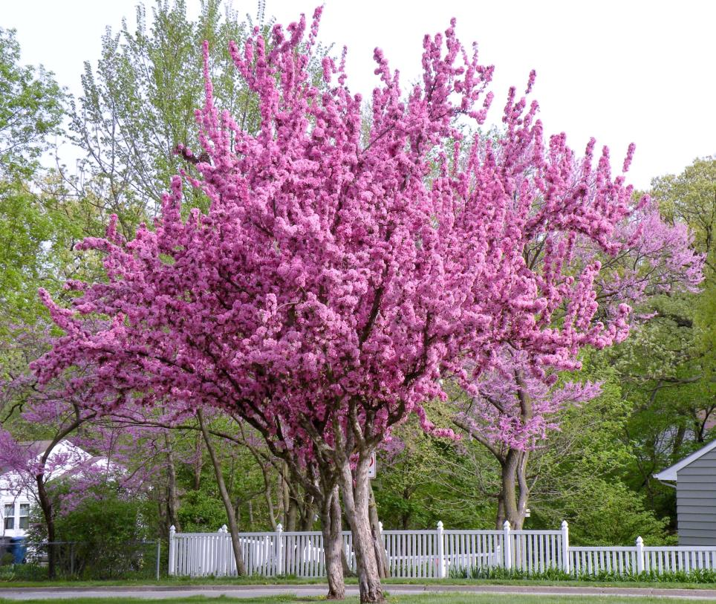
Notes:
Maybe it’s just that I'm enough of a forward thinker to picture the result, not always realizing that some of the discomfort comes from looking at the actions needed to achieve that result. The destination is great, but the journey can be, shall we say, “uncomfortable”?

Slide 25
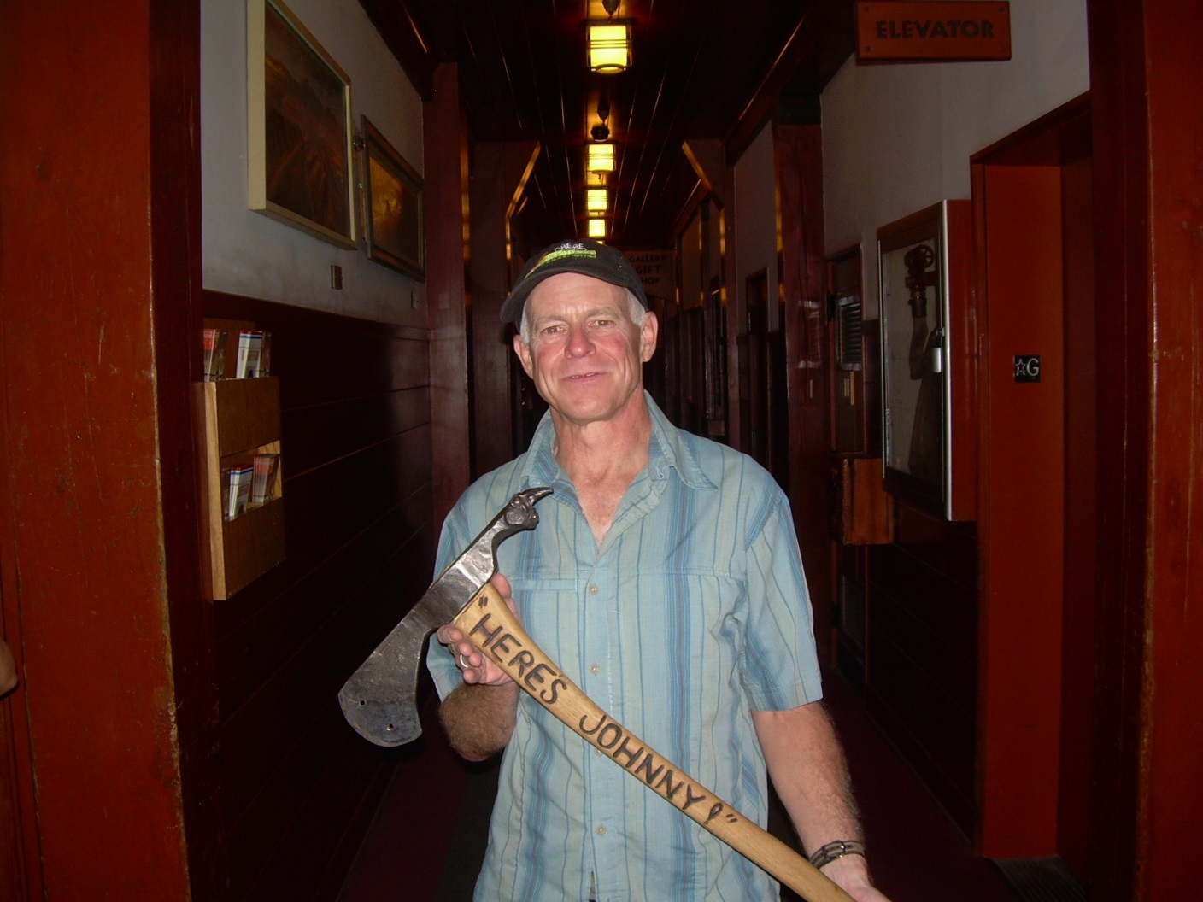

Slide 26
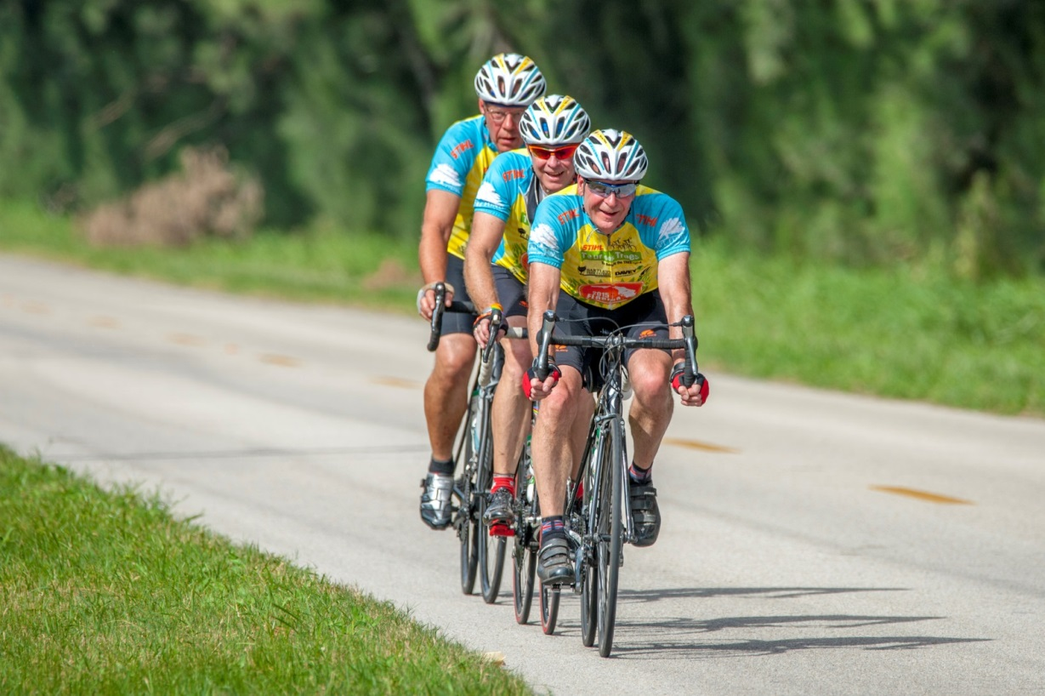
The Journey to IVM
Photo: Shutterjet
Notes:
So I think we've established that Right Tree, Right Place is a decision process that applies to tree selection for just about everybody, but can we make the connection to Integrated Vegetation Management?

Slide 27
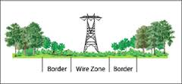

IVM is…
Notes:
ANSI A300 Part 7 defines IVM as a system of managing plant communities in which managers set objectives, identify compatible and incompatible vegetation, consider action thresholds, and evaluate, select, and implement the most appropriate control method or methods to achieve their established objectives.

Slide 28
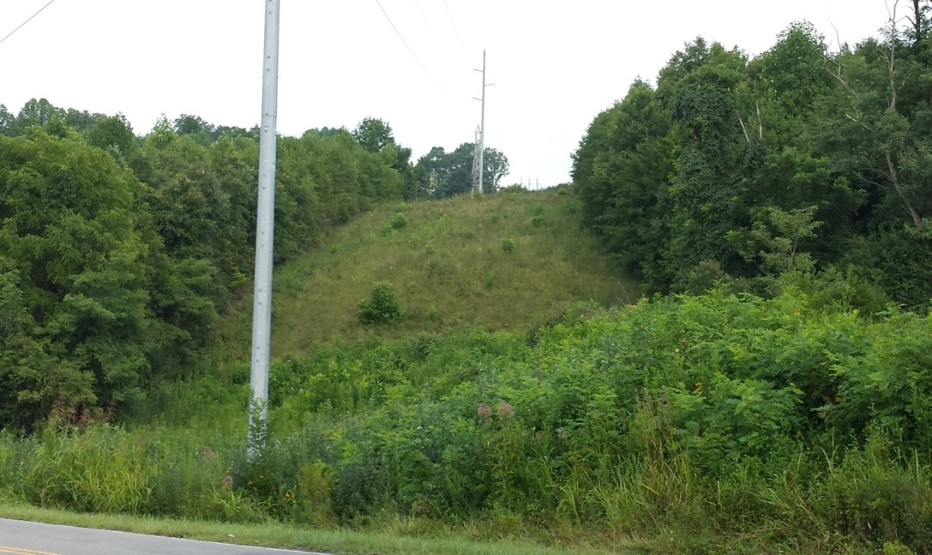
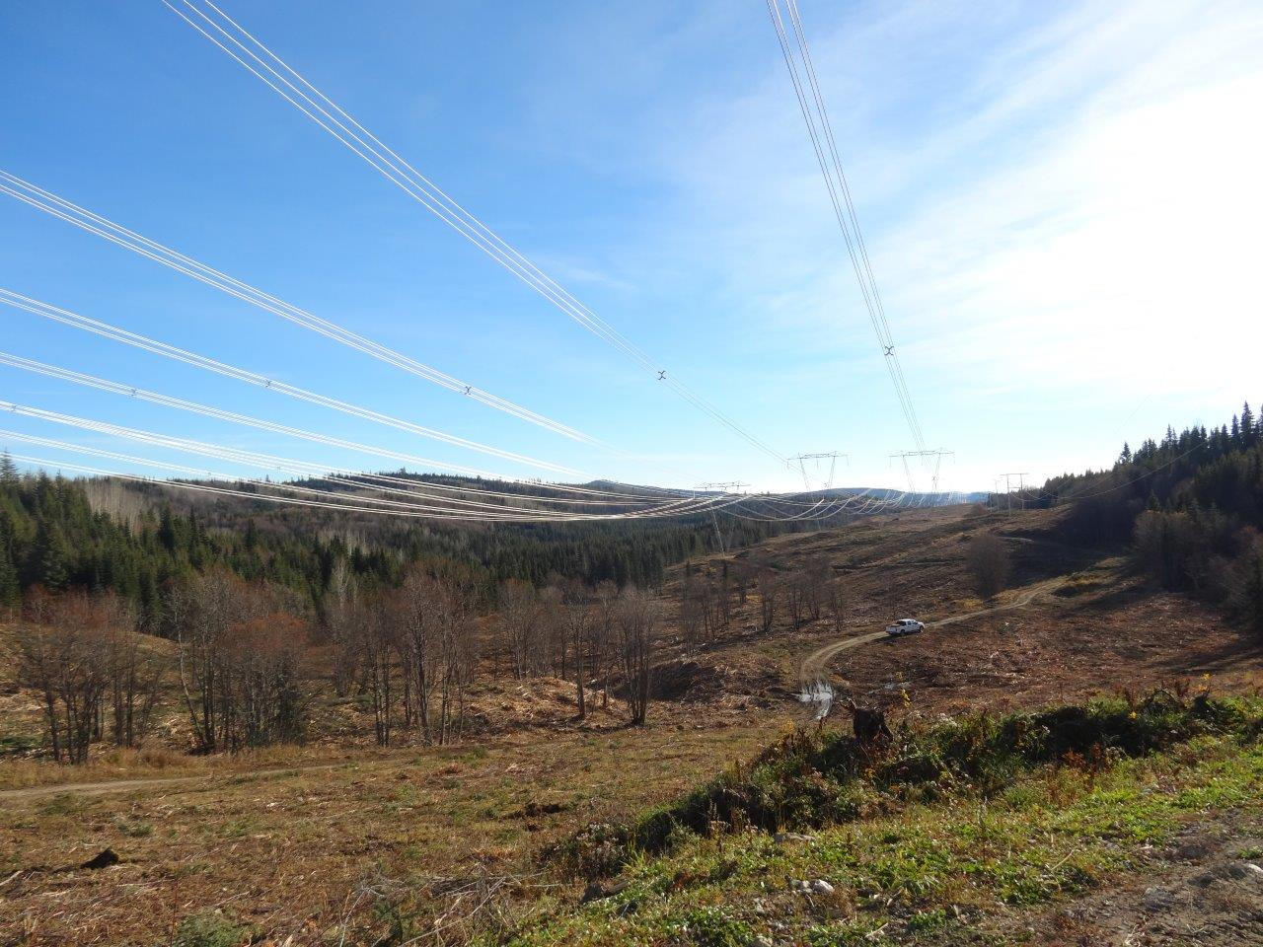
Notes:
Just as I used to view Right Tree, Right Place through the lens of a utility arborist, we tend to view IVM through our own lens. It can be looked at as a way of establishing compatible or desirable vegetation, or through another lens as a tool to get rid of vegetation that SOMEBODY, not necessarily the person looking through their lens, wants to be rid of. I can just picture instead of that tree planting event where John made his comments, an IVM related event where a different "John" is standing in the background saying it is just a way of the utility getting what it wants.

Slide 29
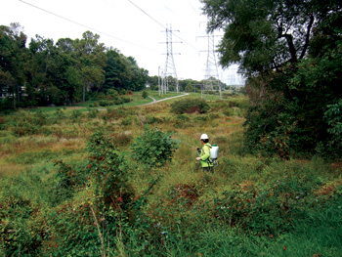
Or is it a way of justifying this?
Notes:
Or, maybe they look at it as a way for the utility to justify the use of CHEMICALS!!!!

Slide 30
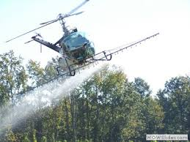
Or this??
Notes:
Once again, maybe it is perception. We look towards the result, while the means to achieve it can be uncomfortable. Back to that idea of a difficult journey to a desirable destination.

Slide 31
But is Right Tree Right Place IVM?
Notes:
But back to the question - Is Right Tree Right Place Integrated Vegetation Management? Or at least a component of it?

Slide 32
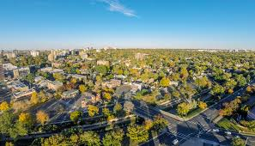
Notes:
IVM is a system of managing plant communities. Trees are a part of the plant community. Ok, we're on the same page here.

Slide 33
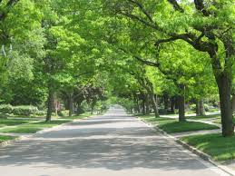
Notes:
Managers set objectives. My objective as a utility manager is to keep trees out of the lines. My friend John's objective as a city forester is to establish a healthy urban canopy.

Slide 34
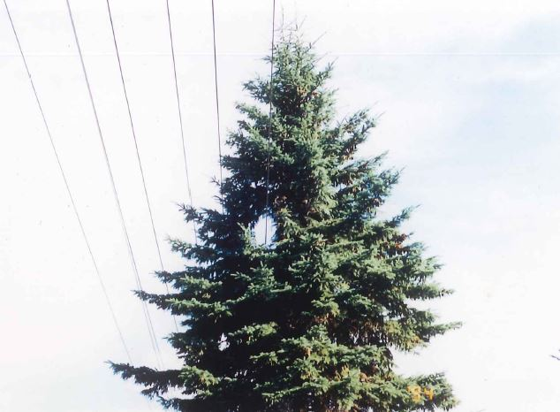
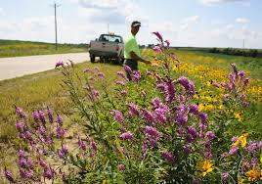
Notes:
IVM identifies compatible and incompatible vegetation. Right Tree Right Place identifies either Right Tree or Wrong Tree for the Place. And both have thresholds, that point where we decide to do something about it.

Slide 35
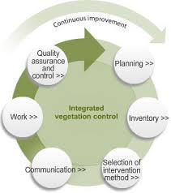
Notes:
Next comes the Evaluation, Selection, and Implementation of the most appropriate control method

Slide 36
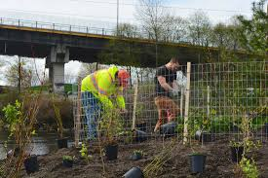
Right plant, right place = IVM
Notes:
IVM may use a variety of control methods. While there may be a "best" method, that isn't always the "most appropriate" method as things like cost, cultural values, environmental sensitivities all come into play in making that evaluation. If your prescription includes planting of compatible species, you are practicing Right Tree, or perhaps Right Plant, Right Place approach. So, removal of a target tree for replacement with a compatible tree is a basic IVM decision.

Slide 37
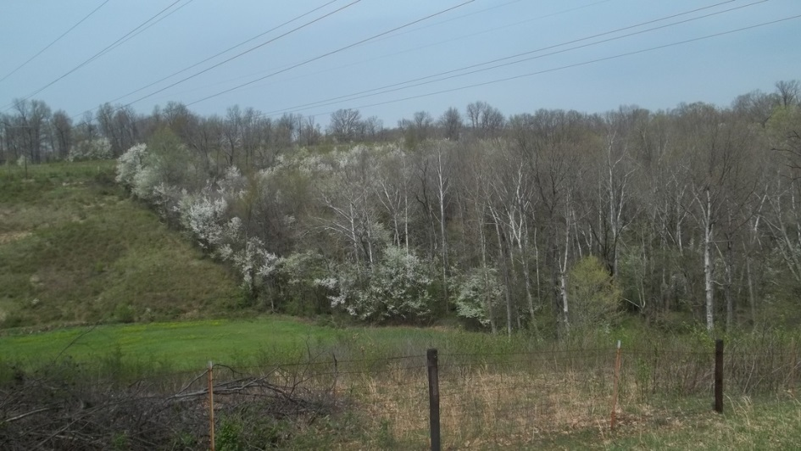
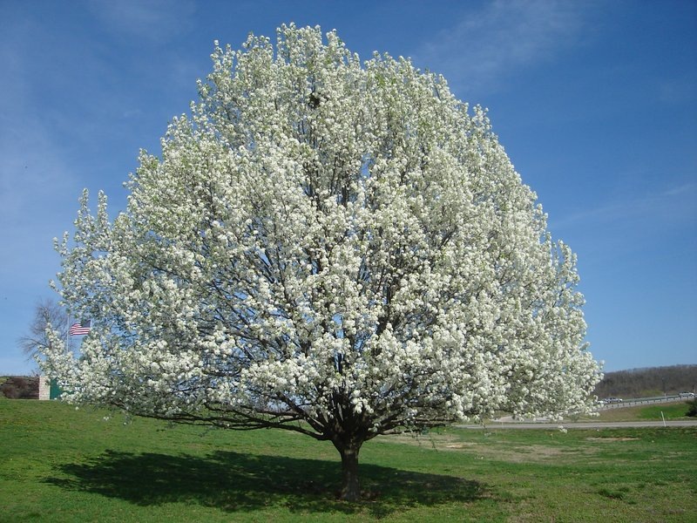
A couple of RTRP examples
Notes:
But we all know that people value trees for so many different reasons, and that makes the Right Tree for the Right Place a little more complicated. When does the wrong tree become oh so right, and how does Right Tree, Right Place become even more than IVM? Consider the Callery Pear. It is clearly a beautiful tree in the landscape, but it is despised by arborists for its poor branching habits, its tendency to self-destruct under minor snow loads, and it is as invasive as all they come.

Slide 38
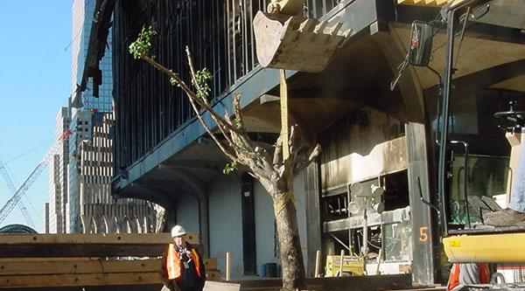
Notes:
Now consider this particular Callery Pear in November 2001. Not very impressive, but now consider its Place. This is ground zero for the 911 disaster at the World Trade Center, and while everything around it was destroyed, this tree fought back and put out new growth.

Slide 39
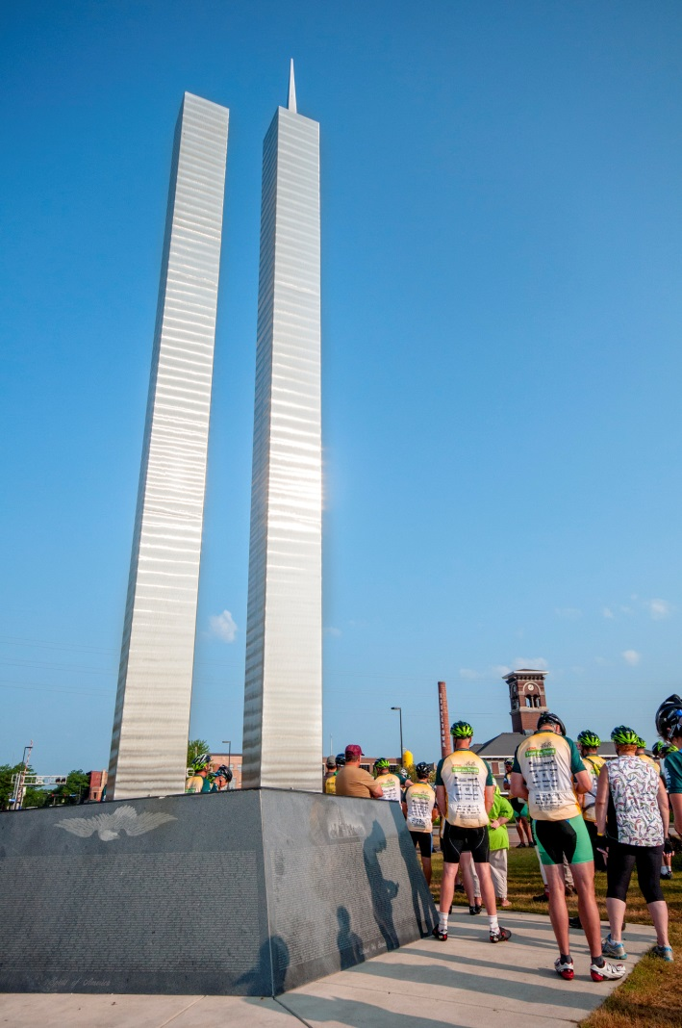
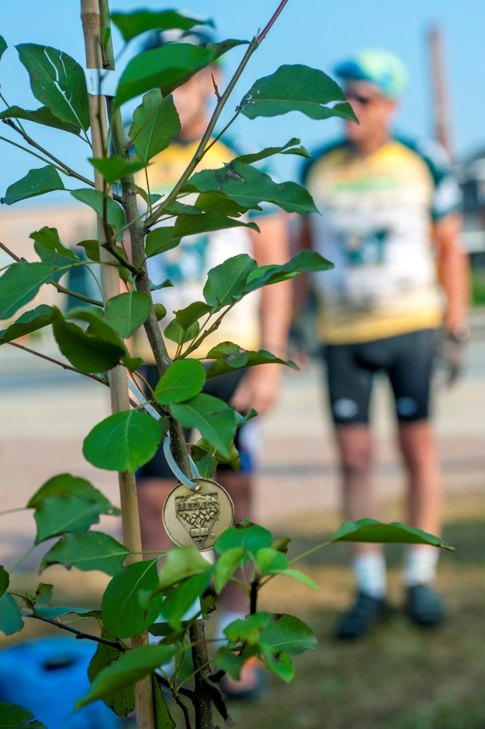
Photos: Shutterjet
Notes:
The tree was taken off-site and nursed back to health, to be replanted at the new memorial. Also, cuttings were propagated and donated to other memorial sites, like this one in Green Bay, Wisconsin, where I got to be a part of dedicating that tree in 2014. I suspect that any place that is chosen for one of these trees will become the "Right" place. And wrong or right, the Callery Pear is now the right tree for that place.

Slide 40
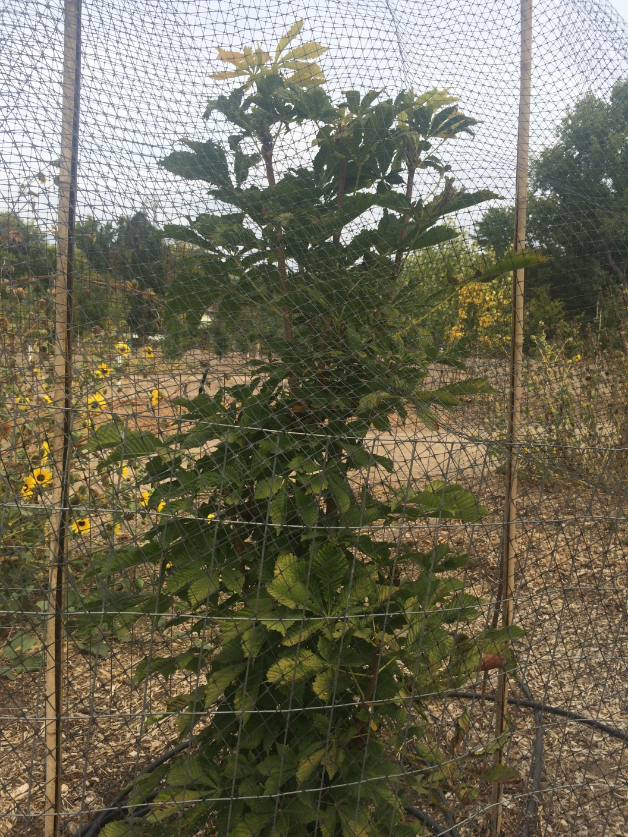
Notes:
Here's another one to think about. I came across this in Boise, Idaho just this fall. This not too impressive looking horse-chestnut is being babied along until it is strong enough to move to its "Place"

Slide 41
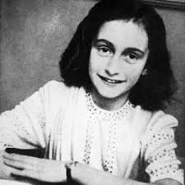
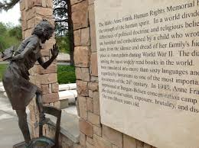
Notes:
It is another propagated cutting, and its original place was in Amsterdam, across from a secret apartment where Anne Frank, her family, and four Dutch Jews hid from the Nazis. It was the only bit of nature that Anne could see from her hiding place. It will be moved to the Anne Frank Human Rights Memorial in Boise when it is strong enough. Again, anywhere that is chosen for cuttings from that tree will be Right places, where a traditional IVM approach of removal and replacement isn’t an option.

Slide 42
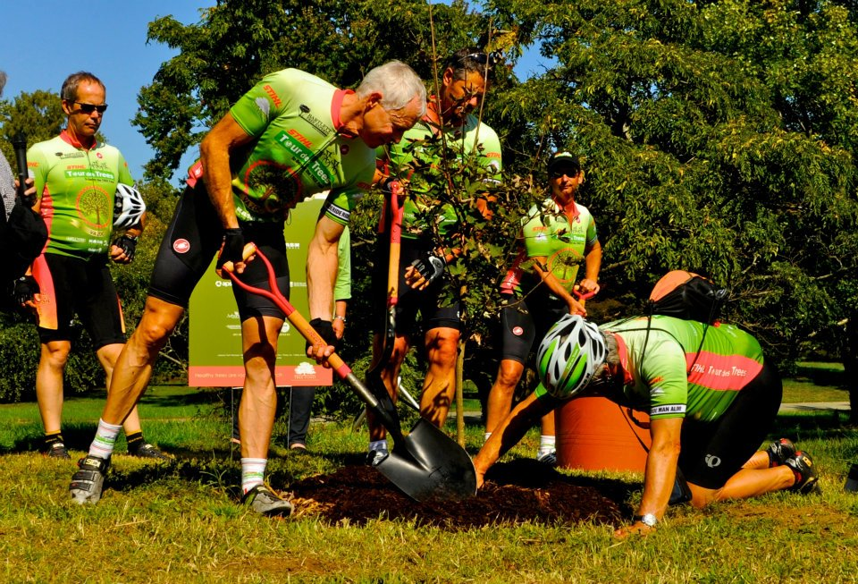
Notes:
So, Right Tree Right Place is essentially a legitimate tool in the IVM toolbox. But when you add the value that people place on trees, it can be so much more than that. This hybrid maple is one of special value to me. A few days before the 2011 Tour, my dad passed away. My tree family rallied around me and dedicated this tree to my dad. Not everyone can say there is a tree in the National Arboretum in Washington DC that is dedicated to their father, but I can. Lucky for me, this tree is in a Right Place.

Slide 43

Notes:
My friend Warren has an alter ego who comes along on the Tour to bring the message to children along the way. I’ll leave the last words to Professor Elwood Pricklethorn as he asks all budding arborists to take the Arborists Pledge.

Slide 44
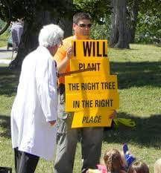
Thank You

