Slide 1
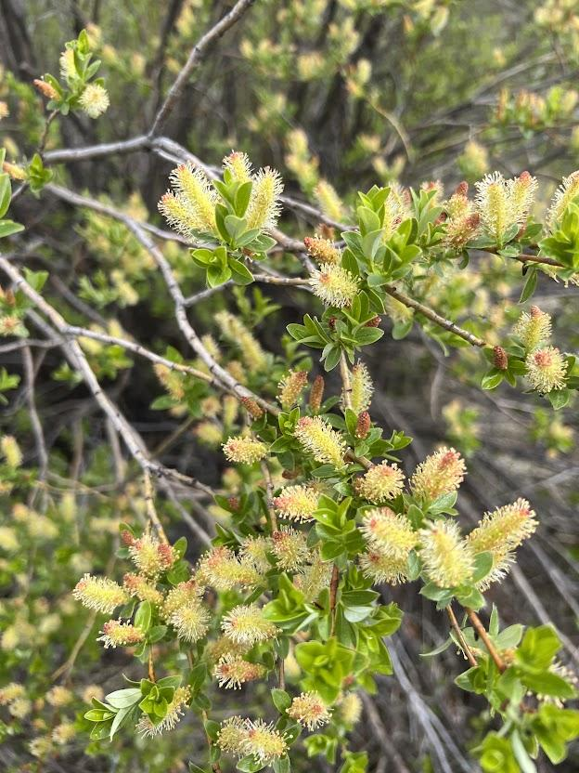
Doing More With More
Creatively enhancing biodiversity and climate benefits through private-public indigenous collaboration and innovative funding approaches.

Slide 2
Some background;
Tony Harrison is one of the founders of Zanzibar Holdings. We have been involved in production Silviculture for over 40 years and over the past 10 years we have diversified in restoration mainly on wildfires but also on flood plains. 7 years ago we did our first NGO funded project for 25,000 trees which then grew exponentially to to the point we are now averaging 3 million trees a year through multiple NGO clients.
Also joining virtually: Wesley Brooks - CCS Forest Ecologist
Alex Laforce - LNIB Cumulative Effects Coordinator
Mike Madill - CCS Senior Forester

Slide 3
Presentation objective
We would like to present some of our ideas and reflect on opportunities for future innovations and collaborations through creative new funding opportunities. But really the most benefit comes for questions and dialogue so we will keep the presentation reasonably brief and hopeful have some good questions from the audience.

Slide 4
Overall context
With the world in full climate crisis and the building social anxiety around all this, we need to boldly look at means of leveraging funding while refining techniques to intensify ecosystem restoration for optimal atmospheric and biodiversity benefit.
This leads to a couple of classic climate quotes from COP26
John Carrie - Climate Change is not going to cost billions it is going to cost trillions and governments can’t afford trillions
Mark Carnie - there are trillions of corporate and NGO funds ready to be applied to climate change but need a path

Slide 5
Creating Paths
A short term path to effective climate action is about enabling creative approaches to increase environment and climate benefit on existing plans.
Nicola Watershed restoration committee chaired by Mike Simpson a great example of information sharing and collaboration on multiple complex restoration plans from diverse players - First Nations, MOTI, DFO, MOF and diverse consultants . (Alex comment?)
The logical longer term path is to expand on future plans by leveraging complimentary funding to then accomplish greater impact on larger areas.
Planning over multiple years enable efficiencies and relationship building . A foundation of this for CCS is a recently awarded 7 year project to plant 40 million trees on priority sites in the Cascade forest district.

Slide 6
Our involvement on pilot MOTI restoration projects
Over the past 2 years Cariboo Carbon Solutions (CCS) has been collaborating with the Ministry of Transportation and Infrastructure to help restore riparian habitat through some 2BT pilots along Highway 5 and 8 impacted by the 2021 flood event. This in partnership with local First Nations communities.
Doing More with More.
Wes and Alex do you have anything to add?

Slide 7
Layering in Production Silviculture techniques
We introduced some production silviculture techniques into our MOTI restoration pilot projects.
Not to say that production planting and small stock size works on all restoration sites but it has a place .
The piece rate approach is an interesting parallel universe populated by industrial athletes (WorkSafeBC term). There is an opportunity to tap into this work place especially on the shoulder seasons like early spring and Fall

Slide 8
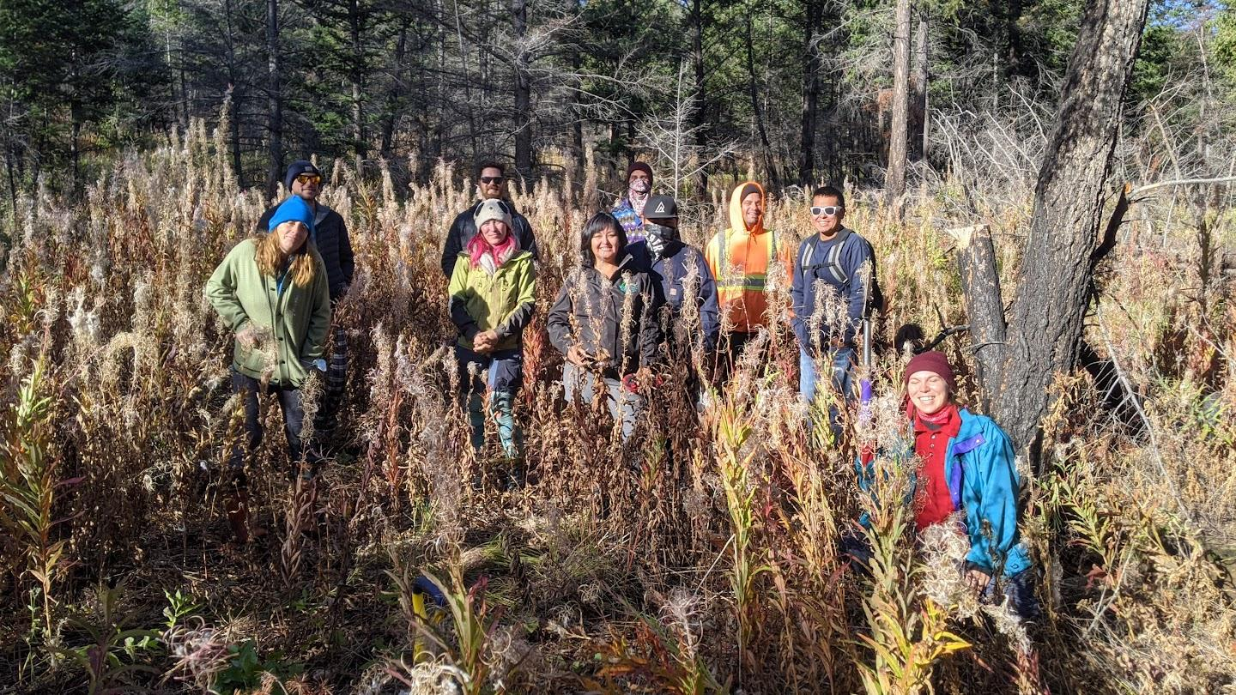
Questions ?

