Slide 1
Excellence in Vegetation Management –
Contracting Perspective
D. Marshall – 2016/11/09
Notes:
Good afternoon.
Thank you for inviting me to speak to the IVMA Conference.
In my career, I have had the opportunity to work for Industry and Contracting.
My career in Industry was for a large forestry corporation.
It was a great opportunity and has given me a good understanding of the economics and challenges associated with successful delivery of a VM program.
I now work in the Contracting/Consulting sector.
I get the opportunity to work with some incredibly skilled and highly experienced individuals each and every day.
Our work environment is one that is very innovative, our practices are continually being evaluated for improvements in efficiency and efficacy.
Today’s talk will focus on how we can work at improvements in order to deliver successful VM projects.
Much of what I will present will likely be seen in other presentations.

Slide 2
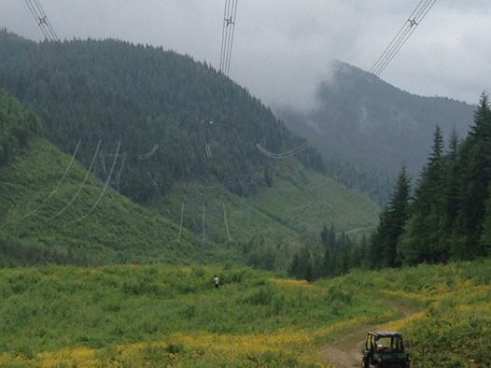
Agenda
Industry challenges
Excellence in VM
Roles for achieving excellence:
  Industry
  Contractors
  Government
  Chemical Companies
Notes:
Here is the ground that we will cover today.

Slide 3
Current Industry Challenges

Slide 4
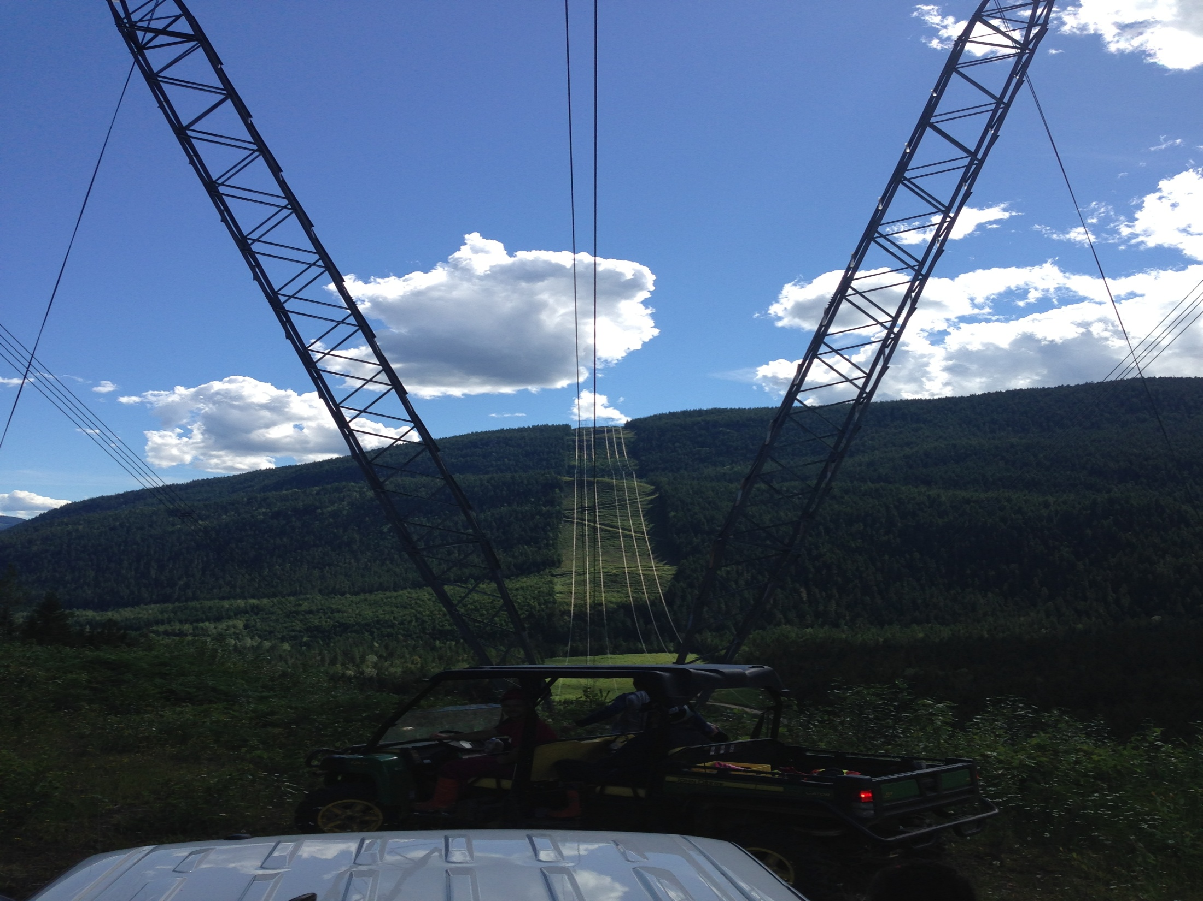
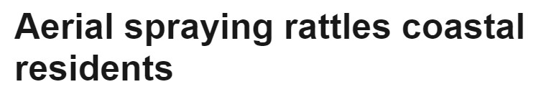
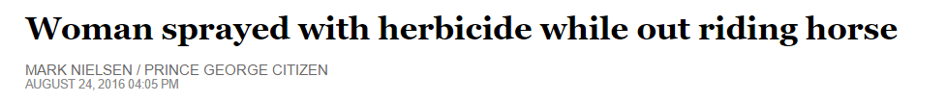
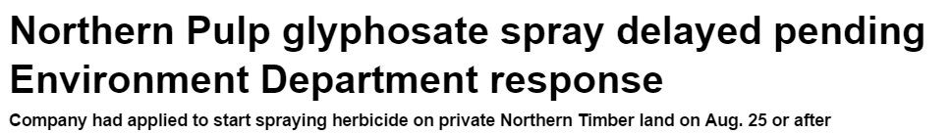
Pesticides in the News
Notes:
Recently I performed a quick Google News search and came up with these headlines pertaining to pesticide usage in Canada.
We continue to deal with the issues of public perception, lapses in our practices and stakeholder issues.
They show us that there is no question – the pesticide component of our industry continues to be very contentious.

Slide 5
Issues Associated with VM
Public perception
Stakeholders and information sharing
Cumulative impacts
Out of jurisdiction impacts
Notes:
We are seeing continued Public Perception Issues – At times, those in our industry can be seen as:
Not clearly stating the objectives of our treatments
Not doing a proper job of highlighting the concepts of integrated vegetation management,
Having poor practices.
Stakeholder Issues increasing– Information sharing requirements with other stakeholders are becoming more robust. Decision makers must constantly consider Aboriginal Rights and Title and the potential for their infringement.
Cumulative Impacts– Work on the land, such as pesticide usage is now starting to get considered alongside other land use impacts such as forestry, mining, oil and gas, transmission and distribution developments and, wind development. These overlapping nature is said to have impacts that are not fully understood.
Out of jurisdiction impacts – these are items outside of BC that detract from us doing our jobs- World Health Organization – Toxicity of Glyphosate; Pest Management Regulatory Agency – bans on cosmetic pesticides are very real, but at the same time are things that can be seen as causing some instability in our industry.

Slide 6

Setback or Opportunity?
Notes:
The increased pressure on IVM is continuing to cause practitioners to reconsider their options (ergo. throwing their hands in the air and surrendering).
We are still hearing our clients say things like:
We have decided not to pursue a PMP at this time – there are too many stakeholders, not enough time and resources.
We don’t understand the process. Bob Jones used to deal with that, but now he’s retired and we are not sure if he will be replaced.
Our planning team is focused on issue x – therefore herbicide applications are not a priority at this time.
We had really poor efficacy last year on some of our treatments – not sure why. Not doing that again.

Slide 7

The Future
Forestry: Change in geographic harvest focus
Industrial: Management of growing infrastructure
Industrial: Remedial maintenance treatments
Invasive: Continued management required.
Notes:
Should we carry on with the thinking from the previous slide, there is a very real risk that the costs to many of the people in this room to manage unwanted vegetation would increase significantly.
A few examples that are current:
Forestry – Current and future harvest areas are located in some of the wettest and richest ecosystems in the Interior of BC on some of the most challenging terrain. Company executives will be looking to forestry staff for cost effective options in order to counter rising log costs associated with working in these environments.
Utilities – The areas associated with utility rights of way is increasing – transmission, distribution, LNG, Wind and Facilities area increasing in area. Again, cost effective treatment options are necessary due to this increase in area that needs to be managed.
Oil and Gas– As we all know, Oil and Gas companies have been in survival mode for the past 2 years. In the future they are going to have to make up for cash conservation efforts deployed during oil downturn. Cost effective options will be necessary.
Invasives – Invasive species are not going away – they require continued annual treatment through a good mix of chemical and non chemical means.

Slide 8
Excellence in Vegetation Management
Notes:
A s a recap, we have seen in the previous section, issues continue to mount in opposition to certain of our VM tools [pesiticide application].
We have also seen that industry is at times seen as taking a bit of a “holding pattern” position on pesticide use - and ultimately this could cause more problems down the road.
We must therefore strive for excellence in everything that we do.

Slide 9
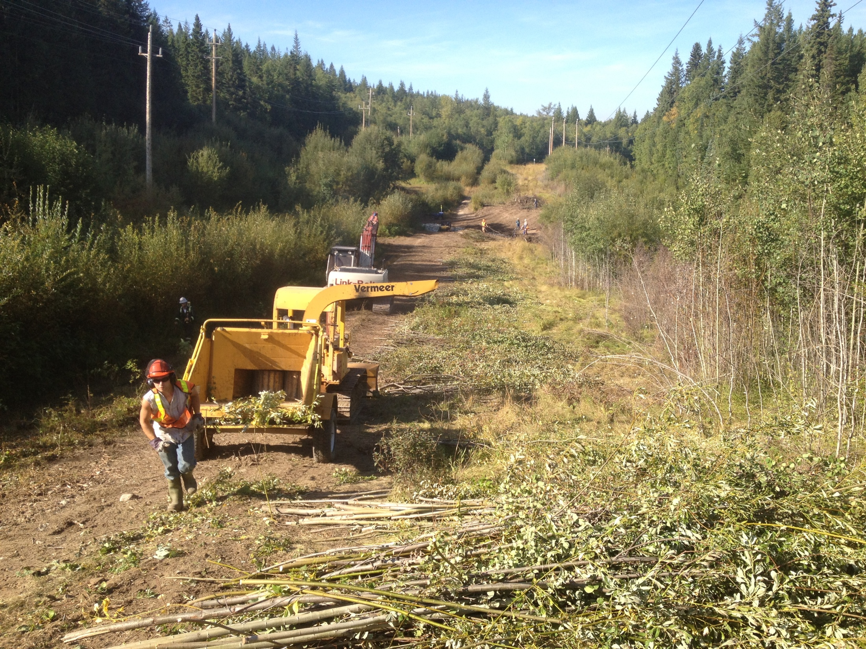
Performance Excellence
Applies to:
  Industry
  Government
  Chemical Companies and
  Applicator Contractors / Consultants
Notes:
A definition of Performance Excellence:
Performance excellence exists in workplace where proactive problem-solving, teamwork, and leadership results in the ongoing improvement in an organization.
In this case, though it may not fit perfectly as we are not all part of the same organization, however I thought it was an apt term to describe the behaviours that we all need to exemplify, within our various teams in order to ensure the continued successful delivery of our vegetation management programs.
Every entity has a role to play and the key players are:
Industry and Vegetation Managers,
Government Agencies,
Chemical Companies and
Application Consultants and Contractors.

Slide 10
Industry Excellence
Notes:
Industry in this section refers to plan or permit holders – the folks who sign the cheques.

Slide 11
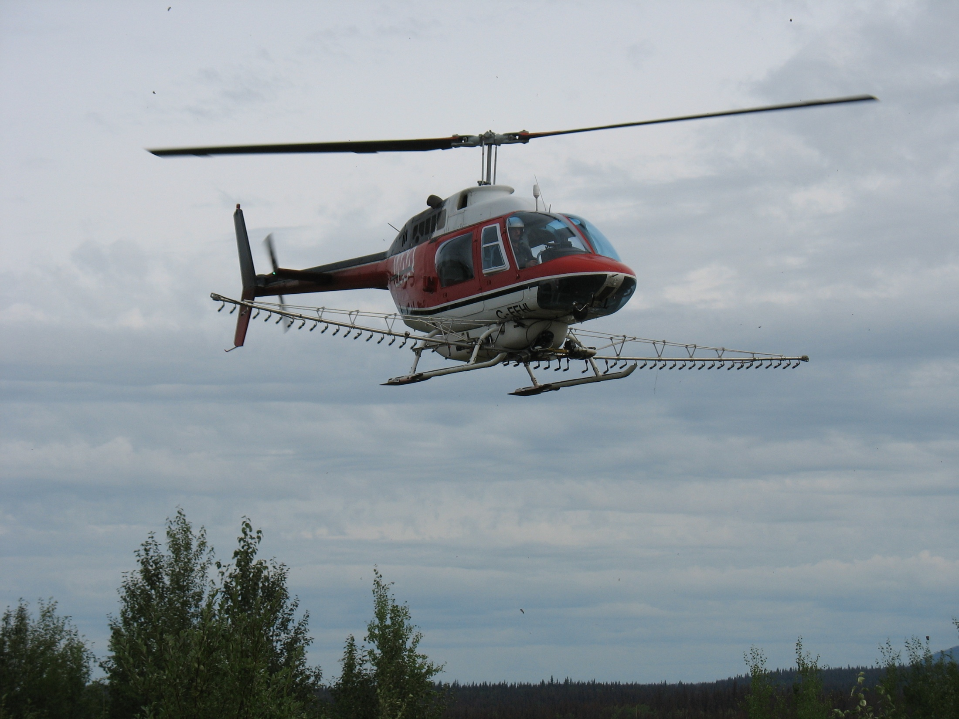
Industry Excellence
Proactive planning
Understanding of VM concepts
High standards of practice
Stakeholder education and promoting successes
Notes:
Our colleagues in Industry/Organizations delivering a program have the key role to play.
They must provide for Proactive Planning: Planning for programs must be done well in advance, and need to take into account any delays that could be encountered in the info sharing process.
There must be a good Understanding of VM Process: All staff need to be trained and well versed in Vegetation Management concepts – this will help in delivering the right prescriptions, enforcing the standards during operations and troubleshooting when things do not go as planned.
They must demand High Standards of Practice in order to minimize the potential for mishaps – that, as we have seen in the press clippings, can be costly.
High performance standards relate to:
Safety (Workers, Emergency Response, Spill Prevention)
Quality (Certification, Industry leadership, Minimum experience requirements)
Quality (Is the applicator experienced and do they understand your objectives and do they stand behind their work)
Delivery (Is the applicator available when you need them)
They must be committed to Stakeholder Education: which includes, at a minimum, participating in Open Houses or Public Advisory Groups – where they would go out and tour areas that have been treated, showcasing successes and highlighting environmental protection efforts.

Slide 12
Government Excellence

Slide 13
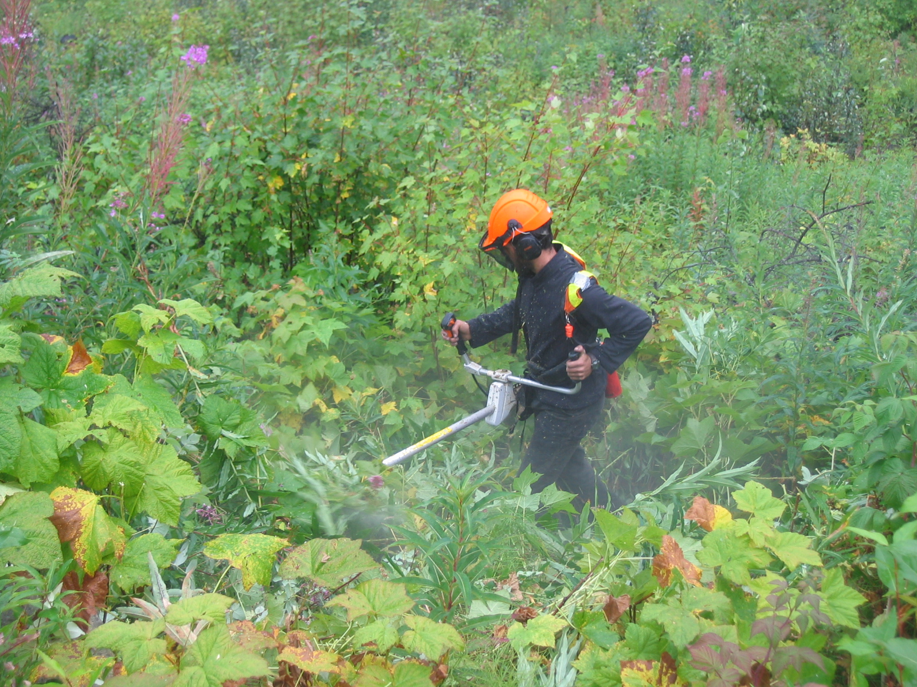
Government Excellence
Regulation and certification
Compliance and Enforcement
Being Proactive
Notes:
Government is part of the team and must demonstrate good leadership. The public expects nothing less.
This can be done through:
Regulation and Certification: continuing to raise the bar and demanding competence in the industry by regularly revisiting legislation [and regulation]; and increasing performance expectations for service licensees and applicators – an example of this would be the certified assistant process.
Compliance and Enforcement: The Ministry of Environment should continue auditing all participants in industry and imposing sanctions on those who cannot perform to the standards. This is the only way to improve credibility for our industry.
Being Proactive: being open for doing business while considering all stakeholder values and views.

Slide 14
Contractor Excellence

Slide 15
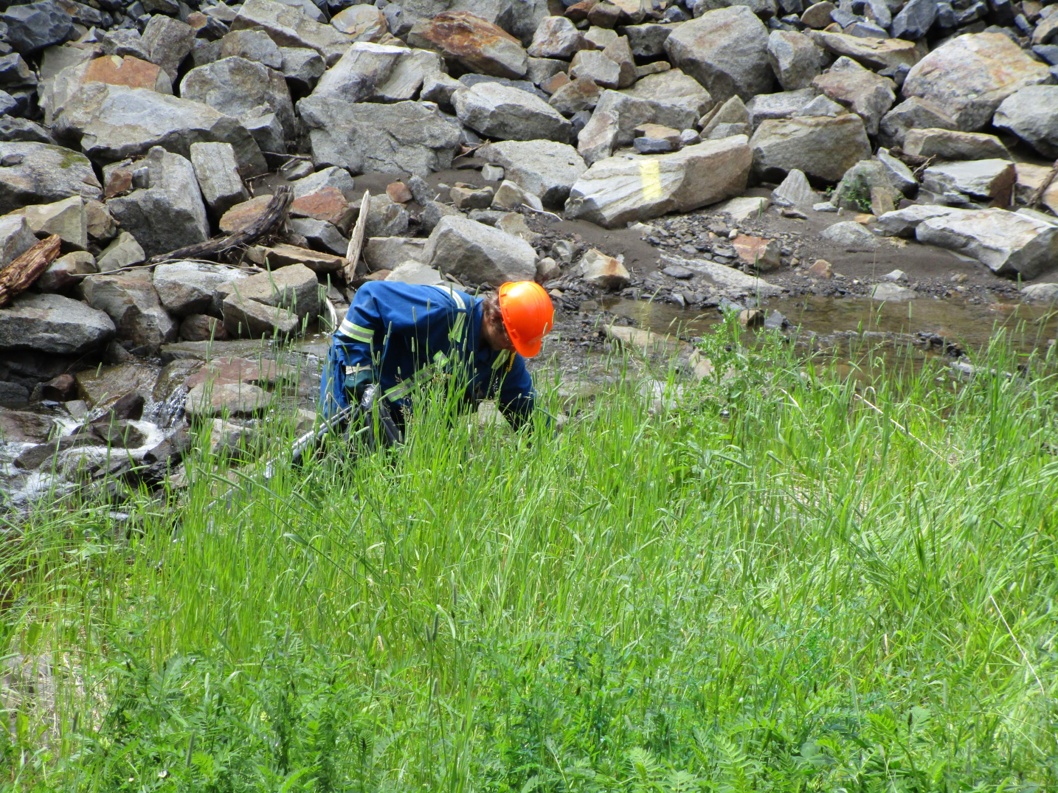
Contractor Excellence
Leadership in Safety
  Safety Manager
  Training
  Mentorship
  Asset Tracking
  Drug and Alcohol Testing
  Incident Reporting and Investigation
Notes:
The contracting workforce engaged in all aspects of vegetation management must demonstrate Safety Leadership.
This is necessary because our vegetation management activities are highly visible.
A robust safety management program goes a long way towards ensuring worker and public safety and builds confidence for our clients. A few examples from Spectrum (but that are not unique to Spectrum) include:
Full time Safety Manager, dedicated solely to ensuring training, compliance, and a positive safety culture are achieved.
Worker training that recognizes all hazards that could be encountered in any situation/
Accredited training programs for all mobile equipment operators – Resource Road Driver, ATV Training.
Ongoing Competency assessments.
Speed monitoring for vehicles in our fleet via GPS.
Mandatory drug testing for all safety sensitive positions – Chainsaw Operators; ATV/UTV Operators; Truck drivers
Robust Hazard recognition process – Daily tailgate meetings
Incident reporting, investigations and root cause analysis

Slide 16
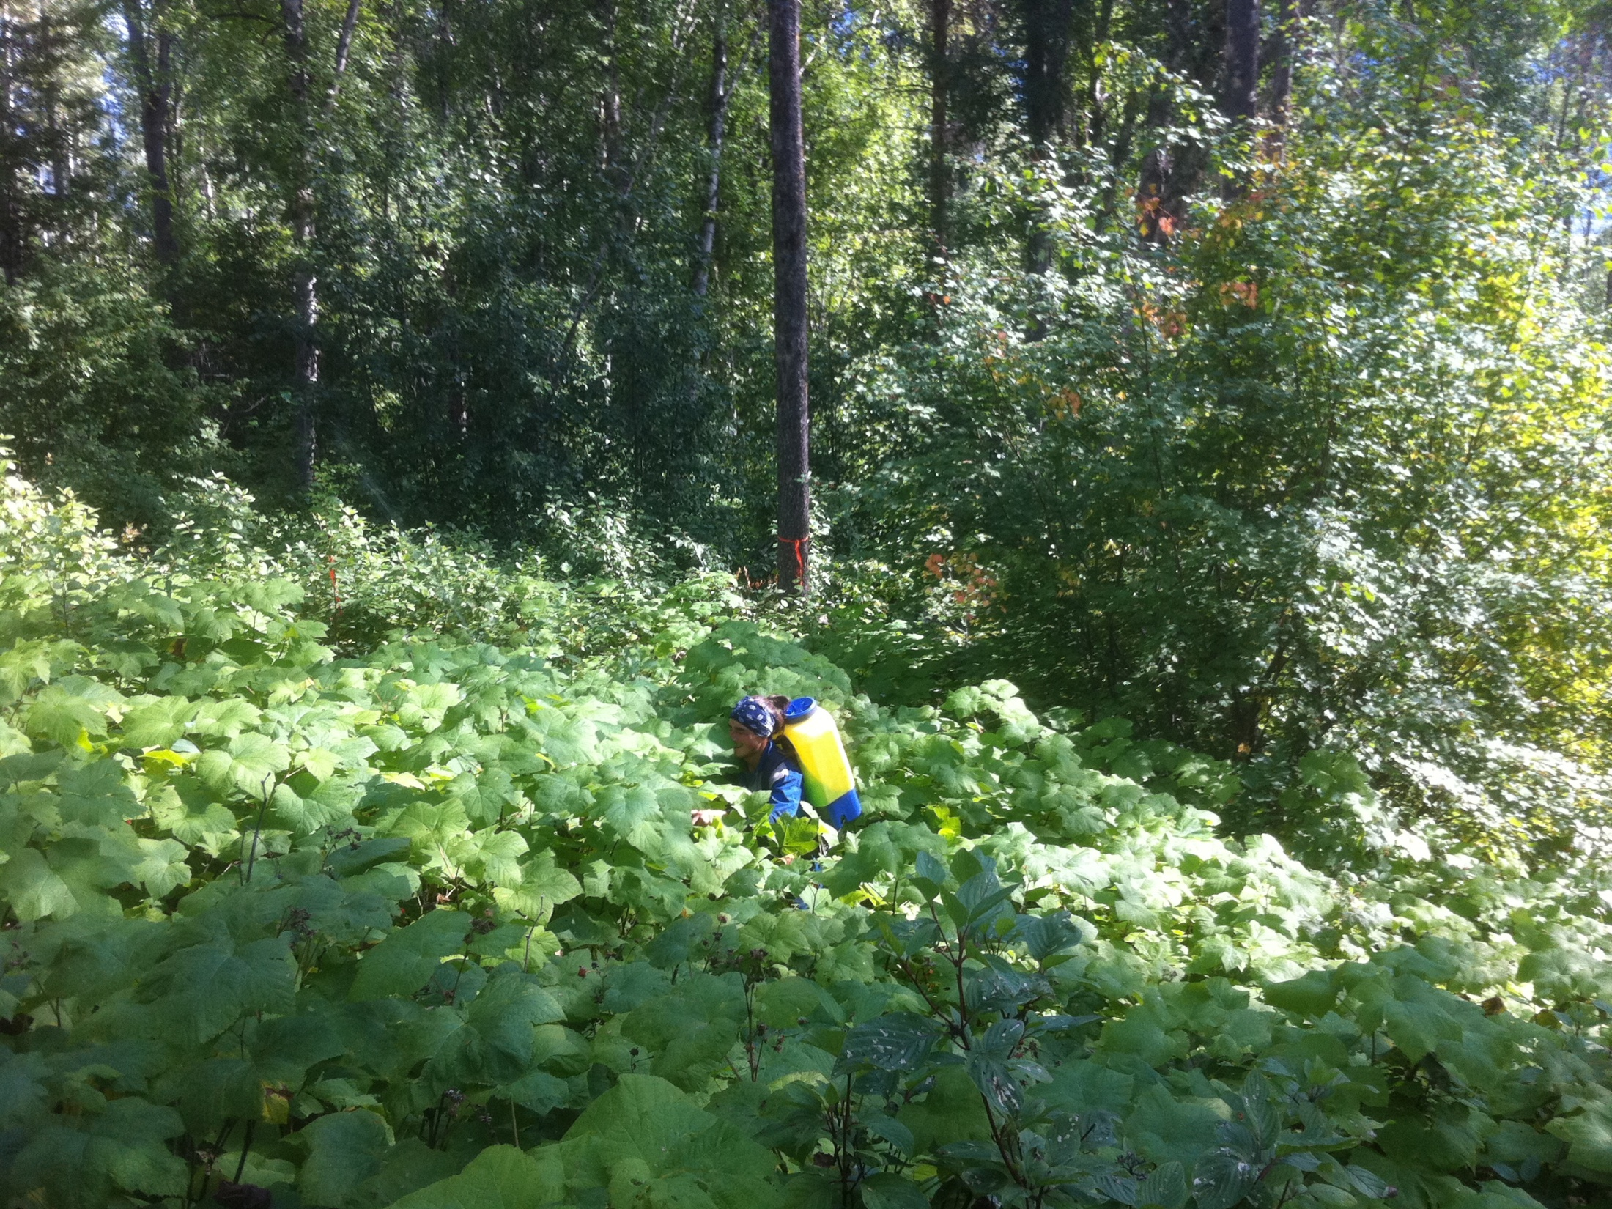
Contractor Excellence
Product Quality
  Competent and knowledgeable personnel
Professionalism
  Highly visible to all stakeholders
Notes:
Quality management and leadership are demonstrated through the deployment of :
A competent and knowledgeable managerial staff.
Assisting clients with efficacy checks, pre season field visits, business improvement sessions and root cause analysis in order to continue building our body of knowledge
Assisting in stakeholder engagement and information sharing sessions with clients.
Standing behind our treatments.
Our crews must demonstrate a high degree of professionalism, after all, in most cases members of the public normally encounter our crews long before they ever have the chance to interact with Company or Government field staff.
Your contractors should be your experts:
Internal training programs – as an example of this: Spectrum’s Invasive Plant Management technicians undergo a week of on the job training; our Aerial Herbicide monitors undergo a full day course.
Higher than legislated certified applicator ratio – all of our invasive plant technicians are certified.
Organized workshops with chemical company representatives. – these are done to educate and give an understanding the chemistry that we are working with and
Targeted training on how to deal with members of the public
Attending sessions like this one

Slide 17
Chemical Companies Excellence

Slide 18
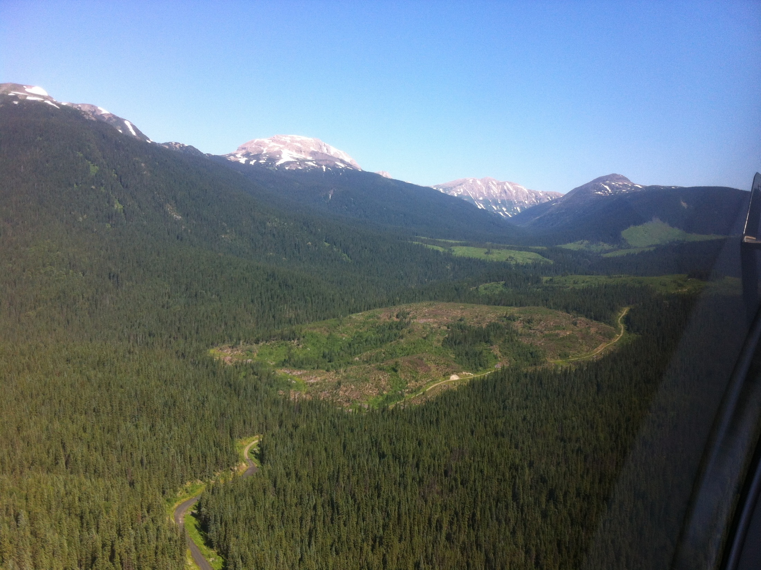
Chemical Companies
Product leadership beyond customer service
Research and development
Notes:
Chemical companies need to continue providing leadership through active involvement with all parties.
Going beyond customer service, providing as much information as possible about their products to all stakeholders.
Making themselves available to act as liaison and intermediary between all participants.
Provide cooperation, funding and/or resources aimed at establishing or maintaining long term studies that determine the effects of their products on the landscape.

Slide 19
In Conclusion

Slide 20
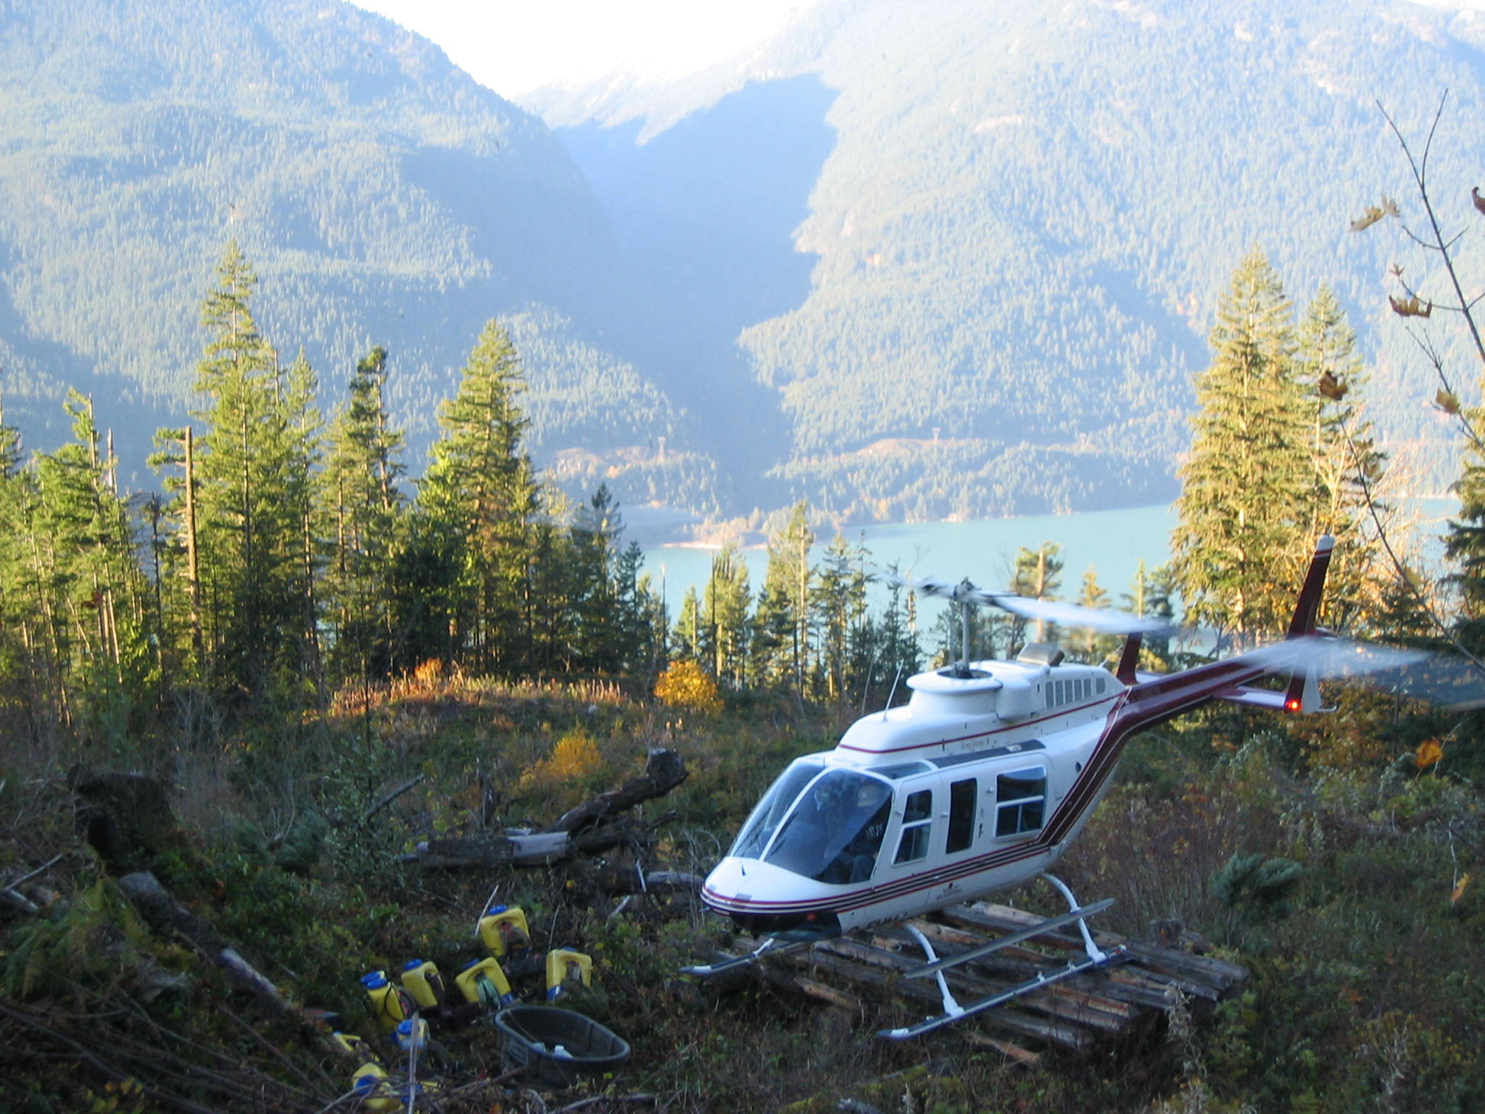
Excellence in Vegetation Management
A philosophy of the workplace where problem-solving, teamwork, and leadership results in the ongoing improvement in an organization.
Notes:
In Conclusion, when we talk of Excellence in our VM programs, the take home message is for all parties to continually go above and beyond with our planning, operations, execution, follow up and enforcement.
It is the only way that we can bolster public trust in what we are doing.

